Slide 1


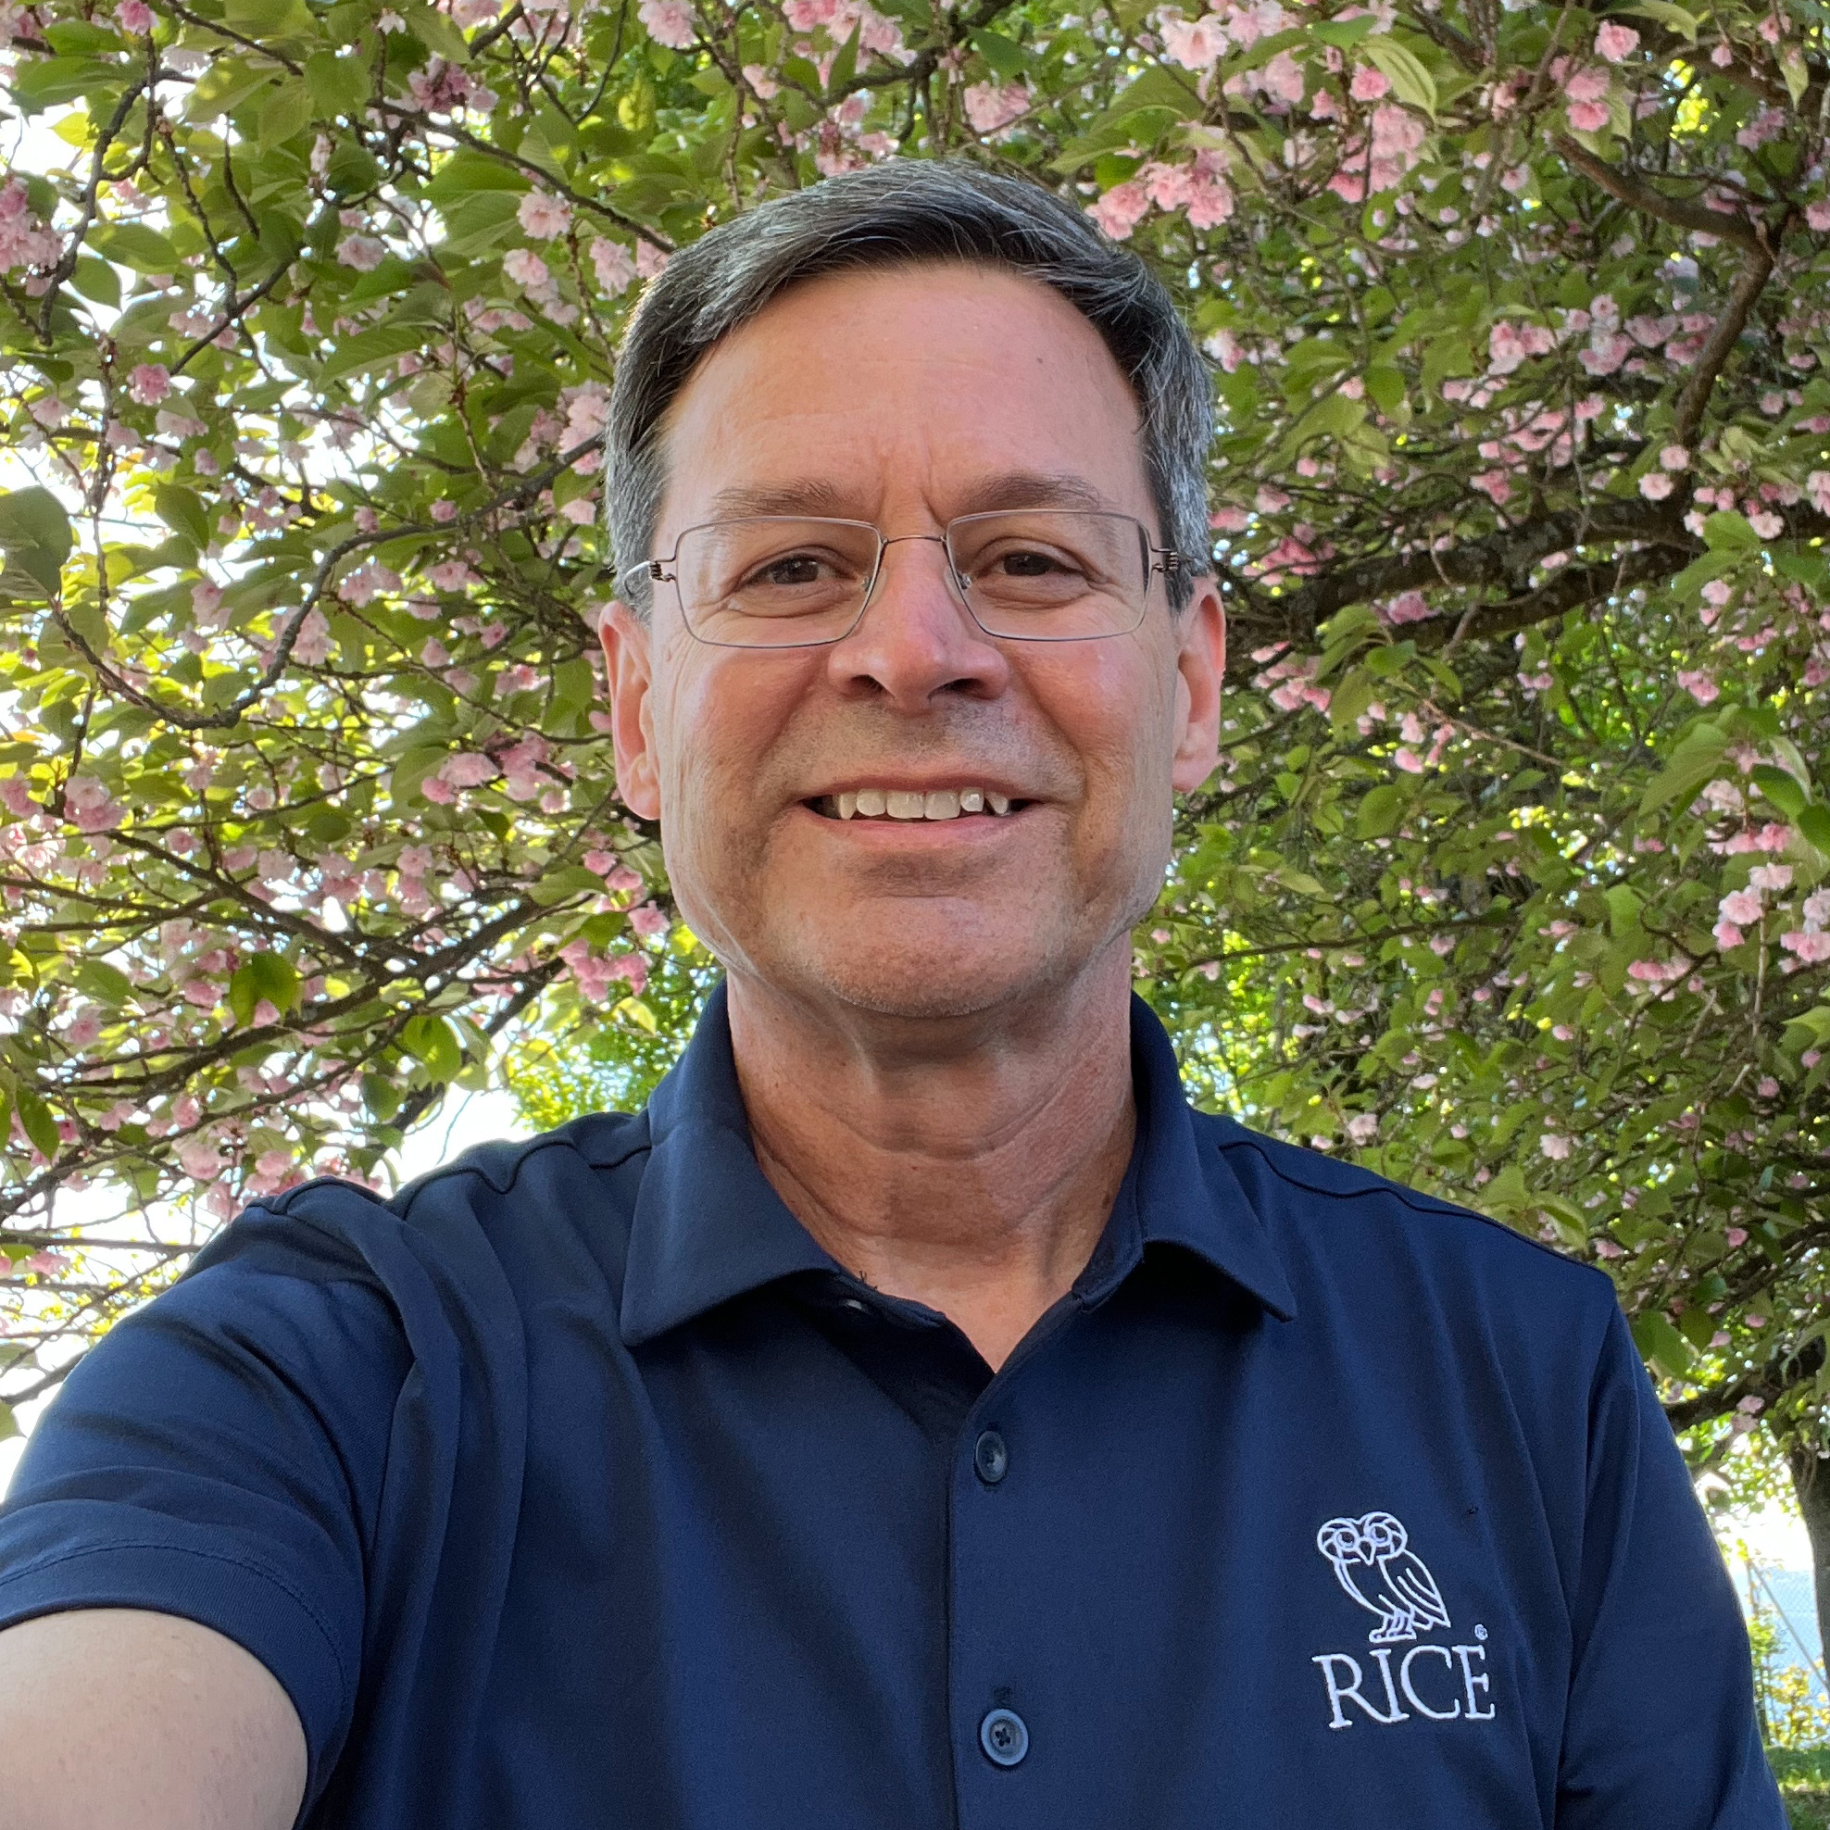
Mentor Perspective
USCMS PURSUE summer program (2023)
Darin Acosta (Rice University)

Slide 2
Mentee and Mentors
Summer Student: Emanuela Riglioni from Xavier University, Louisiana
Faculty mentor: Darin Acosta, Rice University Physics & Astronomy Dept.
Graduate student technical mentor joining me: John Rotter

Slide 3
Mentee Research Project
Title: Training and Validation of Machine Learning Algorithms in the Endcap Muon Track-Finder
Become acquainted with a “trigger system” at a particle collider experiment,
and the muon trigger of the CMS experiment in particular
AI/Machine Learning component: Boosted Decision Tree:
  Used to assign the momentum of muons from detector measurements
  Mentee needed to validate a new python-based software framework to train the algorithm
Assessment:
  The result of these simulations and trainings is validated through plots of:
  Efficiency - How well are you selecting what you want?
  Rate - How much other data are you letting through?
  Resolution - The quality of how well we measure things
This work actually extended the work of a PURSUE project from the previous summer

Slide 4
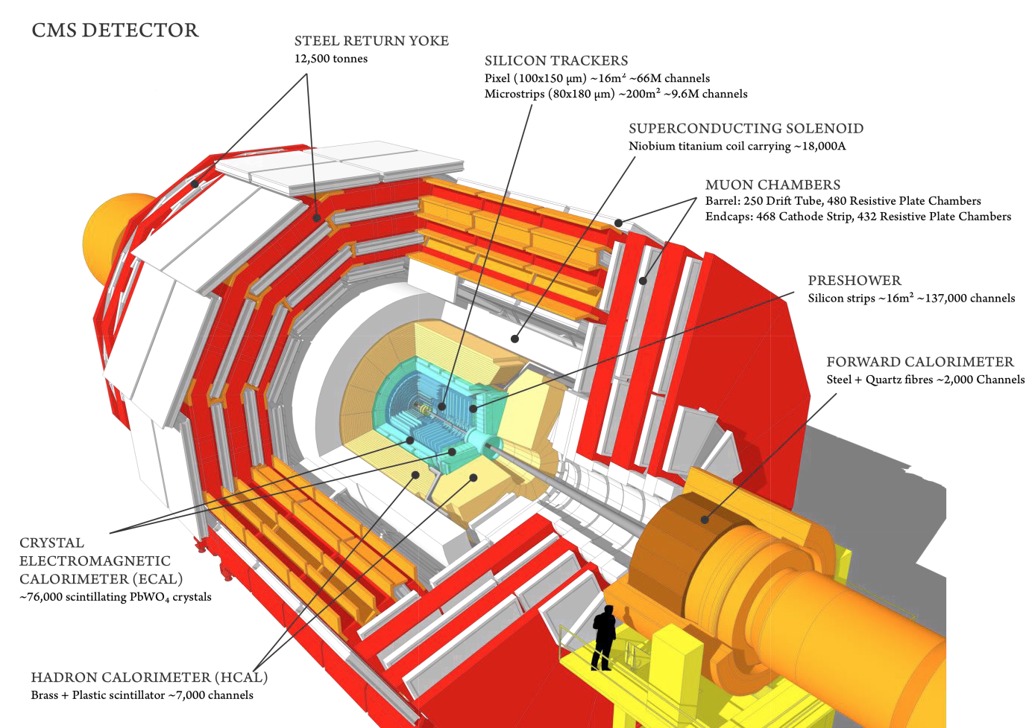
The “Compact” Muon Solenoid (CMS)
Layers of instrumentation surrounding the collision point
3.8T
15m
A large general purpose experiment for a broad physics program
(much like a telescope for the universe)
Notes:
Zoom into one endcap for Scale

Slide 5
Data Acquisition and Trigger System
Not shown in the detector image are the electronics and computers to selectively read out their data
Why is a real-time data selection system (“trigger”) needed?
  Far too much data to continuously stream to disk for storage and/or computer processing reasons
    The LHC collides proton bunches at 40 MHz
    An LHC experiment could generate ~100 terabytes per second!
It is really the first step of a data analysis
  An online data filtering system: select the collisions you want most
  But irreversible – you can’t go back to data you did not record
    e.g. Throw away 99.998% of all LHC crossings…
    But, don’t throw out the baby (Higgs) with the bath water!
Notes:
Was a lot of data to think about 20 years ago

Slide 6
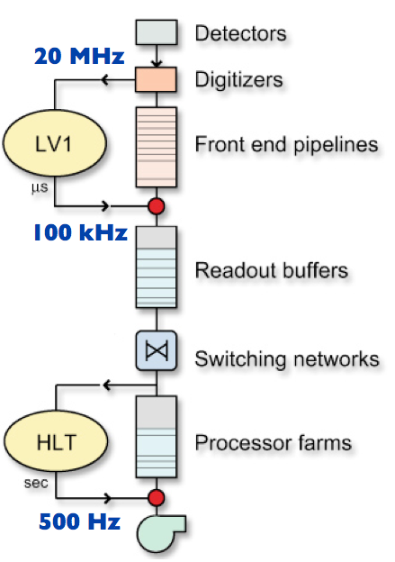
CMS Trigger Architecture
Two levels:
  Level-1: custom electronics to reduce the data from
  a collision rate of 40 MHz to no more than 100 kHz
  for the detector readout electronics, with only a
  4 μs latency (buffer depth)
  High Level Trigger (HLT): event filter farm comprised of
  commercial CPUs (and now GPUs also) running
  software to further reduce event rate to storage to an
  average of ~1 kHz (for LHC Run 2)
    Order of 26k CPU cores
40 MHz
1 kHz
Notes:
HLT rate is increase since Run 1, factor 2 increase in lumi, and from sqrt(s)

Slide 7
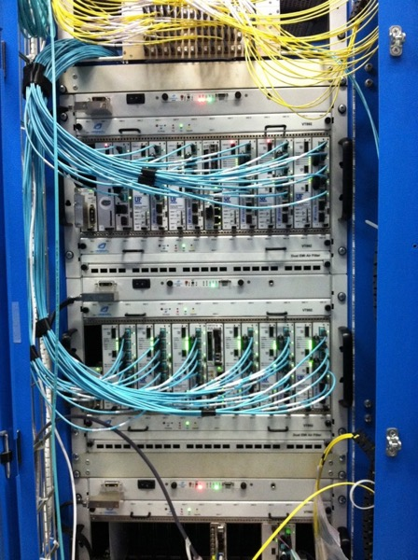
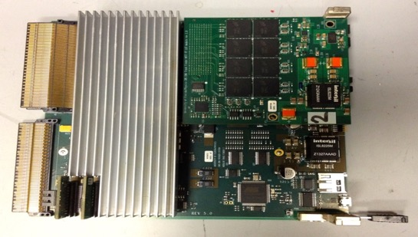
The Endcap Muon Electronic Trigger System
We designed the muon trigger for the CMS endcaps.
Includes AI/ML algorithms to measure muon momenta.
Working on next-gen algorithms and electronics.

Slide 8
Machine Learning
Boosted Decision Trees are a form of machine learning,
like artificial neural networks
  A decision tree repeatedly splits a dataset into smaller subregions based on features in that dataset
The algorithm must be trained with a large sample of examples of desired classification
  Categorization: Cat vs. not a cat; Higgs boson vs. not a Higgs boson
  Regression: momentum =10 vs. momentum =100
  Weights are determined from back propagation and using a specific loss function (penalty)
The application of trained network is known as inference
  This is what is stored in the memory chips of our electronics

Slide 9
Tools used
Machine learning training used the XGBoost python package
CERN ‘Root’ package also used
Emanuela validated the new python code to do all this against an earlier bloated software package, and made graphs of the performance results
We made use of the computing resources offered by the LPC cluster at Fermilab

Slide 10
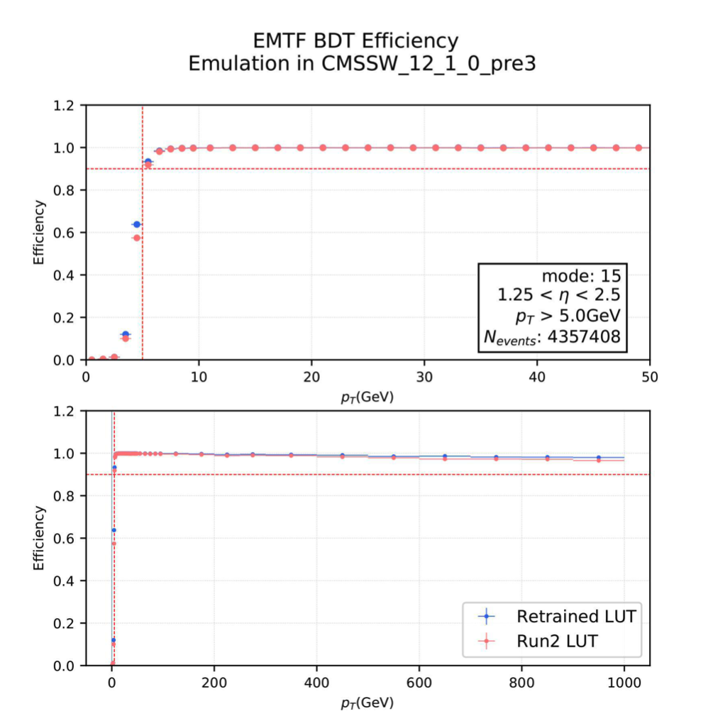
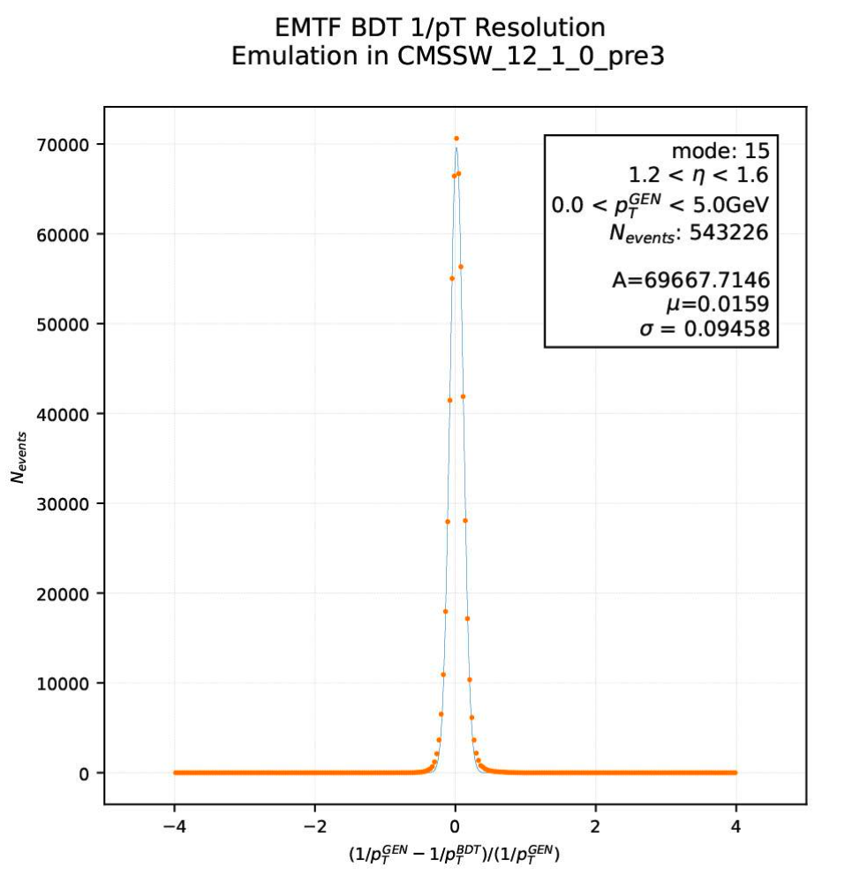
Examples of Research Results
t
Resolution
of P_{T}
Efficiency to select muons

Slide 11
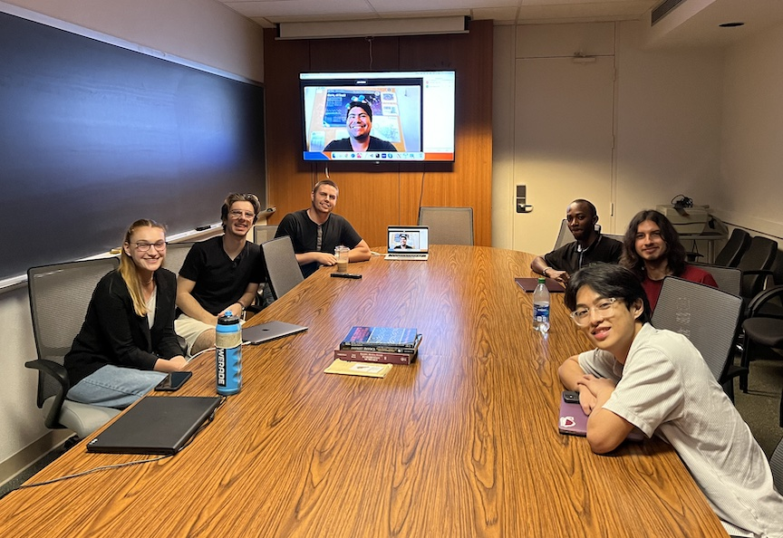
Overall Experience with Program
The USCMS workshops and tutorials held at Fermilab were very helpful for the student,
so it was a smooth process to get started on the research project
After Fermilab, the student spent the remainder of the program at the Rice University campus in Houston
She worked with me, our graduate student, and a cohort of
several other summer students from other ongoing programs
  Group called themselves the “Particle Owls”
Emanuela learned a lot and found the project very interesting
Grad student mentor also found the experience very positive
I was quite pleased as well! ☺ Useful tool for CMS developed and validated!
Emanuela got a chance to present her work at the Gulf Coast Research Symposium
She is now applying to graduate schools (as well as the PURSUE student from year before)

