Slide 1

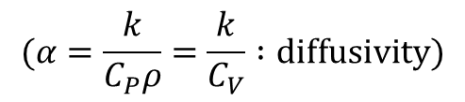
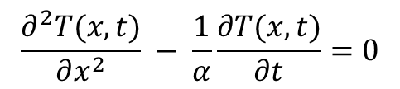
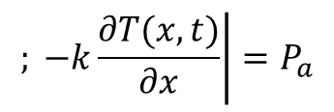
Temperature increase at a metal (superconducting) surface
in the presence of a pulsed rf electromagnetic field
1D heat equation:
$$\frac{∂^{2}T(x,t)}{∂x^{2}} − \frac{1}{α}\frac{∂T(x,t)}{∂t}=0$$
P_{a}
A
$$(α=\frac{k}{C_{P}ρ}=\frac{k}{C_{V}} :diffusivity)$$
0
x
(A is a homogeneous semi-infinite metal)
Boundary conditions:
P_{a}
$$\left.; −k\frac{∂T(x,t)}{∂x}\right|=P_{a}$$
$$T(∞,t)\text{=} T_{o}$$
0
τ
t
x=0
(k and α are assumed here to be temperature independent)
The general heat equation solutions are the so called «error functions»

Slide 2




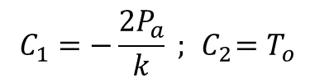
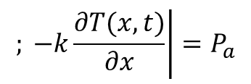
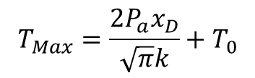
In the case of Neuman boundary conditions, for 0 ≤t ≤τ, the solution is :
$T(x,t)\text{=} C_{1}\sqrt{αt}$ ierfc $\left(\frac{x}{2\sqrt{αt}}\right)$ + $C_{2}$
$T(x,t)\text{=} \frac{2P_{a}}{k}\sqrt{αt}$ $\left[\text{−}\text{ierfc} \left(\frac{x}{2\sqrt{αt}}\right)\right]$ + $T_{o}$
$$\left.; −k\frac{∂T(x,t)}{∂x}\right|=P_{a}$$
$$C_{1}=−\frac{2P_{a}}{k} ;{ C}_{2}=T_{o}$$
$$T(∞,t)\text{=} T_{o}$$
x=0
The espression is the same reported
by I.Wilson , CLIC Note 52 (15.10.87)
The x dependence for t=τ is :
T_{Max}
$$T_{Max}=\frac{2P_{a}x_{D}}{\sqrt{π}k}+T_{0}$$
$$x_{D}=\sqrt{ατ}$$
x/x_{D}
T₀

Slide 3
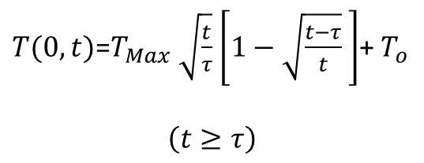
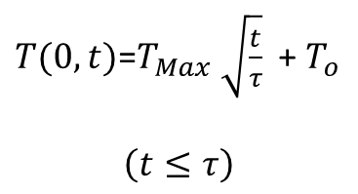
It is easy to show that the overall t dependence, at x=0, is :
$T(0,t)\text{=}T_{Max} \sqrt{\frac{t}{τ}}$ + $T_{o}$
$$\left(t≤τ\right)$$
$T(0,t)\text{=}T_{Max} \sqrt{\frac{t}{τ}}$ $\left[1−\sqrt{\frac{t−τ}{t}} \right]$+ $T_{o}$
$$\left(t≥τ\right)$$
T_{Max}
t/τ
T₀
t/τ
(Note that even for t=100τ the temperature is higher that T₀ . This would be true
for any t, and repeeating the pulses would cause a continuous increase of T_{Max.}
This is simply due to the fact that the model does non include a bath at T₀ .

Slide 4

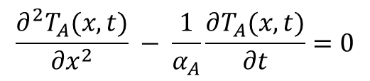

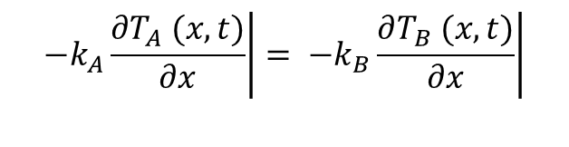
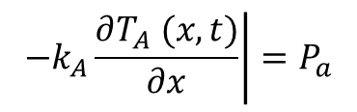

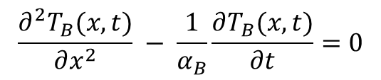
Let’s consider the case of an A/B interface, where A is a metal
of thickness L and B is a homogeneous semi-infinite metal.
L
P_{a}
P_{a}
A
B
0
τ
t
0
x
We need to solve two coupled 1D heat equations:
$$\frac{∂^{2}T_{A}(x,t)}{∂x^{2}} − \frac{1}{α_{A}}\frac{∂T_{A}(x,t)}{∂t}=0$$
$$\frac{∂^{2}T_{B}(x,t)}{∂x^{2}} − \frac{1}{α_{B}}\frac{∂T_{B}(x,t)}{∂t}=0$$
with the boundary conditions:
$$\left.−k_{A}\frac{∂T_{A} (x,t)}{∂x}\right|=P_{a}$$
$$T_{B}(∞,t)\text{=} T_{o}$$
x=0
$$\left.−k_{A}\frac{∂T_{A} (x,t)}{∂x}\right|= \left.−k_{B}\frac{∂T_{B} (x,t)}{∂x}\right|$$
$$T_{A}(L,t)\text{=} T_{B}(L,t)$$
$=P_{a/b}$
x=L
x=L
(neglecting Kapitza resistance)

Slide 5
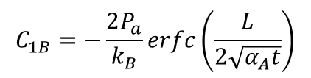



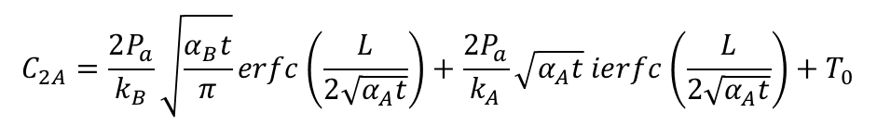





$P_{a/b}=P_{a/b}$ $\left(t\right)$
is the power crossing the A/B interface
The two coupled A/B equations, with the given boundary conditions, cannot (?)
be exactly solved analytically. An approximate solution can be obtained
considering for the solutions the same form of the homogeneous case :
$T_{A}(x,t)\text{≅} C_{1A}\sqrt{α_{A}t}$ $ierfc\left(\frac{x}{2\sqrt{α_{A}t}}\right)$ + $C_{2A}$
$$\left(0≤x≤L\right)$$
$T_{B}(x,t)≅C_{1B}\sqrt{α_{B}t}$ $ierfc\left(\frac{x−L}{2\sqrt{α_{B}t}}\right)$ + $C_{2B}$
$$\left(x≥L\right)$$
The boundary conditions imply :
$$C_{2A}=\frac{2P_{a}}{k_{B}}\sqrt{\frac{α_{B}t}{π}}erfc\left(\frac{L}{2\sqrt{α_{A}t}}\right)+\frac{2P_{a}}{k_{A}}\sqrt{α_{A}t} ierfc\left(\frac{L}{2\sqrt{α_{A}t}}\right)+T_{0}$$
$$C_{1A}=−\frac{2P_{a}}{k_{A}}$$
$$C_{1B}=−\frac{2P_{a}}{k_{B}}erfc\left(\frac{L}{2\sqrt{α_{A}t}}\right)$$
$C_{2B}$ $=T_{0}$
${(P}_{a/b}(t)=P_{a} erfc\left(\frac{L}{2\sqrt{α_{A}t}}\right)$)
C_{1B} and C_{2A} are (mild) functions of t so that T_{A} and T_{B} are not exact solution of the heat equation.

Slide 6
A tipycall x dependence of the temperature is reported below :
A
B
T_{Max}
x_{DB}
T₀
x
>
0
L
2
3
4
(the ratio of the temperature vs x dependence slopes at the A/B interface is k_{A}/ k_{B})

Slide 7
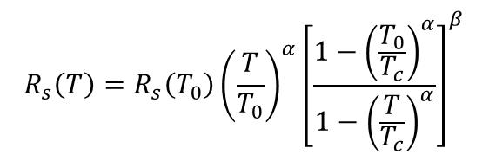

In the model discussed so far, P_{a} is assumed to be deposited as a delta function at x=0
If the surface power is supplied via a r.f. electromagnetic field we can write :
${P_{a}= \frac{1}{2}R}_{s}H_{rf}^{2}=$ ${ \frac{1}{2}R}_{s}{\left(\frac{ε_{0}}{μ_{0}}\right)E}_{acc}^{2}$
R_{s} is the A material surface resistance
E_{acc} is here the maximum surface electric field
Here the power is adsorbed in a layer of thickness δ (λ if the material is a superconductor), so the model approximation is satisfied only if δ (λ ) << L.
If R_{s} = R_{s}(T) (rapidly increasing with T, as is the case of a superconducting material) and if
the power systems keeps the accelerating field E_{acc} = constant , the adsorbed power P_{a} increases with temperature and, depending on the materials parameters and the initial conditions, can cause a large increase of the surface temperaure, up to thermal runaway.
The temperature dependence of R_{s} can be described, for a superconductor, by the two-fluid formula :
$$R_{s}{\left(T\right)=R}_{s}\left(T_{0}\right){\left(\frac{T}{T_{0}}\right)}^{α}{\left[\frac{1−{\left(\frac{T_{0}}{T_{c}}\right)}^{α}}{1−{\left(\frac{T}{T_{c}}\right)}^{α}}\right]}^{β}$$
where $R_{s}\left(T_{0}\right)$ is the surface resistance of the superconductor at the initial temperature
and α=4 , β =3/2 for a BCS superconductor and α=2 , β =0.3 for a HTCS superconductor.

Slide 8
This iterative calculation has been implemented using excell for N=100.
Input parameters are T₀ , k_{A/B} , α_{A/B} (or C_{p} and ρ), τ , L_{A,} R_{s0} , T_{c} and E_{acc} .
τ
τ
T_{Max} (K)
E_{acc} = 49 MV/m
T_{Max} (K)
E_{acc} = 51.06MV/m
P_{a} =cost
t (μs)
t (μs)
The reported examples show the time evolution of the surface temperature for a
Nb/Cu interface (Nb, RRR=30, Cu, RRR=300) with L_{A}= 10μm from the liquid helium
starting temperature. In figure on the left the calculation for P_{a}=cost is also reported.
Thermal runaway occurs for E_{acc} = 51.06MV/m.
The calculation could be further improved including the temperature dependences of k_{A/B} , α_{A/B} , if known in analytical form or tabulated data.

Slide 9

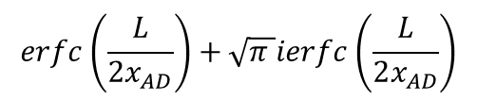
To estimate the error of the approximate solutions, we can set A=B in the solution for T_{Max} :
${T_{Max}≅ T}_{A}(0,τ)\text{=} \frac{2P_{a}x_{AD}}{\sqrt{π}k_{A}}$ $\left[1+\operatorname{erfc}\left(\frac{L}{2x_{AD}}\right)+\sqrt{π }ierfc\left(\frac{L}{2x_{AD}}\right)\right]$+$T_{0}$
We already know that , for a uniform material (A), it is :
${T_{Max}= T}_{A}(0,τ)\text{=} \frac{2P_{a}x_{AD}}{\sqrt{π}k_{A}}$ +$T_{0}$
So that the difference between the approximate solution and the exact in this case is :
$$\operatorname{erfc}\left(\frac{L}{2x_{AD}}\right)+\sqrt{π }ierfc\left(\frac{L}{2x_{AD}}\right)$$
error
L/x_{AD}
The approximation made over estimates the maximum surface
temperature up to a maximum of about 12% when L=x_{AD}

Slide 10
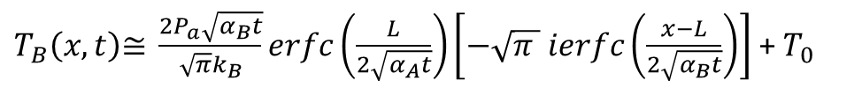
Finally we have :
$T_{A}(x,t)\text{≅} \frac{2P_{a}\sqrt{α_{A}t}}{\sqrt{π}k_{A}}$ $\left[−\sqrt{π }ierfc\left(\frac{x}{2\sqrt{α_{A}t}}\right)+\frac{k_{A}}{k_{B}}\sqrt{\frac{α_{B}}{α_{A}}}\operatorname{erfc}\left(\frac{L}{2\sqrt{α_{A}t}}\right)+\sqrt{π }ierfc\left(\frac{L}{2\sqrt{α_{A}t}}\right)\right]$+$T_{0}$
$T_{B}\left(x,t\right)\text{≅} \frac{2P_{a}\sqrt{α_{B}t}}{{\sqrt{π}k}_{B}}erfc\left(\frac{L}{2\sqrt{α_{A}t}}\right)\left[−\sqrt{π } ierfc\left(\frac{x−L}{2\sqrt{α_{B}t}}\right)\right]$ + $T_{0}$
and :
${T_{Max}≅ T}_{A}(0,τ)\text{=} \frac{2P_{a}x_{AD}}{\sqrt{π}k_{A}}$ $\left[1+\frac{k_{A}}{k_{B}}\sqrt{\frac{α_{B}}{α_{A}}}\operatorname{erfc}\left(\frac{L}{2x_{AD}}\right)+\sqrt{π }ierfc\left(\frac{L}{2x_{AD}}\right)\right]$+$T_{0}$

Slide 11


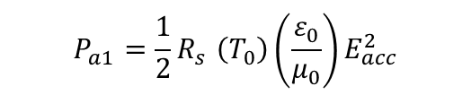


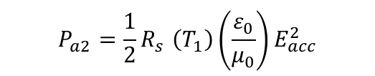
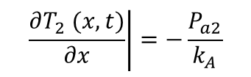



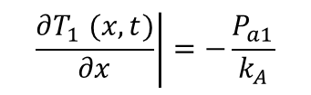
The problem can be easily faced dividing the pulse time lenght τ into N small intervals Δτ
(so that τ= NΔτ) sufficiently small that R_{s} can be considered constant in that interval.
The solution can than be found by a simple iteration procedure :
$$\left(0≤t≤Δτ \right)$$
${ T}_{1}(x,t)=A_{1}\sqrt{α_{A }t}$ $\left[ierfc\left(\frac{x}{2\sqrt{α_{A }t}}\right)\right]$+$T_{0}$
$$\left.\frac{∂T_{1} (x,t)}{∂x}\right|=−\frac{P_{a1}}{k_{A}}$$
, and :
x=0
${ T}_{1}=T_{Max}\left(0,∆τ)\right)=\frac{2x_{AD}}{\sqrt{π}k_{A}}P_{a1}\sqrt{\frac{1}{N}}$ $\left[1+\frac{k_{A}}{k_{B}}\sqrt{\frac{α_{B}}{α_{A}}}\operatorname{erfc}\left(\frac{L}{2x_{AD}}\sqrt{\frac{N}{1}}\right)+\sqrt{π }ierfc\left(\frac{L}{2x_{AD}}\sqrt{\frac{N}{1}}\right)\right]$+$T_{0}$
$$P_{a1}{=\frac{1}{2}R}_{s}\left(T_{0}\right){\left(\frac{ε_{0}}{μ_{0}}\right)E}_{acc}^{2}$$
with :
$$\left(Δτ≤t≤2Δτ \right)$$
${ T}_{2}(x,t)=A_{2}\sqrt{α_{A }\left(t−∆τ\right)}$ $\left[ierfc\left(\frac{x}{2\sqrt{α_{A }\left(t−∆τ\right)}}\right)\right]$+$T_{1}\left(x,t\right)$
, and :
$$\left.\frac{∂T_{2} (x,t)}{∂x}\right|=−\frac{P_{a2}}{k_{A}}$$
x=0
$$= \frac{2x_{AD}}{\sqrt{π}k_{A}}\left\{P_{a1}\sqrt{\frac{2}{N}} \left[1+\frac{k_{A}}{k_{B}}\sqrt{\frac{α_{B}}{α_{A}}}\operatorname{erfc}\left(\frac{L}{2x_{AD}}\sqrt{\frac{N}{2}}\right)+\sqrt{π }ierfc\left(\frac{L}{2x_{AD}}\sqrt{\frac{N}{2}}\right)\right]+\left(P_{a2}−P_{a1}\right)\sqrt{\frac{1}{N}} \left[1+\frac{k_{A}}{k_{B}}\sqrt{\frac{α_{B}}{α_{A}}}\operatorname{erfc}\left(\frac{L}{2x_{AD}}\sqrt{\frac{N}{1}}\right)+\sqrt{π }ierfc\left(\frac{L}{2x_{AD}}\sqrt{\frac{N}{1}}\right)\right]\right\}+T_{0}$$
T₂$=T_{Max}\left(0,2∆τ\right)$
$$P_{a2}{=\frac{1}{2}R}_{s}\left(T_{1}\right){\left(\frac{ε_{0}}{μ_{0}}\right)E}_{acc}^{2}$$
$$\sqrt{α_{A}2Δτ}=x_{AD}\sqrt{\frac{2}{N}}$$
with :
( )

