Slide 1

VPP-IZM-CERN-2022/1-0001
SRP WP3 activities/ results
Andris Ratkus
Researcher/ Accelerator Technology Group Leader
30.11.2023

Slide 2
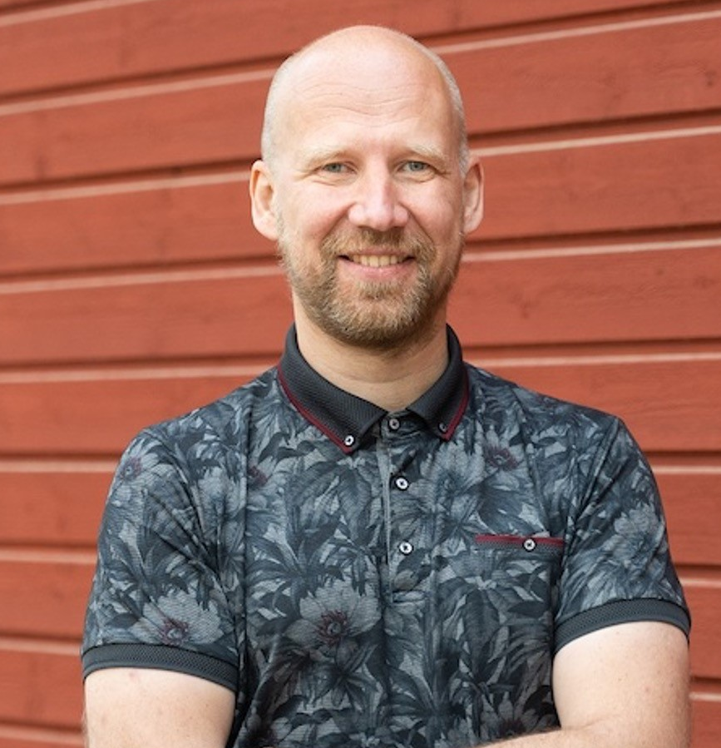
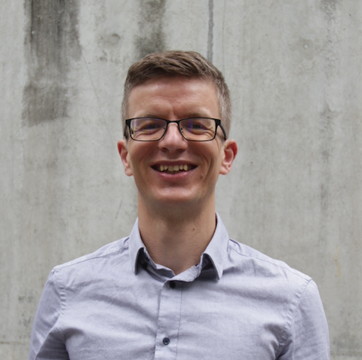
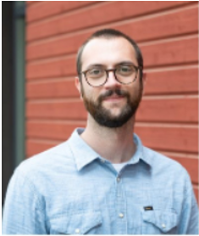
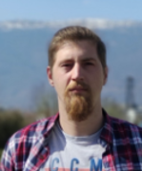
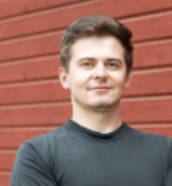
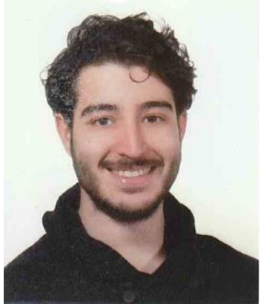

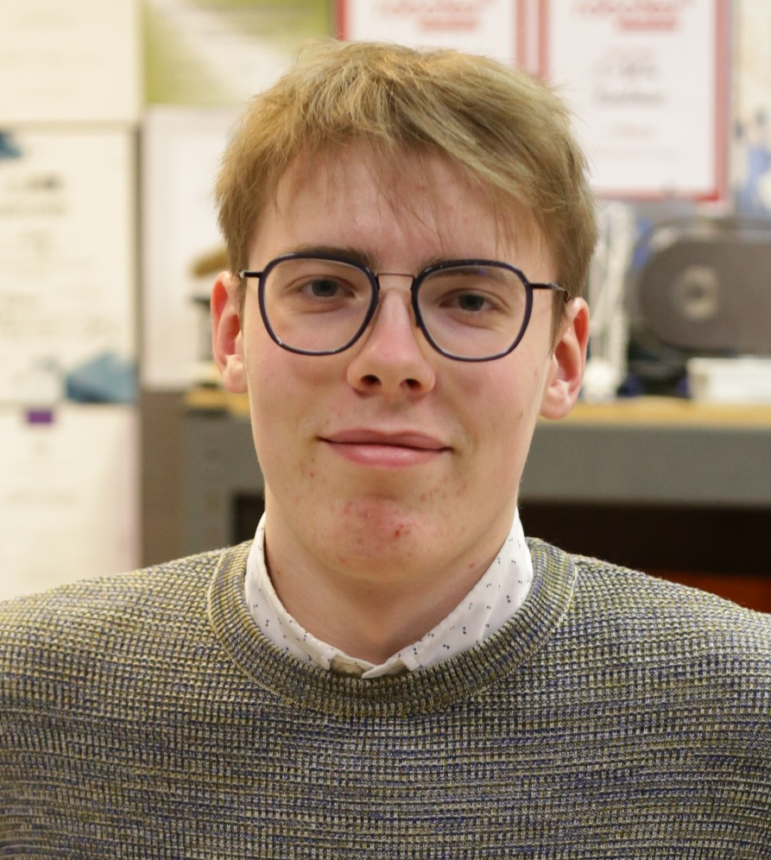

WP3 Team
  Dr. Andris Ratkus
  Guntis Pikurs PhD student
  Luca Piacentini PhD student
  Lazar Nikitović PhD student
  Kristaps Paļskis PhD student
  Vincenzo Alberto Sansipersico PhD student*
  Aurēlija Viņķe Bachelor student
  Dairis Rihards Irbe Bachelor student*

Slide 3

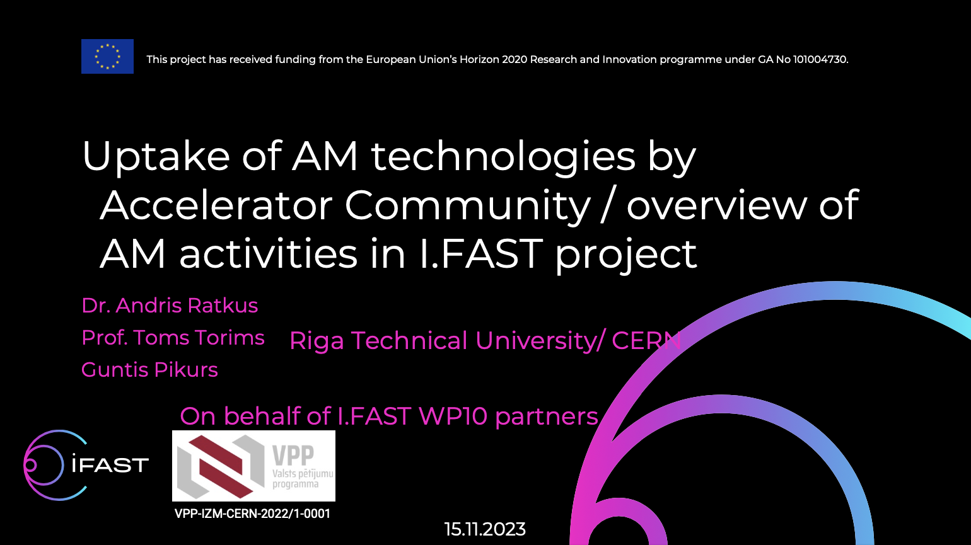
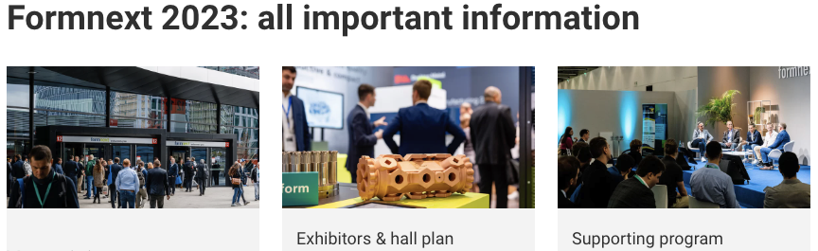
Activities briefly
CERN summer student programm
3rd CERN Baltic Conference 2023 (presentations/ posters)
Into the formnext 2023 ehebition
NIMMS 3rd phase kick-off meeting
Visit and Seminar at Science and Technology Facilities Council (STFC)

Slide 4

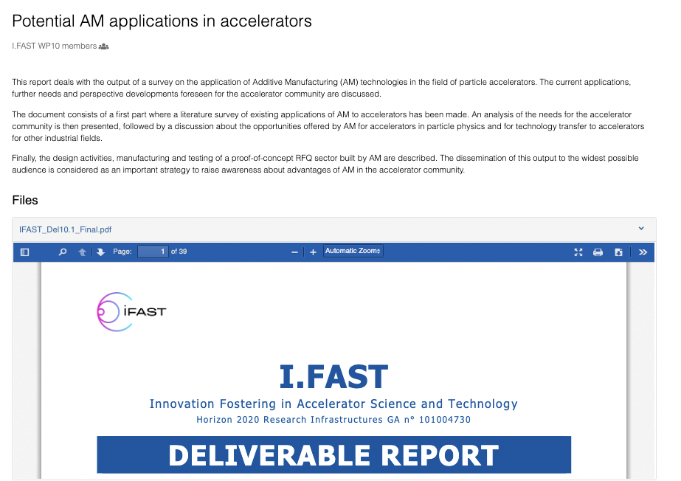
I.FAST Deliverable 10.1
Submited and approved
https://zenodo.org/records/10040936

Slide 5

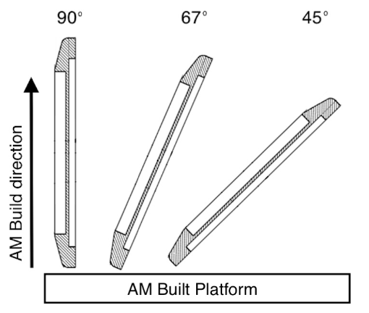
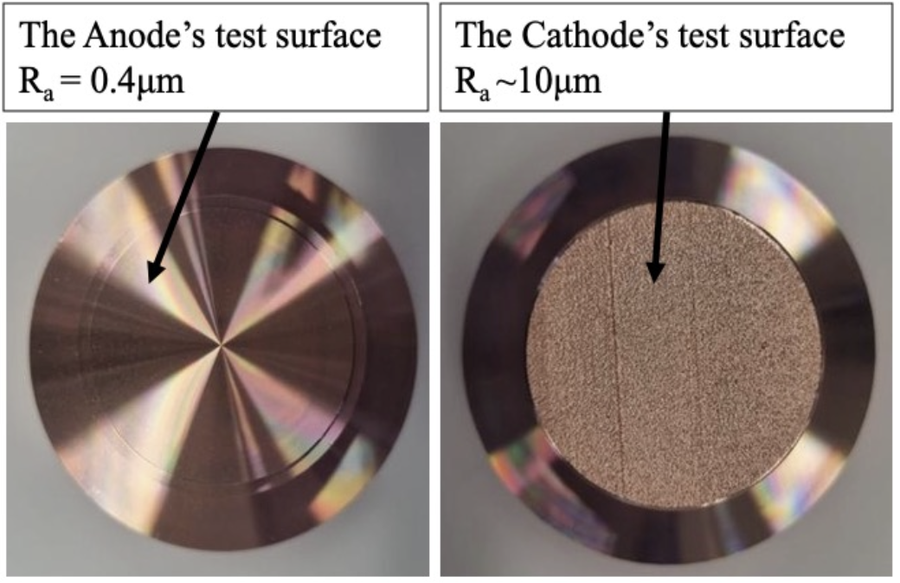
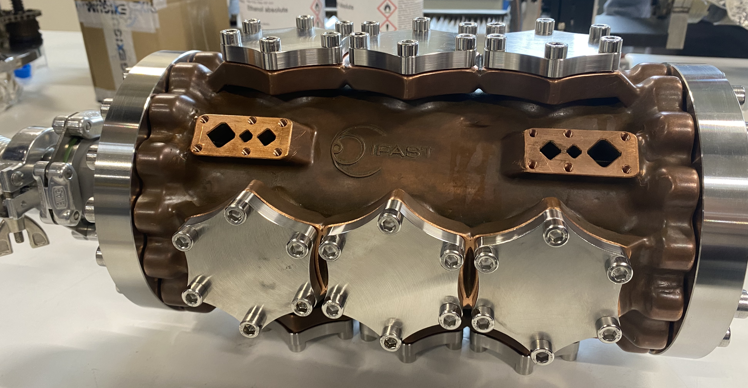
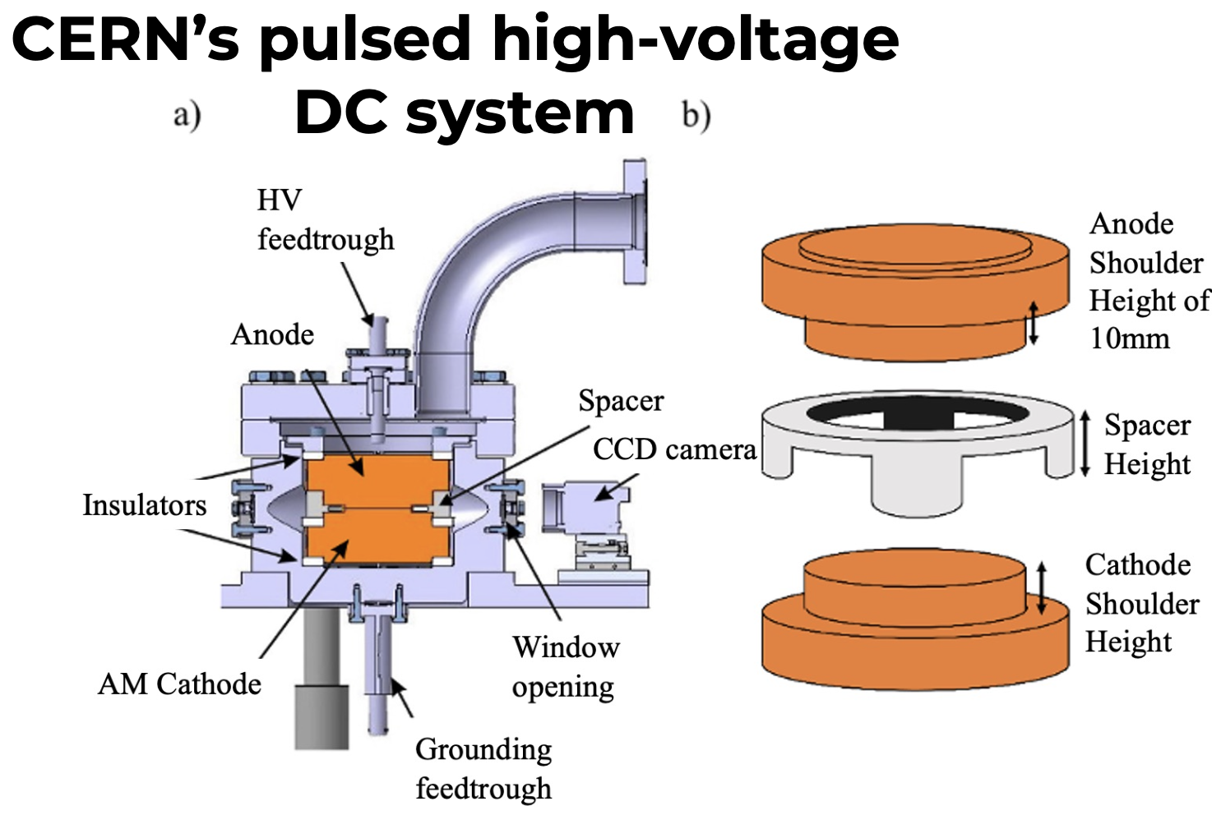
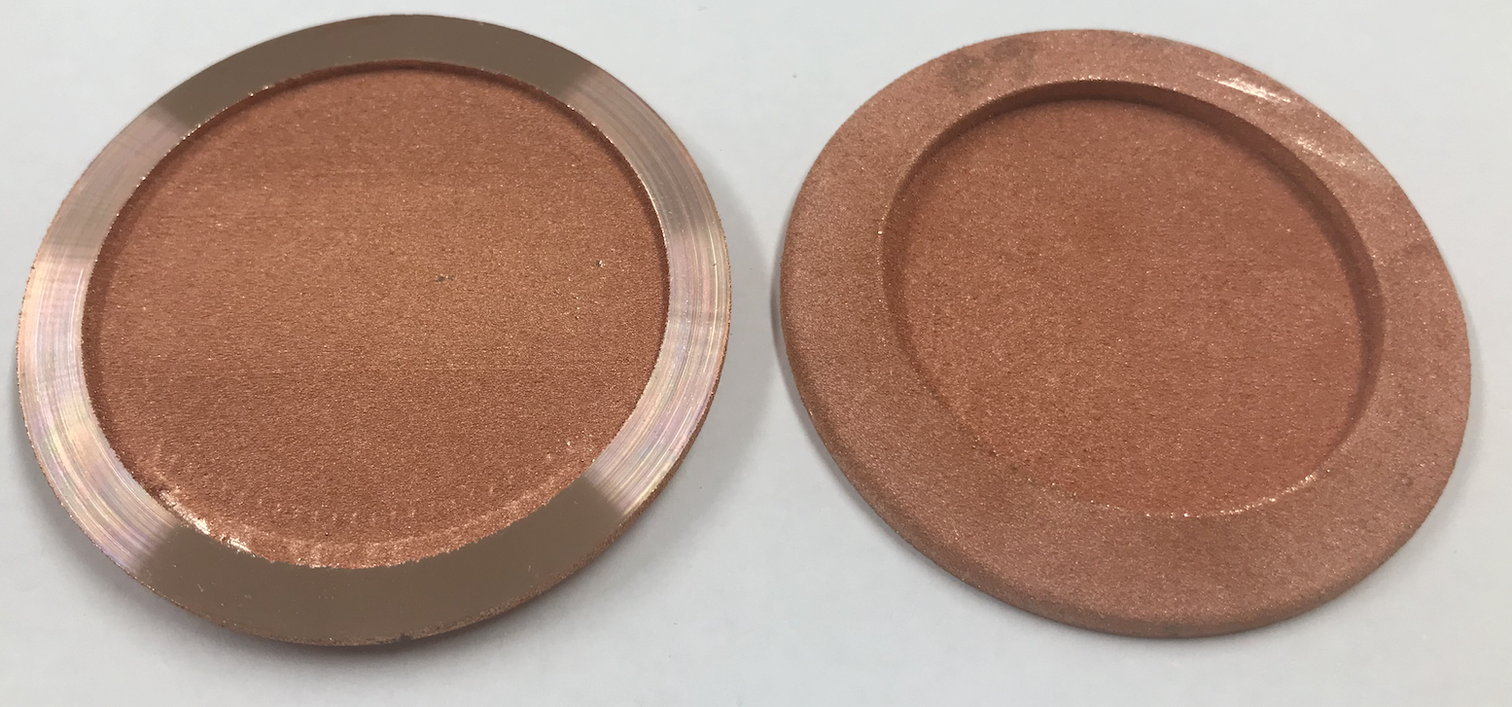
I.FAST activities
Microstructure analyse
HV tests (with 60um gap)
Vacuum tests (@CERN)

Slide 6
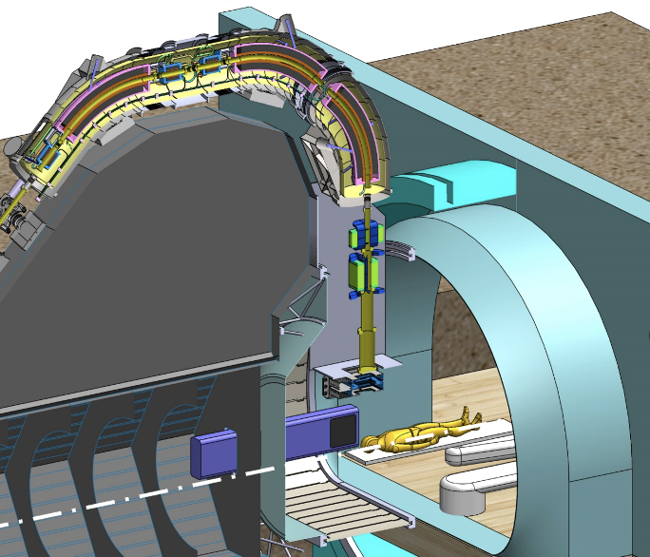
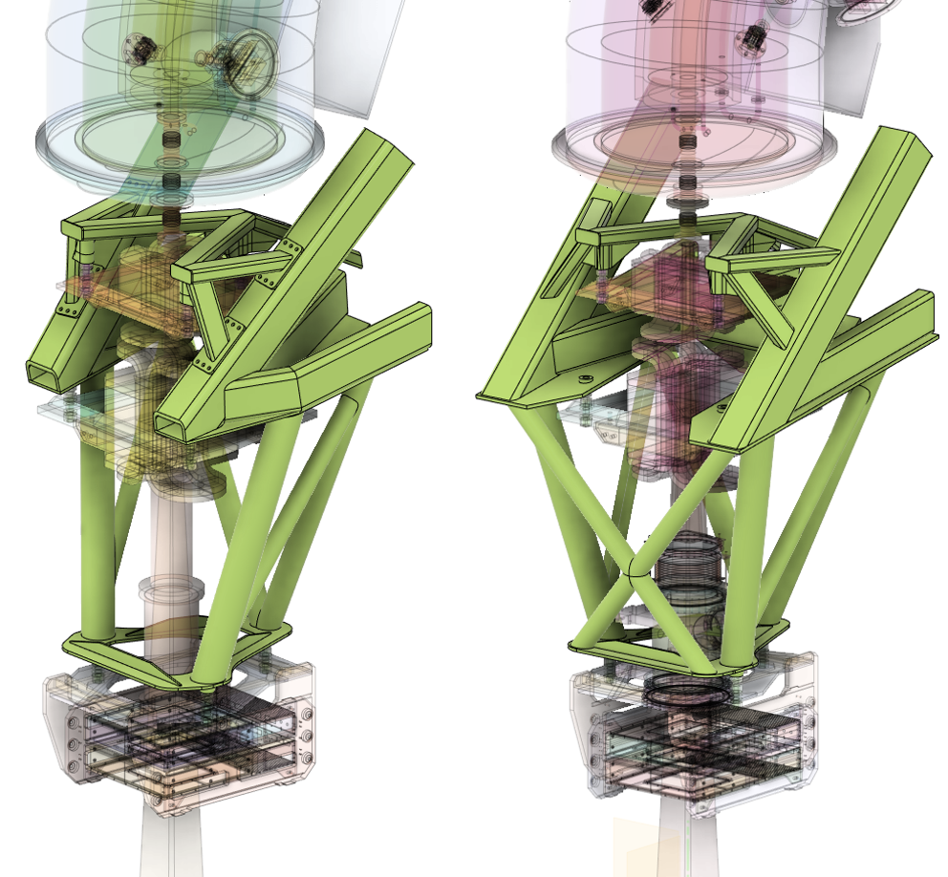
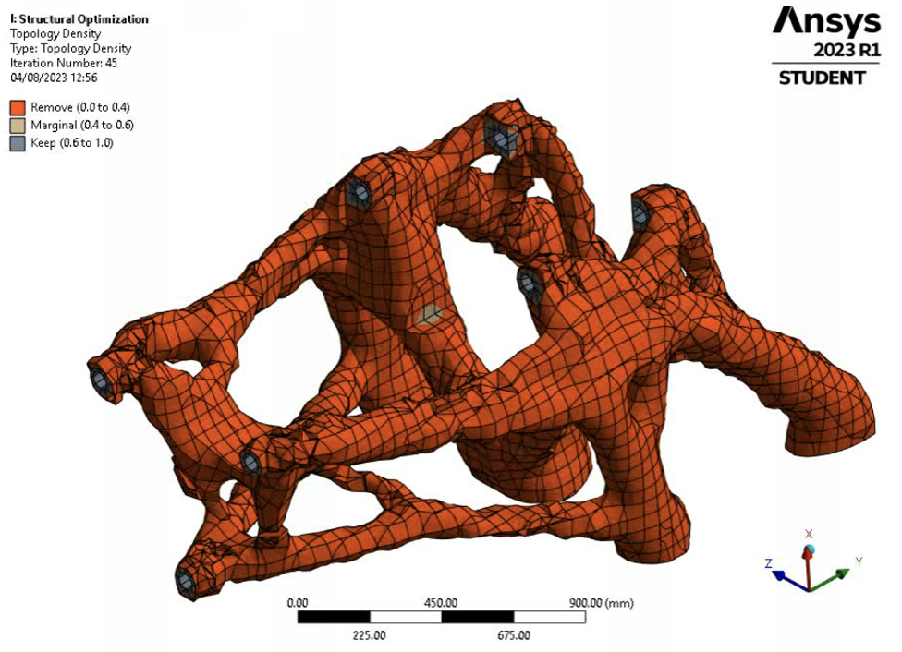
HITRIplus Research Activities
Nozzle design
Courtesy: L. Piacentini
Courtesy: D. Irbe

Slide 7
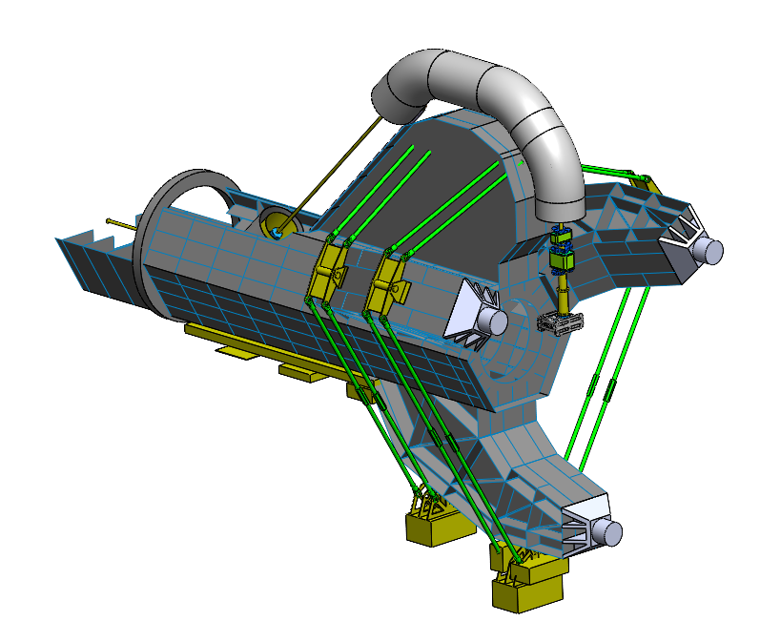
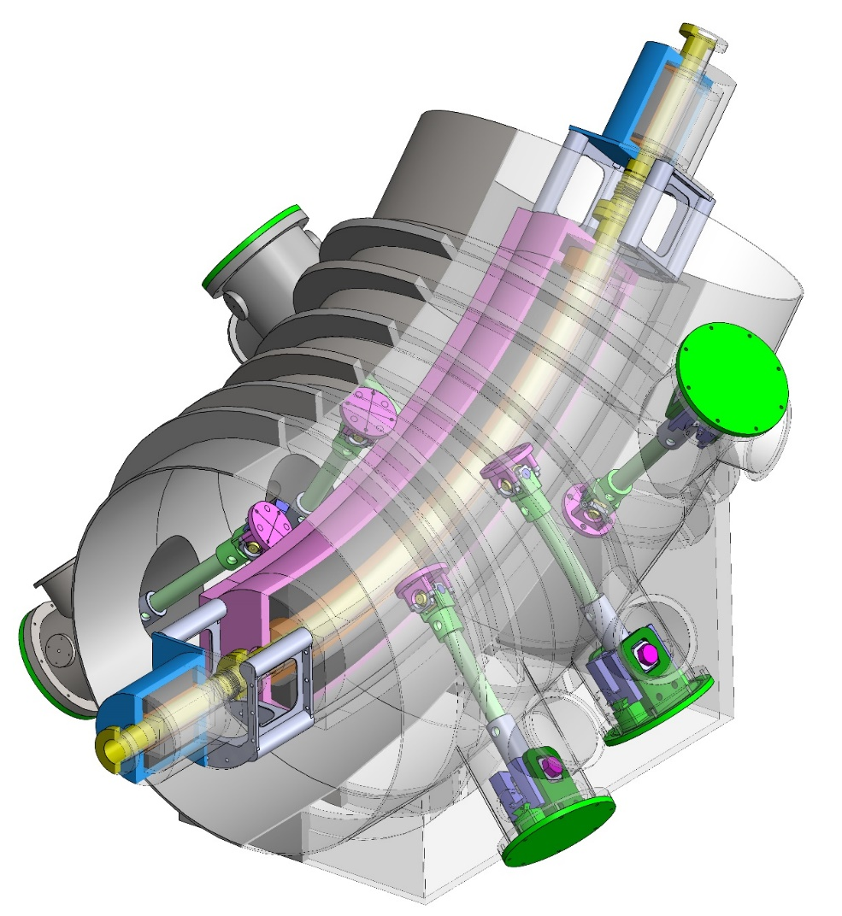
HITRIplus Research Activities
Gantry design/ warm component support alignment
SC magnet support and alignment system
Courtesy: L. Piacentini

Slide 8

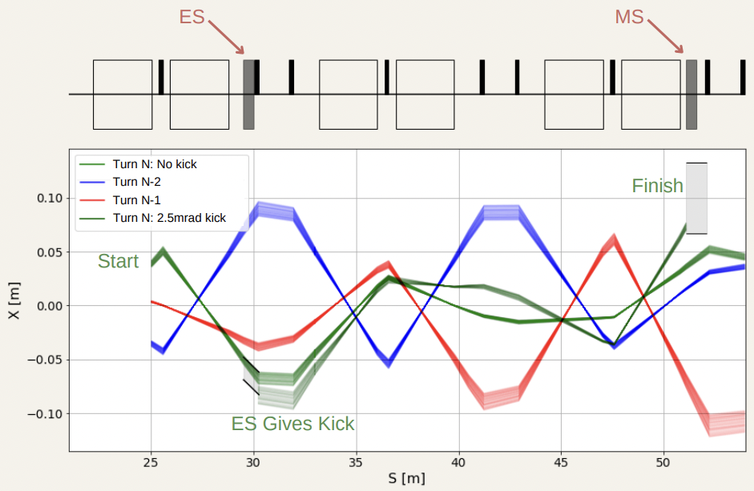
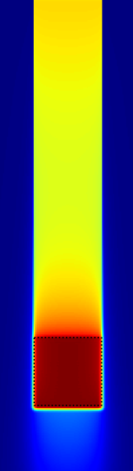
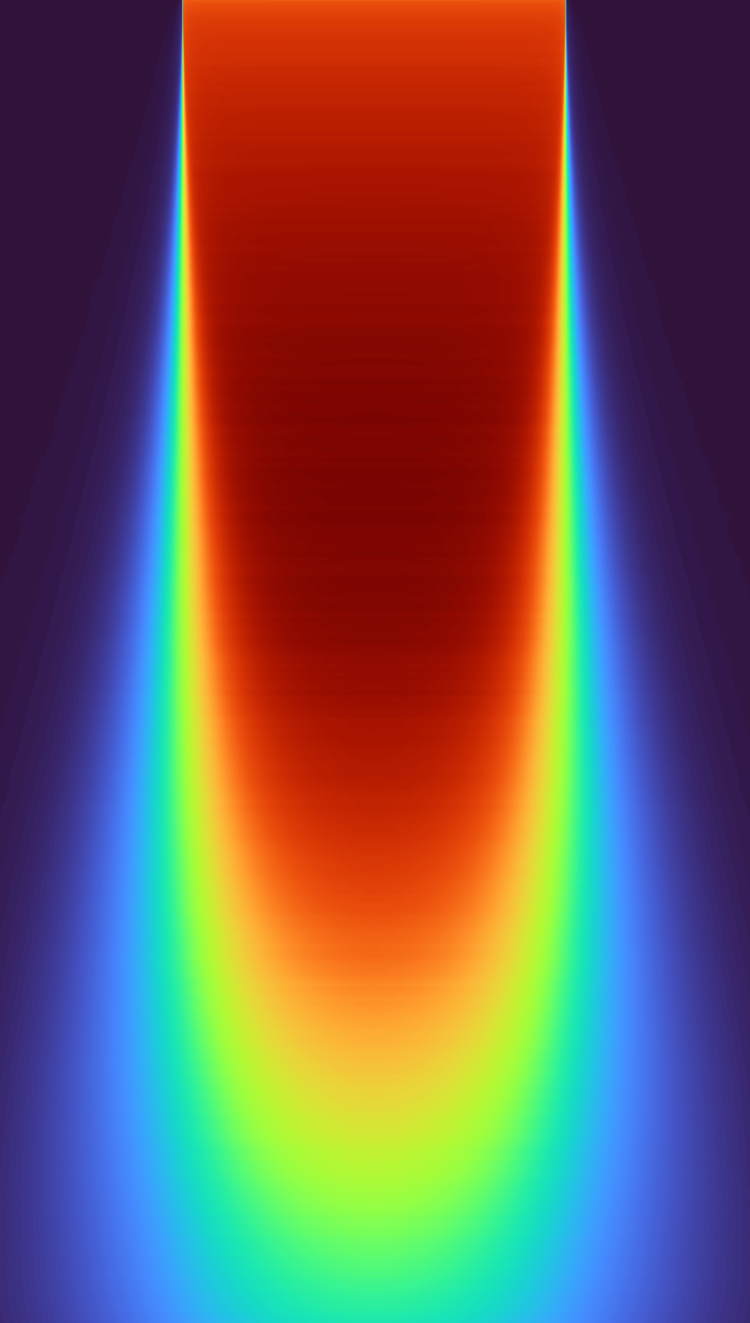
NIMMS research activities
Flash therapy research by Kristaps
Flash extraction by Vincenzo
Courtesy: R. Taylor
Courtesy: K. Palskis

Slide 9

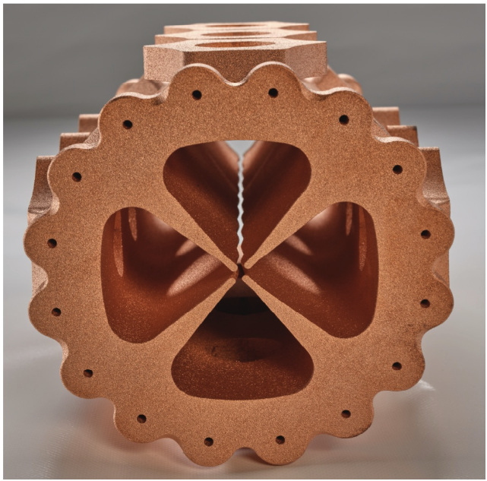
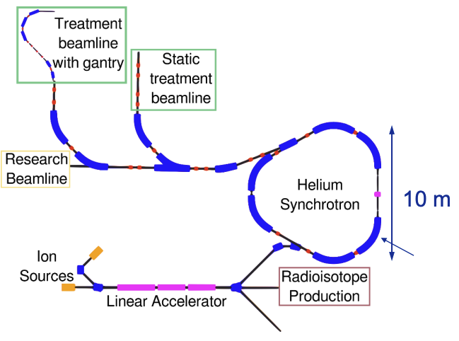
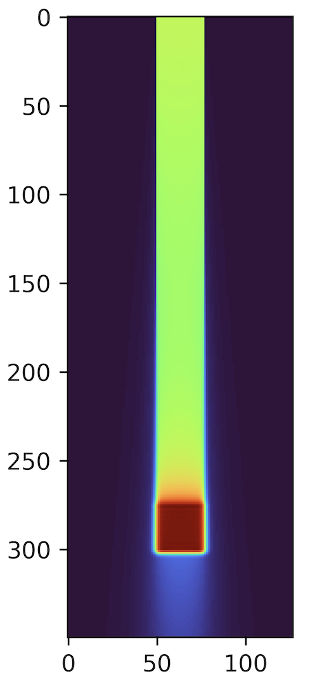
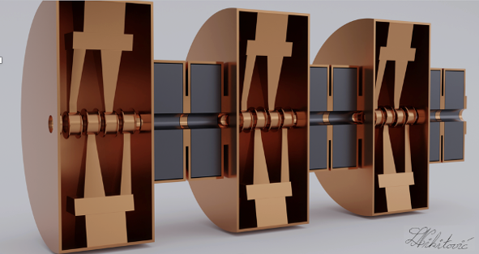
Building the expertise in Accelerator Technologies
Project initiative: Advanced Particle Therapy center in the Baltic States
AM for accelerators
Courtesy: L. Piacentini
Courtesy: L. Nikitovic
Source: M. Vretenar et al., IPAC2022
FLASH therapy
Courtesy: K. Palskis

Slide 10
Closest Steps and Activities
AM copper sampl teats at KTU
RFQ vacuum tests at CERN
RFQ low power RF tests (without vacuum)
Disign New RFQ
Further HITRIplus Gantry design developments
Further NIMMS reserch activities

Slide 11
Thank you!
Andris Ratkus
andris.ratkus@rtu.lv

