Slide 1


Nr. VPP-IZM-CERN-2022/1-0001
Augstas enerģijas daļiņu fizikas pētījumi CMS eksperimentā un progresīvu paātrinātāju tehnoloģiju izstrāde sadarbībā ar CERN
Progress on WP2 «Experimental HEP research at the CMS experiment at CERN» in UL Institute of Chemical Physics
E. Pajuste
N. R. Strautnieks
25.05.2023

Slide 2



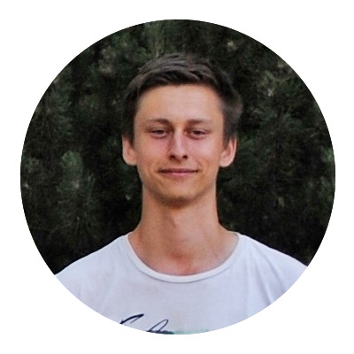
Administrative matters
Team
Team leader, senior. researcher
Asoc. Prof. Dr. chem. Elīna Pajuste
0.2 PLE
PhD student, researcher
MSc. Phys. Normunds Ralfs Strautnieks
1.0 PLE
Pending..
BsC student, lab. assistant
Estere Agnese Tēberga
0.5PLE
Funding

Slide 3
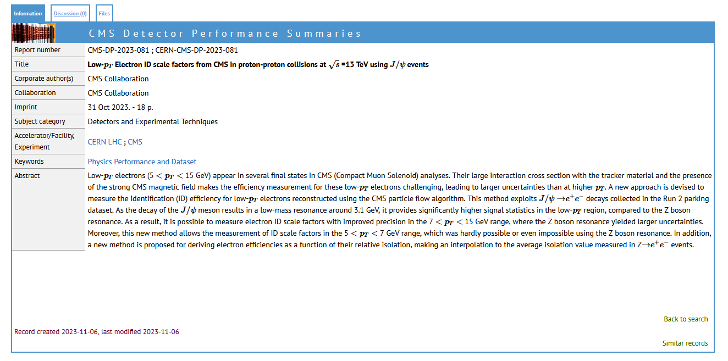
Low-pT electron activities
DPS note:
  Public DPS note on low-p_{T} electron ID SF calculation has been approved and posted on CDS (link)
Low-p_{T} electron publication:
  EGM group is working on writting a dedicated low-p_{T} electron paper
  Our groups study will be a chapter in the paper(AN-23-176) (have to write the initial version before Christmas)
Inclusion of J/ψ efficiency calculations in EGM TnP tool:
  Future activity -> The efficiency calculation logic used for the J/ψ should be integrated inside the official EGM TnP tool (Combination of Z→ee and J/ψ→ee efficiency measurements in single tool for coverage of the low-p_{T} region)
CDS page of the low-p_{T} DPS note (link)

Slide 4

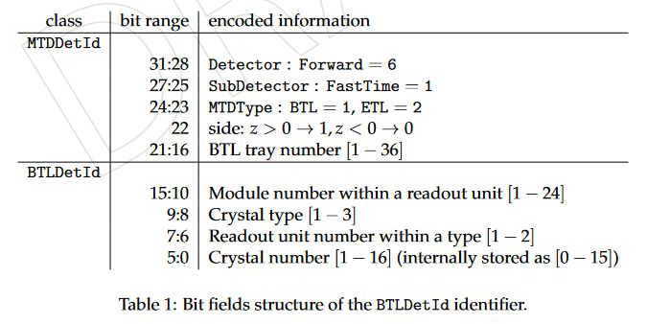
MTD DPG activities
Electron isolation task is finalised -> Validation code is merged with the CMSSW in github and will be included in the newest release. (CMS_14_0_X)
New MTD related task -> Update the MTD BTL geometry with the newest configuration:
  Update the crystal types -> Same LYSO crystal size in all BTL (instead of 3 different sizes)
  Change BTL crystal length
  Change the corresponding component positions accordingly
  Update the BTL crystal indetification numbering scheme (no more crystal sizes and potential other changes)
    32 bit number charaterizing each crystal in the BTL
Table explaining the current (outdated) BTL crystal numbering scheme (link)

Slide 5
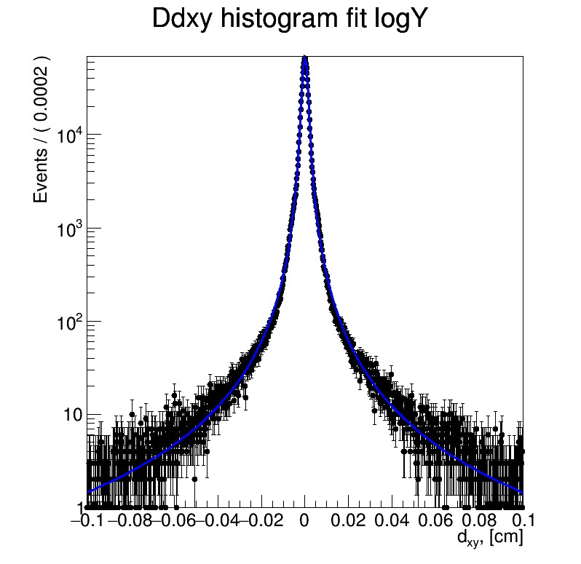
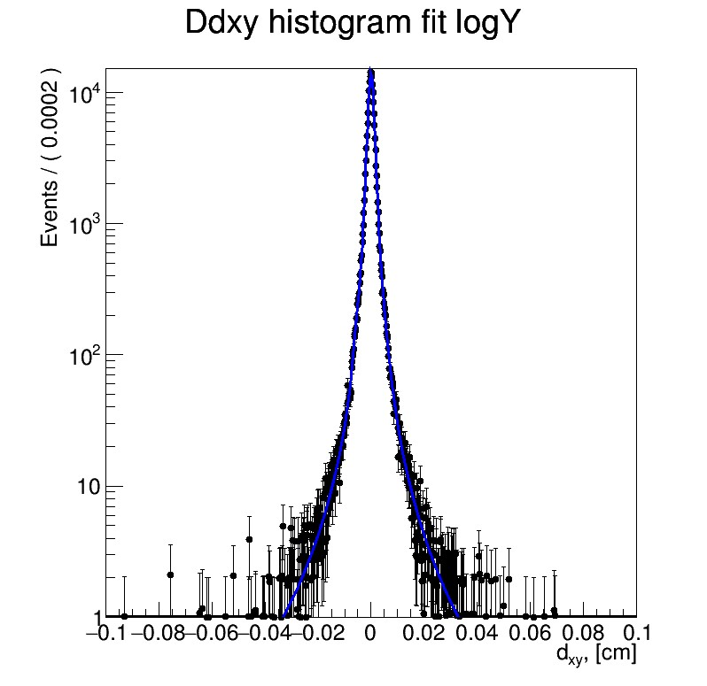
Thesis LFU study
DATA
MC
Low-pT muon scale factors:
  RECO+ID -> Calculated multiple variations. Additional discussion with Muon POG convenors needed for approval.
  ISO -> Calculated from Z->MuMu. Presentation at Muon POG group’s meeting needed for approval.
Lepton dxy corrections for MC using ‘Quantile corrections’ method:
  Fit DATA and MC d_{xy} distributions with a function (PDF)
  Get the CDFs of the fitted functions (PDFs)
  Correct the MC d_{xy} value by using the DATA CDF, to get the expected corrected value
  Do this for each event, so it is not binned reweighting, but a dedicated correction for each MC event/d_{xy} value (Scheme on the right)
DATA (left) and MC (right) d_{xy} value distributions in log scale in 10-20 GeV p_{T} and 0.0-0.9 abs(η) bin. Distributions do not match, a correction is needed for MC.
1
MC
DATA
CDF, [Probability]
CDF value for the Input MC d_{xy} value
2.
1.
3.
0
Corrected MC d_{xy} value
0.1
Input MC d_{xy} value
d_{xy}, [cm]
Schematic description of the quantile corrections method

