Slide 1
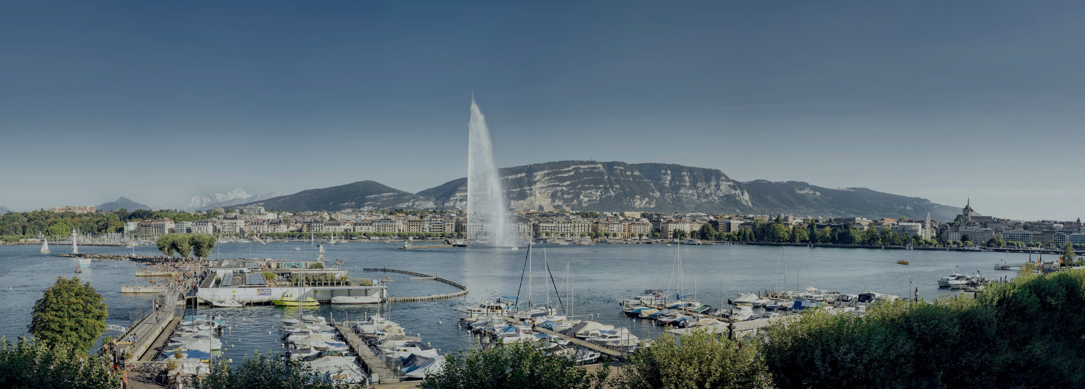


INTERNATIONAL WELCOME CENTRE
@CagiGeneva
PRESENTED BY
Mrs. Veronica Eggly, Deputy Welcome Service, Welcome programme specialist
Mr Michael Cochet, Head of Communications and Cultural Kiosks

Slide 2



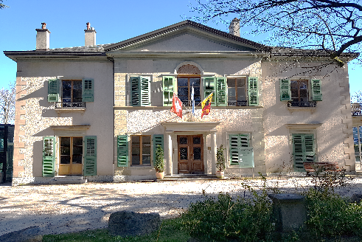
WHO ARE WE ?
A non-profit organisation, founded in 1996
The 'one stop shop' facilitating the settlement and the integration
Assistance to NGOs and support to delegates attending conferences in Geneva
CAGI’s services are free of charge
welcome.cagi@etat.ge.ch
+41 (0)22 546 14 00
La Pastorale
Route de Ferney 106
1202 Genève

Slide 3







































OUR MEMBERS
Founding members
Associate members
Supporting members

Slide 4

WELCOME SERVICE: HOUSING SUPPORT
an online housing platform
VIP Service
settling-in & departure support
proofreading of rental contracts
tenancy law advice
search for office space
Contact
+41 (0)22 546 14 17
welcome.cagi@etat.ge.ch

Slide 5

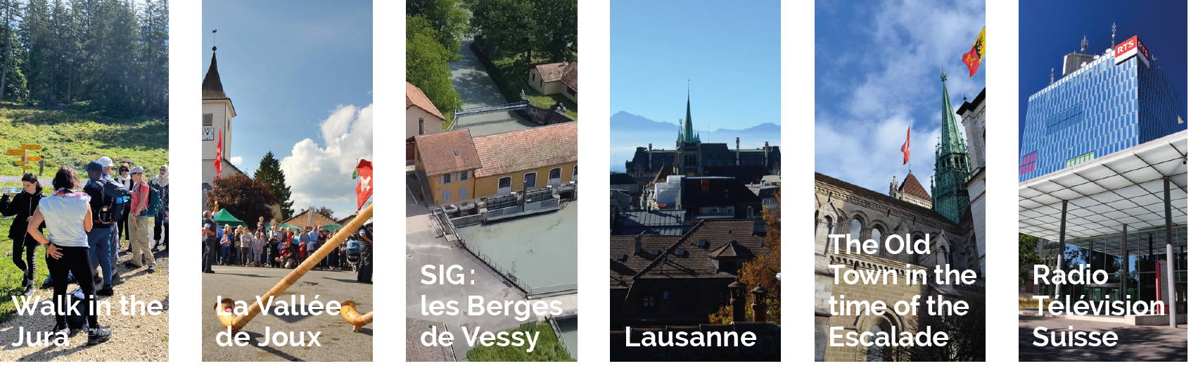
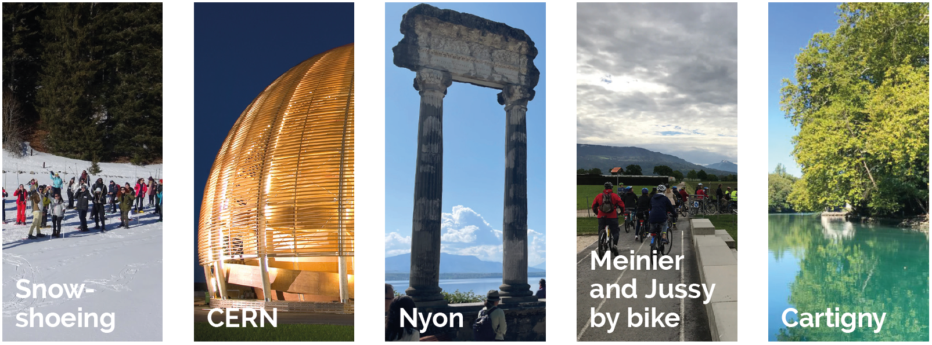
WELCOME PROGRAMME : EXCURSIONS
A programme of excursions and visits for international newcomers, valid one year

Slide 6
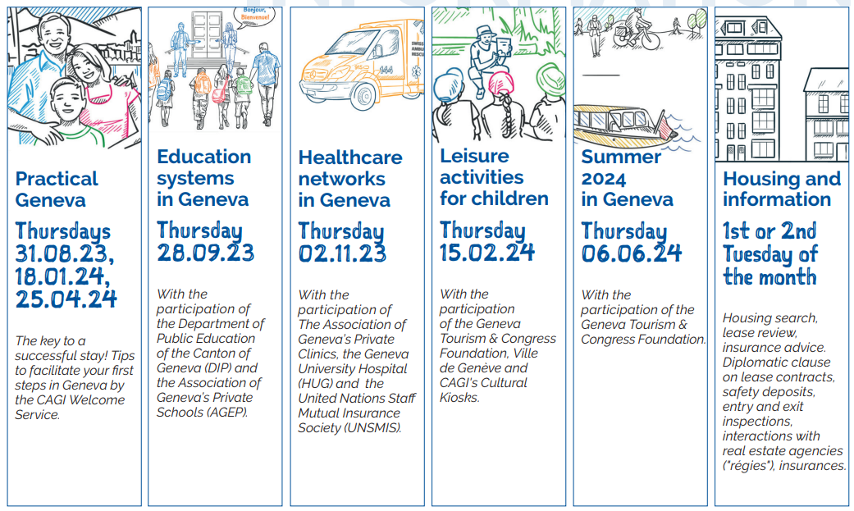
WELCOME PROGRAMME : CONFERENCES
Information sessions on various thematic to facilitate your stay in Geneva

Slide 7
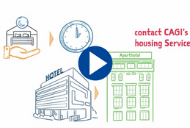
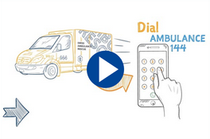



PRATICAL GENEVA
Housing & Insurances
Health & Medical
Education & Family life
Transport & Mobility
Brochure (pdf)

Slide 8


WELCOME PROGRAMME : "BEL"
BEL : Bourse d'Echange Linguistique or Conversation Exchange Programme
Improve and practise speaking any language
of your choice in exchange for your own

Slide 9
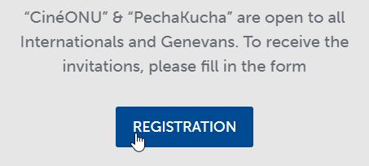



WELCOME PROGRAMME : SOCIAL EVENTS
Discover local events happening in Geneva

Slide 10

SAVE THE DATE !
From 16 to 20 April.
16 UN agencies from across International Geneva will be there to showcase their important work and how it has a positive impact on people around the world.
Come talk to us & learn about the work of International Geneva and its global impact.

Slide 11
SPOUSES / PARTNERS
Conference - Twice a year in collaboration with the Swiss Permanent Mission and Michael Page:
"Spouses/partners of employees of International Geneva – How to succeed with your job search"
Save the date: 25.06.2024 at UNIGE
Save the date: 29.10.2024 at WIPO
CAGI's NGO Recruitment Platform NGO Section
International Dual Career Network: IDCN
Association découvrir – assists qualified migrant women
UNIGE: Horizon académique - Integration in Higher education institutions

Slide 12


CULTURAL KIOSK
AT UN GENEVA & CERN

Slide 13
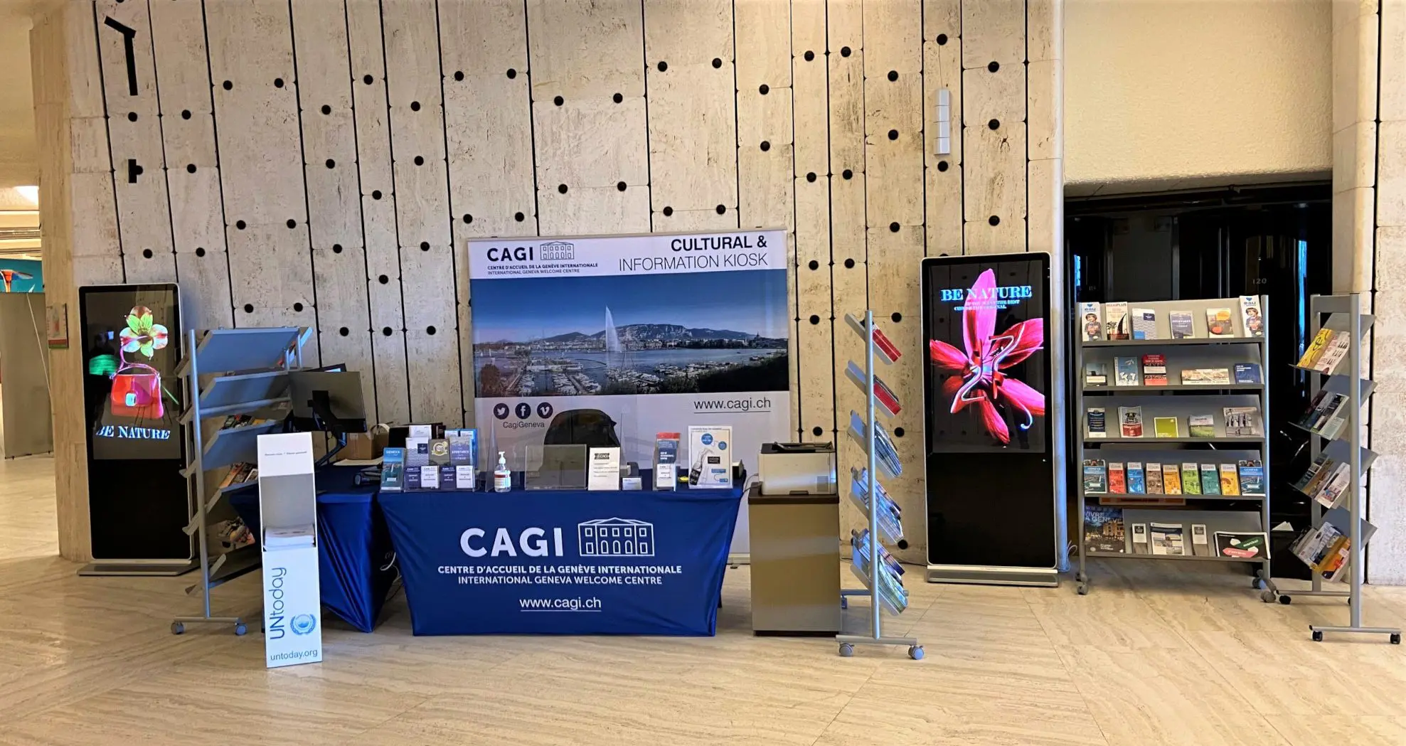
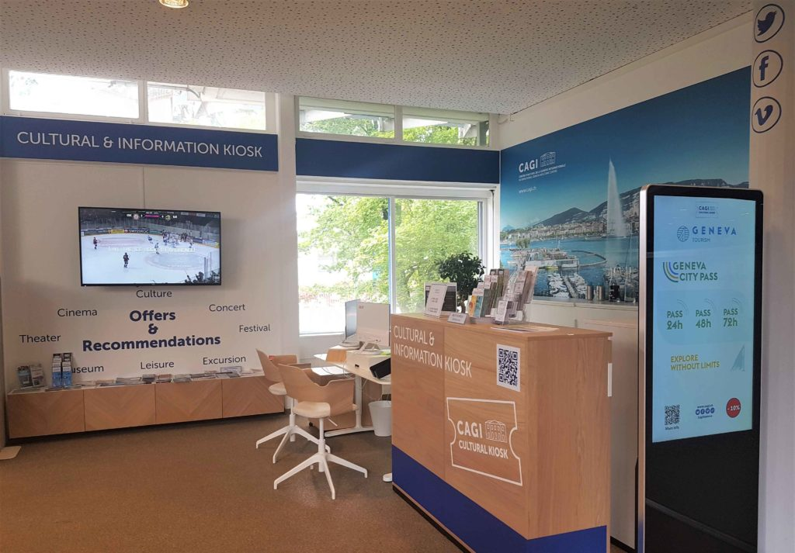

CULTURAL KIOSK : UN Geneva / CERN
One-stop-shop point of information and ticketing for entertainment, shows and cultural activities
Recommendation of tourist and leisure activities in Geneva and Switzerland
Preferential rates on a variety of tickets
Kiosque Culturel ONU Genève
 +41 22 917 11 11
info@kiosqueonu.ch
Kiosque Culturel CERN
 +41 22 766 94 76
info@kiosquecern.ch

Slide 14


CAGI CULTURAL PARTNERS
Sport
Cinema
Concert
Theatre
Festival
Museum
Excursion
Children
Activities

Slide 15

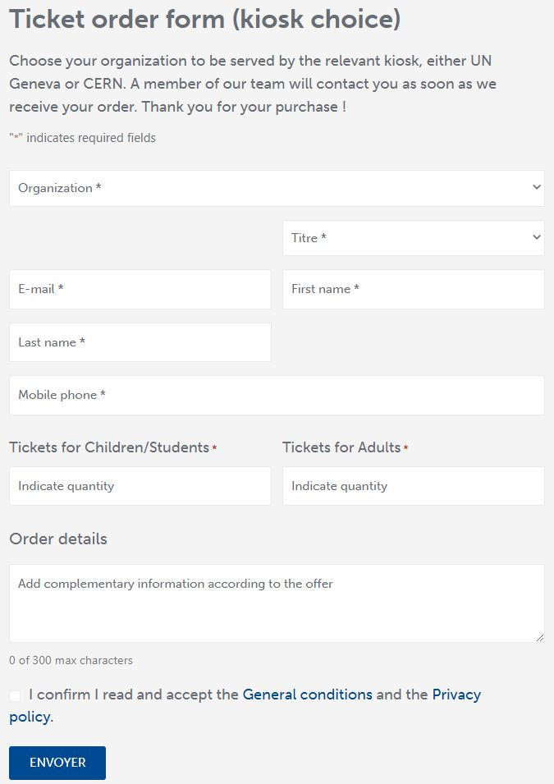

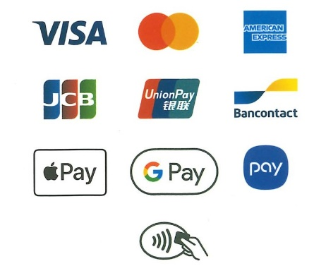

HOW TO PURCHASE TICKETS
DIRECTLY
UN or CERN badge or pass required
Payment by card only
REMOTELY
Online ticket order form
Payment link by email, sms

Slide 16

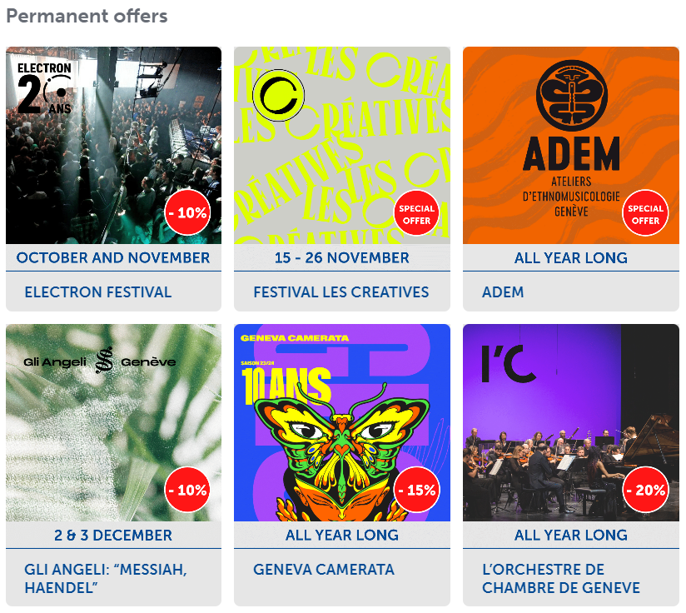
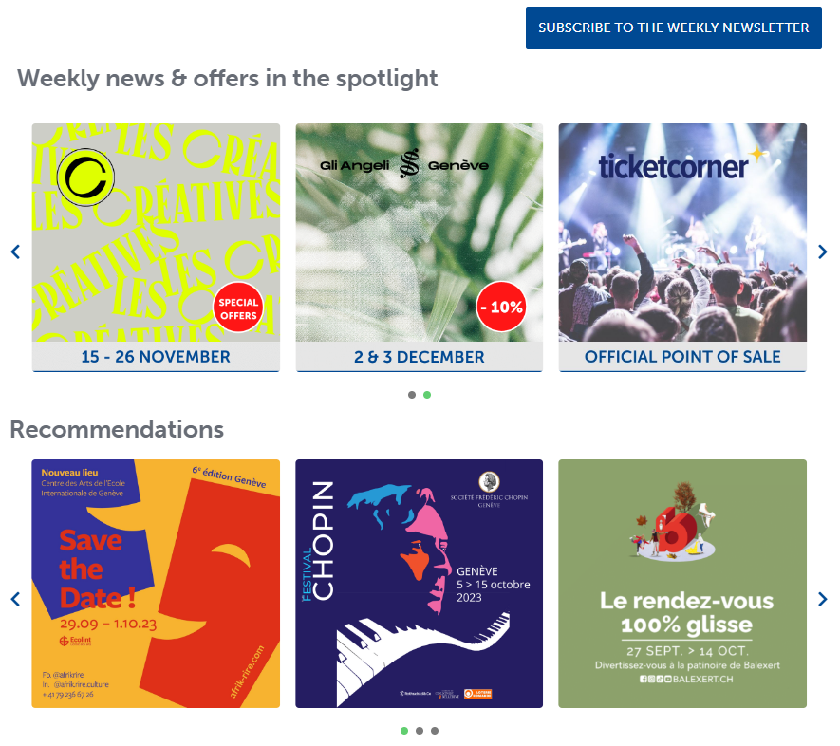
CULTURAL KIOSKS AGENDA

Slide 17
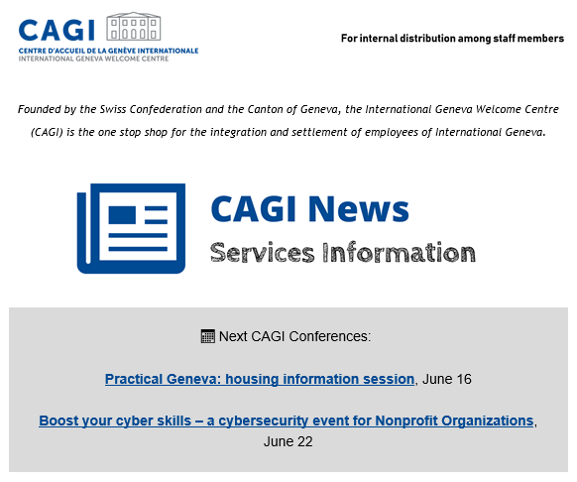


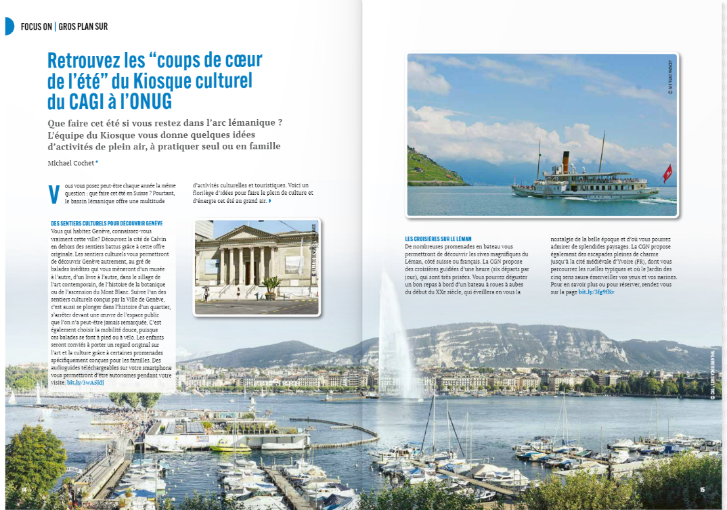

HOW TO STAY INFORMED ?
Weekly Newsletter
UN Today magazine
Subscription eligibility: international employees from UN Geneva, CERN, PM, NGO and other IO
+ Broadcast UN Geneva "What's New"
"Le bulletin" from CERN
Notes:
+ Broadcast UN Geneva "What's New" & CERN Bulletin

Slide 18



SOCIAL NETWORKS
Special
offers
Weekend
ideas &
inspiration
@CagiGeneva
Cultural
recommendations
Practical
Geneva
Information
@cagi.geneva
@CagiGeneva

Slide 19






022 / 546 14 00
welcome.cagi@etat.ge.ch

