Slide 1


@
INTERNATIONAL DUAL CAREER NETWORK
March 2024
IDCN LAKE GENEVA
CERN Spouse Welcome Event

Slide 2
Challenges faced by employee partners/spouses
Integration
Guidance
Language
Culture
Interview Preparation
Social Life
Networking
Work/Job
Overall Wellbeing

Slide 3
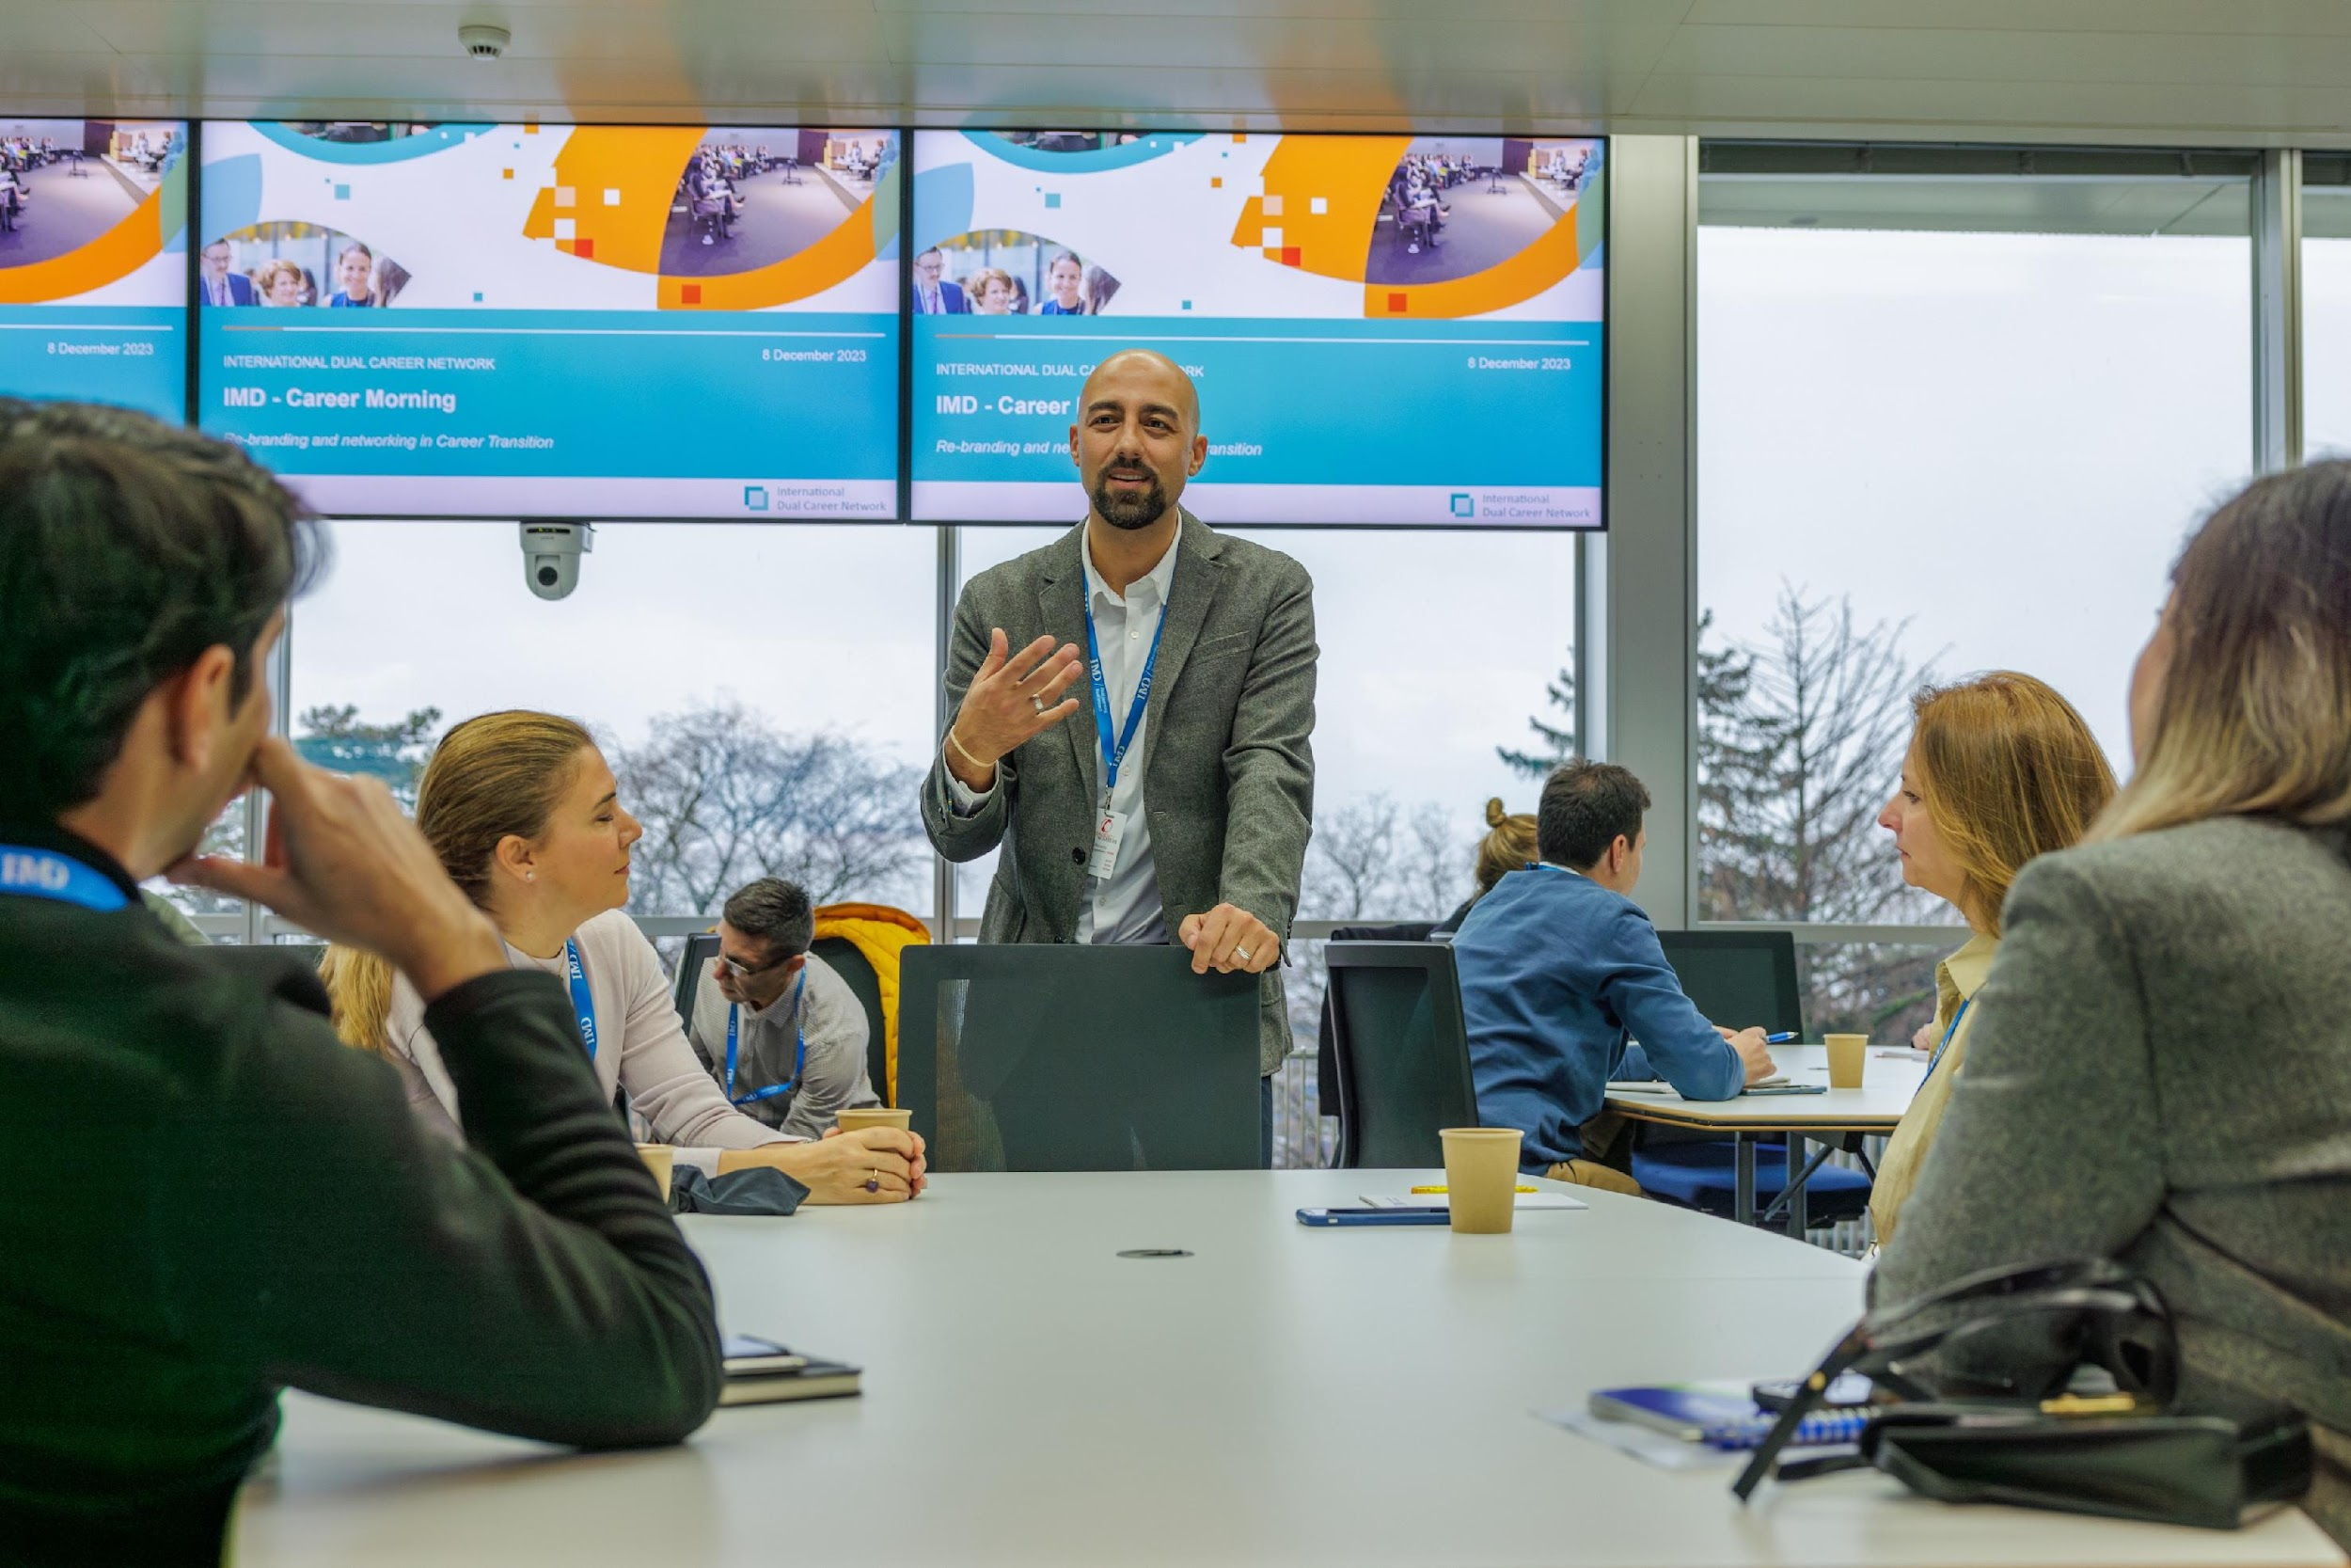
IDCN is an association of multinational and local organizations that aim to support the professional integration of employee partners and spouses by hosting a variety of professional and social networking events, both locally and globally.
By leveraging the talent available through dual-career partners and spouses, the IDCN emphasizes the importance of fulfilling organizational responsibilities towards inclusion, diversity, corporate social responsibility, environmental, social, and governance (ESG) standards, as well as sustainability initiatives.
OUR
MISSION
IDCN helps to make dual career assignments a success
Corporate
Events
Career
Mornings
Master
classes
Workshops

Slide 4
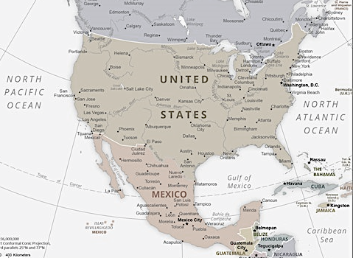
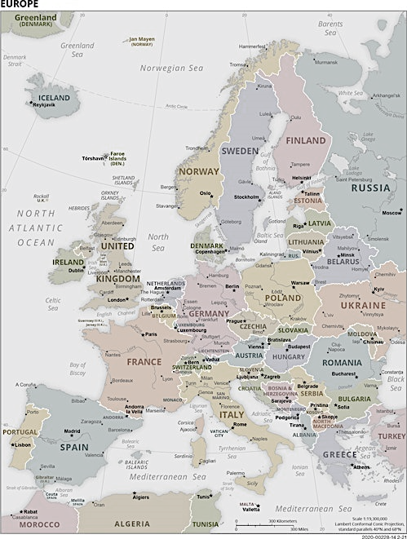


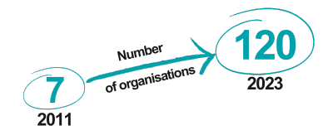
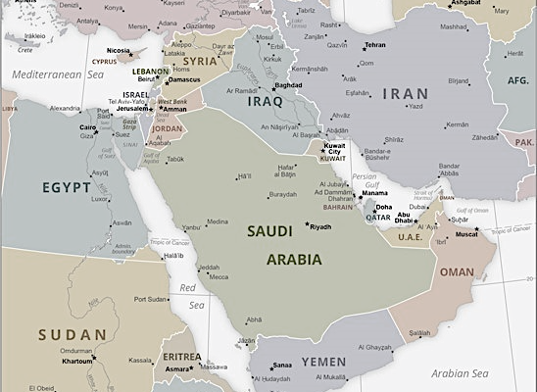
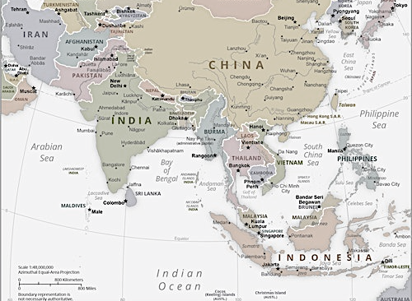
14 IDCN LOCATIONS
WORLDWIDE
Americas
New York
Mexico City
Europe
Lake Geneva
Basel-Zurich
Brussels
Copenhagen
Jutland-Funen (DK)
London
Luxembourg
Munich
Paris
ME & Asia
Dubai
Hong Kong
Singapore

Slide 5
IDCN Lake Geneva, Key Metrics
Corporate Partners - 24
Partner Members - 639
Volunteers 2023 - 15
Employment rate – XX %

Slide 6
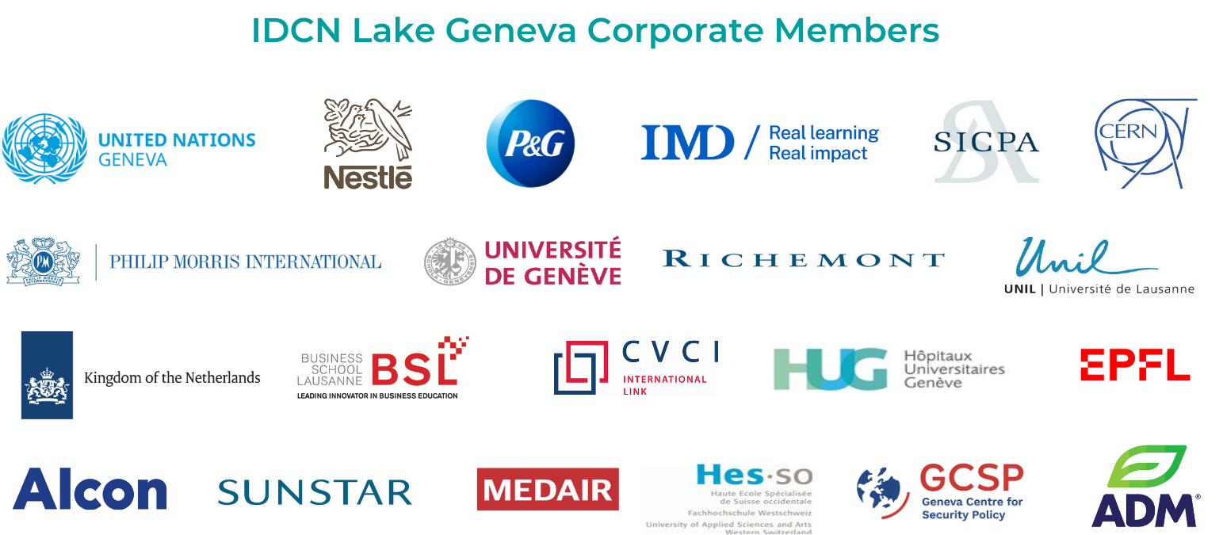



Analytics from caeser – Misha
Numbers and success rate

Slide 7

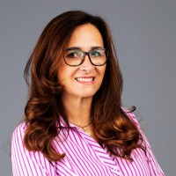

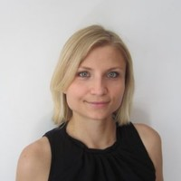

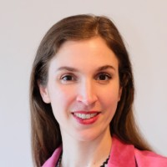

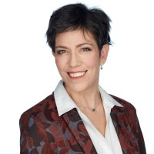

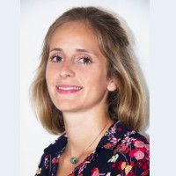

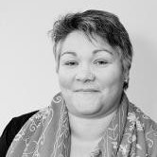
IDCN, Lake Geneva Steering Committee
Claudia Palm,
IDCN Network Lead
Provide guidance and advice to Partner Committee Office
Steering Committee meets quarterly
Veronika Beck
Laurine Chiarini
Homann Magali
Camille Pilet
Anne Meylan

Slide 8
IDCN, Lake Geneva Organization Chart
Partner Committee Office
IDCN Lake Geneva President - Pragya Bhatnagar
IDCN Lake Geneva Vice President - Naman Varma & Mykhailo Kurochkin
Membership | Events | Communication | Measurements
Enhance the overall membership experience | Coordinate and Facilitate networking events | Facilitate internal & external communication | Track key performance metrics that drive overall strategy
Team Lead | Team Lead | Team Lead | Team Lead
Dipanwita Dash | Joreen Mufwaya & Jozi Rachman | Zeinab Hashmat | Rodrigo de Oliveira
Volunteer Manager | Events Team | NewsLetter Manager | Measurements Backup
Dipanwita Dash |  | Zeinab Hashmat | Vacant
 | Momal Talha
Volunteer Coordinator |  | LinkedIN Manager
Vacant | Mykhailo Kurochkin | Ahmet Kaya/Agneszka Wiecek
Membership Manager |  | Creative Designer
Zoi Mavrogonatou | Naman Varma | Jonas Recker
Membership Backup | Lorena Dhamo | Photographer
Adreinne Chandler |  | Diarmid Farquhar

Slide 9












IDCN LG Events Calendar 2023
2023
Jan
Feb
Mar
Apr
May
Jun
Jul
Aug
Sep
Oct
Nov
Dec
Career
Mornings
&
Corporate Events
Summer
Break
The power of Networking 24 Feb
Tips on writing a resumé and getting an interview when you have had a significant career break 31 Oct
Re-branding and networking in Career Transition 8 Dec
Marketing yourself in Switzerland;
Bridging academia and career 28 Apr
CERN. A place like nowhere else on Earth! 29 June
Business Creation in Switzerland 30 Mar
How to prepare for a job interview 3 May Webinar
My relocation experience;
How to start a freelance in Switzerland;
How I set up my company 5 Sep
Acting More, Daring to fail and other confidence boosting tips 21 Nov
IDCN
Events
H1 All Corporate Member Meeting 31 May
Masterclass 24 Feb
Volunteer coffee meet-up 12 Oct
Volunteer Christmas Lunch 12 Dec
New IDCN Partner Members Welcome Event 13 Mar
All Volunteer &
Partner Member Picnic 25 May
Masterclass 17 Jan

Slide 10




IDCN LG Events Calendar 2024
2024
Jan
Feb
Mar
Apr
May
Jun
Jul
Aug
Sep
Oct
Nov
Dec
Career
Mornings
&
Corporate Events
Summer
Break
To be decided
Awaereness Session
Awareness Session
Steering Committee Meeting
Global Webinar 2
Global Webinar 3
IDCN
Events
All Corporate Member Meeting
Welcome event 1
Masterclass 3
Steering Committee Meeting
Volunteer Christmas Lunch 12 Dec
Masterclass 1
Global Webinar 1
Welcome Event 2 + Training
Masterclass 2
All CM Meeting
Welcome Event 3 + Training

Slide 11
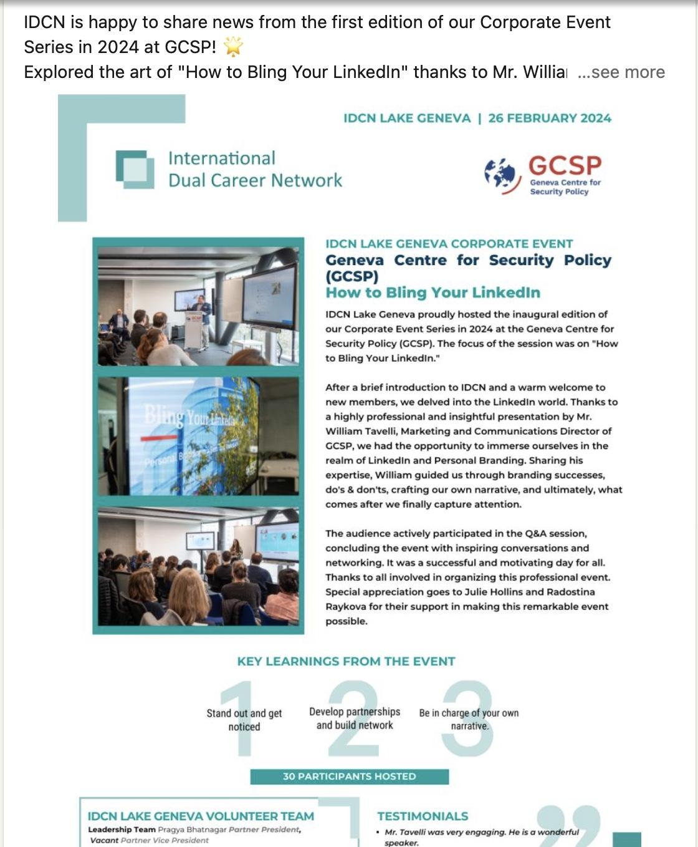
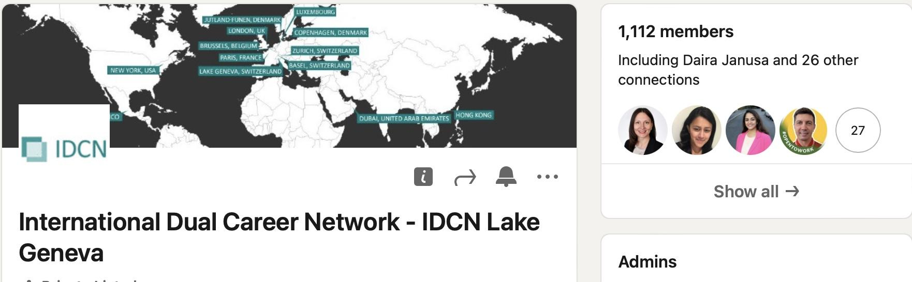



Impact on LinkedIn: Continued Growth
32
1112
7006
Posts
Members
Unique Views

Slide 12
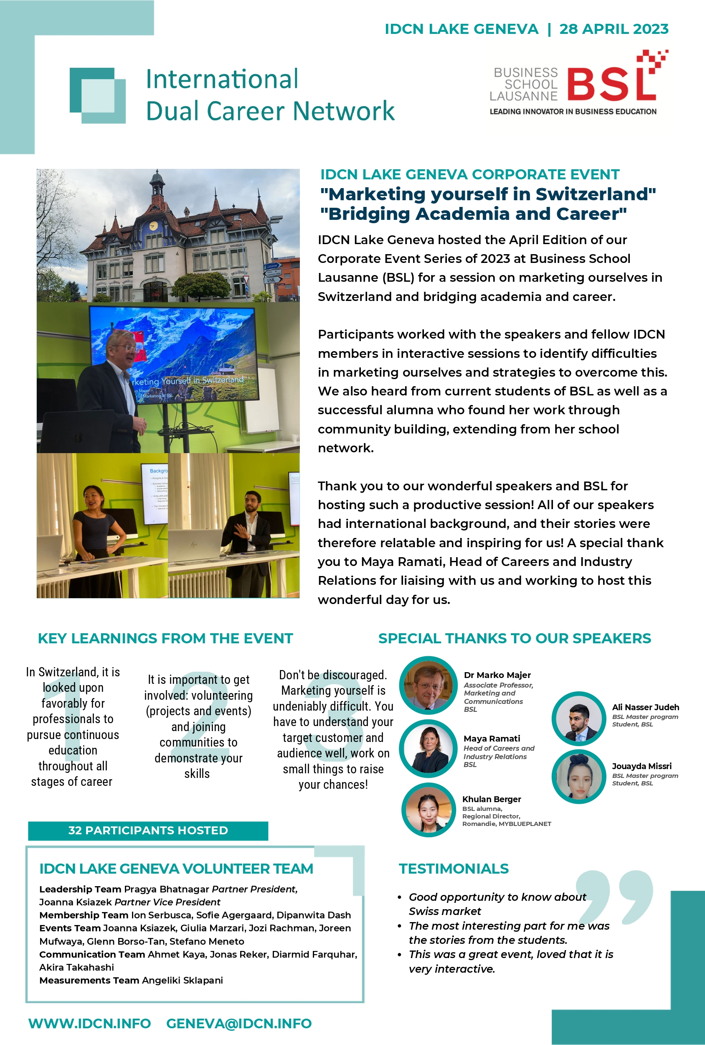
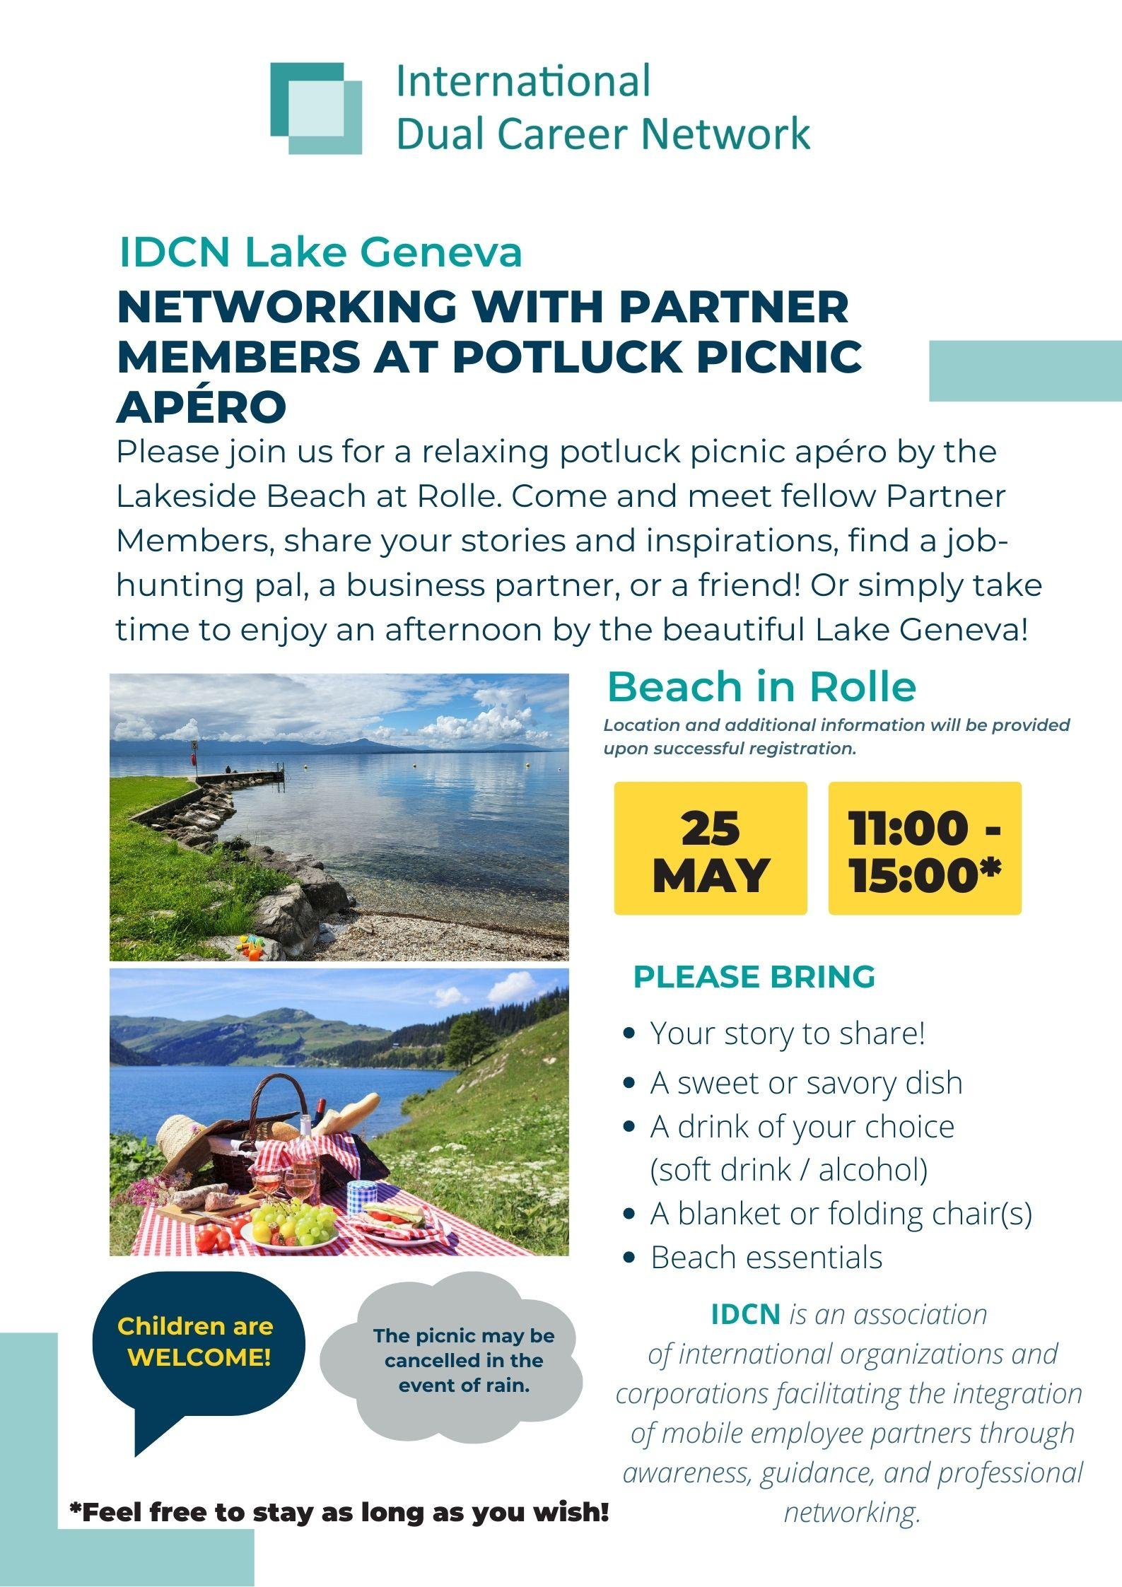
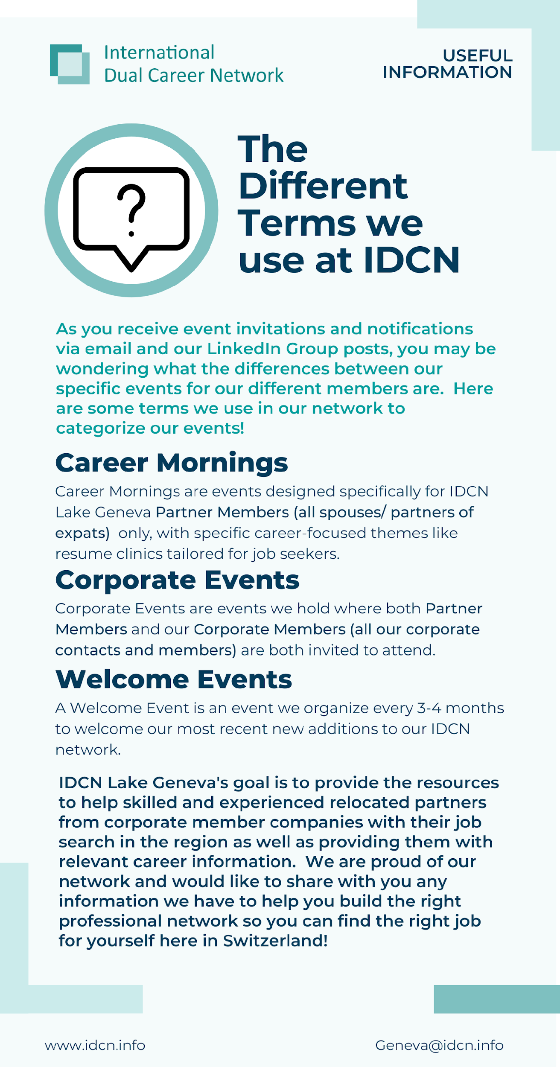
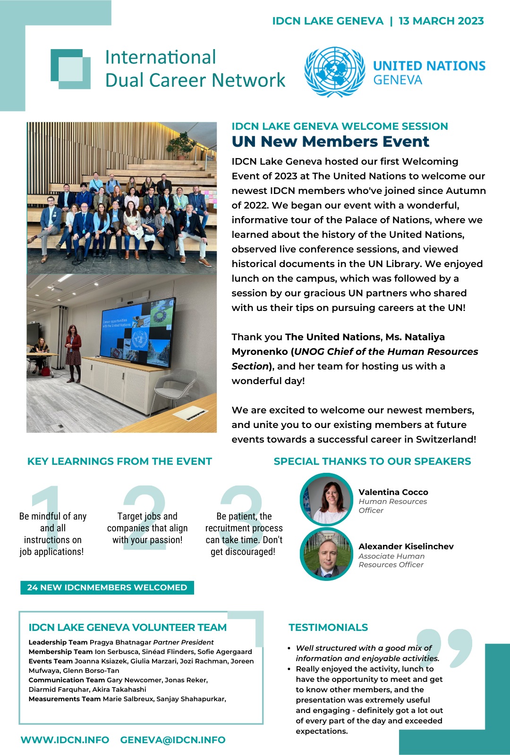
Newsletters, Posters, Success Stories
bi-annual report
success story
published newsletters
volunteer
profiles

Slide 13
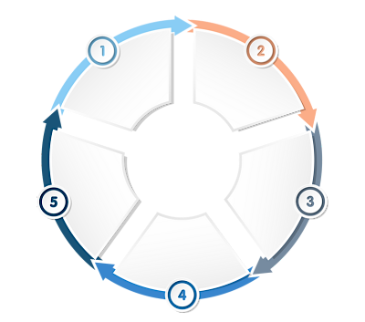
Invitation Process for IDCN Events and Webinars
Events Announcements:
IDCN website
IDCN LinkedIn page
By email
IDCN Membership
is confirmed
Announcement
of the upcoming
event
5 EASY
STEPS
Event details
how to join
Registration
to the event
Attendance
confirmation

Slide 14
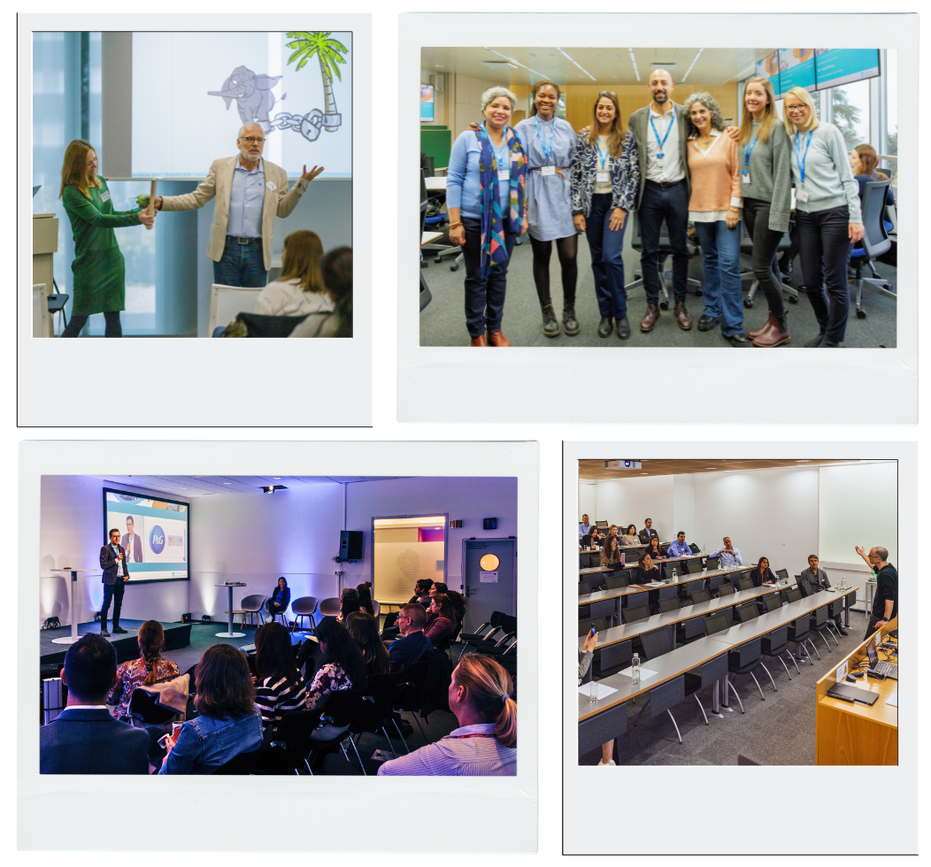




IDCN, Lake Geneva Activities 2023
EXTERNAL EVENTS:
    Corporate Events
    Career Mornings
    Global Webinars
Feb 2023
Dec 2023
Nov 2023
Mar 2023

Slide 15
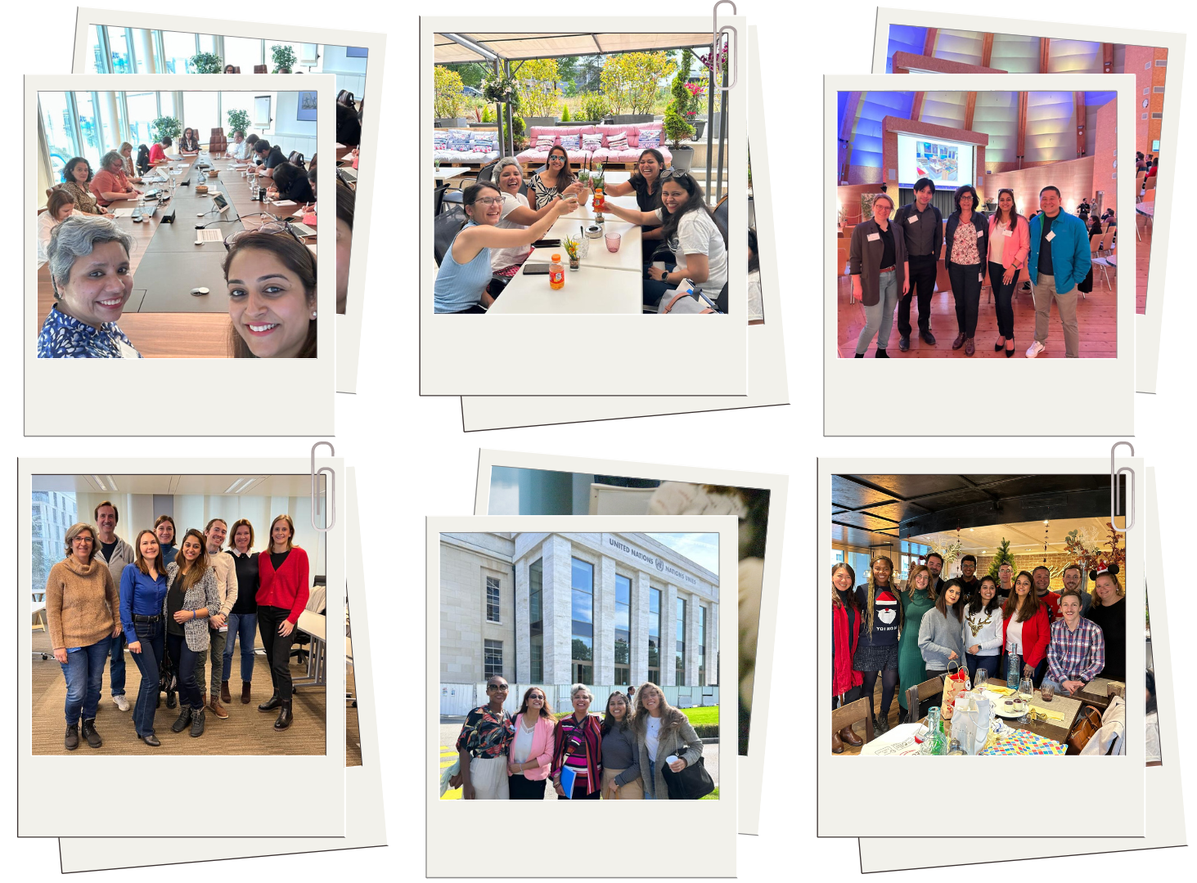




IDCN, Lake Geneva Activities 2023
INTERNALS AND SOCIAL EVENTS:
    Welcome Events
    Masterclasses
    Spouse Welcome
Oct 2023
May 2023
Jun 2023
Jan 2023
Dec 2023
Mar 2023

Slide 16

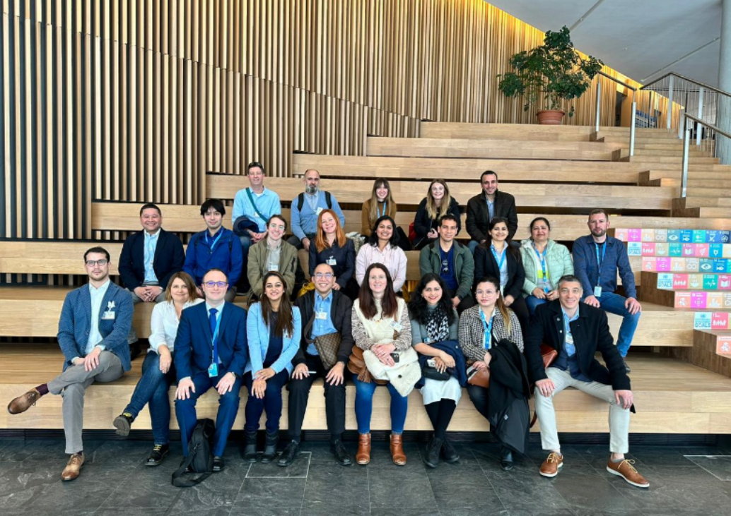
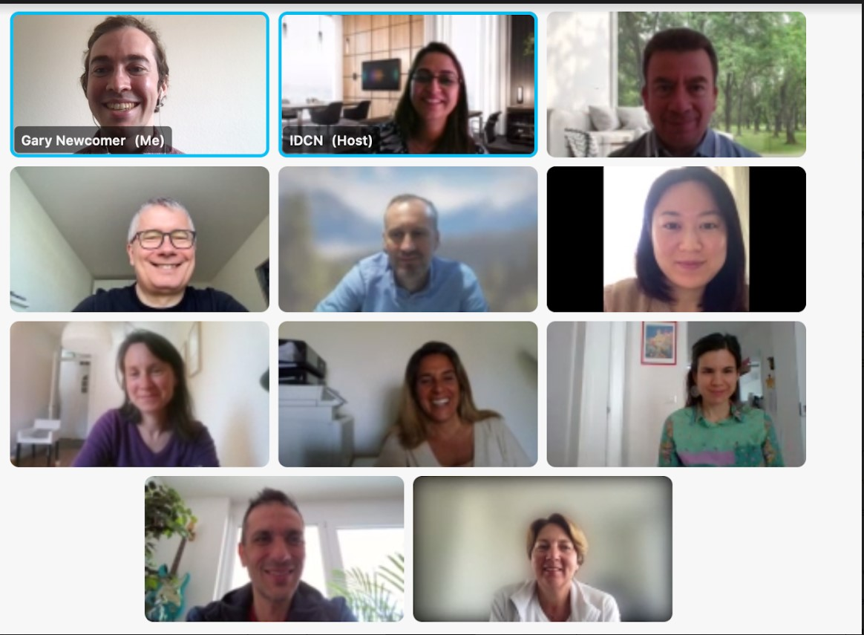
Welcome Events for new Partner Members
MAIN OBJECTIVES:
A warm, informative, and fun welcome session
Presentation and recruiting of volunteers
TIMING:
2-3 times a year
Online
On-site

Slide 17
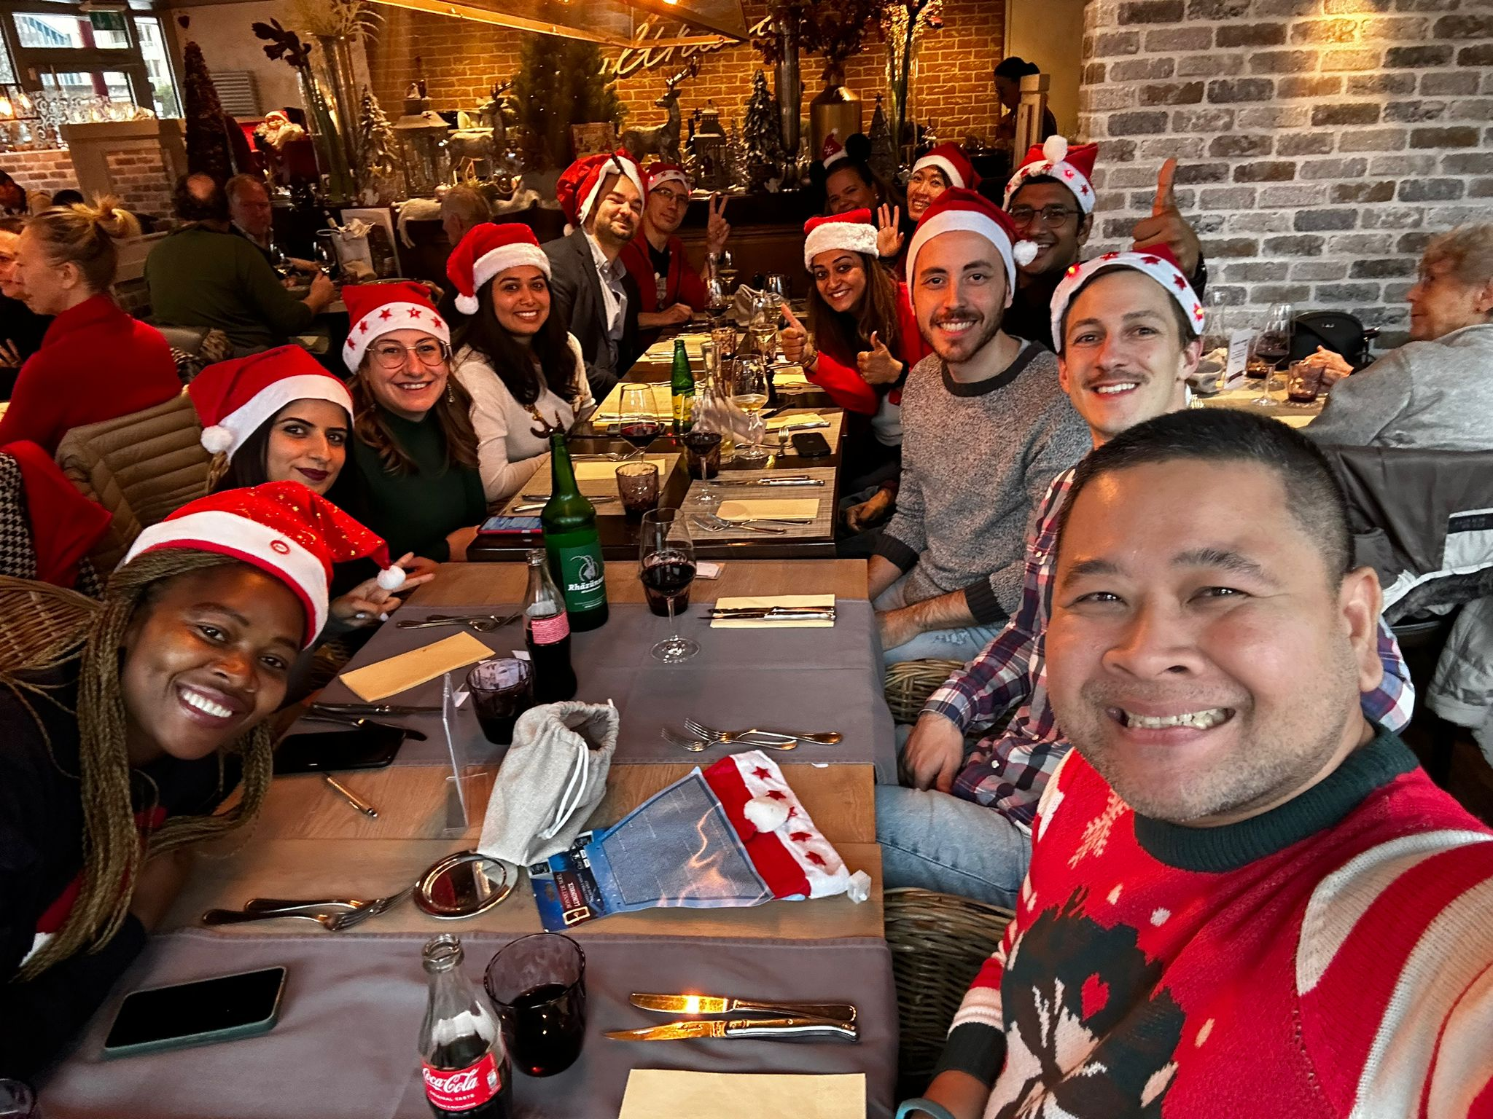
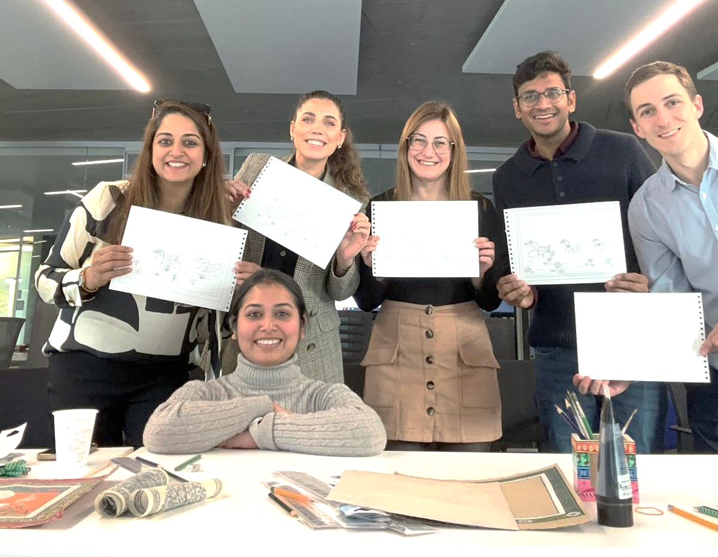
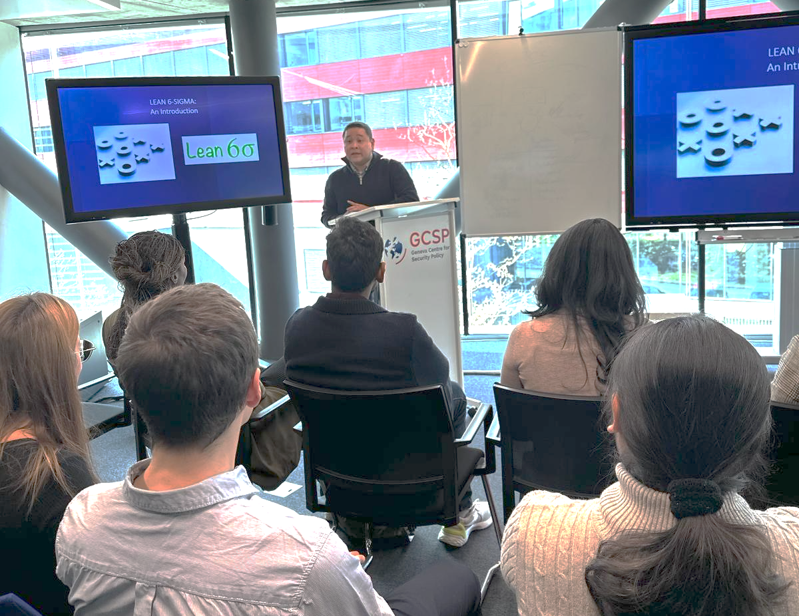
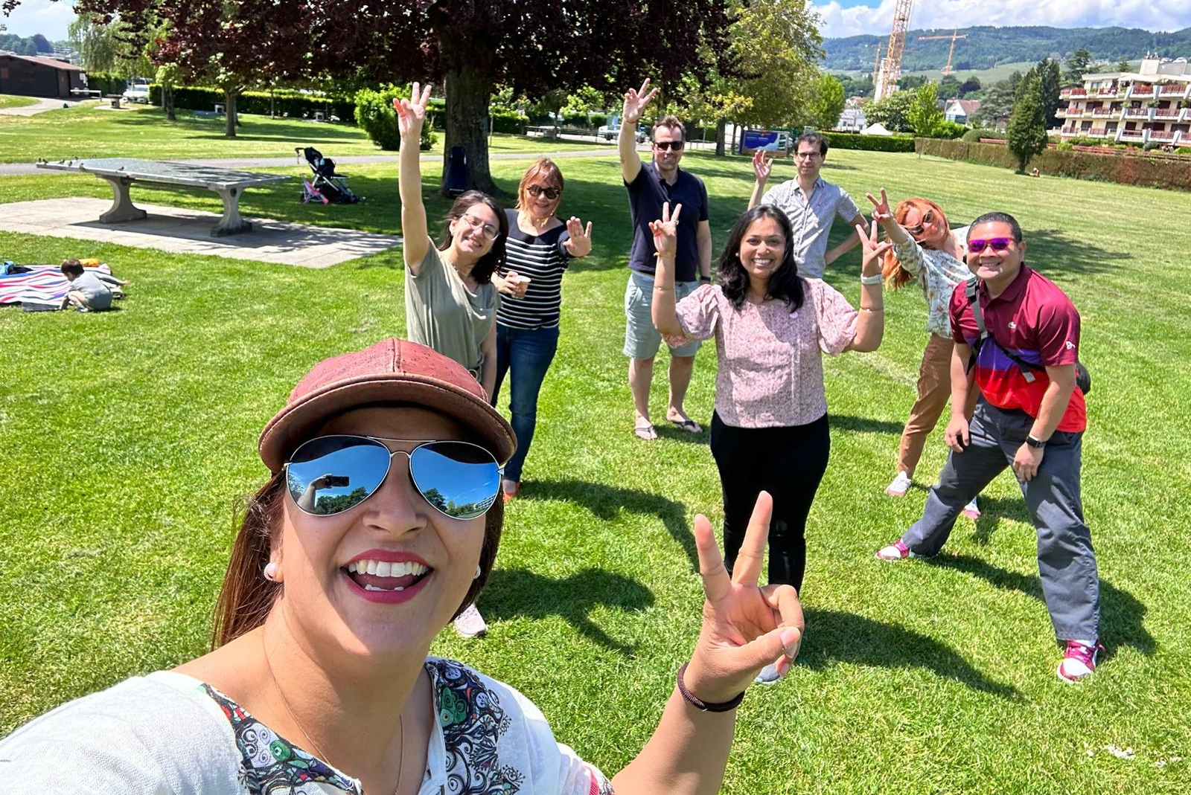
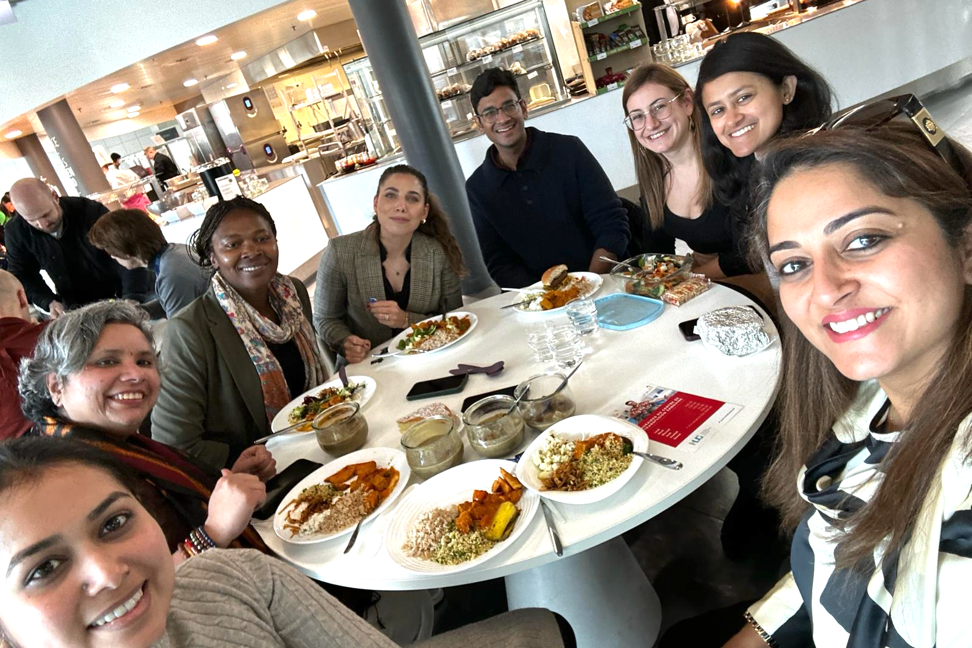
Volunteers and Partners Members Activities
MAIN OBJECTIVES:
To build a positive work environment
To share expertise in job search
To boost team spirit and sense of community
TYPES OF EVENTS:
Masterclasses
Social events

Slide 18
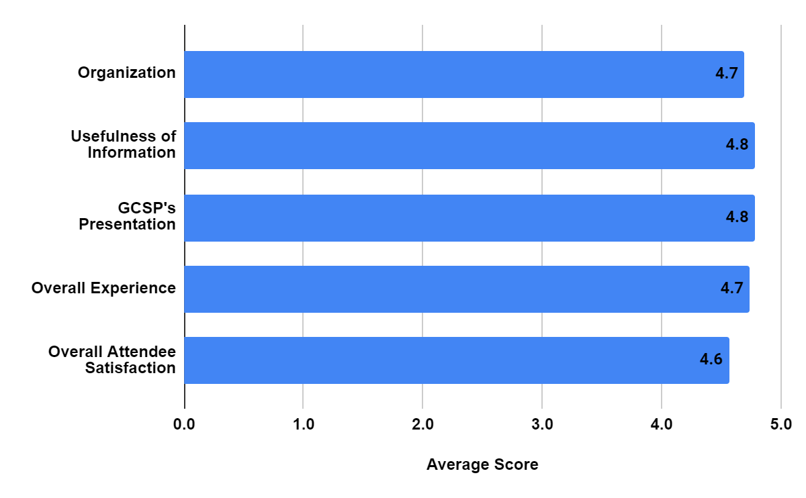
Events Feedbacks and Testimonials
Average Score:
4.7

Slide 19
Events Feedbacks and Testimonials
Positive Feedback
Useful & Informative | Engaging Speakers | Other Comments
“Very helpful and informative! Very practical and useful.” “It was very open-minded presentation and we got very practical tips about effective use of LinkedIn tools! Definitely worth to invest in my time!” “The event on 'how to bling your LinkedIn' was really very interesting and informative. It really helped me to understand recruiters perspective of viewing candidates LinkedIn profile and how we can update and make our profile interesting.” | “Mr. Tavelli was very engaging. He is a wonderful speaker.” “Yet another well organized event with a meaningful and useful content. The speaker was amazing an he provided comprehensive tips about the LinkedIn.” | “The event was very helpful to help me to update my LinkedIn profile with the best tips.” “it helped me to eliminate concerns about linkedin.” “Very well organised, all the provided information was clear.” “Good organization and the topic was very informative.”

Slide 20


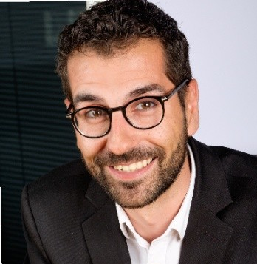
The Next Corporate Event
MAY 6th, 2024
Unleash Your Potential: Discovering Nestlé's Recruitment Secrets
Edouard Morgen
Global Talent Acquisition Lead at Nestlé

Slide 21
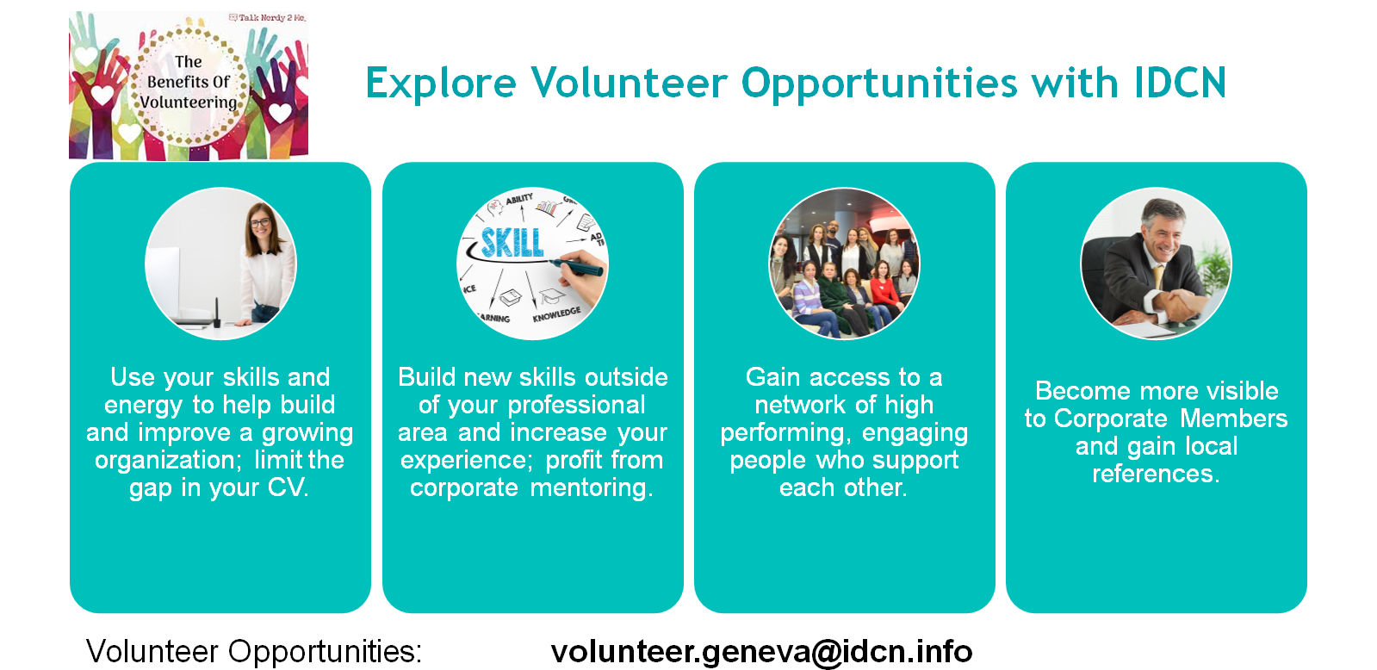

Slide 22
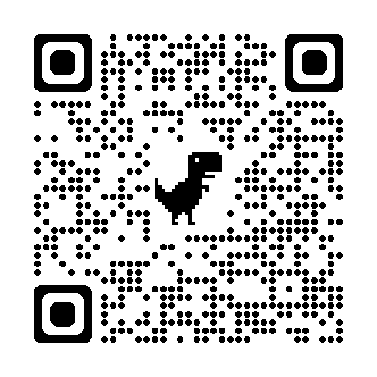
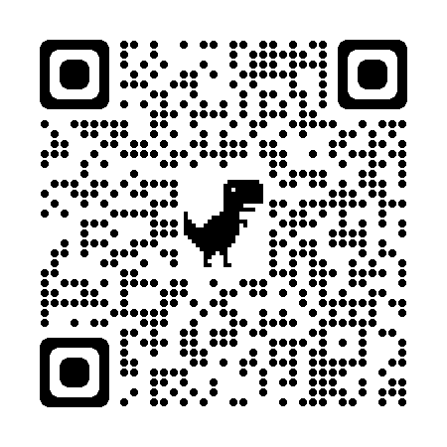
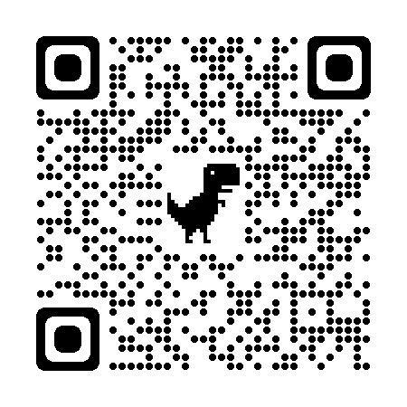
Connect with Us!
IDCN LAKE GENEVA MEMBERSHIP REGISTRATION:
IDCN LAKE GENEVA WEBSITE:
IDCN LAKE GENEVA LINKEDIN PAGE:

Slide 23
Q and A!

