Slide 1

Galactic hydrodynamics with thermodynamic gravity
Máté Pszota
in collaboration with Péter Ván

Slide 2
Overview
Cosmological and galactic simulations with dark matter
Joint description of gravity and thermodynamics in a hydrodynamic framework
Dark matter, modified gravity and galactic rotation curves

Slide 3
Cosmological and galactic simulations
Cosmological observations show dark matter, but a particle has not yet been found
Cold dark matter (CDM) models conflict with various observations (cusp-core, RAR)
Alternative approaches are explored with modified gravity or non-particle DM
N-body simulations
Stars and dark matter particles in the disc, bulge and halo
NEMO framework
Fluid or mixed simulations
Galactic gas along with N-body simulations for the stars and DM
Only hydrodynamic simulations
GADGET-4, RAMSES framework

Slide 4
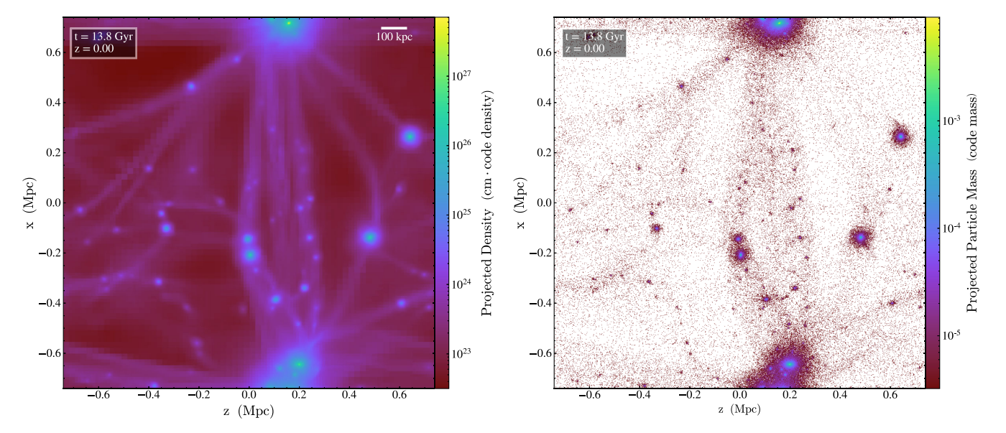
Cosmological and galactic simulations
Evolution of ΛCDM halos in the fluid approximation (left)
N-body simulation (right)
Periodic boundary conditions
FOIDL, RINDLER-DALLER, and ZEILINGER, PHYS. REV. D 108, 043012 (2023)

Slide 5
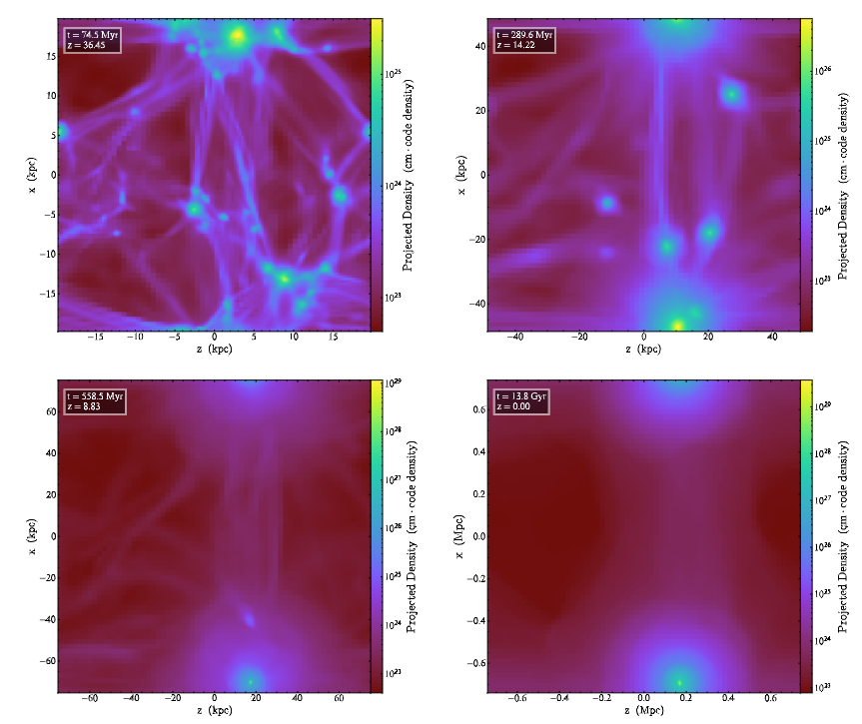

Cosmological and galactic simulations
Scalar field dark matter in a fluid approach as a Bose-Einstein condensate, not particles
Gross-Pitaevskii-Poisson equations with Bohm-potential (Q) and self-interaction (SI) pressure
$$\frac{∂ρ}{∂t}+∇∙\left(ρ\vec{v}\right)=0$$
$$\frac{∂\vec{v}}{∂t}+\left(\vec{v}∙∇\right)\vec{v}=−∇Q−∇Φ−\frac{1}{ρ}∇P_{SI}$$
$$∆Φ=4πGρ$$
$$Q=−\frac{ℏ^{2}}{2m^{2}}\frac{∆\sqrt{ρ}}{\sqrt{ρ}}$$
$$P_{SI}=Kρ^{1+1/n}=\frac{g}{2m^{2}}ρ^{2}$$
FOIDL, RINDLER-DALLER, and ZEILINGER, PHYS. REV. D 108, 043012 (2023)

Slide 6
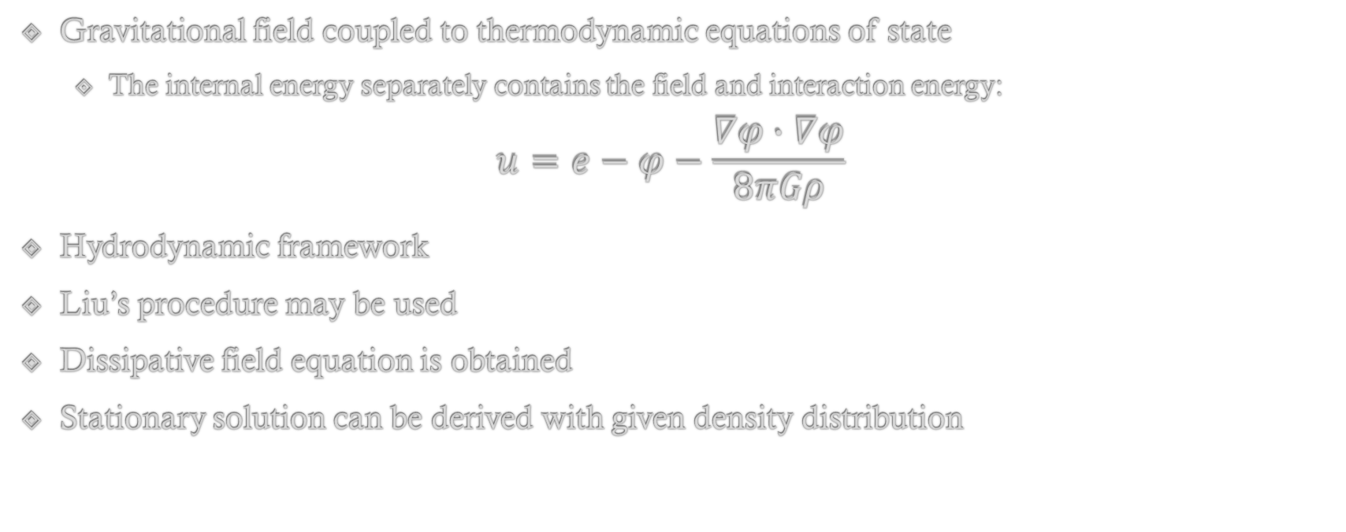
Gravitation and thermodynamics
Gravitational field coupled to thermodynamic equations of state
  The internal energy separately contains the field and interaction energy:
$$u=e−φ−\frac{∇φ∙∇φ}{8πGρ}$$
Hydrodynamic framework
Liu’s procedure may be used
Dissipative field equation is obtained
Stationary solution can be derived with given density distribution
VÁN and ABE, Physica A: Statistical Mechanics and its Applications, 588:126505

Slide 7
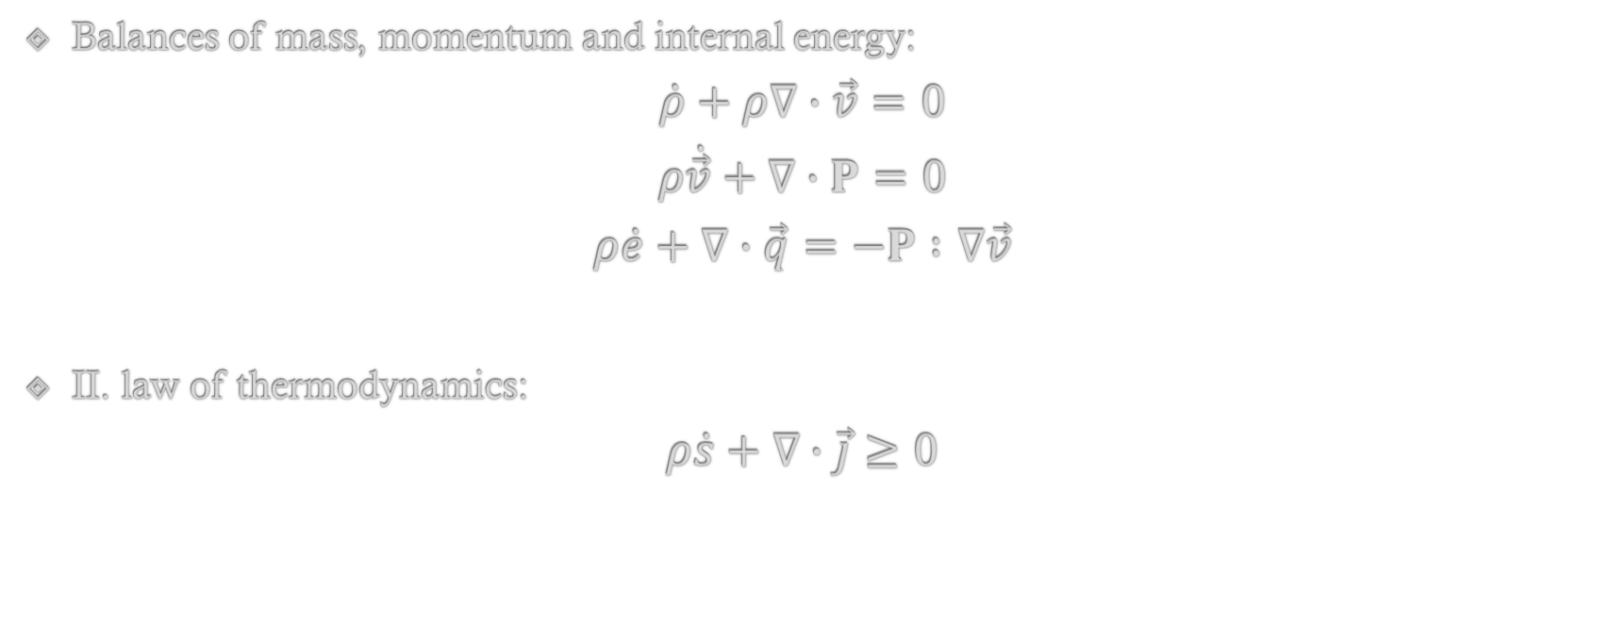
Gravitation and thermodynamics
Balances of mass, momentum and internal energy:
$$\dot{ρ}+ρ∇∙\vec{v}=0$$
$$ρ\dot{\vec{v}}+∇∙P=0$$
$$ρ\dot{e}+∇∙\vec{q}=−P∶∇\vec{v}$$
II. law of thermodynamics:
$$ρ\dot{s}+∇∙\vec{j}≥0$$

Slide 8
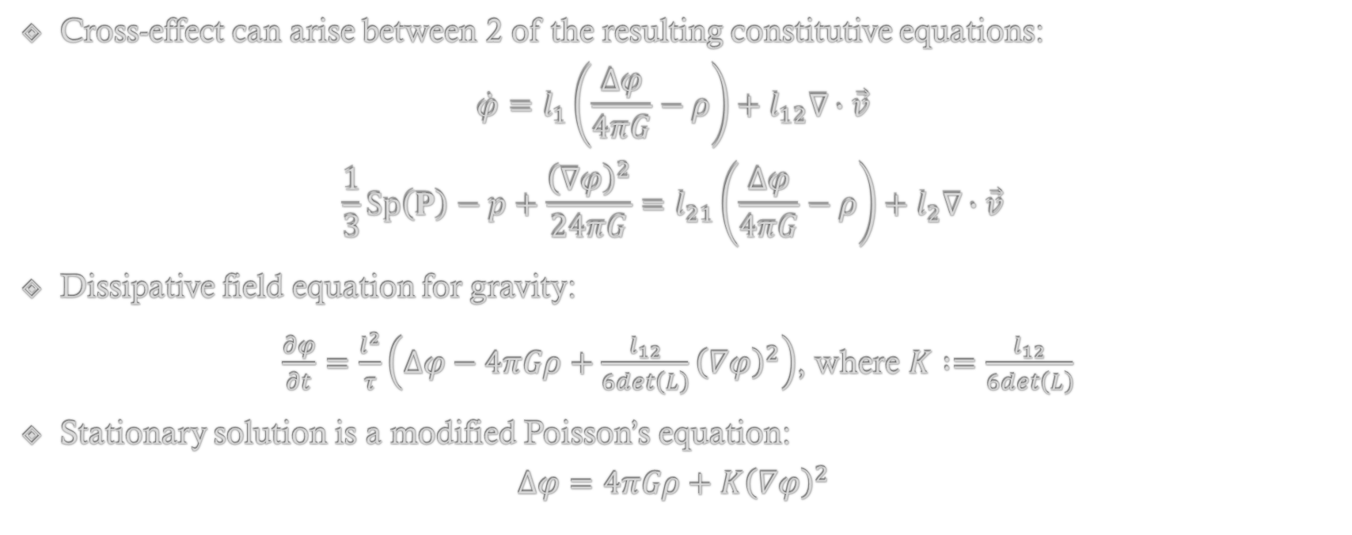
Gravitation and thermodynamics
Cross-effect can arise between 2 of the resulting constitutive equations:
$$\dot{φ}=l_{1}\left(\frac{∆φ}{4πG}−ρ\right)+l_{12}∇∙\vec{v}$$
$$\frac{1}{3}Sp\left(P\right)−p+\frac{{\left(∇φ\right)}^{2}}{24πG}=l_{21}\left(\frac{∆φ}{4πG}−ρ\right)+l_{2}∇∙\vec{v}$$
Dissipative field equation for gravity:
$\frac{∂φ}{∂t}=\frac{l^{2}}{τ}\left(∆φ−4πGρ+\frac{l_{12}}{6det\left(L\right)}{\left(∇φ\right)}^{2}\right)$, where $K∶=\frac{l_{12}}{6det\left(L\right)}$
Stationary solution is a modified Poisson’s equation:
$$∆φ=4πGρ+K{\left(∇φ\right)}^{2}$$

Slide 9
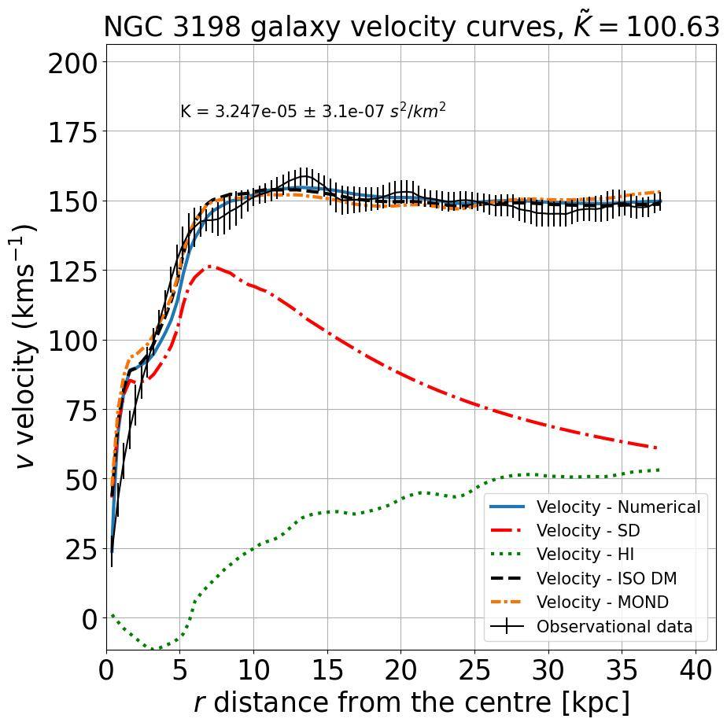
Galactic rotation curves
Rotational velocity of stars some galaxies is unexplained by the inferred baryonic matter distribution
Various proposals:
  Dark matter (N-body simulations, ISO)
  Modified Newtonian Dynamics (MOND)
  Modified Gravity (GR approaches)
  Thermodynamics and gravity
    Jacobson (Thermodynamics of Spacetime)
    Verlinde (Entropic gravity)
    Ván-Abe (Thermodynamic gravity)

Slide 10
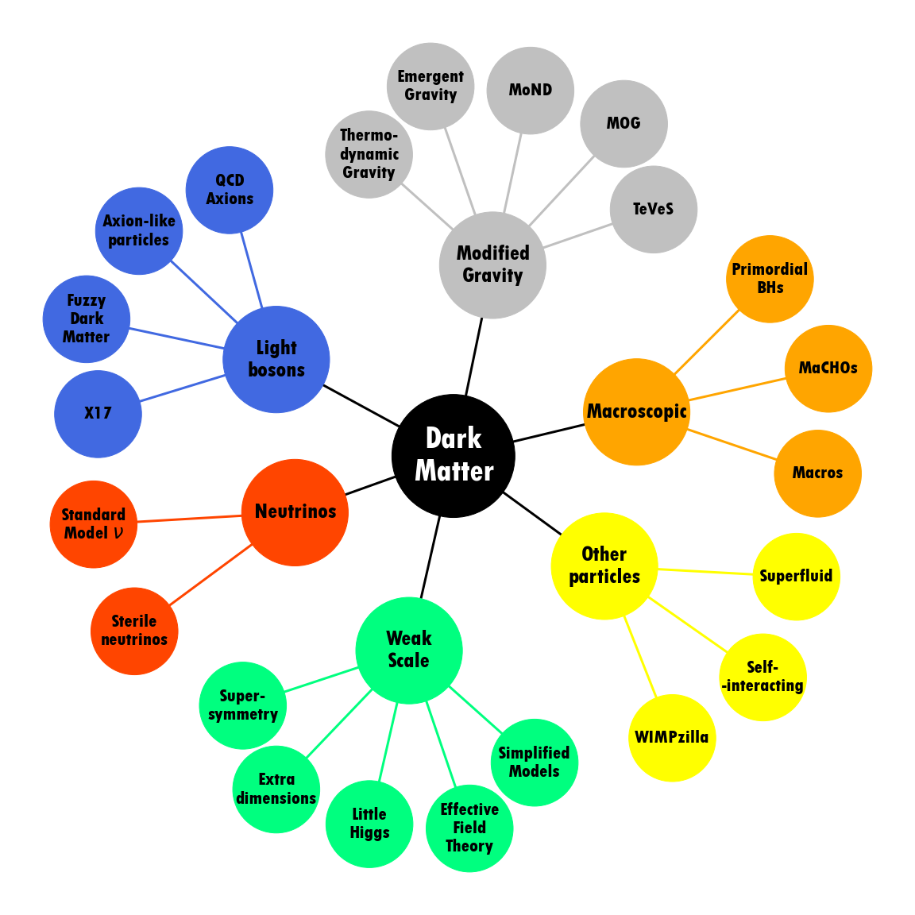
Own work, based on G. Bertone and T. M. P. Tait. Nature, 562(7725):51–56

Slide 11
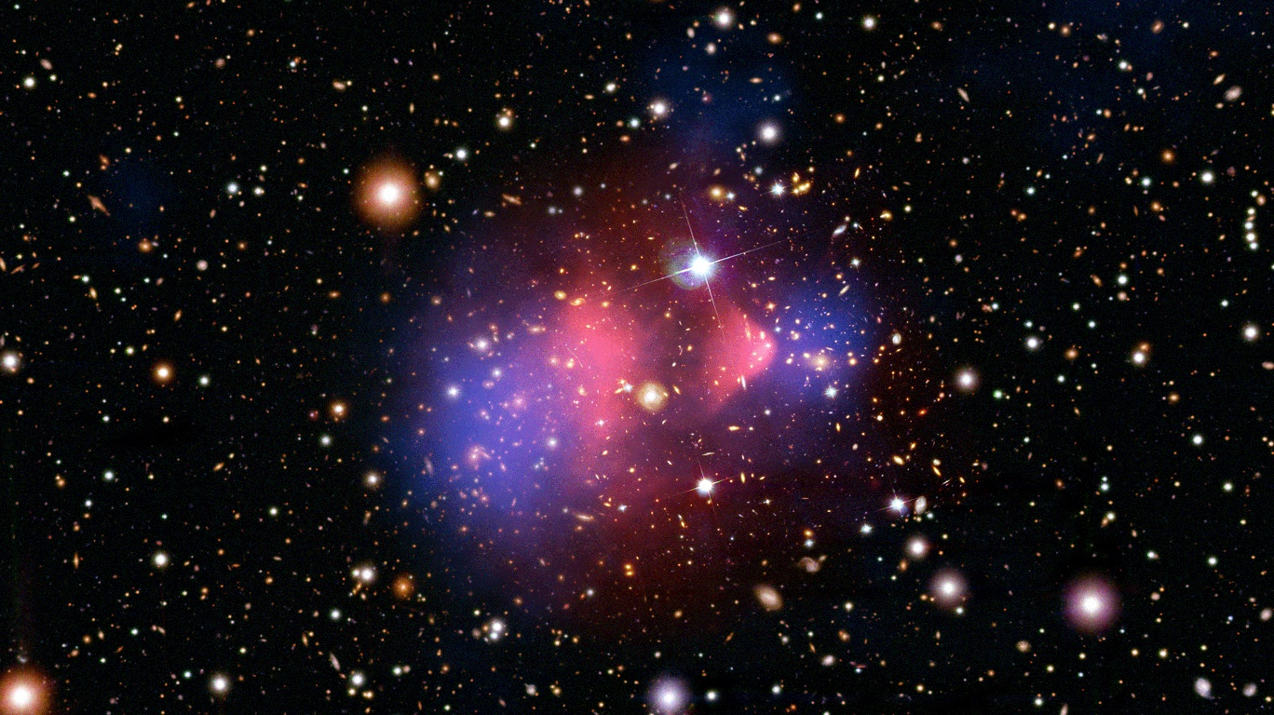
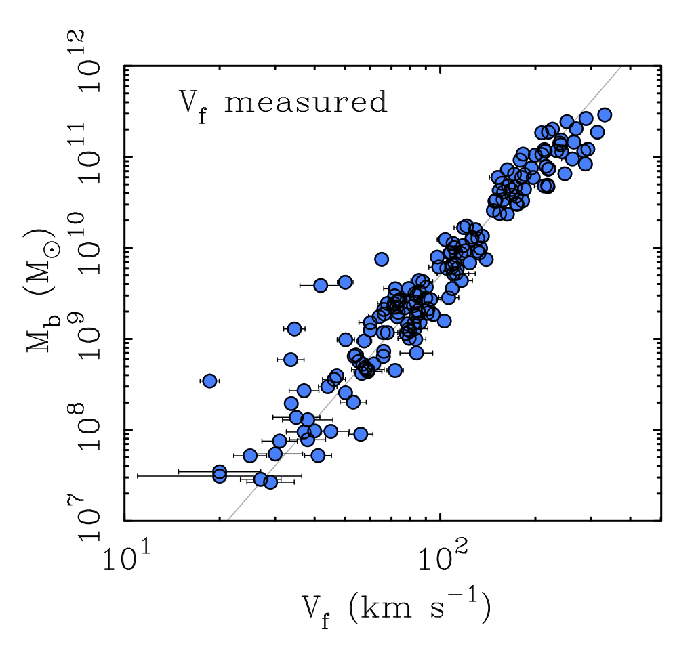
Is modified gravity better than dark matter?
Regularities in local scaling relations between baryons and dynamics in galaxies pose a problem for dark matter descriptions, but explain a broad range of observations
Left: Bullet Cluster (1E 0657-56),
X-ray (pink): NASA/CXC/CfA/M.Markevitch et al.;
Optical: NASA/STScI; Magellan/U.Arizona/D.Clowe et al.;
Lensing Map (blue): NASA/STScI; ESO WFI; Magellan/U.Arizona/D.Clowe et al.
Right: Baryonic Tully-Fisher relation
Stacy McGaugh

Slide 12
Summary
Particle approach to DM has been a long and unfruitful search, while alternatives keep being developed
Models using hydrodynamic description have a powerful potential for describing galactic dynamics
Scalar-field dark matter offers an alternative to CDM, with the potential to resolve the “cusp-core” problem of the latter
Thermodynamic gravity within the hydrodynamic framework offers a potentially powerful method for the description of dynamics on cosmological scales

Slide 13
Thank you for your attention!
References:
  Horst Foidl, Tanja Rindler-Daller, and Werner W. Zeilinger. Halo formation and
  evolution in scalar field dark matter and cold dark matter: New insights from the
  fluid approach. Phys. Rev. D, 108:043012, Aug 2023
  Peter Ván and Sumiyoshi Abe. Emergence of extended Newtonian gravity from
  thermodynamics. Physica A: Statistical Mechanics and its Applications, 588:126505,
  2022
  M. Pszota and P. Ván. Field equation of thermodynamic gravity and galactic rotational curves. arXiv:2306.01825
  Gianfranco Bertone and Tim M. P. Tait. A new era in the search for dark matter.
  Nature, 562(7725):51–56, Oct 2018

