Slide 1

DRD1 co-spokesperson candidates presentations
Piotr Gasik
08.12.2023
Notes:
Logos too big
Titles, test not aligned

Slide 2


Scientific biography
2007 – 2011: PhD at the University of Warsaw, Poland
  FOPI Collaboration
  PhD in Physics: “Study of nuclear matter properties using strange particles: the analysis of Al+Al collisions at 1.9A GeV”
2012 – 2020: Research Assistant at the Technical University of Munich, Germany
  ALICE & RD51 Collaborations
  ALICE TPC Upgrade: development of full-size prototypes, TDR editor, readout chambers production coordinator
  R&D with MPGDs with focus on a detector performance and stability against electrical discharges
  Supervisor to 10 BSc and 4 MSc theses, mentor to 3 PhD students
2019 – 2020: Scientific Associate at CERN, Switzerland
  ALICE TPC Upgrade: installation manager
  R&D on new electrode materials for gaseous detectors
2020 – … : Staff physicist at GSI/FAIR, Darmstadt
  CBM Technical Coordinator
  RD51 WG2 Convener (2023)
  R&D on spark-less amplification microstructures, resistive layers, TPCs
2021 – … : Guest lecturer at the TU Darmstadt
  Habilitation in experimental physics: ”Discharge phenomena in Micro Pattern Gaseous Detectors”

Slide 3
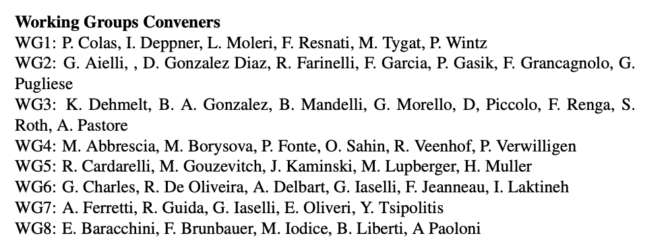
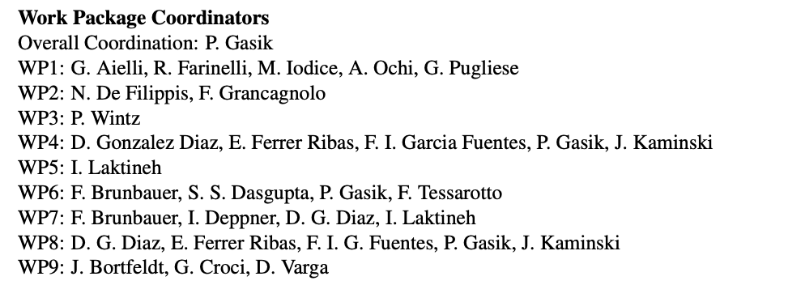
DRD1 biography
Working Group 2 convener (Jan. 2023)
  Contact person & organizer for the WG
  Survey analysis
  Contribute to the proposal drafting
  Definition of Work Packages
Work Package Coordinator (Jun. 2023)
  Extended WP proposal (templates)
  Community meetings
  Several iterations of extended proposals
  and executive summary tables

Slide 4
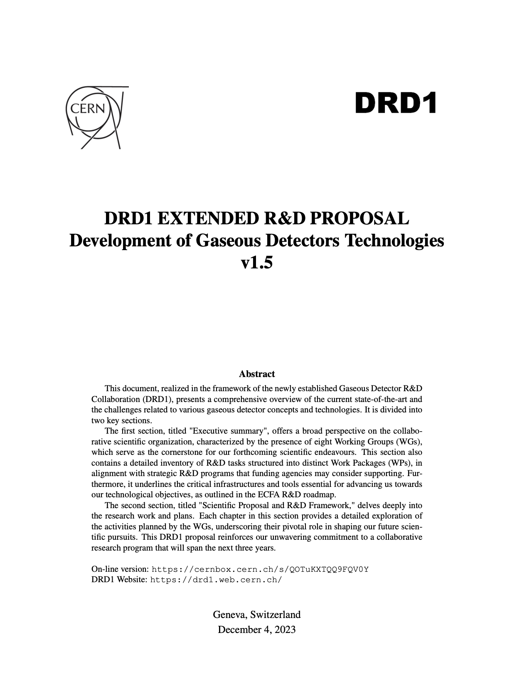
DRD1 proposal
Despite all the challenges, additional requests, last-minute changes and updates, we have made it!
Great atmosphere (thanks Leszek and Anna!)
Comment on Work Packages
  not only tables, tasks, goals, kCHF, and FTEs
  opportunity to start the collaborative activities, who is doing what, and where. Seed of the collaboration!
  Note: in many cases, a single WP mixes different technologies!
  WP coordinators – many thanks for all the great effort!

Slide 5
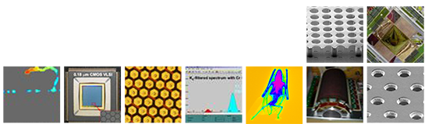
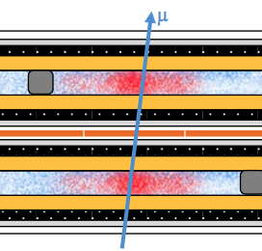
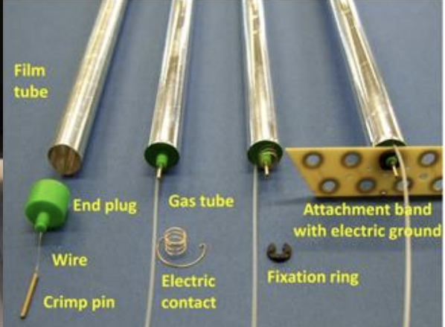
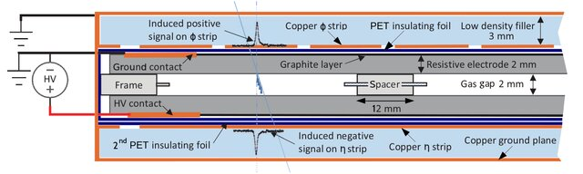
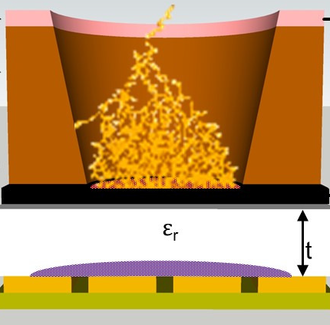
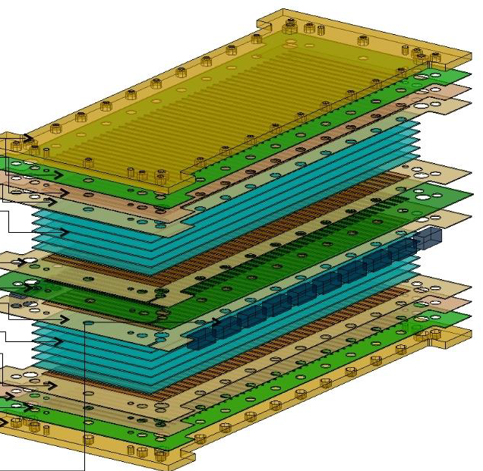

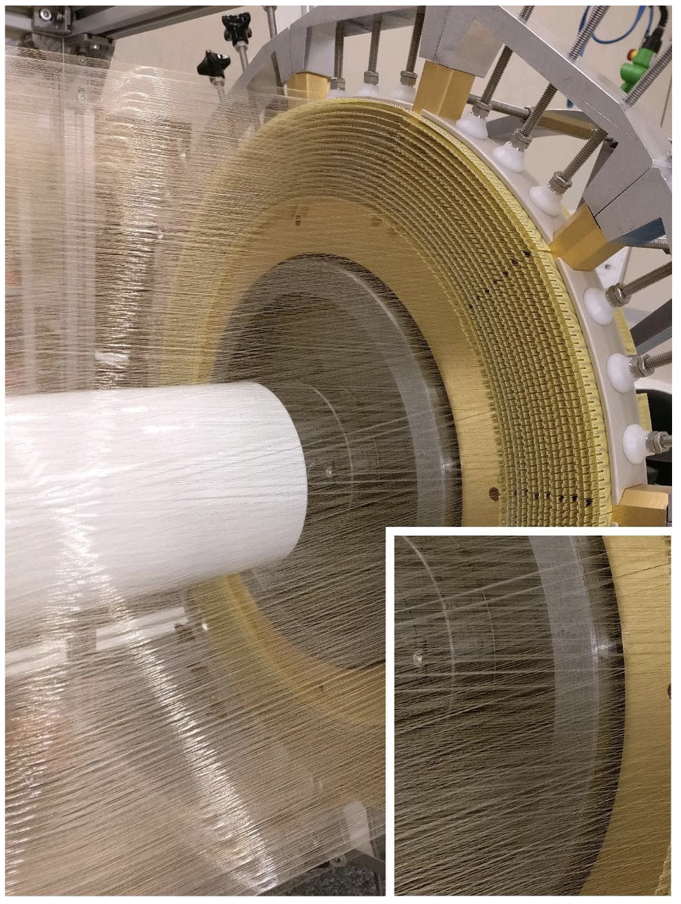
TOWARDS DRD1
I come from the RD51 family and the experience of last year shows that the style in which the RD51 run, can be propagated to the DRD1 family
Bigger group, more technologies, more tools, more challenges, more members ➙ more fun!
DRD1 Collaboration

Slide 6
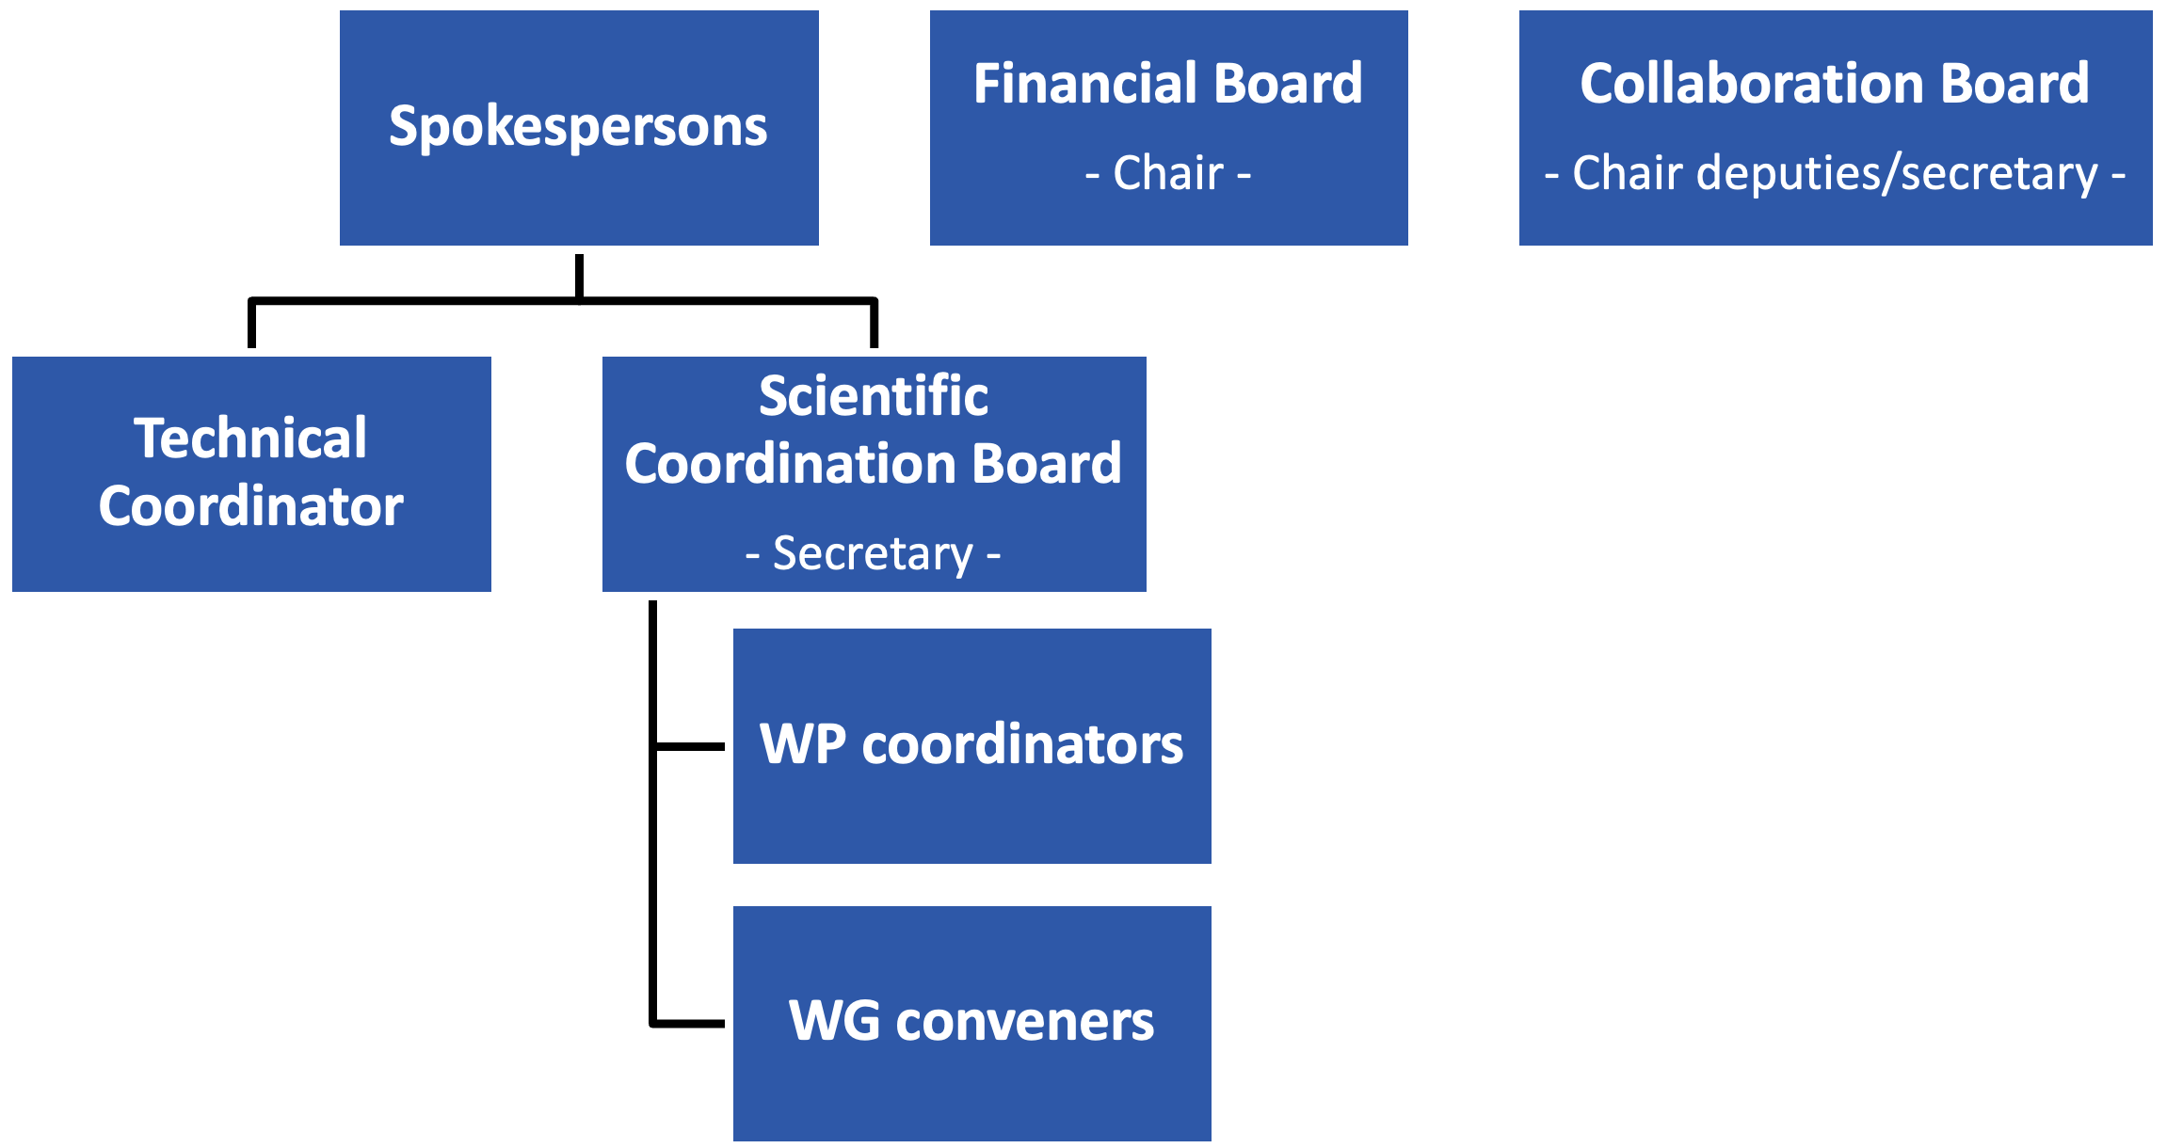
First steps
Establishment of the management team
Representation of the entire community
After one year writing of the proposal, and filling the tables,
we all would like to continue what is the most important: R&D activities
In fact, many of these activities are ongoing anyway
The idea of collaboration: build a community which will allow us to work together in an inclusive and friendly environment, exchange information and know-how, develop common tools, and have experts around who can help us.

Slide 7
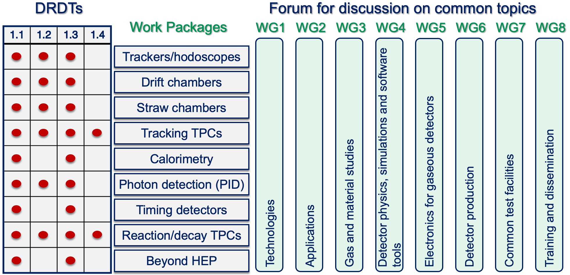
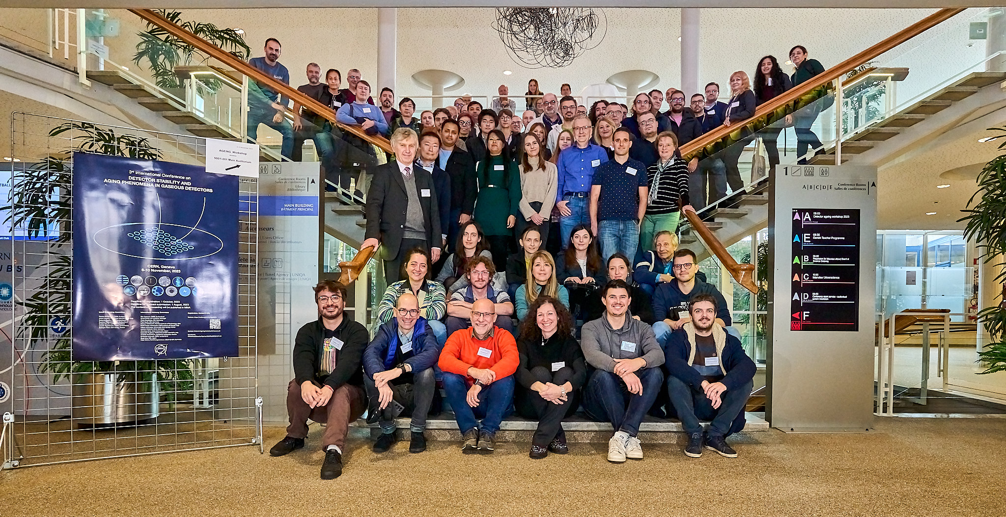
DRD1 Collaboration
Several communities → one structure
Several communities → everybody is welcome on board!
A lot of common challenges in all technologies:
  In R&D but also when integrating different technologies within a single experiment
  Common developments (see next slides)
No need to split into sub-WGs, sub-DRD1s
  We anyway continue working on our technology developments
  We discuss them together and try to find synergies!
  See WP: merging several technologies in single application developments
Gaseous detector community @ Ageing ‘23

Slide 8
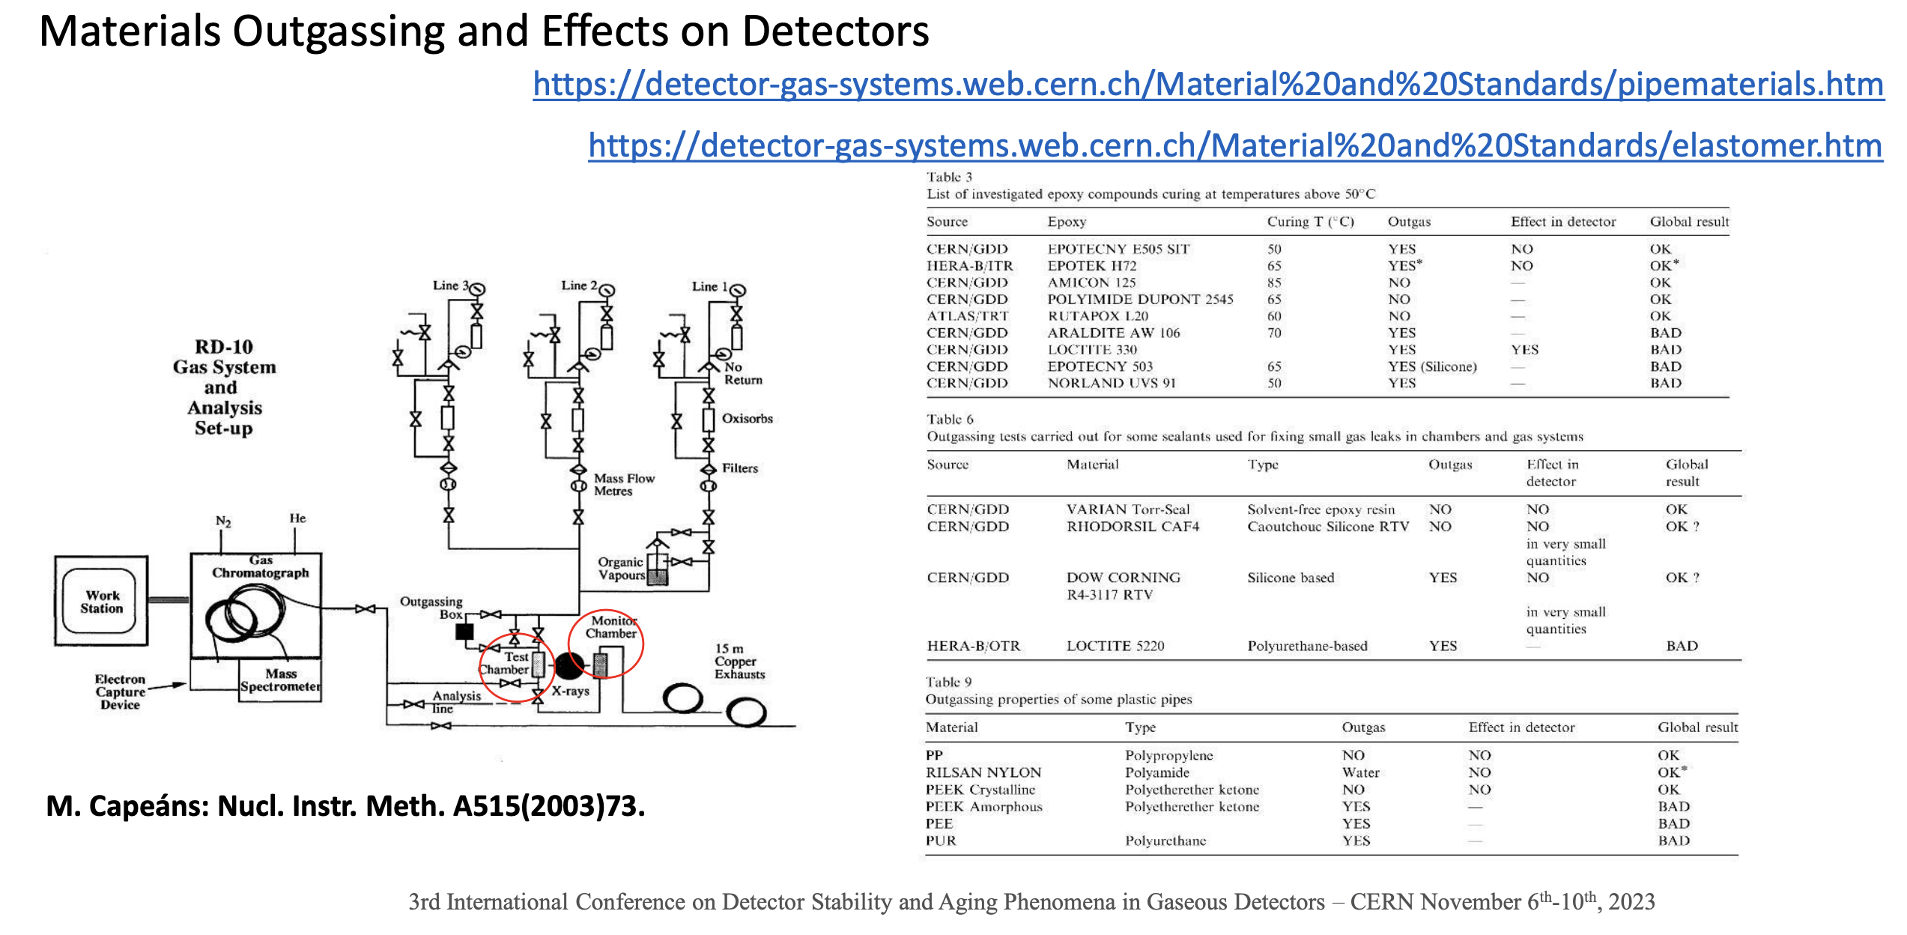
Common activities
DRD1 will foster common activities:
Common projects between institutes
Common investments of several users
Common beamtimes (WG7)
Common developments for several technologies, such as software (WG4), gas/material databases (WG3), and testing infrastructure (WG7), have been discussed since the very first community meeting
Eventually, common activities with other DRDs and national R&D programs
R. Guida – Conference closure and outlook, Ageing 2023

Slide 9
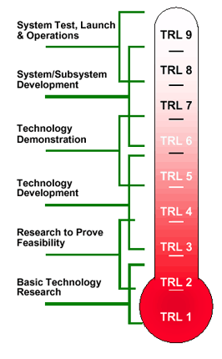
R&D goals
With this community-driven approach → push the frontiers of gaseous detector technology
Blue-sky and Strategic R&D!
Use our strength for common grant/funding applications (WP but not only), execute technology transfers, etc.
Use the fact of being a large collaboration and map possibilities of requesting access to facilities (e.g. beamtimes) at CERN but also in other collaborating institutes
Make sure our results and activities are well-recognized
Participation in DRD1 must be well-recognised!
  DRD1 is a large collaboration: ∼160 institutes, >700 participants, with the DRD Committee review model (as LHCC) and CERN as a host lab
A pivotal role of the new co-spokespersons in exploring these opportunities on behalf of the collaboration

Slide 10
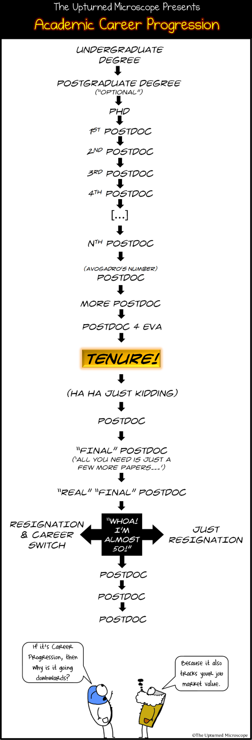
Young researchers @DRD1
Special attention should be paid to the young DRD1 members!
Students
  Make sure they can present their work and receive valuable feedback!
  Detector schools (see recent MPGD School example!), topical workshops, hands-on sessions (e.g. on simulations)
Post-docs, young researchers
  DRD1 - opportunity to reach the next step in the career paths
  Visibility within and outside the community
  Rotating conveners of WGs
  Dedicated common projects for young investigators
© The Upturned Microscope

Slide 11
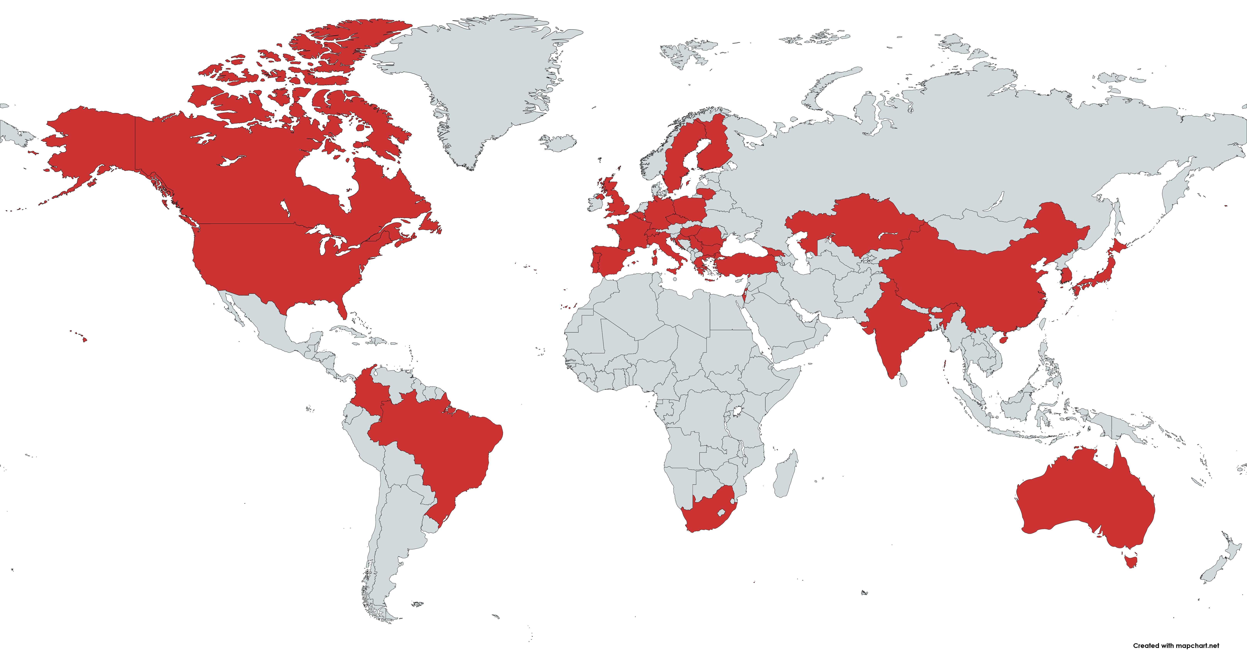
The glue: communication
Key to successful organisation: effective communication
The co-spokesperson and DRD1 management represent the collaboration, implement decisions of the CB and listen to the collaboration!
Transparency is of utmost importance!
Communication within the collaboration: meetings, mini-weeks, workshops
  Consider the worldwide collaboration: meetings outside CERN
  Consider the variety of topics and technologies → topical sessions, topical workshops
  Video participation always available but maximize in-person attendance!
  Explore additional tools: web, forums, messaging platforms, etc.

Slide 12
Summary
It is a great honour to receive the nomination for a DRD1 co-spokesperson
Many of us worked together in the past ∼11 months on the proposal preparation
→ Great seeding experience
We are ready to move forward as DRD1 in January!
I am ready to help shape the new collaboration to make the best out of the many challenges ahead of us!
Thank you for your consideration!

