Slide 1
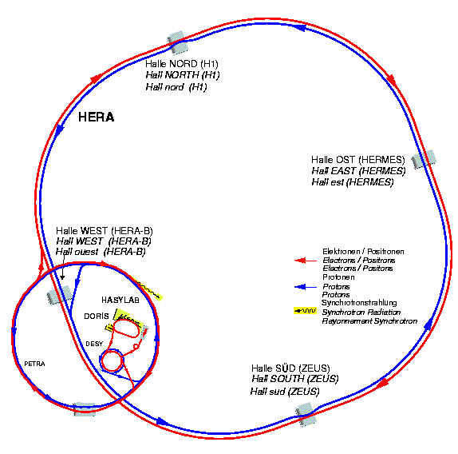
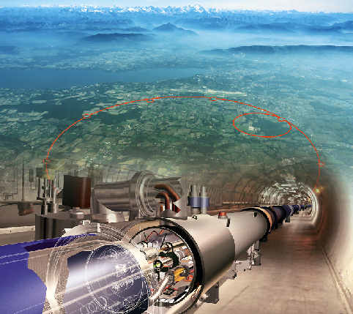
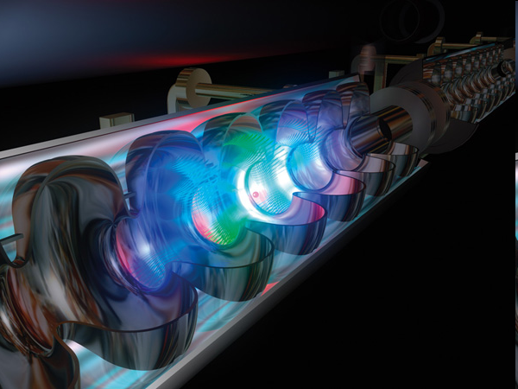
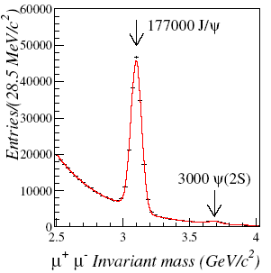
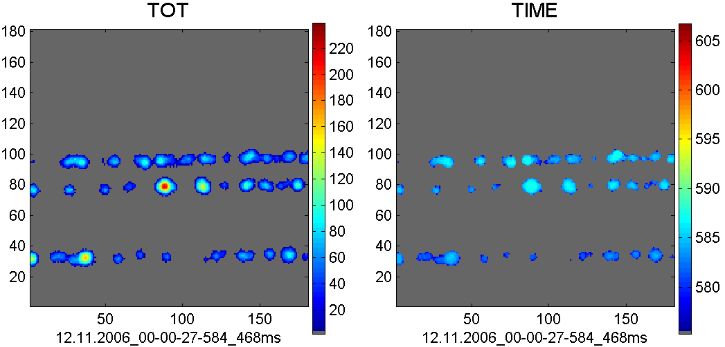
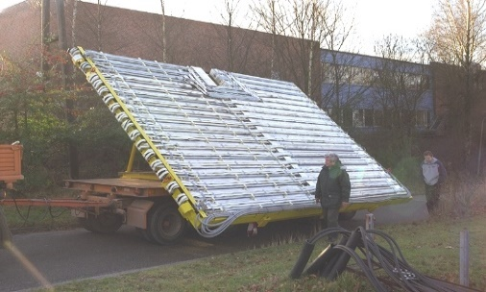
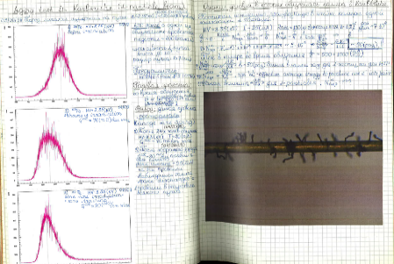
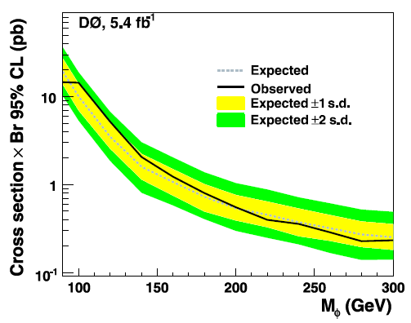
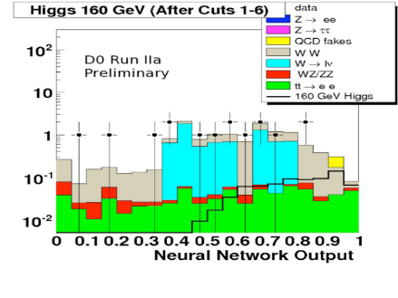
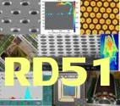
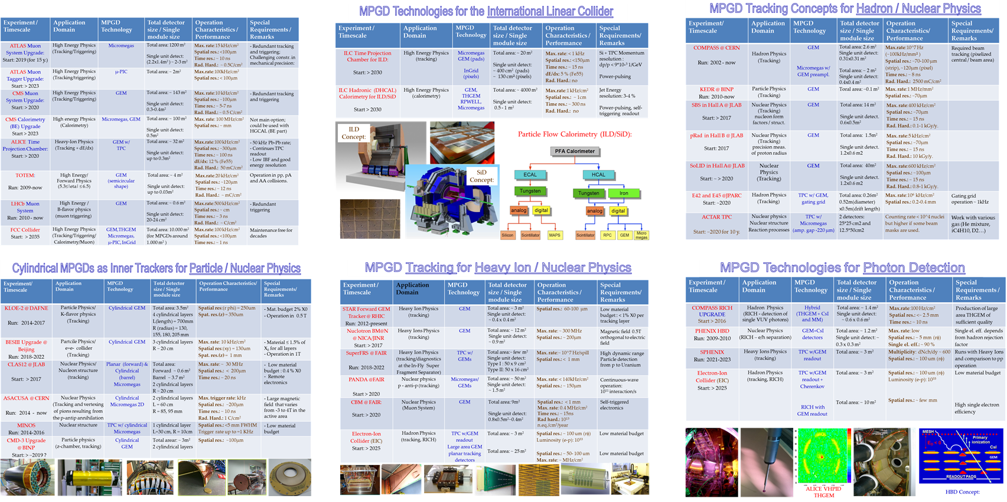
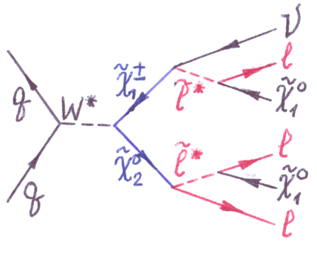
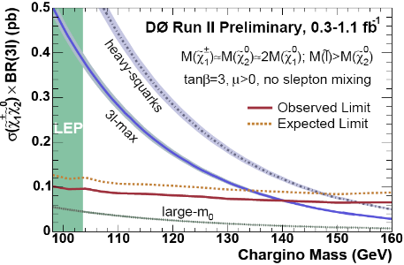
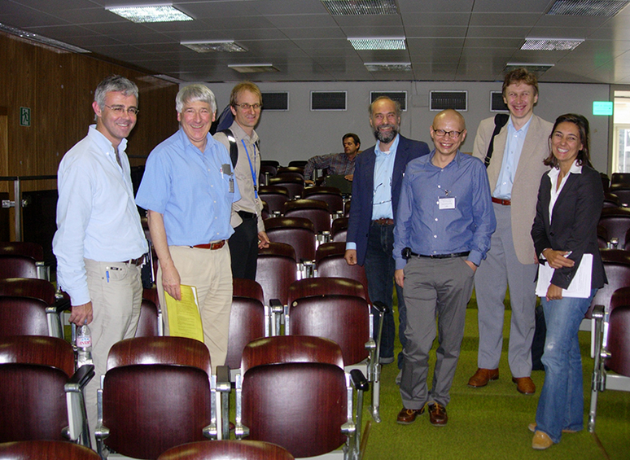
HERA
LHC
TEVATRON
ILC
MAKSYM TITOV: 2024 - 2025 DRD1 Spokesperson Elections
Irfu, CEA Saclay, France
DRD1 SP Candidate Presentations,
CERN, Dec. 8 (2023)

Slide 2


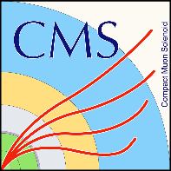


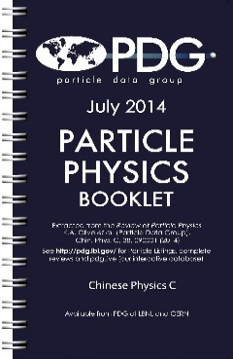
Professional Experience: International Collaborations
1995
2000
2005
2010
2015
2020
1993 – 2003: HERA-B Experiment at DESY / HERA, Hamburg
2003 – 2006: ATLAS Experiment at CERN / LHC, Geneva
2004 – 2011: DZero Experiment at Fermilab / Tevatron, Chicago
2008 – 2023: RD51 Collaboration at CERN, Geneva
2023, 2008 - 2015 Spokesperson of the RD51 Collaboration
2016 – 2022 Scientific Secretary of the RD51 Collaboration
2007 – present: CMS Experiment at CERN / LHC, Geneva
2007 – present: International Linear Collider in Japan (LCC) & LCTPC Collaboration
2007 – present: Particle Data Group (PDG) Collaboration
~ 100 publications, reviews, monographs with major personal contribution (total papers: 1500, h-index: 125)
More than 500 talks at International Conferences and Workshops (including opening and summary talks), national and international institutes, colloquia, seminars and summer/winter schools, as well as talks for diplomatic authorities, government officials, funding agencies and general public

Slide 3
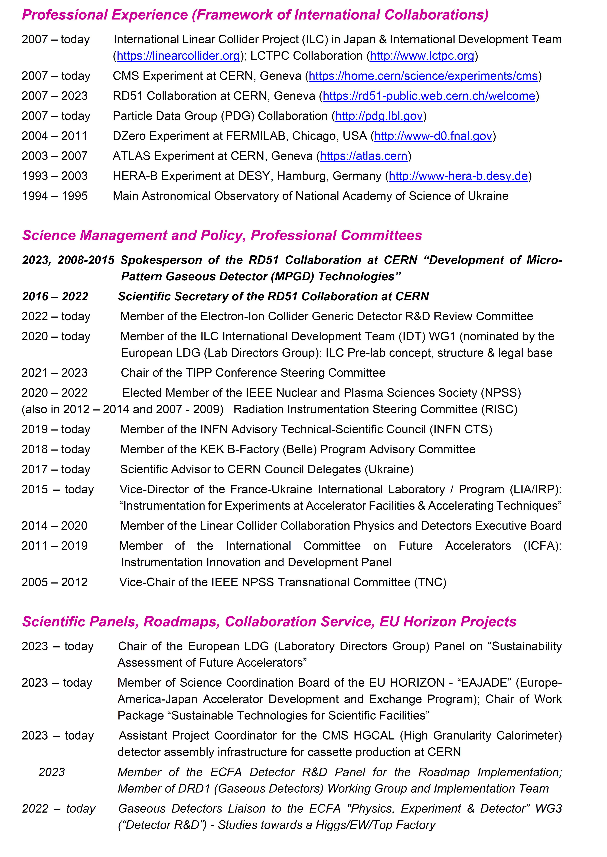
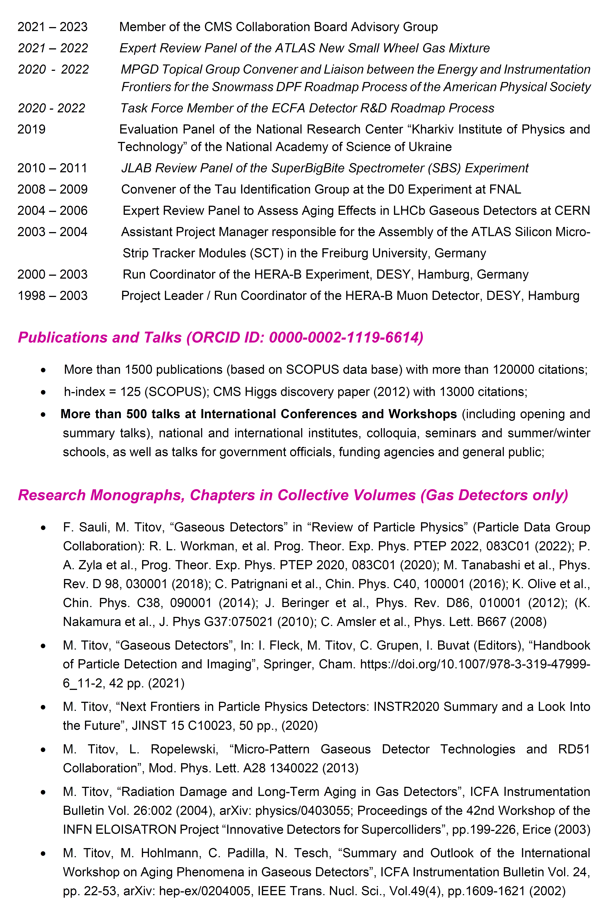
Curriculum Vitae (CV):
https://indico.cern.ch/event/1352912/contributions/5696928/attachments/2766133/4818211/MTITOV_CV_0512023_FINAL.pdf

Slide 4
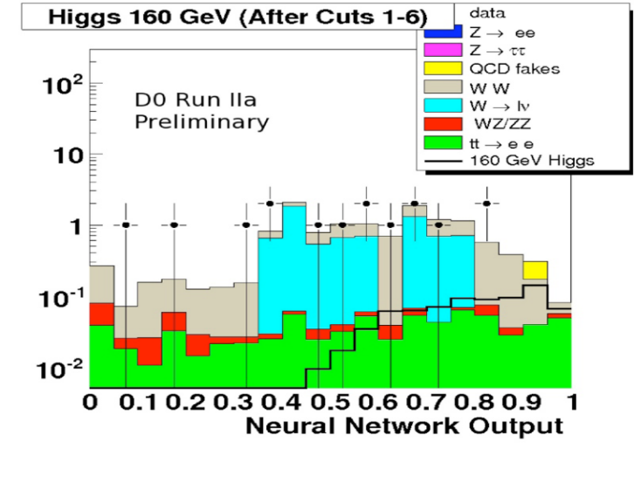

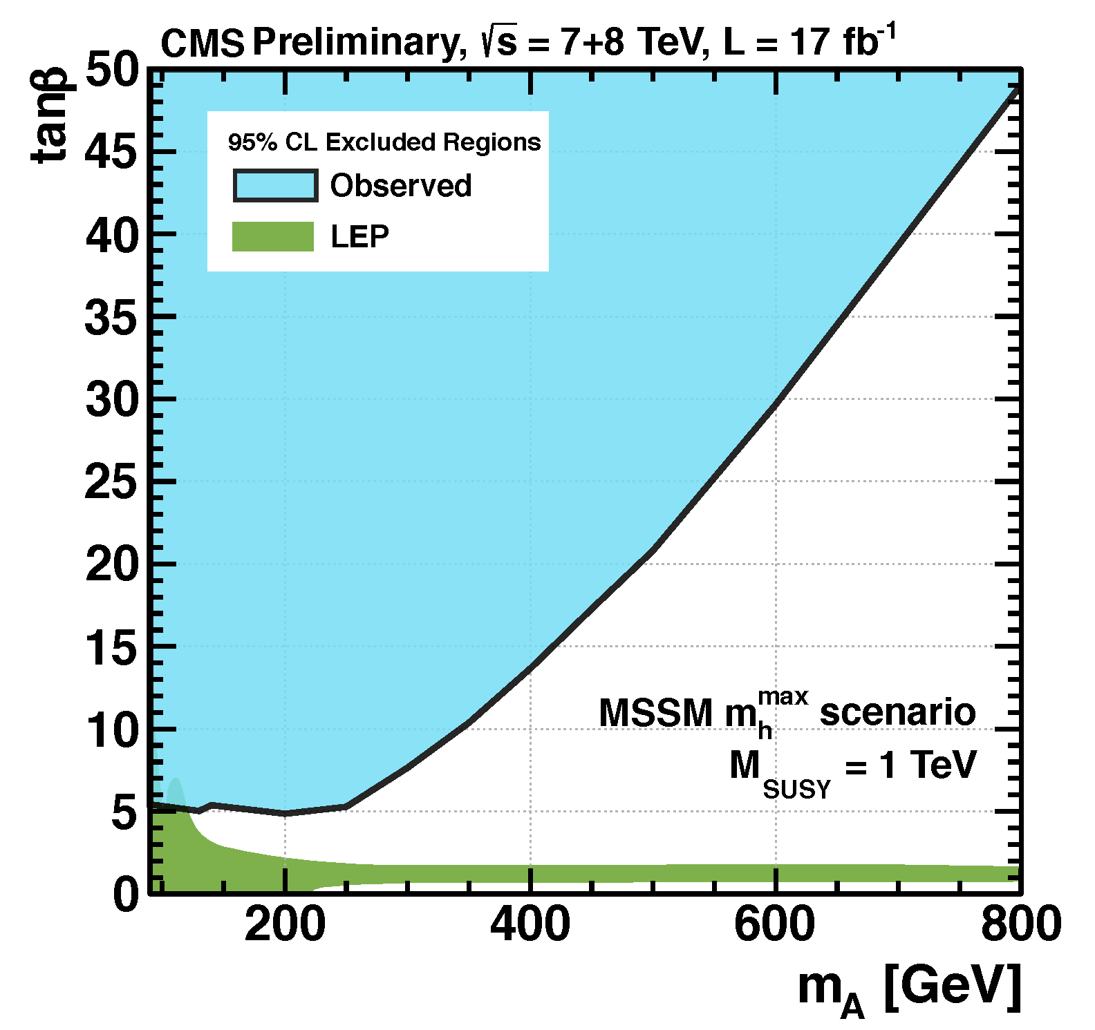
Background: Physics Analysis @ Hadron/Lepton Colliders
Physics Analysis at Hadron / Lepton Colliders: Searches for Higgs Boson, Supersymmetry, and BSM Physics: CMS @ CERN; DØ @ Fermilab; ILC @ Japan; HERA-B @ DESY Hamburg
D0 Experiment:
- Searches for:
SM (Higgs→ WW)
MSSM (Higgs→ ττ)
- SUSY searches in trilepton final states
2004: First H→ WW Neural Network Analysis @ D0
Phys.Lett. B 707, 323-329 (2012)
M. Titov, D0 Note-5537 (2007)
CMS Experiment:
ILC: Search for Dark Matter Particles
SM Z → ττ Measurement
& MSSM (Higgs → ττ)
JHEP 1108 (2011) 117
A. Chaus, PhD (CEA/DESY)
S. Choudhury, PhD (CEA)
Phys.Rev.Lett 106:231801, 2011

Slide 5
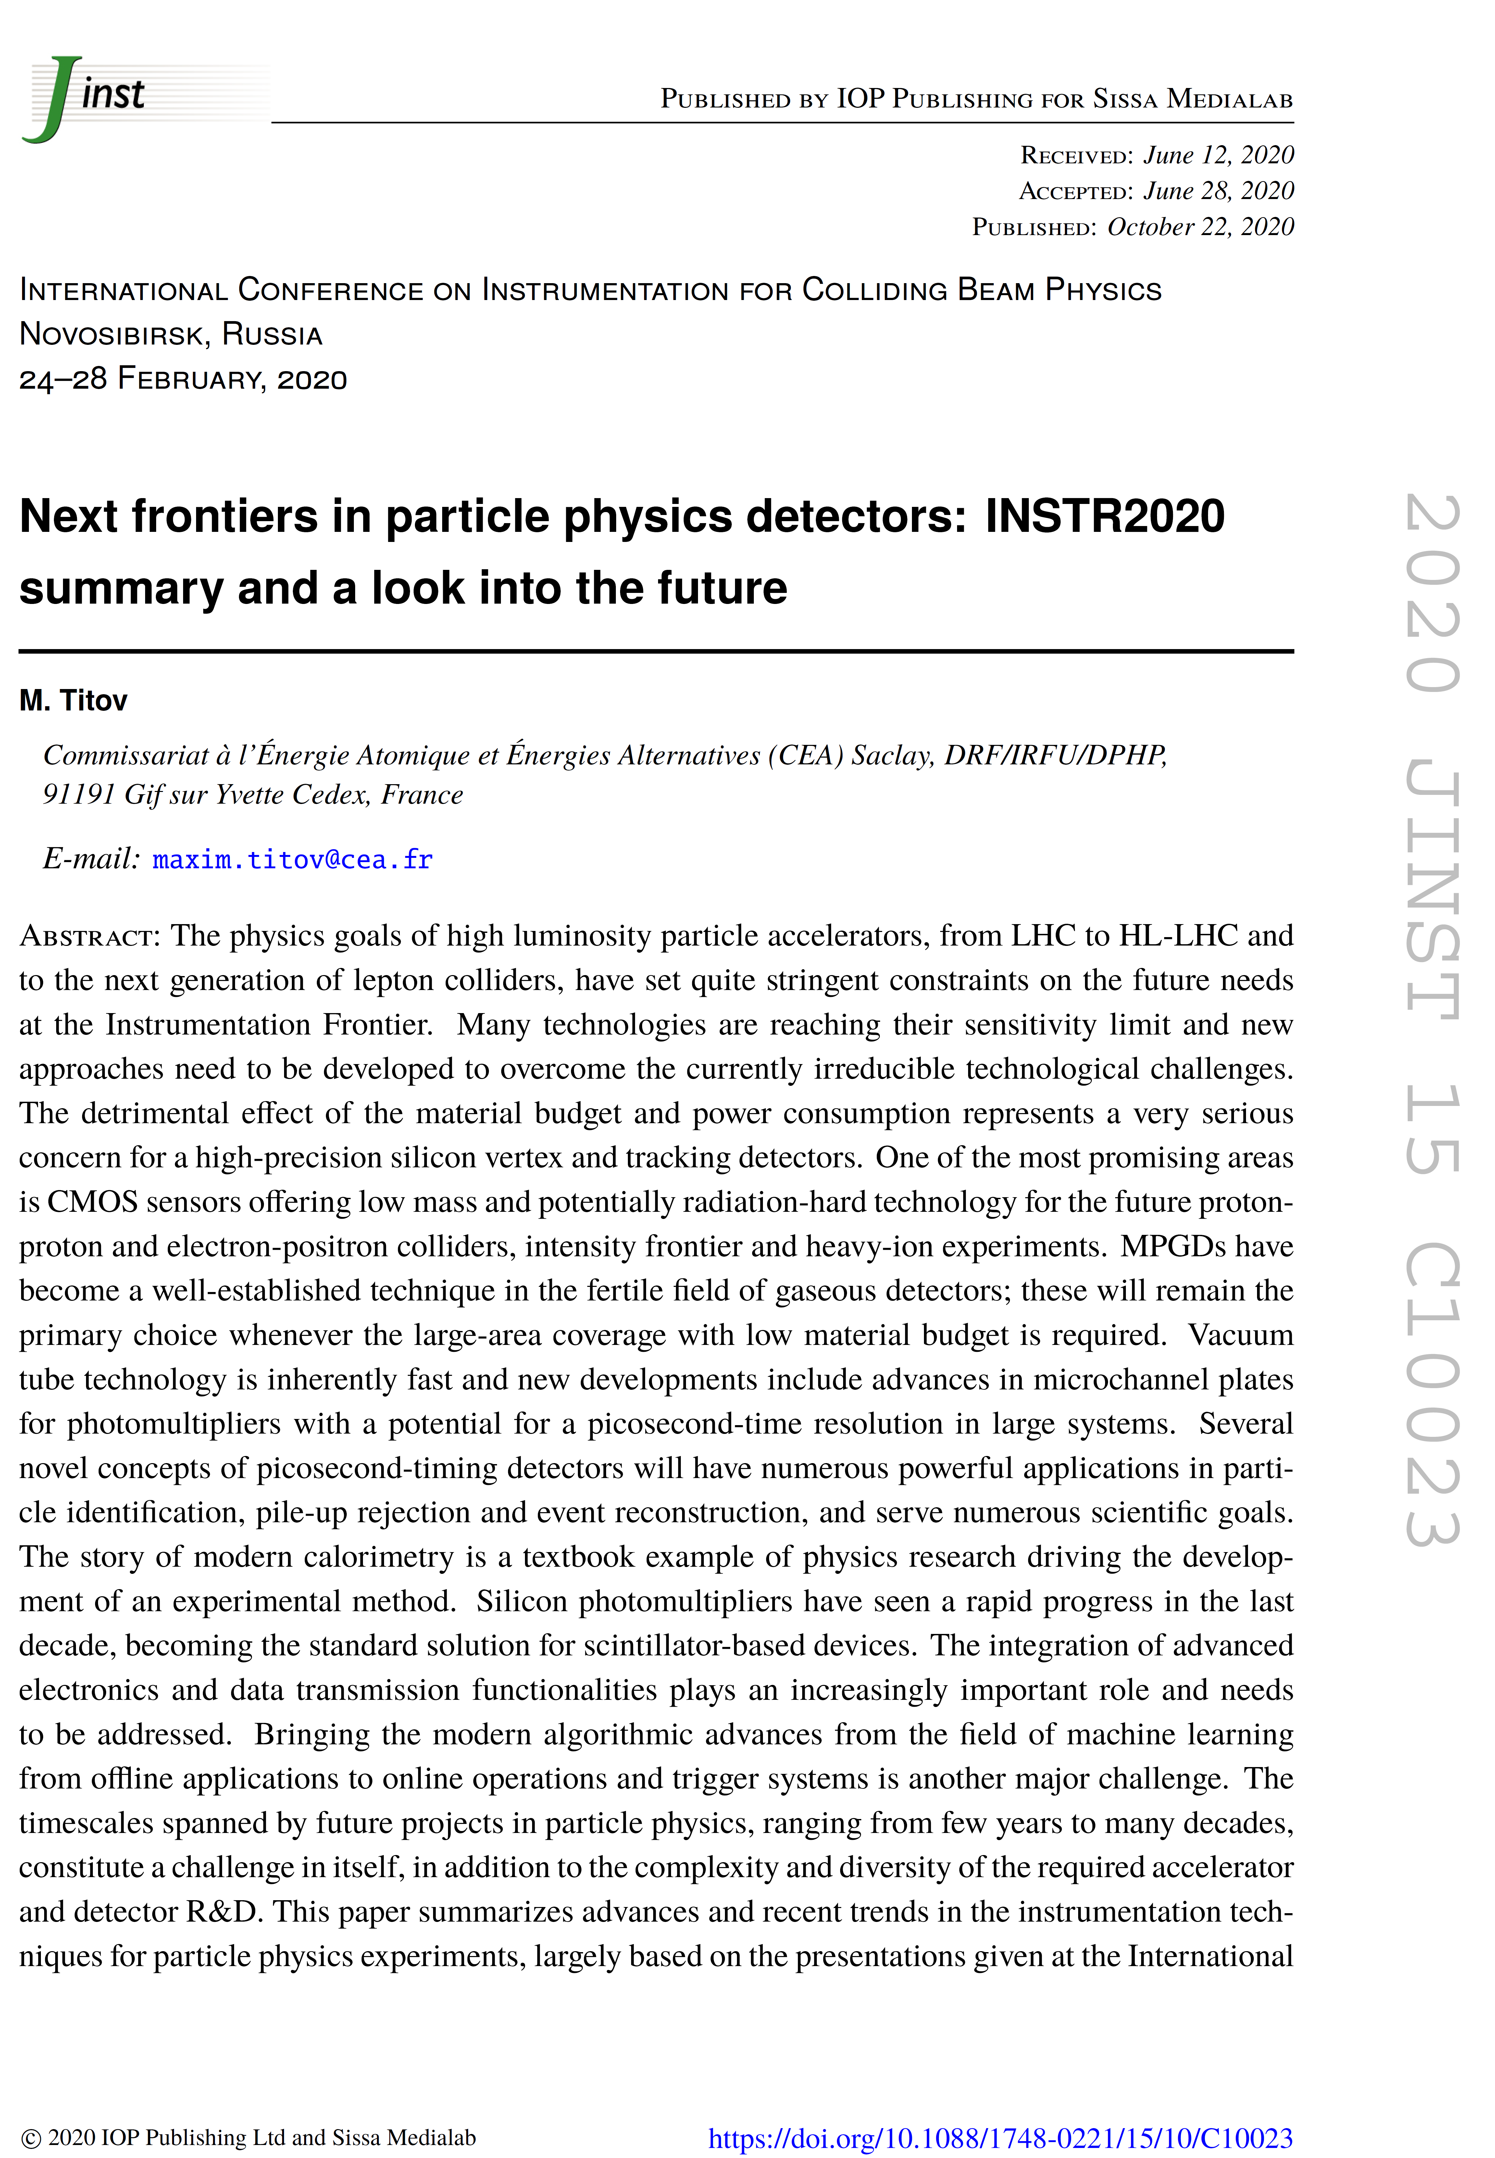


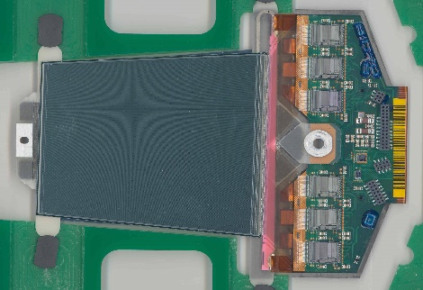
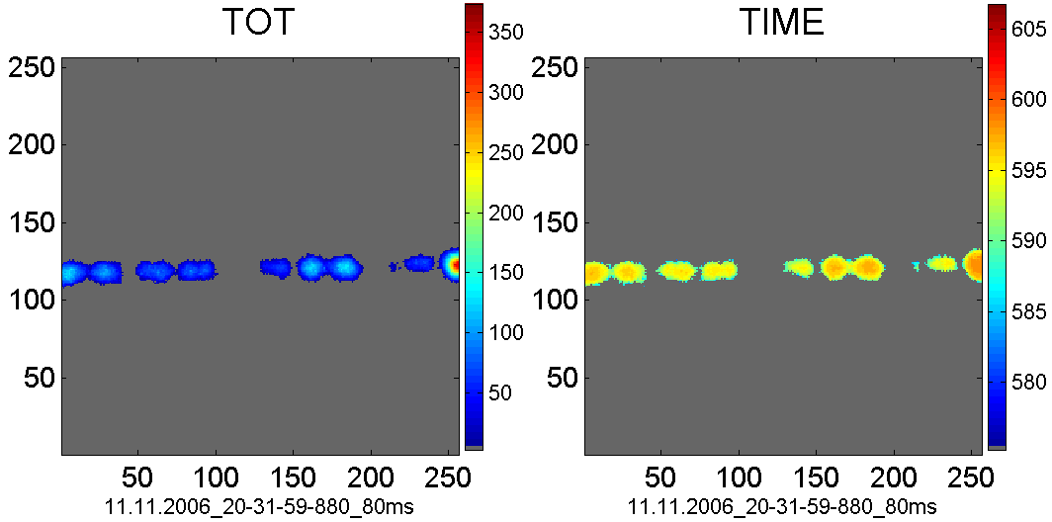
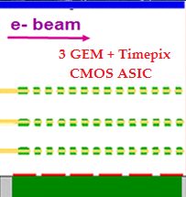
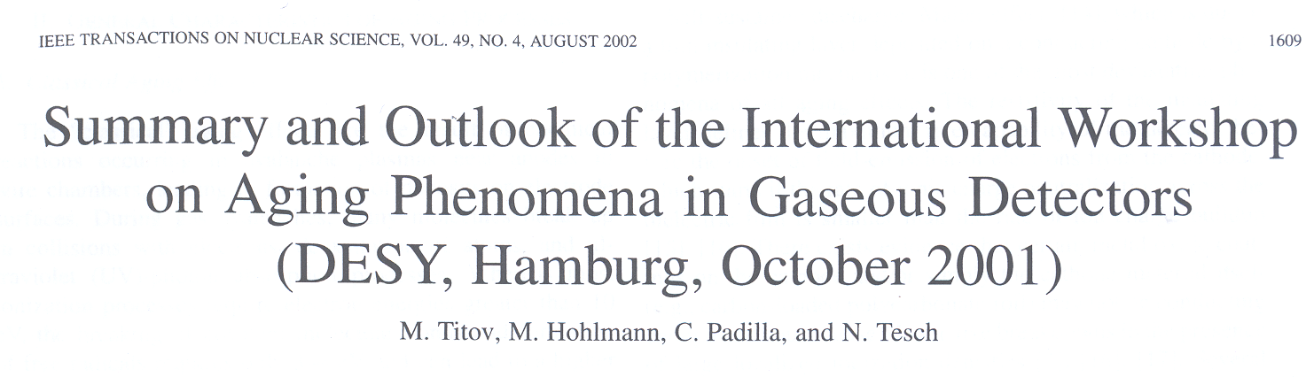
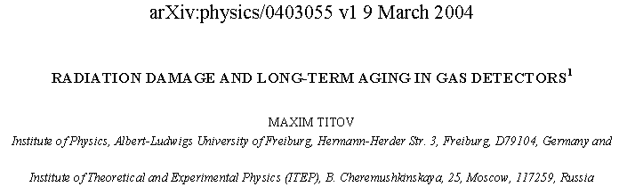
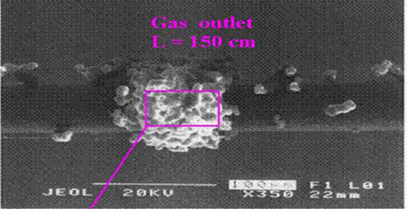
Background: Detector Instrumentation
JINST15 C10023
(2020)
CERN Courrier (2015)
3GEM +
Timepix
ATLAS SCT
module
NIM A581, p.274, 2007
NIM A573, p.361, 2007
NIM A575, p. 353, 2007
IEEE TNS 48(4), p. 1059 (2001)
arXiv: 0403055 (2004)

Slide 6
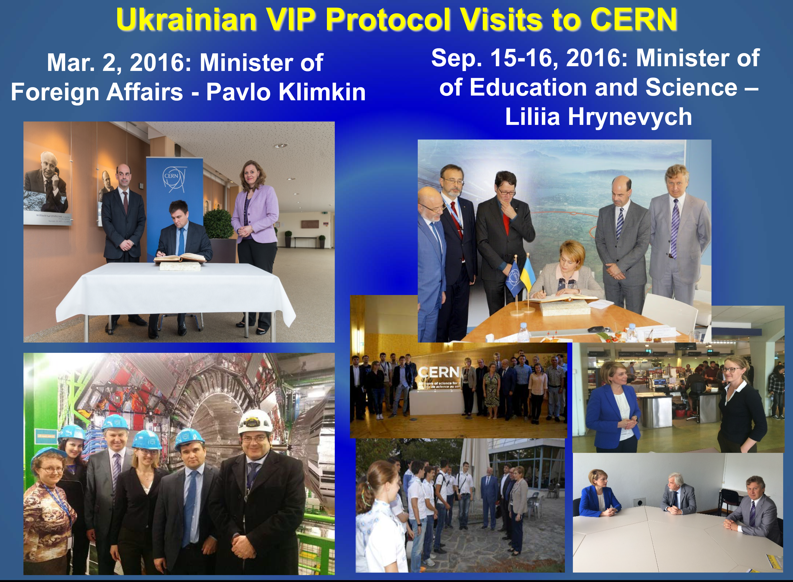
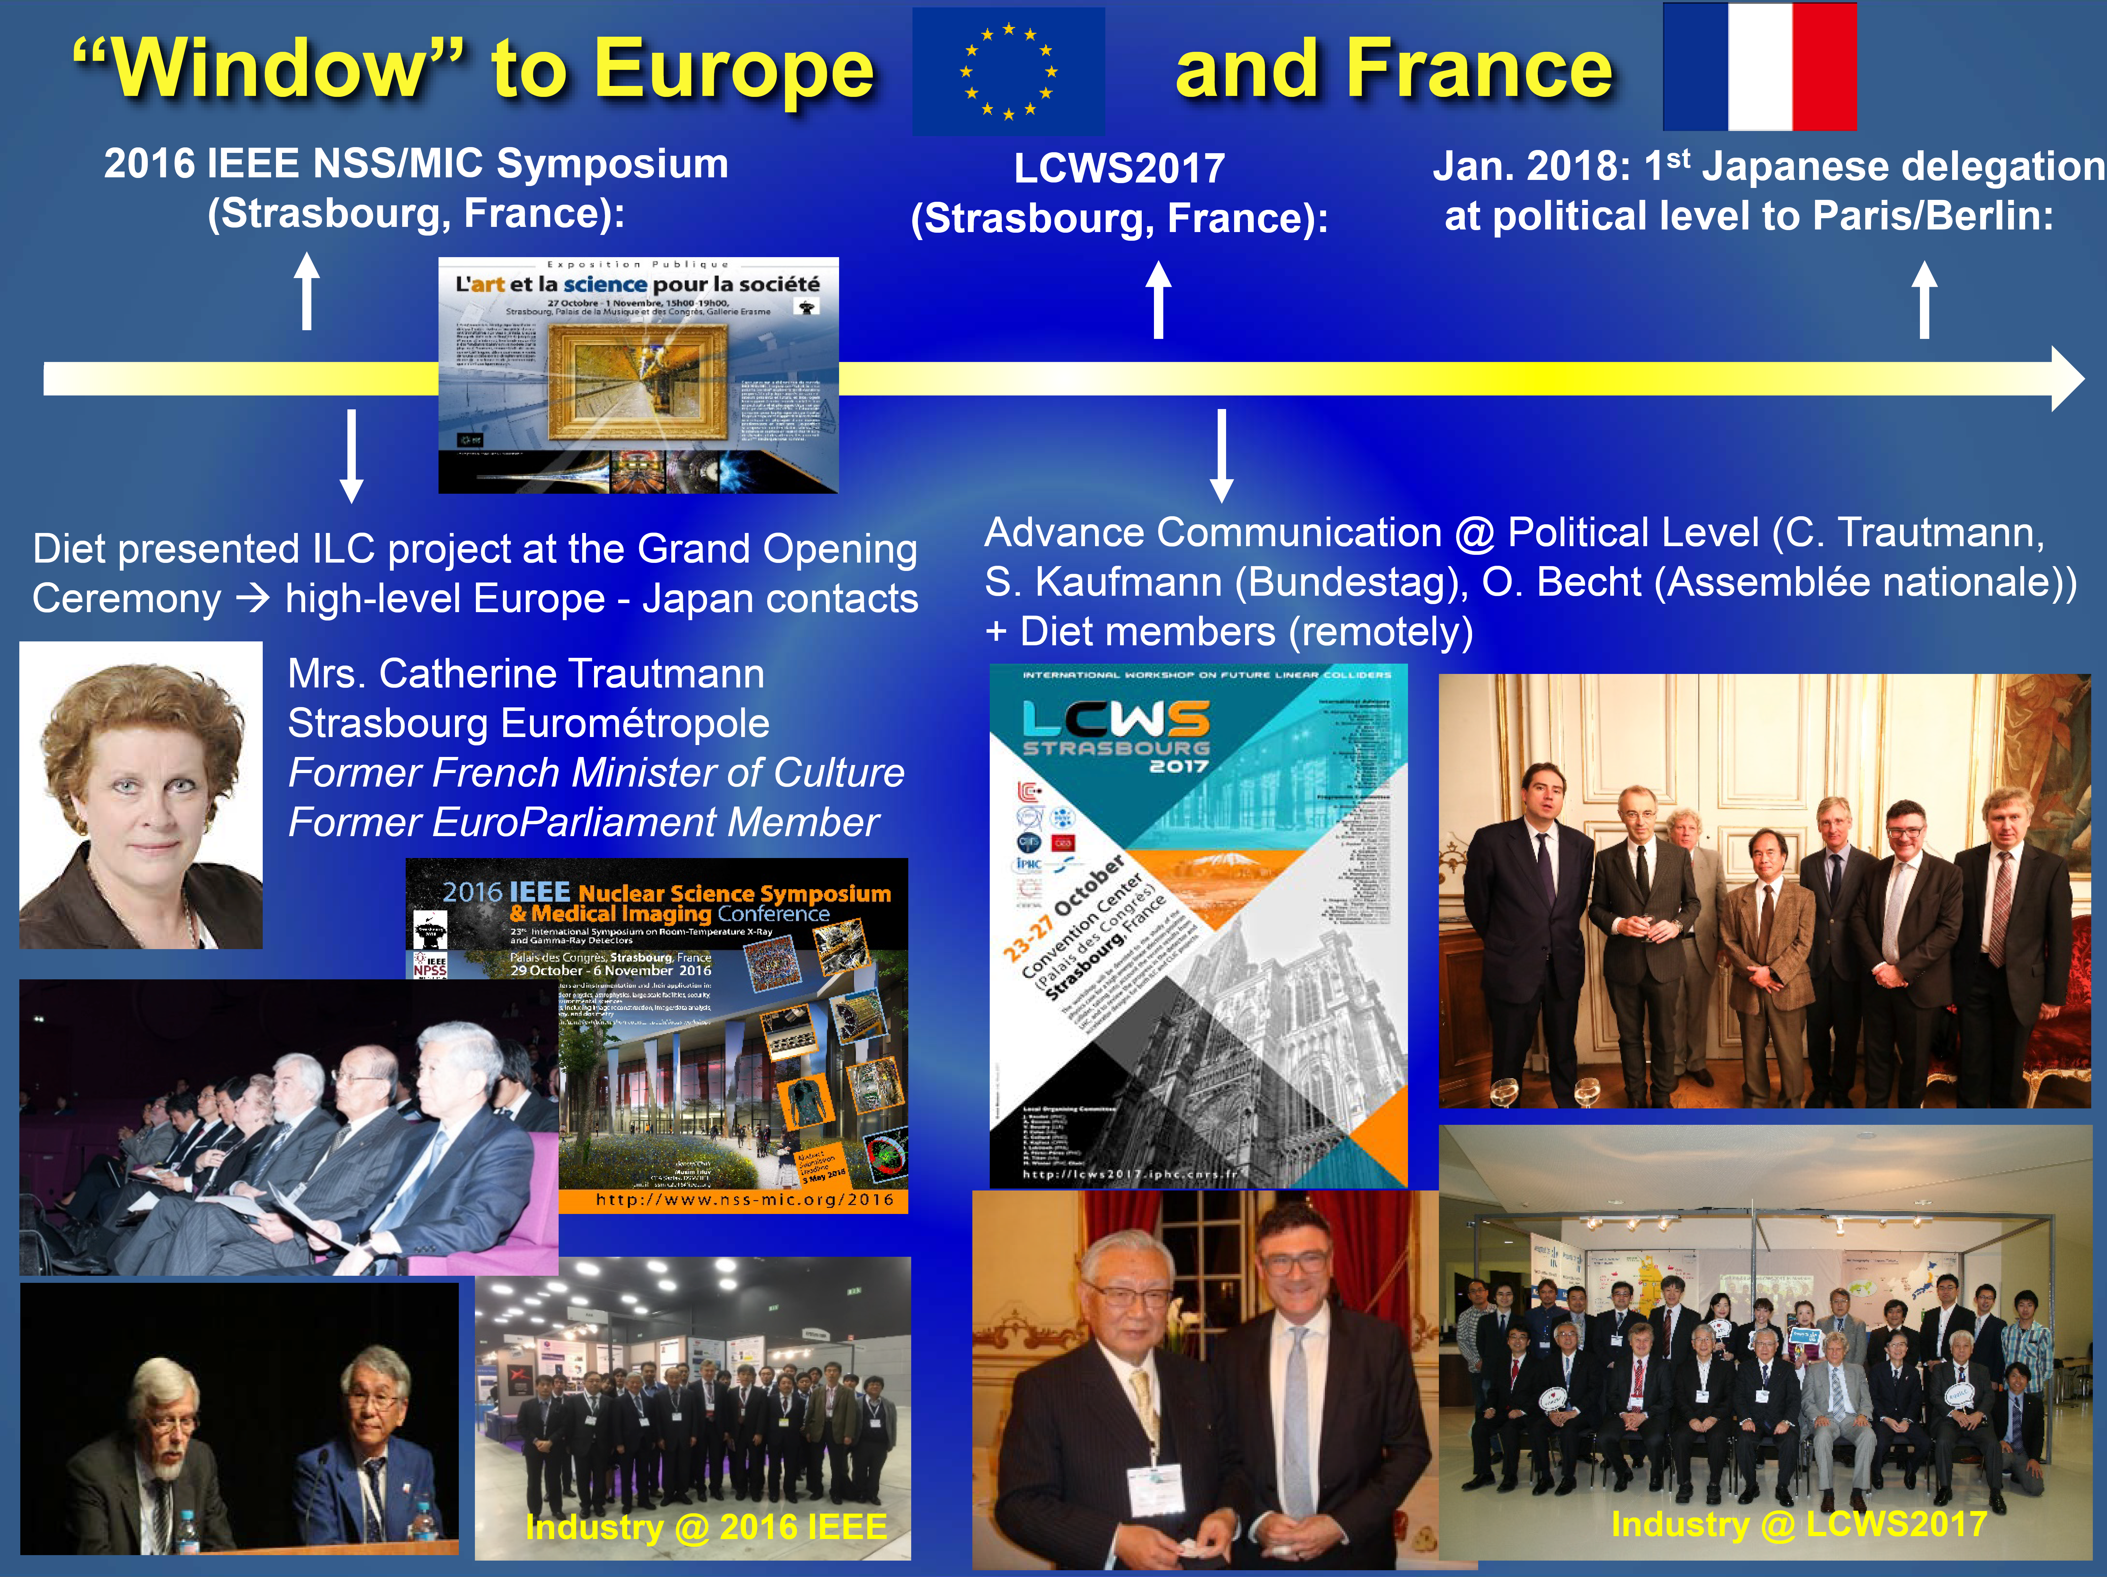
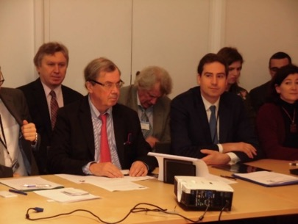
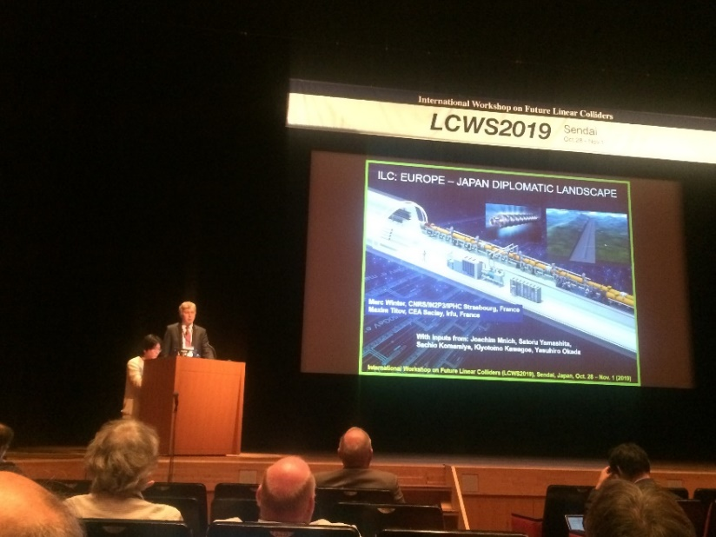
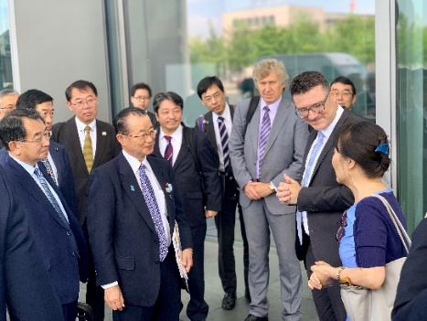
Background: Science Diplomacy
2013-2016: Liaison between CERN & Ukraine Ministry of Science and Education / Ministry of Foreign Affairs
> 2017: Scientific Advisor to CERN Council Delegates (Ukraine)
> 2016: Global effort to facilitate science diplomacy discussions between Japan, US, France, Germany Parliament members for the ILC project in Japan

Slide 7
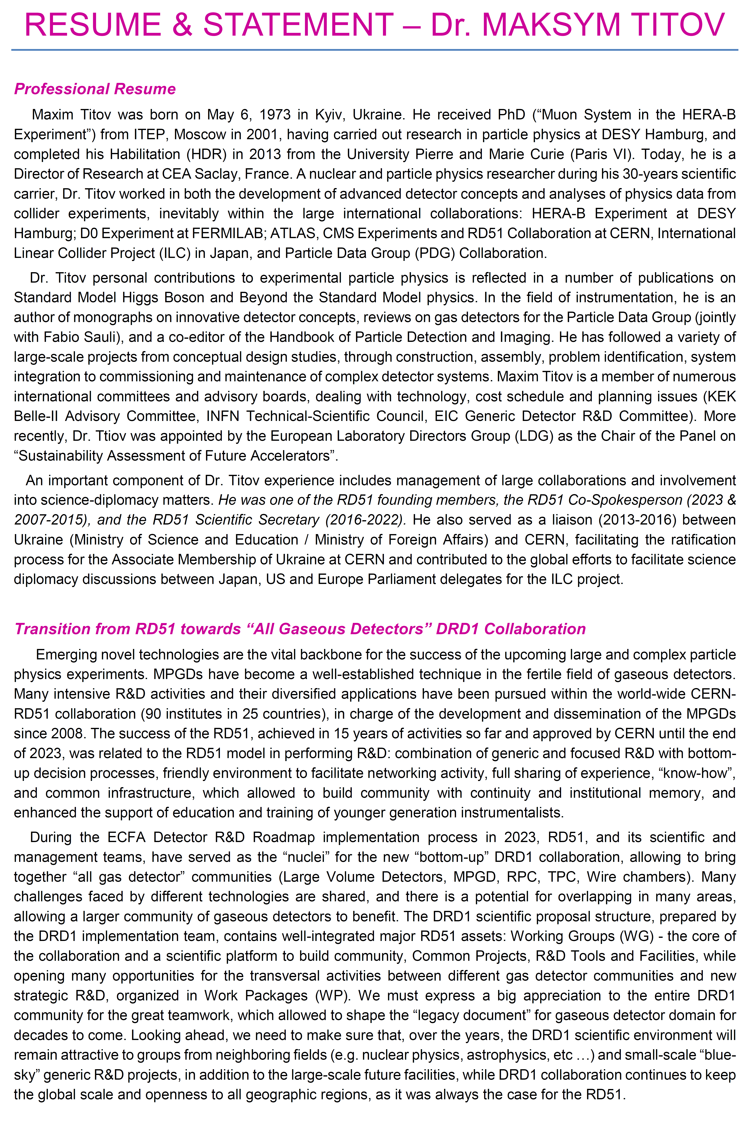
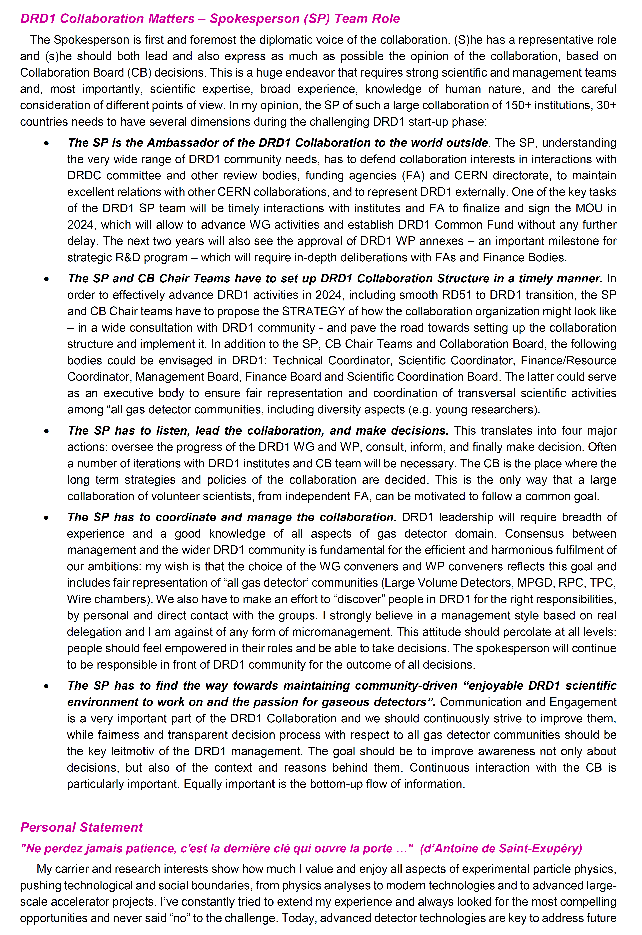
Statement:
https://indico.cern.ch/event/1352912/contributions/5696930/attachments/2766345/4818834/MTITOV_RESUME-STATEMENT_05122023_FINAL.pdf
Professional
Resume
Spokesperson Role
RD51 to DRD1 Transition
Personal Statement

Slide 8
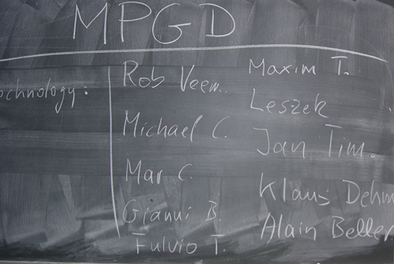
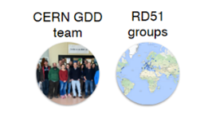
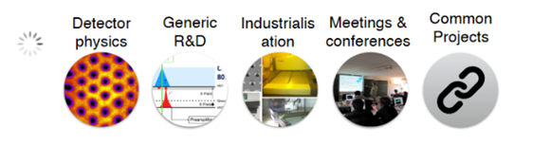
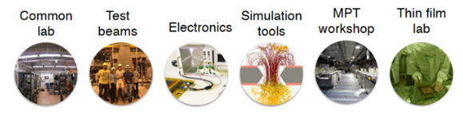
RD51 Legacy: From RD51 to DRD1
The DRD1 scientific proposal structure, contains well-integrated major RD51 assets:
WG - the core of the collaboration and a scientific platform to build community, Common Projects, R&D Tools and Facilities, while opening new opportunities for the transversal activities between different gas detector communities and strategic R&D, organized in WP
https://rd51-public.web.cern.ch/
Community and Expertize
(RD51 Scientific Network)
RD51:
3 MAJOR
ASSETS
RD51 in 2008:
MPGD Technology Development /
Support « Blue-Sky R&D » (Common Projects)
2023:
https://drd1.web.cern.ch/
DRD1 Presentation (P. Gasik) to DRDC (Dec. 4)
DRD1 Approval by CERN RB (Dec. 6)
R&D Tools, Facilities and Infrastructure

Slide 9
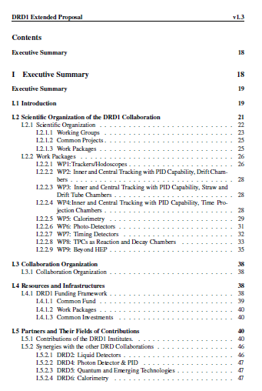
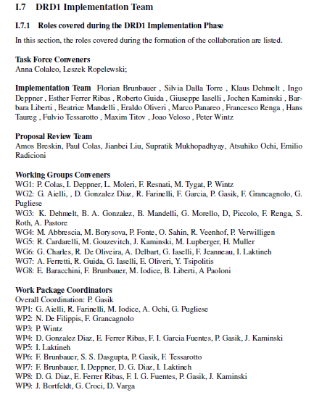
New Epoch: DRD1 – A Community of Gas Detector Physicists
Collaboration Type: Community-driven (“bottom-up”) with the cross-disciplinary R&D environment & exchange: common infrastructures (labs, workshops), common R&D tools (software and electronics)
Scientific Organization in Working Groups (WG): provides a platform for sharing knowledge, expertise & efforts by supporting strategic detector R&D directions, facilitating the establishment of joint projects between institutes.
Work Packages (WP): long-term projects addressing strategic R&D goals, outlined in the ECFA Detector R&D roadmap with dedicated funding lines.
Common Projects (CP): short-term blue-sky R&D or common tool development with limited time and resources, supported by the Collaboration Common funds.
Big APPRECIATION to the DRD1 COMMUNITY for great TEAMWORK, which allowed to shape the “legacy document” for gaseous detectors domain for decades to come

Slide 10
The Role of Spokesperson (SP) & Challenges in 2024-2025
A) The SP is the First Servant and Ambassador of the DRD1
defend collaboration interests in interactions with DRDC committee and other review
bodies, funding agencies (FA) and CERN directorate, to maintain excellent relations with
other CERN collaborations, and to represent DRD1 externally:
- timely interactions of the DRD1 SP Team with institutes and FA to finalize and sign the
MOU in 2024 → advance WG activities and establish DRD1 Common Fund
- approval of DRD1 WP annexes – an important milestone for strategic R&D program – will
require in-depth deliberations with FAs and Finance Bodies
The SP & CB Teams have to set up DRD1 Structure in a timely manner
propose the structure for the collaboration organization – in a wide consultation with DRD1
community - and pave the road towards its setting up and timely implementation:
- several DRD1 bodies could be envisaged, in addition to SP and CB Teams: Technical
Coordinator, Scientific Coordinator, Finance/Resource Coordinator, Management Board,
Finance Board and Scientific Coordination Board (SCB)
- SCB could serve as an executive body to ensure fair representation and coordination of
transversal activities among “all gas detector communities” (MPGD, RPC, TPC, WIRE)
- diversity aspects → young researches should be recognized and be the part of SCB
C) The SP has to listen, lead the collaboration, and make decisions
four major actions: oversee the progress of the DRD1 WG and WP, consult, inform, and finally
make decision. Often a number of iterations with DRD1 institutes & CB Team will be necessary

Slide 11
The Role of Spokesperson (SP) & Challenges in 2024-2025
D) The SP has to coordinate and manage the collaboration
consensus between management and the wider DRD1 community is fundamental for the
efficient and harmonious fulfilment of DRD1 ambitions
- choice of the WG conveners and WP coordinators reflects fair representation of “all
gas detector’ communities (LVD, MPGD, RPC, TPC, WIRE)
- discover” people in DRD1 for the right responsibilities, by direct contact with the groups
- a management style based on real delegation (without micromanagement) → this attitude
should percolate at all levels: people should feel empowered in their roles and be able to
take decisions → SP remains responsible in front of DRD1 community for all decisions
E) The SP has to find the way towards maintaining community-driven “enjoyable DRD1 scientific environment to work on and the passion for gaseous detectors”
communication and engagement is a very important part of the DRD1 Collaboration and we
should continuously strive to improve them,
- fairness and transparent decision process with respect to all gas detector communities
should be the key leitmotiv of the DRD1 management
- improve awareness not only about decisions, but also of the context and reasons behind them
- equally important is the bottom-up flow of information
The Most Important Person in DRD1 is not the SP … It is YOU !!!!

Slide 12
Spokesperson Candidate: Maksym Titov
Being a candidate to the highest management role of DRD1 is a GREAT HONOR and
I am thankful for being considered
The DRD1 Implementation Process have shown that we have many talented people in the
Collaboration on and we should build a dynamic and diversified DRD1 community:
- ensure strong DRD1 Support to Young Scientists by helping them to grow and be able
to take higher responsibilities
We have to develop a robust STARTUP STRATEGY n 2024:
- fair representation of all gas detector communities in DRD1 coordination
- transparent decision-making process
- delegation of responsibilities (no micromanagement)
I will be always available to listen to the collaboration members in order to define strategic planning and build consensus for DRD1 next steps, priorities, and goals in an ambiance of collegiality, cooperation and greater intellectual freedom
Based on my past experience in RD51, other international collaborations, and deep understanding of the CERN environment, I’ll look forward working with all of you, guided by science, RD51/DRD1 collaborative spirit and the principle of inclusiveness
THANK YOU FOR YOUR ATTENTION!

