Slide 1


Comparison of High-Performance Distributed File Systems on two Platforms: Linux and Windows
The superiority of EOS-based Comtrade Distributed File System (CDFS) for Earth Observation Data Storage
Gregor Molan
Comtrade Group / Comtrade360

Slide 2
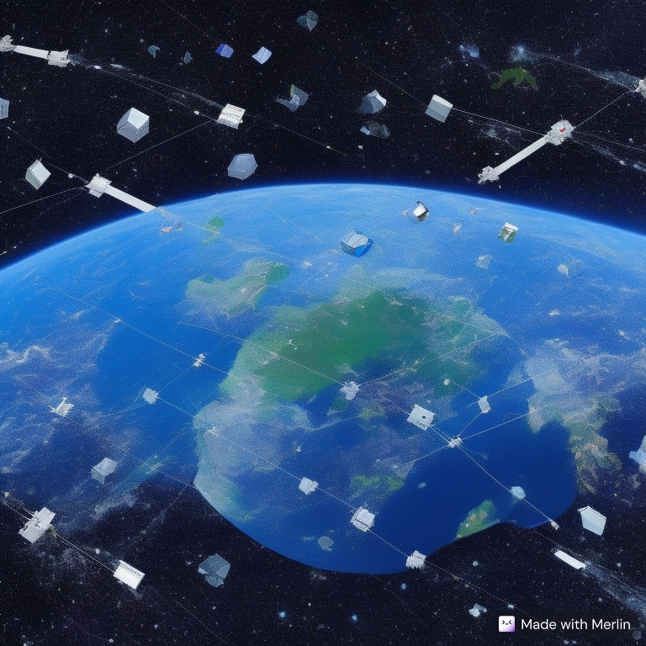

The Rising Quantity of Earth Observation Data
The proliferation of Earth observation satellites has led to a surge in data generation, posing significant data storage and management challenges.
History of Earth observation data collection
The exponential growth of new satellites, including nanosatellites

Slide 3

Need for High-Performance Data Storage in Earth Observation
The demand for high-performance data storage in Earth observation is essential for:
  Extracting,
  Storing,
  Processing,
  Analysing
Insights from the vast volumes of satellite data.

Slide 4
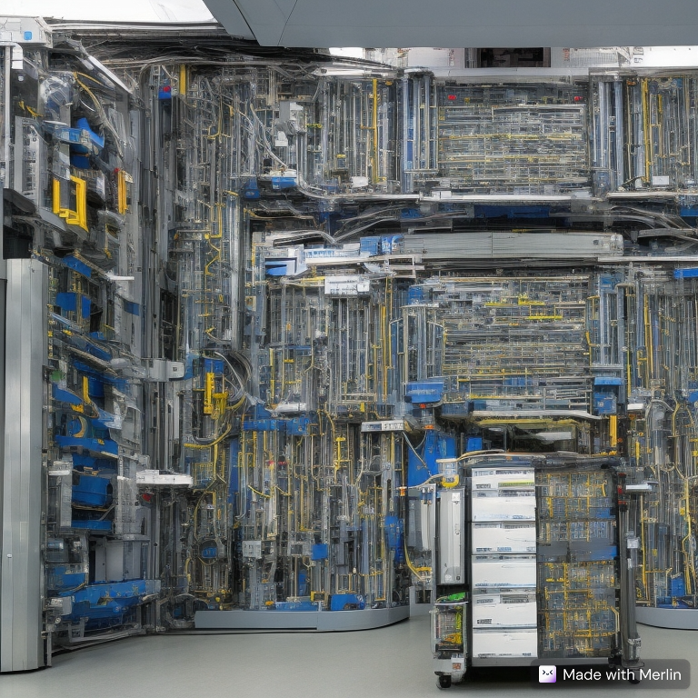
Data Volume Challenge
Increasing number of satellites
Increasing data collection size
Increasing data requests from users
The consequence:
  Managing the sheer volume of Earth observation data efficiently is a critical challenge.

Slide 5

Data Accessibility Challenge
Crucial needs for timely analysis and decision-making are:
  Fast access to space data
  Reliable access to space data.

Slide 6
Comparison of High-Performance File Systems
Comparison of the following aspects in rigorous speed-testing
  EOS based CDFS
EOS distributed file system has been subjected alongside other high-performance file systems, such as Ceph, Lustre, IBM Spectrum Scale, and Hadoop, demonstrating its superiority in various aspects.

Slide 7

Advantages of EOS (CDFS) for Earth Observation Data Storage
CDFS offers seamless scalability to accommodate the growing volume of Earth observation data.
Reliability for Earth Observation Data Storage.
CDFS ensures data integrity and availability, which is critical for mission-critical applications.
CDFS provides high-performance storage capabilities, enabling rapid data access and analysis.

Slide 8
CDFS's Superiority in Handling Earth Observation Data
CDFS's architecture and features
Well-suited for handling
  The unique requirements of Earth observation data
  Handling large volumes
  Handling diverse formats
  Satisfying real-time processing needs

Slide 9
CDFS: EOS Implementation Prepared to Collect Earth Observation Data
The initial set-up prepared at Comtrade as a PoC
to collect and handle Earth observation data:
  Management Nodes:
    32 threads, 2x Intel® Xeon® Silver 4208 Processor
    384 GB RAM, 2x 2 TB SSDs
  Storage Nodes:
    32 threads, 2x Intel® Xeon® Silver 4208 Processor
    64 GB RAM, 1x 2 TB SSD, 6x 2 TB HDDs
  Client Node Nodes:
    12 threads, Intel® Core™ i5-12400 Processor
    16 GB RAM, 1 TB SSD

Slide 10
Prospects and Enhancements for CDFS in Earth Observation
Potential future enhancements and developments in EOS that could further improve its capabilities for Earth observation data storage and management:
Enhance EOS installation.
Specify the EOS parameters to scale between throughput speed, latency, and reliability.
Specify the EOS source code files and header files to additionally finetune the dependences between throughput speed, latency, and reliability.

Slide 11


Key Takeaways and Conclusion
Overview of the key takeaways of EOS to emphasise EOS's role as a superior Earth observation data storage solution.
Advantages of spreading EOS and CDFS to Earth observation data storage.
Recommendations for the EOS team considering extending EOS for Earth observation data needs.
Gregor Molan
gregor.molan@comtrade.com
gregor.molan@cern.sh

