Slide 1


EOS Status at IHEP
Haibo LI<lihaibo@ihep.ac.cn>
On behalf of the IHEP CC storage team
March 15, 2024

Slide 2
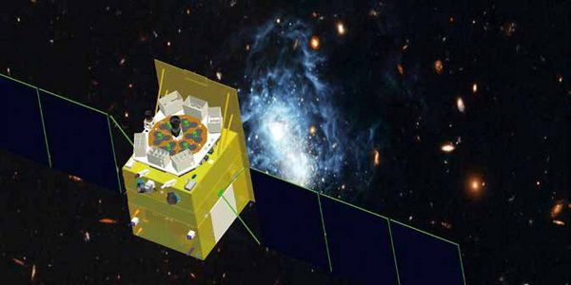
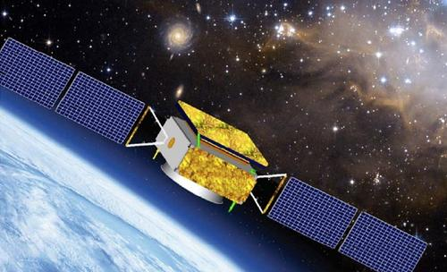
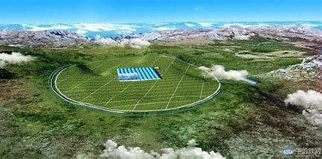
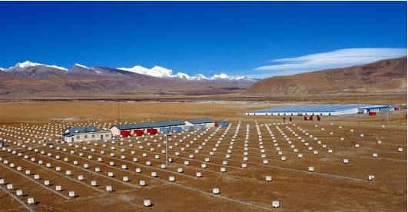
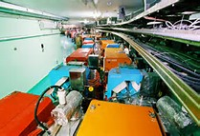
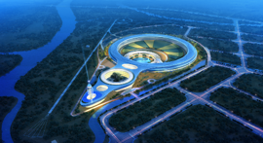
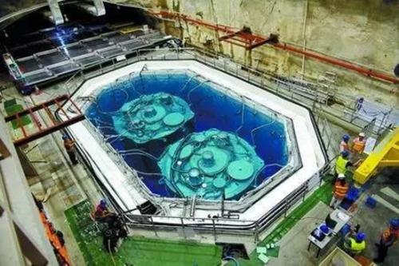
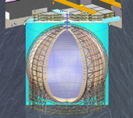
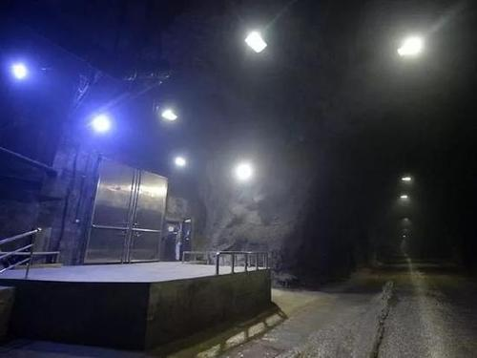
IHEP at a glance
Institute of High Energy Physics (IHEP) is a premier research institute in China, dedicated to the study of particle physics, accelerator physics, and related fields.
Data storage requirements for HEP experiments at IHEP
  Beijing Electron Positron Collider BEPCII/BESIII
    1PB/year, with an accumulation of over 10PB
  Jiangmen Neutrino Experiment
    2PB/year
  Large High Altitude Air Shower Observatory (LHAASO)
    10PB/year
  High Energy Synchrotron Radiation Light Source (HEPS)
    100PB/year
  High-Energy Space Astronomy Experiments such as
  HXMT/HERD/eXTP/GeCAM, etc.
    10PB/year
  WLCG: CMS, ATLAS, LHCb, BelleII, etc.
Space astronomy
satellite
（HXMT, HERD）
~550KM
High Altitude Cosmic
Ray Observatory
（LHAASO, YBJ）
~4400M
~-5M
Particle collider
（BEPCII, HEPS,CSNS）
-2500M
~-300M
Underground Neutrino
Experiment
（JUNO, Dayabay）

Slide 3
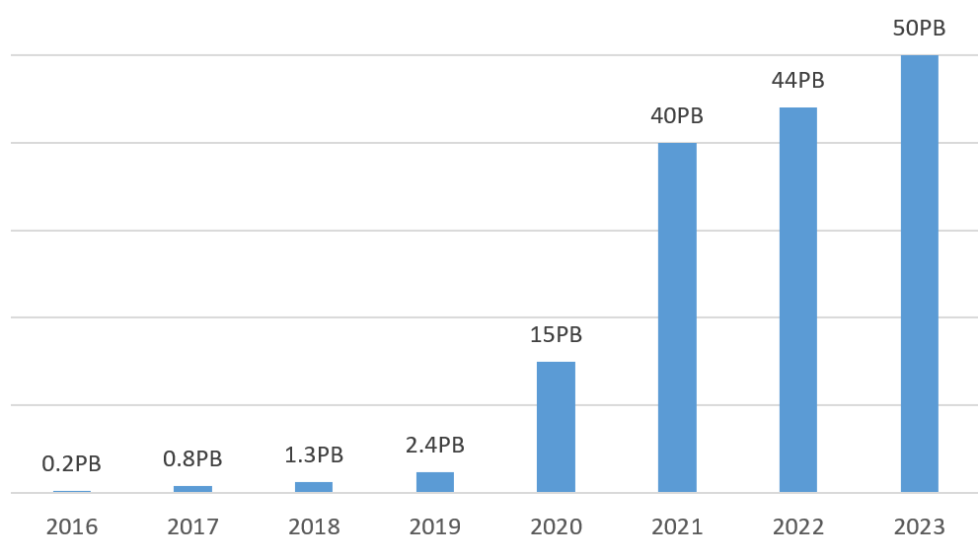
EOS deployment at IHEP
Raw Capacity | ~ 50PB
Disk server | 148
Number of fs | 3906
Number of files | ~ 700 Mil
Number of directories | ~ 15 Mil
Peak throughput | >100 GB/s
EOS is one of the major storage systems at IHEP
  Serves for LHAASO, JUNO, CTA and IHEPBox
EOS in production since 2016
11 EOS instances
  6 instances for physics
  4 instances for CTA
  1 instance for IHEPBox
EOS versions
  MGM: 5.1.25, 5.2.X FST: 5.1.25, 5.2.X
  Computing nodes: 5.1.25
Replica 2
Access via xrootd at batch nodes
Fusex at login node

Slide 4
EOS Hardware
RAID array
  Disks per RAID: 84
  Disk sizes:12TB, 20TB
  Mainly used in Daocheng site, Sichuan province (at the altitude of 4410m)
JBOD array
  Disks per JBOD: 84
  Disk sizes: 12TB, 16TB，20TB
  Connected with two FSTs, configured with 25Gbs network
FST servers
  16-40 cores, 128GB-256 GB RAM, 960GB SSD

Slide 5
Updates in 2023 – SE from DPM to EOS
EOS SE replace DPM as WLCG T2 storage
  One instance servers for ATLAS, CMS, BelleII
  Capacity: 2 PB
  Use RAID array
  One replica
  EOS version: 5.1.25
EOS SE and CTA used for LHCb T1 storage
  1 instance for SE, 1 instance for CTA
  SE Capacity: 6.69 PB
  Use JBOD array
  Replica 2
  EOS version: 5.1.25
  Ready, undergoing data challenge now

Slide 6
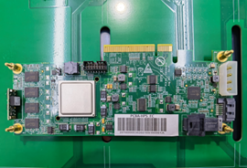
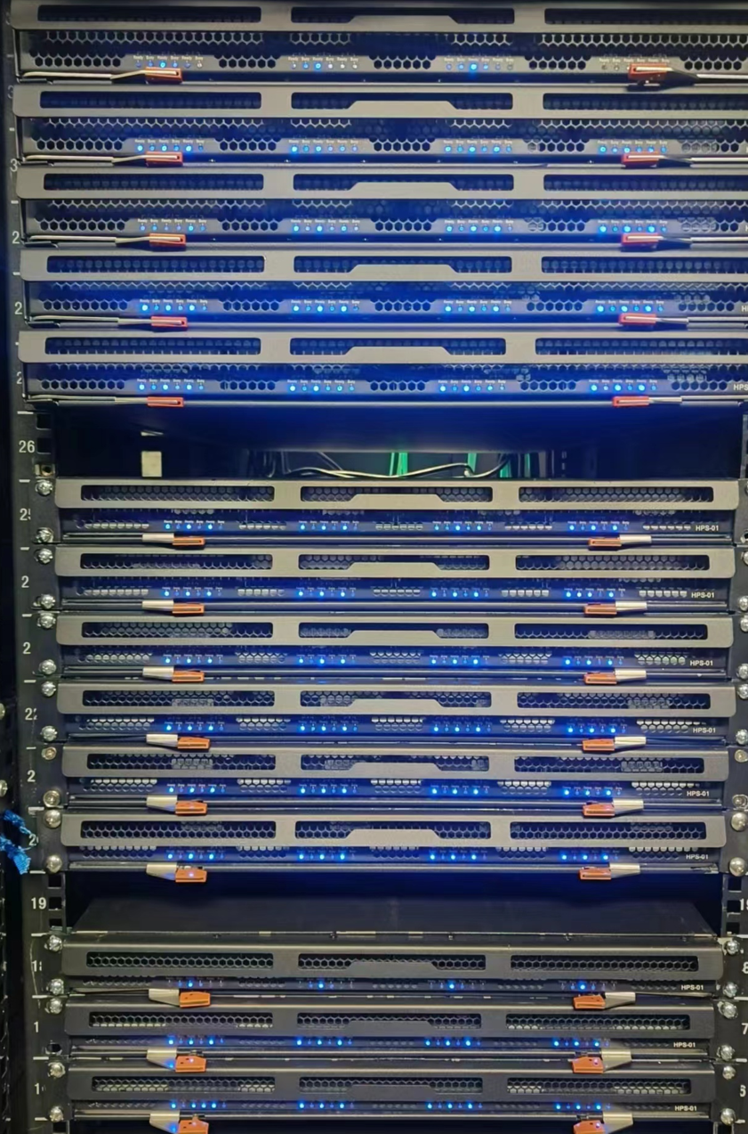
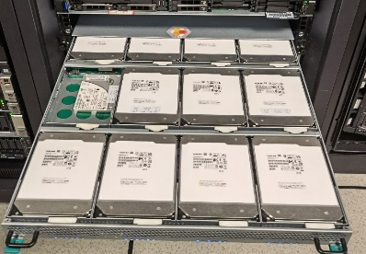
Updates in 2023 – ARM EOS in Production
ARM EOS in production since Oct. 2023
  2 PB gross capacity, 310 TB used
  OS: Ubuntu 18.04.6
  Recompile EOS
  EOS version: 5.1.27
  CPU: 4*ARM@1.8G Neon
  NIC: 10 Gbps
  Disk: 12 disks * 16 TB

Slide 7
Updates in 2023 – Capacity Expansion and Upgrade
Expansion of 6 PB of storage in 2023
Upgrade EOS version to EOS5
  4.8.48 -> 5.1.25, 5.2.0, 5.2.16
  Use eosxd instead of eosd
Migrated from LevelDB to extended attributes
Verified EOS on Alma Linux 9.3

Slide 8
Issues in 2023 – MGM Stuck
LHAASO EOS instances have been experiencing MGM stuck since we update to EOS V5.1
  ‘eos ViewRWMutex’ shows high latency，related to the EOS global namespace lock
  Ask for help from CERN, and back to normal after upgrading to version 5.2.0
Characteristics of LHAASO EOS instance
  Currently 46 PB, 450 M files, 90% used
  Many small files, like 1KB, 1MB, 10MB files
  A large number of files are read and written within a short period of time
  Frequent use of ‘eos newfind’ and ‘eos stat’ commands
Some measures
  Limit user threads: threads:* => 200
  Optimize user jobs
Current status
  The occurrence of MGM unresponsiveness has significantly decreased, though they still occur occasionally
  Generally caused by individual users, who can be identified using ‘eos ipc:// ns’
  Restricting the access for the identified user

Slide 9
Issues in 2023 – Others
Data deletion stress
  Storage runs full for long periods of time and deleting data is a routine task
  When user use the ‘eos rm -rf’ command to delete a directory, it may fail with timeout
  ‘’eos rm‘’ on administrator's side will cause MGM to be unresponsive
  Currently we use ‘eos newfind -f’ to generate a list of files first, and then delete them one by one in the background, which takes a long time
Fusex client crashed
  Fusex client sometimes generates coredump, the /root/core.* file needs to be cleaned regularly
  Sometimes the Fusex cache is not cleared automatically, resulting in full space and crashed
  Sometimes files are not synchronized
  EOS client version: 5.1.25, we will update it to 5.2.19 later

Slide 10
Plans in 2024 – New EOS instance for LHAASO
Add new instances for LHAASO to reduce the pressure on MGM
Be transparent to experiments and provide unified MGM endpoint
  Use ‘eos route link‘ to federate these two instance
Functionality has been verified to work
New instances and old instances are distinguished by different directories

Slide 11
Plans in 2024 - Others
Capacity expansion 6PB of gross space
Migrate to Alma Linux 9.3 by June 30 of this year
Construction of T2 EOS SE sites for other universities in China
Update EOS version to the latest 5.2.x

Slide 12
Summary
EOS SE Replaces DPM as WLCG SE at IHEP
ARM EOS is currently in production and running stable
As the data increases, the EOS systems face more and more demands and challenges, and we need do more efforts
EOS provides good storage guarantee for LHAASO experimental data processing and ensures the output of LHAASO scientific results
Thanks for great support from the CERN EOS team!

Slide 13
Thanks for your attentions!
谢谢！

