Slide 1
The I.FAST Challenge Based Innovation
Online welcome meeting
1st July 2024
Nicolas DELERUE / CNRS
with Phil Burrows/Oxford, Bob Holland/ESI,
Elias Metral/CERN, Louis Rinolfi/ESI, Valeriia Starovoitova/IAEA, Maurizio Vretenar/CERN

Slide 2
The I.FAST project
I.FAST = Innovation Fostering in Accelerator Science and Technology
https://ifast-project.eu/home
49 partners (research organizations, industry,…) including: CERN, CNRS (France), University of Oxford and other UK Universities, INFN (Italy), DESY, GSI (Germany), ESI,…
Gathering top researchers in the field of particle accelerators
Looking at innovative applications of accelerator technology

Slide 3

I.FAST Challenge Based Innovation
The I. FAST CBI is one of the many tasks within the I. FAST Project.
The aim of the challenge:
Use accelerator technology to address a given problem:
“Accelerators for health: imaging and new treatment modalities”
Can you suggest innovative use of accelerator technology to address the challenge?

Slide 4
The process
To help you better understand accelerators and the challenge, there will be seminars on both topics.
There is also some material at http://www.ifast-cbi.particle-accelerators.eu/material-about-particle-accelerators/
Feel free to contact the seminar speakers for additional details about their presentation.

Slide 5
The program
The online seminar program is on indico: https://indico.cern.ch/category/17672/
The in-person seminars program will be posted soon on indico.
In addition to the seminars there is:
  Plenty of time for collaborative work
  A visit of CERN
  A visit of Annecy
  Two “conferences”

Slide 6
Seminars
There will be 4 online seminars organised before the challenge (all at 17:00 Geneva time):
  Thursday July 4th, 17h, Willy Mondelaers, "Small particle accelerators and their applications in medicine and industry"
  Tuesday July 9th, 17h, Joao Seco, "Introduction to Radiation Biology"
  Thursday 11th July, 17h, Ugo Amaldi, "History of hadrontherapy"
  Tuesday July 16th, 17h, Christine Darve, "Accelerating Medical Knowledge Sharing for a Sustainable Future"
  Thursday July 18th, 17th, Industry forum, Several industrial partners will make a short presentation on their activity on medical accelerators.
Please mute your microphone during the seminars.
Feel free to ask questions at the end. Even if the question seems trivial, it is not a problem to ask it!

Slide 7
Collaborative spirit
Although this is a challenge, it is important to keep a collaborative spirit between teams.
In the accelerator world, everyone tries the best for his/her facility but we also go to other facilities to help at critical times.
If you have information that may be relevant to another team. We encourage you to pass it to them.

Slide 8
Who are you? / Teams
You should have received an email with your team number.
You will have a dedicated meeting this week to meet your team (you have received an email with the time/date).
Each team is balanced (based on the answers you gave in the application forms) in gender, in academic training (physicists, engineers, life scientists, medicine students,…) and in country of study.

Slide 9
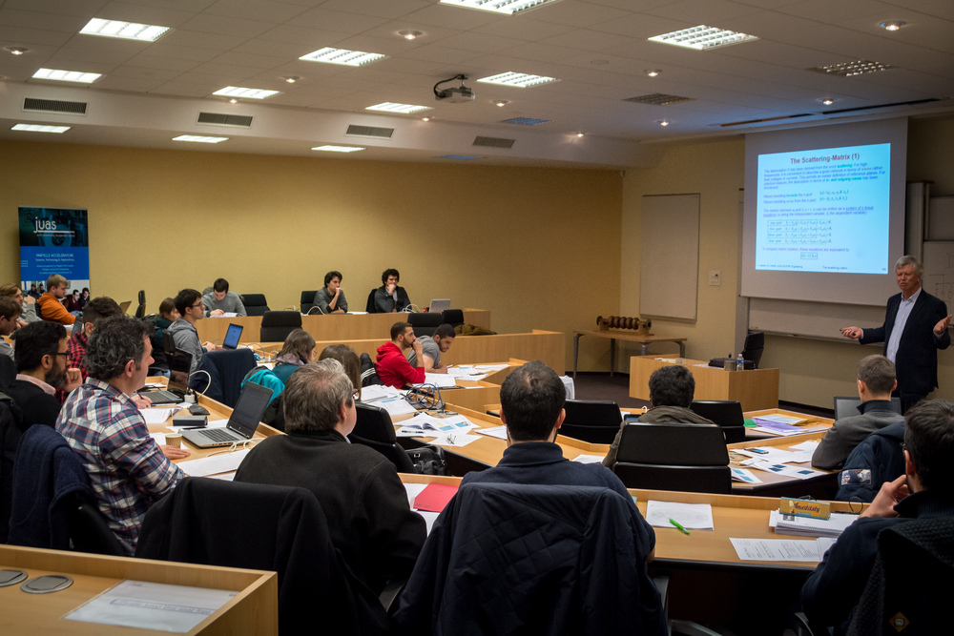
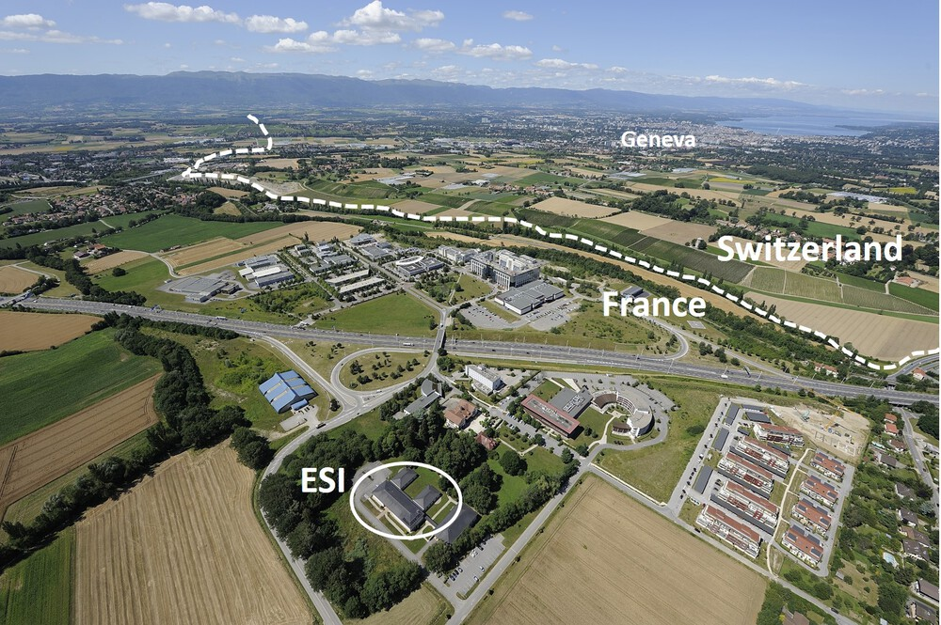
Hosting
The challenge will take place at the European Scientific Institute (ESI) in Archamps near Geneva: https://www.esi-archamps.eu/
ESI has strong experience in hosting scientific schools
The ESI team is taking care of the logistics, accommodation and travel arrangements for the participants.
Presentation after this one.

Slide 10
Outlook
Looking forward to the I.FAST CBI 2024!
See you in Archamps on July 23rd!

