Slide 1



Phase stability of CLIC Drive Beam
Alexander Gerbershagen
University of Oxford, FONT group
CERN, BE-ABP-CC3 group
18/04/2011
Phase Stability of CLIC Drive Beam
1
Notes:
1

Slide 2
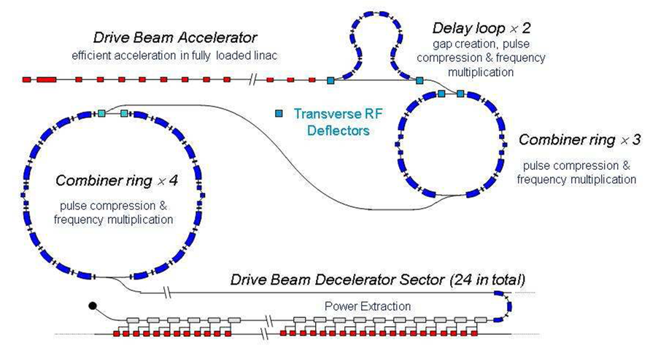
Content
Part 1: Analyse the error, consider 4 steps:
1. Chicane (by Avni Aksoy)
2. Drive beam accelerator (by Rolf Wegner)
3. Combination scheme (by Daniel Schulte and me)
4. PETS -> main linac (by Oleksiy Kononenko)
Part 2: Correct the error: feedforward system
Also apply feedforward using phase monitor
18/04/2011
Phase Stability of CLIC Drive Beam
2

Slide 3
Part 1: Analysing the errors
18/04/2011
Phase Stability of CLIC Drive Beam
3

Slide 4
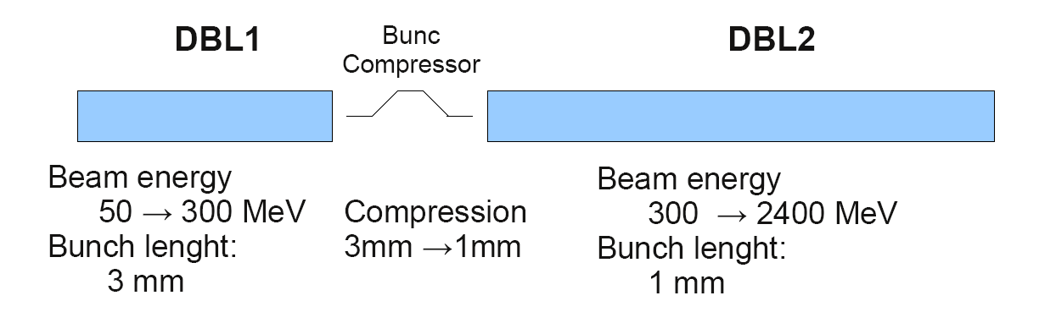
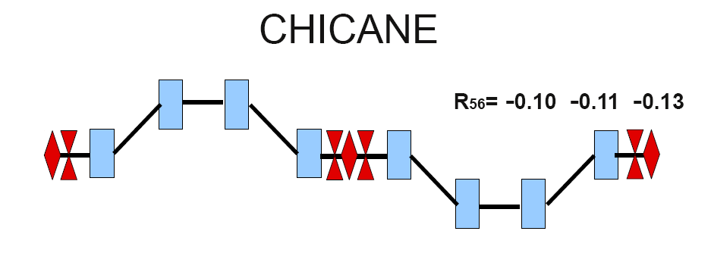
Analysing the errors:
Step 1 - chicane
Avni comes to conclusion that best stability
is provided by chicane with R₅₆=-0.1
18/04/2011
Phase Stability of CLIC Drive Beam
4

Slide 5
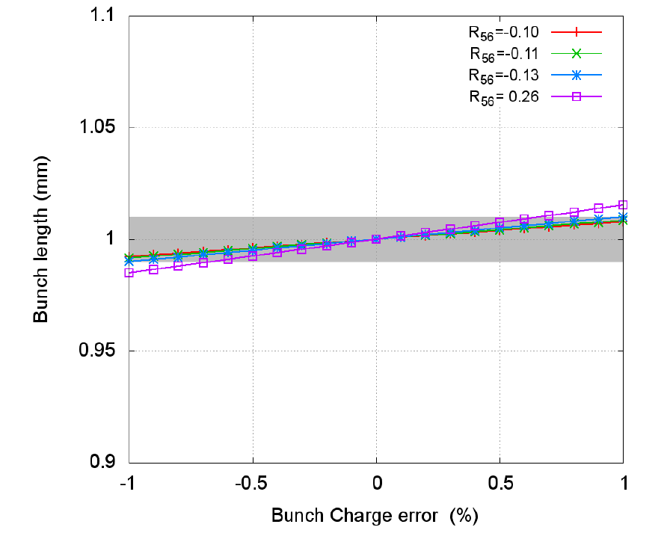
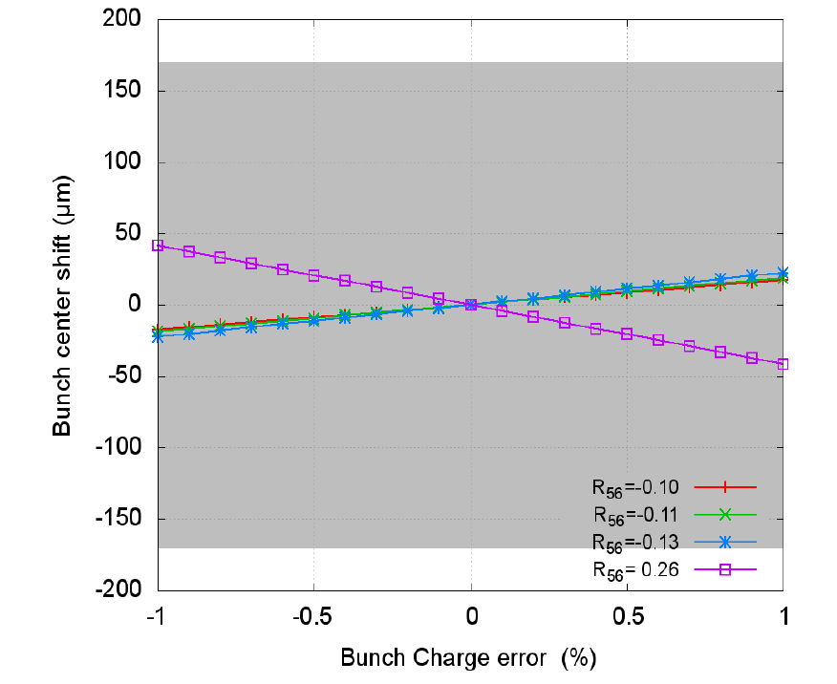
Analysing the errors:
Step 1 - chicane
Bunch length variation tolerance of 1% dictates bunch charge tolerance of1%
Hence, for this simulation a bunch charge error of maximal 1% is used
18/04/2011
Phase Stability of CLIC Drive Beam
5

Slide 6
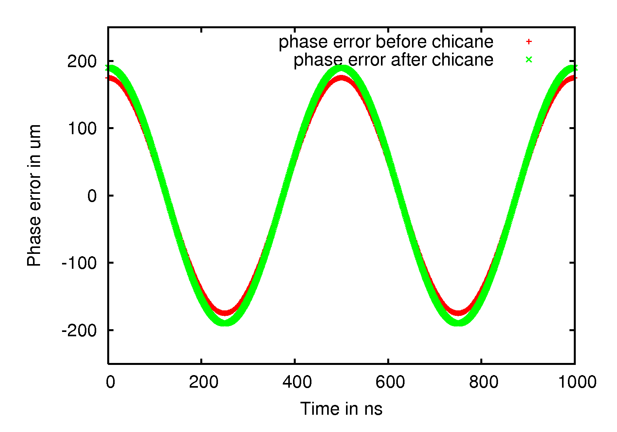
Analysing the errors:
Step 1 - chicane
Calculation made for ‘worst case scenario’, meaning that
    Starting phase error is 175 μm
    Charge error is 1%
    Phase and charge errors are in resonance
18/04/2011
Phase Stability of CLIC Drive Beam
6

Slide 7
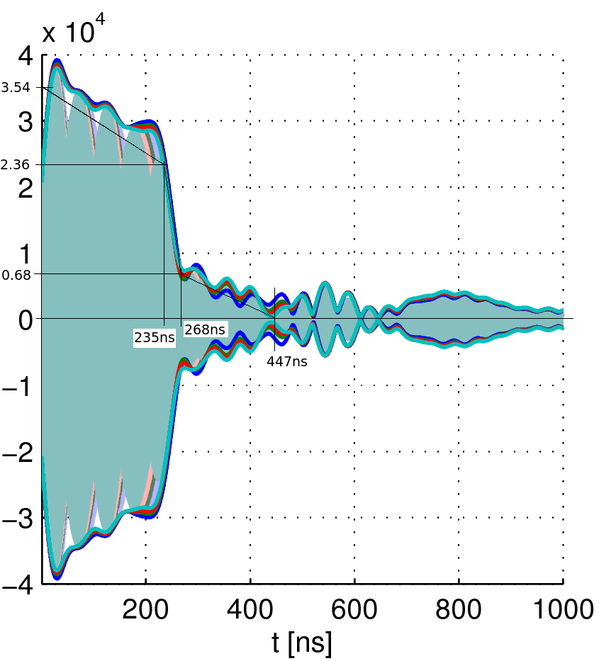
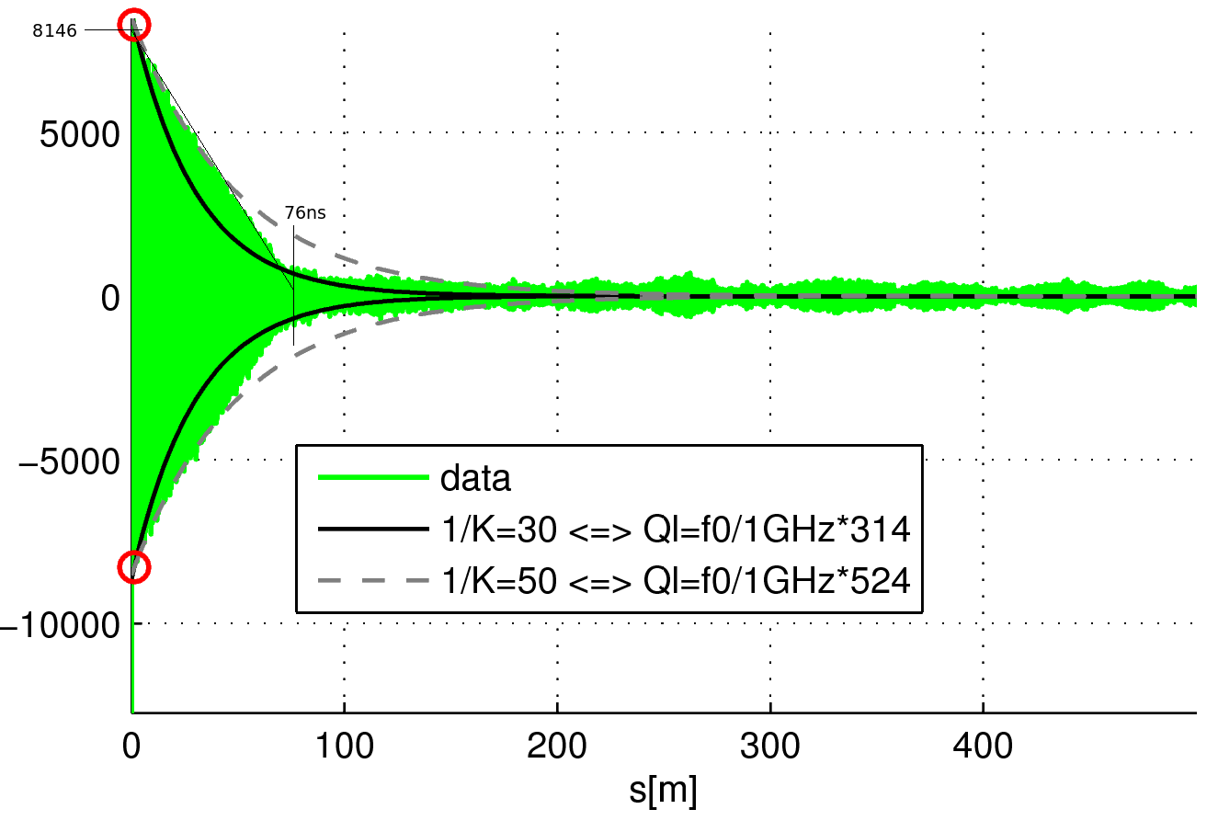
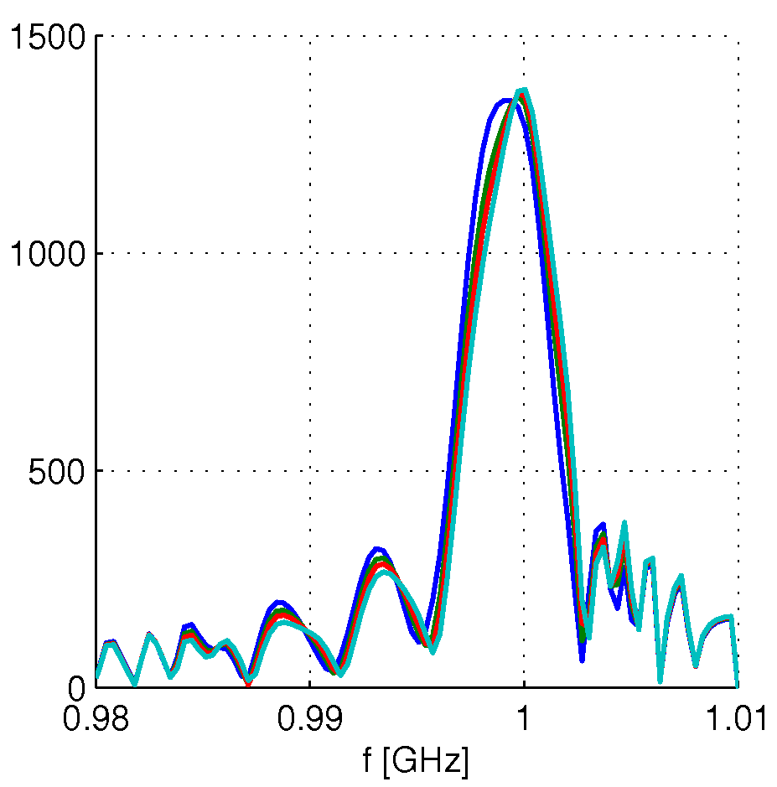
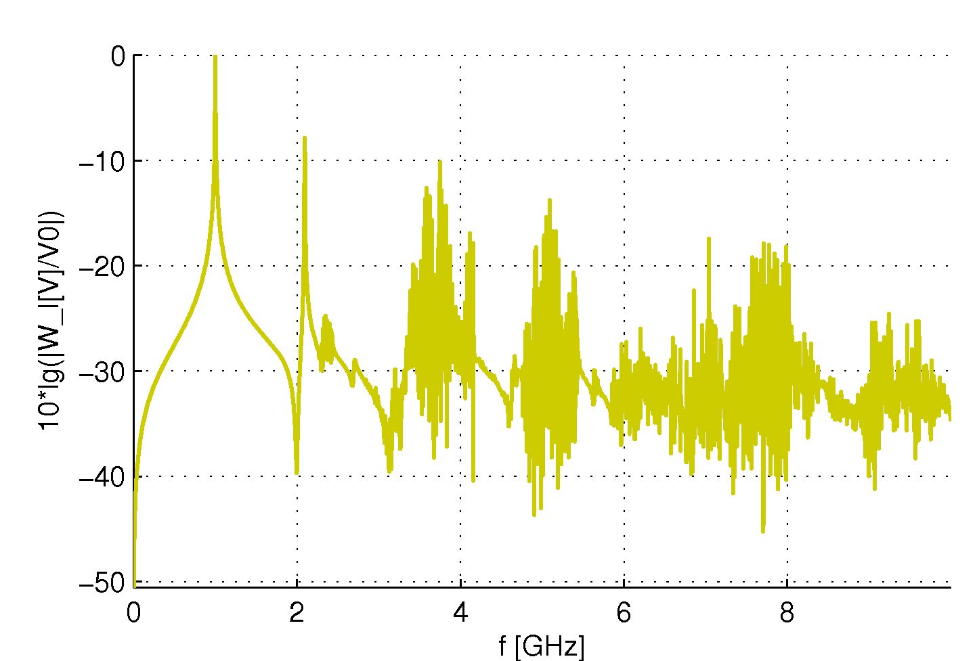
Analysing the errors:
Step 2 – drive beam accelerator
Bunch charge errors cause beam loading error in DB accelerator
Beam loading error causes a phase shift in the chicane
Calculated in frequency domain, then fft to time domain
Higher order resonances included in wake fields calculation
3 points per sinus wave, hence strong beating in RF potential
RF potential
Wake potential
RF potential (V)
Wake potential (V)
18/04/2011
Phase Stability of CLIC Drive Beam
7

Slide 8
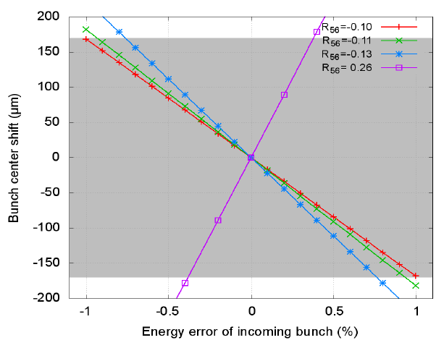
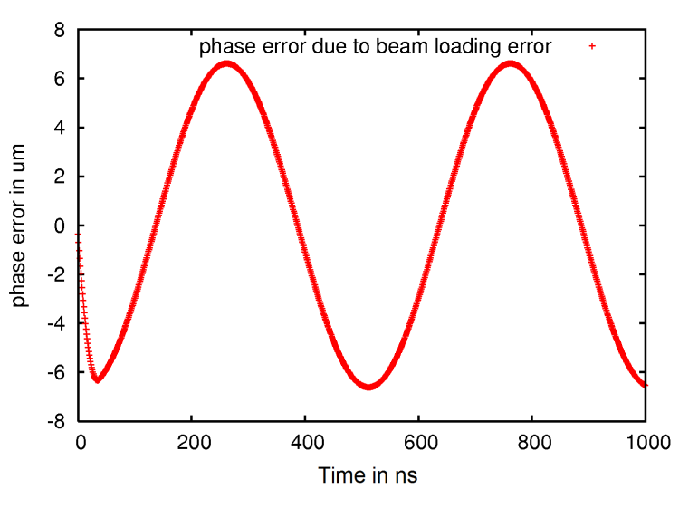
Analysing the errors:
Step 2 – drive beam accelerator
=>
+
Negative R₅₆ means that effects of beam loading error compensate part of charge error
18/04/2011
Phase Stability of CLIC Drive Beam
8

Slide 9
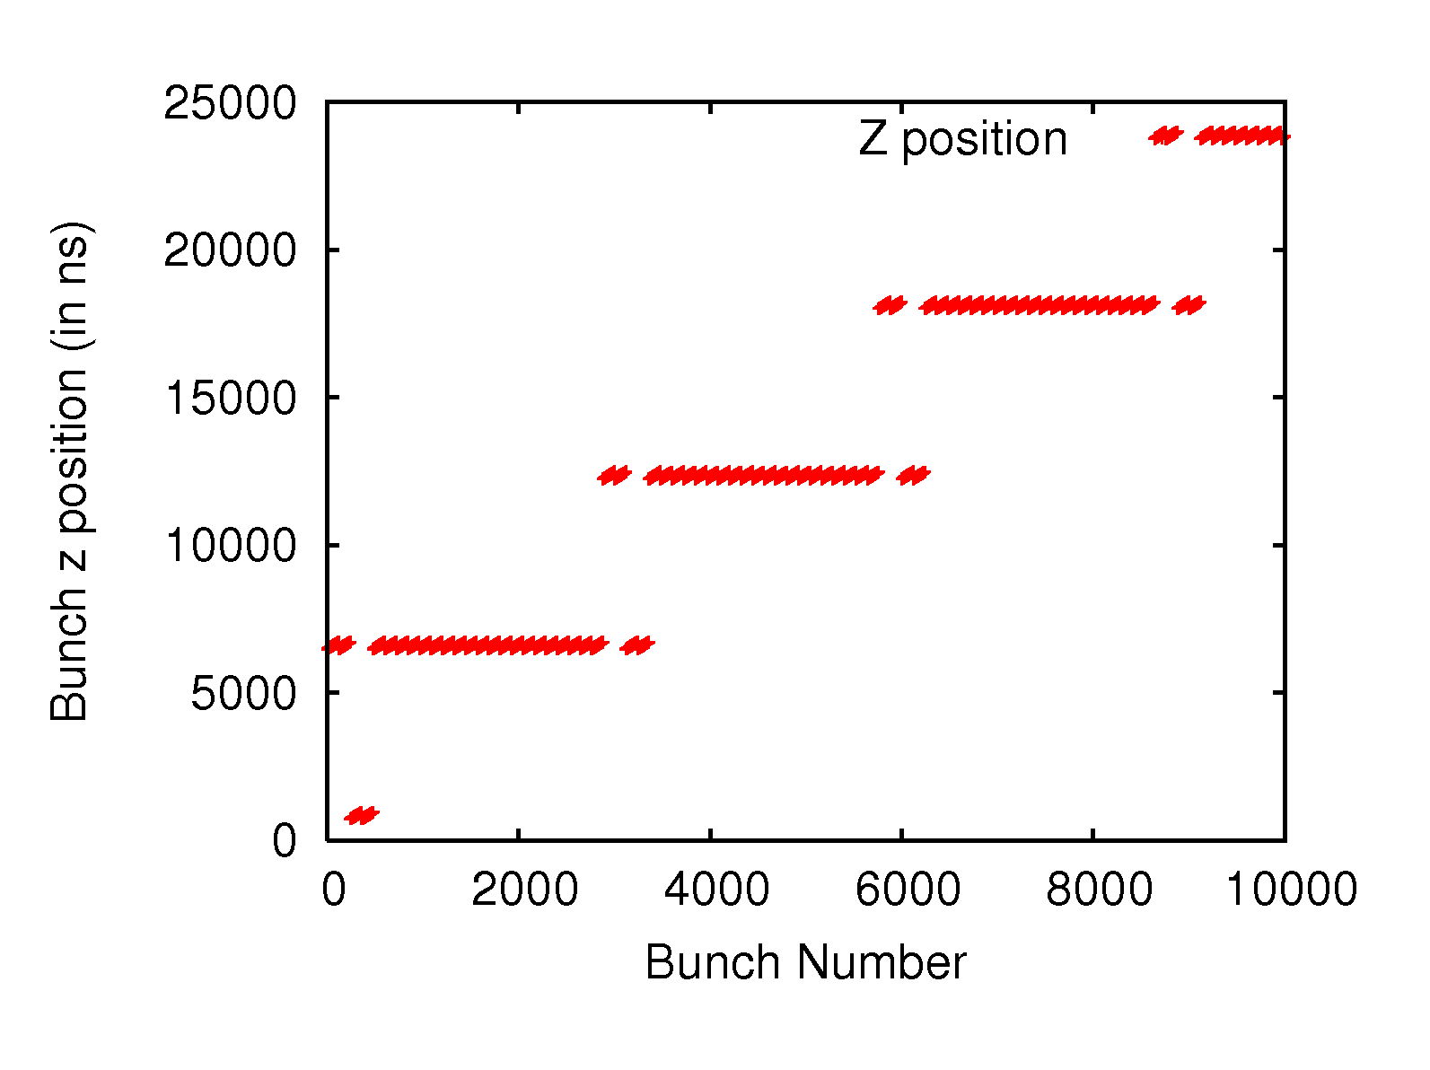
Analysing the errors:
Step 3 – combination scheme
Bunches are recombined in the combination scheme in a non-trivial way
because of the principle of operation of the first combiner ring
18/04/2011
Phase Stability of CLIC Drive Beam
9

Slide 10
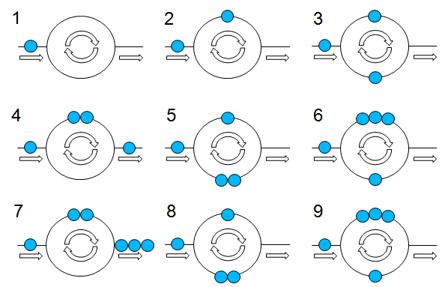
Analysing the errors:
Step 3 – combination scheme
18/04/2011
Phase Stability of CLIC Drive Beam
10

Slide 11
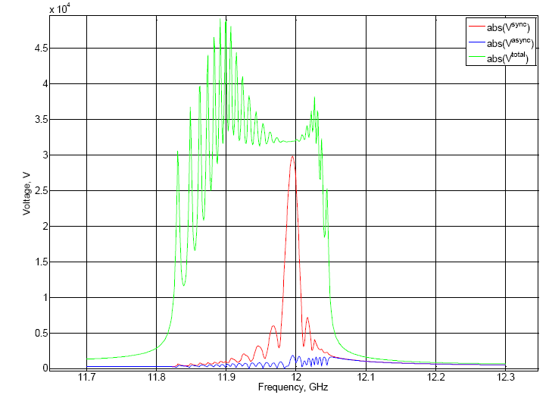
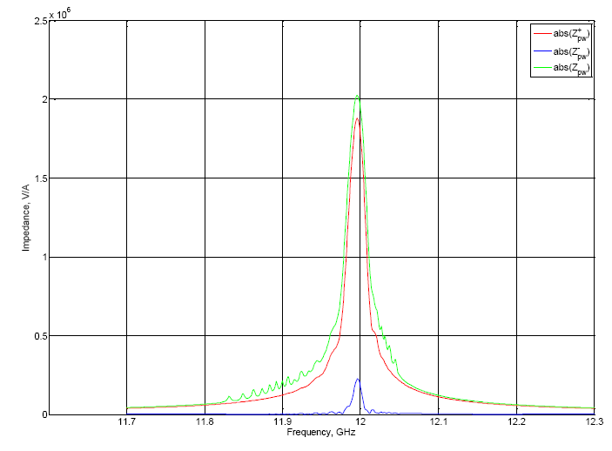
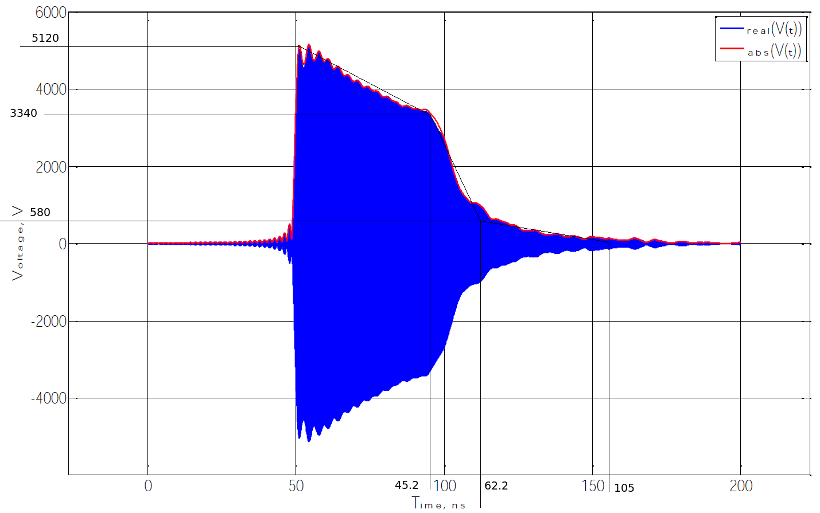
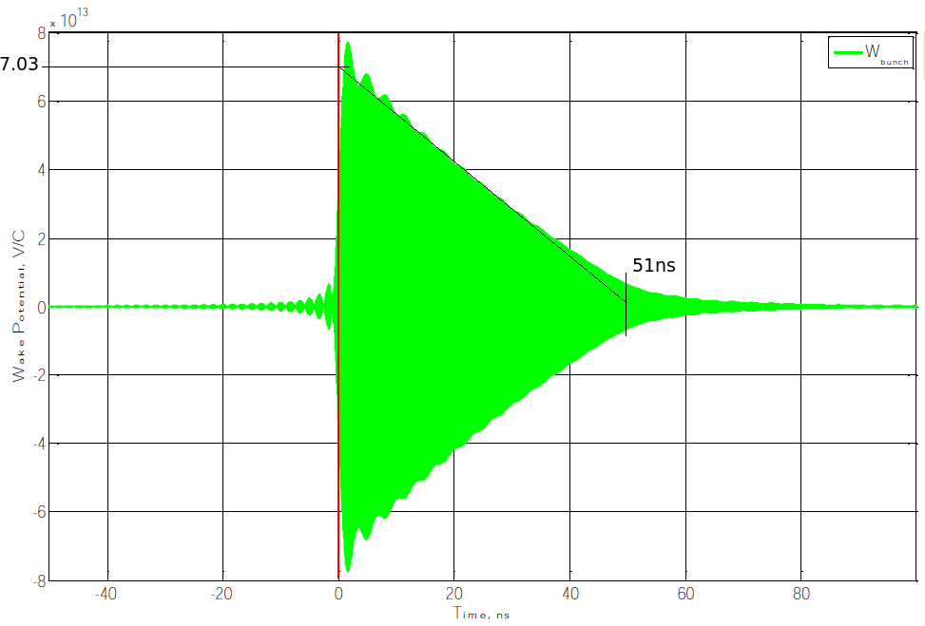
Analysing the errors:
Step 4 – main beam accelerator
Interval 11.7 GHz – 12.3 GHz
Calculate in frequency domain, then fft
18/04/2011
Phase Stability of CLIC Drive Beam
11

Slide 12
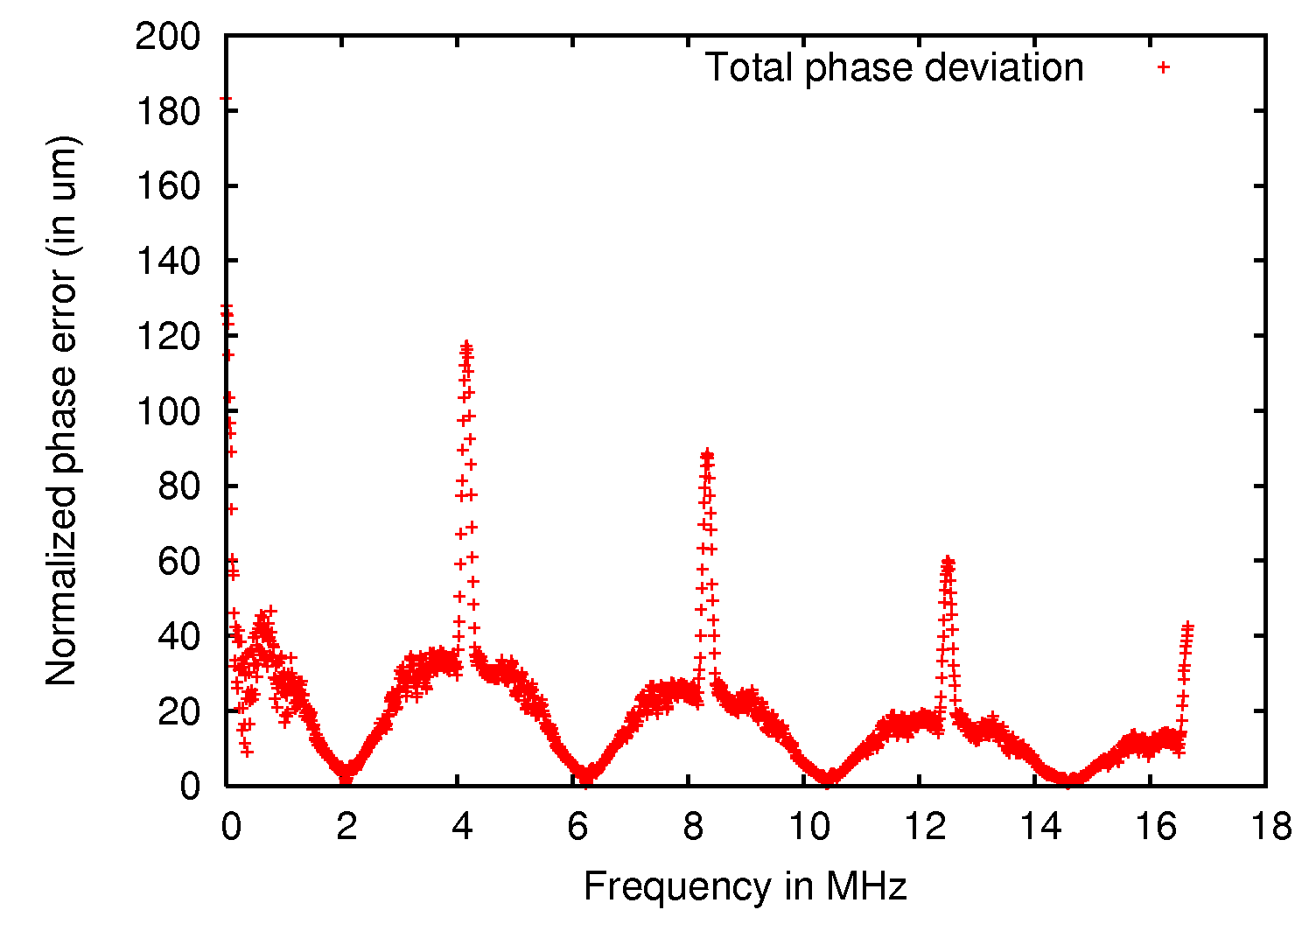
Analysing the errors:
Result
Peaks from 240ns long trains in combination scheme
Suppression of peaks from 240ns drive beam accelerating structures
Suppression of high frequencies by convoluting the signal
with main beam accelerating structure RF filling
18/04/2011
Phase Stability of CLIC Drive Beam
12

Slide 13
Part 2: Correcting the errors
18/04/2011
Phase Stability of CLIC Drive Beam
13

Slide 14
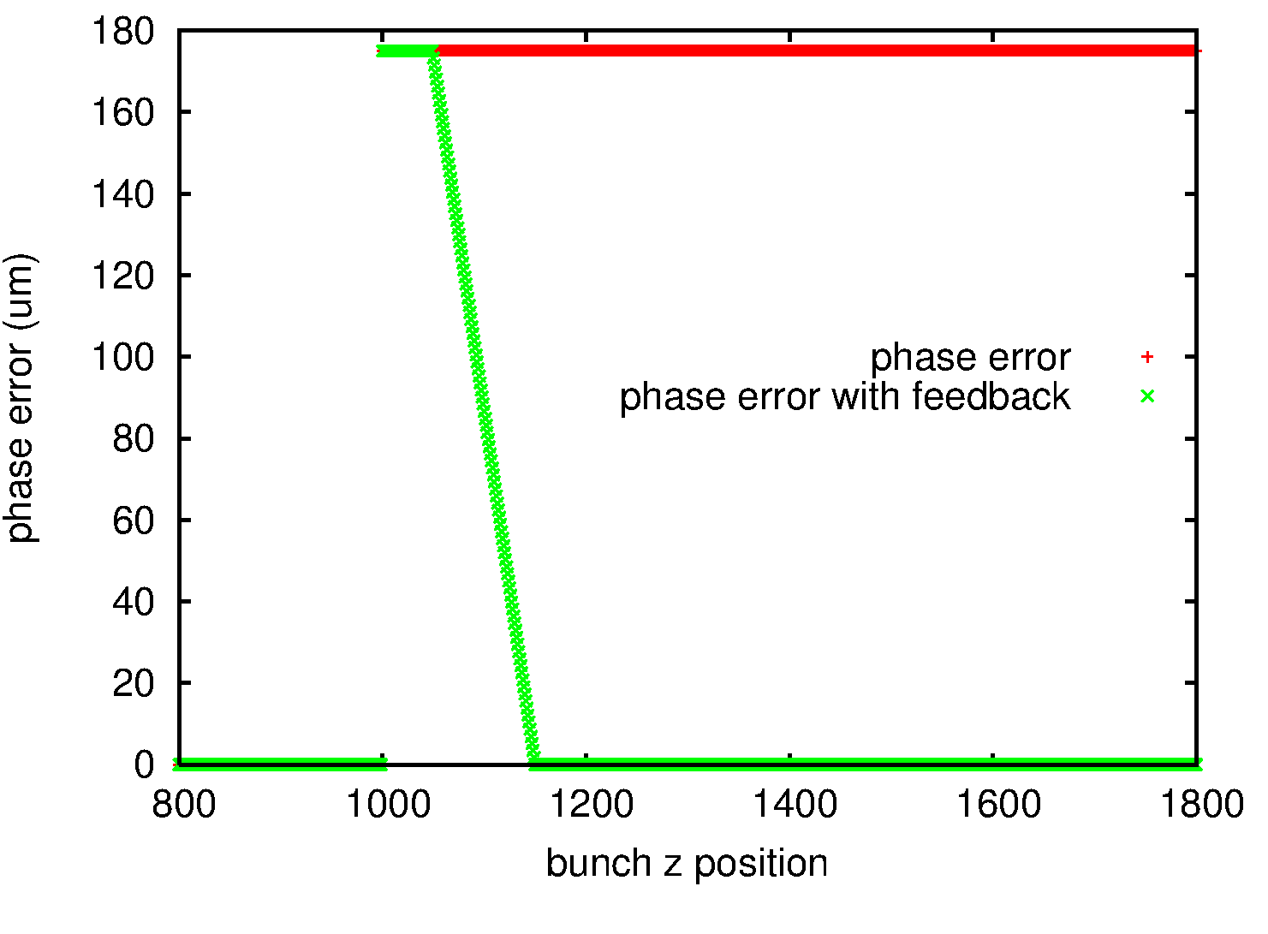
Correcting the errors:
Ideal feedback
Delay of xns
Linear rise in yns
18/04/2011
Phase Stability of CLIC Drive Beam
14

Slide 15
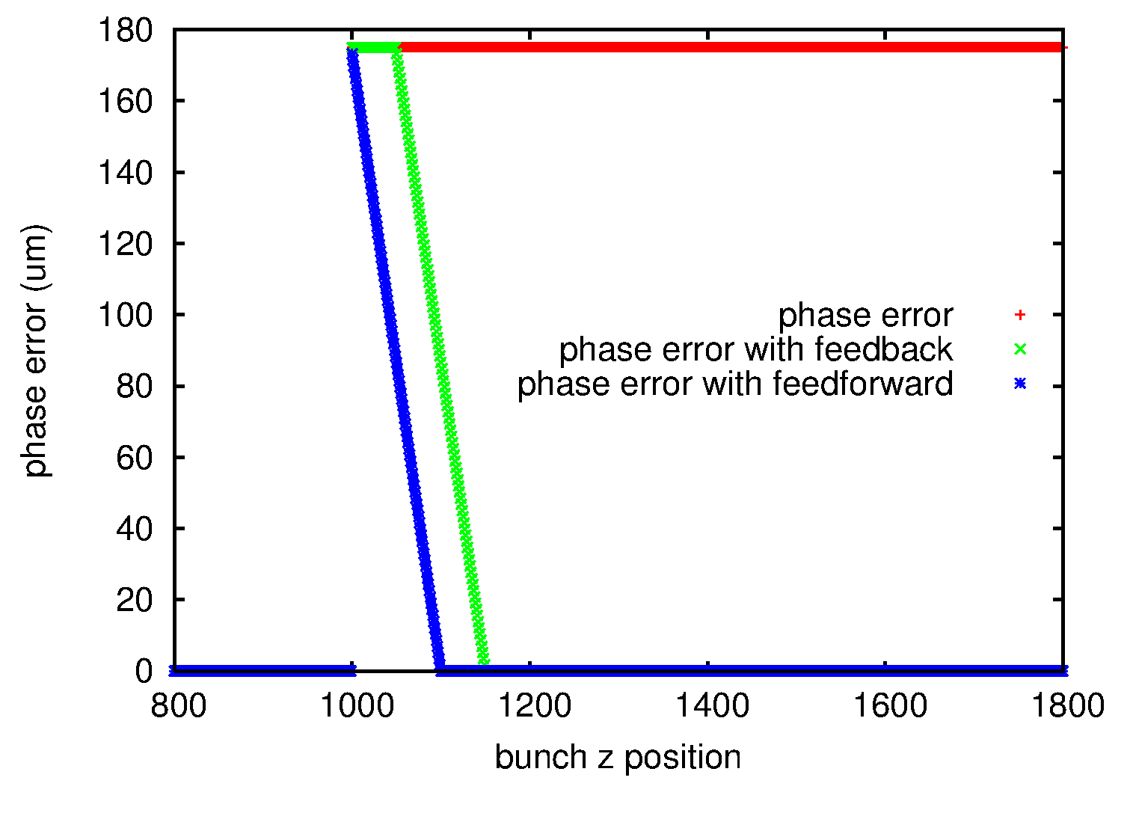
Correcting the errors:
Ideal feedforward
folder options
Feedforward has no delay
Linear rise in xns
18/04/2011
Phase Stability of CLIC Drive Beam
15

Slide 16
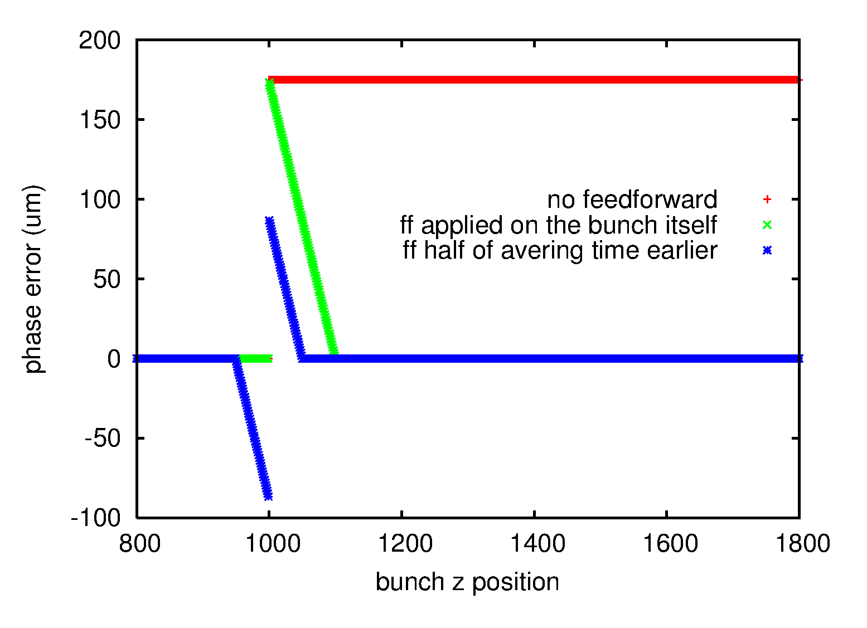
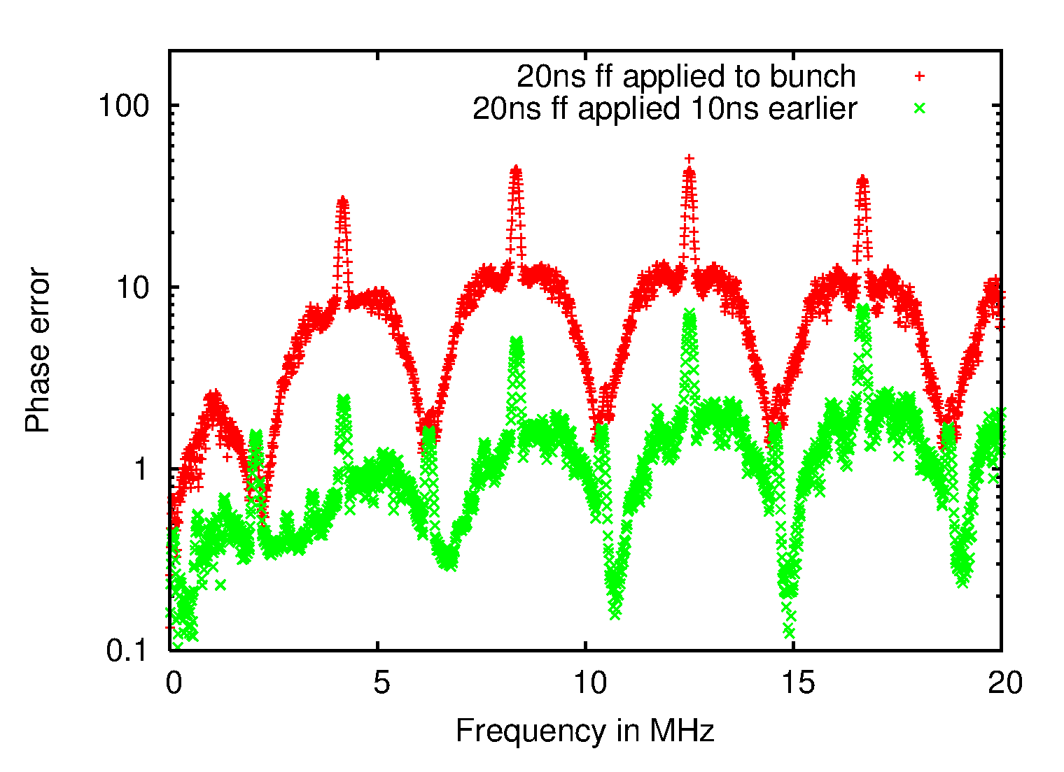
Correcting the errors:
Ideal feedforward
folder options
Feedforward correction can be applied
before the bunch with the measured error
18/04/2011
Phase Stability of CLIC Drive Beam
16

Slide 17
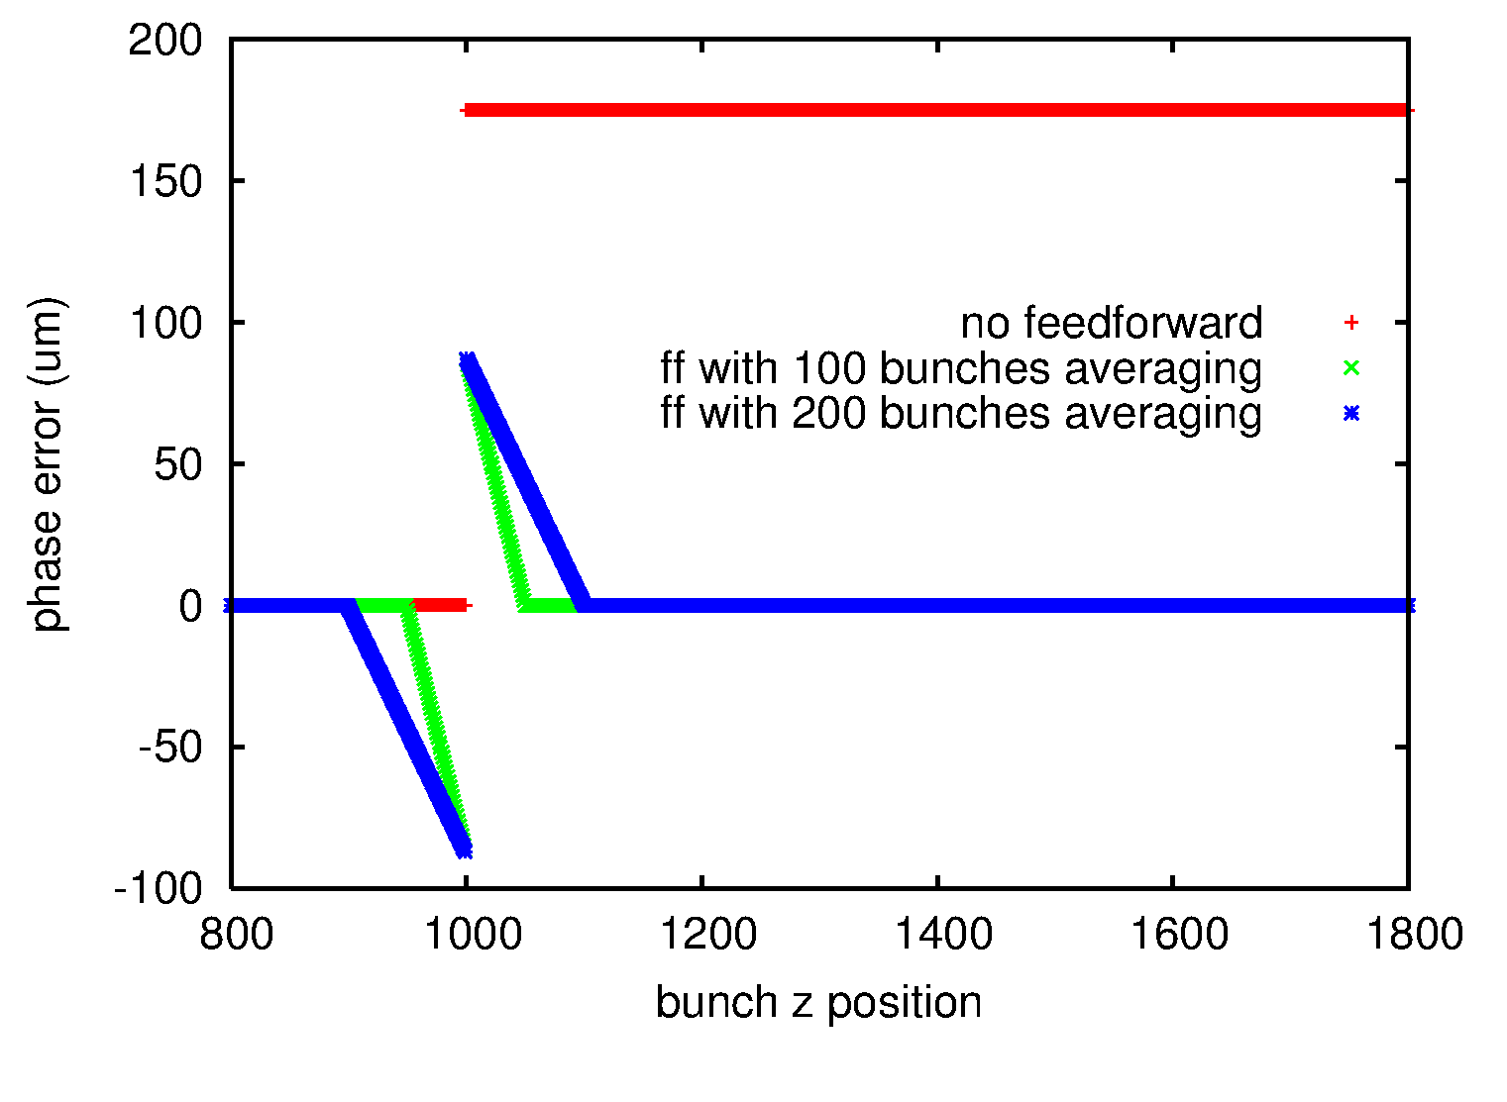
Correcting the errors:
Ideal feedforward
folder options
Efficiency depends on the averaging time
18/04/2011
Phase Stability of CLIC Drive Beam
17

Slide 18
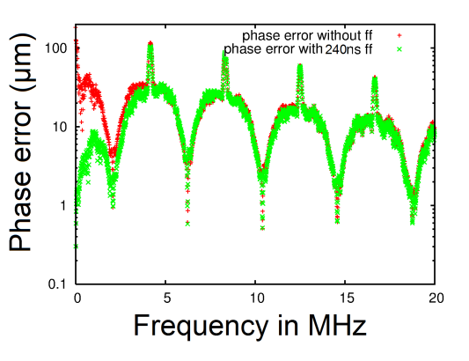
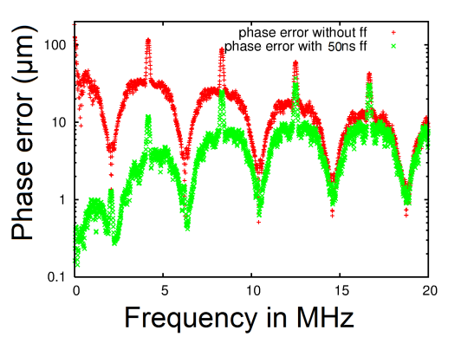
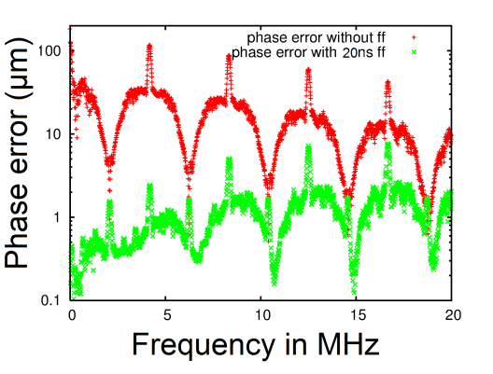
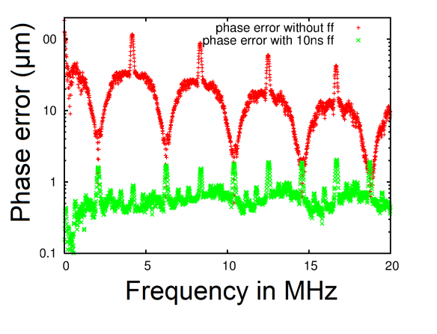
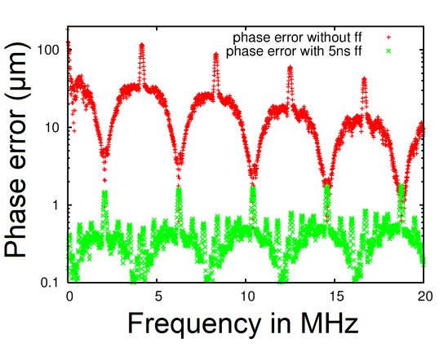
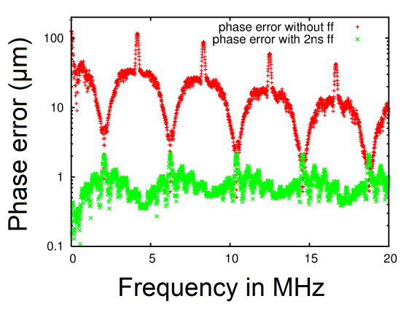
Total phase error
and feedforward averaging time
240ns
50ns
20ns
10ns
5ns
2ns
18/04/2011
Phase Stability of CLIC Drive Beam
18

Slide 19
Total phase error
and feedforward averaging time
Feedforward averaging time | no comb | no ff | ff 240ns | ff 50ns | ff 20ns | ff 10ns | ff 5ns | ff 2ns
Absolute total error (μm) up tp 50 MHz | 129.64 | 10.829 | 9.2737 | 5.4779 | 2.2161 | 0.8535 | 0.4851 | 0.8051
Absolute total error (μm) up to 2 MHz | 129.64 | 29.324 | 4.2861 | 0.5826 | 0.3799 | 0.371 | 0.3266 | 0.6013
18/04/2011
Phase Stability of CLIC Drive Beam
19

Slide 20
Total phase error
for different types of noise
Slide edited 15/04/11. Values for ‘no ff’ (error after combination scheme without feedforward) have been corrected
18/04/2011
Phase Stability of CLIC Drive Beam
20

Slide 21
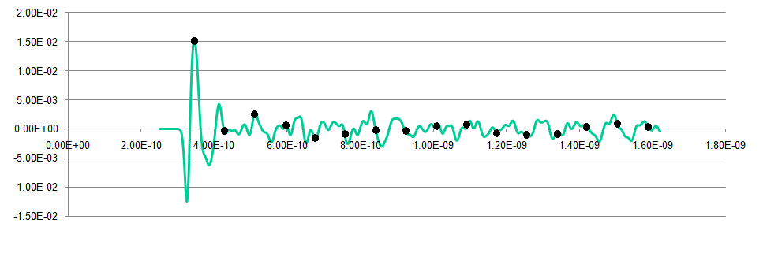
Total phase error
and phase monitor
Phase monitor impulse response
Put first bunch of the correction on maximum
Problem: sum of all corrections is 0.572 (normalized to maximum value)
Possible solution: set the first bunch so that the total sum is 1
18/04/2011
Phase Stability of CLIC Drive Beam
21

Slide 22
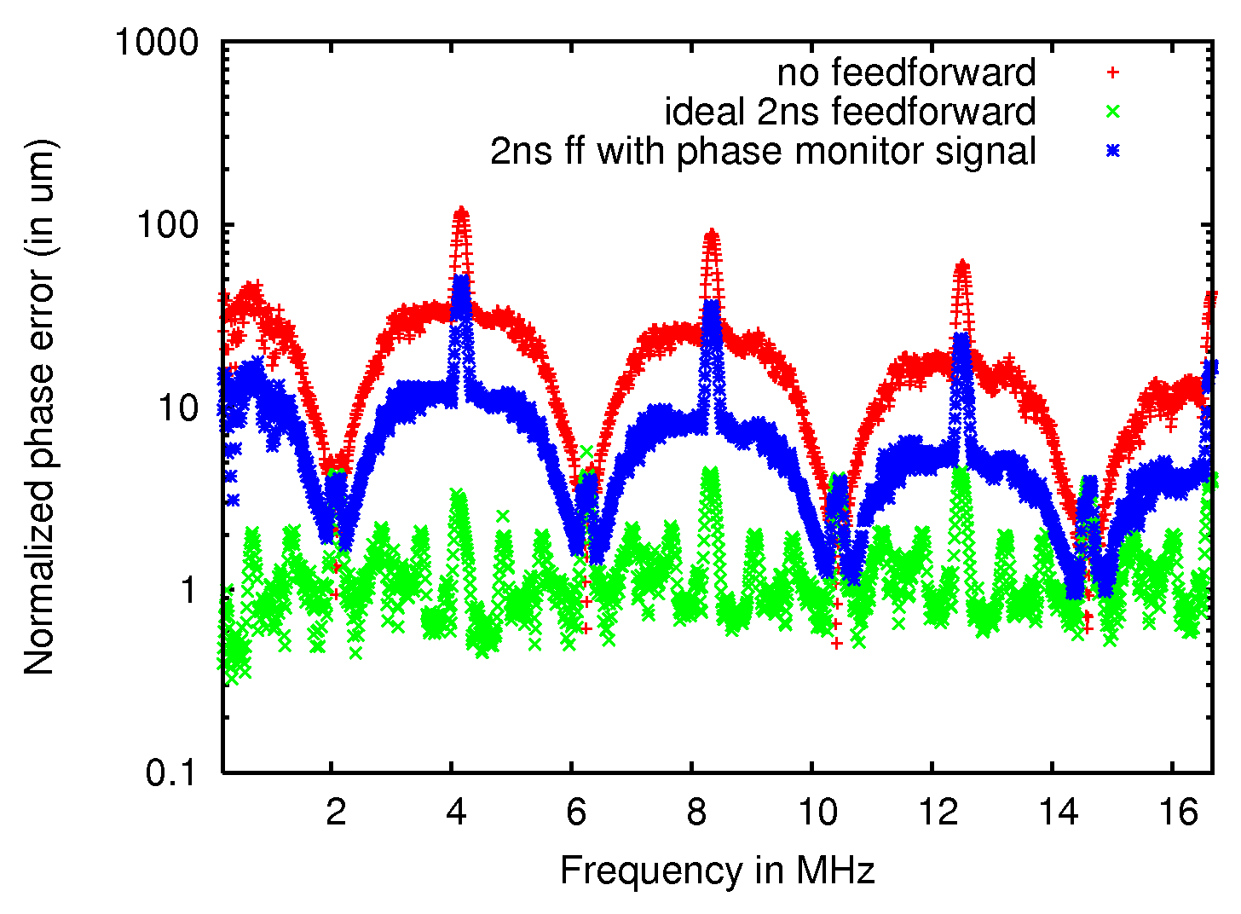
Total phase error
and phase monitor
Rebecca Black
18/04/2011
Phase Stability of CLIC Drive Beam
22

Slide 23
Summary
Part 1: Putting together the effects of
1. Compressor chicane
2. Drive beam accelerator
3. Combination scheme
4. PETS -> main linac
leads to the error function with peaks at frequencies corresponding to 240ns, declining at higher frequencies
Part 2: Feedforward needs to have a high bandwidth
(dependent on type of noise, generally ~10ns
for factor 10 correction)
Improvement of phase monitor is required
18/04/2011
Phase Stability of CLIC Drive Beam
23

