Slide 1
Procurement Overview
for Slovenia
(Associate Member State in
the pre-stage to membership)

Slide 2
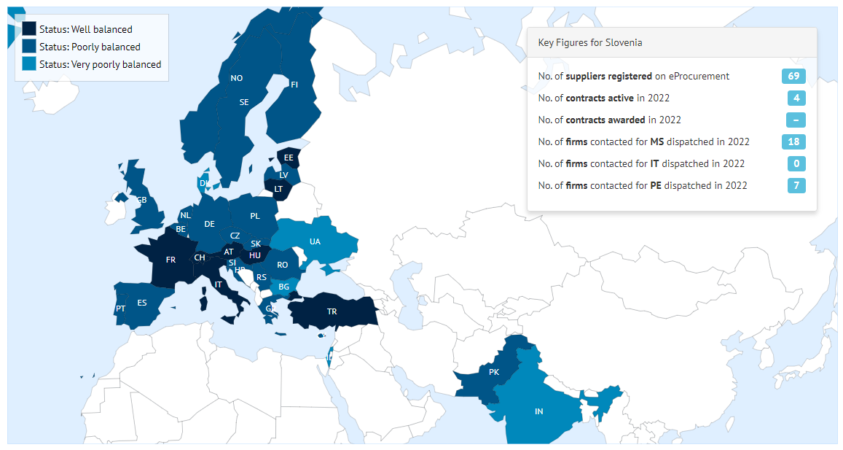
Status of Member States (For Supply contracts from 01.03.2023 until end of February 2024)

Slide 3
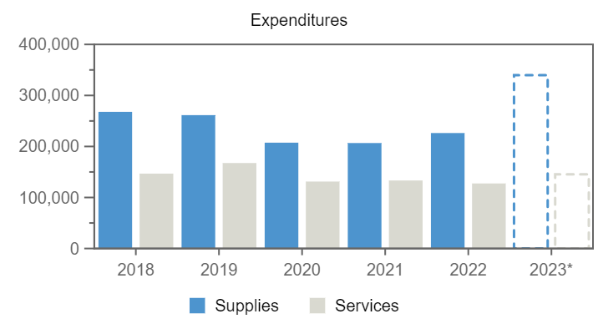
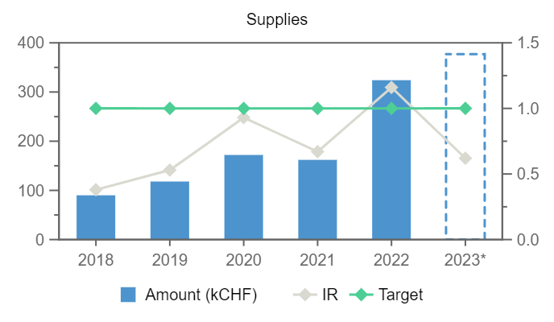

Expenditures (Slovenia, kCHF)
Year
Supplies
Services
2018
90
–
2019
118
–
2020
172
–
2021
162
–
2022
324
–
2023*
377
–
Annual contributions and industrial returns for Slovenia
Contributions (kCHF)
Expenditures (All countries totals, kCHF)
Expenditures (Slovenia, kCHF)
Year
Country Contribution
All Countries
%
Year
Supplies
Services
Year
Remaining
Procurement**
Personnel
2018
1 000
1 148 237
0.09
2018
267 860
146 760
2018
813
90
97
2019
1 000
1 171 420
0.09
2019
261 375
167 528
2019
748
122
130
2020
1 065
1 196 893
0.09
2020
207 407
131 216
2020
640
187
239
2021
1 410
1 199 321
0.12
2021
206 717
133 358
2021
945
168
297
2022
1 485
1 205 987
0.12
2022
226 311
127 469
2022
663
330
491
2023
2 207
1 230 382
0.18
2023*
339 655
145 402
2023*
1 312
394
502
Industrial Return
Annual Industrial Return
Supplies
Services
Year
Ratio
Target
Ratio
Target
2018
0.38
1
–
0.4
2019
0.53
1
–
0.4
2020
0.93
1
–
0.4
2021
0.67
1
–
0.4
2022
1.16
1
–
0.4
2023*
0.62
1
–
0.4
*Provisional figure based on commitments

Slide 4
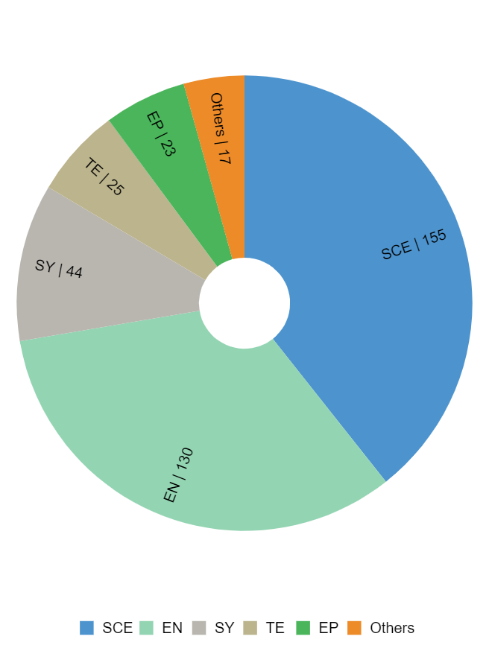
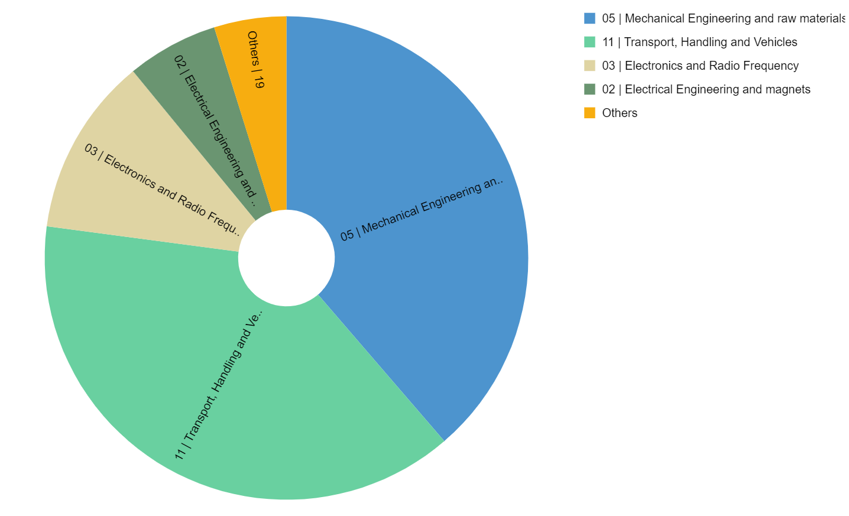
Expenditure by department and procurement codes for Slovenia
Expenditure by Department (kCHF)
Expenditure by (Activity|Procurement) Code (kCHF)

Slide 5
Top Suppliers in Slovenia
By Country of Supplier
By Country of Origin
Supplier Name
Town
No. Orders
CERN Budget (CHF)
Teams Budget (CHF)
Supplier Name
Supplier Country
No. Orders
% SI
CERN (CHF)
Teams (CHF)
ELGOLINE LTD
Cerknica
9
–
682 290
ELGOLINE LTD
SI
9
100
–
682 290
ZUSTAL
Ziri
35
121 029
–
RRG SUISSE SA
CH
1
85
151 149
–
PROPLACE
Slovenia
4
–
115 226
ZUSTAL
SI
35
100
121 029
–
INTEC TIV
Kranj
31
42 765
6 790
PROPLACE
SI
4
100
–
115 226
JOZEF STEFAN INSTITUTE
Ljubljana
11
21 658
4 173
INTEC TIV
SI
31
100
42 765
6 790
KAMBIC, LABORATORIJSKA OPREMA DOO
Semic
1
23 952
–
JOZEF STEFAN INSTITUTE
SI
11
100
21 658
4 173
KAMBIC, LABORATORIJSKA OPREMA DOO
SI
1
100
23 952
–
VINE
Spodnja Idrija
3
6 068
–
JACQUET OSIRO
CH
8
36
13 312
–
FOLK PLAST
Laporje
1
2 582
–
VINE
SI
3
100
6 068
–
RLS MERILNA TEHNIKA D O O
Komenda
3
1 630
–
FOLK PLAST
SI
1
100
2 582
–
CRAFTRUM
Slovenska Bistrica
1
43
–

Slide 6
List of contract/orders with the highest turnover in 2023 for Slovenia
Contract/Order
Description
Supplier
Amount (CHF)
CA9441329
LIGHT ELECTRICAL CARS
RRG SUISSE SA
151 149
CA1002035
OIL BATH FOR STANDARD RESISTORS
KAMBIC, LABORATORIJSKA OPREMA DOO
23 952
CA1065905
J3083226 THERMAL SHIELD DQWCM1 ALU PARTS
ZUSTAL
18 111
CA1068084
INTECTIV (41334/RAMIREZ) EDA-04541-V2-0
INTEC TIV
15 035
CA1004431
CE:SI: IRRAD. OF HGCAL TEST STRUCTURES
JOZEF STEFAN INSTITUTE
14 363
CA1067096
J3086605 LHC RF ADAPTER 25-40
ZUSTAL
13 320
CA1003159
J3083886 METALLIC PARTS RF CRAB VIREUR
ZUSTAL
11 522
CA1000289
J3081635 TROLLEY FRAME FOR 120A LEADS
ZUSTAL
10 069
CA1003542
J3084655 CMS GE2.1 GEM
ZUSTAL
4 849
CA1002542
J3083711 CINTRAGE Q1 HL-LHC / WP12 CTC
ZUSTAL
4 770

Slide 7
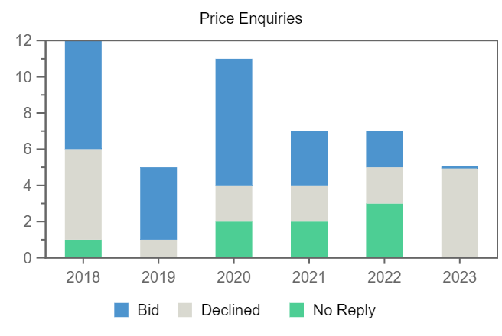
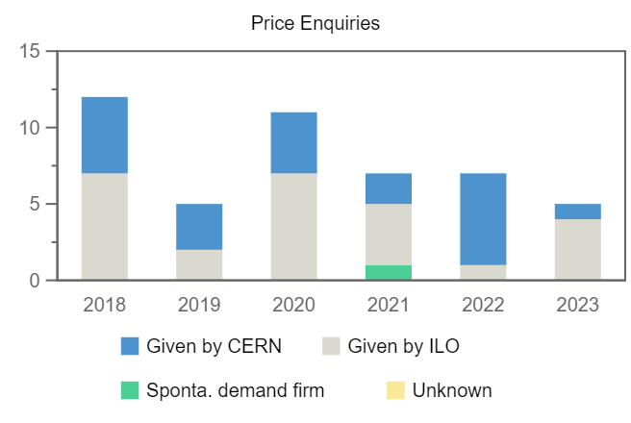
Price Enquiries above 50k CHF for Slovenia
Number of firms contacted
Origin of firms contacted
Year
Firms Contacted
RANK (1)
RANK (2)
RANK (3)
2018
12
–
2
1
2019
5
–
1
1
2020
11
1
–
–
2021
7
–
–
–
2022
7
–
–
2
2023
5
–
–
–

Slide 8
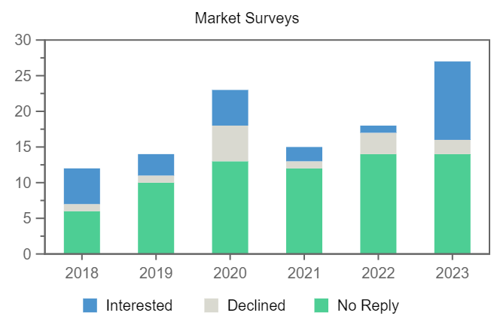
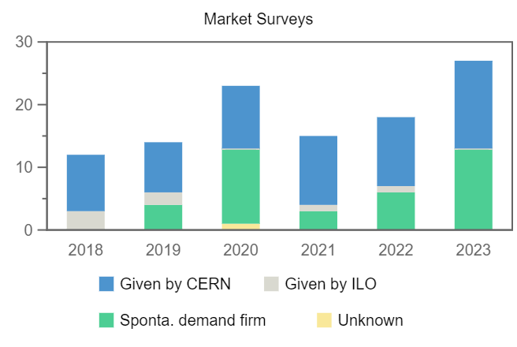
Market Surveys for Slovenia
Number of firms contacted
Origin of firms contacted
Year
Firms Contacted
Interested
Declined
No Reply
Selected
2018
12
5
1
6
1
2019
14
3
1
10
1
2020
23
5
5
13
2
2021
15
2
1
12
–
2022
18
1
3
14
1
2023
27
11
2
14
–

Slide 9
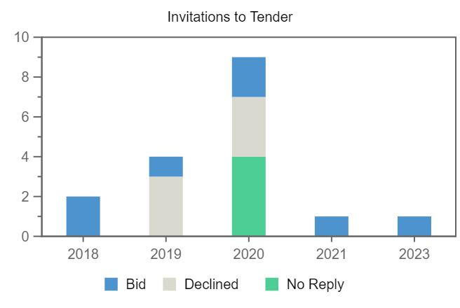
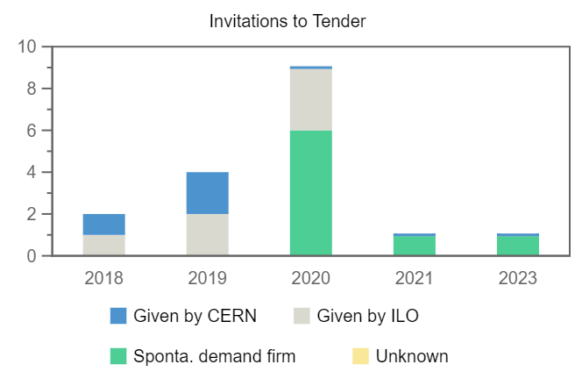
Invitations to Tender for Slovenia
Number of firms contacted
Origin of firms contacted
Year
Firms Contacted
RANK (1)
RANK (2)
RANK (3)
2018
2
–
–
–
2019
4
–
–
–
2020
9
–
–
–
2021
1
–
–
–
2023
1
–
–
–

