Slide 1
Slovenian Teacher Programmes

Slide 2
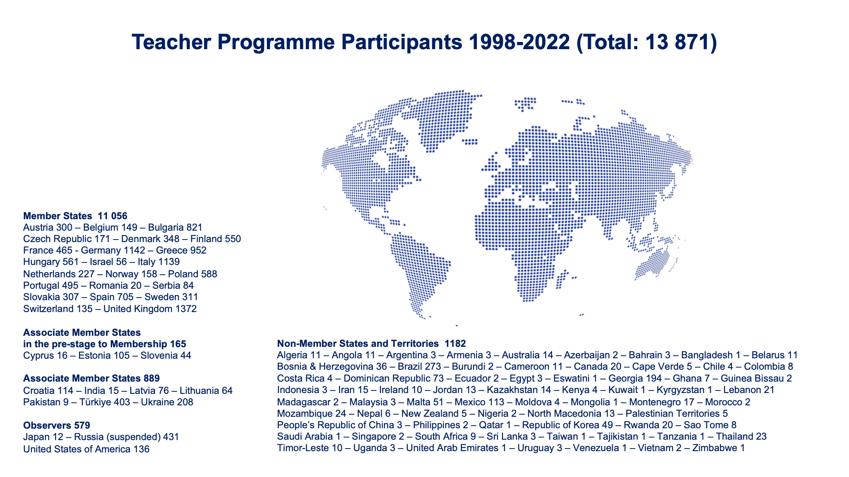

Slide 3
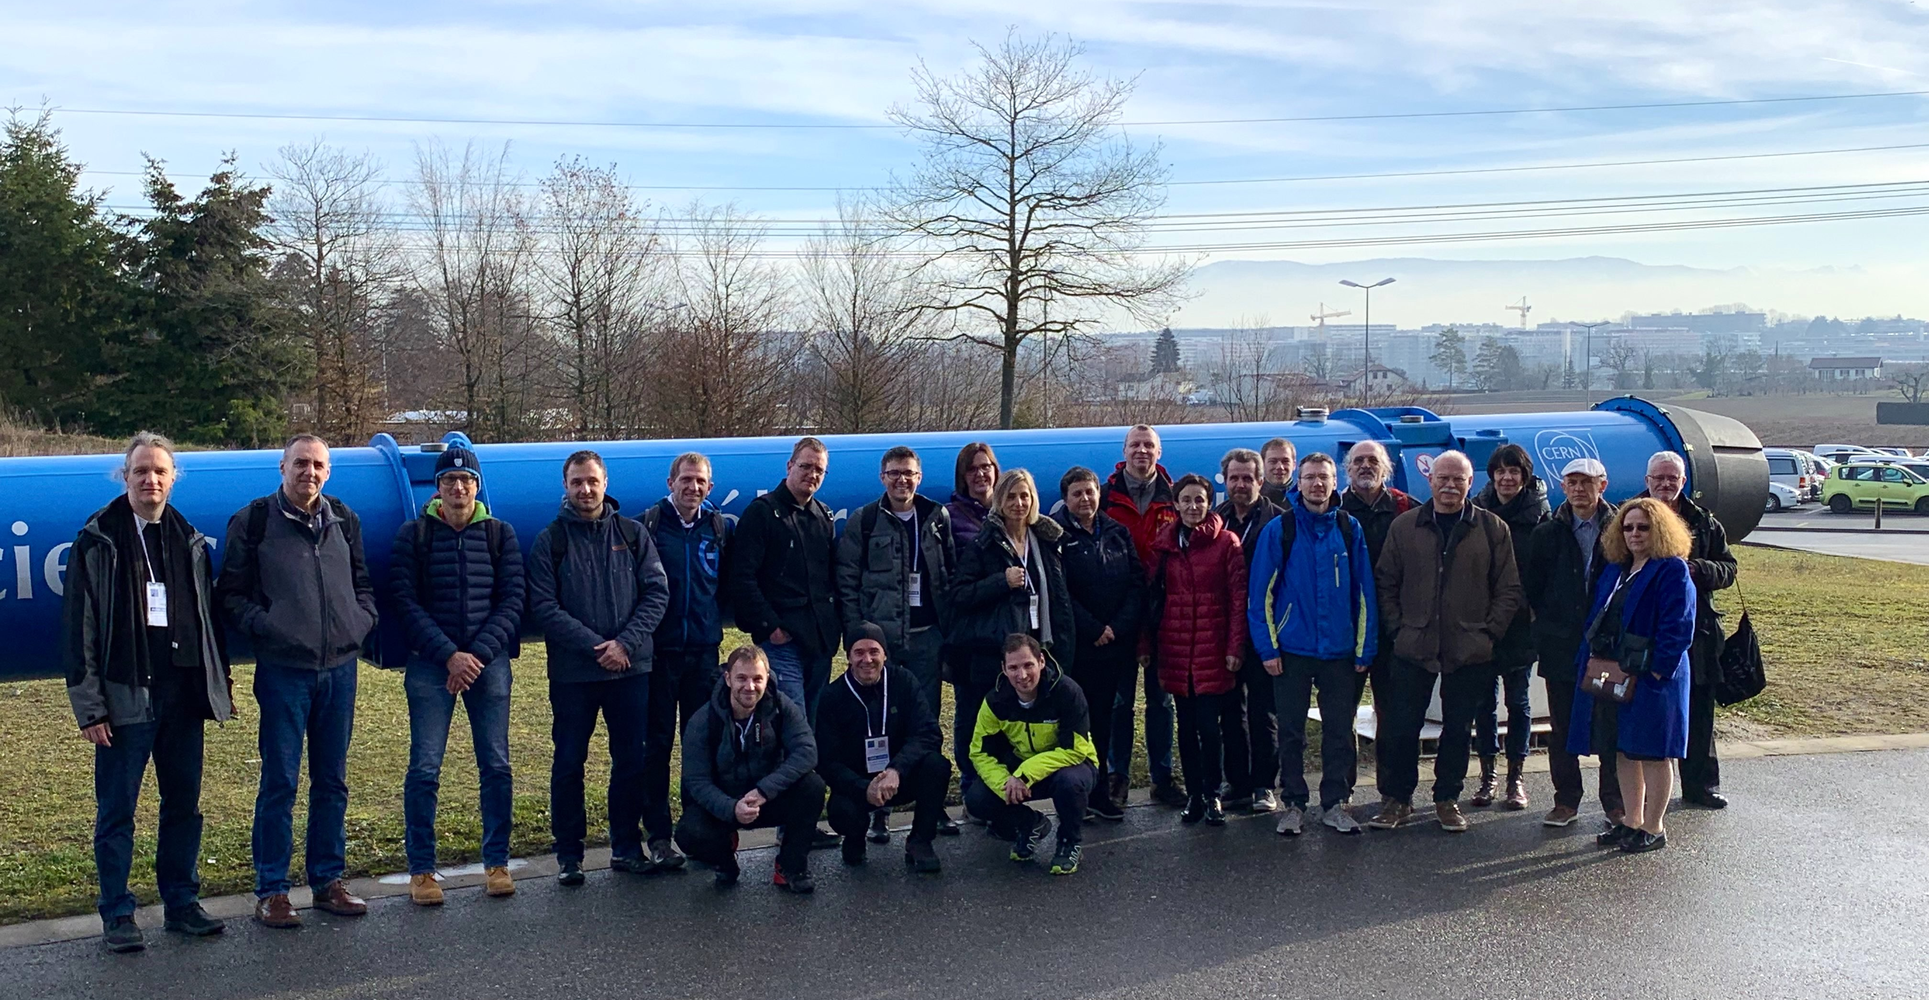
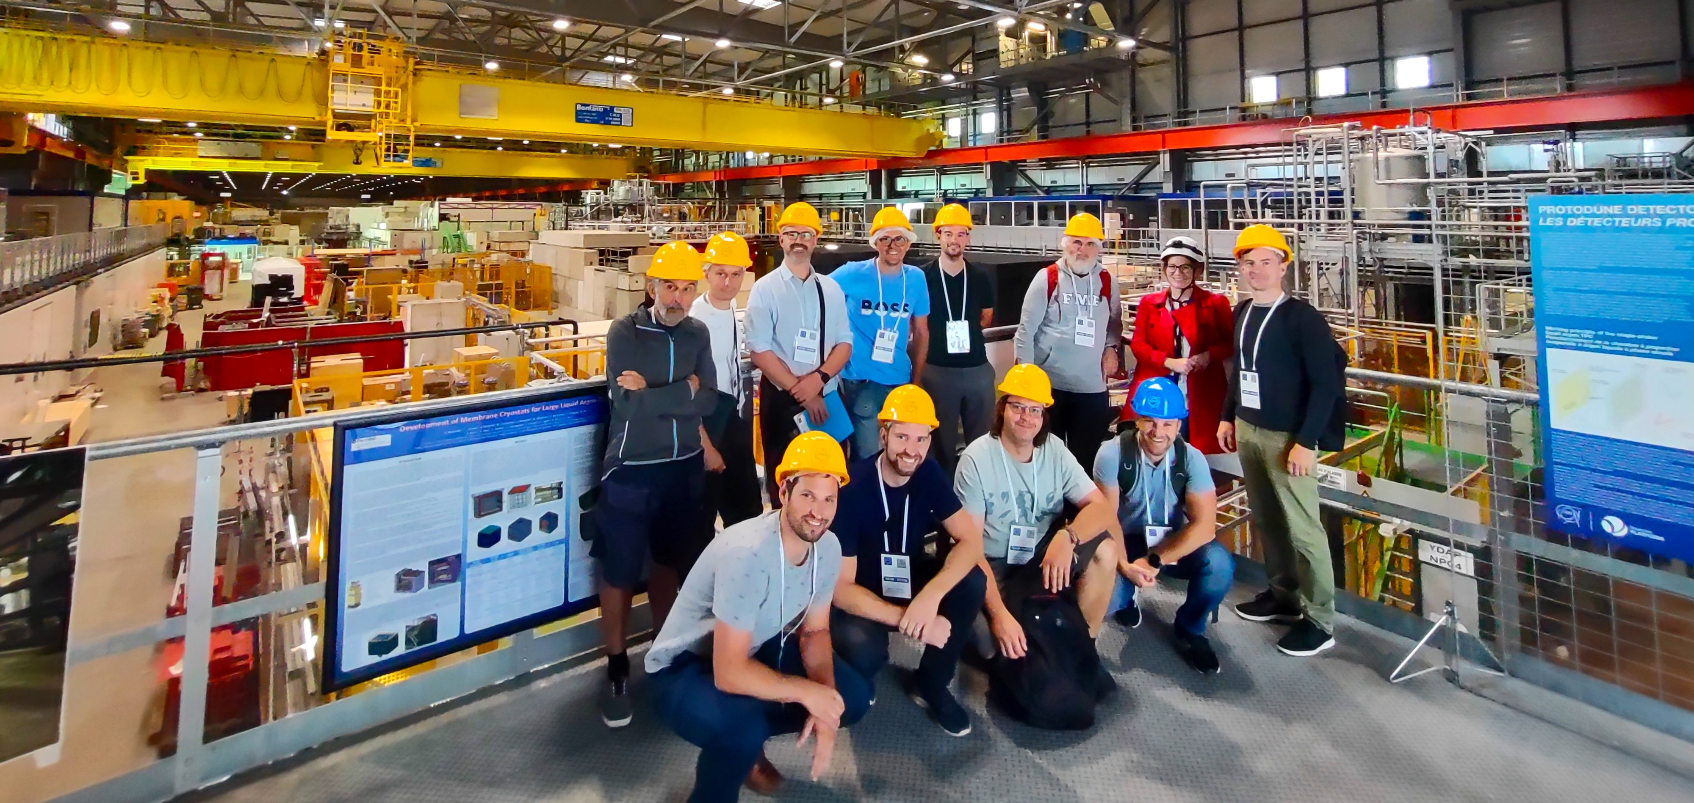
Slovenian Teacher Programmes
56 Slovenian teachers in total
54 in National Teacher Programmes
2 in International Teacher Programmes
Slovenian Teacher Programme 2019
Slovenian Teacher Programme 2023

