Slide 1

The Preparation Process of Slovenia for Full Membership of CERN
CERN – Slovenia Joint Commission Meeting
MVZI, Ljubljana, December 4th, 2023
Dr. Tomaž Boh
Acting Director General
Science and Innovation Directorate
Ministry of Higher Education, Science and Innovation,
Republic of Slovenia

Slide 2
The status of Associate Member in the pre-stage to Membership at CERN of Slovenia has entered into force on 4th July 2017. Slovenia requested in 2022 an exceptional extension of the status of Associate Member in the pre-stage to Membership from the CERN Council for a period by up to two years from July 2022, prior to acceding to full Membership of CERN.
The extension of the existing status was necessary due to some financial and organisational challenges in Slovenia, as well as some necessary structural reforms of our National R&I system. Moreover, the COVID-19 circumstances have also contributed to our request.
Slovenia confirms again its interest to enter into full Membership at CERN following the exceptional extension period of time granted by the CERN Council till July 2024.

Slide 3
We are increasing and we will even more significantly increase financial investments in science and research, according to the new Law. This will contribute to the faster development of science and transfer of knowledge to society and economy. We encourage the involvement of Slovenian researchers in the international environment to achieve synergies between development funds, and co-funded postdoctoral projects for our most recently educated scientists abroad.
We are preparing the grounds for establishing a “Big Science Office” on the Governmental level that should also improve our participation in the CERN Procurement processes. Ministry of Higher Education, Science and Innovation has recently improved the agreement with the Slovenian Chamber of Industry and Commerce concerning the cooperation within CERN and functions of ILO. We are also considering a possibility to additionally employ a person at our Permanent Mission to UN in Geneva only responsible for CERN.
In the following slides we present the crucial systemic changes in our R&I system in last two years that have significantly improved it in many ways…

Slide 4
Governance of R&I
Policy
Government
Ministry of Higher Education, Science and Innovation
Financing
Slovenian Research Agency (ARRS)
Slovenia Business Development Agency (SPIRIT)
Performance
RPOs
Ministry of Economy, Tourism and Sport
Other ministries
Competence centres, centres of excellence, Strategic Research and Innovation Partnerships (SRIPS)
Technology parks, centres & networks
Agency for Research and Innovation of Slovenia (ARIS)
Advisory bodies
Development Council of the Republic of Slovenia
National Assembly. Committee on Education, Science, Sport and Youth

Slide 5

R&I capacities
Higher Education
Industry
Research
RPOs:
4 public & 3 private universities
20 national research institutes
› 600 R&I industry units

Slide 6
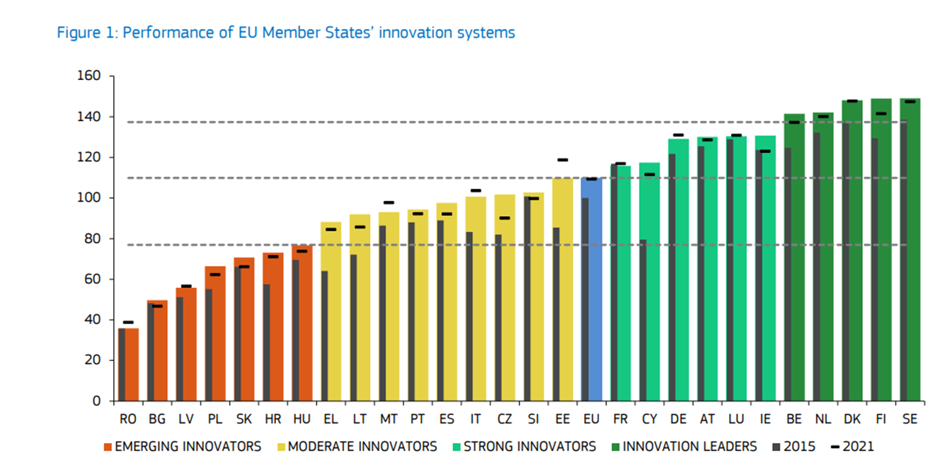
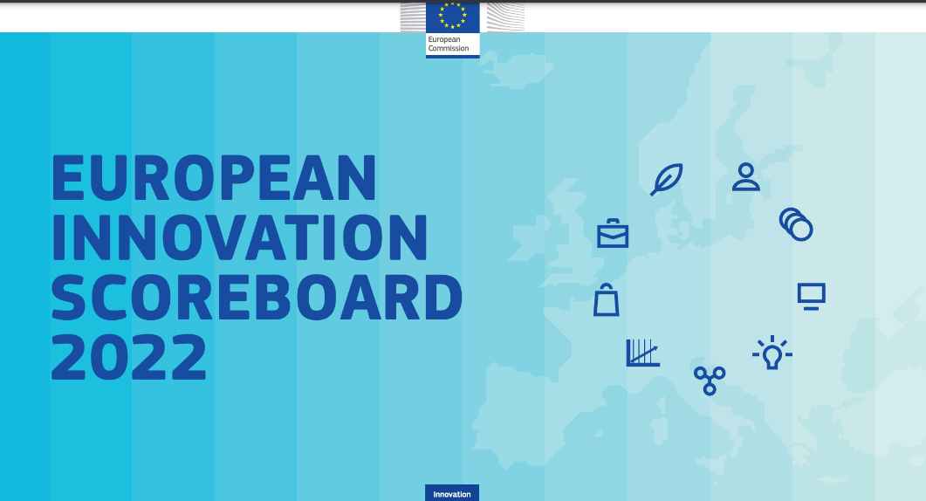
Slovenia in EIS 2022
Goal to become INNOVATION LEADER till 2030

Slide 7

Policy priorities
Strategy for Scientific Research and Innovation – ZRISS 2030 (04/2022)
New Scientific Research and Innovation Activities Act– ZZRID (01/2022)
Smart Specialization Strategy – S5 (03/2022)
Other sectoral programmes (for example National Programme on Encouraging the Development and Use of AI by 2025)(2022)

Slide 8
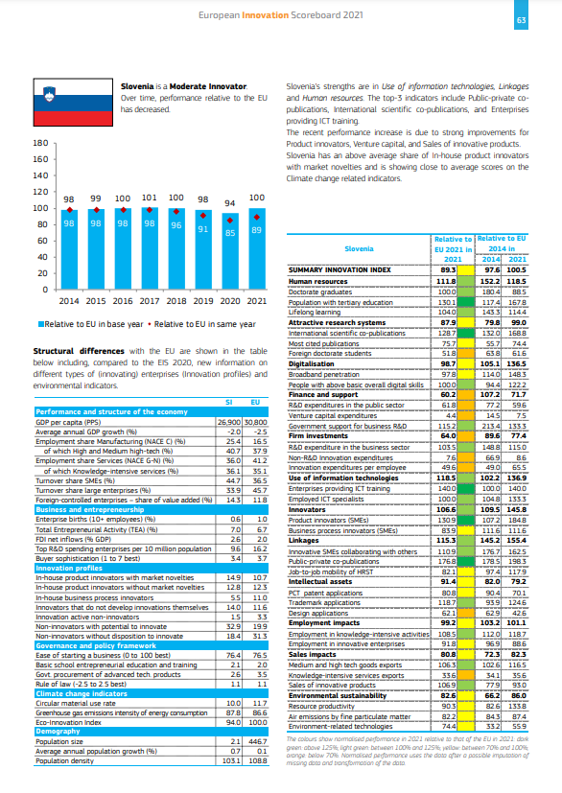
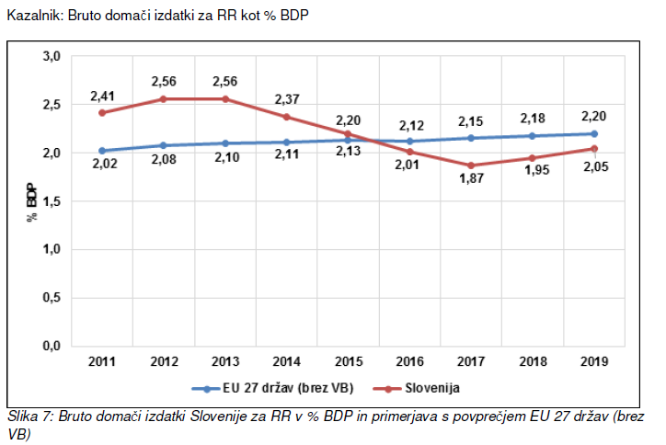


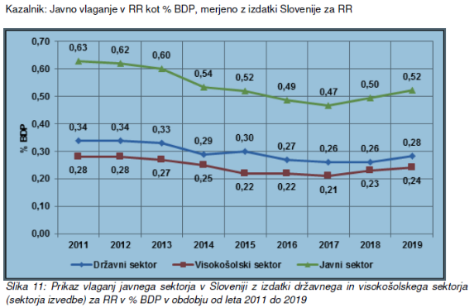
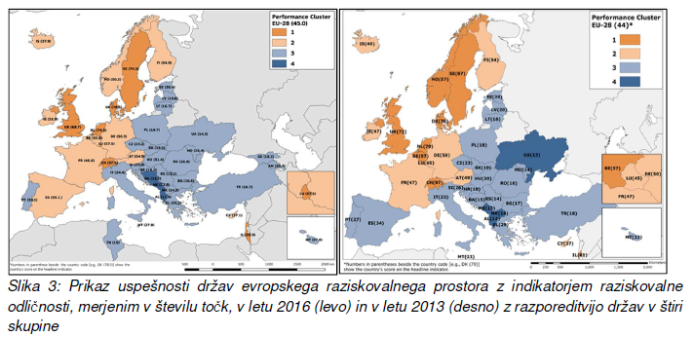
Scientific Research & Innovation Activities Act
What‘s new?
  Increased autonomy for RPOs
  Increased financing
  Stable funding – block funding of institutions
  Attractive renumeration possibilities
  Key performance indicators
  Negotiable targets
  Better governance
  General research and innovation ecosystem

Slide 9
Scientific Research & Innovation Strategy 2030 (ReZrIS30)
Public investment in R&I to reach 1.25% of GDP by 2030, with public investment at least 1% of GDP by 2027, and total investment R&I to reach 3.5% of GDP by 2030
By 2030, Slovenia wishes to be among innovator leaders on the European Innovation Scoreboard
Research and innovation will to be targeted at broad areas, within which those addressing key issues to address the challenges of sustainable development, in line with the objectives of the 2030 Agenda, the Green Transition and the Slovenian Smart Specialization Strategy

Slide 10
Reforms in line with ReZrIS2030
Governmental reorganization
New funding/implementing agency ARIS
Funding and ecosystem for innovation

Slide 11
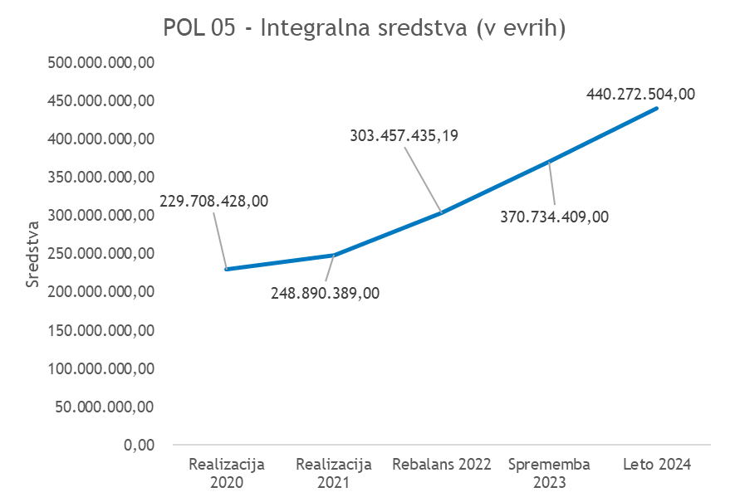
Financing R&I
Financing Science 2020 - 2024
New Act:
Stable funding is introduced, with the budget for scientific research proposed to be gradually increased to reach at least 1% of GDP till 2027
370,7 mio EUR (2023) & 440,2 mio EUR (2024) = substantial increase compared to previous years

Slide 12

Cohesion policy funding for R&I 2021 - 2027
  Enhancing collaborative research in line with Smart Specialization Strategy;
  Researchers‘ Intersectoral mobility;
  Widening instruments and complementarity → Teaming, MSCA cofund etc;
  Funding of Research infrastructure in line with national priorities;
  Improving and enhancing knowledge transfer (knowledge transfer activities and „death valley“ projects)
  Demonstration and Training Centre for Carbon-Free Technologies in Zasavje region (JTF)
  Laboratory for Biomass Bio-refining Research in Savinjsko–Šaleška Region (JTF)

Slide 13

Other resources
Resilience & Recovery Fund
  to improve governance and efficiency of public investments in R&I (new Act, programme committee, improving the support environment for internationalization of RPO, capacity building of research and innovation agencies + TSI project)
  Investments to support collaboration between academia and private sector, focusing on green and digital transition
  Investments to enhance international mobility and reintegration of Slovenian researchers and support to internationalization (complementarity scheme to MSCA)

Slide 14

Research infrastructures
ESFRI infrastructures:
17 ERIC infrastructures from all research domains;
FAIR infrastructure;
Belle II infrastructure;
CERN;
SEEIIST proposal
National capacities:
TRIGA nuclear reactor;
NMR spectrometry centre (800MHz → plan to acquire 1GHz);
Crio microscopy;
Quantum research (emerging field);
VEGA HPC node

Slide 15
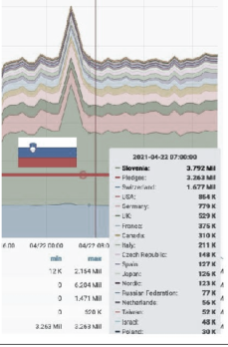

Euro HPC Infrastructure
Part of EuroHPC initiative
1st peta scale facility → among 50 most capable computers in the world

Slide 16

Researchers
Source: stat.si

Slide 17

Framework programmes
FP5
contracts: 385
participants: 481
EC financing: € 39,6 m
HORIZON 2020
contracts: 1013
participants: 1475 (329 SMEs)
coordinators: 199
EC financing: € 379,4 m
FP6
contracts: 503
participants: 616
coordinators: 31
EC financing: € 76,4 m
HORIZON EUROPE so far
contracts: 283
participants: 429 (83 SMEs)
coordinators: 40
EC financing: € 133,1 m
Success rate: 23,72%
FP7
contracts: 718
participants: 930
coordinators: 58
EC financing: € 170,4 m

Slide 18
Thank you for your attention!

