Slide 1
EU-Horizon
INFRA-2024-TECH-01-01
Summary
L. Bottura
With contributions of: M. Calvi, S. Casalbuoni, X. Chaud, C. Darve, F. Debray, K. Foraz, R. Losito, L. Garcia Tabares, J.M. Jimenez, E. Lelievre, J.M. Perez, L. Rossi, C. Roux, D. Schulte, P. Spiller, P. Vedrine, M. Vretenar
4 December 2023

Slide 2
The leading theme of the proposal
High Temperature Superconductors (HTS) are game changers in SC magnet technology:
  They have already enabled new technology, because of the extraordinary current carrying ability in high field (e.g. Bruker 1.2 GHz, NHMFL 32T, CFS/MIT TFMC)
  They will displace existing technology, because of the ability to operate at temperature higher than liquid helium, a minimal cryogen content, possibly different fluids
Time is ripe for this step because:
  The set challenges in HEP (e.g. FCC-hh, Muon Collider), high field science (e.g. EMFL, NHMFL, ILL, ESS), UHF NMR (Bruker), LS and FEL (EUXFEL), and fusion cannot be met unless we switch to HTS
  There is increased awareness towards sustainability and energy efficiency, and the risk of the helium supply chain
  There is a growing production infrastructure and availability of superconductor at decreasing price (REBCO)

Slide 3
EU-MAHTS
EUropean Magnet technology Advances through HTS, for science and societal applications:
  Physics – High Energy Physics (MuCol, FCC-hh), Nuclear Physics, Detectors
  Material and Life Sciences – Synchrotron Light and FEL, High Field Science, Neutron Spectroscopy, NMR
  Energy and Mobility – Magnetically confined fusion, motors and generators
  Medicine – Particle therapy, MRI

Slide 4
Main objective
Bridge the gap between laboratory realizations and deployment (i.e. advance TRL by 2…3 units) by :
  Developing technology bricks required for the next step in HTS magnets (presently TRL3 to TRL4)
  Build and test demonstrators, “usable” in field, as engineering templates for a transfer to industry (achieve TRL5 to TRL6):
    40T class, small bore, all-HTS solenoid (increase the field reach and prove all-HTS as viable solution for UHF)
    10T-class, large bore, large stored energy, all-HTS solenoid (manage large magnet dimensions, forces, stored energy)
    2T, 10mm period, 5mm gap all-HTS undulator (extend photon energy range)

Slide 5
Relevance of demonstrators
 | High Energy Physics | Nuclear Physics | Light Sources and FEL | Neutron scattering | HF science and NMR | Medical applications (therapy and MRI) | Power generation (fusion, aeolics) | Transportation and mobility (motors, levitation, aviation)
Ultra-high field solenoids
High field, large bore solenoids
High field undulators and super-bends
Relevant development
Relevant technology

Slide 6
Proposed structure
WP6 - Test Infrastructures
Exploit existing EU test infrastructure for high field testing in variable temperature environment, extending measurement capability with upgraded sensor technology or new measurement principles
WP5 – Demonstrators
Design and build demonstrator magnets, to be used “in field”, and as templates for transfer of technology to industry
WP4 - Materials and Technologies
Identify R&D crucial to HTS magnets and advance in areas of high relevance and return
WP2 – Strategic Roadmap
Develop an inclusive strategic roadmap for HTS magnet technology
WP1 - Coordination and Communication
Oversight, coordination & communication across work packages, industry participation
WP3 – HTS Magnet Applications
Review HTS magnet challenges towards higher performance, energy efficiency and sustainability. Study novel concepts and quantify impact of HTS magnet technology for the specific fields of application

Slide 7
WP1 – Coordination and Communication
Objective: Oversight, coordination & communication across work packages, industry participation

Slide 8
WP2 – Strategic Roadmap
Objective: Develop an inclusive strategic roadmap for HTS magnet technology
Previous work of relevance:
  European Strategy for Particle Physics
  CohMag and SciMag
  Neutron Spectroscopy
  Fusion
  SC Global Alliance

Slide 9
WP3 – HTS Magnet Applications
Objective: Review HTS magnet challenges towards higher performance, energy efficiency and sustainability. Study novel concepts and quantify impact of HTS magnet technology for the specific fields of application
Study areas:
  Energy efficiency and sustainability
  HEP and NP applications
  LS and FEL applications
  Neutron scattering applications
  High field science and NMR
  Medical applications, including therapy and MRI
  Power generation, including fusion
  Transportation and mobility

Slide 10
WP4 – Materials & Technologies
Objective: Identify R&D crucial to HTS magnets and advance in areas of high relevance and return
Technology R&D areas:
  Energy efficient and sustainable cryogenics
  HTS cables and conductors for DC and AC magnet applications
  HTS winding, insulation control, mechanics and protection
  Diagnostics, sensors and controls
  Radiation properties and radiation hardness

Slide 11
WP5 – Demonstrators
Objective: Design and build demonstrator magnets, to be used “in field”, and as templates for transfer of technology to industry
  All-HTS ultra-high field solenoid: 40 T class solenoid, 50 mm bore, compact winding, high engineering current density, cryogen-free for accelerator applications (horizontal beam)
  All-HTS standalone background field for laboratory testing: 10 T class solenoid, 500 mm bore, split magnet with large forces, stored energy and energy density, cryogen-free. Relevant technology for split and super-bends in a beam line
  All-HTS small period undulator: achieve 2 T gap field, with 10 mm period and 5 mm clear gap in an undulator demonstrator for next generation synchrotron light sources and FEL

Slide 12
WP6 - Test Infrastructures
Objective: Exploit existing EU test infrastructure for high field testing in variable temperature environment, extending measurement capability with upgraded sensor technology or new measurement principles
  High field testing: measure the electro-mechanical and thermo-physical characteristics of superconducting and resistive materials, cables, and small-size coils
  Variable temperature: explore operation in different conditions of cryogenic heat transfer and cooling
  Diagnostics and measurements: extend measurement capability by using upgraded sensing technology or new measurement principles
Test infrastructures and test methods are instrumental to the success of the work proposed

Slide 13
Partners - Beneficiaries (Grant Agreement)
✓
High Energy Physics – CERN (ESFRI) and associated laboratories (INFN+UMIL, CEA, CIEMAT)
Synchrotron light sources and FEL facilities – EUXFEL (ESFRI) and associated laboratories (PSI)
Nuclear physics – FAIR (ESFRI) and GSI
Neutron scattering – ESS (ESFRI)
High Field Science – EMFL (ESFRI) laboratories (LNCMI, HLD, HFML)
✓
✓

Slide 14
Partners - Associates (Consortium)
Other institutes and universities
  Contribution defined in the consortium agreement (scope, milestones, deliverables, value)
  Funding under the auspices of the Beneficiaries
  Magnetically confined Fusion – EUROFusion, F4E and associations
Industry
  Access to consortium, covered by limited funding amount (e.g. 100 kEUR total ?) to formally qualify, participate to meetings, and respond to internal tender actions
  Participate to internal tender actions managed by one of the Beneficiaries (e.g. CERN ?)

Slide 15
Budget allocation
 | Activity | EU Funds (kEUR) | Matching (kEUR)
WP1 | Coordination and communication Administration Industry participation | 300 150 2000
WP2 | Strategic Roadmap | 300
WP3 | HTS Magnet Applications | 300
WP4 | Materials and Technologies | 500
WP5 | 40T class solenoid 10T class split solenoid 2T short period undulator | 2000 2000 2000
WP6 | Test Infrastructures | 300
Total |  | 9850
Preliminary

Slide 17
Four HTS magnets challenges
Ultra-high field solenoids (from 20 T up to 40 T, and possibly beyond)
  Material science in high field
  NMR and life sciences
  Muon collider (muon beam cooling)
  Neutron scattering experiments
High field/large bore/large stored energy solenoids (up to 20 T, 1 m bore)
  HEP experiments (e.g. axion searches)
  Fusion
  Muon collider (muon beam production)
  Hybrid (SC/NC) high field magnets
High field/low consumption/compact dipoles and quadrupoles (up to 20 T, up to 150 mm bore, up to 20 K)
  FCC-hh: 14 T…20 T, 50 mm
  Muon collider (collider ring): 16 T…20 T, 150 mm, 5 W/m
  HEP experiments (e.g. axion searches)
  Low consumption beam line magnets, light source main ring magnets, medical applications: 1 T…4 T
  Motors and generators
High field undulators and super-bends
  Synchrotron light sources, Free electron lasers: 2 T gap field, 5 mm clear gap, short period (10 mm range)
  Synchrotron light sources: Super-bends: ≈ 10 T peak, ≈ 1 Tm integral

Slide 18
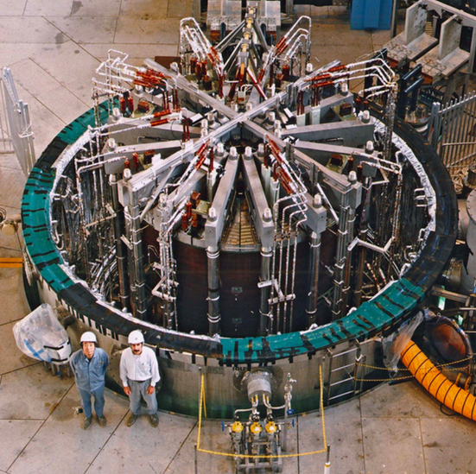
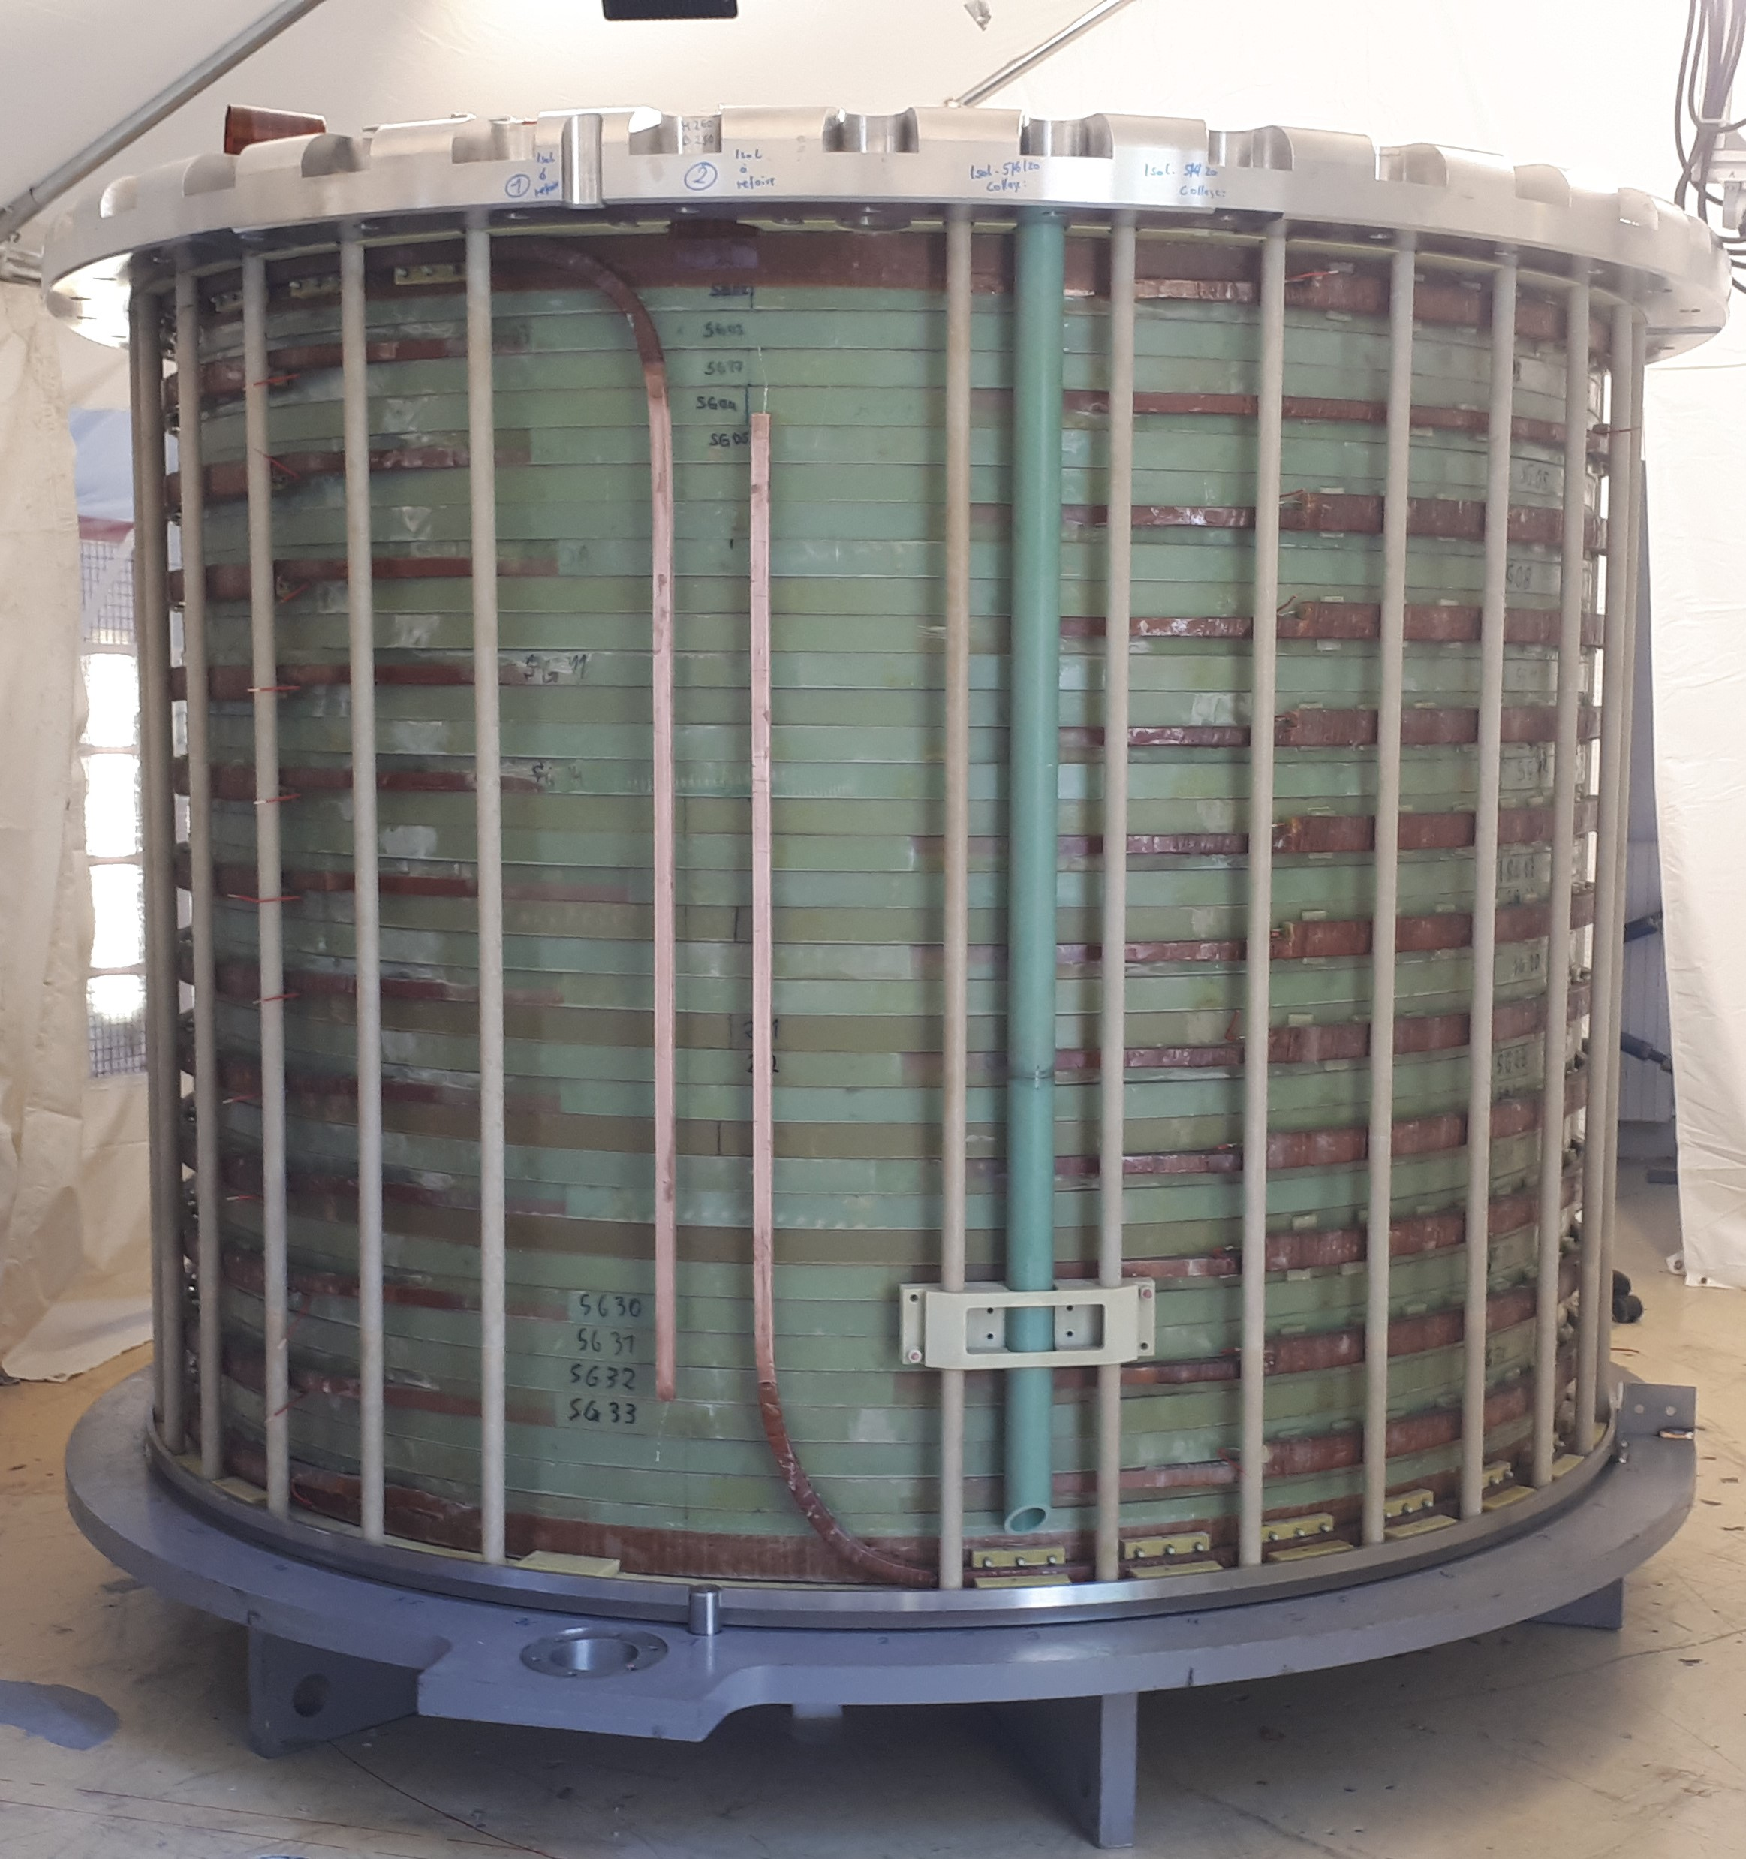
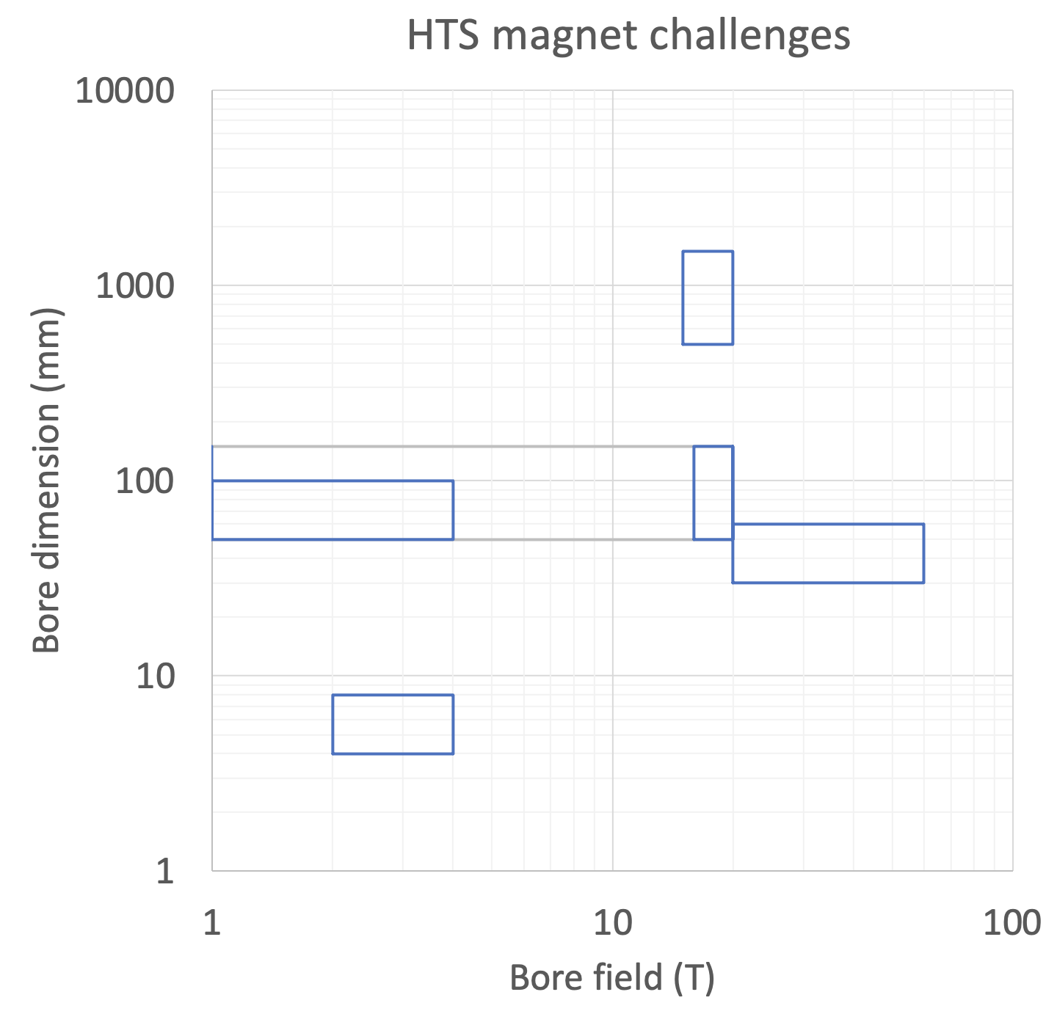
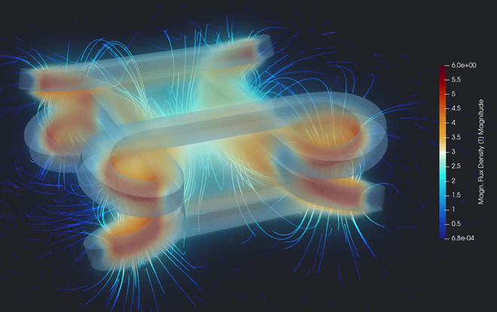
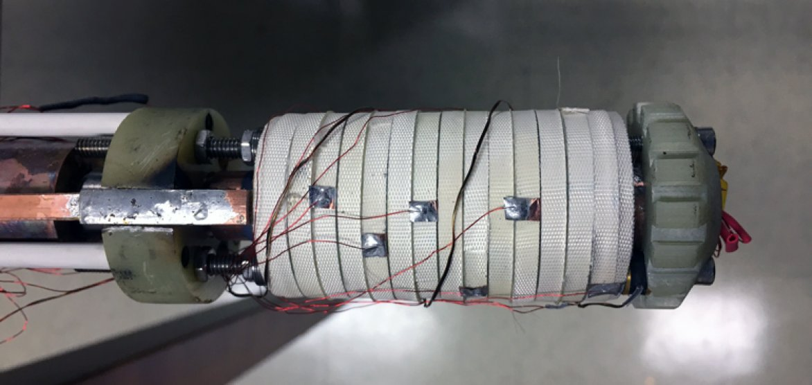
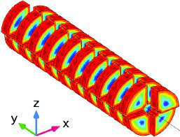
Four HTS magnets challenges
High field and large bore solenoids
Accelerator magnets
UHF solenoids
Undulators

Slide 19
Materials and Technologies
Energy efficient and sustainable cryogenic technology
  Cryogenic fluids and cycles for high temperature (20 K)
  Heat management (dry, indirectly cooled, gas cooled,…)
  Minimal cryogen (reduced fluid inventory)
HTS cables and conductors technology
  High current cables and conductors (10…50 kA)
  Cables for DC and ramped (AC, low loss) magnets
HTS winding technology
  3D shapes (non-planar coils)
  Interturn insulation/resistance control
  Joints and terminations
  High current- and energy-density (implications for mechanics and protection)
Diagnostics, sensors and control technology
  Quench detection (voltage and other techniques)
  Field control (field shaking, field feedback)
Radiation properties and radiation hardness
  HTS superconductors
  (Insulators)

Slide 20
Energy Efficient Cryogenics
HTS Winding
Diagnostics and Controls
HTS Cables and Conductors
Radiation Hardness
Ultra-High Field Solenoids
Large Bore High Field Solenoids
Compact, Efficient Accelerator Magnets
Undulators, Wigglers, Super-bends

Slide 21
Relevance of magnet challenges
 | High Energy Physics | Nuclear Physics | Light Sources and FEL | Neutron scattering | HF science and NMR | Medical applications (therapy and MRI) | Power generation (fusion, aeolics) | Transportation and mobility (motors, levitation, aviation)
Ultra-high field solenoids
High field, large bore solenoids
High field, low consumption, compact dipoles and quadrupoles
High field undulators and super-bends
Relevant development
Relevant technology

Slide 22
Relevance of Muon Collider R&D
 | Physics detectors (dark matter, space) | Nuclear Physics | Light Sources and FEL | Neutron scattering | HF science and NMR | Medical applications (therapy and MRI) | Power generation (fusion, aeolics) | Transportation and mobility (motors, levitation, aviation)
Ultra-high field solenoids
High field, large bore solenoids
High field, low consumption, compact dipoles and quadrupoles
Fast pulsed, high power, energy efficient converters
Relevant development
Relevant technology

Slide 23
Are solenoids relevant ?
Solenoid model coils built with modest conductor lengths and size (few km) can probe performance limits at extreme values:
  Field (20 T…40 T) – high and ultra-high field characterization of the critical surface J_{C}(B,T,α)
  Force and stress (500 MPa…700 MPa) – engineering test at levels relevant and beyond full-size accelerator magnets
  Current density (600 A/mm²…900 A/mm²) and energy density (300 MJ/m³) – quench detection and protection in a new regime, where present technical solutions do not work (detection time would be too short, quench heater power would be too high)
“Simple” engineering, fast turnaround

