Slide 1
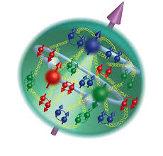

Spin Session
Introduction to 3D nucleon structure and spin physics
U. D’Alesio INFN and Cagliari University
B. Badelek Warsaw University
8–14 Sept 2024
Hotel Tonnara Trabia,
Palermo, Sicily

Slide 2
Outline
Why spin, why 3D
What
How
Where

Slide 3
Why?
Single spin asymmetries…
puzzling in collinear pQCD
at leading twist

Slide 4
Why?
Origin of the proton spin
How the constituents of the proton contribute to the proton spin?

Slide 5
What: TMDs and GPDs

Slide 6
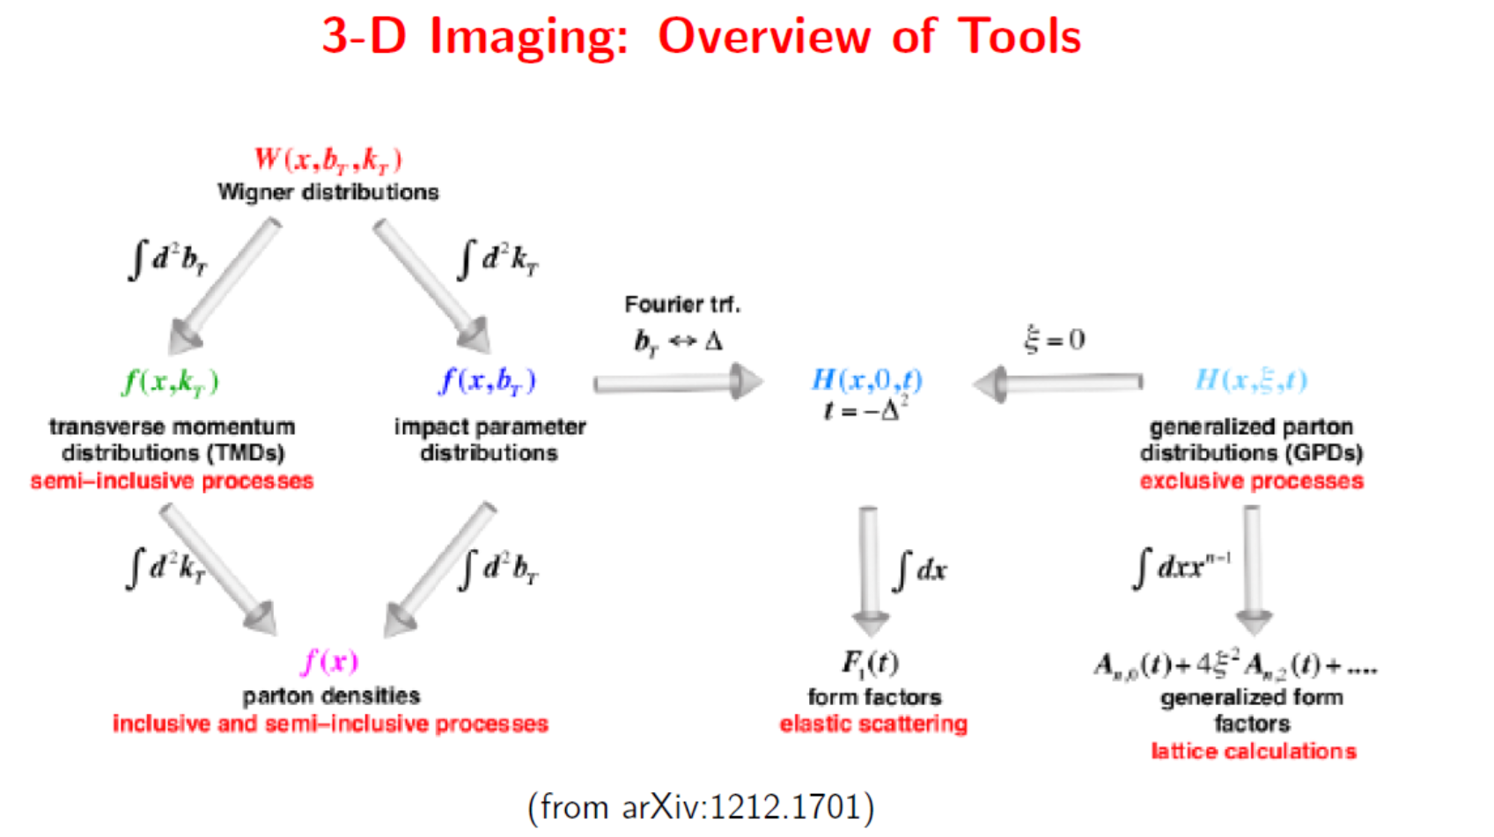
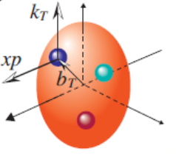

Slide 7
Wigner function: importance

Slide 8

Spin-kT correlations: quark TMDs for spin-1/2 hadrons
Unpol and Helicity: very good knowledge of x dep.
Unpol: good knowledge of kT dep.
Sivers (T-odd) and transversity (chiral odd): fair knowledge (mainly x dep.)
Others: some hints
Tensor charge: tension with lattice
T-odd
T-odd
8 TMD-PDFs
The Sivers function $f_{1T}^{⊥}$
Tensor charge

Slide 9
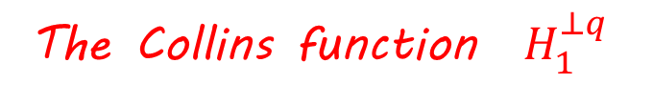
Spin-kT correlations: quark TMDs for spin-1/2 hadrons
Unpol and Helicity: good knowledge of x dep.
Unpol: some knowledge of kT dep.
Collins FF: fair knowledge (mainly z dep.)
Polarizing FF: preliminary knowledge
Others: Almost unknown
8 TMD-FFs
The Collins function $H_{1}^{⊥q}$

Slide 10
and gluon TMDs
Unpol and Helicity: good knowledge of x dep.
Unpol: some hints on kT dep.
Others: almost unknown
Modelling
Theoretical and phenom. more challenging

Slide 11
Quark GPDs
GPDs encode correlations between parton
longitudinal momentum and transverse position
8 GPDs: 4 chiral even and 4 chiral odd

Slide 12
What can we learn from GPDs?
GFFs: information about internal distributions of mass, energy, pressure and shear

Slide 13
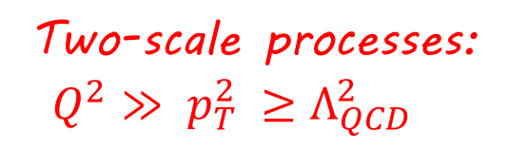
How can we acces TMDs?
Two-scale processes:
$Q^{2}≫$ $p_{T}^{2}$ $≥Λ_{QCD}^{2}$
TMD factorization proven

Slide 14
Access to gluon TMDs

Slide 15
Other interesting processes
Jet-jet correlations
Quarkonium production in ep and pp collisions
SSAs in inclusive processes (twist-3…connection to TMDs)
Connection to low-x physics and unintegrated PDFs (C. Marquet)

Slide 16
and GPDs? Exclusive reactions
DDVCS
Gluon GPDs
Timelike Compton Scattering

Slide 17
TMDs from SIDIS

Slide 18
TMD structure and factorization
Courtesy of A.Bacchetta
Each convolution….
Analysis in Fourier-transformed space….

Slide 19
Scale dependences: more complicate w.r.t. DGLAP….
CSS/SCET, Rapidity divergences and all that

Slide 20
Modified universality
Collinear PDFs: factorization universality
Final state interactions in SIDIS
Initial state interactions in DY
First experimental hints
at STAR, COMPASS
T-odd TMDs: Sivers function
colored gluons at work ….

Slide 21
GPD..some more info
Factorization fully proven for DVCS/TCS/Double-DVCS whereas partial proof for DVMP only at LO for longitunally polarized photon
GPDs are universal
TCS to test the universality of GPDs and to access the real part of the Compton FF

Slide 22
Status
TMDs:
- theory, phenom. and modelling (M. Radici)
- global fits, towards a precision era
Lattice: significant progress (K. Cichy, S. Muckerjie)
GPDs: theory and modelling. still open issues but improving fast

Slide 23
Where
Several experimental facilities/programmes:
- HERMES,
- COMPASS (B. Badelek, K. Lavickova),
- JLab (J.P. Chen),
- BaBar, Belle, BESIII,
- RHIC (R. Seidl),
- LHCspin (M. Santimaria),
- EIC (P. Nadel Turonski)]
Enjoy the SPIN session

Slide 24
Backup slides

Slide 25
What: TMDs and GPDs

Slide 26
