Slide 1
Experimental Spin Program at Jefferson Lab
Jian-ping Chen, Jefferson Lab, Virginia, USA
Diffraction2024, Palermo, Sicily, Sept. 8-15, 2024
Introduction
Highlights of JLab12 Spin Program
  Spin structure in valence region
  A1n@high-x in Hall C
  A1p@high-x: RGC@CLAS12
  quark-gluon correlations, twist-3 matrix element
  d2n@medium-high Q² in Hall C
Spin Moments (Sum Rules and Polarizabilities) at Low-Q²
  Proton: g2p@Hall A (T) and EG4@Hall B (L)
  Neutron: SAGDH@Hall A with pol. ³He (both L/T)
  Bjorken (p-n) Sum and (Effective) Strong Coupling
Summary
Acknowledgment: Thanks to X. Zheng, M. Chen, B. Sawatzky, J. Chen, A. Deur, K. Slifer, S. Kuhn, P. Pandey and collaborators.

Slide 2
Nucleon Spin Structure Study
1980s: EMC (CERN) + early SLAC
quark contribution to proton spin is very small
ΔΣ = (12+-9+-14)% ! ‘spin crisis’
1990s-2000s: SLAC, SMC (CERN), HERMES (DESY)
ΔΣ = 20-30%, the rest: gluon and quark orbital angular momentum
(½)ΔΣ +Lq + ΔG +L_{G} =1/2
gauge invariant (½)ΔΣ + Lq + J_{G} =1/2
Bjorken Sum Rule verified to <10% level
2000s-2020s: COMPASS (CERN), HERMES (DESY), RHIC-Spin, JLab, … :
ΔΣ ~ 30%; ΔG contributes (RHIC-Spin), orbital angular momentum significant
Needs full spin-flavor separation: valence quarks and sea quarks
spin moments (sum rules/polarizabilities) → test of QCD theoretic approaches
Reviews: Sebastian, Chen, Leader, arXiv:0812.3535, PPNP 63 (2009) 1;
Chen, arXiv:1001.3898, IJMPE 19 (2010) 1893; …

Slide 3
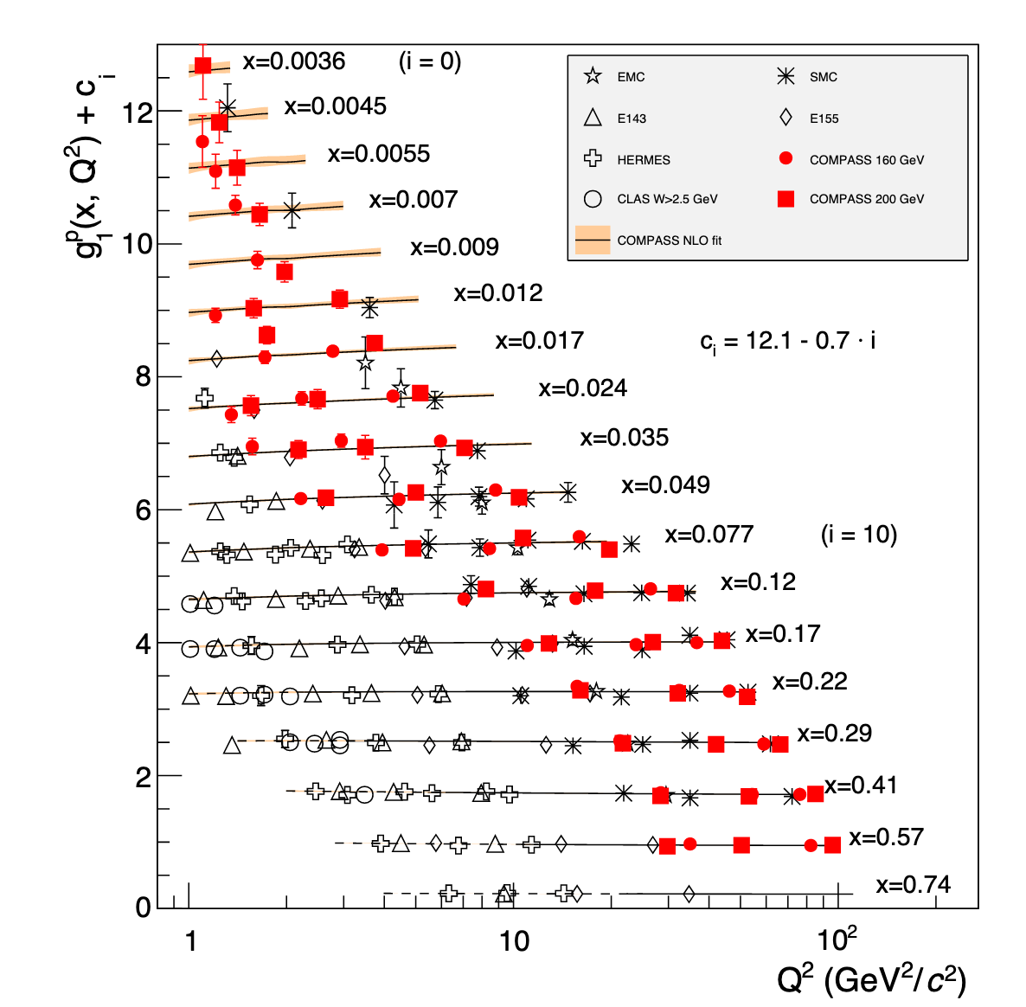
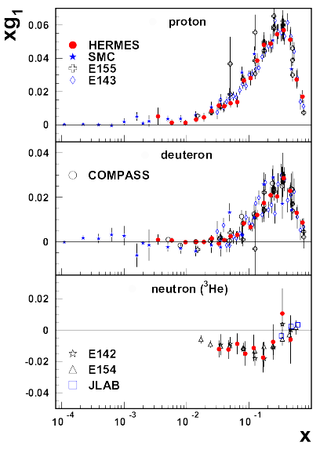
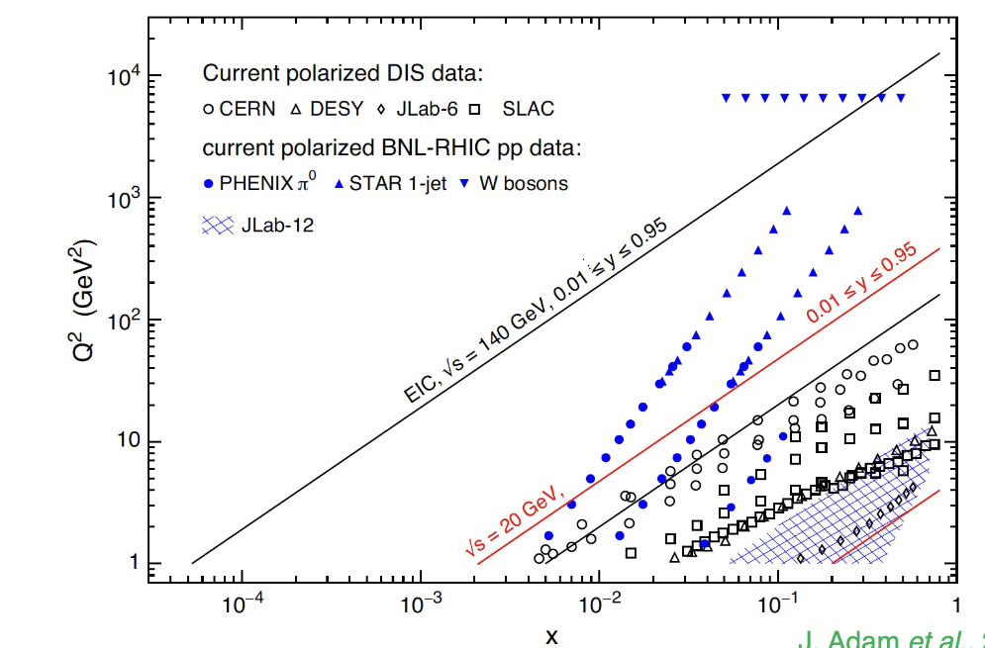
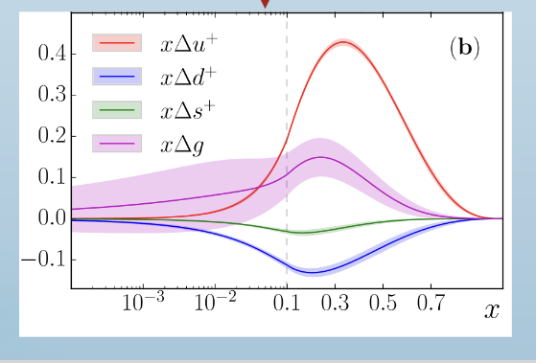
Polarized Structure functions
PDG
(online 2023)
JAM

Slide 4
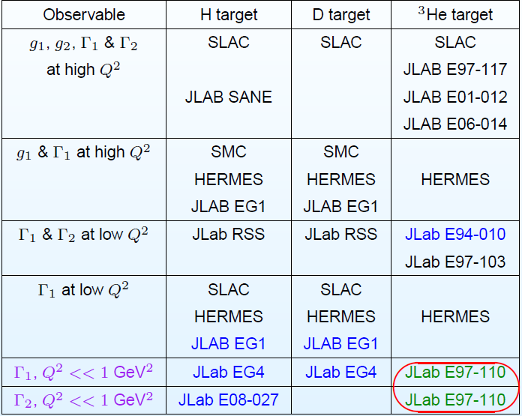
Summary of Spin Experiments
JLab12
A1n d2n
RGC
COMPASS
RHIC-Spin
SAGDH
g2p

Slide 5
Highlights of JLab12 Spin Program I
Spin Structure in Valence Quark Region
Preliminary results from A1n(³He)@high-x:
spin structure in valence region
Overview of RGC@CLAS12: A1p (A1d) @high-x
spin structure with longitudinally polarized p and d

Slide 6
A₁ at High-x: World Data
a clean domain where QCD (and many other models) can make predictions for (the ratio of) structure functions
ratios of pol/unpol pdfs at x→ 1 provide unambiguous, scale invariant, non-perturbative features of QCD
proton
neutron
SU(6)

Slide 7
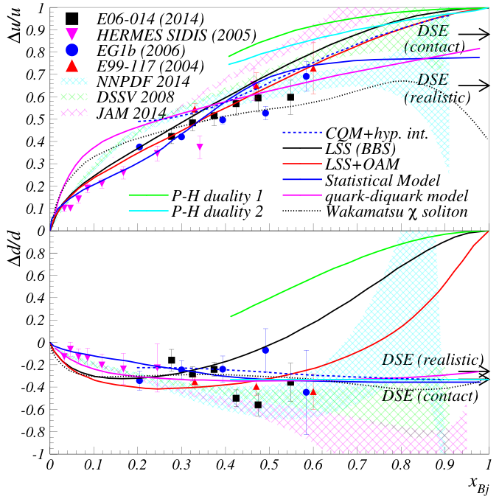
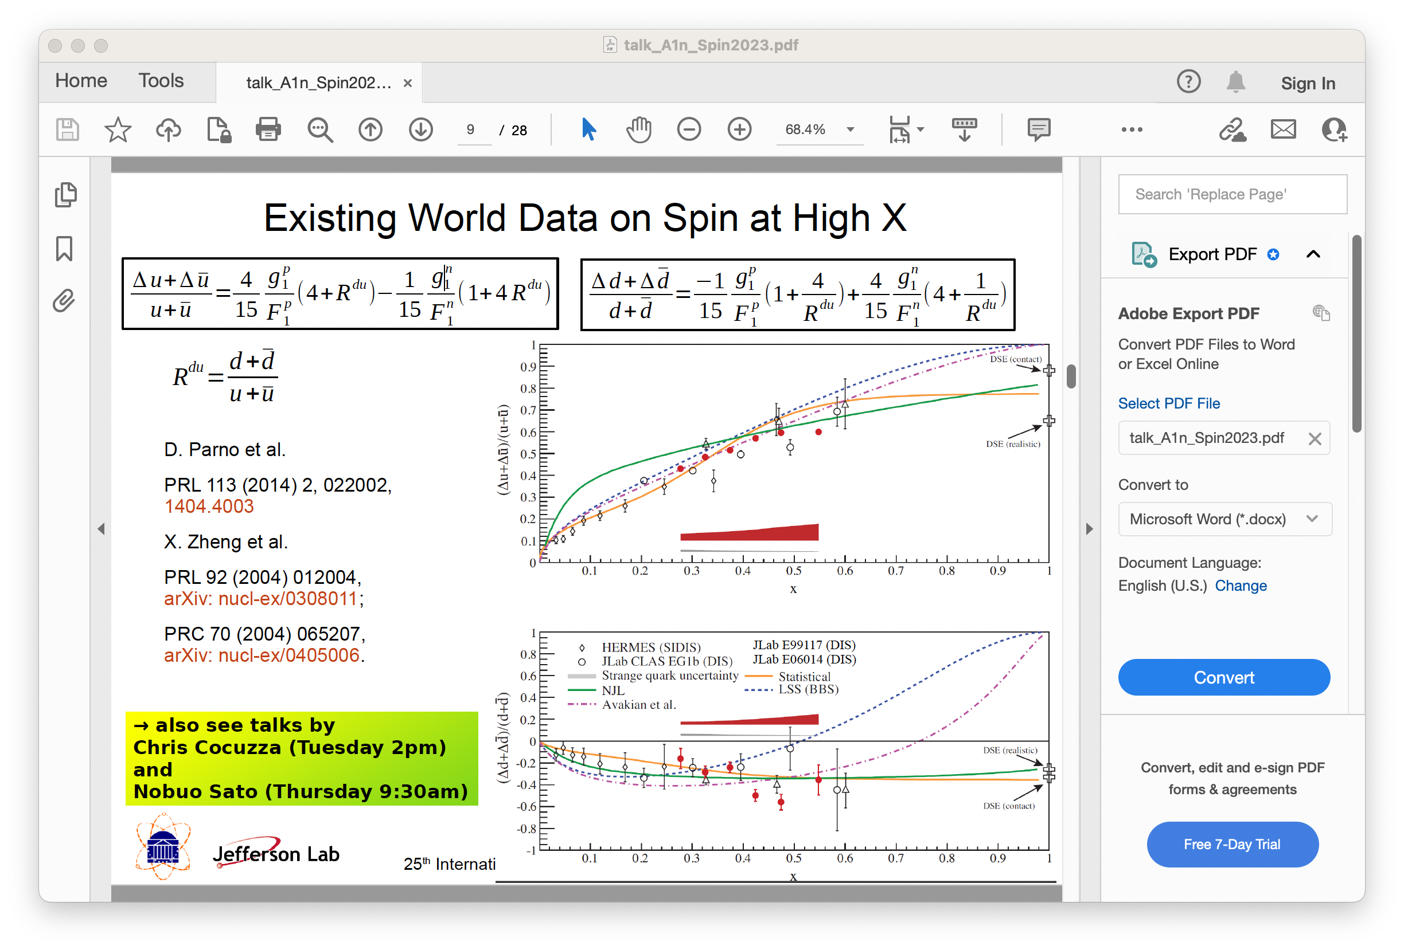
Simple Spin-flavor Decomposition at High-x
pQCD with quark OAM,

Slide 8
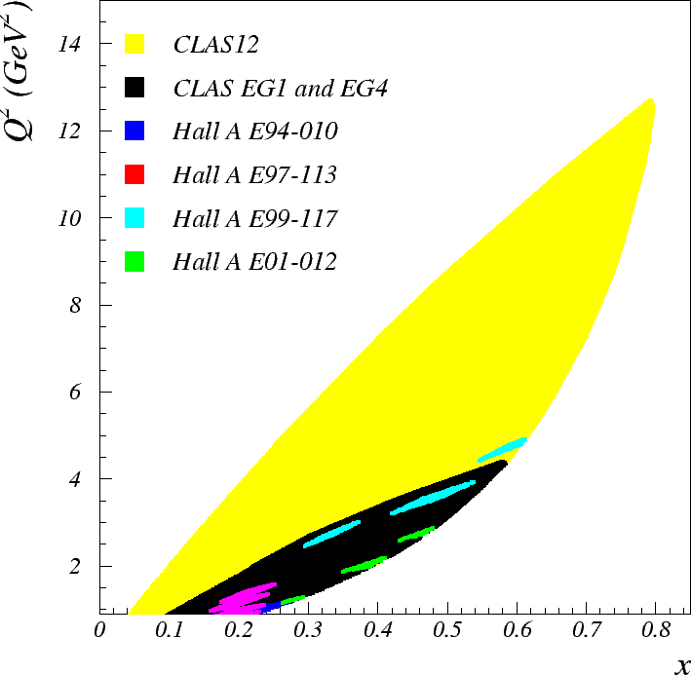
Reaching Deeper Valence Quark Region with 12 GeV
CLAS12 Kinematics
Hall C A₁^{n} Kinematics

Slide 9
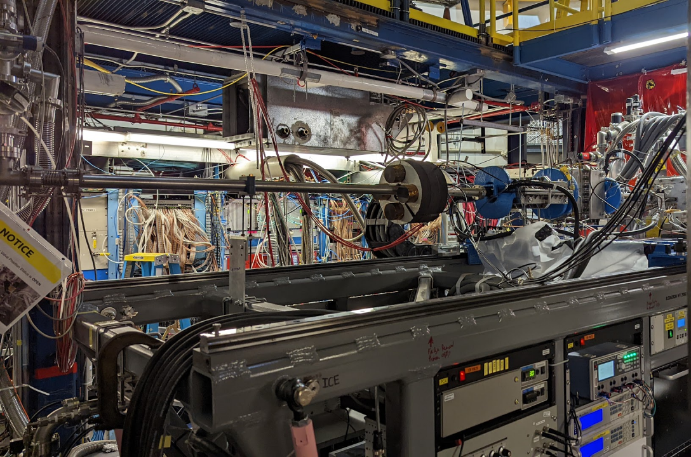
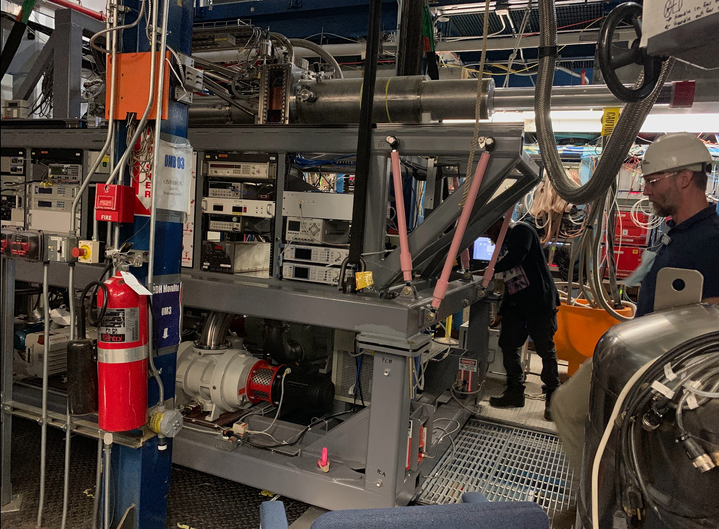
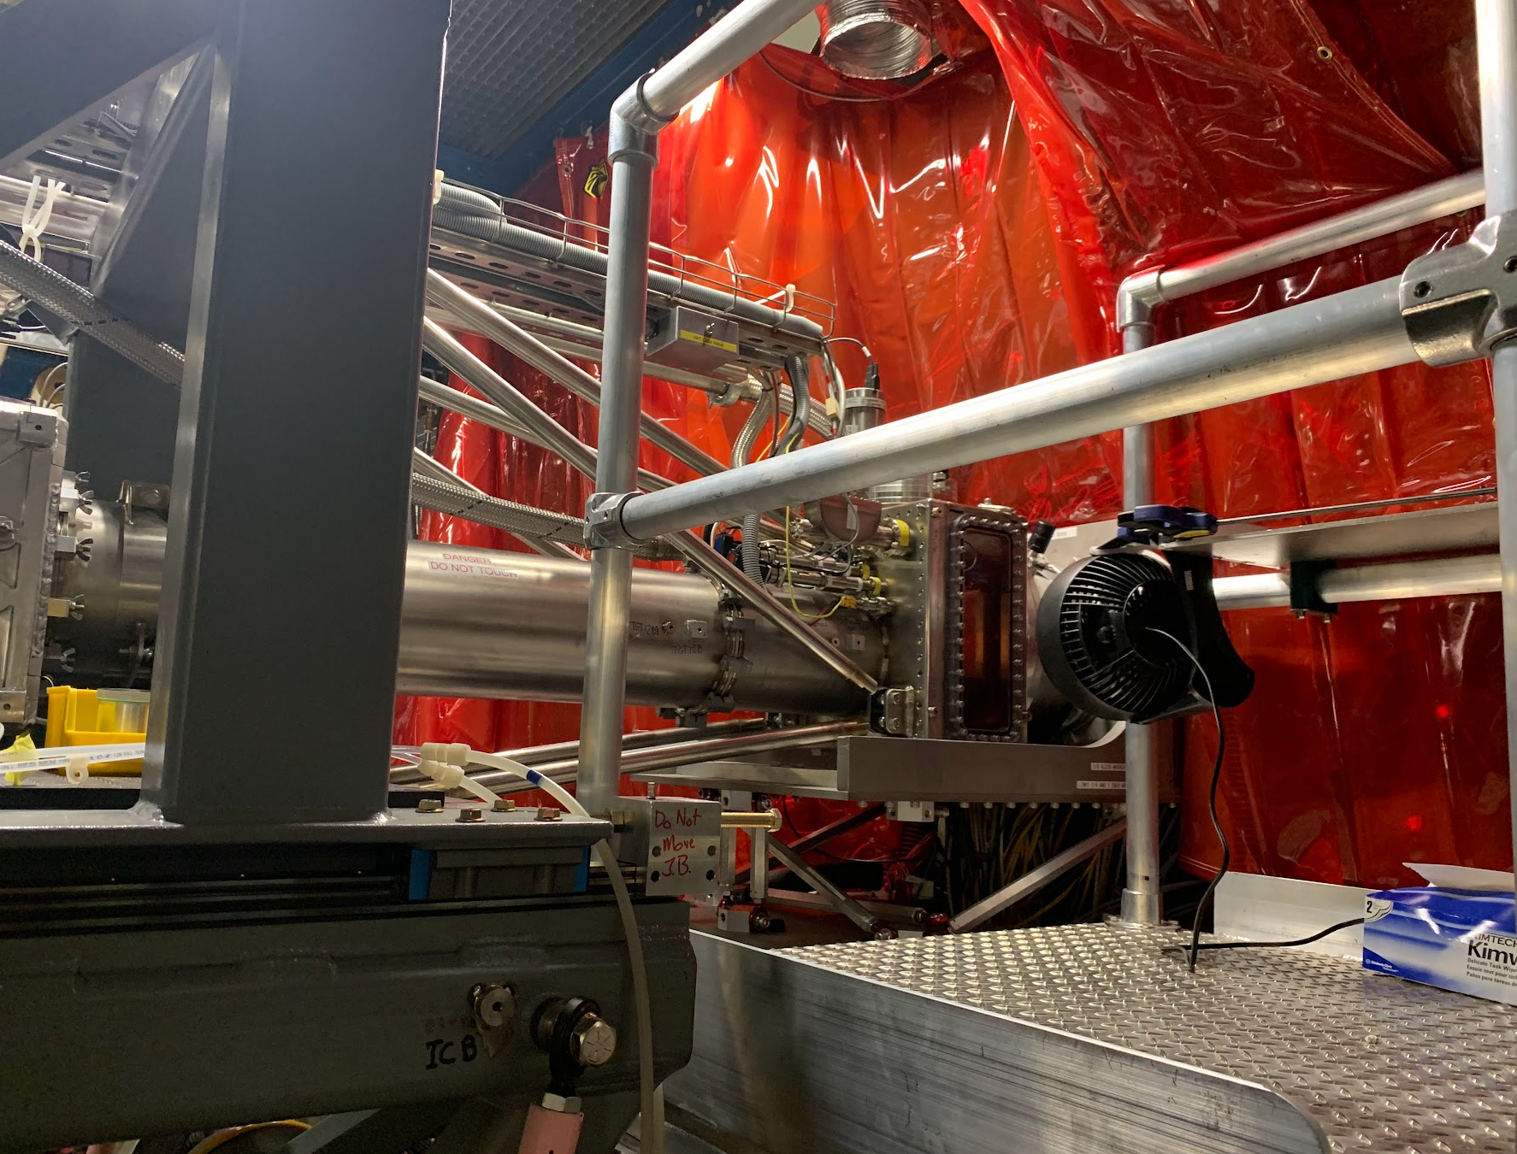
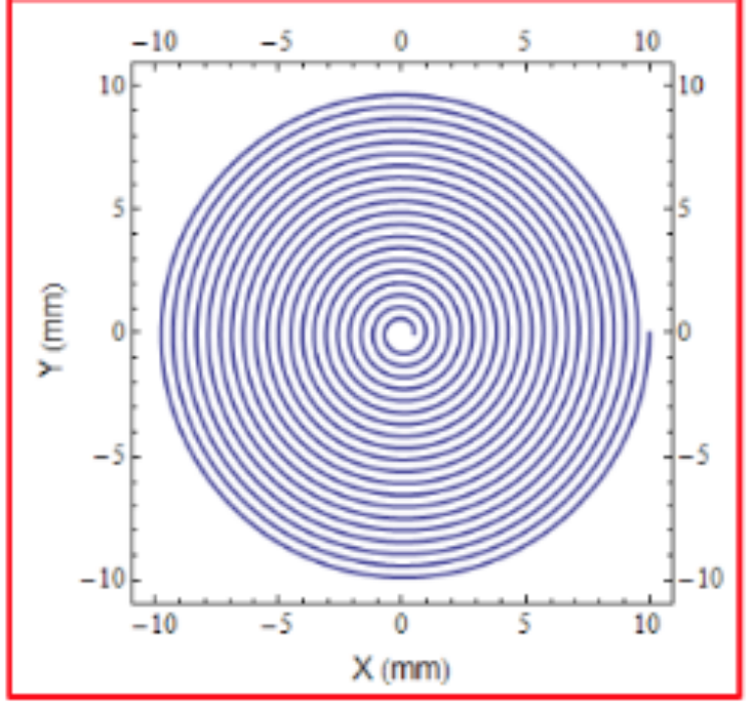
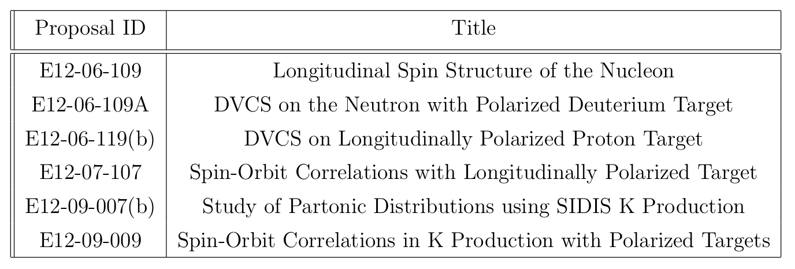
RGC@CLAS12 with Longitudinally Polarized proton/deuteron Targets
P. Pandey
Evacuated Beamline
Raster magnets
RGC scheduled for 9 calendar months (240 calender days), data collected for 190 days, 80% of allotted beam time.
Collected data from 06/11/2022 to 03/20/2023 with some breaks due to Magnet power supply failure (firmware issue) and configuration changes.

Slide 10
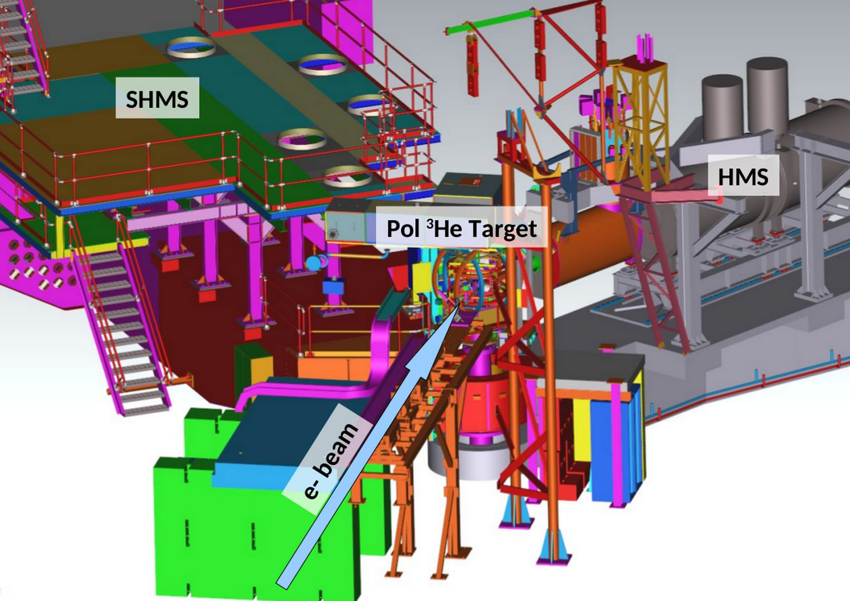
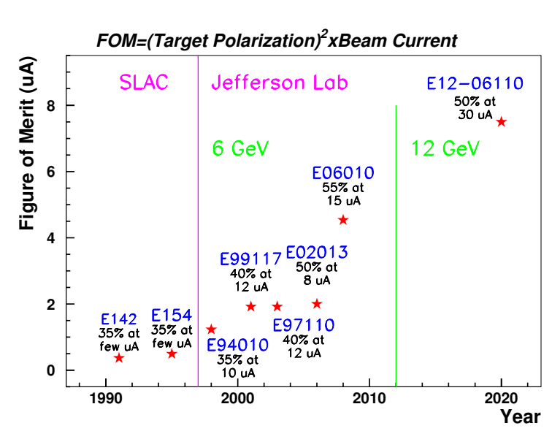
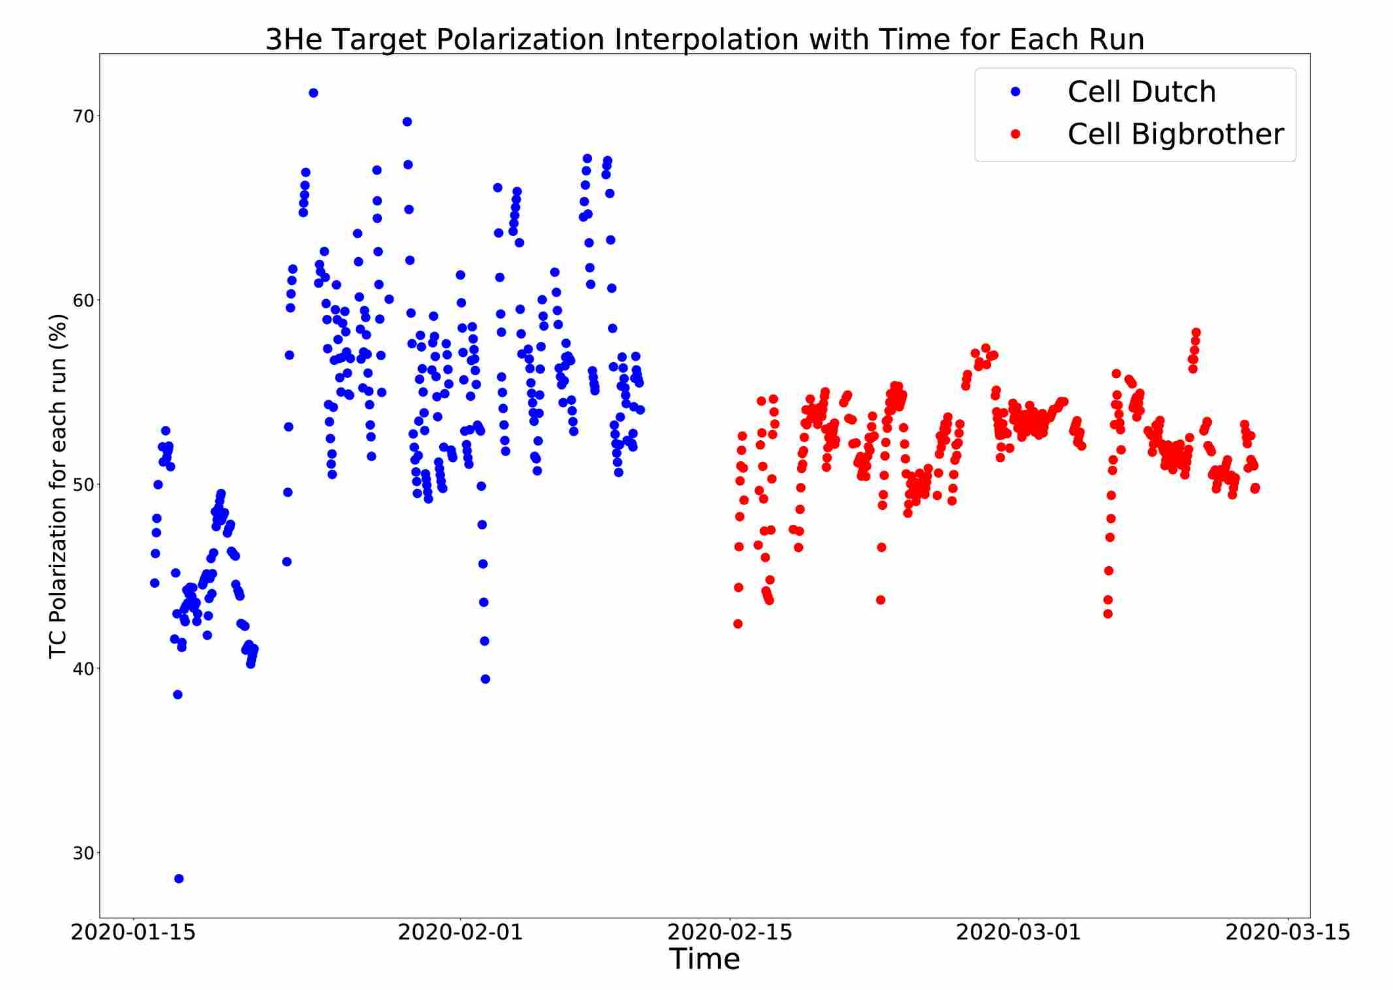
A1n@High-x: E12-06-110 in Hall C
Spokespersons: X. Zheng, G. Cates, J. P. Chen, Z. E. Meziani
Ph.D Students: M. Chen, M. Rehfuss
30 uA, 85% polarized 10.4 GeV electron beam
40 cm L/T polarized ³He with in-beam polarization reach up to 60% (average ~ 50-55%)
luminosity (2x10³⁶ cm⁻²s⁻¹) and FOM are
a factor of 2 improved over the world record
60
50

Slide 11
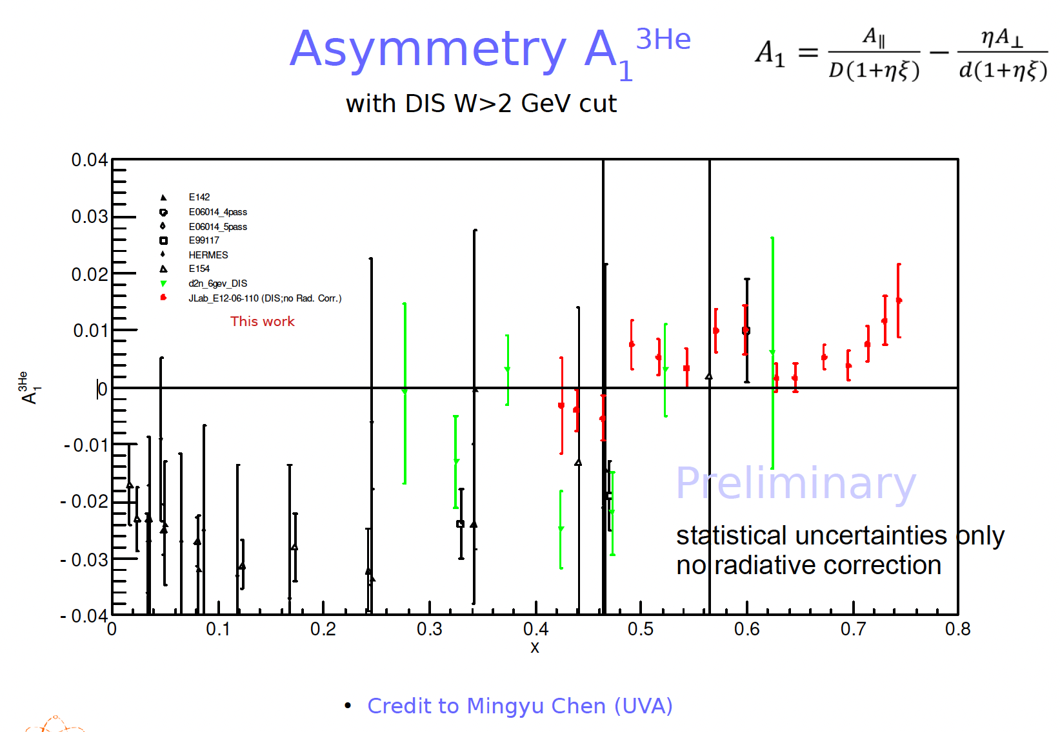
A1n@High-x: Preliminary Results

Slide 12
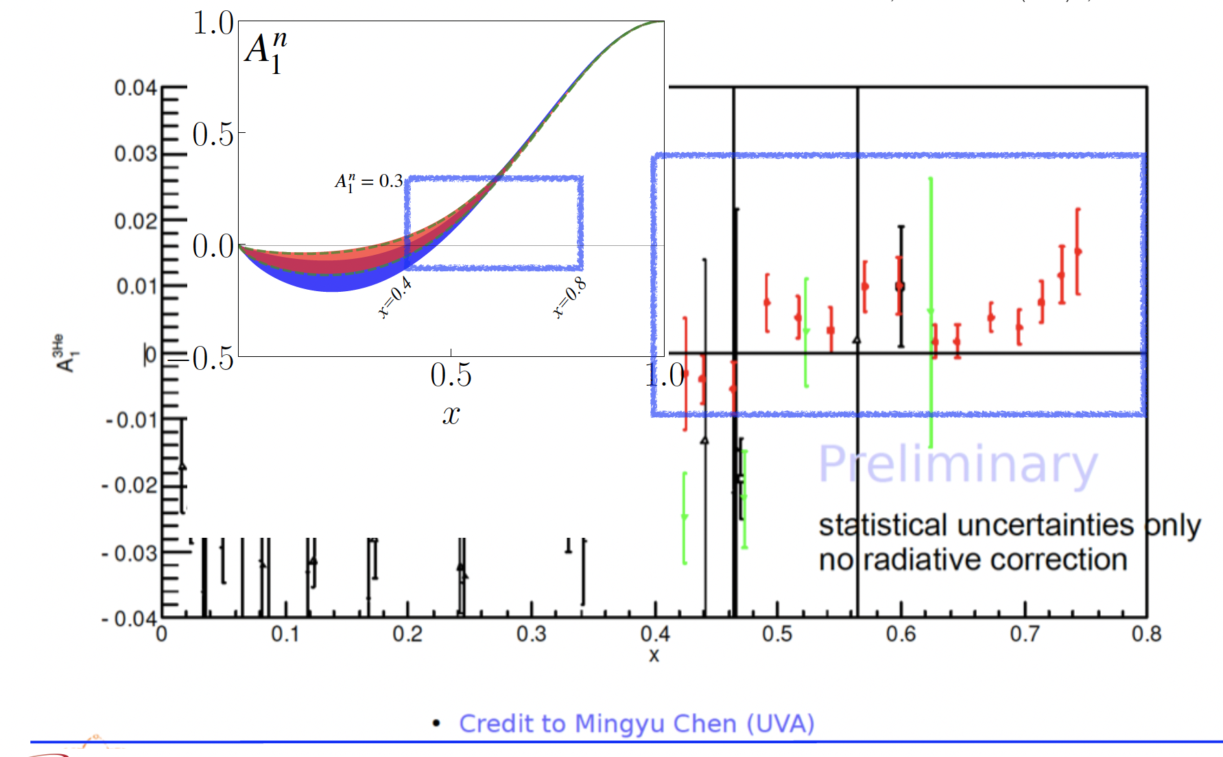
A1n@High-x: Preliminary Results

Slide 13
Highlights of JLab12 Spin Program II
Spin Moments @ Intermediate Q²
Preliminary results from d2n(³He) in Hall C:
twist-3 matrix element → quark-gluon correlations
(color polarizability/color Lorentz force)

Slide 14
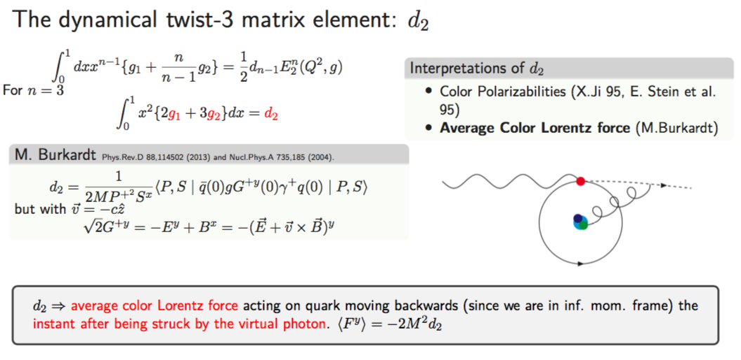
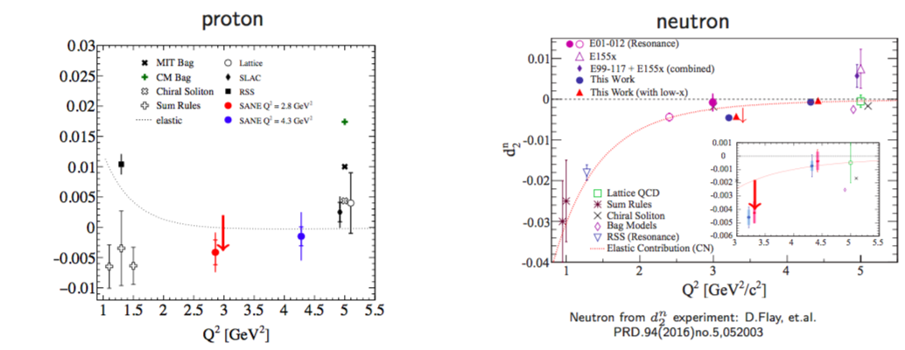
6 GeV Results for d2 Moment
Dynamic twist-3 matrix element
Proton from SANE,
PRL 122, 022002 (2019)
g2p2 Proposal
12 GeV d₂^{n}

Slide 15
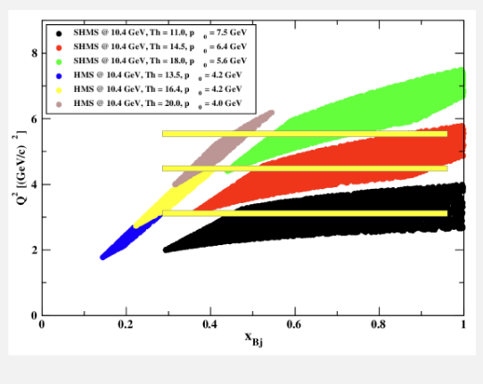
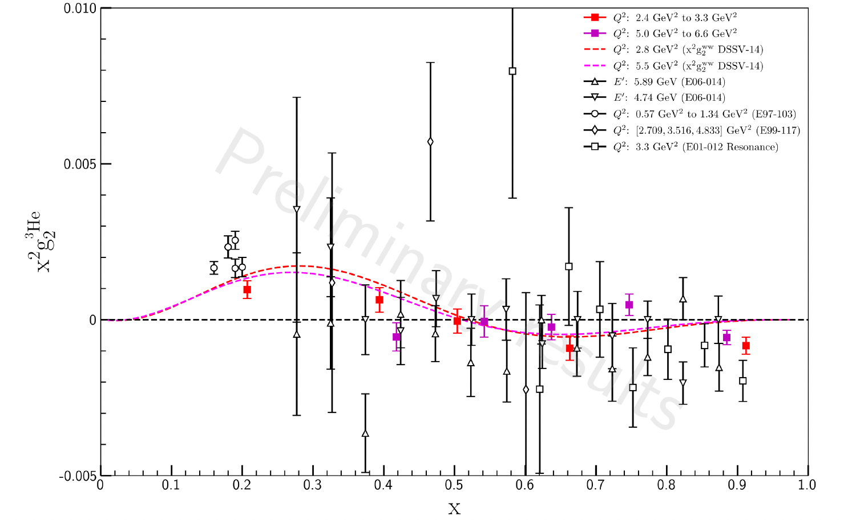
12 GeV d₂^{n}: Color Polarizability/Lorentz Force
Measurement of g₁ and g₂ structure functions and d₂ moments at 3 GeV² < Q² < 5.5 GeV² for the neutron using a polarized ³He target
Study quark-gluon correlations (twist-3) and provide a benchmark test of LQCD calculations.
Data taking completed, analysis on-going
preliminary results on g₂n/g₂³He ( J. Chen)

Slide 16
Recent Published Results on Spin Moments:
Sum Rules and Polarizibilities @ Low-Q
Sum Rules
Nucleon Structure ←→ Global Properties
mass, spin, magnetic moment, polarizabilities, …
How the structure is related (gives rise) to the global properties?
How the global properties emerging from the structure?
→ Help study/understand Strong QCD

Slide 17
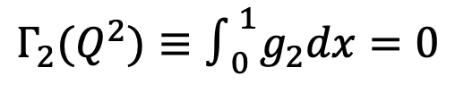
Bjørken Sum Rule, GDH Sum Rule, Generalized Sum Rule
Bjørken Sum Rule
(high Q²)
GDH Sum Rule
Real photon (Q²=0)
Generalized GDH Sum Rule
Q²-dependence of GDH Sum Rule provides a bridge linking strong QCD to pQCD
  Bjorken and GDH sum rules are two limiting cases
  High Q², Operator Product Expansion : S₁(p-n) ~ g_{A} → Bjorken
  Q² → 0, Low Energy Theorem: S₁ ~ κ² → GDH
  High Q²: pQCD, Operator Product Expansion
  All Q² region: Lattice QCD calculations
  Low Q² region (< ~0.1 GeV²): Chiral Effective Field Theory (χEFT)
B-C Sum Rule:
$$Γ_{2}(Q^{2})≡∫_{0}^{1}g_{2}dx=0$$

Slide 18
Spin Polarizabilities (higher moments)
Polarizibilities @ low Q²
They can be calculated with χEFT and Lattice QCD (4-point functions)
Polarizibilities @ Intermediate-to-high Q²
Color polarizability (X. Ji)
Color Lorentz force (M. Burkardt)
Dynamic twist-3 matrix element: quark-gluon correlations
Lattice QCD calculations

Slide 19
Low-Q Spin Experiments @ JLab
Hall B EG4: proton g₁: Spokespeople: M. Ripani, M. Battaglieri, A. Deur, R. de Vita
Students: H. Kang, K. Kovacs
X. Zheng et al., Nature Physics, vo. 17 736-741 (2021)
Hall A g2p: proton g_{2:} Spokespeople: K. Slifer, J. P. Chen, A. Camsonne, D. Crabb
Students: D. Ruth, R. Zielinski, C. Gu, M. Allada (Cummings), T. Badman, M. Huang, J. Liu, P. Zhu
D. Ruth et al, Nature Physics 18, 1441 (2022)
Hall A SAGDH: neutron g₁ and g₂ with L/T polarized ³He
Spokespeople: J. P. Chen, A. Deur, F. Garibaldi.
Students: V. Sulkosky, C. Peng, J. Singh,V. Laine, N. Ton, J. Yuan.
V. Sulkosky et al., Nature Phys., 17 687 (2021)
V. Sulkosky et al., PLB 805 135428 (2020)
Combining EG4 and SAGDH to form Bjorken Sum: A. Deur et al., Phys. Lett. B 825 (2022) 136878
Extracting effective coupling α_{g1}: A. Deur, et al., Particles, 5-171 (2022)
Low-Q workshop at Crete, Greece, May 2023 (https://sites.temple.edu/lowq/)

Slide 20
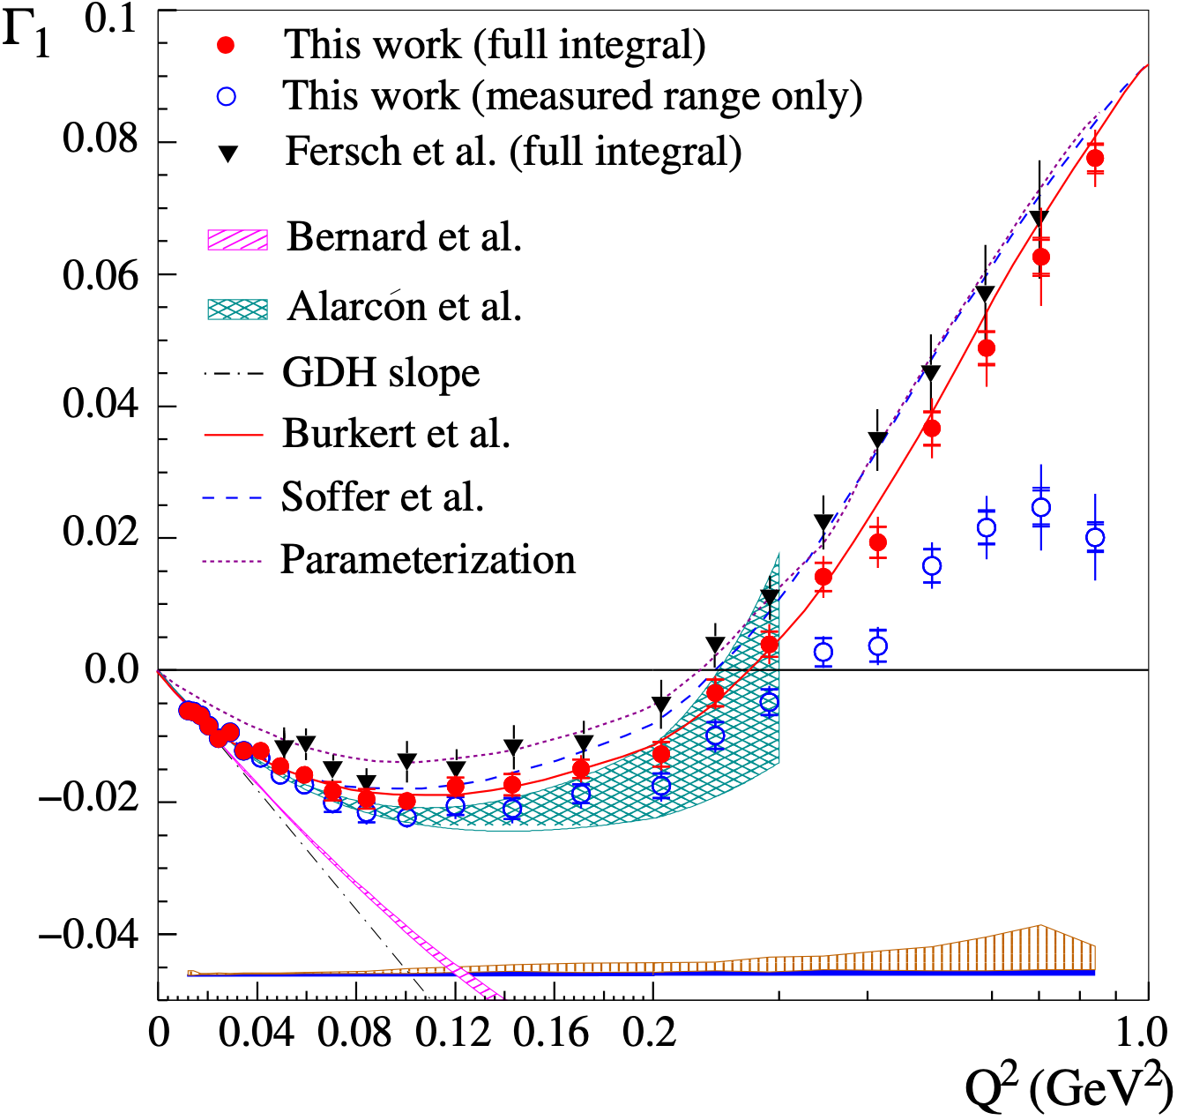
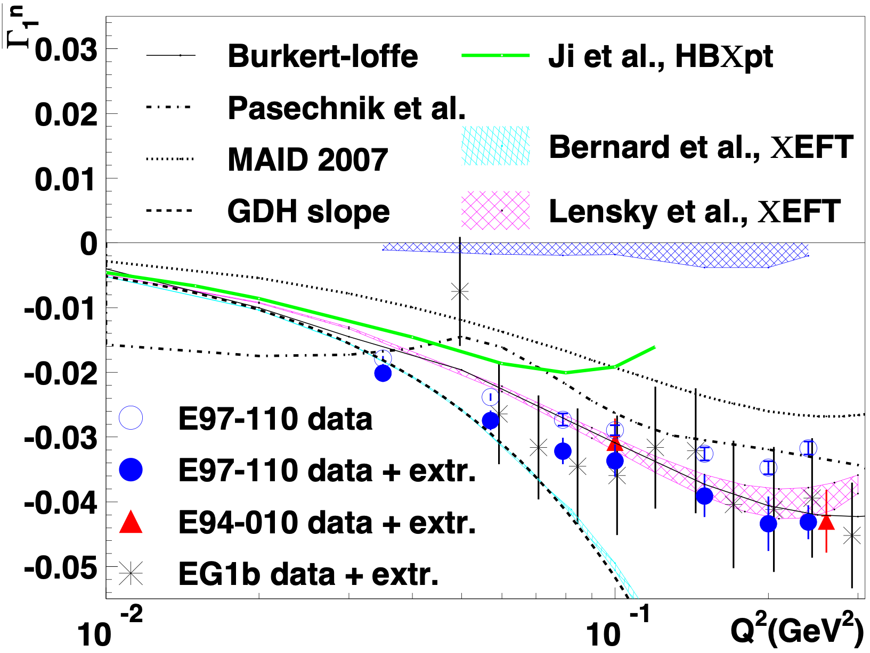
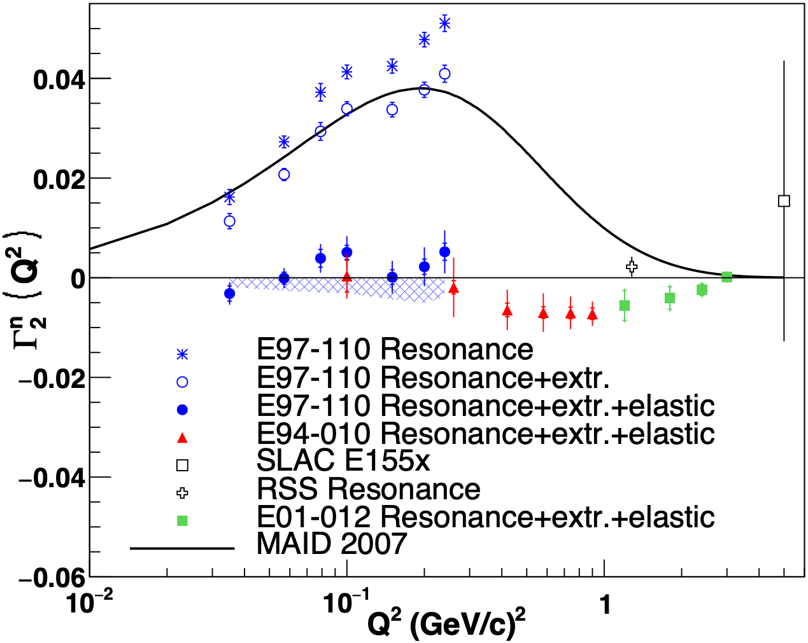
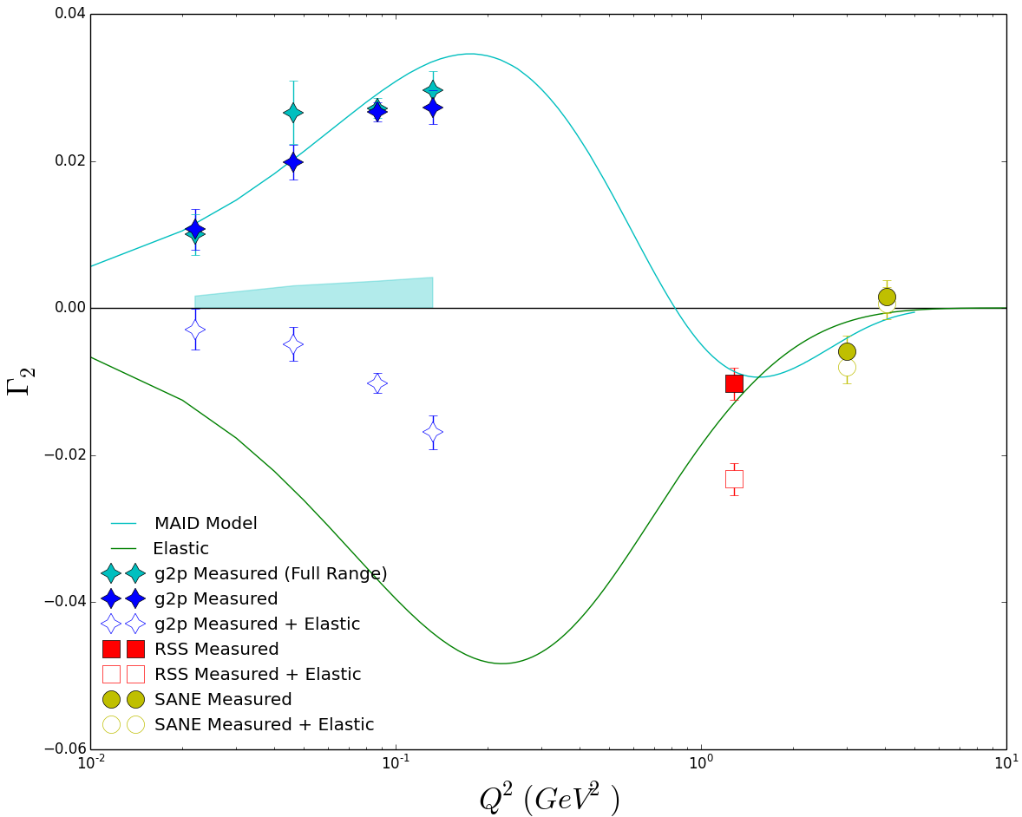
low-Q Γ_{1 ,} Γ₂ (spin sums) for proton and neutron
proton
neutron
Γ₁
Nature Physics 17, 736
(2021)
PLB
805, 135428 (2020)
Γ₂
To be published
Preliminary results from JLab g2p experiment
(D. Ruth)

Slide 21
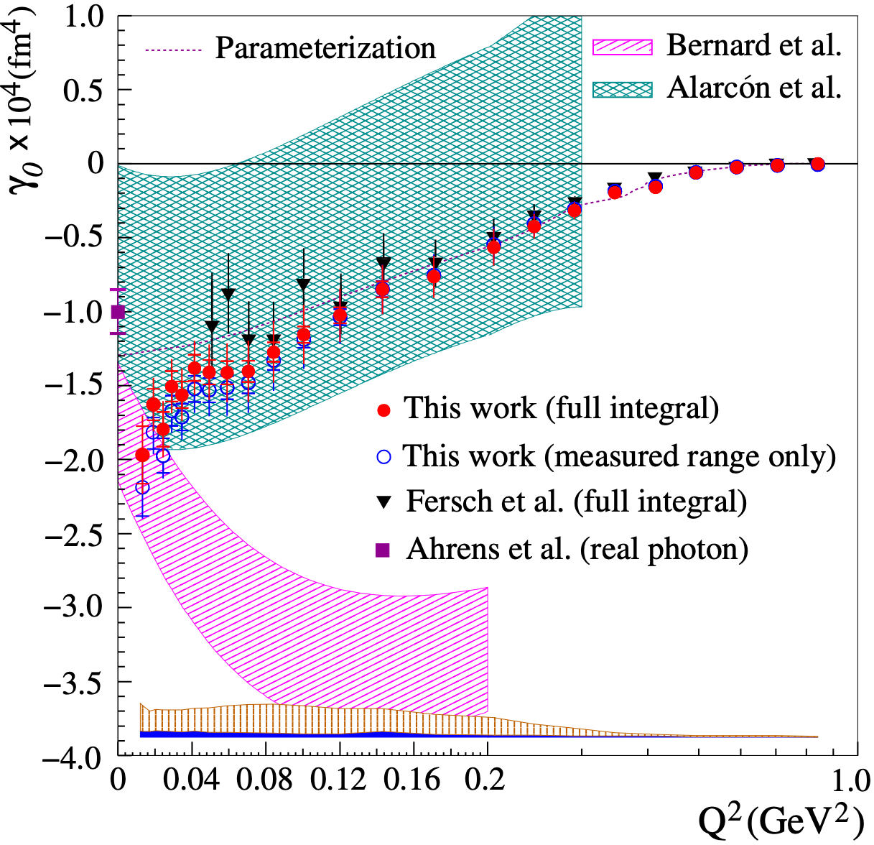
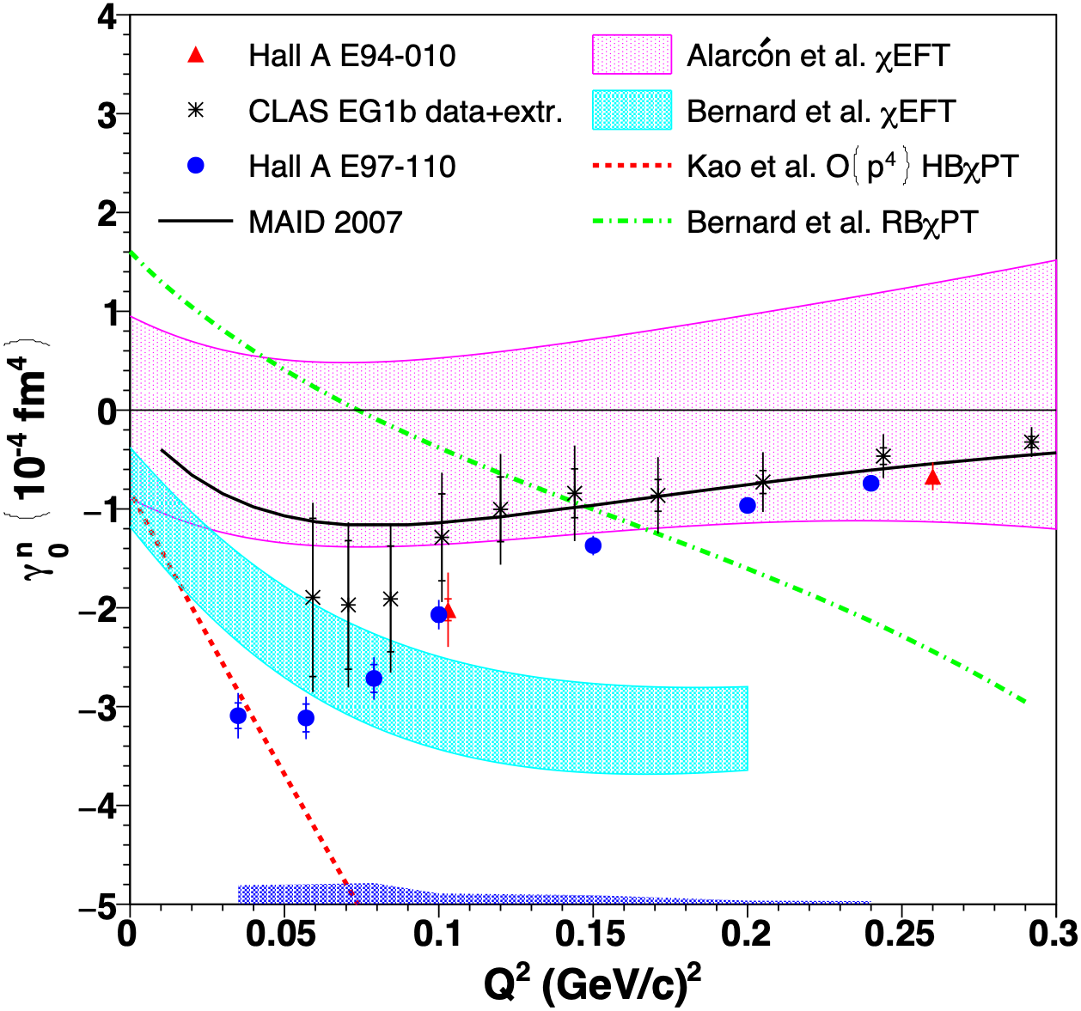
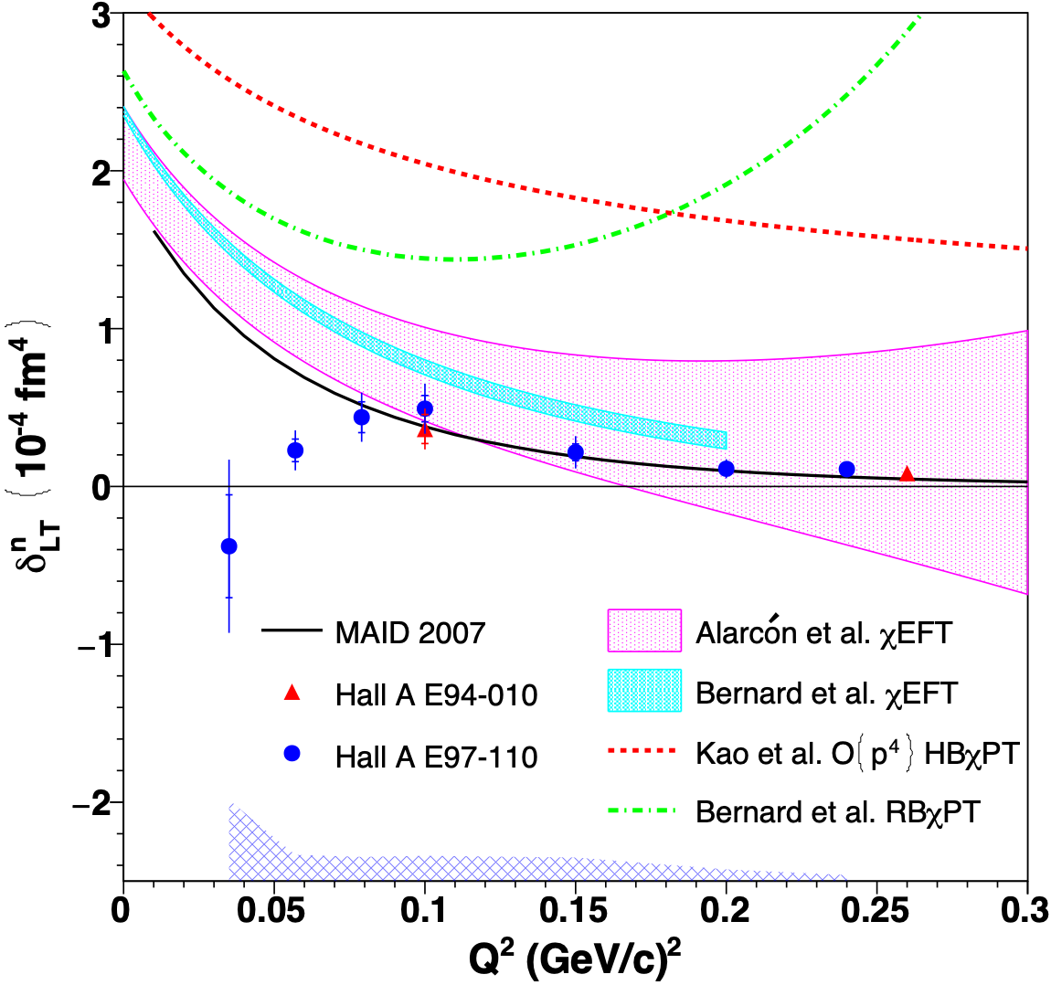
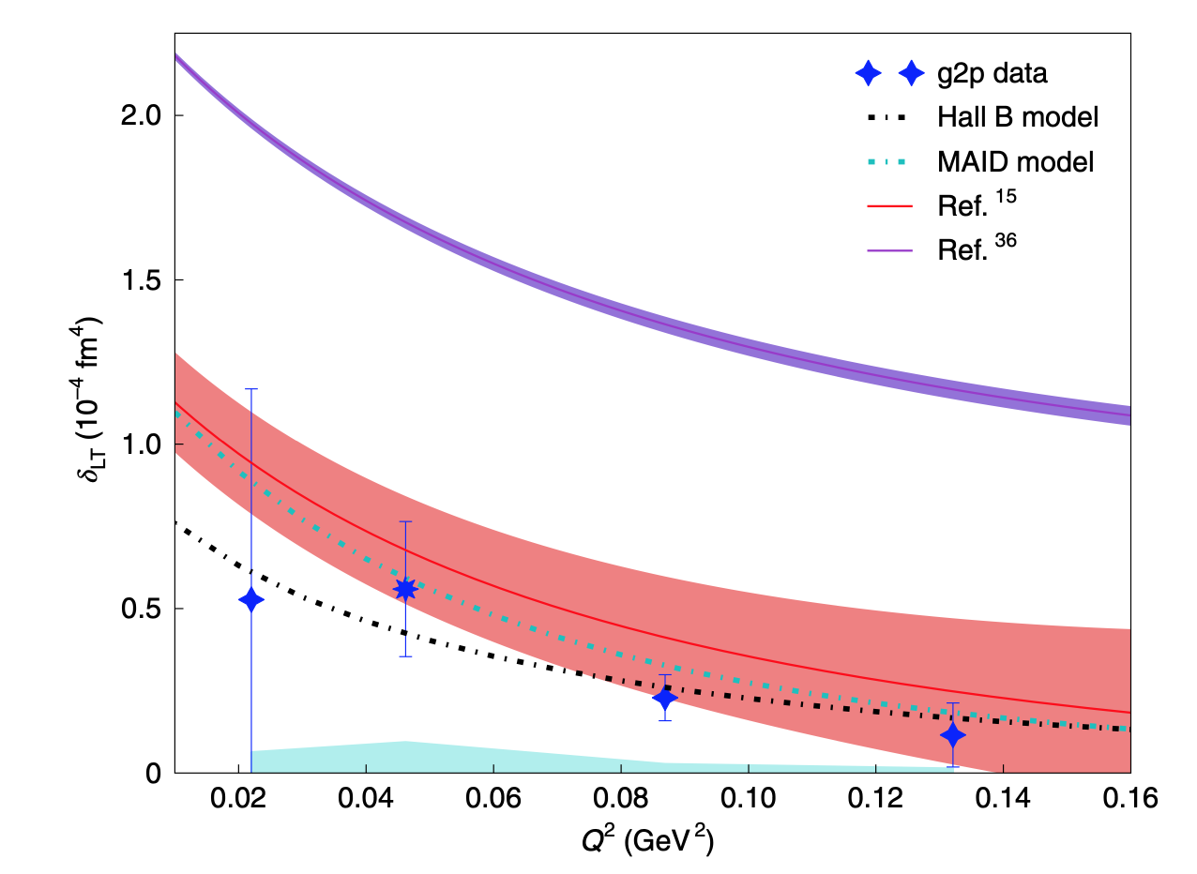
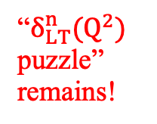
low-Q γ_{0 ,} δ_{LT} (spin polarizabilities) or proton and neutron
proton
neutron
γ₀
Nature Physics 17, 736
(2021)
Nature Physics 17 687 (2021)
Nature Physics 18, 1441 (2022)
δ_{LT}
“$δ_{LT}^{n}(Q^{2})$ puzzle” remains!
Comparisons with χEFT calculations: favor Alarcon et al., strong disagreement with Bernard et al.

Slide 22
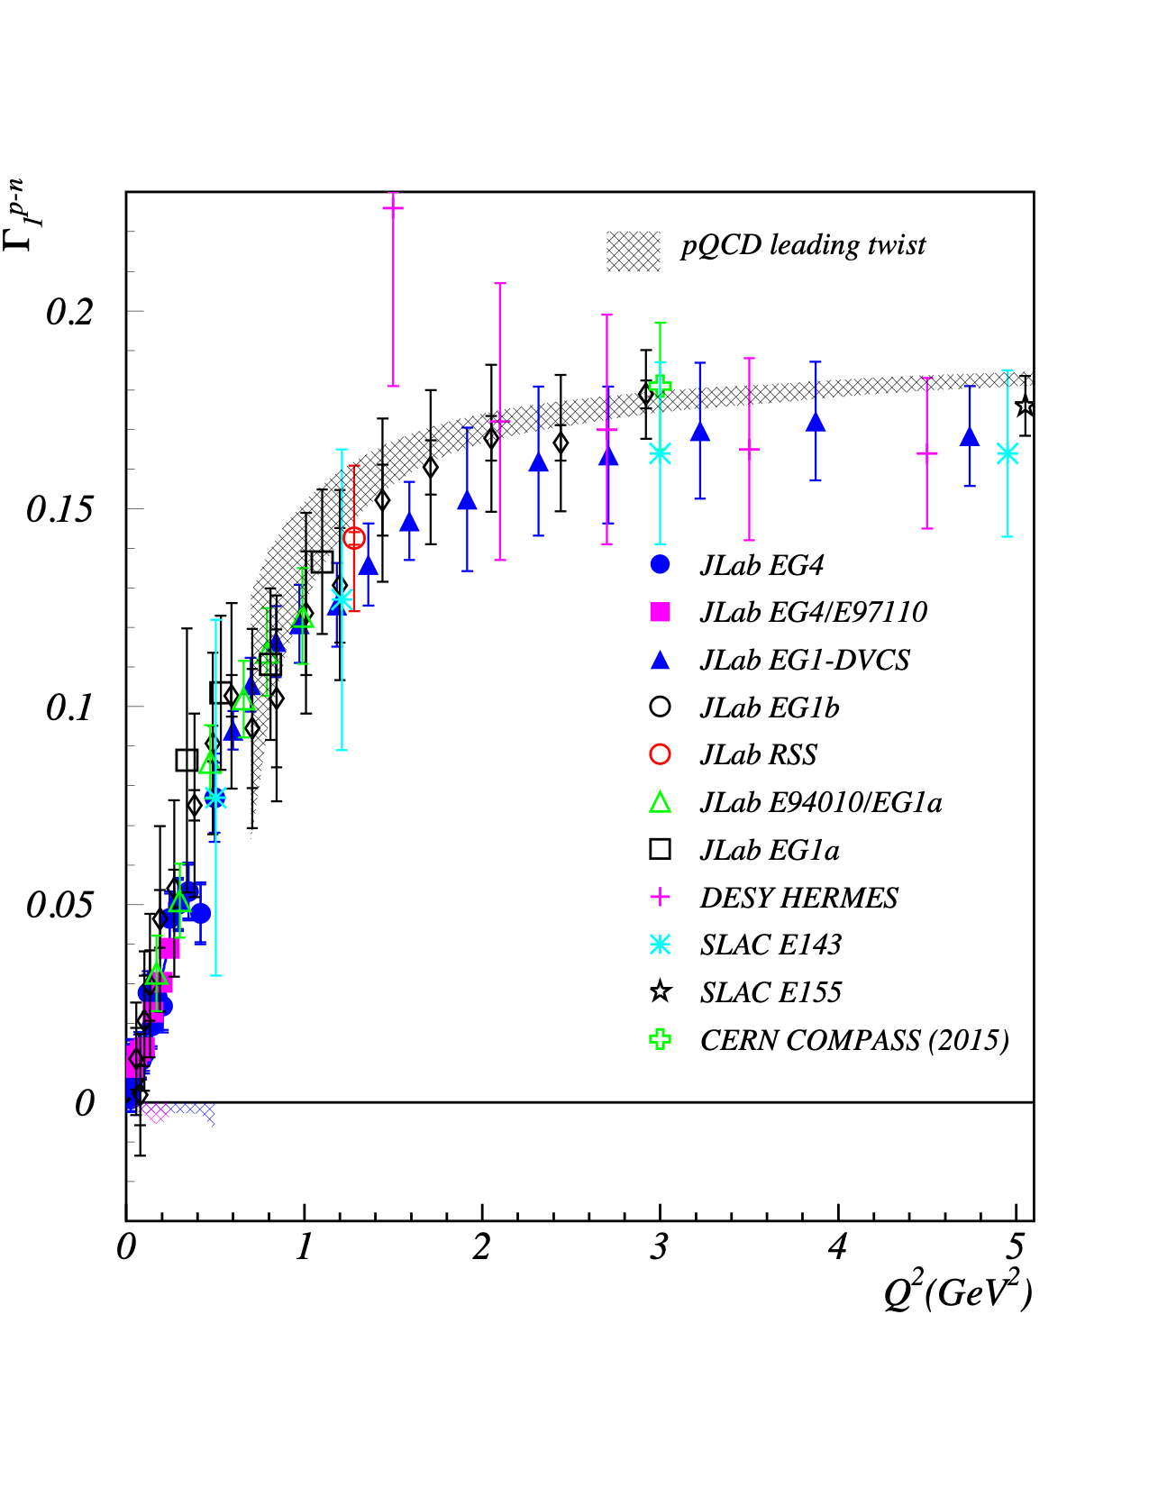
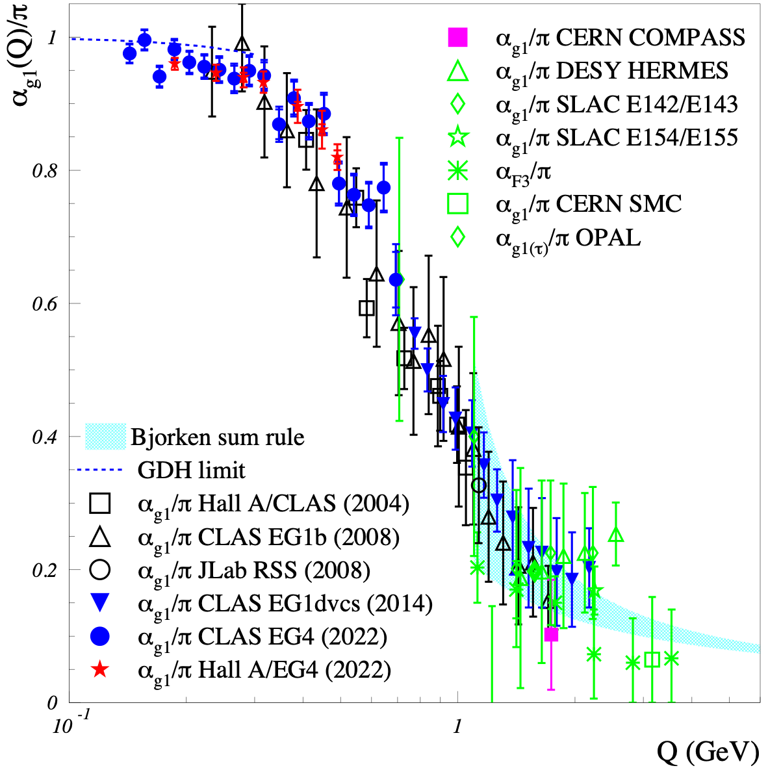
α_{g1} Extracted from the Bjorken Sum data
Bjorken sumΓ₁^{p-n} measurements
Effective coupling α_{g1}
1
α_{g1}
Γ₁^{p-n}≙ g_{A}(1- )
6
π
A. Deur, et al.
Physics Letter B
825 (2022) 136878
A. Deur, V. Burkert, J. P. Chen and W. Korsch
Particles, 5-171 (2022)

Slide 23
Summary and Outlook
Highlights of Spin structure study @ JLab12:
Preliminary results on A1n @ high-x in Hall C: valence behavior
Data taking complete for A₁(p/D)@CLAS12
Preliminary results on d2n in Hall C: twist-3, q-g correlations, LQCD
Generalized Spin Sum Rules/Polarizabilities
→ clean means to study QCD over full range of Q2
Exciting results from 3 JLab low-Q spin experiments
Γ₁, Γ₂, γ₀, δ_{LT} for proton and neutron
results in 3 nature physics, 1 PRL, 1 PLB, + more
combined results (Bjorken sum) in 1 PLB, α_{g1} extraction in 1 Particle
Extensive tests of χEFT calculations
Lattice QCD predictions becoming available
Future: real photon GDH@Hall D, d2n@SoLID, …
g2p2 (spin moments/d2p) proposal in Hall C
Bjorken sum and α_{s} extraction @ JLab22 …
3-D spin structure (TMDs, GPDs) (not covered in this talk)

Slide 24
Backup Slides

Slide 25
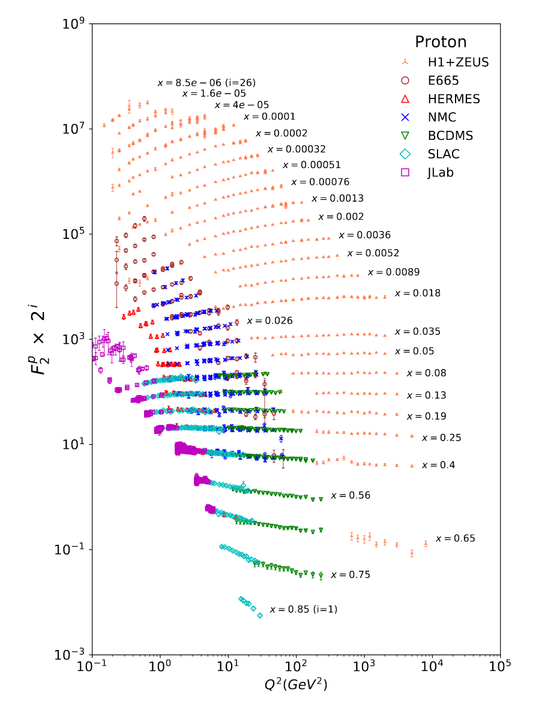
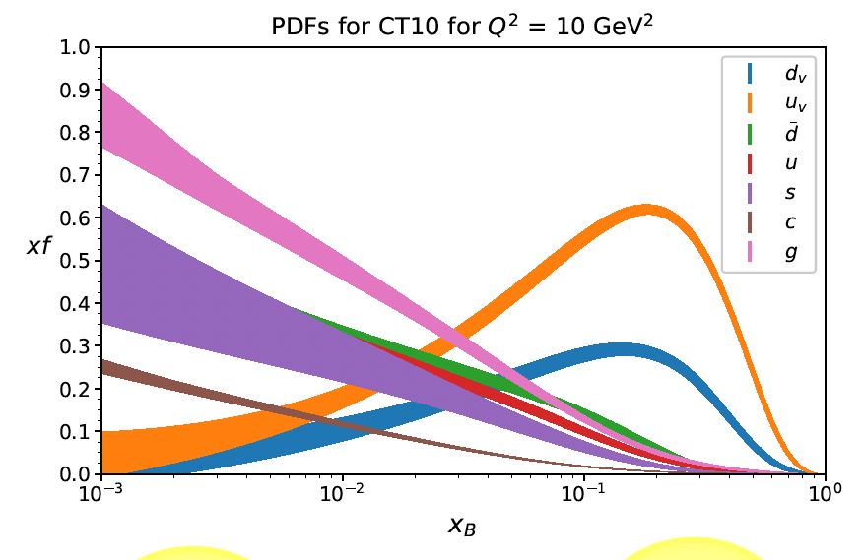
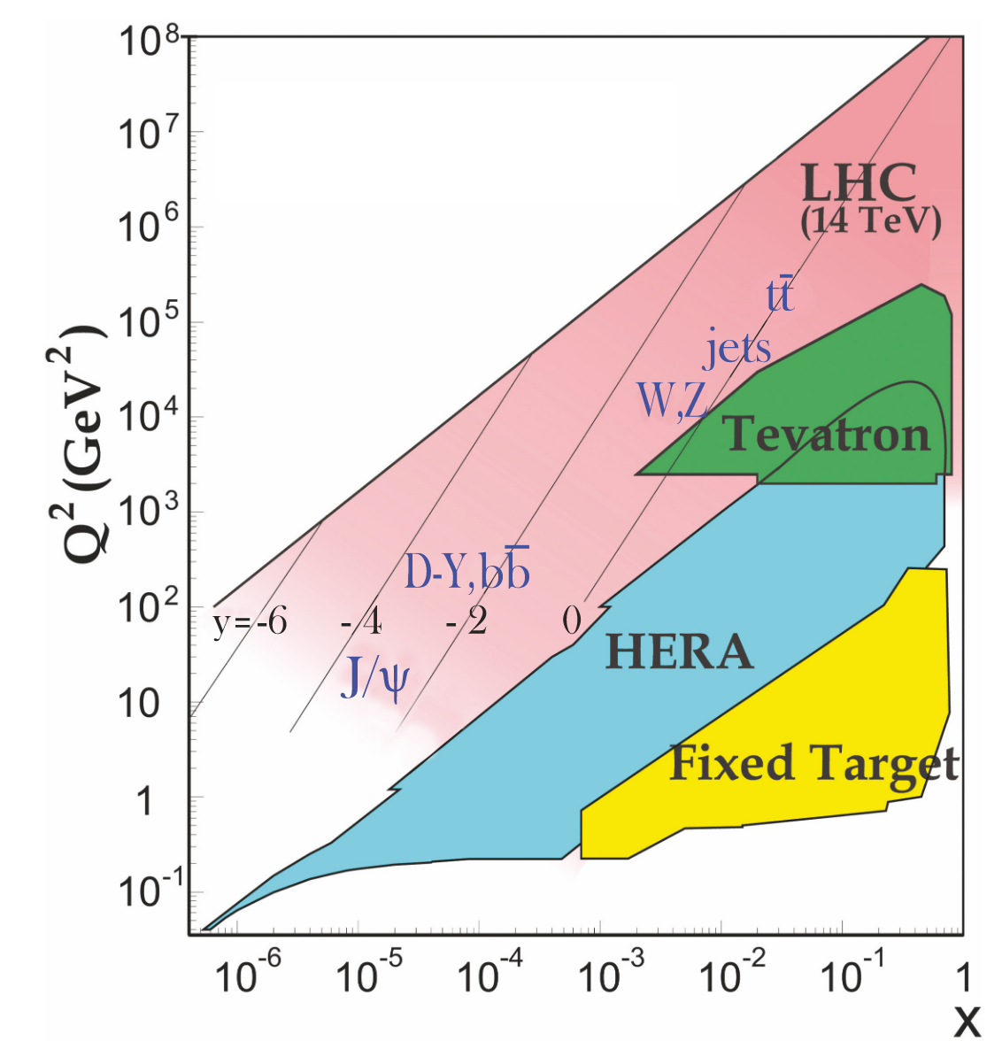
UnPOLARIZED Structure Functions
Q² evolution: one of the best tests of QCD
Notes:
Change – just show A1p and A1d results (incl eg1dvcs), and JAM fits

Slide 26
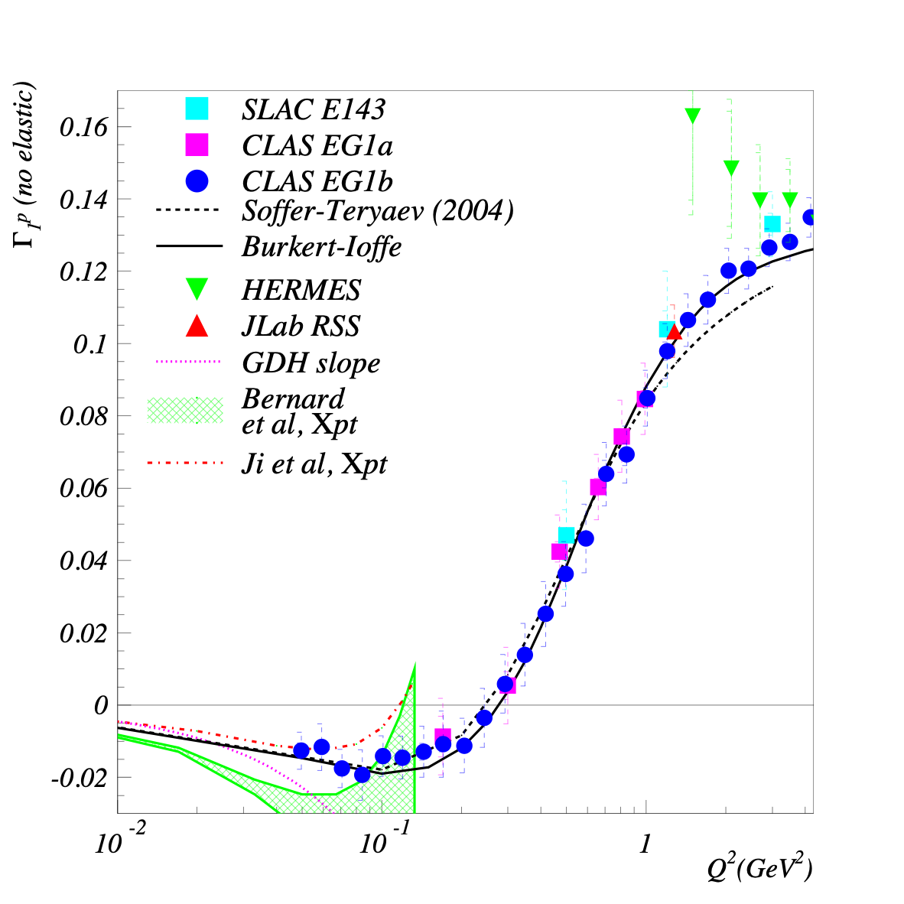
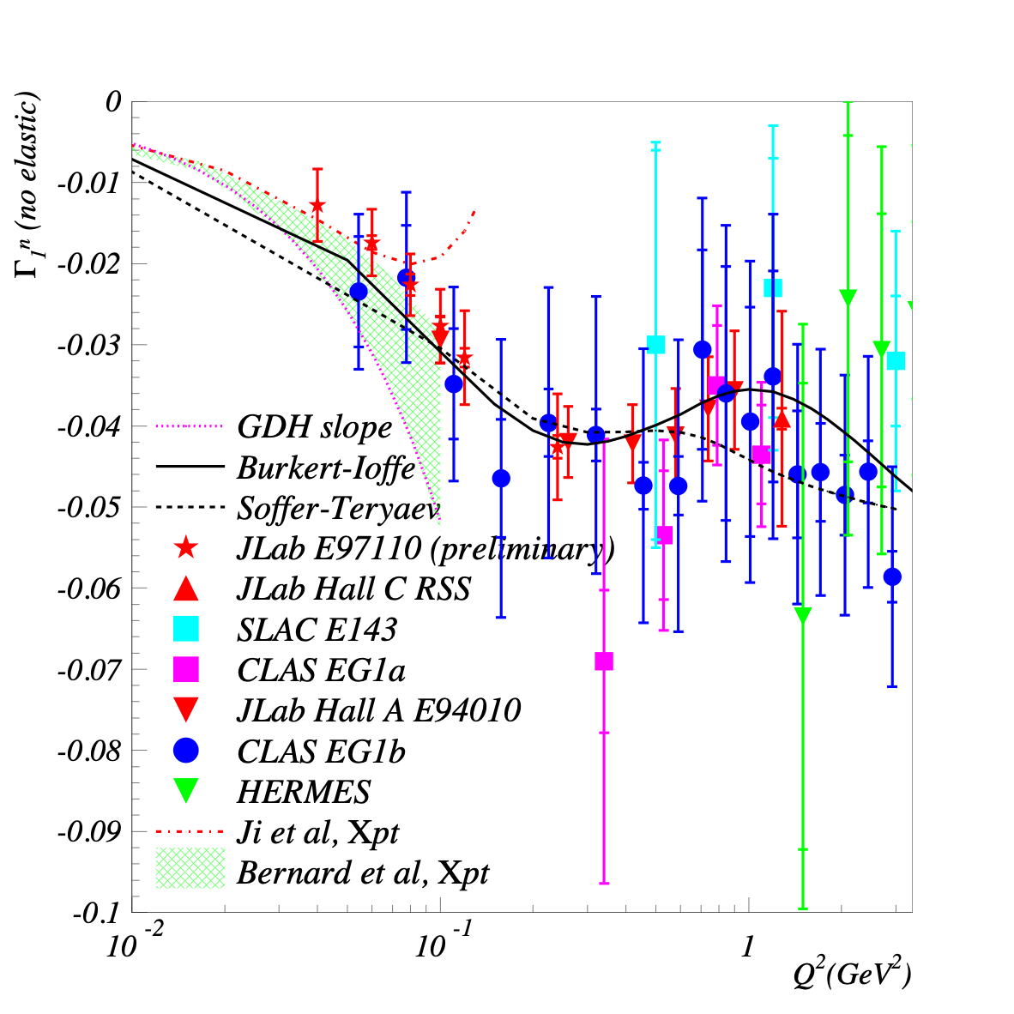
Previous world Γ₁ data before low-Q experiments
Proton
Neutron
Precise mapping of spin structure function moments in intermediate Q² region
PQCD, models and data agree.
How about χEFT predictions? Not clear.

Slide 27
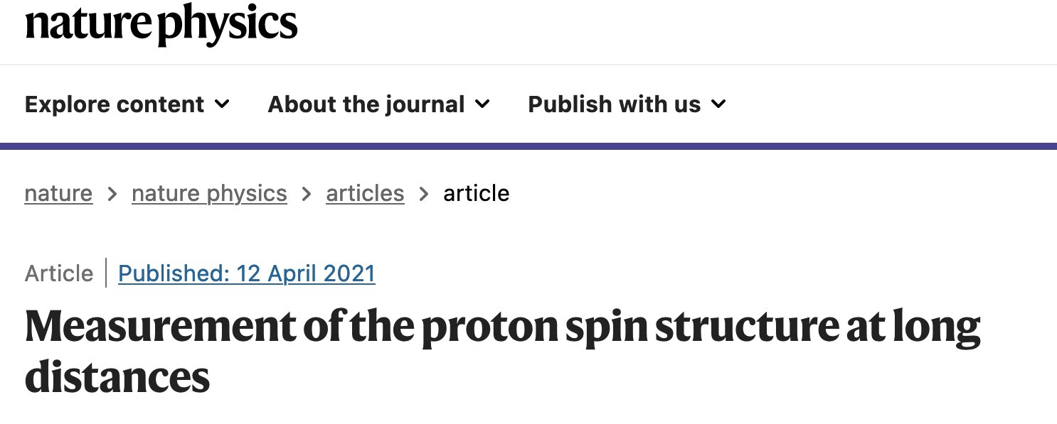
EG4: new low-Q data on Γ₁ for proton
X. Zheng et al., Nature Physics, 17, 736-741 (2021)
Slight tension between EG4 and EG1 above Q² ~0.1 GeV².
EG4 and χEFT agree up to Q² ~0.04 GeV² (Bernard et al) or Q² >0.2 GeV² (Alarcón et al.)
Phenomenological models (Pasechnik et al, Burkert-Ioffe) agree well.

Slide 28
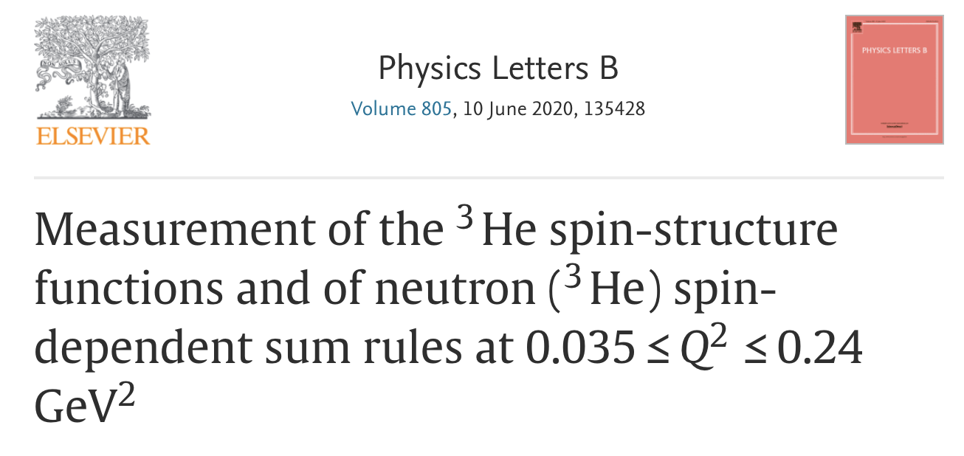
SAGDH: new low-Q data on Γ₁ for neutron
V. Sulkosky et al.,
Physics Letter B
805, 135428 (2020)
E97-110 agree with existing data at larger Q² (EG1b, E94-010).
E97-110 and χEFT agree up to Q² ~0.06 GeV² (Bernard et al) or Q² >0.08 GeV² (Lensky et al.)
Some phenomenological models (Burkert-Ioffe) agree well with data, other (MAID, Pasechnik et al) not as much.

Slide 29

SAGDH: new Γ₂ data for neutron: Burkhardt–Cottingham sum rule
$$Γ_{2}(Q^{2})≡∫_{0}^{1}g_{2}dx=0$$
V. Sulkosky et al.,
Physics Letter B
805, 135428 (2020)
E97-110 verifies the B-C sum rule at low Q². Older experiments at higher Q² also verify it.

Slide 30
g2p: new Γ₂ data on proton: BC Sum Rule
To be published

Slide 31
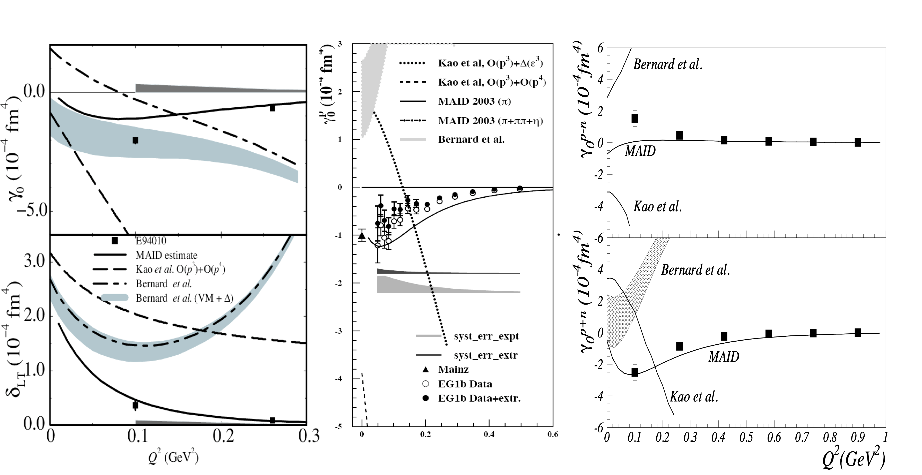
Previous JLab spin polarizabilities data before low-Q experiments
neutron
JLab E94-010
proton
JLab EG1b
Strong disagreement with χEFT predictions available at that time: “δ_{LT} puzzle”

Slide 32

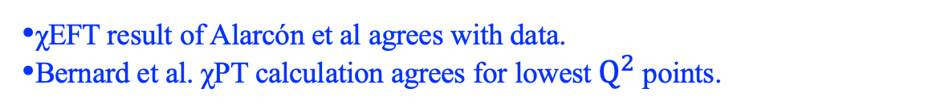
EG4 results on $γ_{0}^{p}(Q^{2})$
X. Zheng et al., Nature Physics, 17, 736 (2021)
EG4
EG1b
MAMI
χEFT result of Alarcón et al agrees with data.
Bernard et al. χPT calculation agrees for lowest $Q^{2}$ points.

Slide 33
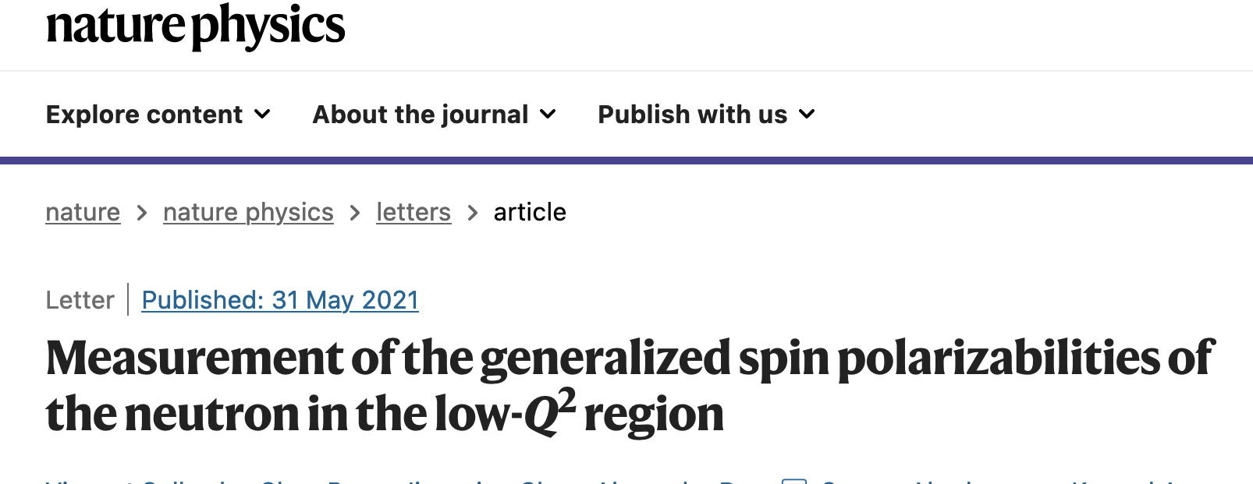
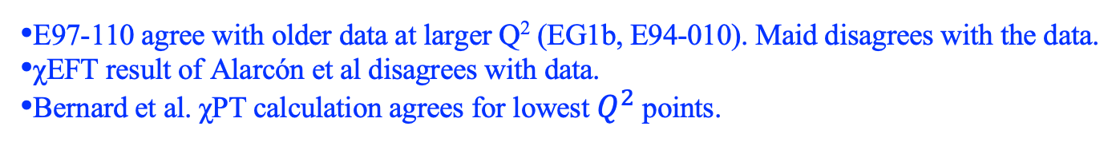
Generalized forward spin polarizability $γ_{0}^{n}$ from SAGDH
V. Sulkosky et al., Nature Physics, 17, 687 (2021)
E97-110 agree with older data at larger Q² (EG1b, E94-010). Maid disagrees with the data.
χEFT result of Alarcón et al disagrees with data.
Bernard et al. χPT calculation agrees for lowest $Q^{2}$ points.

Slide 34
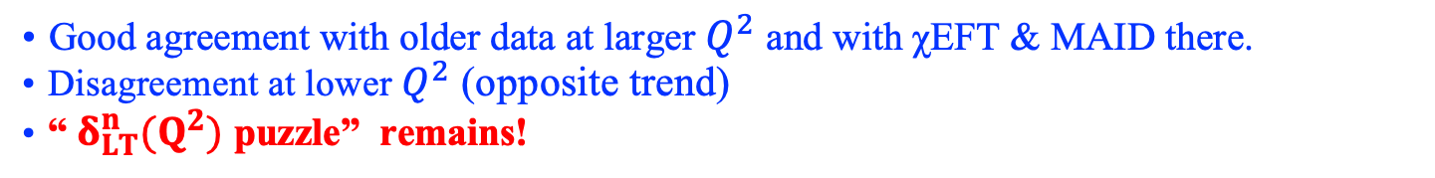
Generalized Interference Spin Polarizability $δ_{LT}$ from SAGDH
V. Sulkosky et al., Nature Physics, 17, 687 (2021)
Good agreement with older data at larger $Q^{2}$ and with χEFT & MAID there.
Disagreement at lower $Q^{2}$ (opposite trend)
“$δ_{LT}^{n}(Q^{2})$ puzzle” remains!

Slide 35
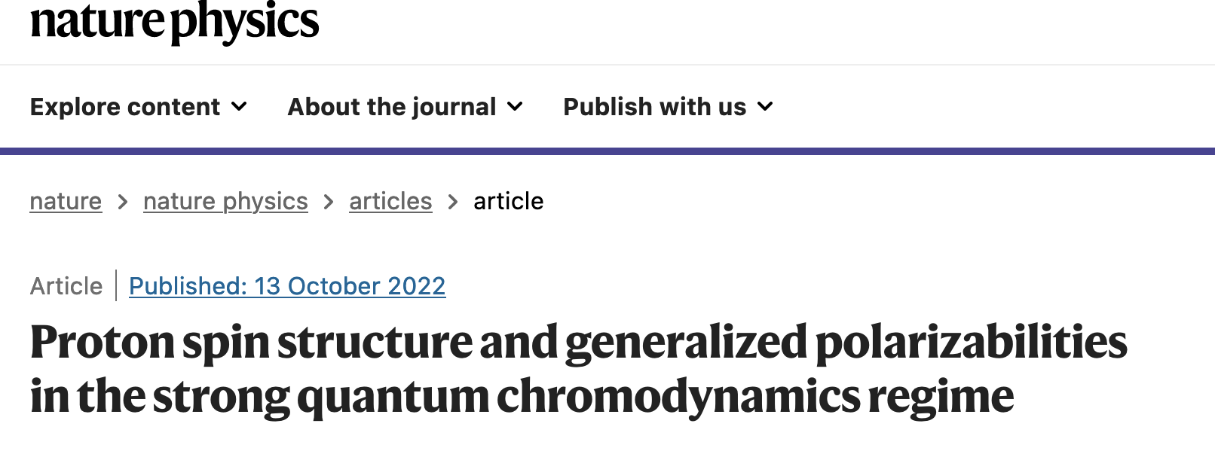
δ_{LT} for Proton from g2p
D. Ruth et al, Nature Physics 18, 1441 (2022)
Bernard et. al
Alarcón, Hagelstein, Lensky & Pascalutsa
Comparisons with χEFT calculations: favor Alarcon et al.,
strong disagreement with Bernard et al.

Slide 36
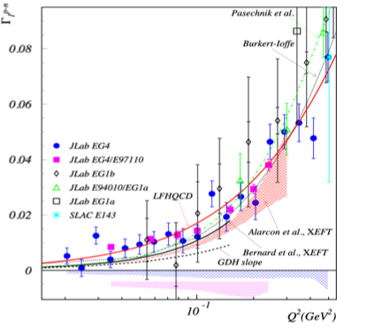
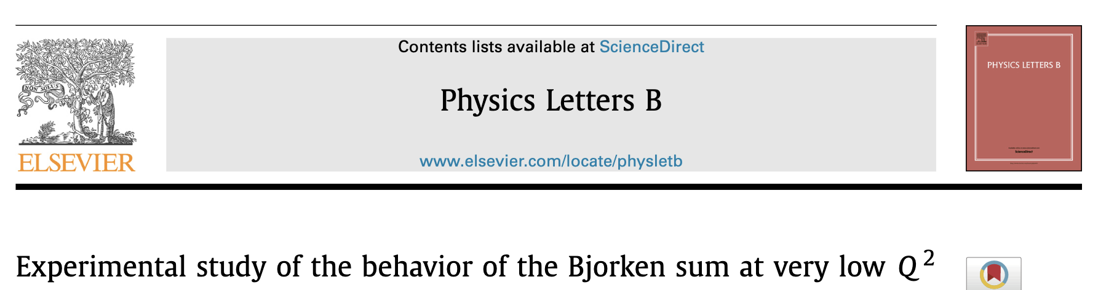
Bjorken Sum: Γ₁ of p-n (EG4 and SAGDH)
A. Deur, et al.
Physics Letter B
825 (2022) 136878

Slide 37
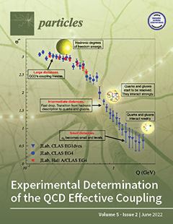
Effective Coupling and Impact
Featured as Cover
Featured in JLab News
https://phys.org/news/2022-08-strength-strong.html
Featured in YouTube
https://www.youtube.com/watch?v=8BTZOz850GI&t=497s
Base for understanding of emergence of hadron properties
Impact on:
hadron spectroscopy
PDFs and GPDs
quark mass functions
pion decay constant
scale of QCD, Λs
QCD Phase/Hot QCD
…
A. Deur, V. Burkert, J. P. Chen and W. Korsch
Particles, 5-171 (2022)

