Slide 1
Public Events Committee
Meeting on 5 December 2023

Slide 2
Agenda
New Public Events Curator (Deadline for applications: 8 Jan)
Membership and ToR of the committee
Update on current season (2023/24) and look ahead to CERN70 season and 2024/25 season
Proposals for evaluation, for 2024/25

Slide 3
Members of the Public Events Committee
Claudia Marcelloni (IR-ECO)*
Ana Godinho (IR-ECO)
Frederick Bordry (former Director for ATS)
Manuella Cirilli (IPT-KT)
Melania Coletta (HR-D&I)
Tim Smith (IT-CEO)
Pascale Goy (C&SF)
Loraine Massarotti (SG-VI)
François Briard (SG-VI)
Matthew Chalmers (IR-ECO) (proposed)
* Convener of the Committee
Committee has been asked to:
Include an active research physicist
  This role was carried out by Rolf Landua, then James Gillies
Formalise the process of membership
  Have nominations approved by IR Director?
This is an opportunity for us to:
Discuss the ideal composition of the committee
  Is anyone missing?
Finalise the ToR
  Initial draft here
1. Purpose
The purpose of the Public Events Committee is to ensure the diversity of the public events programme in terms of format, content, gender and language of the presenter, target audience, etc. Using their professional network, members are invited to suggest content for the chosen themes.
2. Responsibility
The committee is responsible for reviewing proposals received from internal and external sources once feasibility has been established by the Public Events team.

Slide 4
Public Events Programming Strategy
At CERN – in Globe or SGW
Thematic Events
Events for the general public (e.g. talks, performances, Sparks!...)
Goal is to have a season of events running from Sept to June
Off-Theme Events
Public Events Committee

Slide 5
Overview of current and next seasons
2023/24 (ongoing)
2024 – CERN70
2024/25 (work in progress)
  Nov 2023 - Jan 2024 (exceptionally)
  13 Oct – Partage ta science
  30 Oct – L’aventure de la première grande découverte au CERN
  3 Nov - Dark Matter Day
  9 Nov - CineGlobe
  16 Nov – Sparks! - Future Quantum
  27 Nov - The New Frontier of Interstellar Objects
  8 Dec – Music and physics: a space-time voyage back to our origins
  12 Jan – The Infinite Monkey Cage
  Jan 2024 - Jul 2024
  30 Jan – CERN’s 70 years of scientific discoveries, as part of 1st Arts & Science Summit
  7 Mar - Innovations Driving Breakthroughs in Particle Physics and Beyond - Medtech
  18 Apr – Innovations Driving Breakthroughs in Particle Physics and Beyond – other tech
  15-19 May - Inclusive Science, inclusive Society: The Transformative Potential of Global Collaboration @CineGlobe
  9 Jun - Mapping Particle Physics’ Open Questions and Research Directions (Strings conf)
  18 Jul – Tackling Particle Physics’ Grand Challenges with Advanced Accelerators (Future facilities)
  24 Apr - Progrès de l’étude de faisabilité du FCC
  Oct 2024 - June 2025
  Oct – Partage ta Science and Dark Matter Day (recurrent)
  Jan - Arts & Science Summit (recurrent)
  May – CineGlobe (recurrent)
  Q1 2025 – Sparks! – Future Quantum (recurrent)
  plus others - from those discussed today

Slide 6
Proposals received for events in 2024/25

Slide 7
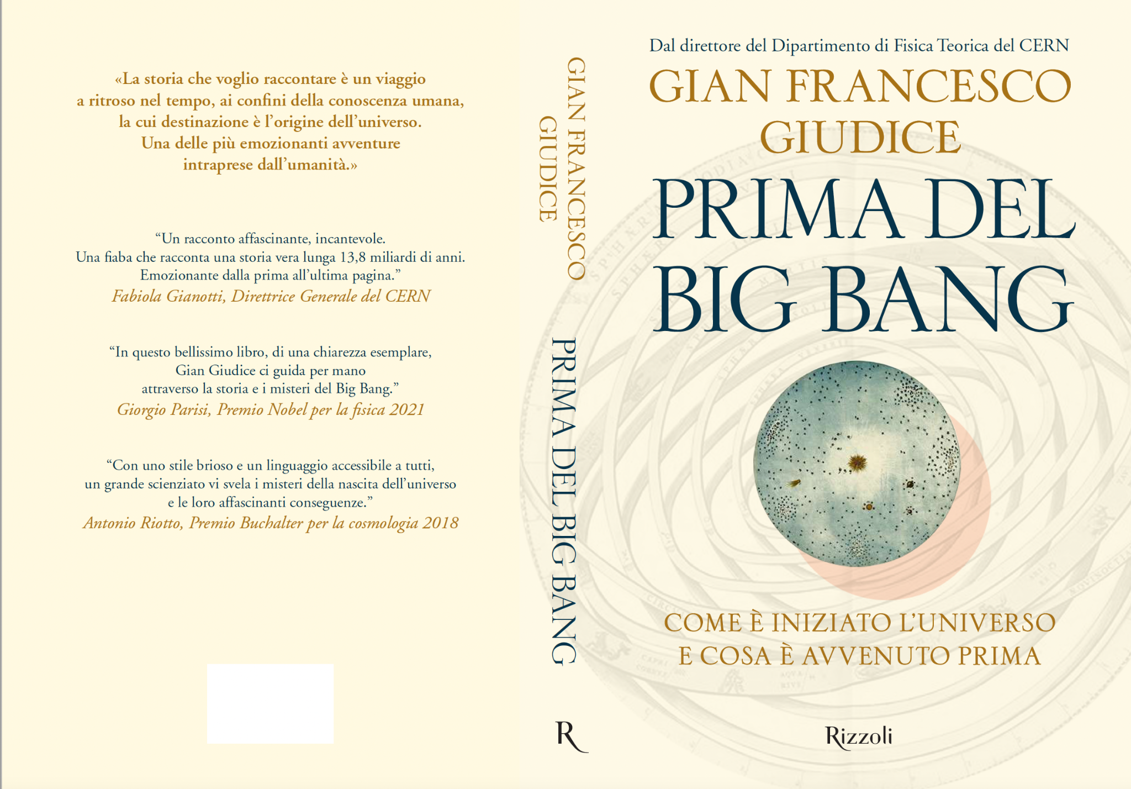
The Mysteries of the Universe (approved)
Gian Giudice et al
Theme: The Big Bang
Proposed by: Gian Giudice
Format: Talk
Duration: 75 min
Audience: General public / Language: IT / Gender: M
Description:
“The mysteries of the Universe”, with three talks (15-20 min each): Chiara Caprini - gravitational waves
Alba Grassi - the mathematical universe
Gian Guidice – the Big Bang,
followed by a discussion based on questions from the public, with a moderator
Cost: none
Date: 19 June (proposed), in the Globe
Status: Confirm date

Slide 8
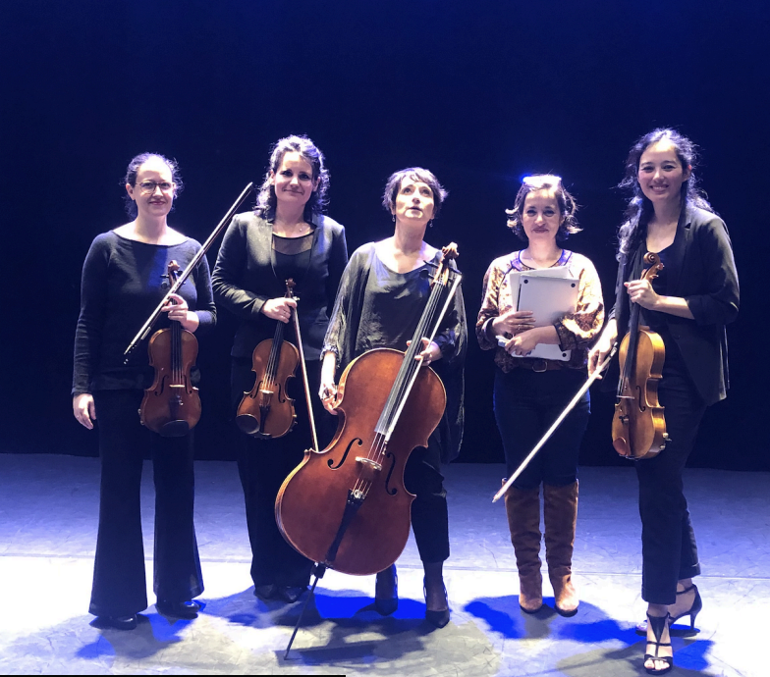
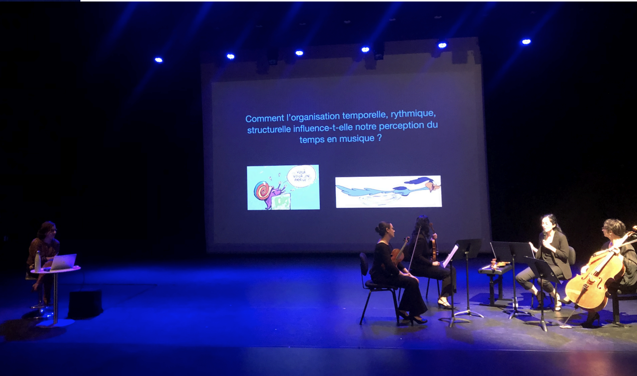
Temps en temps (approved)
Theme: Time (in physics and in music)
Proposed by: Yasmine Sara Amhis (LHCb)
Format: Talk + performance
Duration: 60 min
Audience: General public / Gender: F / Language: FR
Description:
Une création artistique et scientifique qui explore le rapport au temps ainsi la perception du temps en physique et en musique. Le temps étant un élément central de ces deux disciplines, en plus d’explications présentées par l’altiste du quatuor, un support musical est employé par le quatuor pour illustrer des concepts comme le rubato, le rythme, le musique répétitive etc. En ce qui concerne la physique, on évoque la notion de temps absolu, de temps relatif et ce en passant par des exemples de la physique fondamentale comme la mécanique classique et la relativité restreinte. Ici ce sont des transparents projetés qui servent de support en plus des explications.
Full description here.
Costs: 4 KEUR
Dates: Feb 2025?
Status: Need to assign and confirm a date

Slide 9
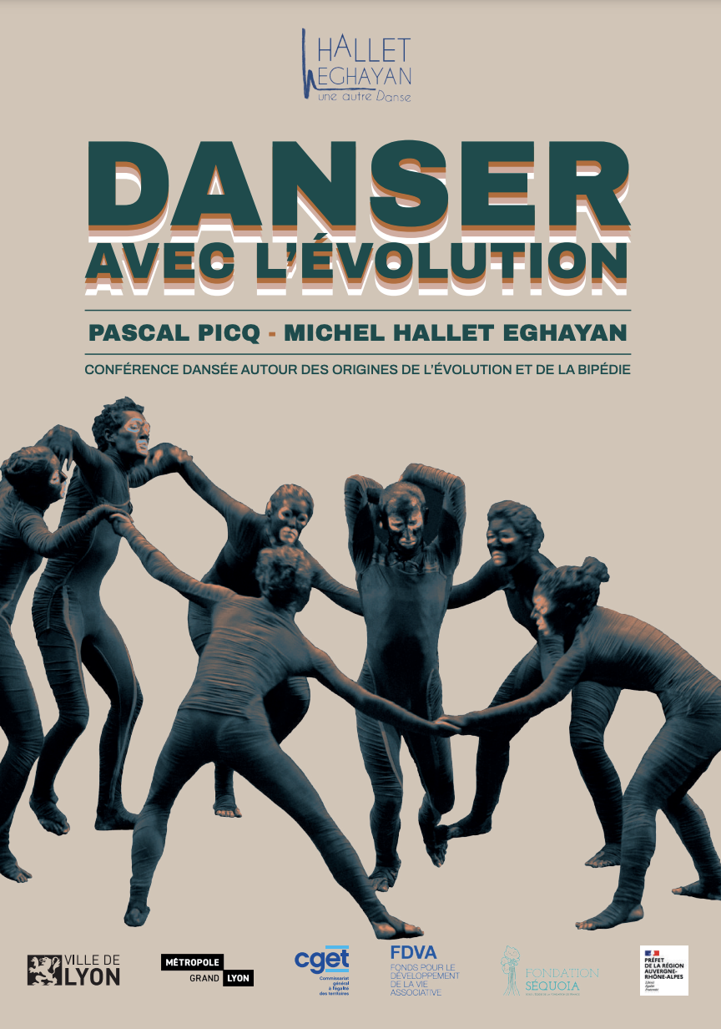
Dance avec l’evolution
Hallet Eghayan and Pascal Picq
Theme: Evolution of bipedalism
Comms Hook: possible link to the temporary joint exhibition with the Museum of Natural History. of Geneva (Oct-Dec24/early 2025)
Proposed by: Self
Format: Dance and talk, can be on stage or around the space
Duration: 60 min
Audience: General public / Gender: all / Language: FR
Description: CONFÉRENCE DANSÉE AUTOUR DES ORIGINES DE L’ÉVOLUTION ET DE LA BIPÉDIE with anthropologist PASCAL PICQ and choreographer MICHEL HALLET EGHAYAN.
Full description here.
Costs: 7 KEUR (1 performance); 10KEUR (2 performances) + travel and accommodation
Date: around November 2024 / early 2025
Status: Work on joint exhibition starts in Jan 2025, so “evolution” as a topic will be known after then.

Slide 10
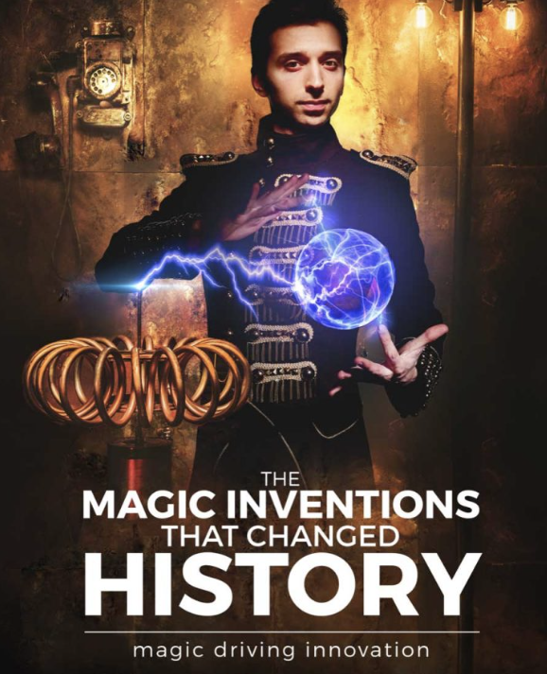
Magic and Science Academy (Cambridge) –
THE MAGIC INVENTIONS THAT CHANGED HISTORY
Theme: scientific discoveries
Proposed by: Francois Briard
Format: Magic show / Duration:
Audience: General public / Gender: M / Language: EN
Description: From mechanical tools to chemical reactions and from electrical devices to flying and disappearing objects! Embark on an enchanting journey exploring the spell binding inventions that changed history and transformed life, as if by magic! While the purpose of magistery was always to produce mystery and awe, some of the most history changing tools, devices and practices were invented by magical scientists that kept them secret to captivate their audiences! And as expectations and capabilities were evolving, they kept innovating, producing technologies that at the time seemed as if they were magical! https://www.magicacademy.co.uk/shows/
https://cernbox.cern.ch/s/1p6QYT3WuJqurAD
Costs: 3700 EUR/show (10 KEUR for pack of 3 shows)
Dates: June 2025?
Status: Decide go/no-go in light of cost. If go, find a date
Notes:
Anja has been in touch with them and would be interested in bringing this, along with TSP, etc
JG reminds us this used to happen from within CERN, going to local schools

Slide 11
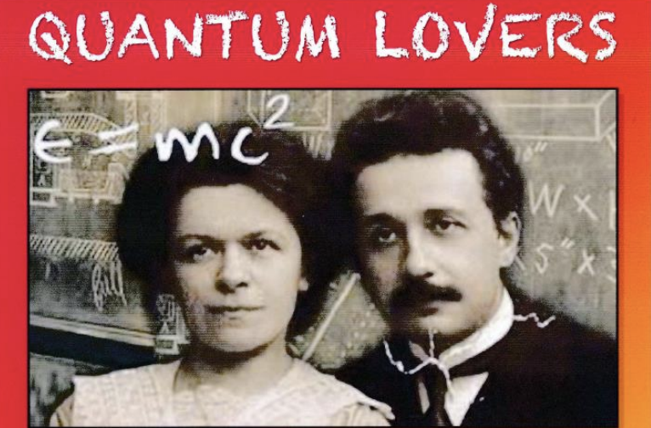
Quantum Lovers
Hasan Padamsee
Theme: Einstein’s life
Proposed by: James Gillies
Format: Musical
Duration: xx / Audience: General public / Gender: All / Language: EN
Description: in two acts by Hasan Padamsee (Cornell University), performed by GAOS (Geneva Amateur Operatic Society). Inspired by Einstein in Love by Dennis Overbye, NY Times Writer, Einstein in Berlin by Thomas Levenson. QUANTUM LOVERS is about the turbulent love affair and tragic break-up between Albert Einstein and his first wife, Mileva Maric, a bittersweet tale that took place in the tumultuous times of World War I
Costs: xx
Date: March 2025?
Committee recommendation: Committee approved JG going to talk to GAOS informally. James to talk to GAOS informally
Status: Waiting for GAOS proposal (that will include cost estimate)
Notes:
Committee approves James going to talk to GAOS informally

Slide 12
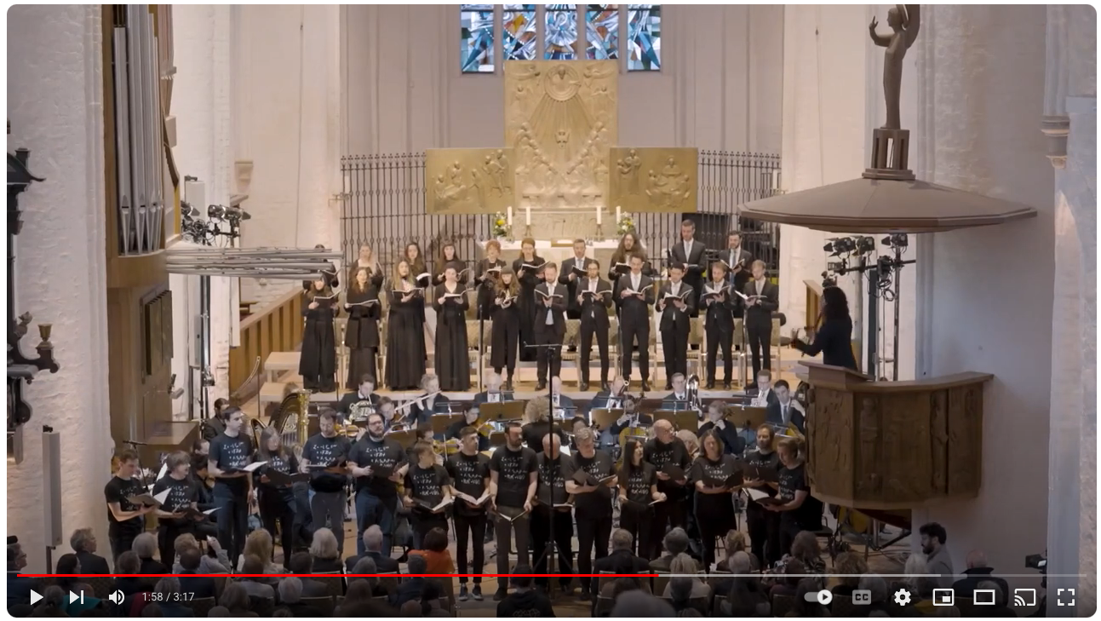
Creation (New)
Gloria Bruni
Theme: The Big Bang
Proposed by: Barbara Warmbein (supported by James Gillies)
Format: Opera
Duration: xx / Audience: General public / Gender: All / Language: DE?
Description: The work was inspired by conversations between the composer and scientists at DESY (German National Centre for Nuclear and Particle Physics).
“Fragments of Creation” is Gloria Bruni’s musical contribution to humanity’s search for answers to questions about the origin of the universe, life and humanity, and shares a concern for the future of our planet as a place worth living.
Costs: xx
Date: xx
Status: First presentation to the committee. Recommendation to pursue?
https://www.youtube.com/watch?v=C7PLZKE22Ww&t=5s

Slide 13
The universe in a grain of sand (New)
Mark Levinson
Theme: Understanding of nature; Art-science
Proposed by: Claudia
Format: Movie
Duration: 60min / Audience: General public / Gender: All / Language: EN
Description: A meditation on the way both scientists and artists make sense of the world, using their understanding of nature to develop new tools, techniques and processes to explore the deepest mysteries of the universe". The film will be released in 2024.
Costs: xx
Date: xx
Status: First presentation to the committee. Recommendation to pursue?

