Slide 1
PUR Jack Taskforce
Meeting #4 12/12/2023
P. Bestmann

Slide 2
Agenda
Minutes approval
  Any comments or remarks for the minutes of the Meeting No. 3?
Latest News
Mechanical simulations
Ageing tests and sample fabrication
Test jacks
Tracing & implementation

Slide 3
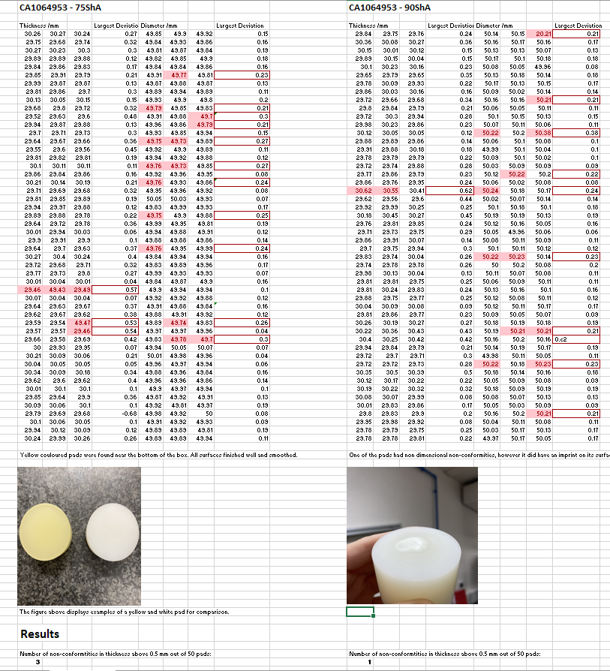
Latest news
Replacement delivery arrived
  Mechanical Dimensions are looking good
  Mechanical tests in line with the past
Already build in for the jacks for H6/H8
Assembly procedure produced by Sylvain
    https://edms.cern.ch/document/2975241/

Slide 4
Grease testing
  Possible candidate is MOLYCOTE PG-65 Plastislip
    It has excellent compatibility with plastics such as PET, HDPE, PTFE, nylon, and PBT and rubbers such as NBR, PIB, polyurethane, and neoprene. It has a low coefficient of friction and offers good lubricity at high operating speeds.
  Need to check radiation aspects
    R2M experts Dominika and Sonia contacted
    Lithium thickener might liquify at 1MGy
    Absence of PTFE is confirmed by Dupond
    Slot at nTOF under preparation for radiation tests (grease + pad)
    Is a gamma irradiation of loaded pad useful? With and w/o grease?
  Other candidates ?

Slide 5
Chemical testing
  Delivered batch showing again 2 different colors for the pads
  Compression and recovery tests are similar
  Punch testing showed other break behaviour
  Might indicate different reticulation rate
  Swelling tests on 75ShA pads are proposed
    CRHJPULP-CR000007 white translicide
    CRHJPULP-CR000008 slightly yellow

Slide 6
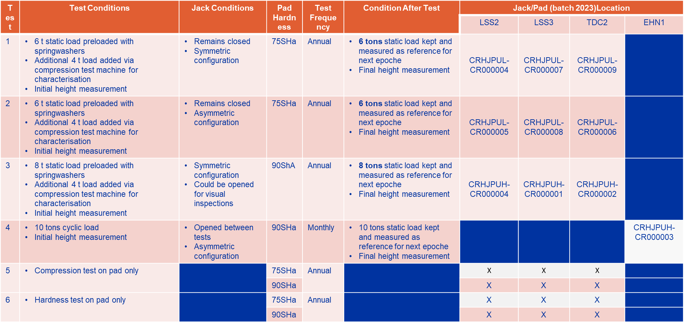
Jack test stands
  Test stands are ready for initial measurement
    https://edms.cern.ch/document/3001273/1

Slide 7
Jack tests
  Test procedure in the Lab to be setup and validated

Slide 8
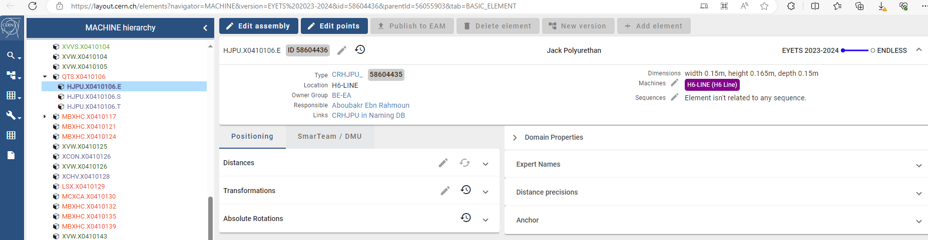
Tracing
  Tracing structure in place
    A bit time consuming to do this manually
    Asset CRHJPUL-CR000004 (cern.ch)
    Asset CRHJPULP-CR000008 (cern.ch)
    The files for upload utility are under preparation
      For attachment of the batch to the individual jacks
      For the creation of individual pad assets for tests
    Functional position created in H6/H8
      How do we proceed for the functional positions?
      Layout (cern.ch)

Slide 9
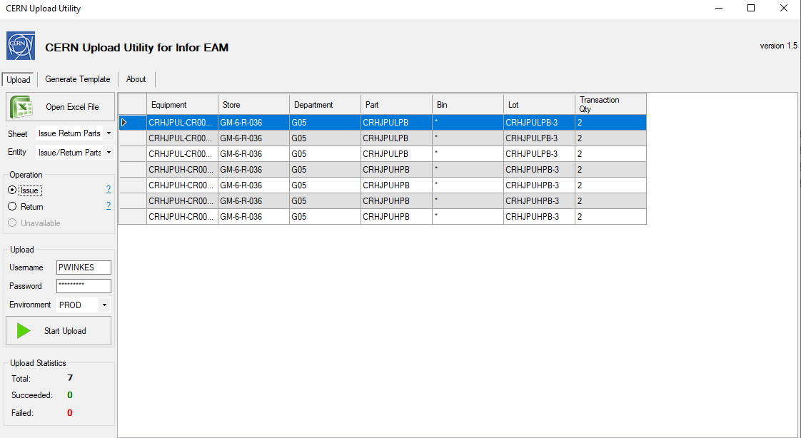
Tracing
  Batch upload via excel file and upload utility

Slide 10
Ongoing / upcoming Tests
  Molycote BBR2 compatibility test Roland ongoing
  Compression tests with DIC (on pads) Mickael upcoming
  Tensile tests (depending on samples) Mickael upcoming
  Swelling Tests (on pads) Benoit upcoming
  Compression Tests on Test Stands Michael preparation
  Radiation Test nTOF (pad+grease PG65/BBR2) Sonia planning
  Radiation Test on full jack gamma facility Sonia planning

Slide 12
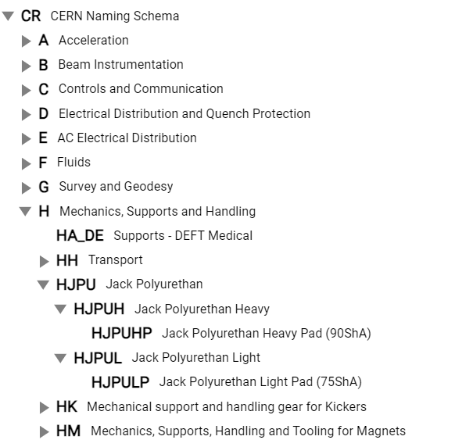
Naming convention
  Naming fully defined and active
    Using CERN general Scheme
    Test cell in layout?
  Drawing code active
  Preparing serial numbers and stickers
    First deployment in YETS23-24?
  Pads tracked by batch
    Test samples are tracked individually
    Custom fields to be defined

Slide 13
Tracing
BE-GM will take care of the sticker production
Responsible groups should take care of tracking:
  Pad batch inside each individual jack
  Refurbishment date
  Installation date and position
Can we start in this YETS with one line?
  H6-H8 with full ynew jacks could be transparent
  SPS Ring would demand ressources, but should be done as long as we can rely on the todays sitution

Slide 14
Sample Properties
Custom fields for all samples
  INFOR documentation
  Follow up of Samples
  Documentation of test results
  Full overview of history

Slide 15
Needs for Test samples
Mechanical tests
  Compression, Punch & Hardness On full pad 6 samples per batch
  Tensile tests Casted strip 2 or 4 mm thick (how many?)
  Artificial ageing by temperature On full pad 3 samples per temp step
  Chemical analysis On full pad 2 samples per batch
    Samples from other SPS use case and different conditions are needed
    Some extracted from SPS with partially known properties
  Chemical compatibility Casted or cutted strips

Slide 16
Test Matrix for new production
What are the reception tests do be developed?
  We keep the mechanical tests, dimensions, hardness, compression, recovery, punch
    What else?
  Chemical analysis to confirm PUR type
    Can we do more, what are the other paramètres to monitor?
    Can we quantify the soft and hard bonds? Or the relation between?

