Slide 1
Updates Compatibility Test of PU Pads
Jean-Sébastien RIGAUD, Roland Piccin on behalf of Polymer Lab (TE-MSC-SMT)
12/12/2023

Slide 2
Aging degradation currently in progress
Materials :
Robnor ResinLab EL217C - (85 Shore A)
SikaBiresin UR350 - (80 Shore A)
Synthene HPE Elastomer - (70 Shore A)
Aging :
7d / Molykote BR2 Plus / 60°C / 5% strain applied on the samples
7d / Molykote BR2 Plus / 60°C / no strain applied on the samples
Tests:
Tensile tests with Tinius Olsen and extensometer for rubber testing at 100mm/min
Shore A hardness tests
Visual inspection
The polyurethane (75 & 90 Shore A) of the batch of 2023 will be test after the ones mentioned above.

Slide 3
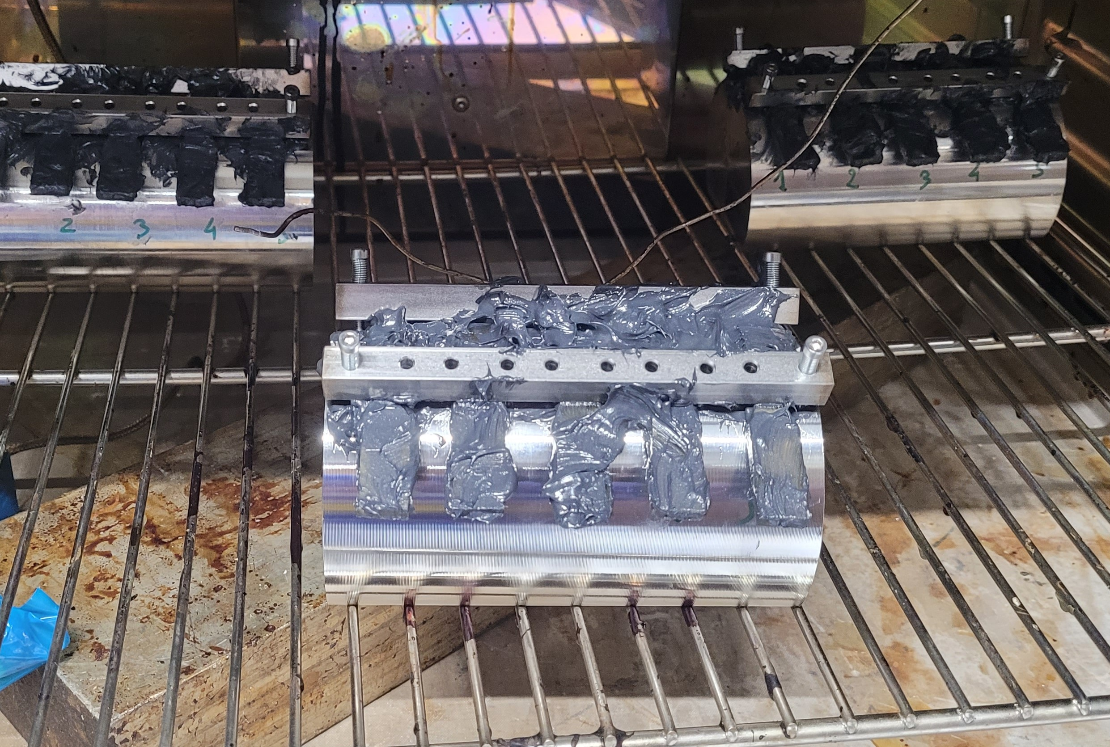
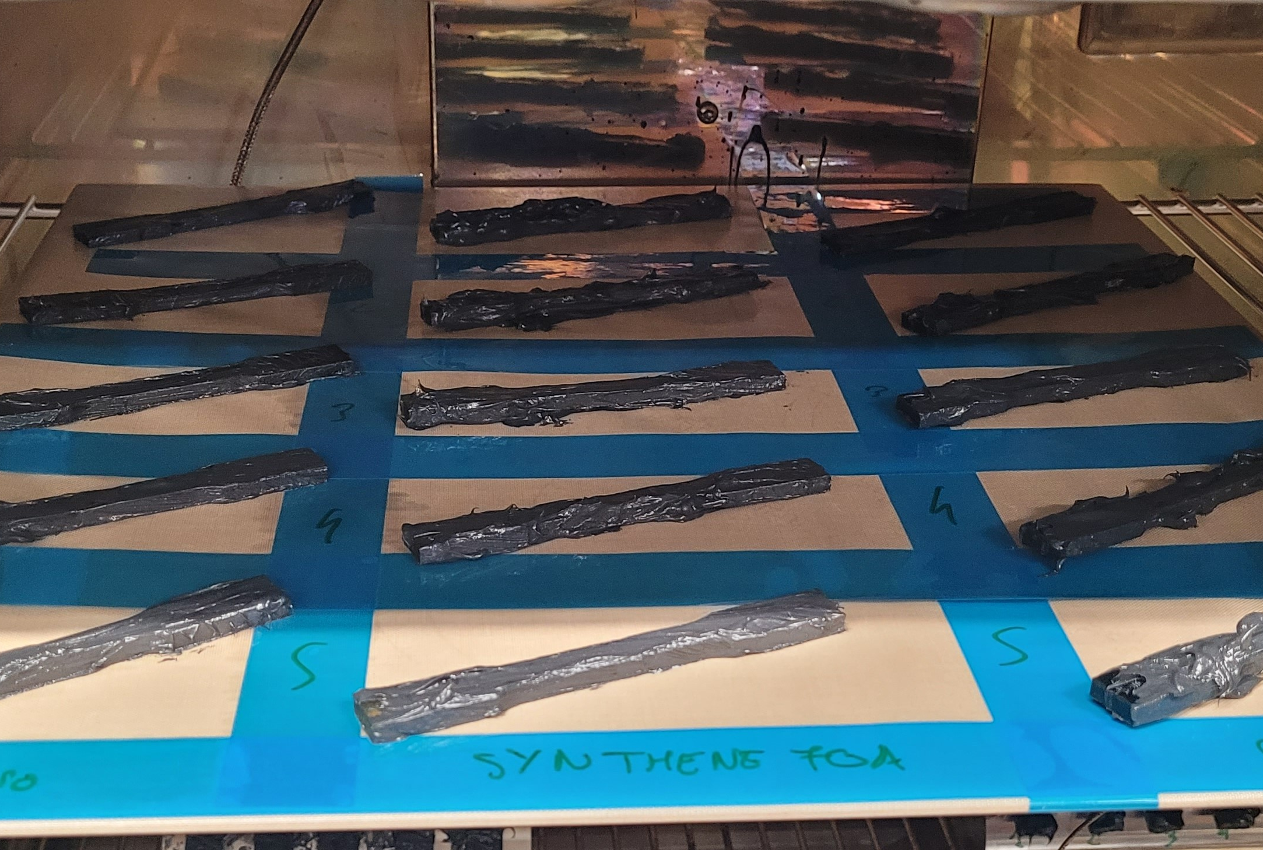
Photographs of the samples during aging
5% Strain
No Strain

Slide 4
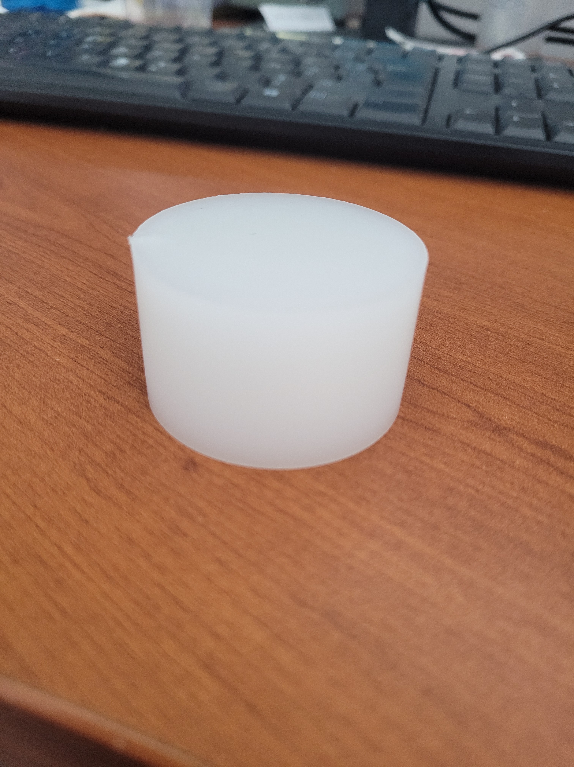
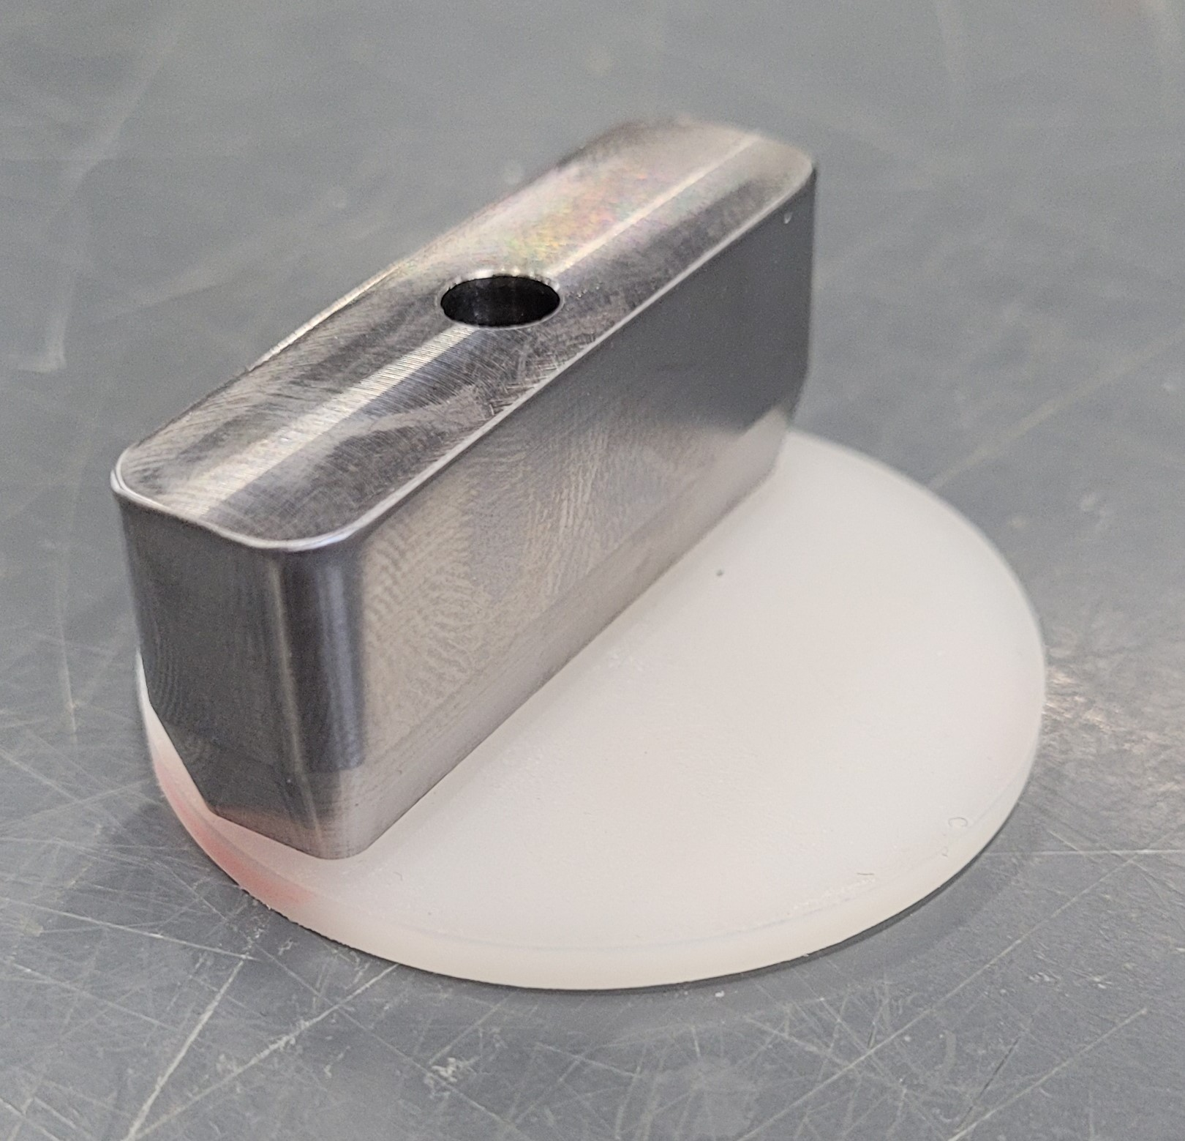
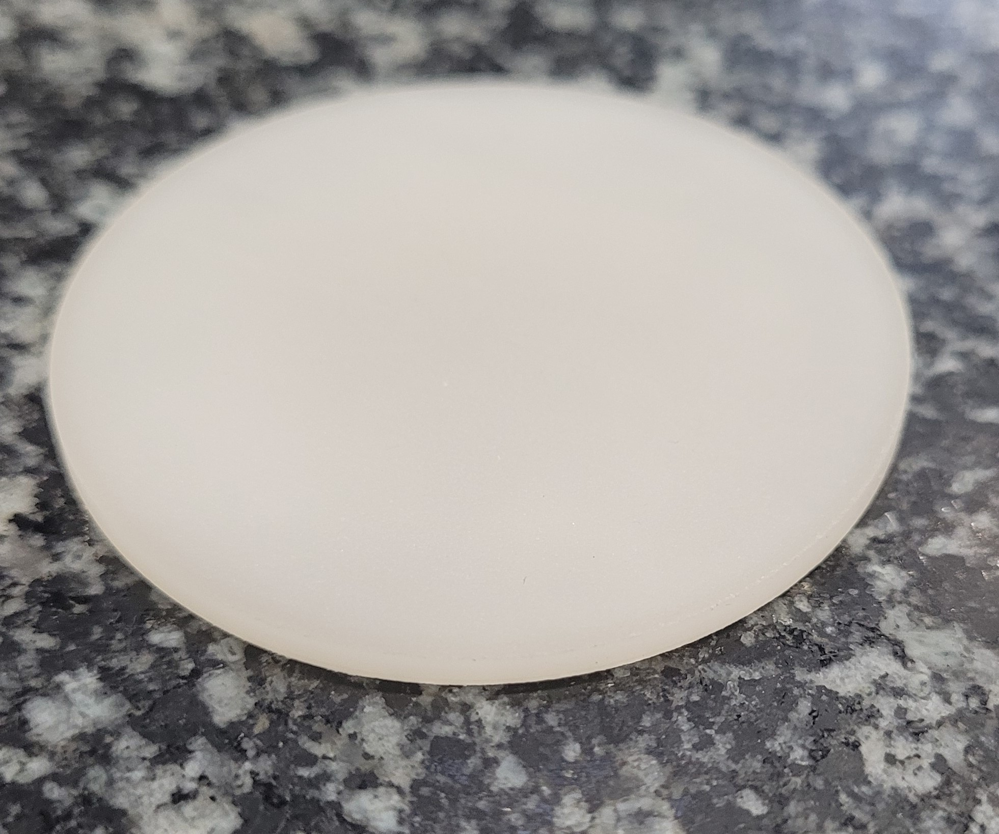
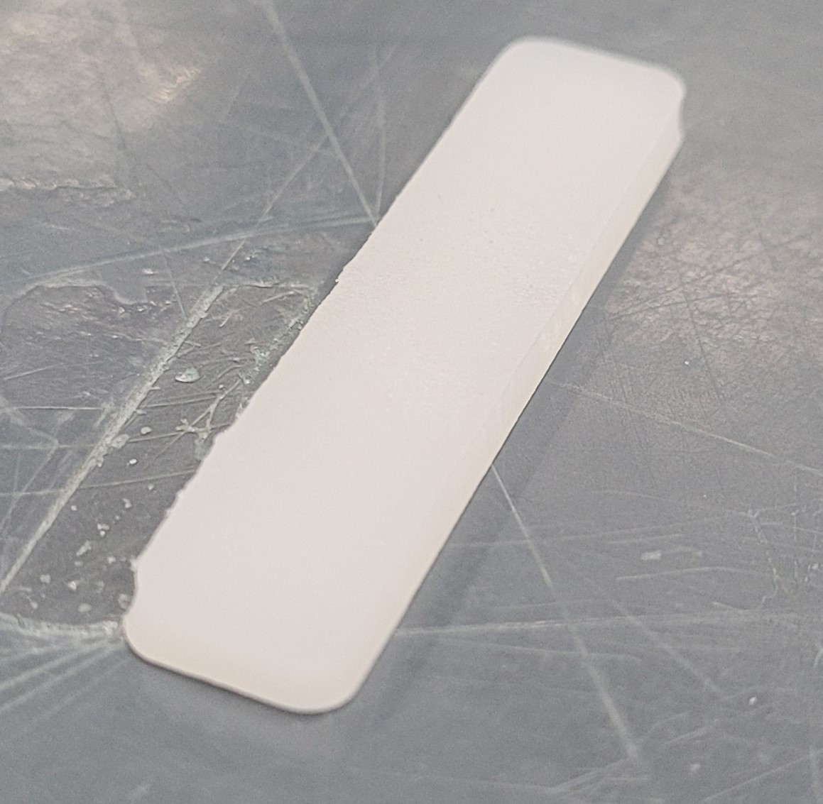
PUR Jacks cutting
Note: It is possible to obtain 4 slices of 3mm thick per jacks. In our case, we can obtain 8 test samples per jacks.
Saw cut to obtain a 3.5mm slice
Two samples of 45x10x3mm are obtained per slice.
With a custom-made shape cutter, the slice is cut using a press
Milling both sides to obtain a 3mm slice

