Slide 1






TRIESTE
1 - 4 OCTOBER 2024
www.bsbf2024.org
Paolo ACUNZO
Head of ENEA service
ILO Network Italia
IOC/LOC Coordinator
BSBF Trieste 2024 Director
paolo.acunzo@bsbf2024.org
Host Organisers of BSBF Trieste 2024

Slide 2











BSBF – Big Science Business Forum is a business oriented congress which congregates the main European Research Infrastructures, focused on technology and with the aim to be the main meeting point between Research Infrastructures and industry.
BSBF 2024 in Trieste will be the third edition of the event after the success of the previous edition in Copenhagen (2018) and Granada (2022), where thousands of participants from hundreds of organisations and dozens of countries gathered together to discuss the future prospects of the Big Science Market.

Slide 3
BSBF Trieste 2024 structure
Leader of the Italian candidature is the Autonomus Region of Friuli Venezia Giulia. In order to manage all BSBF activities, it has been established an ad hoc specialized structure, called BSBF Trieste 2024 and composed of representatives of:
Autonomus Region of Friuli Venezia Giulia
ILO Network Italia (CNR, ENEA, INAF, INFN)
Area Science Park, Trieste
PromoTurismo FVG
Moreover the BSBF Trieste 2024 candidature is activelly supported by many Italian Ministries (University & Research, Environment & Energy, Foreign Affairs & International Cooperation and Economic Development), the international government association Central European Initiative (CEI), the major national research agencies (CNR, ENEA, INAF, INFN) and many local or trans-border research institutions.

Slide 4
BSBF Trieste 2024 overvivew
The spirit of our programme is to consolidate the BSBF brand, involving all Big Science Organizations (BSOs) currently partners and continue the trends seen in Copenhagen and Granada, maintaining the cornerstones of best practice while, at the same time, trying to improve some aspect and introduce our own innovative ideas
3-day event with an industrial exhibition
3 plenary sessions
16 parallel sessions
1 to 1 (B2B-B2C) meetings in parallel
Satellite meetings and side events
Social programme
Visit to research infrastructure in Italy and Slovenia

Slide 5
BSBF2024 Programme
As foreseen in the BSBF2022 programme, three plenary sessions will be organized during Day 1 and Day 2 addressing common issues and topics of general interest. These sessions will be moderated by a high-profile facilitator, carefully selected to be able to capture the gist of the event, communicating this to the audience in a short period of time, introducing the plenary session participants and summarizing the main points after each speaker’s talk.
Day 1 Plenary session I: Welcome and presentations from the BSBF partners
Day 2 Plenary session II: Towards a Big Science common market in Europe (NEW)
Day 2 Plenary session III: Closing of BSBF2024

Slide 6
BSBF2024 Programme
Following the format of the past BSBF editions, we plan to organize industry-track parallel sessions where the forthcoming opportunities, investment and industrial engagement actions will be
presented by representatives of each Big Science Organizations.
BSBF Trieste 2024 has proposed 16 parallel sessions divided in 4 slots
(A, B, C, D) in two days (2 and 3 October 2024), according to the following list.

Slide 7
Parallel sessions A (Wed 2 Oct 2024, 14h00-15h50)
A1 Opportunities for Big Science in Central Europe (NEW)
A2 Robotics and remote handling systems
A3 Diagnostics, detectors, sensors, optics and instruments
A4 Affiliated Big Science Organizations (ABSOs) I
Parallel sessions B (Wed 2 Oct 2024, 16h10-18h00)
B1 Industrial experiences towards BSCM - Big Science Common Market (NEW)
B2 Superconductivity and superconducting magnets
B3 Complex buildings, construction and its safety related systems
B4 SME involvement (SMEs Track Call) and key aspects for Procurement
Parallel sessions C (Thu 3 Oct 2024, 11h10-13h00)
C1 Electrical, power electronics, electromechanical and RF systems
C2 High precision, small and large mechanical components
C3 Instrumentation and control systems
C4 Innovative & green procurement and public/private partnership (NEW)
Parallel sessions D (Thu 3 Oct 2024, 14h00-15h50)
D1 ICT challenges: Information and Communication Technologies
D2 Vacuum, cryogenic and leak detection technologies
D3 Basic material technologies and advanced manufacturing techniques
D4 Affiliated Big Science Organizations (ABSOs) II (NEW)

Slide 8
Focus – SMEs
In parallel we intend to organize a SME session, where pre-selected SMEs active in the Big Science market will have the opportunity to explain their activities to an audience of technical representatives from Big Science organizations, including affiliated members.
As in the 2022 edition, a call for SME poster will be conducted prior to the event. In the same way we confirm parallel sessions dedicated to SME’s involvement (B1), focusing on the key aspects for procurement in order to facilitate SMEs participation in the Big Science domain.
SMEs Track Call:
According to the past experience, PERIIA in collaboration with BSBF Trieste 2024 has organised a new edition of SME’s Track (SMEs Track call) in close collaboration with BSBF Trieste 2024.
OPEN: deadline 9th January 2024
https://www.bsbf2024.org/bsbf-calls/

Slide 9
Focus – ABSOs
BSBF Trieste 2024 plans to give the floor to selected affiliated Big Science Organizations, as it was carried out in the first and second BSBF edition. It will be given the chance to the ABSOs selected to present themselves and their industrial opportunities during 2 parallel sessions (A4, B4) and relevance throughout different BSBF tools (website dedicated section, Programme book, etc.)
ABSOs Call:
ILO Network Italia within BSBF Trieste 2024 has prepared and it has been published a call for Affiliated Big Science Organisations (ABSOs call) following the criteria and methodology already adopted.
OPEN: deadline 18th December 2023
https://www.bsbf2024.org/bsbf-calls/

Slide 10
BSBF2024 Programme
Plenary session II: Towards a Big Science common market in Europe (NEW) (3rd October, 09h00-11h00)
This session intends to present the current situation in the European Big Science market from different perspectives, taking into account industrial experience working for different BSOs, and focusing on a panel discussion involving high-level European representatives on why and how to develop a real Big Science Common Market in Europe.
BSCM Call:
BSBF Trieste 2024 will select industries via a call for nominations (BSCM call) open to those companies that gained different tenders from at least two or three BSOs. The industries chosen will be asked to explain the differences in working practices of BSOs and be asked to make suggestions based on their experience on how to establish a Common Market of Big Science. This activity is connected with parallel session C4 on the same day.

Slide 11
Focus – Technology Transfer
According with the results of the past, a new edition of Technology Transfer Track (TT Track call) will be launched with some innovations. For examples it will be requested to the applicants to submit industrial posters on relevant experiences and possible applications in Big Science domain.
As in the past a specific section of BSBF2024 website on Technology Transfer will be implemented. Moreover a dedicated exhibition of the selected posters will be organized during the Forum in Trieste in order to disseminate best practices and incentive discussion on the topic among enterprises and research infrastructures.
Technology Transfer Track Call:
BSBF Trieste 2024 will organise the dedicated website section and a new edition of Technology Transfer Track (TT Track call) in collaboration with interested BSOs and PERIIA Network.

Slide 12
Focus – BSBF2024 Calls
Industry selection will also be done through a dedicated new kind of call to Big Science common Market (BSCM call) in addition to the other traditional calls to SMEs (SMEs Track call), to spread Technology Transfer (TT Track call) and to select Affiliated Big Science Organizations (ABSOs call) already implemented in previous BSBF editions, such as the call to host BSBF next edition.
All these calls will be prepared and launched under responsibility of BSBF Trieste 2024 and they will be published on www.BSBF2024.org website
Big Science Organizations and ILOs will disseminate notice regarding those calls throughout their channels.

Slide 13
B2B and B2C sessions
BSBF Trieste 2024 considers B2B and B2C meetings to be one of the main purposes of BSBF in order to build partnerships and networking for construction of a Big Science Common Market. For this reason, we included the options to organize a significant number of 1 to 1s (B2B and B2C meetings) running at the same time as 16 parallel session presentations, industrial exhibition and we add the possibility to have special kind of B2C even during the morning of Day 3.
B2B open: 2 – 4 October 2024, in two separate halls.
As for past editions, It will be provided a matching system to fix B2B among participants through BSBF2024 website and app.
It will also be possible to arrange informal bilateral meetings during breaks and in other free moments. Furthermore, we are also planning to offer places for informal dates in Trieste and the possibility of arranging videoconference meetings in the weeks following the event.

Slide 14
Exhibition /Sponsors
BSOs, ILOs and companies will have at disposal a huge exhibition spaces, organized in a double hall in the Trieste Conference Centre located by the sea. Bearing in mind the high requests from companies in the past editions, we have planned to have the biggest BSBF exhibition with more than 130 booths in Trieste in order to provide all potential exhibitors with as much visibility as possible, so developing business impact and public awareness for the whole BSBF brand.
As usual the industrial exhibition it will be inaugurated on Day 0 with an authorities walk and It will be open in Day 1 and 2. An extra day opening would be available in Day 3 for BSOs and companies involved in career opportunities satellite session.
Exhibition area open: 1 – 4 October 2024, in two separate halls.
Exhibition fares and Sponsor packages are already published on https://www.bsbf2024.org/exhibition/
Standard open registration from end November 2023

Slide 15
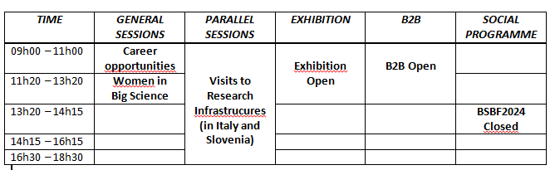
4th October 2024 programme (NEW)
Free access to BSBF2024 (to increase participation of young researchers, women in Big Science, interested general public, etc);
Free stay in exhibition area for BSOs and companies boothes involved in Day 3 satellite meetings for direct contacts;
Extra opening day for B2B and B2C meetings;
Visits to Research Infrastructure reserved to registered in BSBF2024

Slide 16
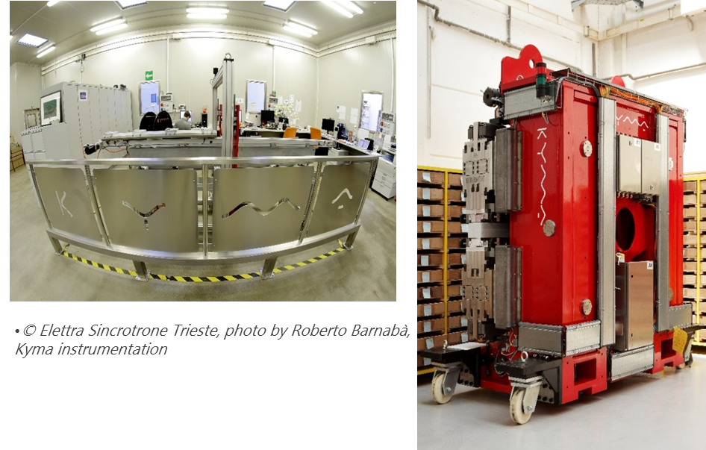
4th October 2024 - Visits Research Infrastructures
As usual BSBF Trieste 2024 is organising visits to nearby cross borders relevant Research Infrastructures in Italy and Slovenia. Reservation is restricted to persons registered to BSBF2024
Option 1
Elettra Sincrotrone Trieste & Kyma
Option 2
Josef Stefan Institute & Nanocenter
Option 3
The National Institute of Oceanography
and Applied Geophysics – OGS

Slide 17
4th October 2024 – Career opportunities
EURES Satellite session
According with the success of the BSBF2022 session «Career opportunities and pathways in the Big Science Market» in Granada, BSBF Trieste 2024 strongly supports the proposal to replicate and improve the Career opportunities dimension in the Forum.
For this reason It will be garantee free access for attending two hours Career opportunity plenary session during Day 3, involving speakers from BSOs and other interested stakeholders.
Moreover It has been established a collaboration with the EURES Network of European Commission in order to adapt their matching system for Job Fair and a new dedicated section to the Big Science domain.
BSBF Trieste 2024 will collect availabilities from BSOs and companies in order to organise this new initiative.

Slide 18
4th October 2024 – Women in Big Science WBS Satellite session
According with the final report on WBS first edition in Granada 2022, BSBF Trieste 2024 strongly supports the proposal to replicate and improve the WBS experience.
For this reason It will be garantee free access for attending two hours WBS plenary session during Day 3.
Any relative activity will be under the responsability and directly managed by WBS Committee composed by representative of BSOs and other interested bodies. The organizers of BSBF2024 will collaborate with the WBS Committee.

Slide 19
BSBF Promotion – Presentation in conferences
BSBF Trieste 2024 wants to promote participation and consolidate the BSBF brand in the research and business international context. For this reason It will be present with promotional material in many conferences, where it will have the chance to present BSBF activities.
Those are some events where presence is already planned:
IPAC’23 – International Particle Accellerator Conference (May 2023)
IOD’23 – Industrial Opportunity Days (June 2023)
ISFNT15 – International Symposium on Fusion Nuclear Technology (September 2023)
Precision Fair – Brabanthallen, The Netherlands (November 2023)
Big Science Poland – Cracow (January 2024)
Big Science Sweden – Lund (January 2024)
BSBF Trieste 2024 will promote a dedicated series of dissemination events in different Capitals, in collaboration with CEI – Central European Initiative.

Slide 20
BSBF Promotion – BSOs and ILOs
BSBF Trieste 2024 will organise some industrial visits to BSBF infrastructures partners in collaboration with related ILO Network.
BSBF visits Big Science Organizations, a new format for industries:
A one visiting day to the major research infrastructure in Europe reserved to international companies, including presentantions by hosting BSO and BSBF organizers.
Information campaign on this new opportunity for companies to get closer and to know better Big Science will be disseminated jointly by BSOs, ILOs and BSBF channels.
List of BSBF visits to:
F4E at ITER Organization, Cadarache (FR), 25 Oct 2023
European XFEL, Hamburg (DE), 19 Jan 2024
CERN, Geneve (CH), 9 Feb 2024 (New deadline for registration: 15 Jan 2024)
ESA, Noordwijk (NL), 15 March 2024

Slide 21
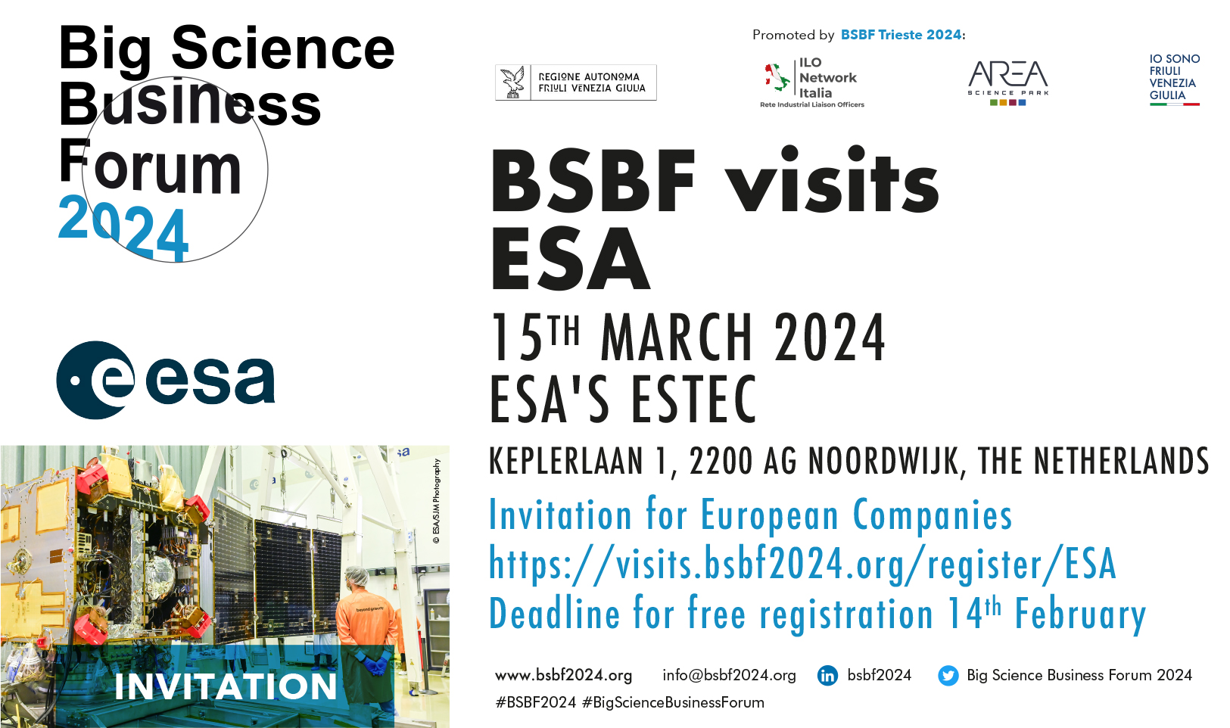
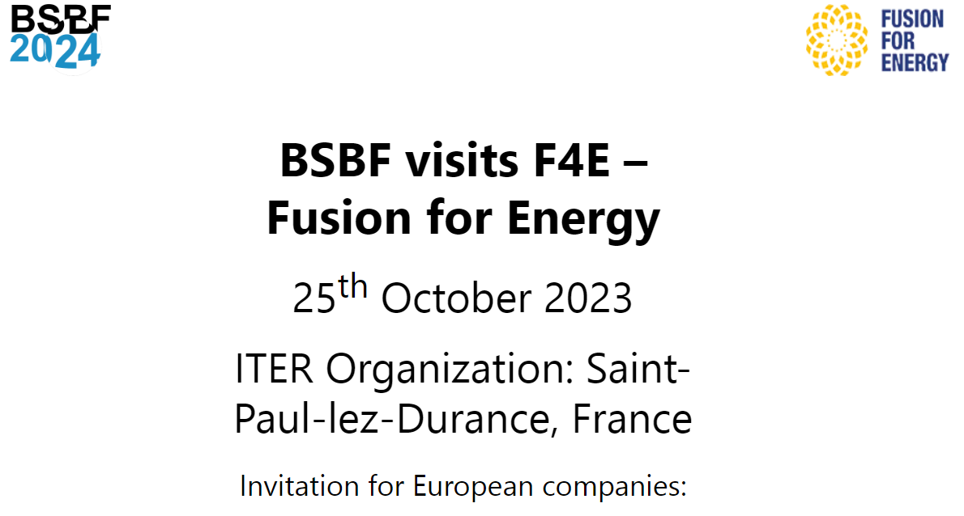
https://www.bsbf2024.org/bsbf-visits-f4e-fusion-for-energy/
After the success of BSBF visits F4E at ITER Organization,
(100 persons, 84 companies from 12 countries) new BSBF visits will be launched at
CERN, European XFEL, ESA, ESO and ESS.

Slide 22




BSBF 2024 is a business oriented congress promoted by the main European Research Infrastructures, focused on technology and innovation with the aim to be the main meeting point between Research and Industry.
TRIESTE
1 - 4 OCTOBER 2024
www.bsbf2024.org
https://newsletter.bsbf2024.org/subscribe/BSBF2024/
Host Organisers of BSBF Trieste 2024
Paolo ACUNZO
IOC/LOC Coordinator
BSBF Trieste 2024 Director
paolo.acunzo@bsbf2024.org

