Slide 1
Short introduction to the GF activities
CERN, December the 11th, 2023
Mieczyslaw Witold Krasny
Gamma Factory group leader
LPNHE, CNRS and University Paris Sorbonne
and CERN, BE-ABP

Slide 2
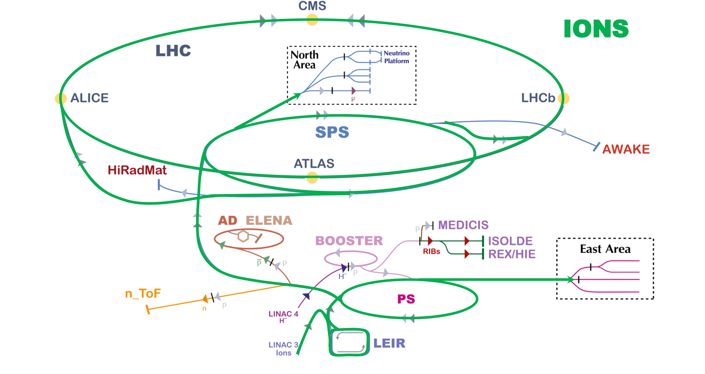
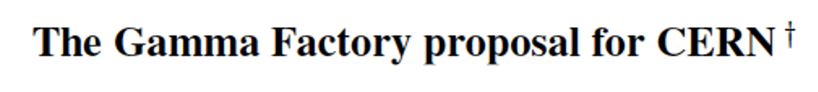
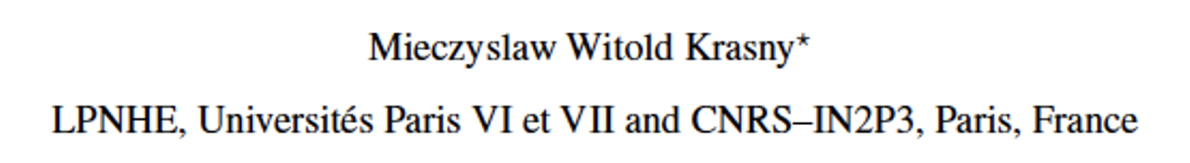

CERN experimental programme with proton and ion beams
protons
Gamma Factory goal:
extension of the CERN programme with beams of improved quality and intensity + unique GF research programme – both with “minor” accelerator infrastructure investment!

Slide 3
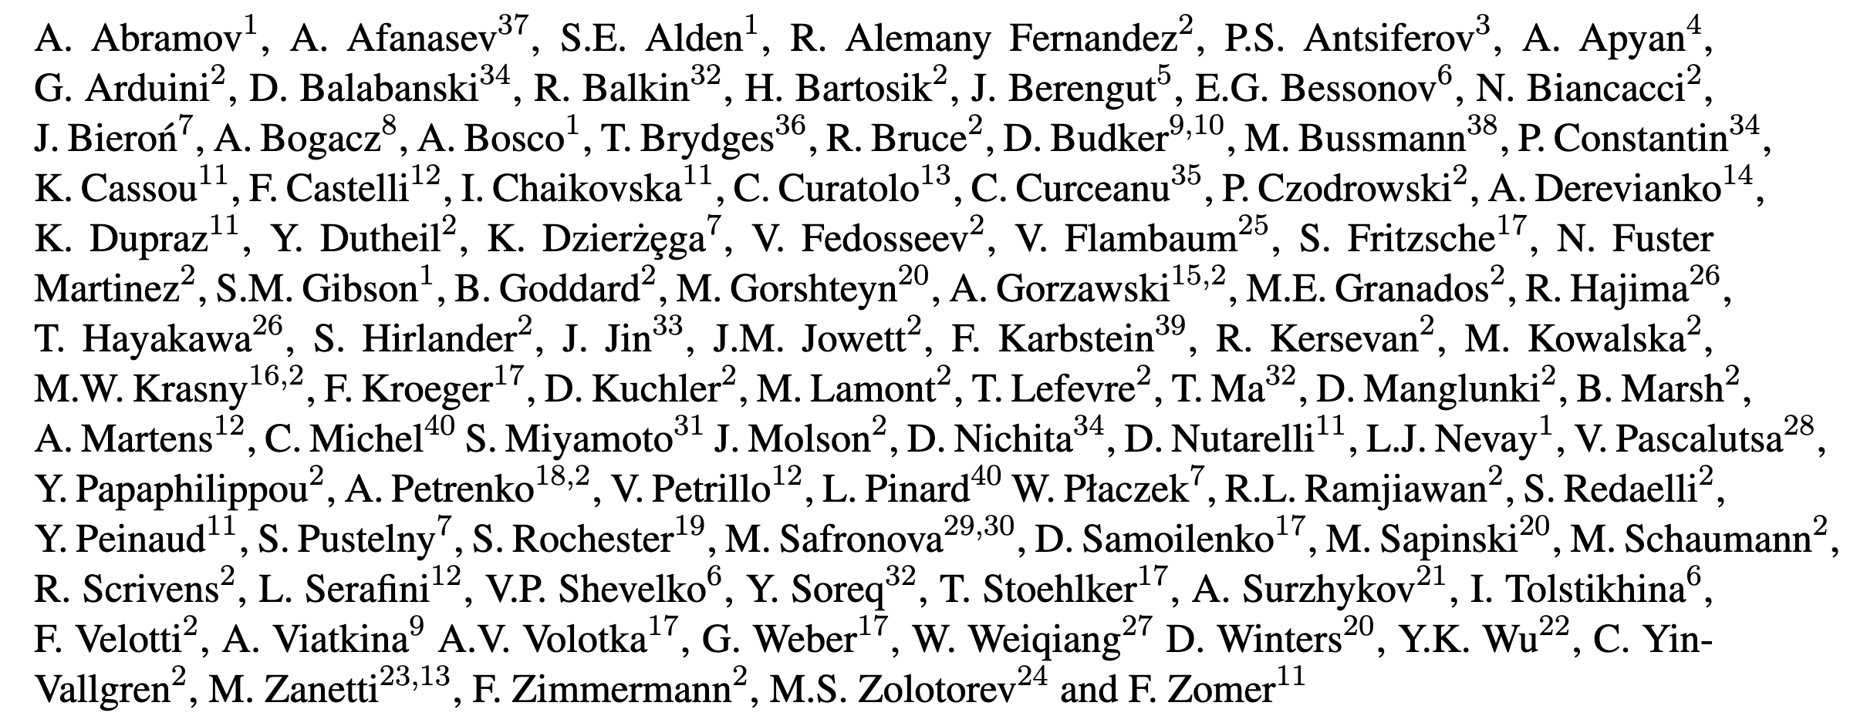
“Gamma Factory”
Gamma Factory studies are supported by the CERN Physics Beyond Colliders (PBC) framework.
More info on all the GF group activities:
  https://indico.cern.ch/category/10874
We acknowledge the crucial role of the CERN PBC support in bringing our accelerator tests, GF-PoP experiment design and software development to their present stage!
~100 physicists form 40 institutions have contributed so far to the Gamma Factory studies
3

Slide 4
Gamma Factory status

Slide 5
Gamma Factory accelerator and beam-storage requirements:
Modification of the ion stripping scheme
Storage of atomic beams in the LHC

Slide 6
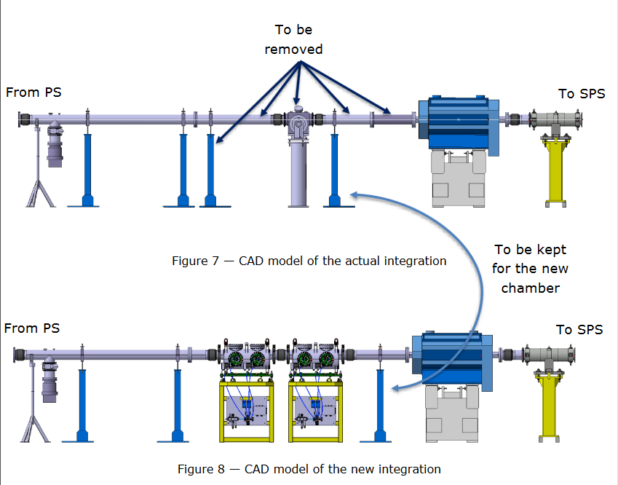
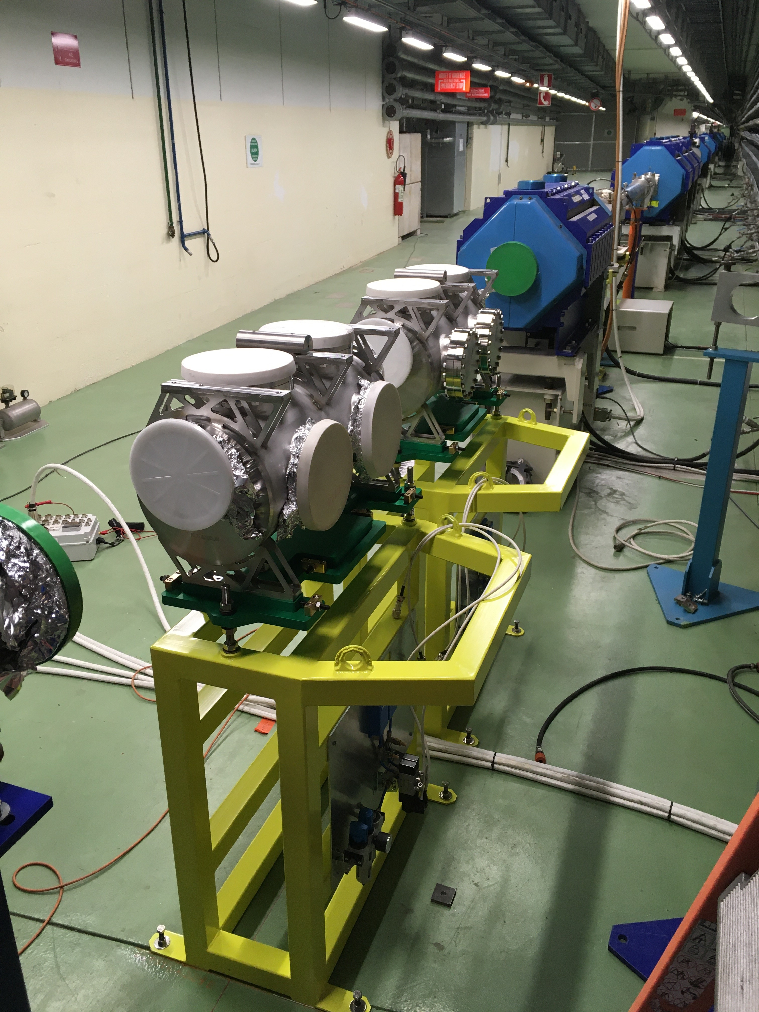
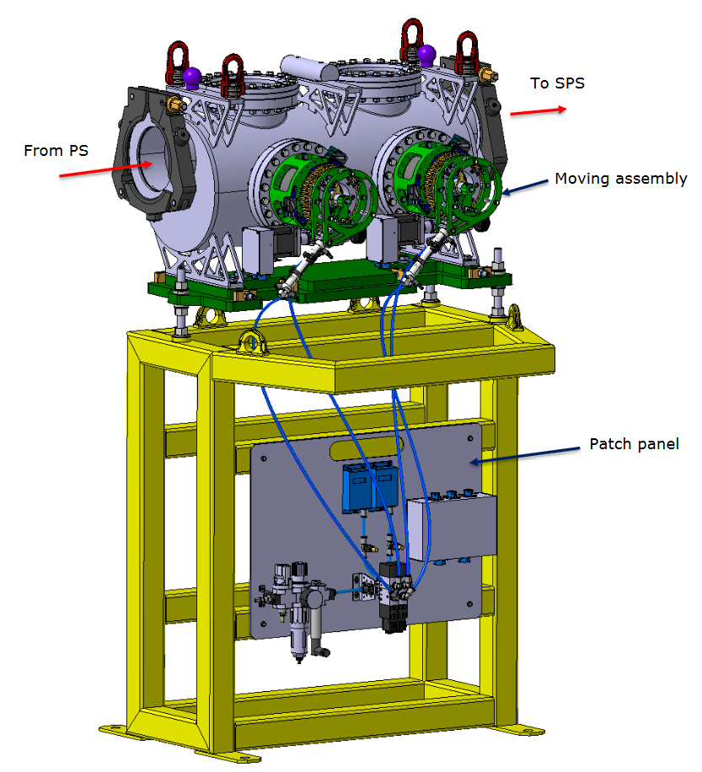
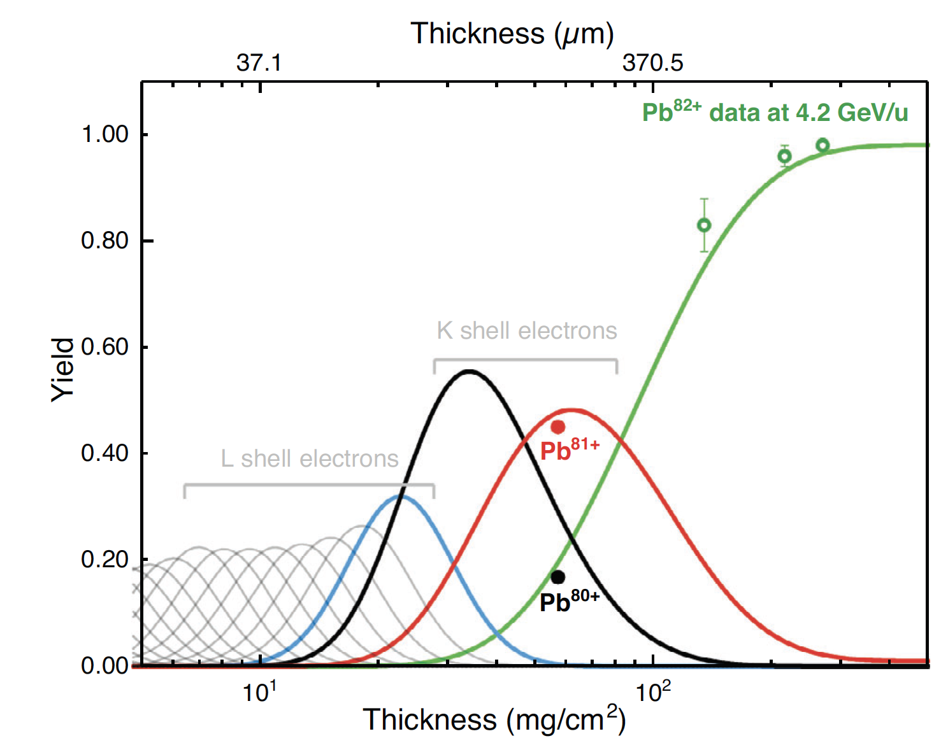
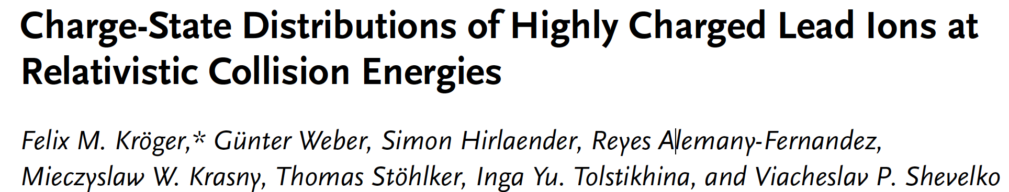
Requisite TT2 stripper system installed
Stripping of Pb+54 ions in the TT2 PS-→ SPS transfer line
PoP experiment
Pb+79
R. Alemany-Fernandez (BE.OP), E. Grenier-Boley and D. Baillard (SY.STI)
The two tanks of the new stripper system were installed during YETS 2021-2022 and YETS 2022-2023. Four stripper foil mechanisms operating at ~Hz frequency.

Slide 7
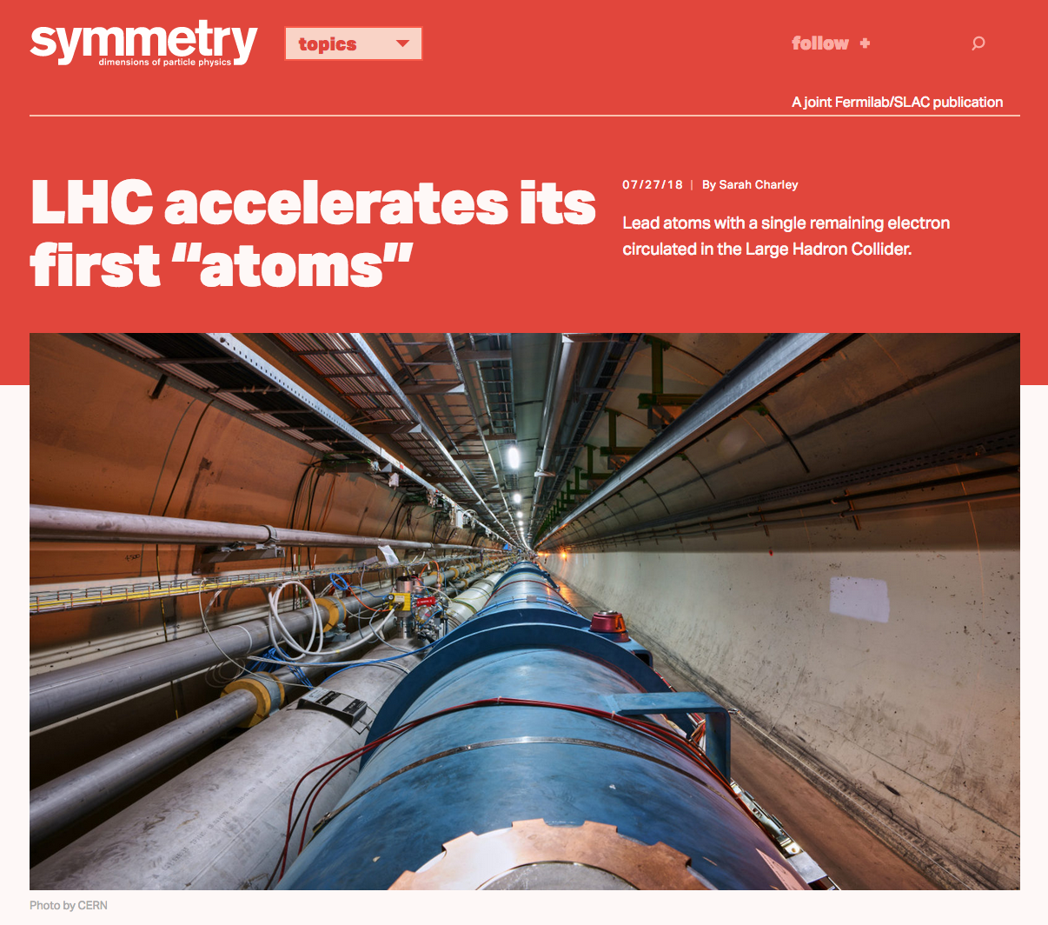
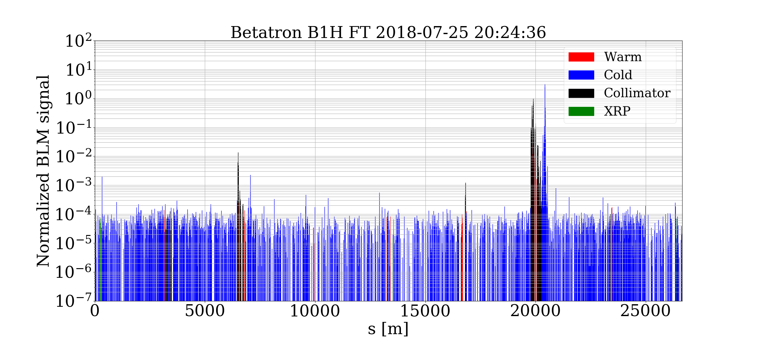
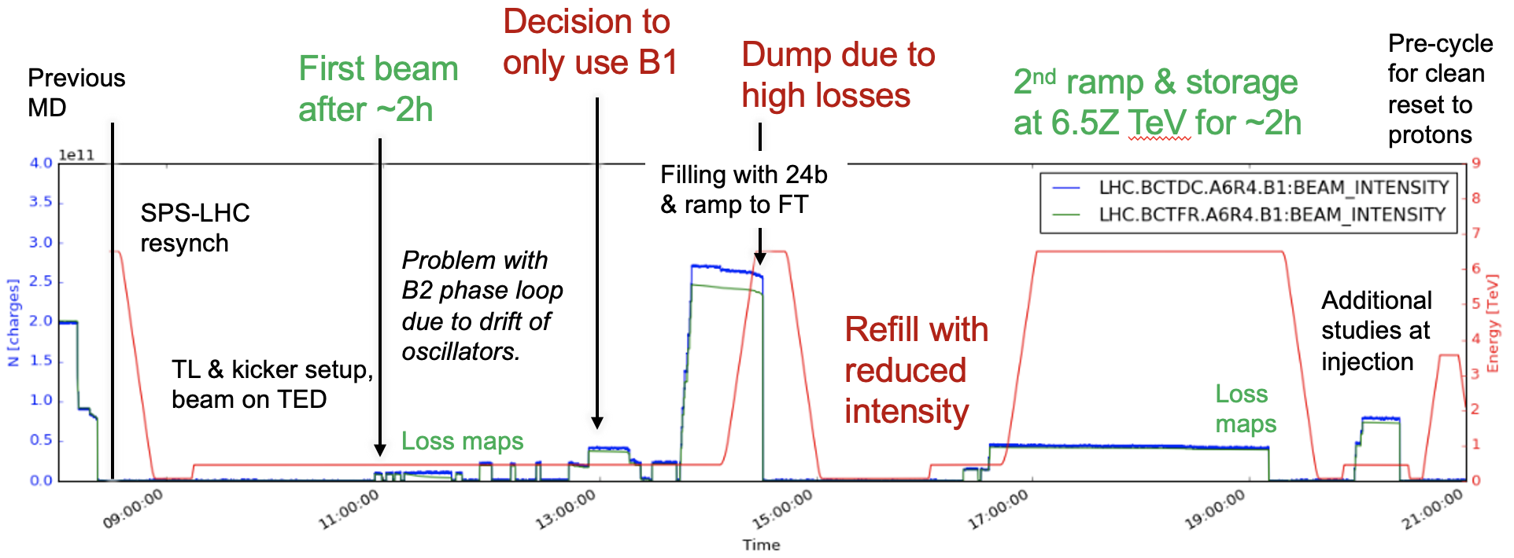
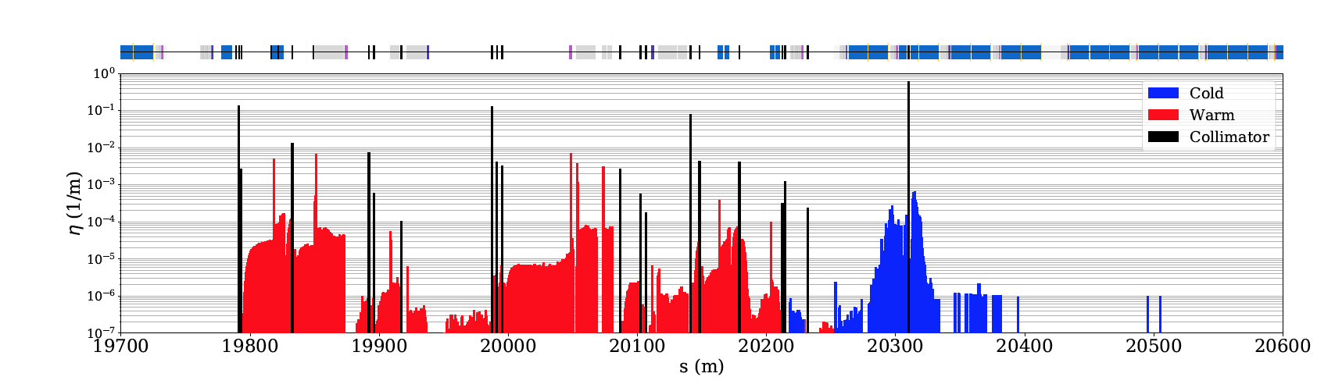
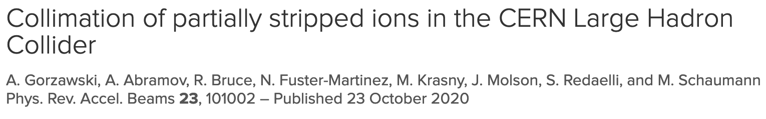
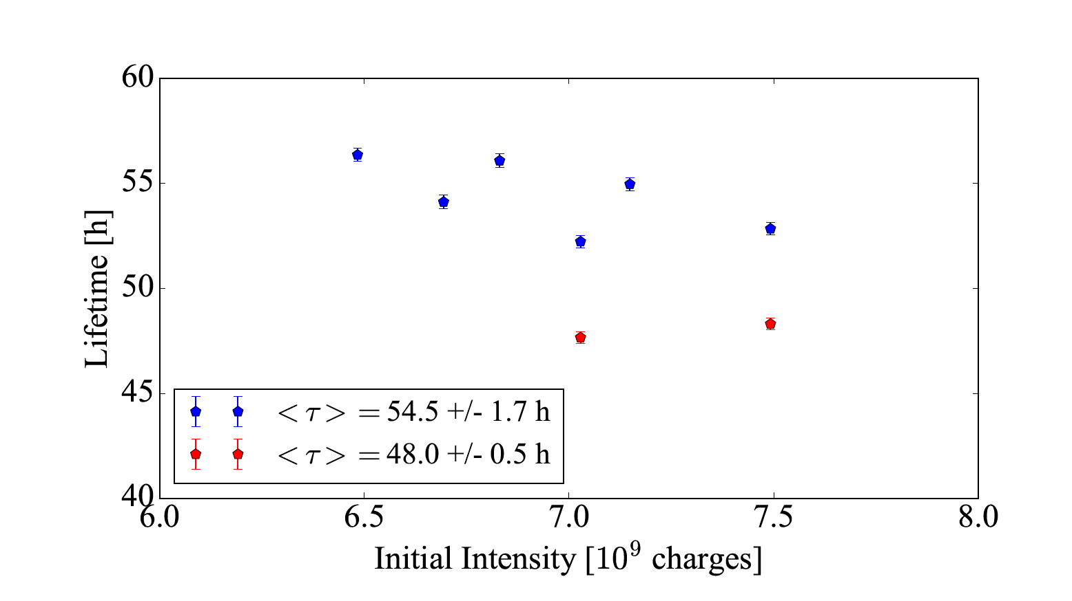
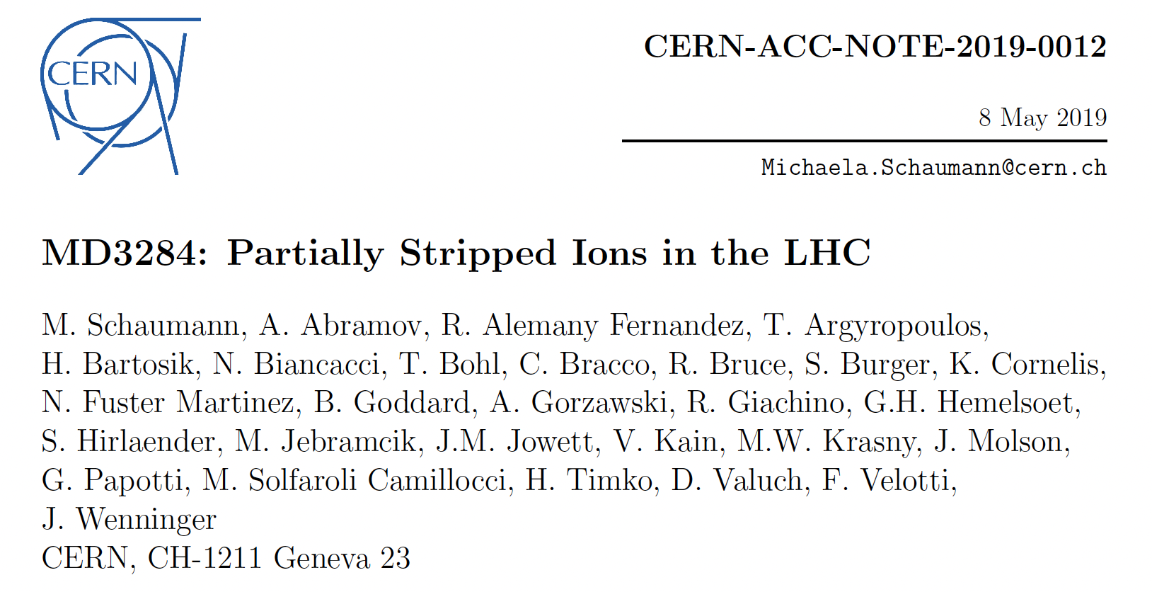
Mitigation strategies:
1. Dispersion suppressor collimator (TCLD)
2. Crystal collimation
3. Laser collimation.
Stable storage of atomic beams in the LHC demonstrated (Hydrogen-like Lead )
The beam intensity limit is determined by
the beam collimation efficiency in IR7
s = 20430 m
IR7
zoom
Simulation
studies
Lifetime of PSI bunches ~ 50h
A dedicated LHC MD with crystal collimation of the PSI (H-like Pb) beam is a natural next step…

Slide 8
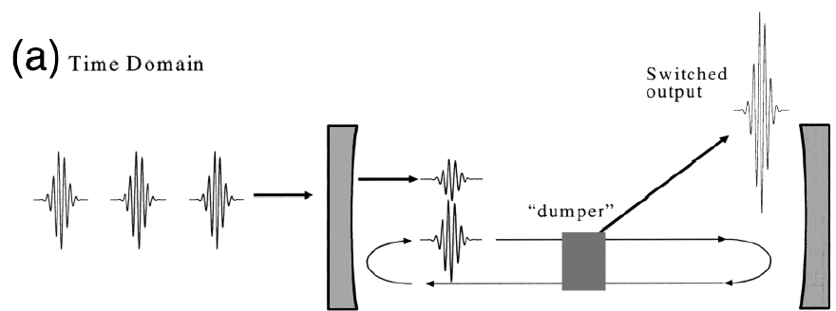
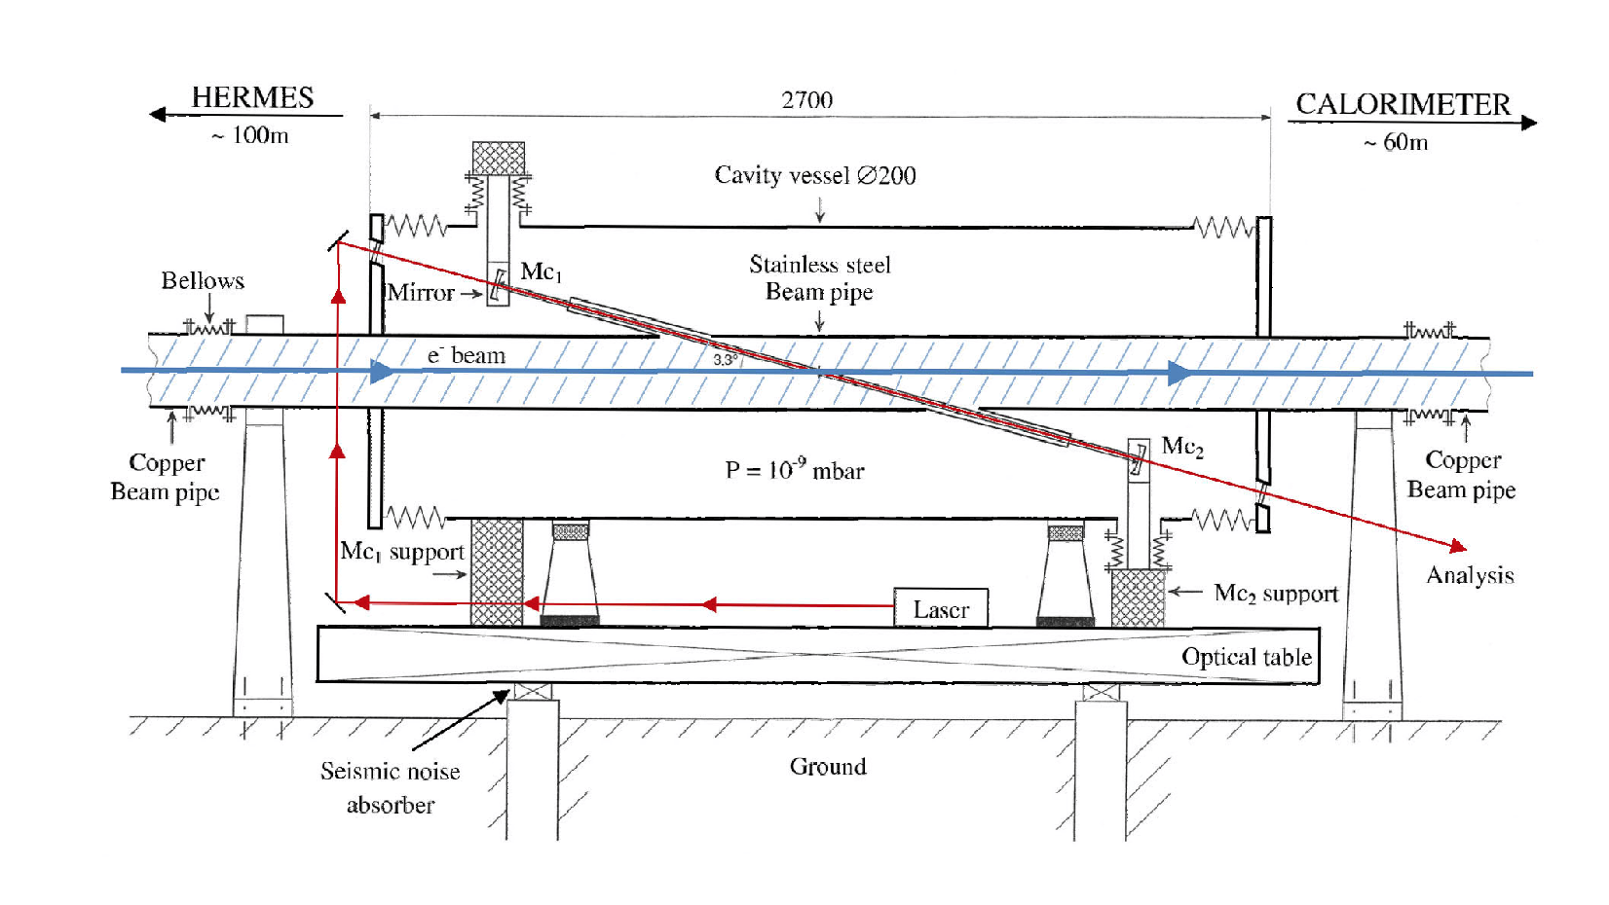
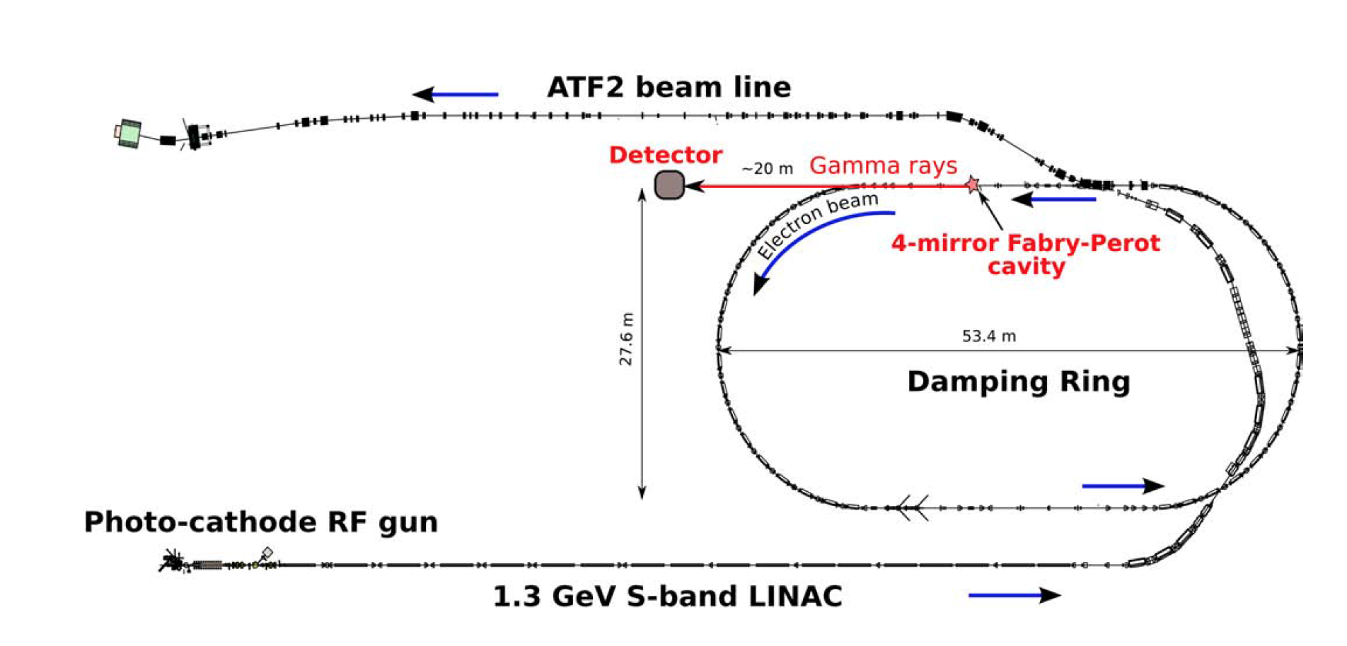
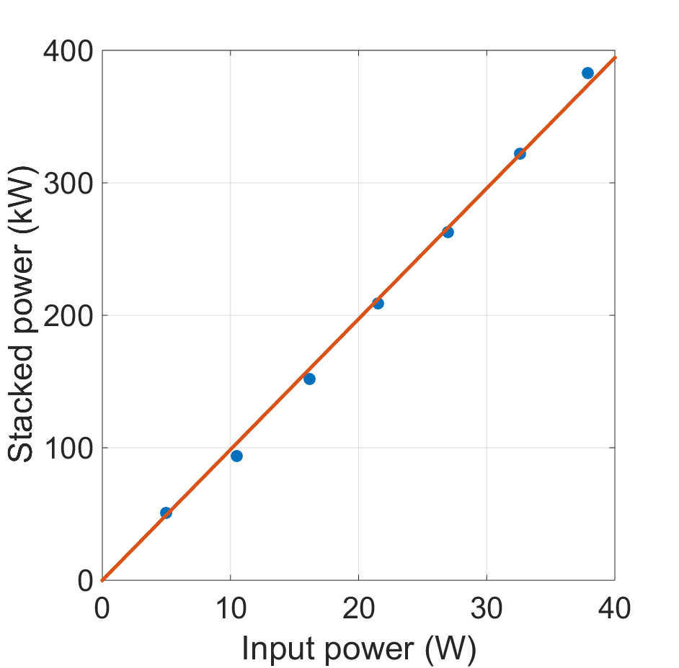
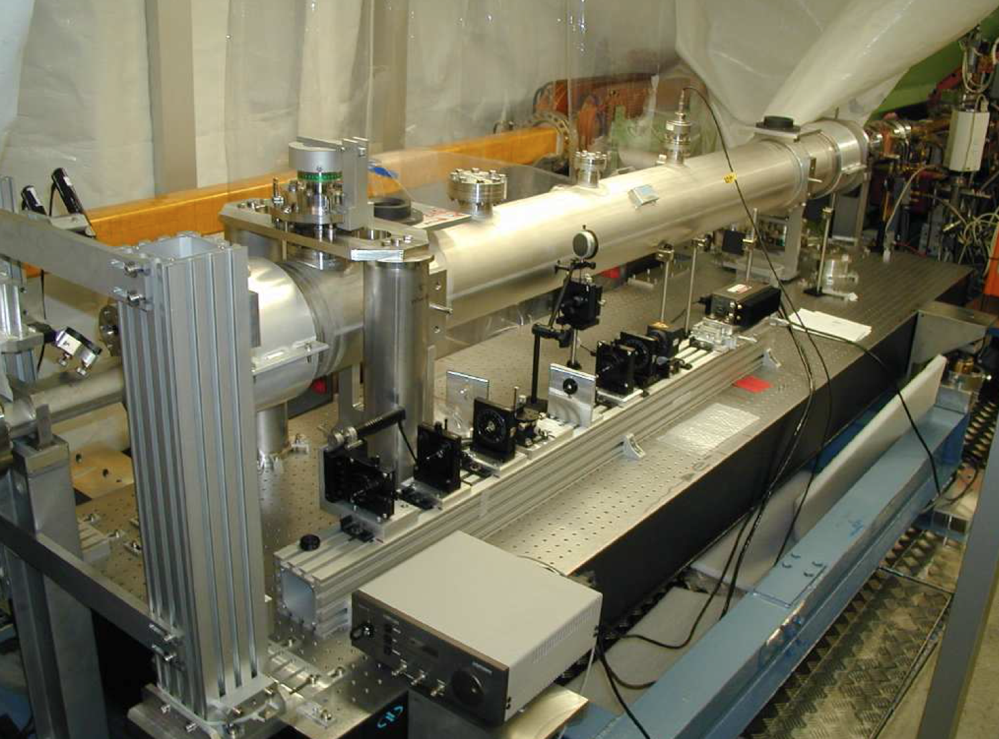
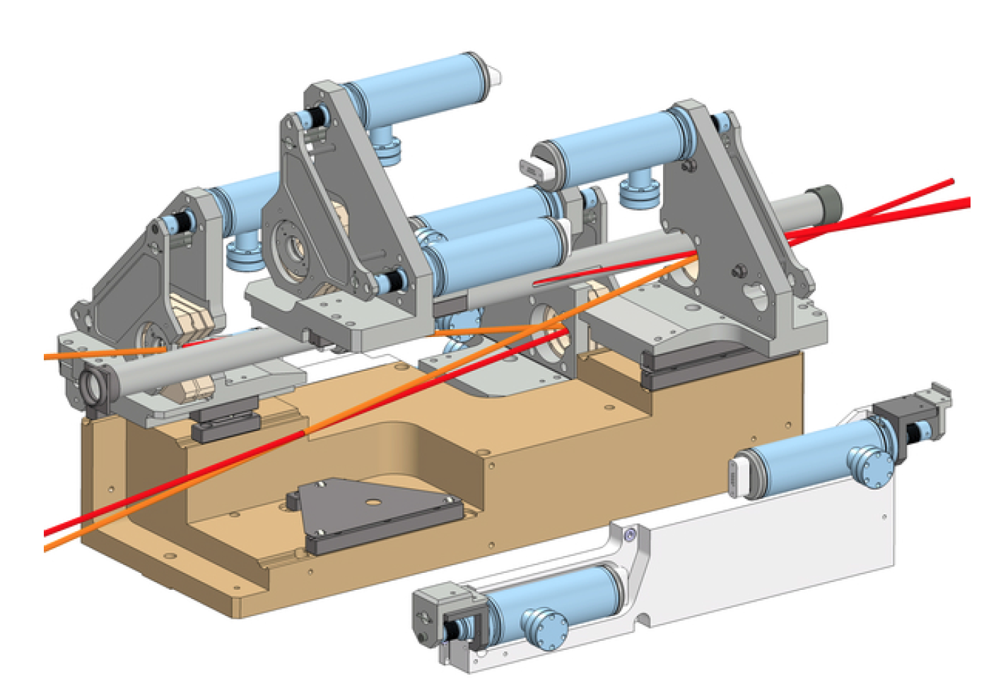
Fabry-Pérot resonator
Fabry-Pérot (FP) resonators
and their integration in the electron storage rings
HERA storage ring
KEK – ATF ring
mirror
mirror
~10¹⁶ ph/pulse
Laser pulses
Amoudry L. et al., Applied Optics 59(2020)116
GF requirement:
< 5mJ pulses @ 40MHz, (200kW photon beam)

Slide 9
Proof-of-Principle experiment at SPS

Slide 10
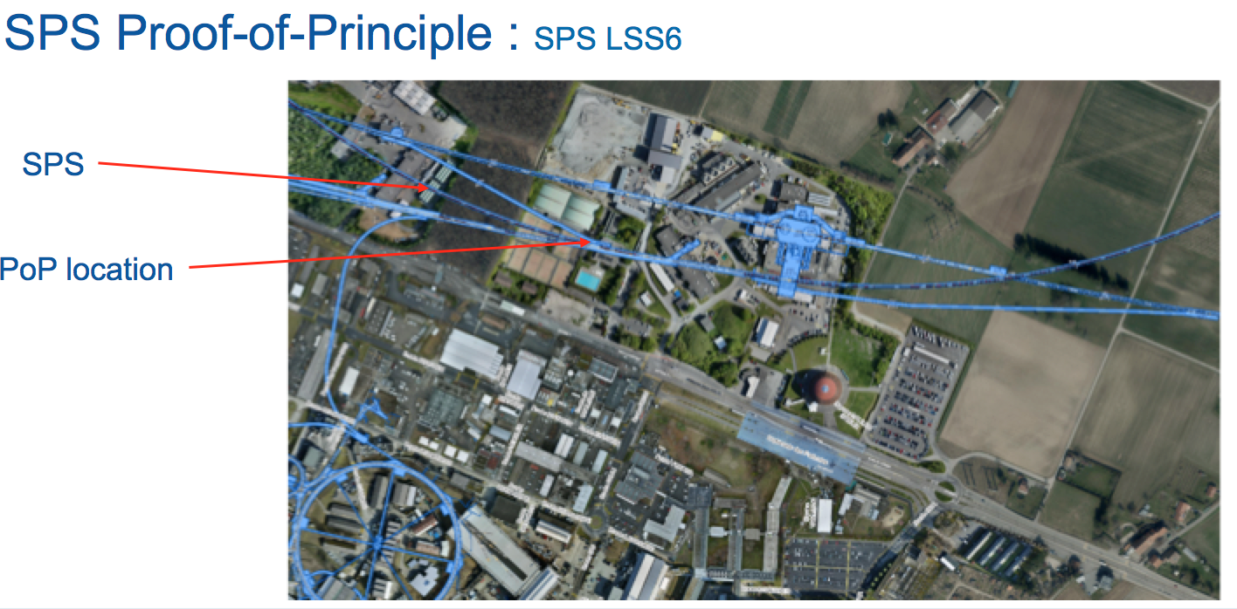
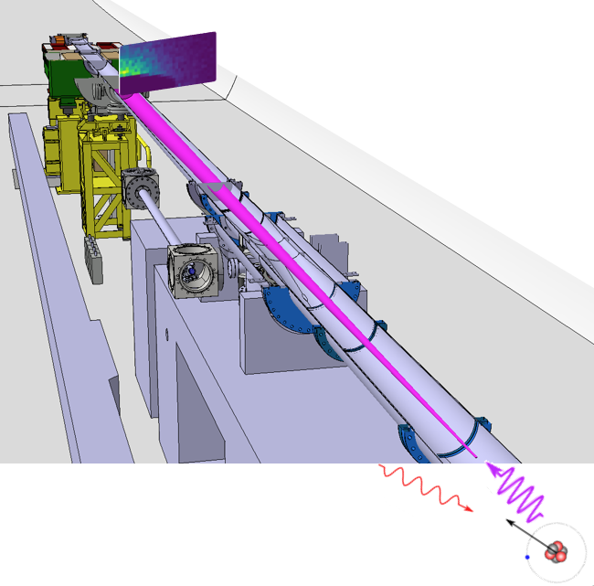
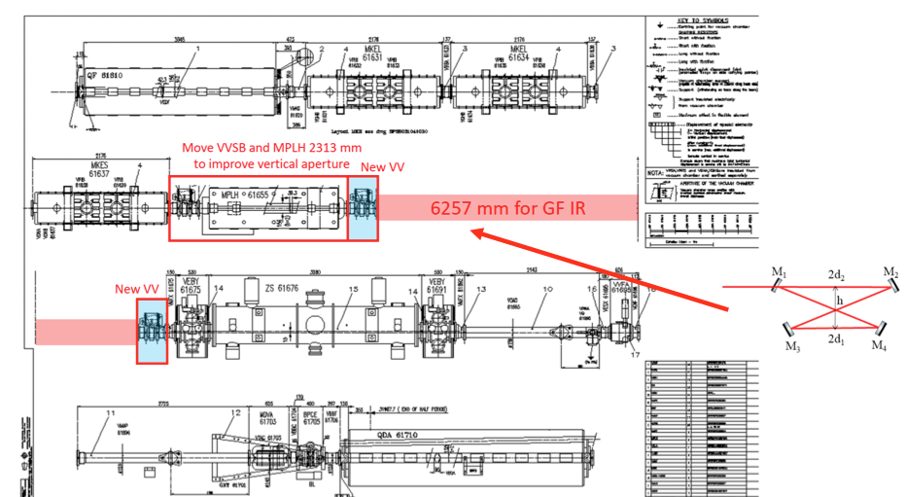
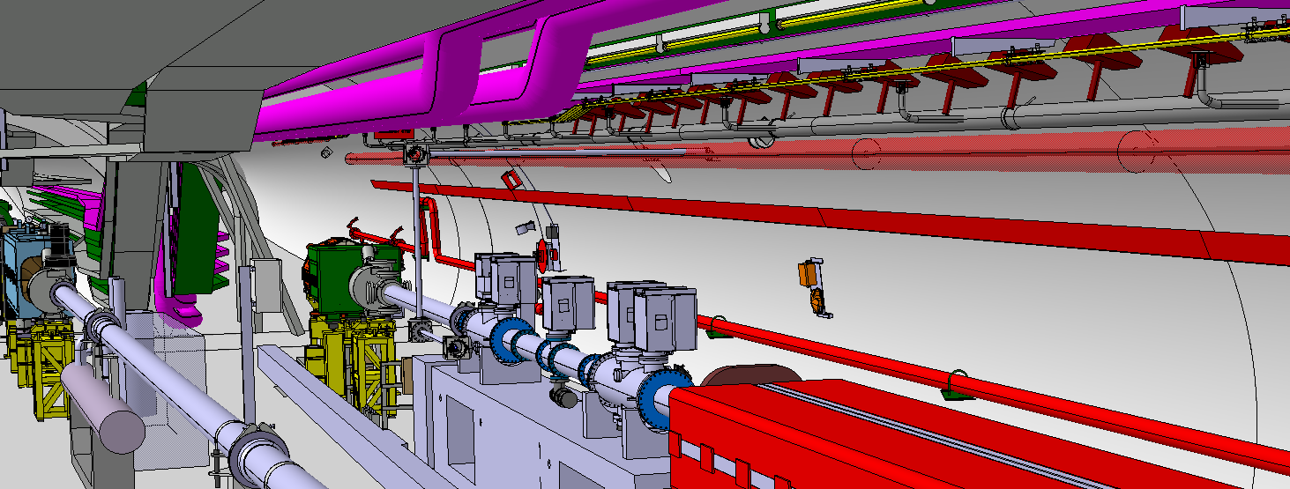
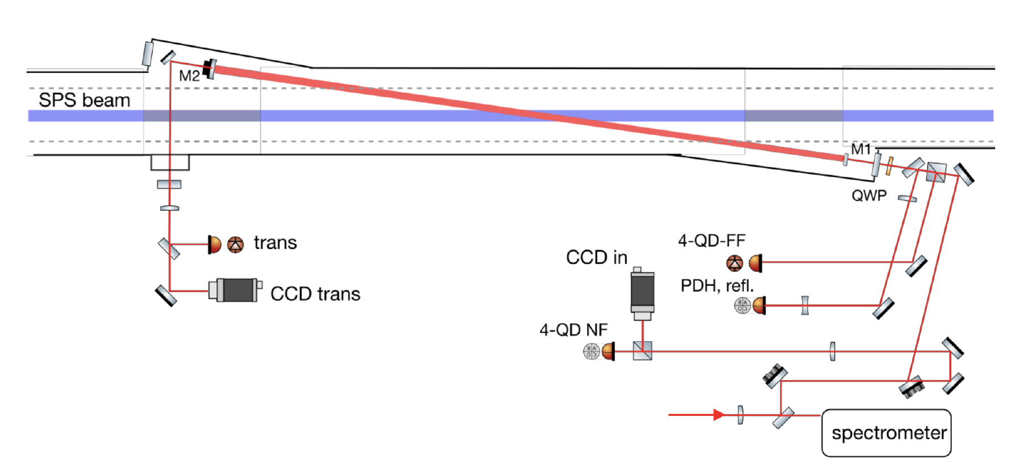
Gamma Factory Proof-of-Principle (PoP) SPS experiment
Lithium-like lead ion bunches in the SPS
Detection of produced
X-rays in resonant
excitation of the
(2s—>2p)_{1/2}
transition
SPS half-cell 621 with side tunnel TI18
LSS6 zone
F-P cavity – “in beam” position
F-P cavity
F-P cavity length – 3.75 m -- vertically tilted by 2.6 degrees

Slide 11
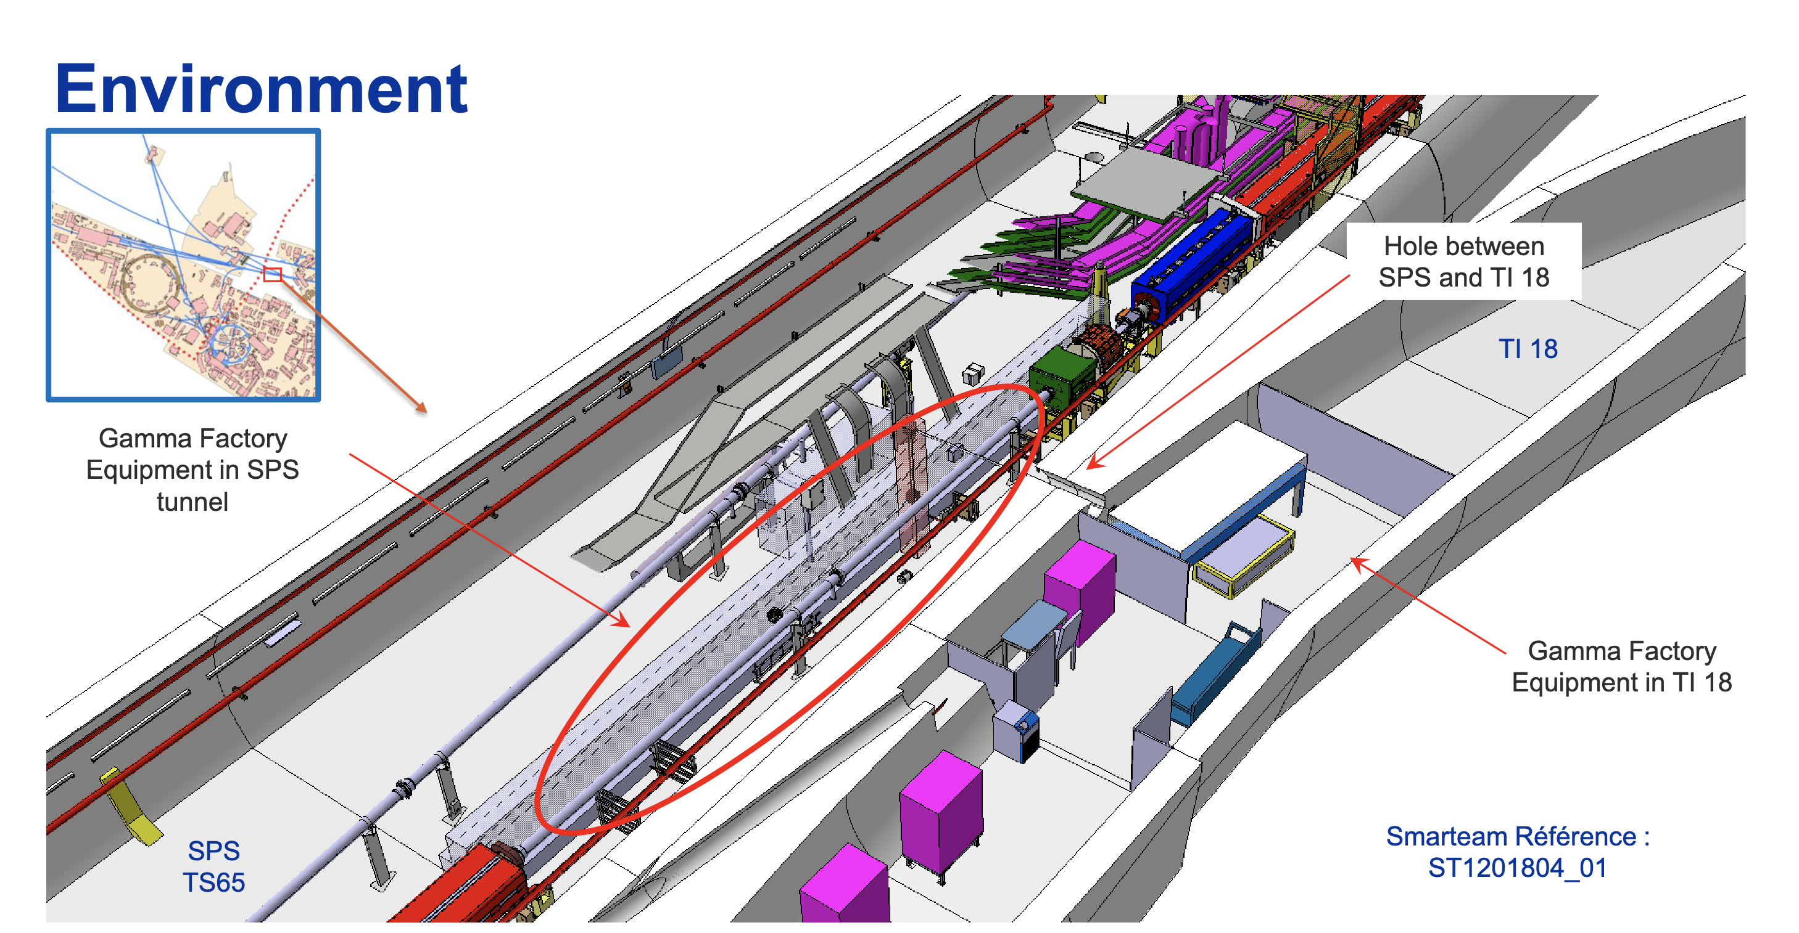
Old SPS to LEP
beam transfer
tunnel
GF PoP
experiment
laser room

Slide 12
The purpose of the GF SPS PoP experiment
1
5
Demonstrate ion beam cooling: longitudinal and then transverse
6
Atomic physics measurements
4
2
3
Demonstrate stable and repeatable operation
Confront data and simulations
Demonstrate that an adequate laser system (5mJ@40MHz) can be (remotely) operated in the high radiation field of the SPS.
Demonstrate that very high rates of photons are produced : almost all PSI’s are excited in single collision of the PSI bunch with the laser pulse
Estimated cost of the experiment 2.5 MCHF

Slide 13
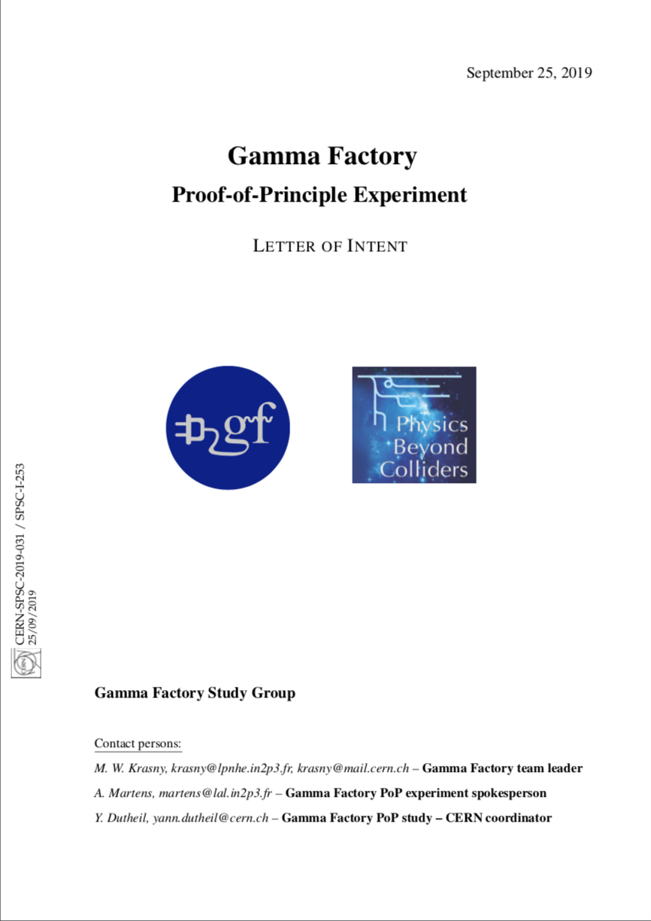
PoP experiment status
As received from the SPSC referees:
« The SPSC recognizes the Gamma Factory's potential to create a novel research tool, which may open the prospects for new research opportunities in a broad domain of basic and applied science at the LHC. »
Integration and operation model of the PoP experiment finalized
Design of the laser light transport line finalized
“Menhir Photonics” laser delivered on the 2nd November 2023
Power test experiment with this laser, R&D amplifier, and new R&D mirrors at IJCLab (Orsay) ongoing
Vibration tests in the SPS tunnel –- YETS 2024/2025
Experiment installation – LS3 - 2026-2027

Slide 14
Gamma Factory research programme

Slide 15
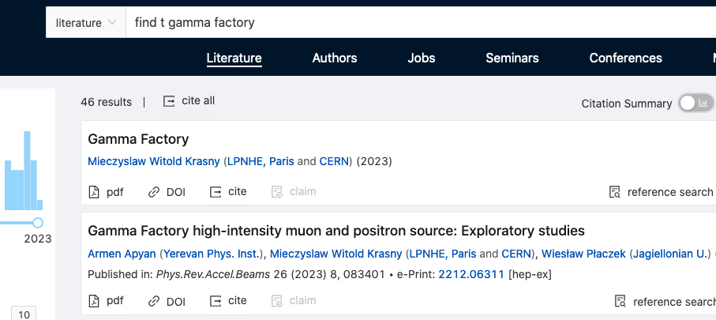

GF studies: recently published papers (INSPIRE)
Special issue of “Annalen der Physik” -- devoted to the GF physics highlights -- published in March 2022.

Slide 16
Examples of potential applications domains of
the Gamma Factory research tools
particle physics (precision QED and EW studies, vacuum birefringence, Higgs physics in γγ collision mode, rare muon decays, precision neutrino physics, QCD-confinement studies, …);
nuclear physics ( nuclear spectroscopy, cross-talk of nuclear and atomic processes, GDR, nuclear photo-physics, photo-fission research, gamma polarimetry, physics of rare radioactive nuclides,… );
atomic physics (highly charged atoms, electronic and muonic atoms, pionic and kaonic atoms);
astrophysics (dark matter searches, gravitational waves detection, gravitational effects of cold particle beams, ¹⁶O(γ,α)¹²C reaction and S-factors…);
fundamental physics (studies of the basic symmetries of the universe, atomic interferometry,…);
accelerator physics (beam cooling techniques, low emittance hadronic beams, plasma wake field acceleration, high intensity polarised positron and muon sources, beams of radioactive ions and neutrons, very narrow band, and flavour-tagged neutrino beams, neutron sources…);
applied physics (accelerator driven energy sources, fusion research, medical isotopes and isomers production).

Slide 17
Long term vision

Slide 18
A potential place of the Gamma Factory (GF) in the future CERN research programme
The next CERN high-energy frontier project (if ever constructed) may take long time to be approved, built and become operational, … unlikely before 2050-ties
The present LHC research programme will certainly reach earlier (late 2030-ties?) its discovery saturation (L_{int} ~ 0.5L_{goal}) -- little physics gain by a simple extending its pp/pA/AA running time
A strong need will certainly arise for a novel multidisciplinary programme which could re-use (“co-use”) the existing CERN facilities (including LHC) in ways and at levels that were not necessarily thought of when the machines were designed
The Gamma Factory research programme could fulfil such a role. It can exploit the existing world unique opportunities offered by the CERN accelerator complex and CERN’s scientific infrastructure (not available elsewhere) to conduct new, diverse, and vibrant research in particle, nuclear, atomic, fundamental and applied physics with novel research tools and methods

Slide 19
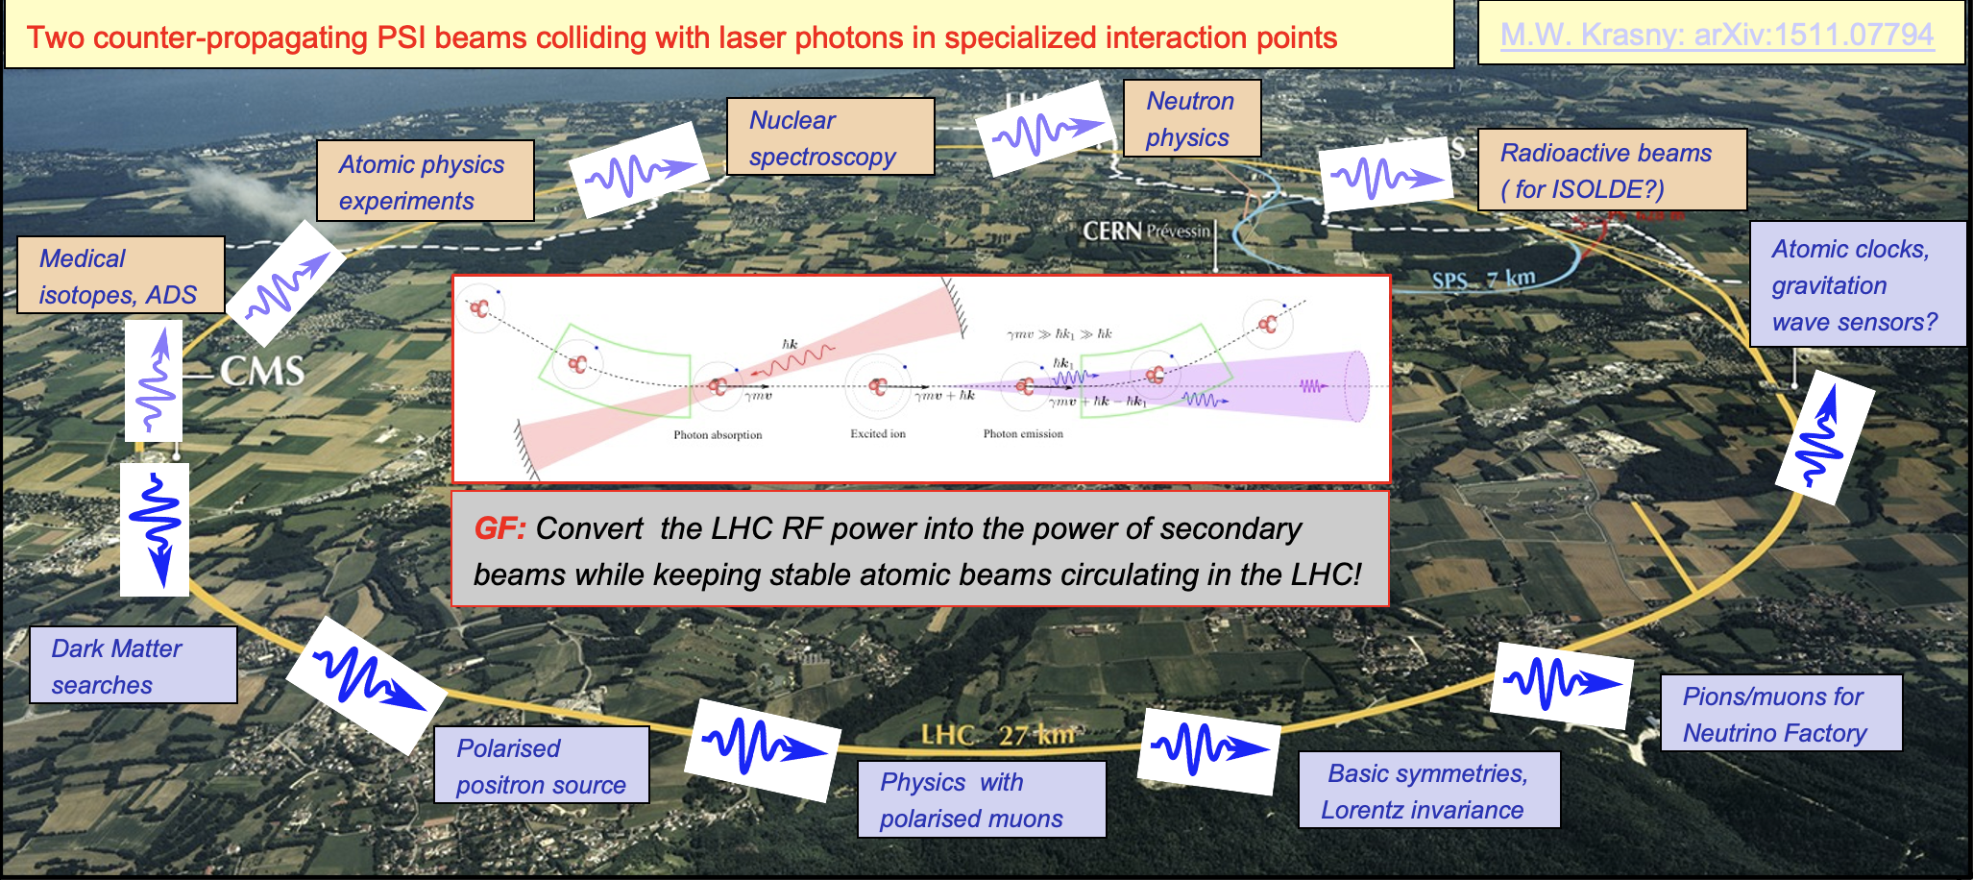
  A vision of the LHC operation in in the post-HL-LHC phase

