Slide 1

LS3 integration of
IR collimators and TCLM masks at point 1,5 / L,R
HL-LHC Integration meeting
L. Gentini (MME)

Slide 2
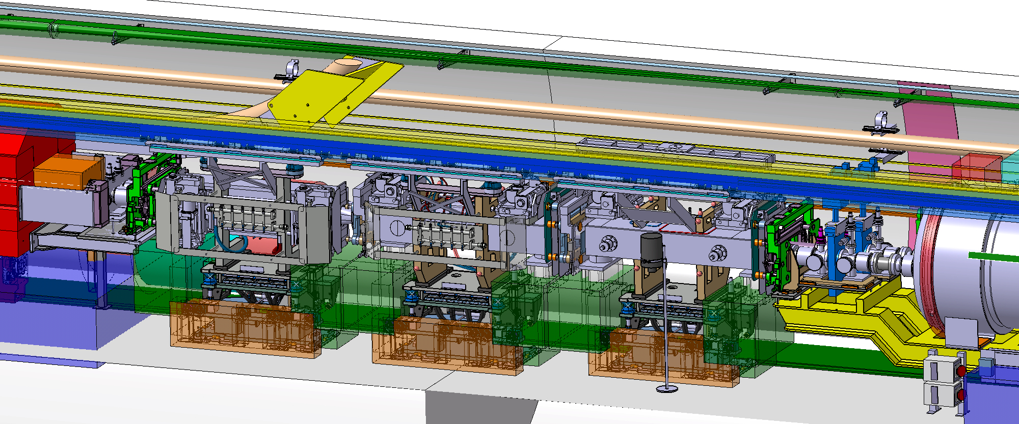
IR COLLIMATORS
Status of the simplified models
P5R

Slide 3
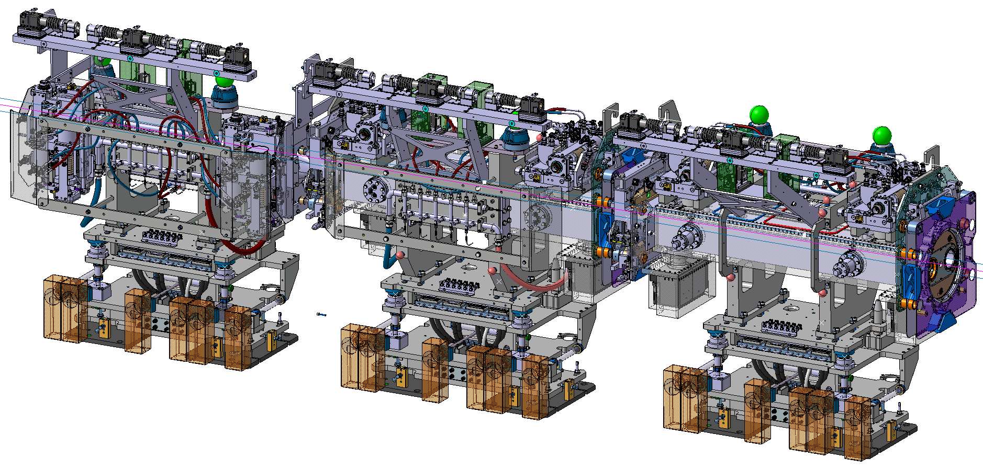
IR COLLIMATORS
Status of the simplified models
P5R
TCTPXV
TCTPXH
TCLPX

Slide 4
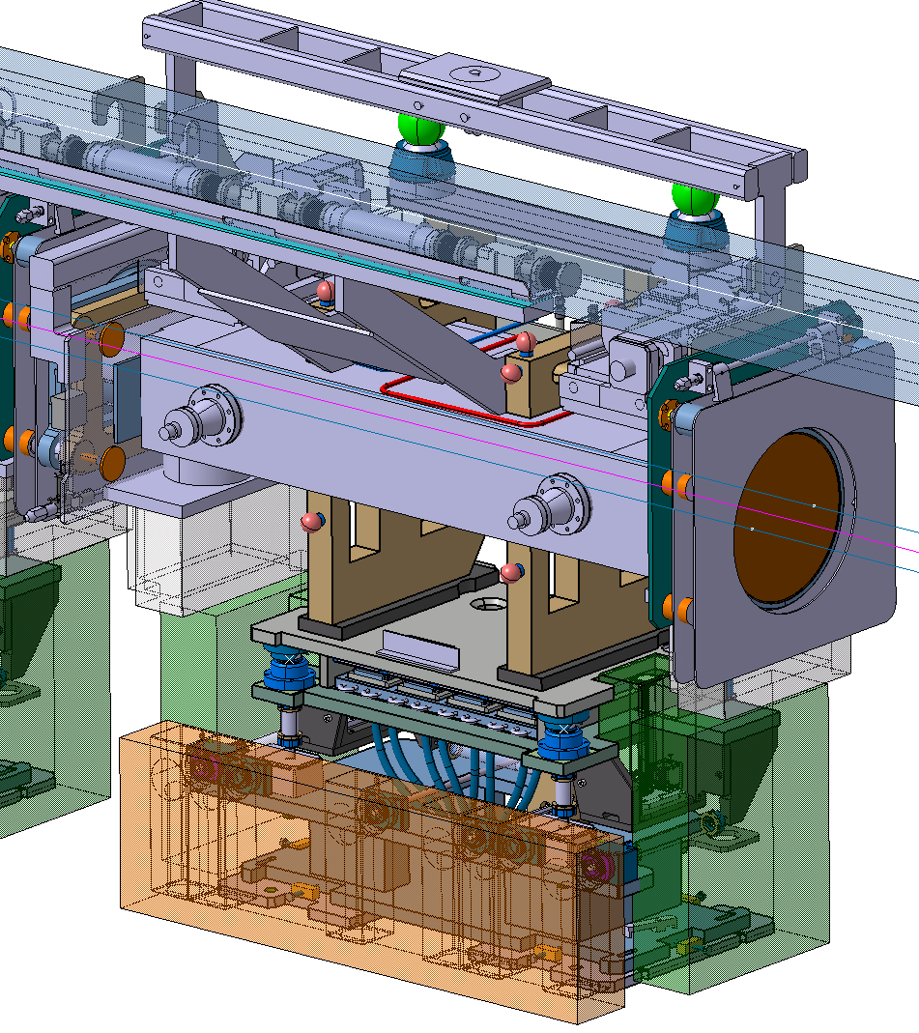
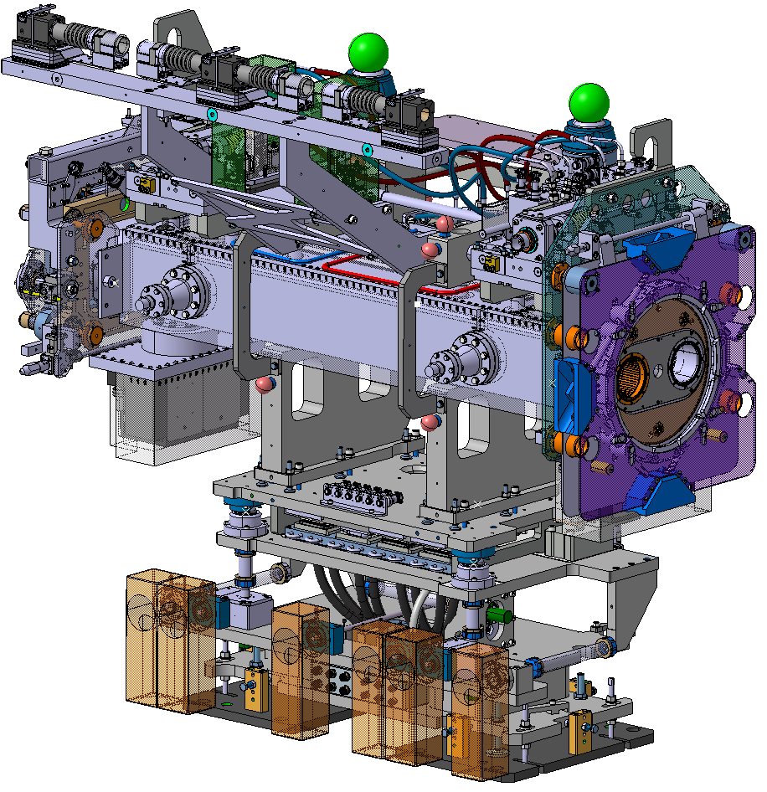
IR COLLIMATORS
Old simplified models VS current design
New detailed design of P5R
Differences
- WPS support is 50 mm higher.
- The two inclinometers are on the top of the collimators.
- On the support there are two adjustment systems: one between the floor and the support and one between the support and the plug-in. This is done to keep the UAP system vertical.
- Stiffeners on the frame
Same dimensions and flange to flange length
TCLPX

Slide 5
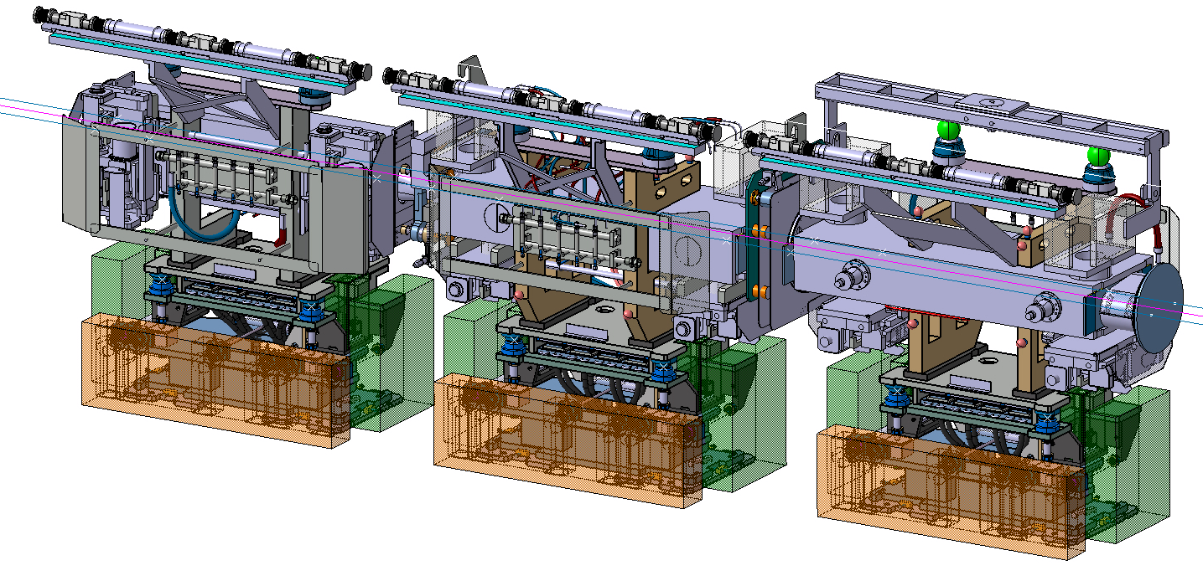
IR COLLIMATORS
Status of the simplified models
P5L

Slide 6
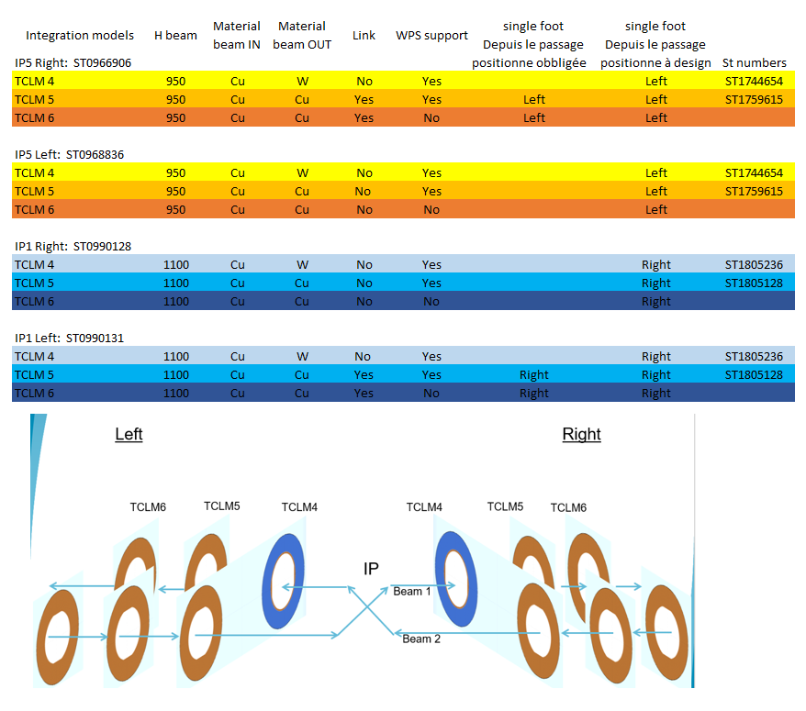
TCLM masks integration IP5R (ST0966906)

Slide 7
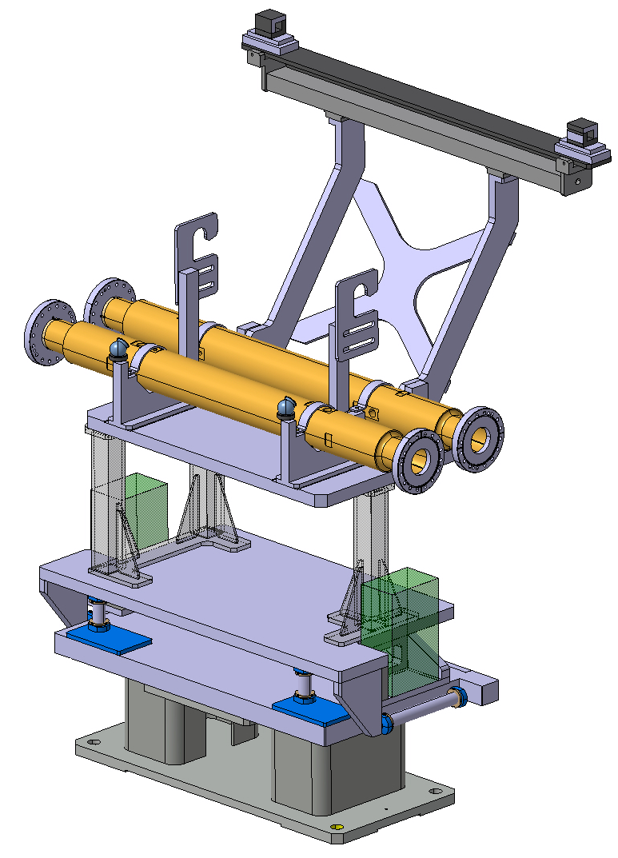
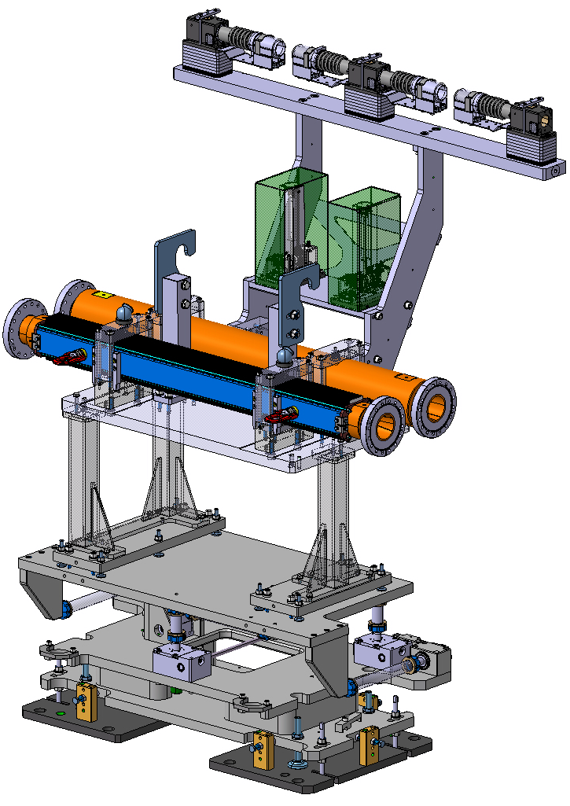
TCLM masks
Old simplified models VS current design
New detailed design of P5R
Differences
- WPS support is 50 mm higher.
- The two inclinometers are on the top of the collimators.
- On the support there are two adjustment systems: one between the floor and the support and one between the support and the plug-in. This is done to keep the UAP system vertical.
- Mask design
- Just one W mask for TCL4
- W absorber done by laminations
- Relative positioning adjustment
Same dimensions and flange to flange length

Slide 8
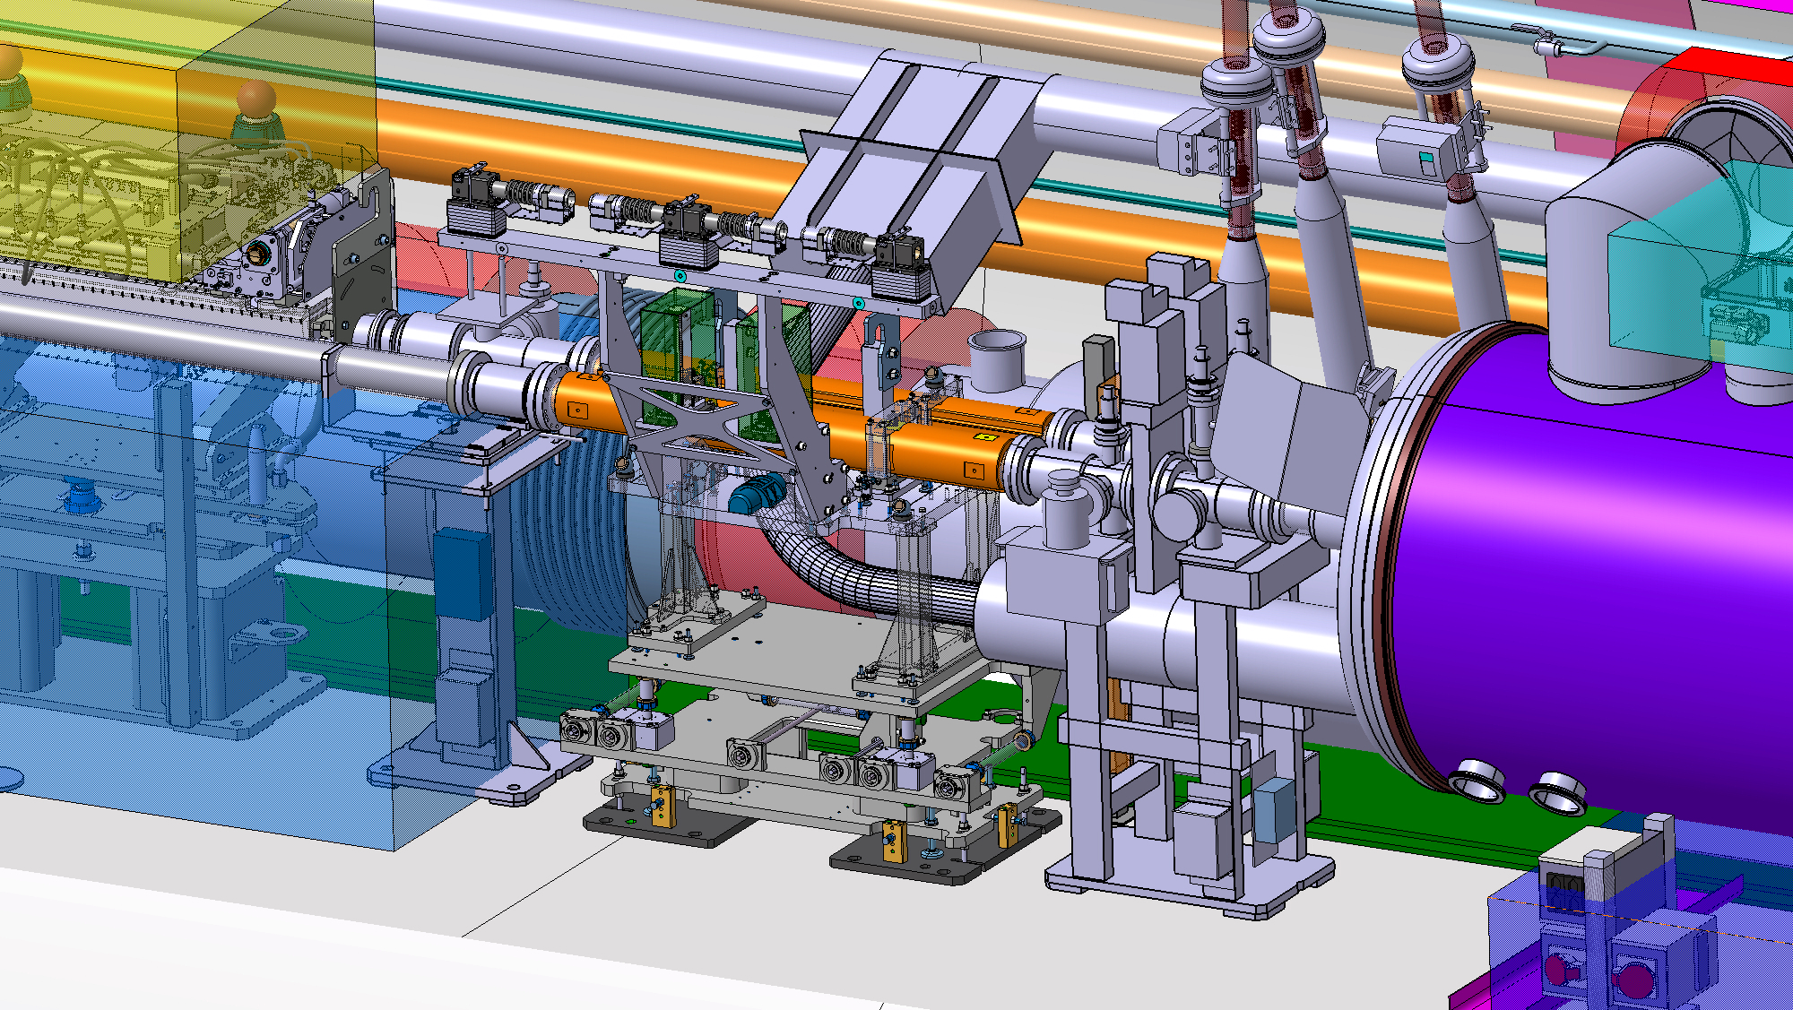
TCLM masks integration IP5R (ST0966906)
TCLM 6

Slide 9
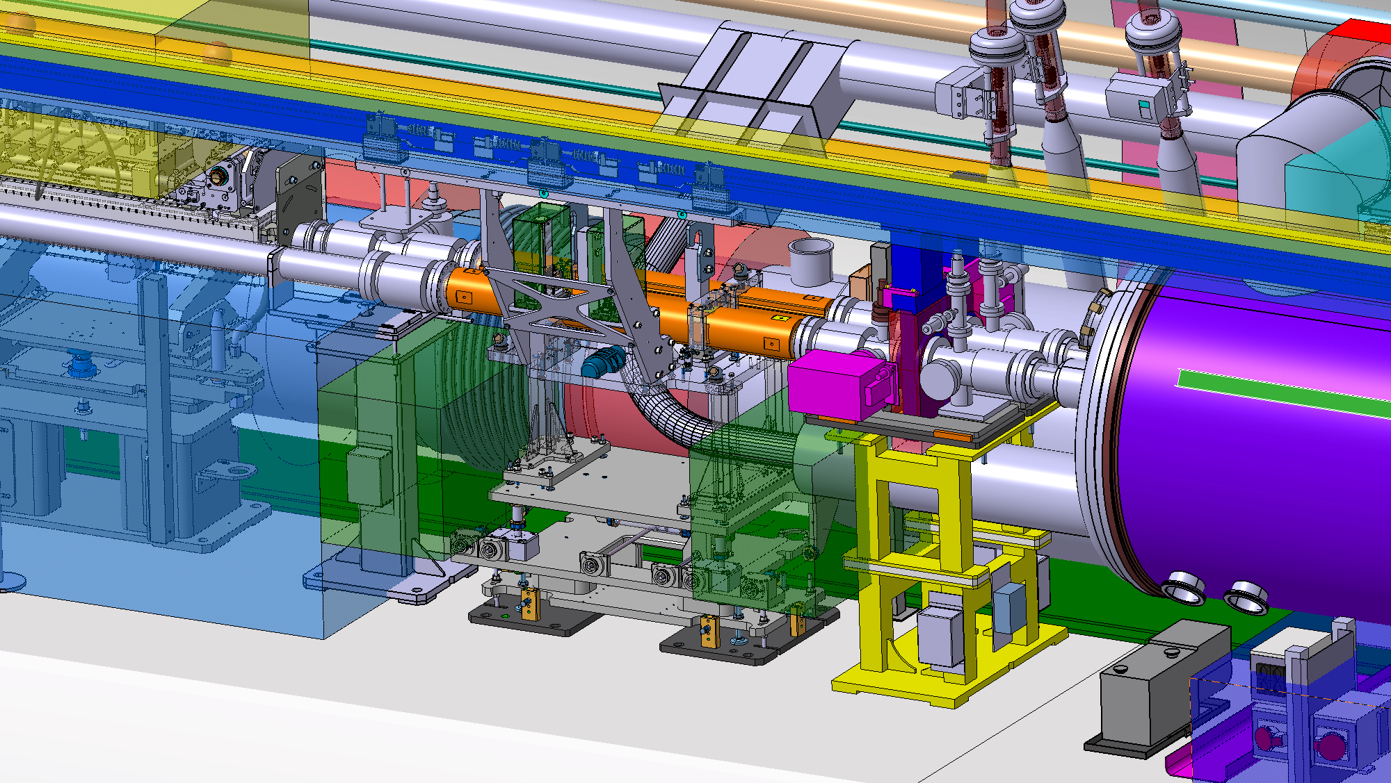
TCLM masks integration IP5R (ST0966906)
TCLM 5

Slide 10
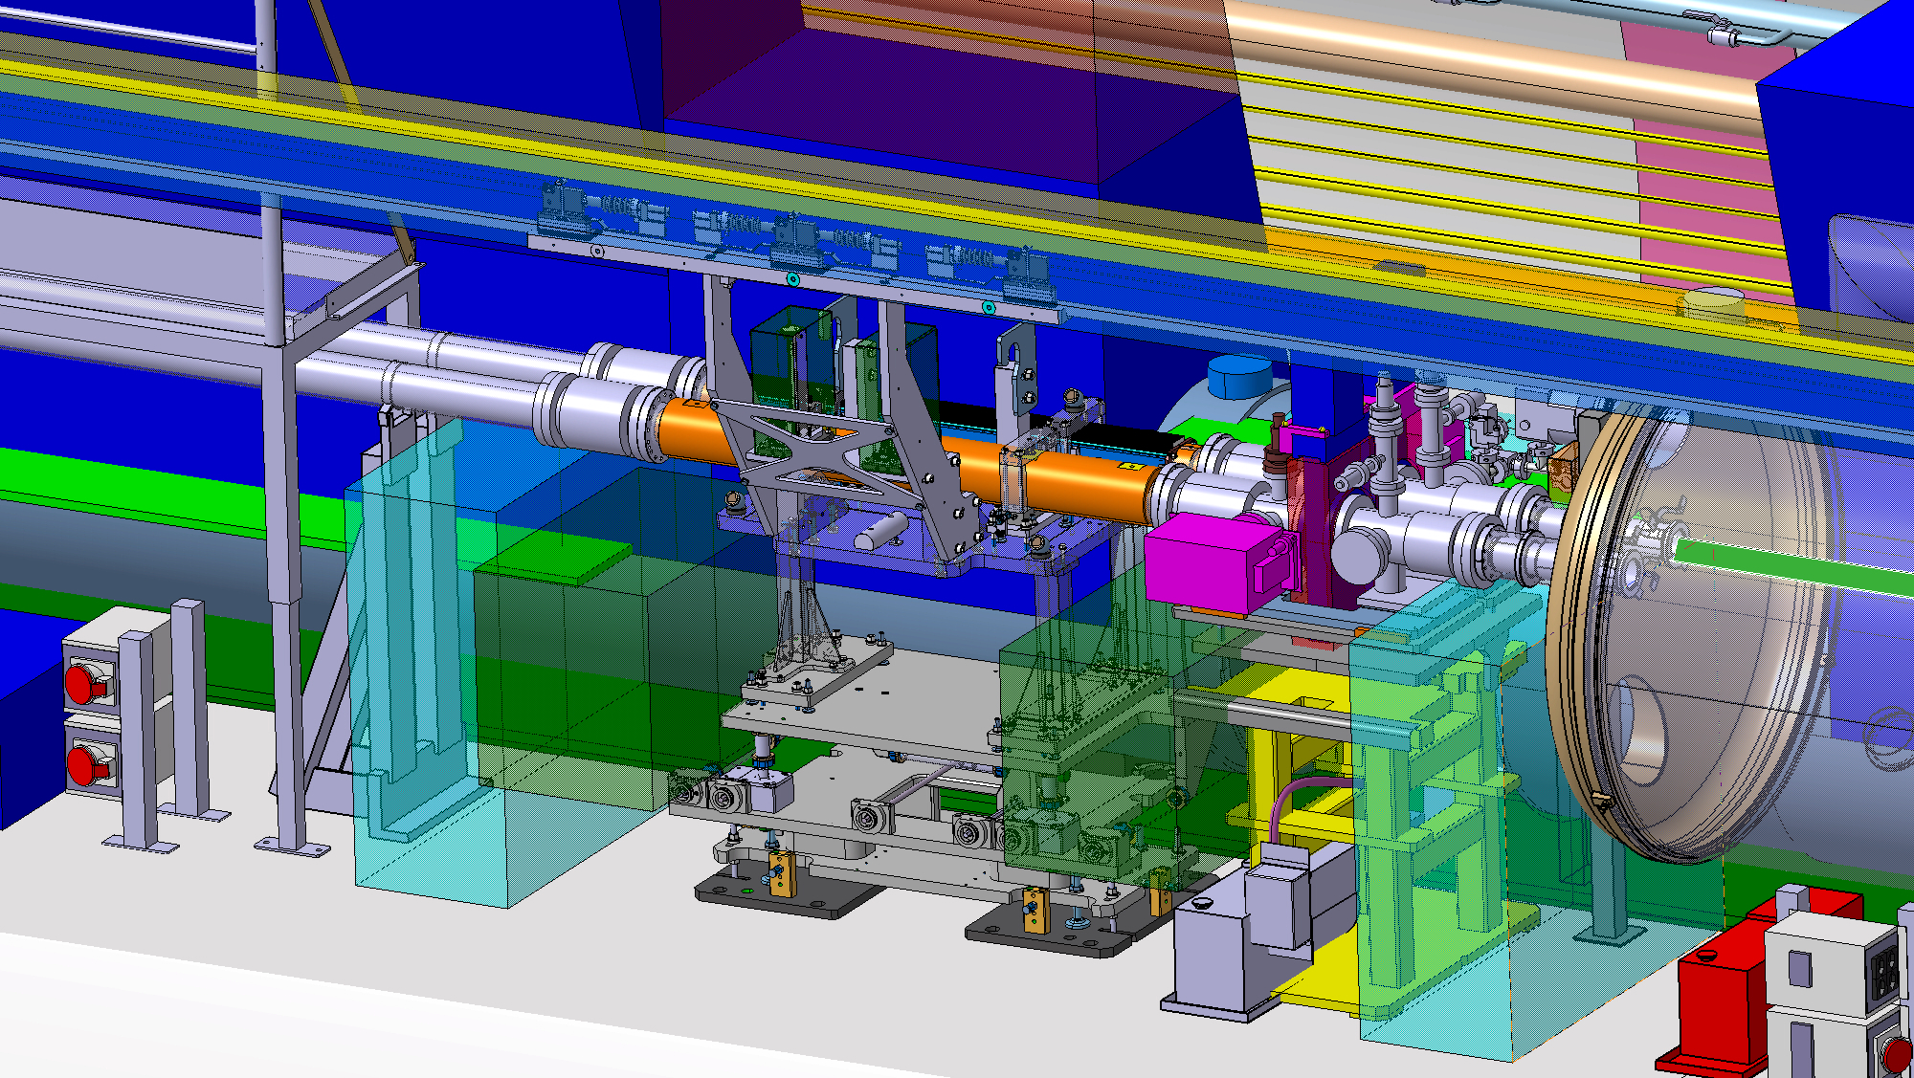
TCLM masks integration IP5R (ST0966906)
TCLM 4

Slide 11
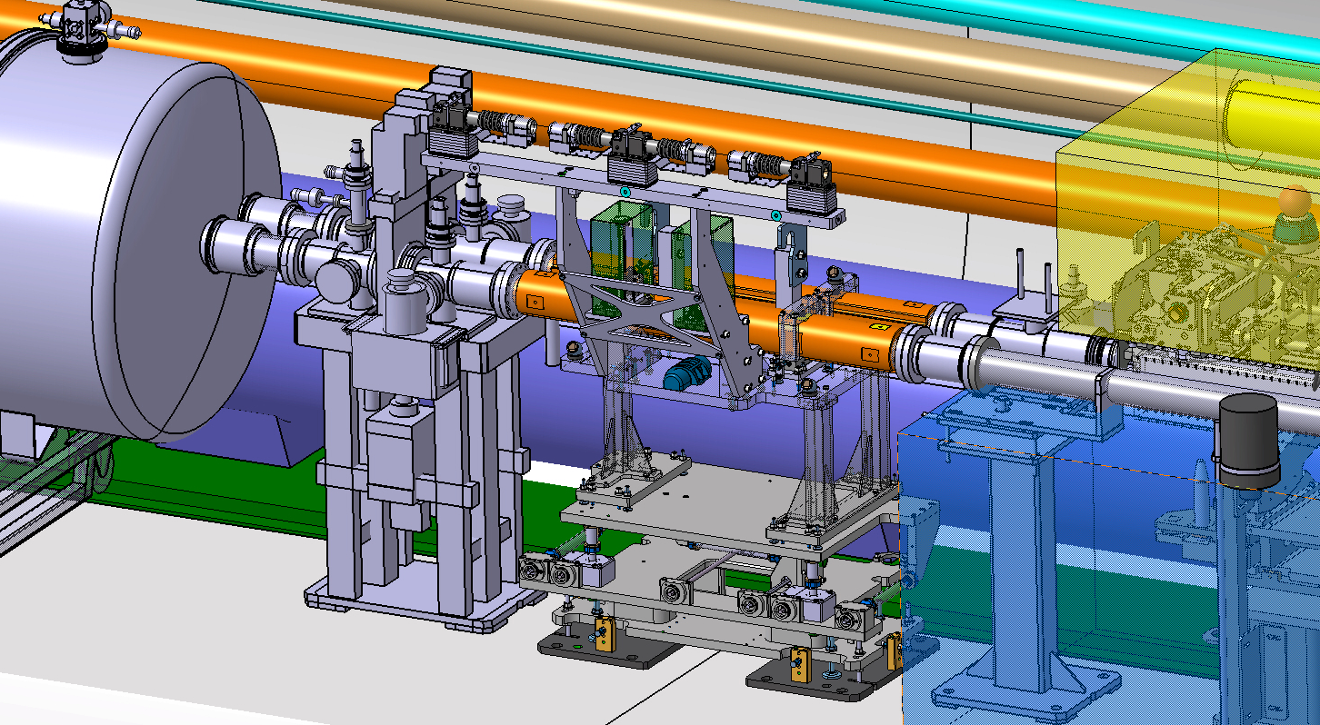
TCLM masks integration IP5L (ST0968836)
TCLM 6

Slide 12
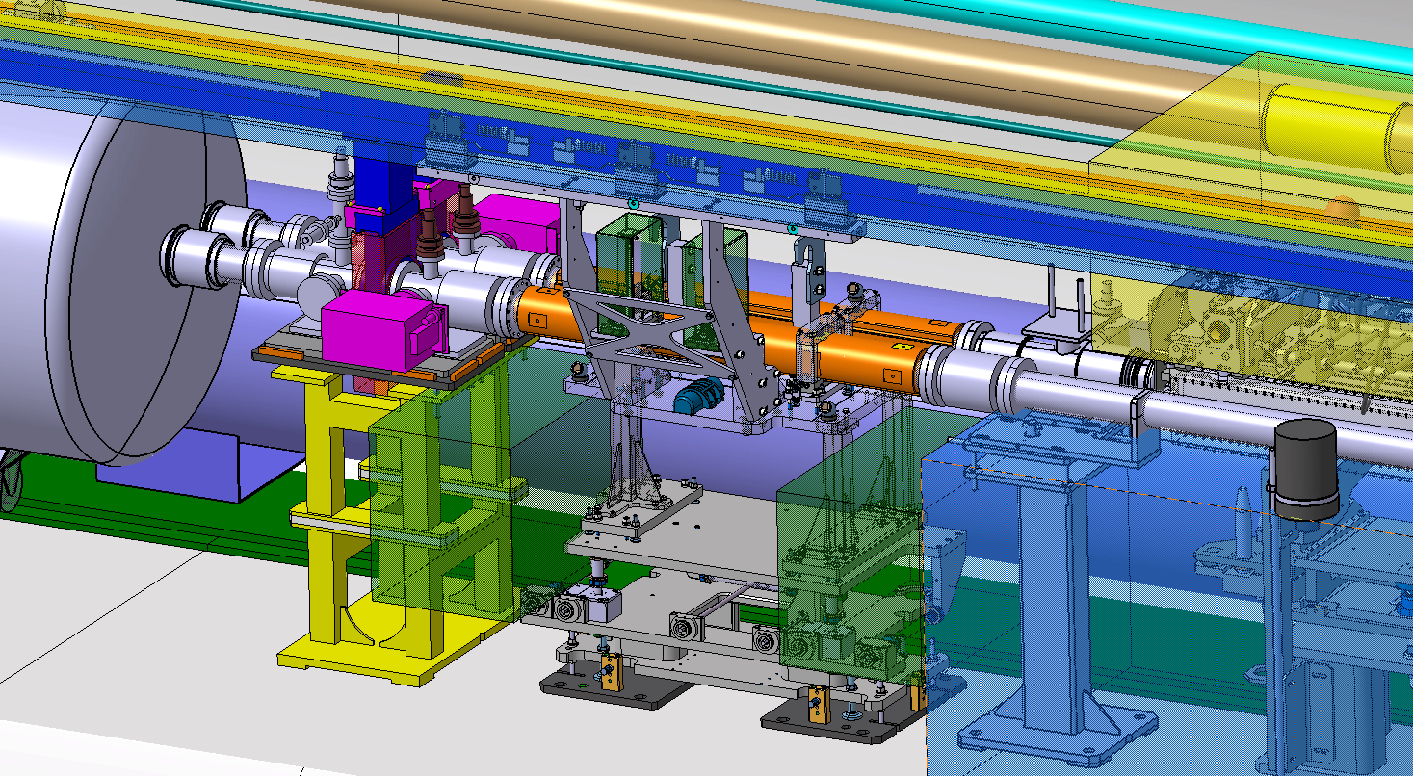
TCLM masks integration IP5L (ST0968836)
TCLM 5

Slide 13
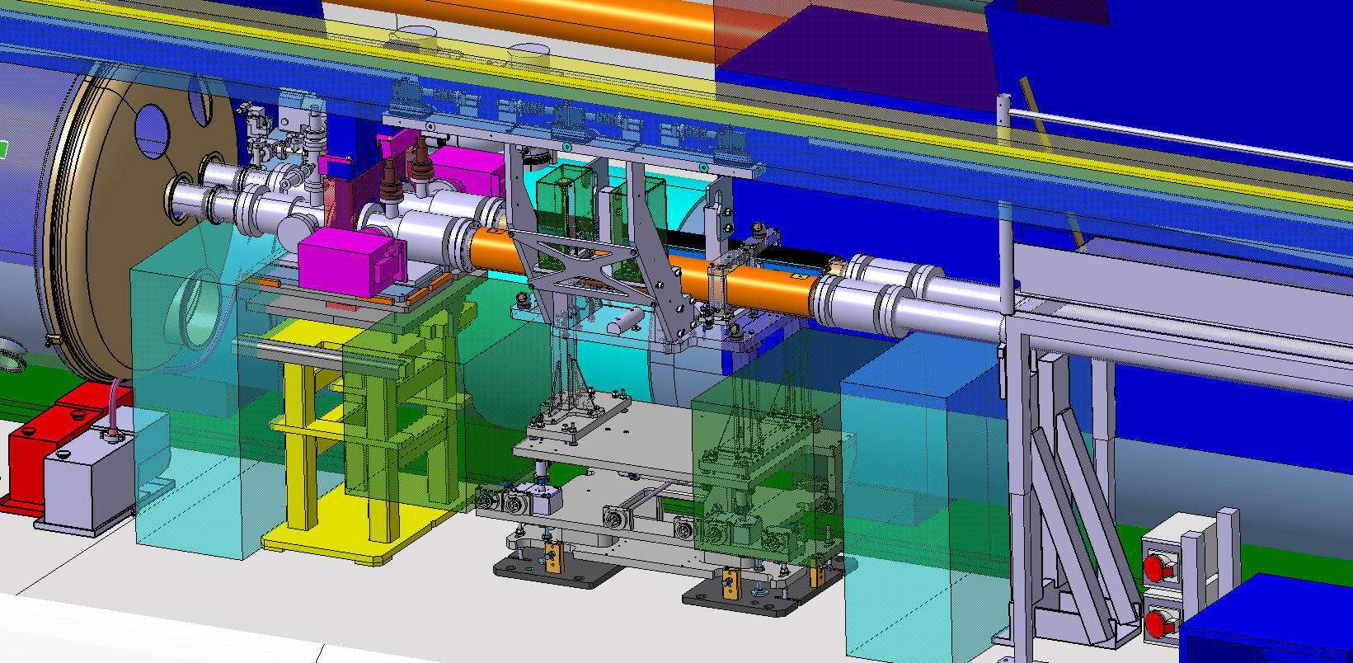
TCLM masks integration IP5L (ST0968836)
TCLM 4

Slide 14
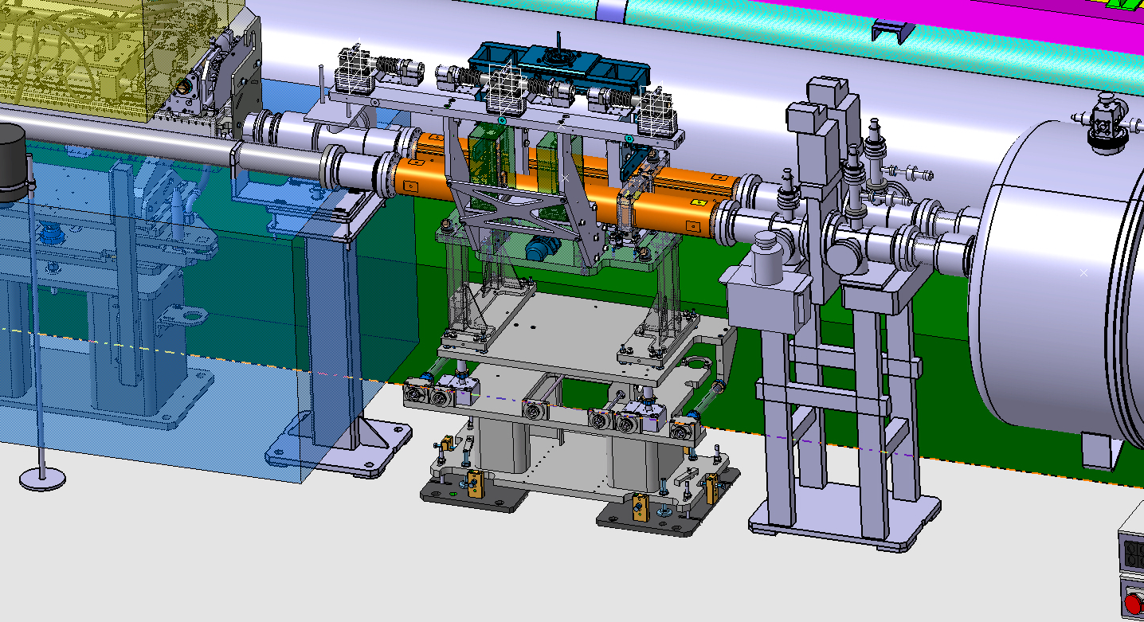
TCLM masks integration IP1R (ST0990128)
TCLM 6

Slide 15
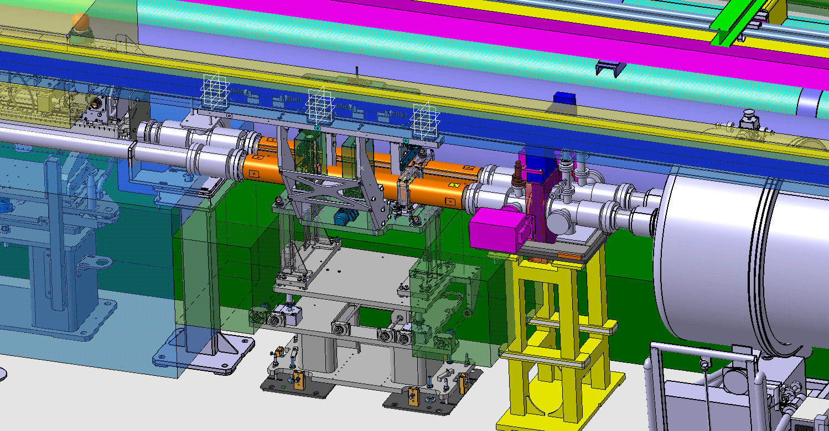
TCLM masks integration IP1R (ST0990128)
TCLM 5

Slide 16
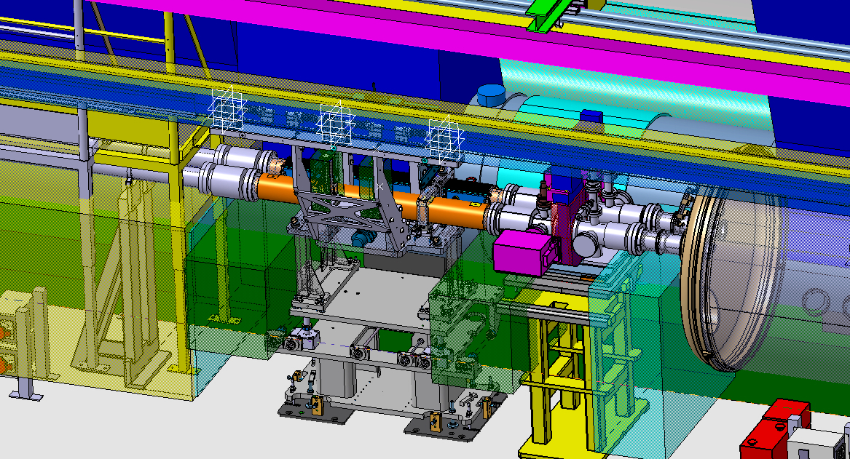
TCLM masks integration IP1R (ST0990128)
TCLM 4

Slide 17
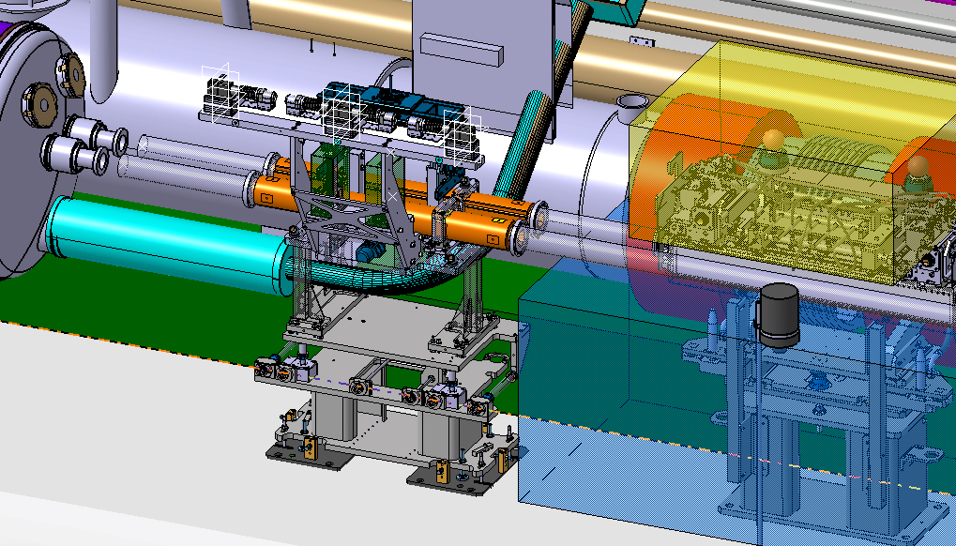
TCLM masks integration IP1L (ST0990131)
TCLM 6

Slide 18
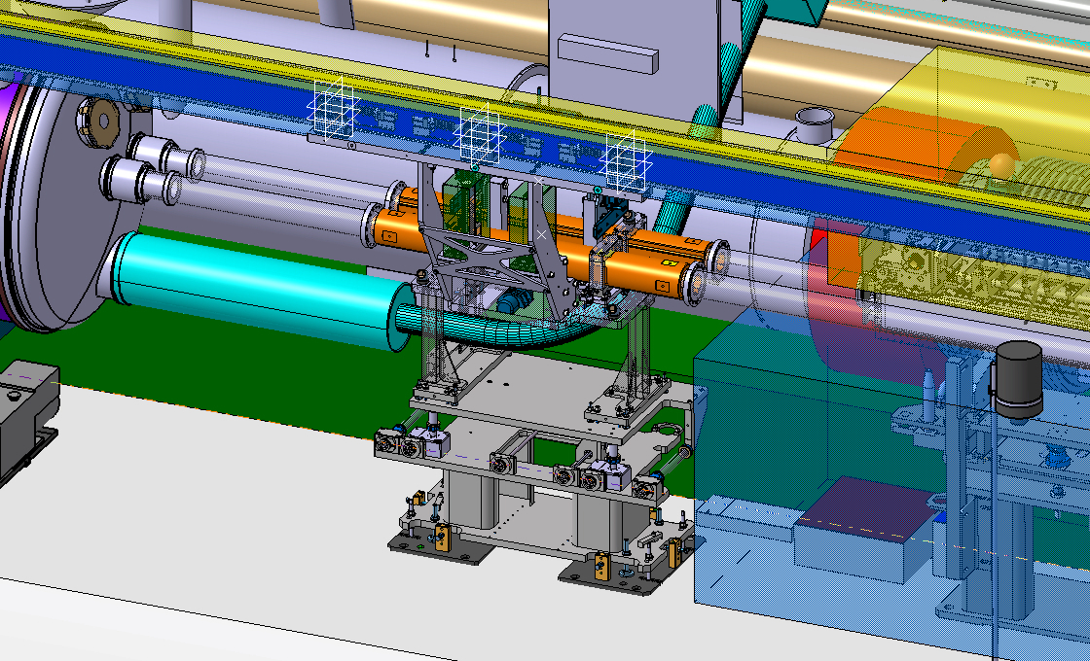
TCLM masks integration IP1L (ST0990131)
TCLM 5

Slide 19
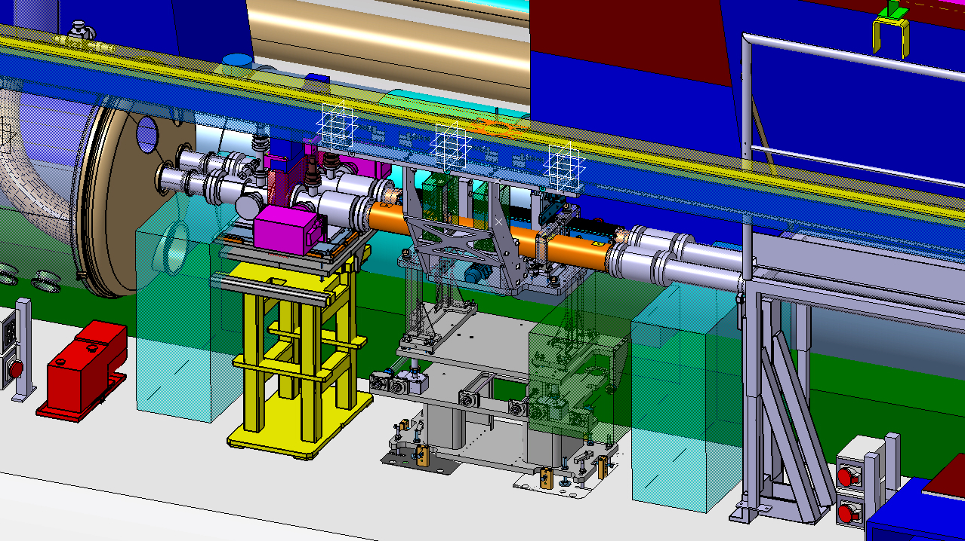
TCLM masks integration IP1L (ST0990131)
TCLM 4

Slide 20
Thank you for your attention

