Slide 1


The ATLAS RPC Phase II ugrade for High Luminosity LHC era
PAolo Camarri (university of Roma «Tor Vergata» and infn roma tor vergata
On behalf of the ATLAS muon community
XVII Conference on Resistive Plate Chambers and Related Detectors
Santiago de Compostela (Spain), 9-13 September 2024

Slide 2
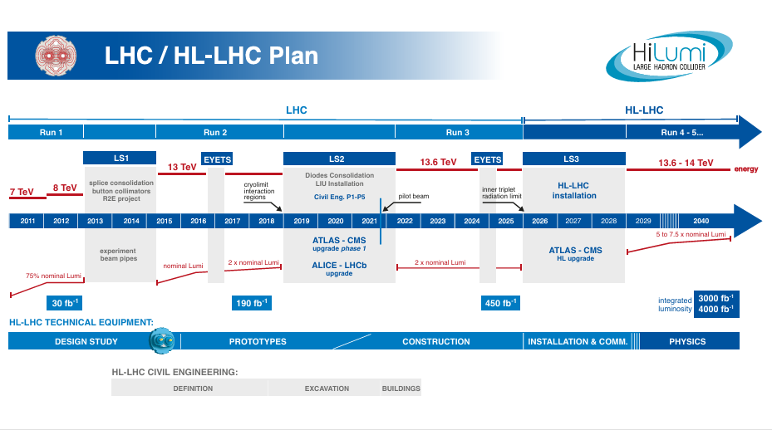
The High-Luminosity LHC

Slide 3
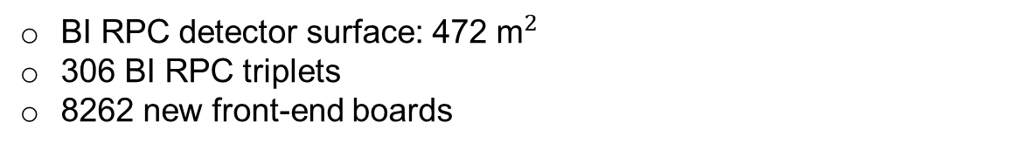
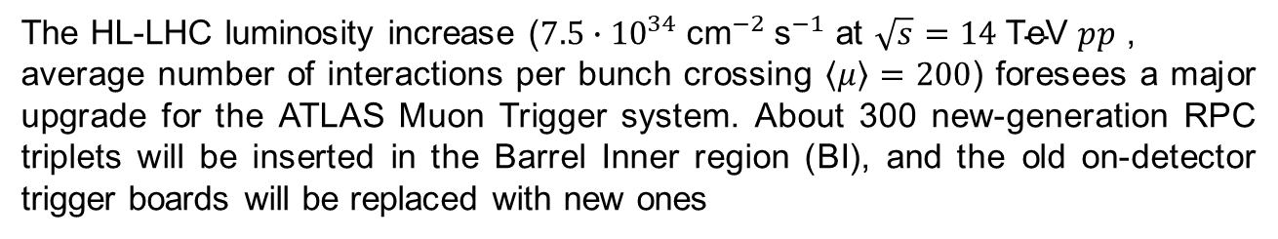
The ATLAS RPC upgrade for Phase II
The HL-LHC luminosity increase (${7.5∙10}^{34} {\text{cm}}^{−2} {\text{s}}^{−1}$ at $\sqrt{s}=14 \text{TeV} pp$ ,
average number of interactions per bunch crossing $\left\langle μ\right\rangle =200$) foresees a major upgrade for the ATLAS Muon Trigger system. About 300 new-generation RPC triplets will be inserted in the Barrel Inner region (BI), and the old on-detector trigger boards will be replaced with new ones
BO
BM
BI
Improved trigger redundancy (from 6 to 9 layers)
Increased trigger acceptance (from 78% to 92%, and to 96% by requiring BI-BO coincidence)
Improved time resolution for time-of-flight measurements: new thin-gap RPCs (1 mm) and new read-out electronics (0.4 ns for BI RPCs, from 2 ns to 1.1 ns for legacy RPCs)
BI RPC detector surface: 472 ${\text{m}}^{2}$
306 BI RPC triplets
8262 new front-end boards

Slide 4
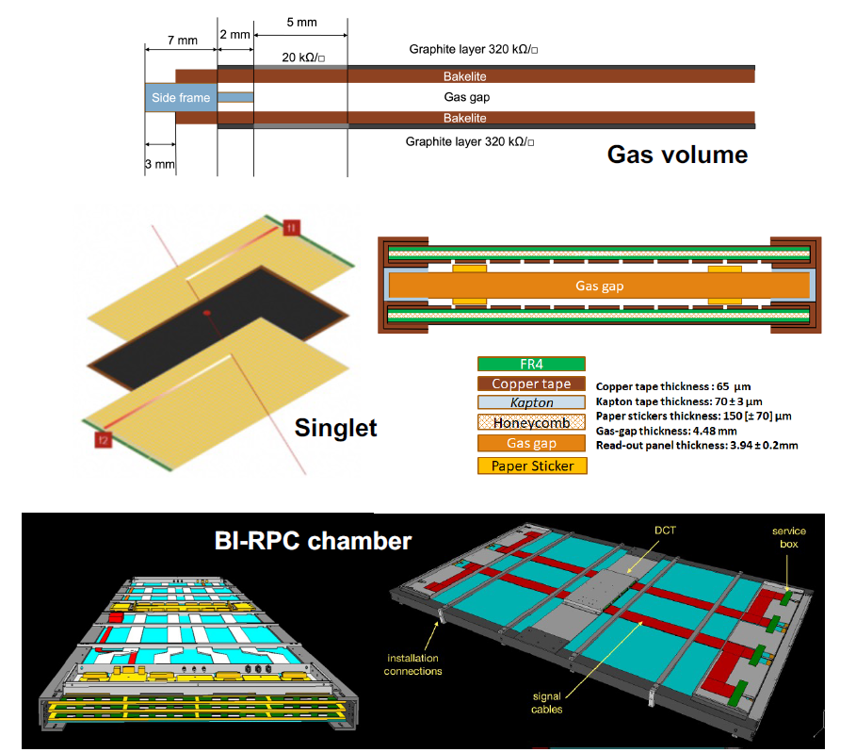
BI-RPC: gas volumes, singlets and chambers
Gas volume: a gas volume is composed of a gas gap enclosed between two High-Pressure Laminate (HPL) plates. A graphite layer is deposited on the external face of each HPL plate. Total gas-volume thickness: about 4.5 mm
Singlet: the gas volume is enclosed between two read-out panels with η-oriented strips (parallel to the long side of the chamber), forming a «singlet». The gas volume with the read-out panels is enclosed in a Faraday cage consisting of the outer faces (copper) with their edges connected by conductive copper tape. Singlet thickness: about 13 mm
BI chamber: three singlets (a «triplet») are inserted within a suitable mechanical structure to form a BI chamber. BIL-RPCs will be inserted in the Large sectors, while BIS-RPCs will be inserted in the Small sectors. BI chamber thickness: about 65 mm

Slide 5
New gas volumes
A new design for the gas volumes has been used, with several changes with respect to the ATLAS legacy RPC detectors:
Gas-gap thickness: reduced from 2 mm to 1 mm
The gas distribution was re-designed, with 4 inlets for connecting the gas pipes on the corners of the gas volume, drilled in the profile
New HV-cable connection on the the gas-volume side
The 6 mm diameter gas pipes were replaced with 3 mm diameter gas pipes
The graphite-layer resistivity was reduced from 500 kΩ/□ to 320 kΩ/□ and the footprint was redesigned to reduce the risk of possible current leaks
Electrode thickness: reduced from 1.8 mm to 1.4 mm
The production of the gas volumes in Italy has started in 2023 and is expected to end in 2025, carried out by General Tecnica Engineering (GTE).
Two new possible production centers are undergoing a qualification process: Munich (Max Planck Institute, MPI) and Hefei (University of Science and Technology of China, USTC)
(P. Camarri and M. Schioppa’s other talk for more details on the QA/QC of BIL RPCs)

Slide 6
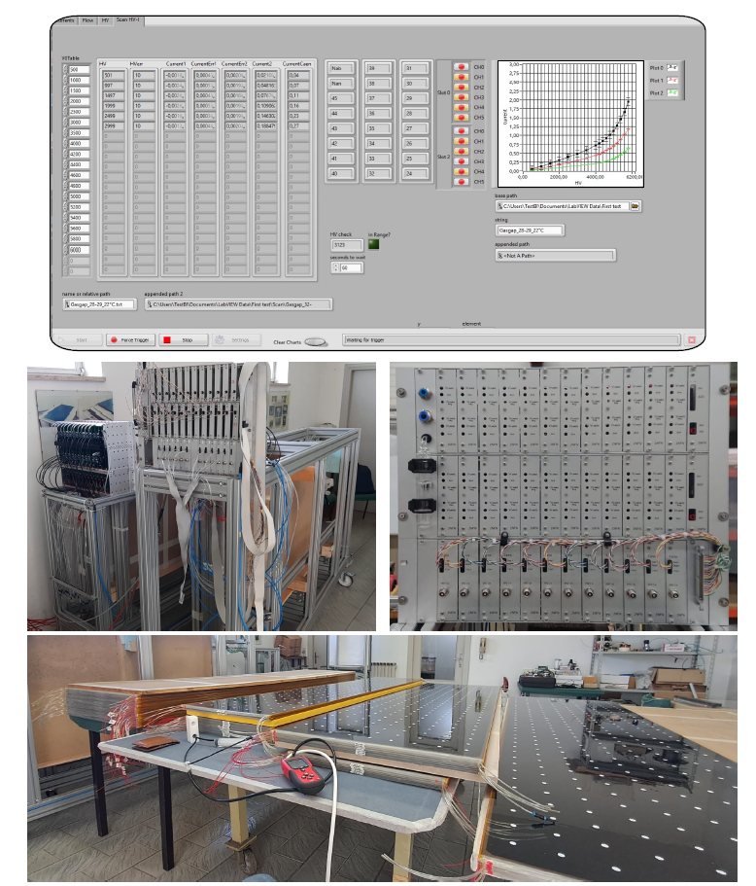
Qualification of gas volumes
Tests of HPL plates are carried out by INFN at GTE:
Measurement of the HPL bulk resistivity (maximum value accepted: 10¹¹ Ω cm)
Sample measurement of plate thickness
Visual inspection for detecting any possible macroscopic defects
Gas-volume tests are carried out at GTE and CERN:
10 tests are carried out by the manufacturer
3 tests are carried out by CERN-INFN
  Current vs Voltage (I-V) characterization (max 1 μA @ 3.5 kV – max 3 μA @ 6.1 kV after ohmic-current subtraction)
  Gas-tightness test (Δp < 0.1 mbar after 3 minutes)
  Current-leak test
Conditioning at GIF++
  The I-V curve is measured again with the source off
  The gas volumes are exposed to γ radiation from a ¹³⁷Cs source, at approximately 4800 V (max 20 μA/m²)

Slide 7
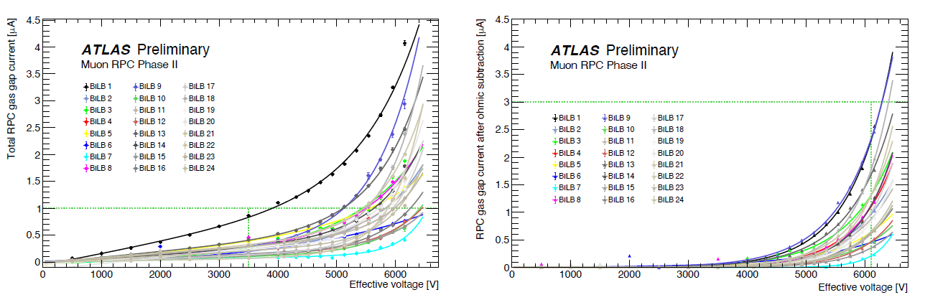
Current vs voltage test of gas volumes
The BI-RPC gas volumes are in production. In agreement with the tender requirements, gas volumes are accepted if the measured total current is less than 1 μA at 3.5 kV and a measured current less than 3 μA at 6.1 kV after subtracting the ohmic component, extrapolated by performing a linear fit in the [0 – 3] kV range
All gas volumes must undergo this test before invoicing. The plots below show the total current (left) and the recalculated current after subtracting the ohmic component (right) as a function of the applied voltage, for a whole production batch of BIL gas volumes
This tested production batch met the acceptance requirements

Slide 8
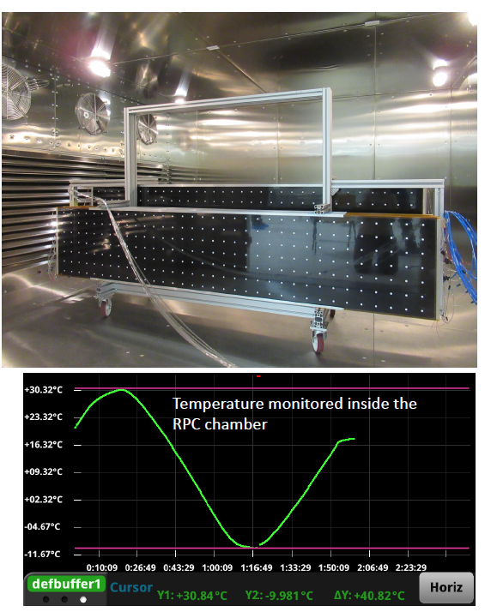
Gas-volume thermal tests
Stress tests were carried out on 4 BIL-type gas volumes with thermal cycles in the climatic chamber of the ATLAS laboratories at INFN Frascati. Additional tests are performed on BIS-type gas volumes at the Cambridge University.
Several cycles were carried out:
5 x [10 °C – 30 °C]
4 x [0 °C – 30 °C]
3 x [-10 °C – 30 °C]
3 x [-20 °C – 30 °C]
The gas volumes were flushed in parallel during the thermal cycles with low dew point dry air, applying 1.8 mbar overpressure at the gas inlet:
2 temperature sensors were inserted into the gas gaps to evaluate the delay in temperature variation and the attenuation of the cycle range
At the end of each cycle, the thermal-equilibrium conditions were verified after 15 minutes
Mechanical strength and gas tightness were monitored during the thermal cycles

Slide 9
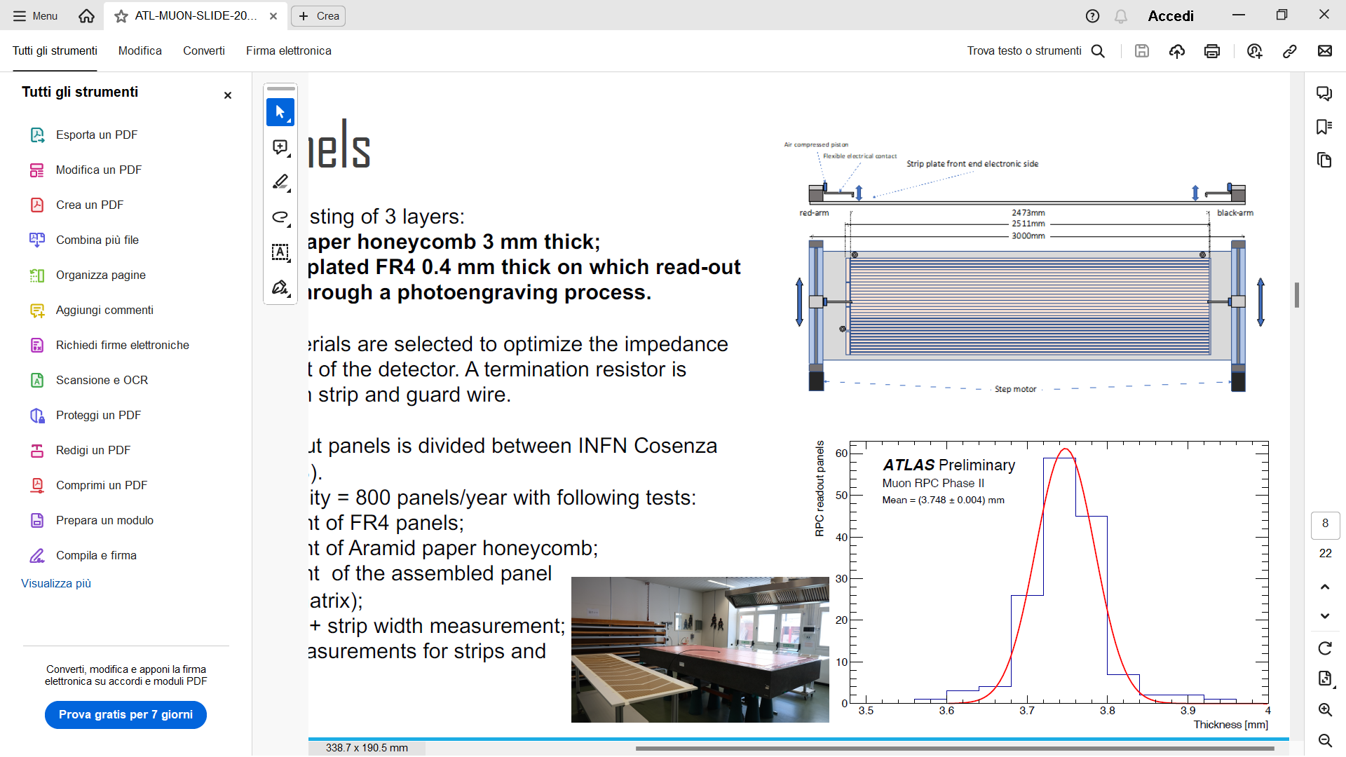
Read-out panels
New read-out panels consisting of 3 layers:
One layer of 3 mm – thick aramid paper honeycomb
Two layers of 0.4 mm – thick copper-plated FR4 on which the read-out strips are made by a photo-engraving process
Panel thickness and materials are chosen to optimize the strip impedance and the detector weight. A termination resistor is soldered to the ends of each strip and guard wire.
The construction of the read-out panels is shared between INFN Cosenza (BIL) and Hefei China (BIS).
INFN Cosenza site capability = 800 panels/year, also carrying out the following tests:
Thickness measurement of FR4 panels
Thickness measurement of Aramid paper honeycomb
Thickness measurement of the assembled panel surface (7 cm x 7 cm matrix)
Panel length and width + strip-width measurement
Electrical continuity measurements for strips and guard wires
(see P. Camarri and M. Schioppa’s other talk for more details on the production of BIL-RPC read-out panels)

Slide 10
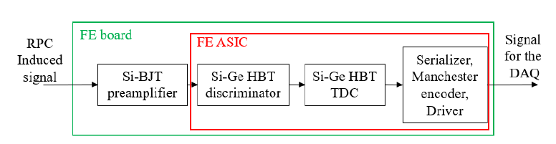
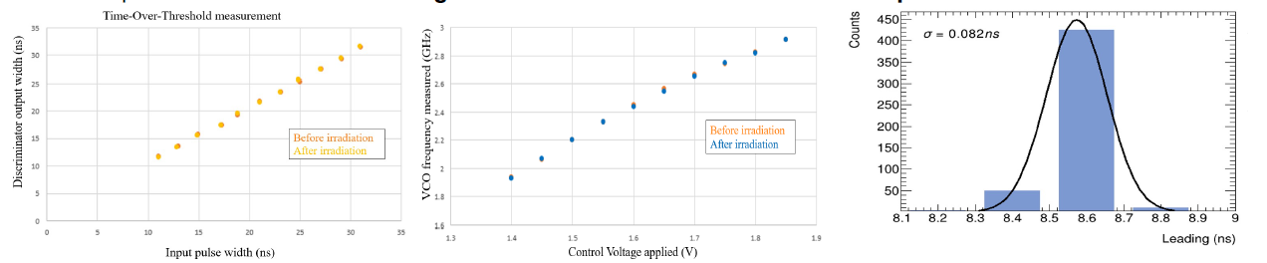
Front-End electronics
For BI-RPCs, an ASIC chip has been developed by INFN Roma Tor Vergata, integrating preamplifier, discriminator and TDC. This new design results in improved stability and sensitivity compared to the BIS-78 FE and also allows the ϕ-coordinate reconstruction:
Detectable signal of 1-2 fC
Minimum discrimination threshold of 0.3 mV
Voltage-Controlled Oscillator (VCO) defining the TDC time resolution driving the scaler (50-150 ps RMS)
Data encoded using the Manchester code
Each ASIC chip has 8 channels, each with its own serial transmission line
(L. Pizzimento’s talk for more details on the new FEE)
10 ASIC chips were irradiated with a neutron flux of 10¹³ n_{eq}/cm² at the China Spallation Neutron Source (Dongguan) to check the chip radiation hardness: no change was observed in the discriminator and in the VCO response after the irradiation.

Slide 11
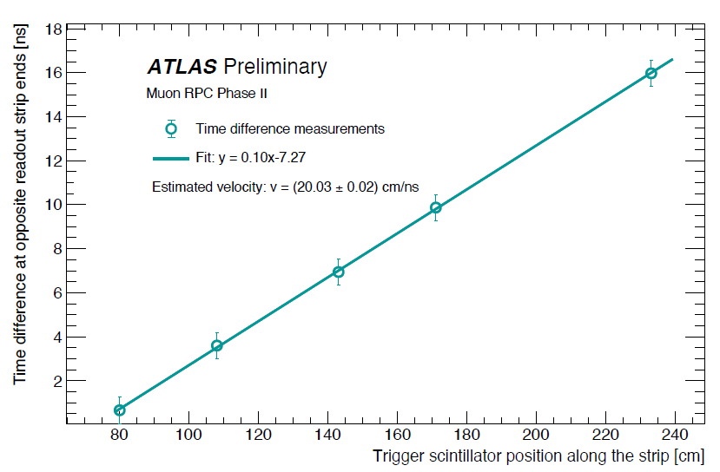
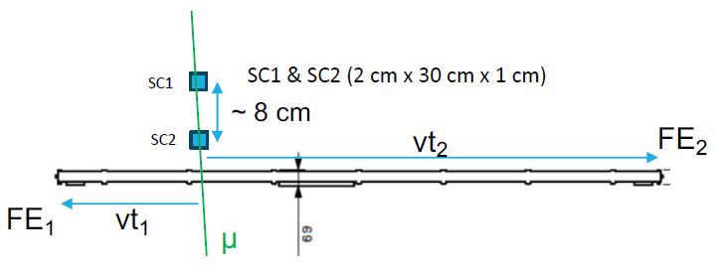
ϕ-coordinate measurement
The BI-RPC detectors have only η-oriented read-out strips, equipped with FE electronics using a TDC with 100 ps time resolution at the opposite ends.
The ϕ-coordinate reconstruction is obtained from the propagation time of the signals on the strips and from the propagation velocity.
The signal propagation velocity on the strip can be measured by measuring the time difference on the opposite read-out strip ends.
This measurement has been carried out by placing 2-cm wide trigger scintillators orthogonal to the strip, at different positions.
A signal propagation velocity of 20 cm/ns was measured on a BIL-RPC equipped with BIS-78 like FE board
The resulting spatial resolution for the ϕ reconstructed coordinate was about 2 cm, driven by the scintillator geometry
The spatial resolution for the η coordinate depends on the event cluster size

Slide 12
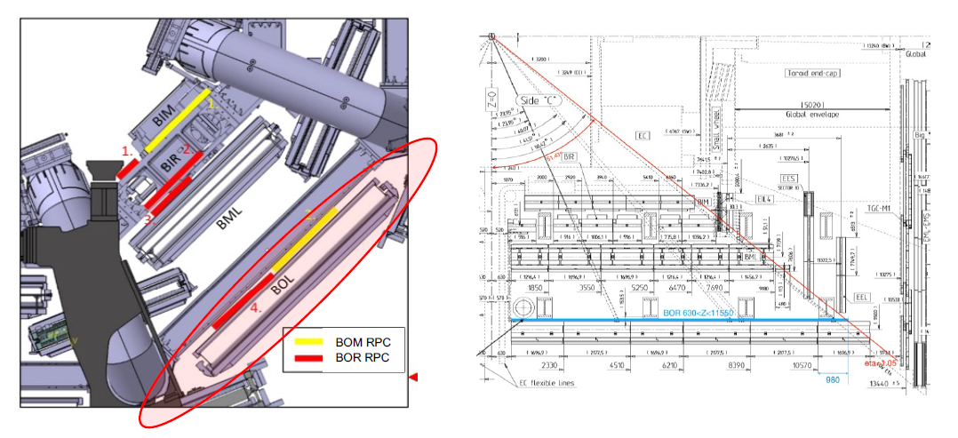
Layout of the BI-RPC chambers
The design of the BI-RPC mechanics has been defined for all the main chambers (4 BIL types: BIL 680S – BIL 680L – BIL 620S – BIL 520S covering 75% of the BIL sectors; 2 BIS types: BIS1 and BIS from 2 to 6, covering all the BIS sectors involved in the Phase-II upgrade) and other special cases.
In the feet sectors (S11 and S15) new chambers will be installed in the Barrel Outer region: 80 identical BOR-BOM chambers without overlapping, of BIS-like size.

Slide 13
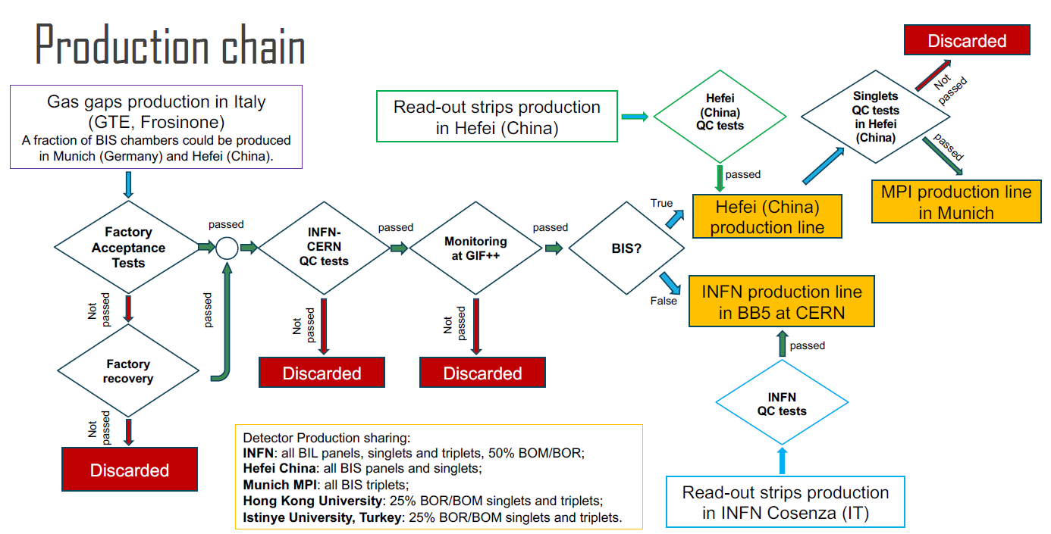
Production chain

Slide 14
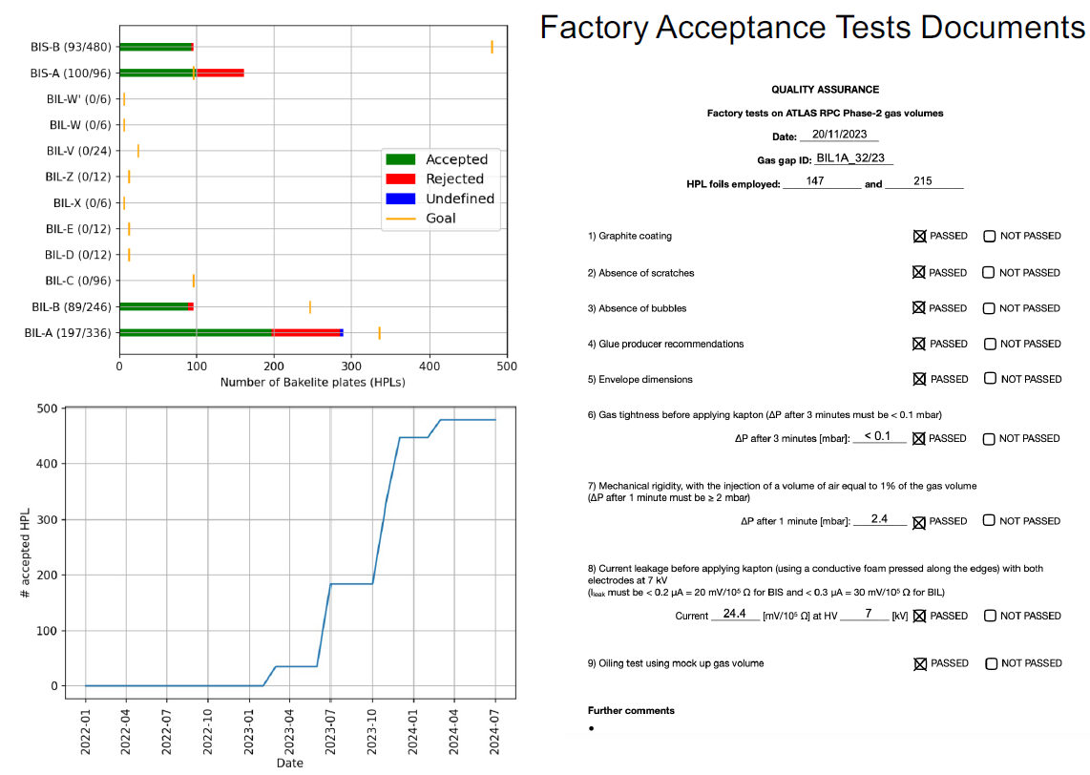
Production Database
Infrastructure
mySQL DB managed via a web interface to keep track of components (gas gaps, HPL plates)
  Including relationships (i.e. what goes into what)
Web interface for presenting QA/QC test results (e.g. I-V curves) for the components
Based on CERN login, now restricted to the users directly involved in this activity
Status
Management of panels and gas gaps ready
Next step: implementation of singlets
Long-term goal: implementation of triplets and chambers

Slide 15
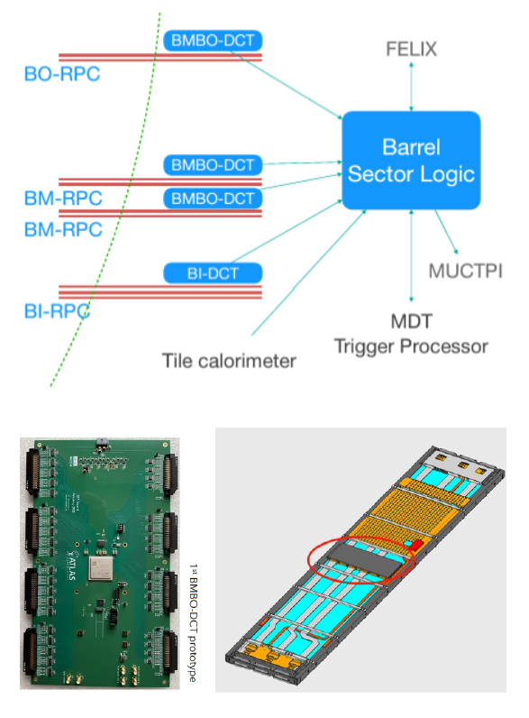
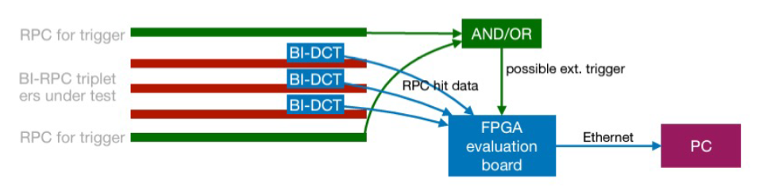
Data Collector and Transmitter (DCT)
The DCT connects the detector FE with the ATLAS Barrel Sector Logic (SL), where trigger logic operations are carried out. Two kinds of DCT are developed:
BMBO-DCT (Legacy RPC system): receives hit analog pulse from the FE, measures the arrival time with FPGA-TDC and sends time data to the SL.
  First prototype extensively tested (both HW ans SW):
    Communication test with SL
    Read-out test with a BML RPC at INFN Roma Tor Vergata:
      0.8 ns time resolution on the cosmic-ray time of flight between two RPCs
      0.24 ns TDC time resolution on η-ϕ panels facing the same gas volume
  Second prototype under test: irradiation test completed
  1208 BMBO-DCT foreseen to be installed
BI-DCT (BI-RPC): receives hit time digital data from FE-TDC, decodes and sends «Bunch Crossing ID» tagged time data to SL, reconstructs ϕ coordinate from time difference of two η-η read-outs
  Schematics ready, first prototype being submitted
  FE-DCT communication test ongoing
  Planned to be tested in the cosmic-ray station at CERN BB5
338 BI-DCT foreseen to be installed

Slide 16
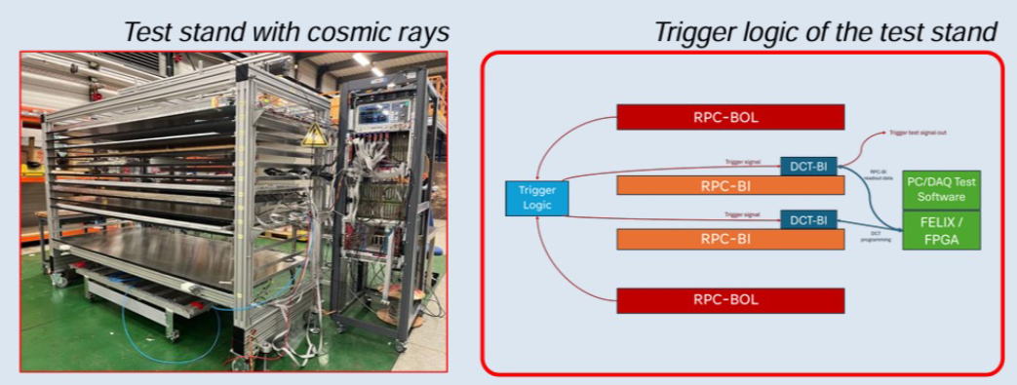
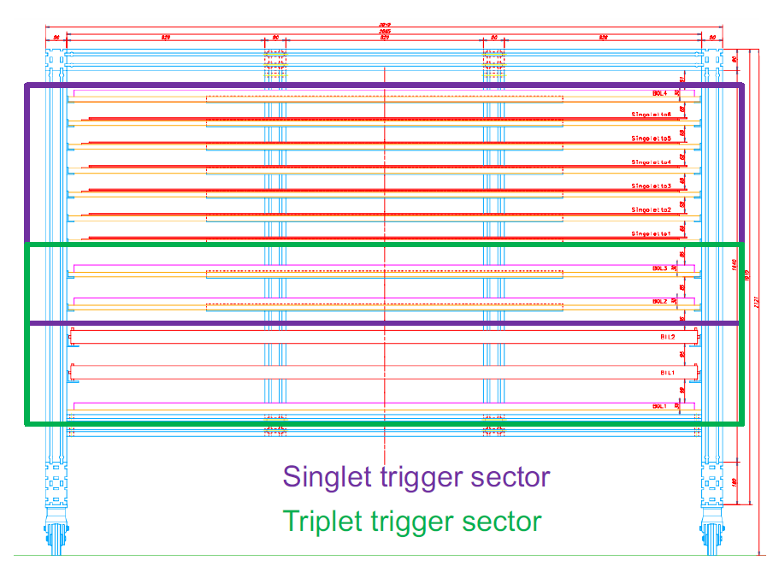
Cosmic-ray test stand
Two trigger sectors available for QA/QC test:
Upper sector to certify up to 6 BIL singlets
Lower sector to certify up to 2 BIL chambers (triplets)
Tower structure with 4 RPC Legacy detectors used as trigger
1 at the top
2 in the middle
1 at the bottom
The height of the trigger detectors can be adjusted depending on the number of detectors under test and to optimize the certification speed during the production.
All the 4 RPC gas volumes and 8 read-out panels have been refurbished and the trigger detectors have been assembled and installed at CERN.

Slide 17
Conclusions
New state-of-the-art RPC detectors have been developed:
New gas volume with 1 mm gas-gap thickness with improved gas and high-voltage distributions:
  improved time resolution (from 1 ns to 0.4 ns)
  reduced singlet thickness (13 mm)
New FE electronics with Si-technology preamplifier and SiGe-HPT ASIC with discriminator and TDC embedded:
  sensitivity to 1-2 fC
  TDC time resolution around 100 ps
Second-coordinate reconstruction capability through difference of signal propagation times along the strip
Improved rate capability up to 10 kHz/cm²
New on-detector DCT developed with about 250 ps time resolution
Production of the detector components started:
Gas-volume production and test in Italy; two additional producers under qualification
Read-out panel assembly and test at INFN Cosenza and Hefei China
FE electronics close to complete the integrations tests; ASICs partially produced
BMBO-DCT second prototype under validation; BI-DCT close to production
Prototype of the chamber mechanical structure started after tender assignment

Slide 18
Back-up slides

Slide 19
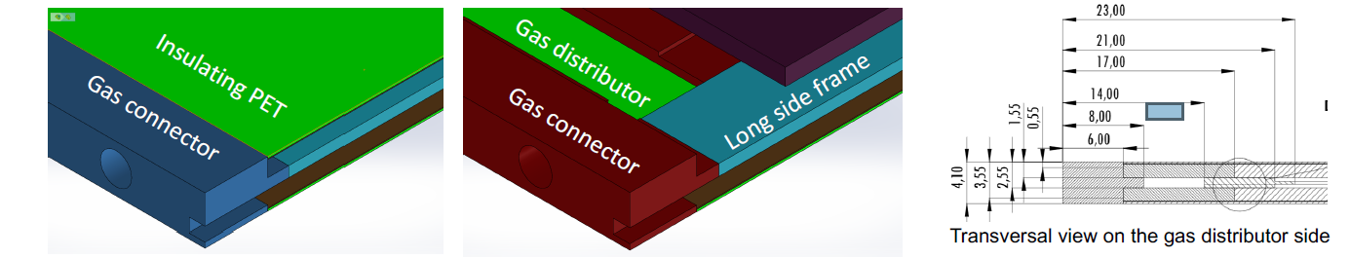
Details of BI-RPCs

Slide 20
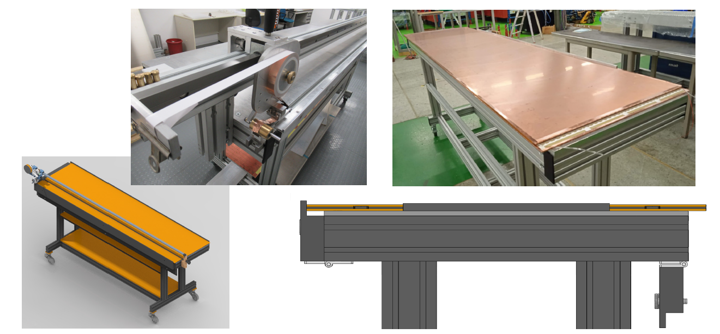
Production at CERN

Slide 21
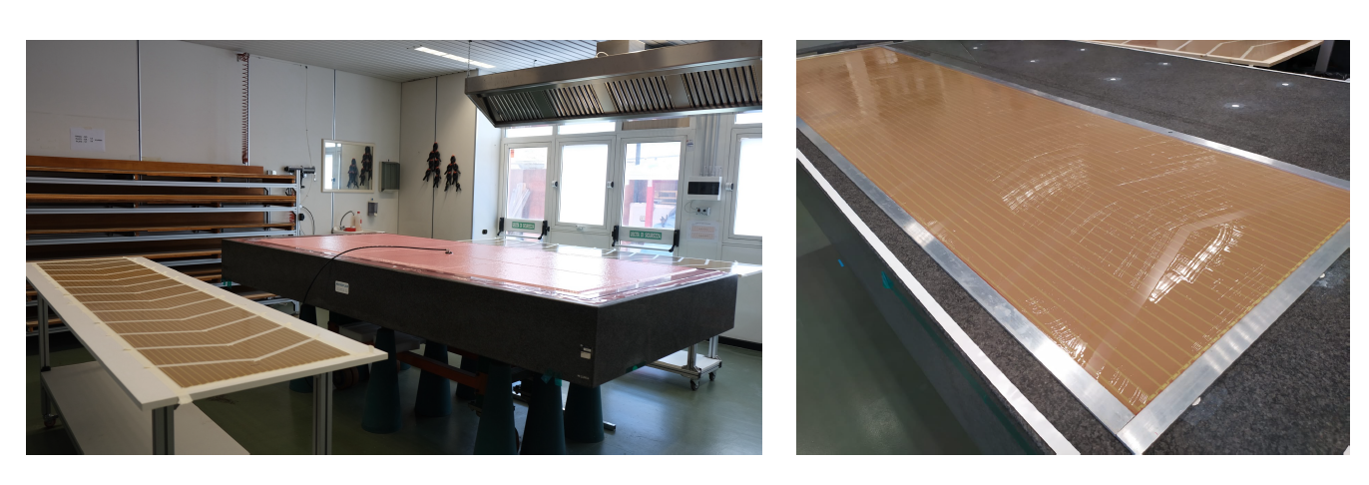
Read-out panels

Slide 22
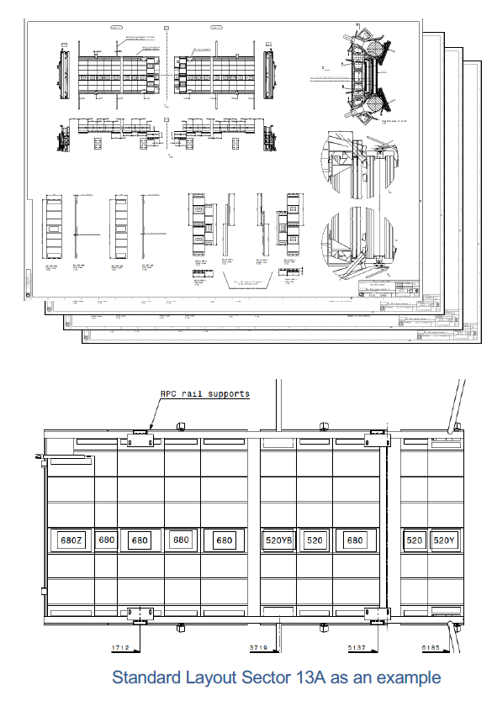

Slide 23
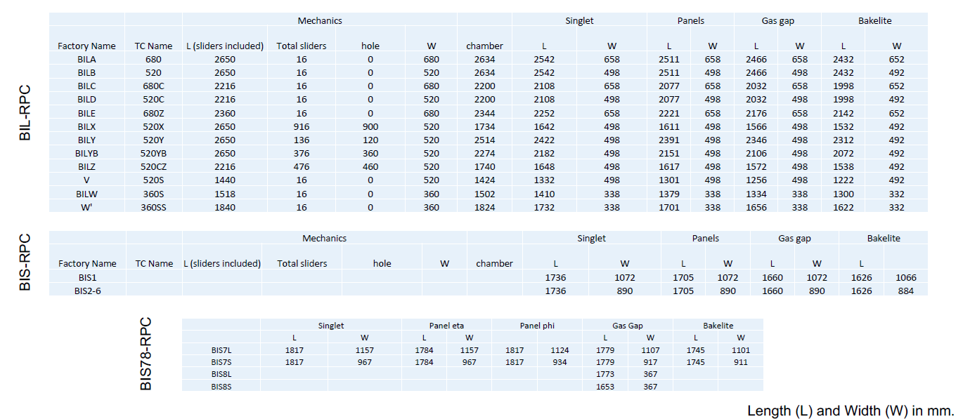
BIL and BIS dimensions

Slide 24
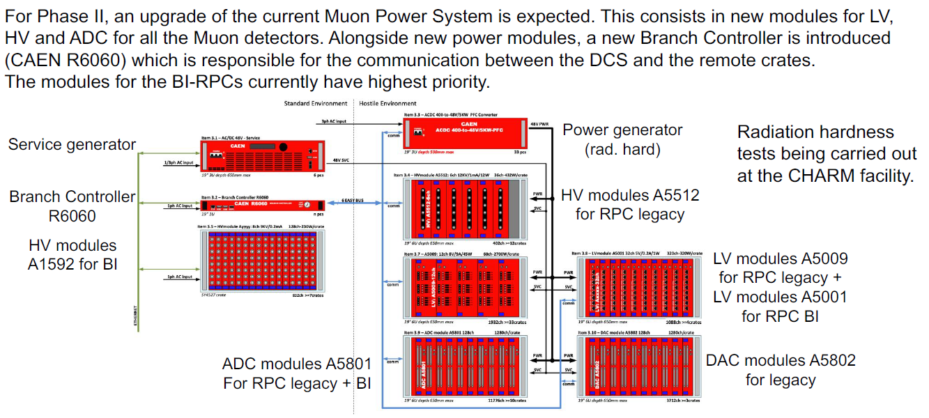
Power System

Slide 25
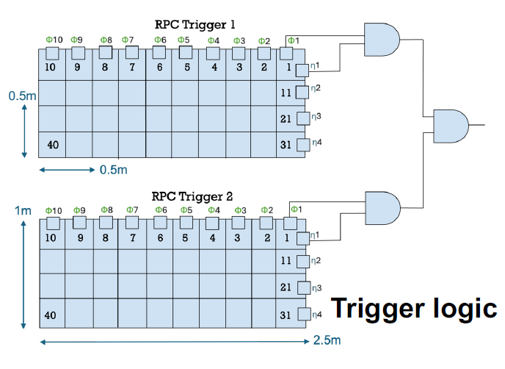
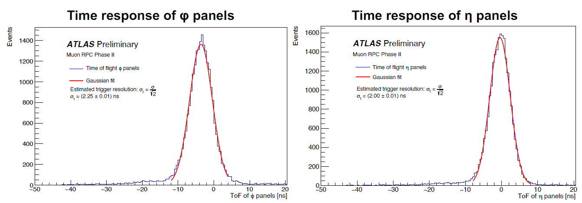
Test-stand trigger logic and performance
A measurement of the trigger time resolution for the cosmic-ray test stand has been performed after the installation of 2 trigger detectors.
The trigger logic has been implemented on an open FPGA module with up to 196 input-output channels interface:
Quadruple coincidence of 4 read-out planes (2 RPCs with η and ϕ coincidences)
40 Regions od Interest (RoIs) defined in the FPGA to perform an online trigger topology and tracking and acquired with a TDC to validate the system.
The time of flight is estimated by selecting tracks with hits in each of the 4 panels.
Time resolutions of 2.25 ns and 2.00 ns were measured for ϕ and η panels, respectively.
The rate produced by the FPGA trigger logic is also compared with an equivalent NIM one.

