Slide 1

Particle IDentification (PID) in the HMPID
Erlend Flatland
University of Agder / CERN

Slide 2

Outline
HMPID Description
HMPID structure
Particle IDentification (PID) in the HMPID
Current PID algorithm in the HMPID

Slide 3
HMPID Description

Slide 4
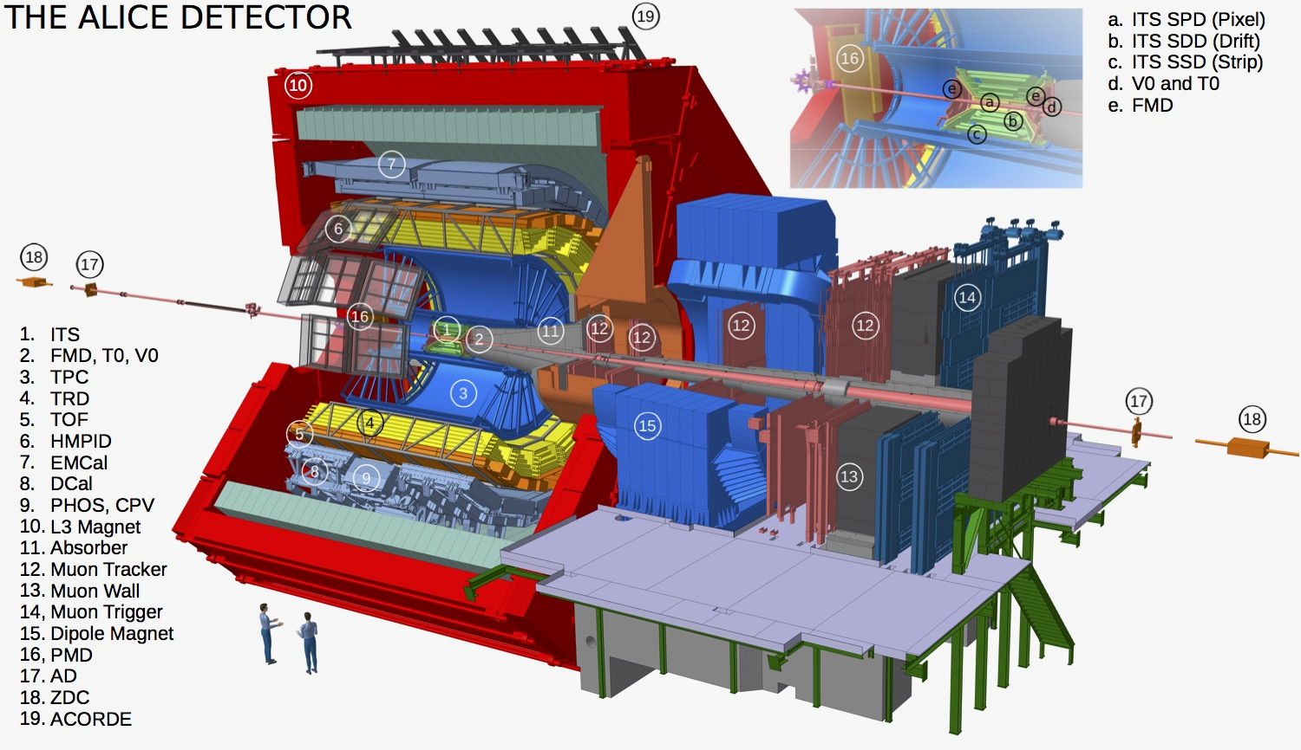
HMPID description
The HMPID gets track information from the ITS, TPC, TRD and TOF
HMPID has 5 % of TPC acceptance
Notes:
The PID in HMPID is a joint effort;
The HMPID gives an estimate of the mass with help of information given by other detectors
The HMPID gets track information from the ITS, TPC, TRD and TOF

Slide 5
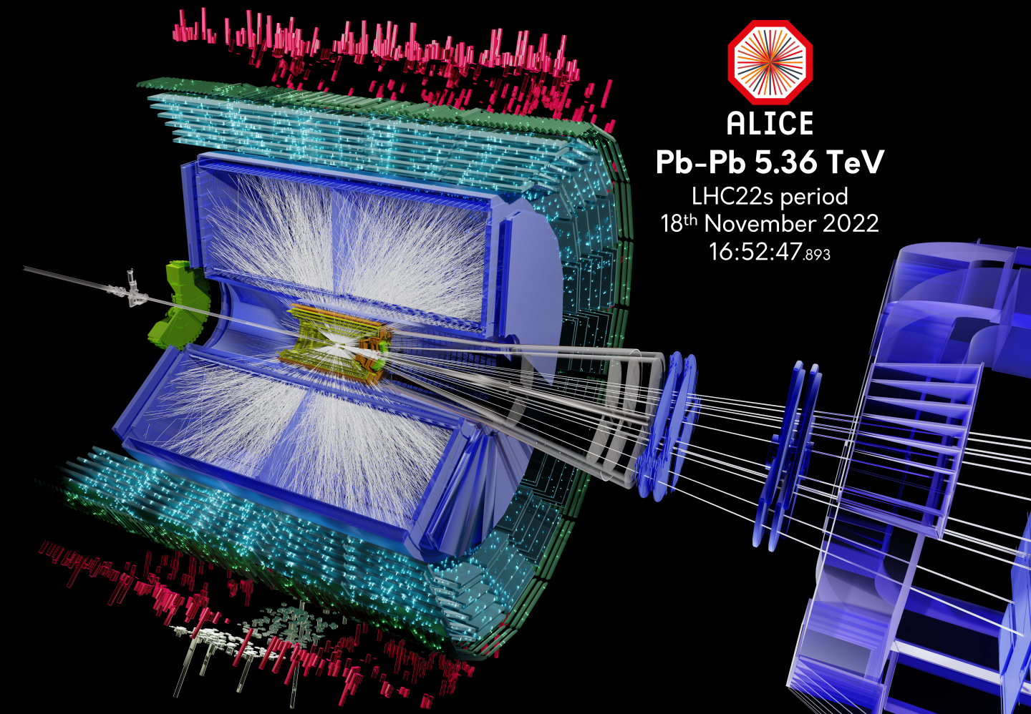
ALICE event display
Notes:
ALICE-PHO-GEN-2022-009
https://cds.cern.ch/record/2841865
ALICE event displays and geometry rendering of lead-lead ion collisions during Run 3
Event displays of the first Pb-Pb collision of Run3 taken at ALICE which sees its first event displays of heavy ion - lead-lead (Pb-Pb) - collisions during Run 3. Lead beams travelled for 3 days (17-19 November) in the LHC accelerator. ALICE is one of the main experiments on the LHC who profits mostly from the results of the lead-lead ion beam optimized to study the collisions of nuclei. The aim is to study the physics of strongly interacting matter at the highest energy densities reached so far in the laboratory.
Photograph: Dobrigkeit Chinellato, David
Keywords: ALICE; Run 3
Note: General Photo

Slide 6
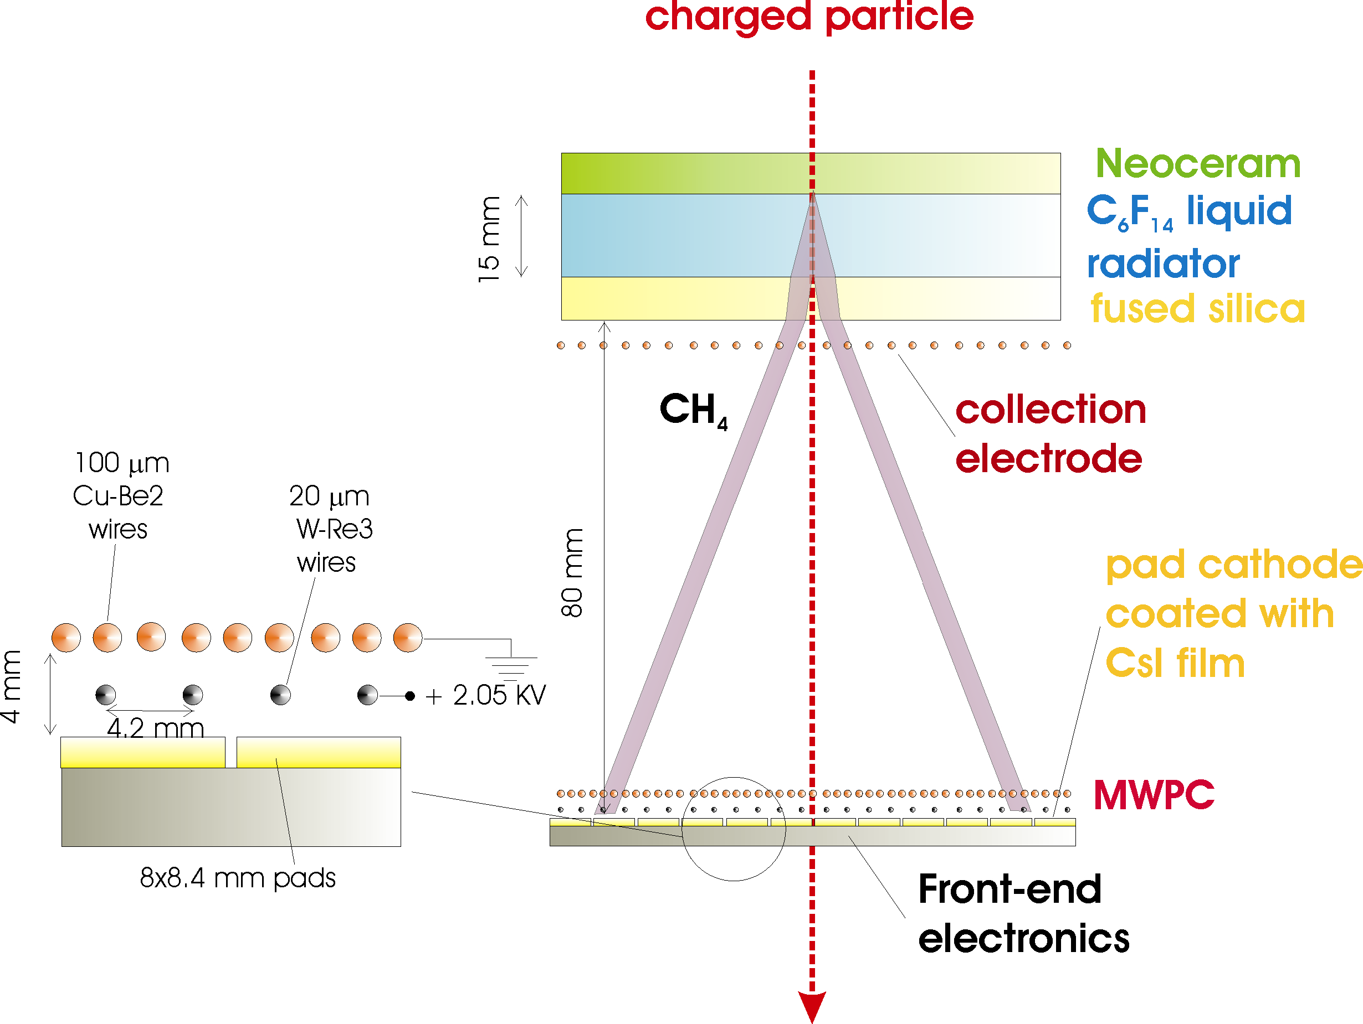
HMPID description
ALICE-HMPID (High Momentum Particle Identification Detector) performs charged particle track-by-track identification by means of the measurement of the emission angle of Cherenkov radiation and of the momentum information provided by the tracking devices.
It consists of seven identical proximity focusing RICH counters.
RADIATOR
15 mm liquid C₆F₁₄, n ~ 1.2989 @ 175nm, β_{th} = 0.77
PHOTON CONVERTER
Reflective layer of CsI QE ~ 25% @ 175 nm. The largest scale (11 m²) application of CsI photo-cathodes in HEP
≈ 5 % of TPC acceptance
PHOTOEL. DETECTOR
- MWPC with CH₄ at atmospheric pressure (4 mm gap) HV = 2050 V.
- Analogue pad readout
Notes:
Cherenkov photons are emitted if the velocity threshold β_{th} = 0.77 is exceeded in the Radiator
Credits to Giacomo Volpe https://indico.cern.ch/event/1246704/?view=nicecompact
The Cherenkov photons are detected using Multi-Wire-Proportional-Chambers (MWPC) flashed with CH4 and equipped with Pad-segmented cathodes
activated with a 300 nm thick layer of CsI [6, 4].
In the HMPID, the production of Cherenkov radiation is done by using a radiator medium in the form of liquid C6 F14 (perfluorohexane) [6].

Slide 7
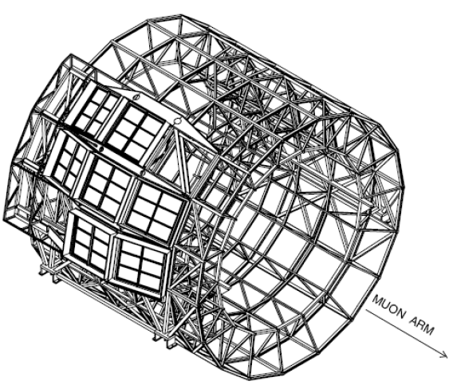
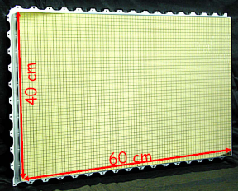
HMPID description
Six photo-cathodes per module
CsI photo-cathode is segmented in 0.8x0.84 cm pads
Notes:
Credits to Giacomo Volpe https://indico.cern.ch/event/1246704/?view=nicecompact

Slide 8
Cherenkov radiation

Slide 9
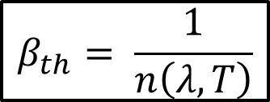
Cherenkov radiation
Velocity threshold
A charged particle emits Cherenkov radiation if its velocity exceeds the phase velocity of the medium it travels through.
An analog can be made to the creation of sonic booms when the speed of sound is exceeded
For the given material, with refractive index n(λ, T),
Cherenkov radiation occurs if the velocity-threshold is exceeded:
$$β_{th}= \frac{1}{n\left(λ,T\right)}$$
phase velocity of medium
RADIATOR
15 mm liquid C₆F₁₄, n ~ 1.2989 @ 175nm, β_{th} = 0.77
Typical phase velocity of the HMPID radiator :
Notes:
Credits to Giacomo Volpe https://indico.cern.ch/event/1246704/?view=nicecompact

Slide 10
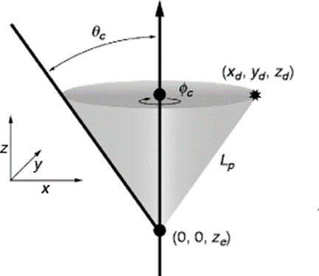
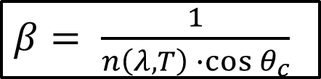
Cherenkov radiation
Cherenkov angle
The Cherenkov photons will form a cone-like shape along the particle trajectory and have an angle
(the Cherenkov angle), increasing with speed.
The relation between the particle’s speed 𝛽 and the Cherenkov angle is given by the Cherenkov equation:
$β$ $= \frac{1}{n\left(λ,T\right)∙cos{θ_{c}}}$
Notes:
Figure on right :
Blair Ratcliff and Jochen Schwiening. “Cherenkov Counters.” In: Handbook of Particle Detection and Imaging.
Ed. by Claus Grupen and Irène Buvat. Berlin, Heidelberg: Springer Berlin
Heidelberg, 2012, pp. 453–471. isbn: 978-3-642-13271-1.
doi: 10.1007/978-3-642-13271-1_18.
url: https://doi.org/10.1007/978-3-642-13271-1_18.

Slide 11
HMPID Structure

Slide 12
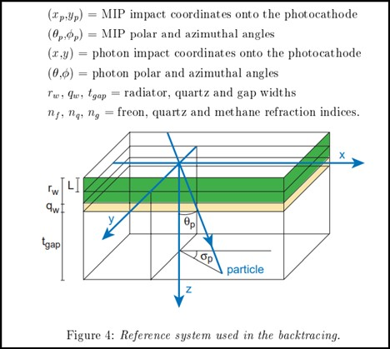
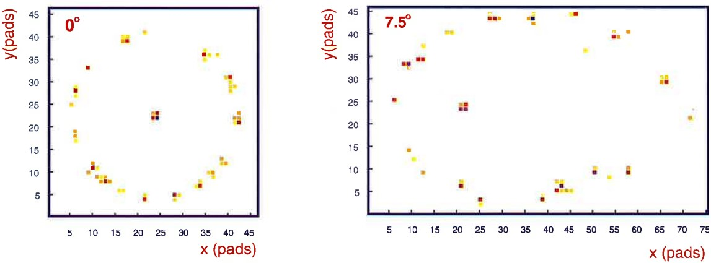
HMPID Structure
Track impact parameters
• Impact point on RAD
• MIP position (x_{p}, y_{p}) in PC-plane
RAD
Track inclinations
• Track polar angle θ_{p}
• Track azimuthal angle ϕ_{p}
θ_{p}
ϕ_{p}
(x_{p}, y_{p})
PC
Cherenkov patterns for different θ_{p}
Notes:
Figure adapted from HMPID TDR:
Dariusz Czerwinski et al. “Alice Technical Design Report of the High Momentum Particle
Identification Detector.” In: Sept. 1998.
Isbn : ISBN 92-9083-134-0.

Slide 13
Particle IDentification (PID) in the HMPID

Slide 14
PID in the HMPID
Momentum ranges for PID in ALICE
“Relativistic rise”
TPC + ITS
(dE/dx)
π/K
K/p
e /π
TOF
e /π
π/K
K/p
HMPID
(RICH)
π/K
K/p
0 1 2 3 4 5 p (GeV/c)
TRD e /π
PHOS γ /π⁰
EMCAL
1 10 100 p (GeV/c)
Solid: track-by-track
Dashed: only statistical
Notes:
The HMPID carries out particle identification by means of measurement of the emission angle of Cherenkov photons, combined with momentum measurements provided by the central tracking systems in ALICE (ITS and TPC) [14].
Credits to Giacomo Volpe https://indico.cern.ch/event/1246704/?view=nicecompact

Slide 15
PID in the HMPID
Particle IDentification (PID) in the HMPID
For PID : the mass and charge of the mass has to be known to establish which specie a particle is
The PID in HMPID is a joint effort;
  The HMPID gives an estimate of the mass with help of track information given by other detectors (ITS, TPC, TRD and TOF)

Slide 16
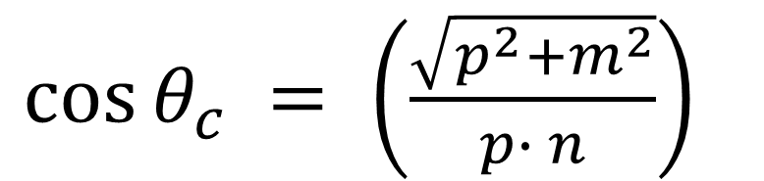
PID in the HMPID
Particle IDentification (PID) in the HMPID
$\cos{{θ_{c}}_{ }= \left(\frac{\sqrt{p^{2}+m^{2}}}{p∙ n}\right)}$
Momentum (p) given from TPC
Refractive index (n) is constant
Cherenkov angle ( θ_{c} ) to be measured by the HMPID
By inverting the equation, m can be calculated
Notes:
Figure adapted from HMPID TDR:
Dariusz Czerwinski et al. “Alice Technical Design Report of the High Momentum Particle
Identification Detector.” In: Sept. 1998.
Isbn : ISBN 92-9083-134-0.

Slide 17
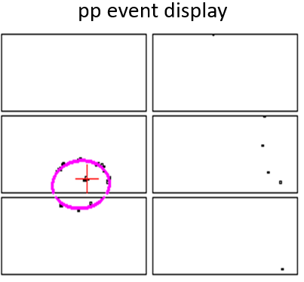
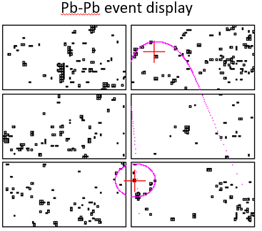
PID in the HMPID
Event Display
Notes:
The biggest challenge in Particle IDentification in the HMPID is in PbPb collisions because of lower Signal-to-Noise Ratio (SNR)
Credits to Giacomo Volpe https://indico.cern.ch/event/1246704/?view=nicecompact

Slide 18
PID in the HMPID
Track-MIP matching
Every track to be reconstructed has to be matched with a Minimum Ionizing Particle (MIP) cluster on the HMPID Photo-Cathode
The MIP has distinct features in detected charge and cluster size
One can do a separation of MIPs from photons by applying cuts for the charge and size
  For instance, 200 ADC channel charge and more than 2 pads fired

Slide 19
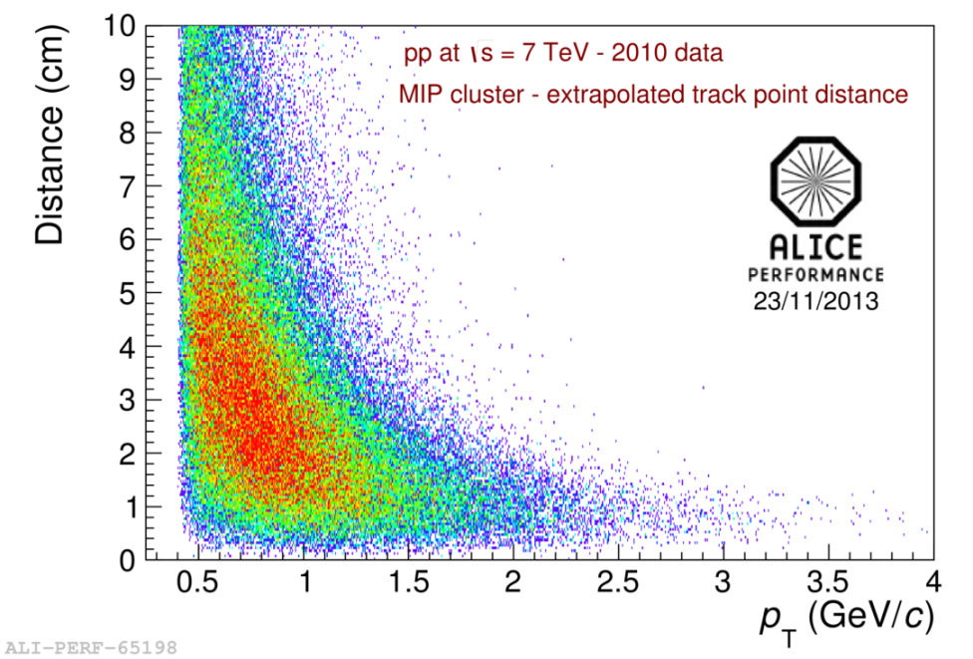
PID in the HMPID
Track-MIP matching
The distance from the extrapolated track to the MIP is a crucial parameter for PID
A cut for the distance is applied; only reconstructing tracks under a certain distance
Notes:
Credits to Giacomo Volpe https://indico.cern.ch/event/1246704/?view=nicecompact

Slide 20
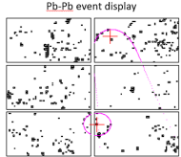
PID in the HMPID
PID : Parameters
Track impact parameters
RAD
• Impact point on RAD
→ Extrapolated to PC
• MIP position (x_{p}, y_{p}) in PC-plane
Track parameters
ϕ_{p}
(x_{p}, y_{p})
PC
• Track azimuthal angle ϕ_{p}
• Track polar angle θ_{p}
• Track momentum p
Cluster map
All clusters in a given chamber of an event
Clusters have numerous features, most important :
size (number of pads fired)
Charge
Position (x, y)
Notes:
Figure on top adapted from HMPID TDR:
Dariusz Czerwinski et al. “Alice Technical Design Report of the High Momentum Particle
Identification Detector.” In: Sept. 1998.
Isbn : ISBN 92-9083-134-0.
Credits to Giacomo Volpe for figure on bottom https://indico.cern.ch/event/1246704/?view=nicecompact

Slide 21
Current PID algorithm in the HMPID :
Difficulties with PID in Pb-Pb collisions in the HMPID
PID workflow in the HMPID
Hough Transform Method
Single and ring-average Cherenkov photons distributions
Evaluation of performance

Slide 22
Current PID algorithm in the HMPID
PID workflow in the HMPID
Difficulties with PID in Pb-Pb collisions in the HMPID
The biggest challenge in PID in the HMPID is in Pb-Pb collisions because of lower Signal-to-Noise Ratio (SNR)
The PID algorithm involves finding emitted Cherenkov photons in the Photo-Cathode emitted by a track matched with a MIP
The ability to distinguish the actual signal (the Cherenkov photons) from background signals are limited.
Background signals are for instance emitted photons that belongs to other tracks, feedback photons and secondary charged particles

Slide 23
Current PID algorithm in the HMPID
PID workflow in the HMPID
PID workflow in the HMPID
Particle IDentification (PID) is undertaken using the Hough Transform Method (HTM)
The method is used for track-by-track identification of charged particles in the HMPID
For every event, the following is done :
Try to match every track given by the tracking devices that intersects the HMPID acceptance with MIPs in the HMPID Photo-Cathode (PC) [MatchHMP.cxx#L391]
If the track is matched with a MIP : evaluate the distance from the MIP to the extrapolated track’s intersection with the PC-plane [MatchHMP.cxx#L538]

Slide 24
Current PID algorithm in the HMPID
PID workflow in the HMPID
PID workflow in the HMPID
Only consider tracks that are under a certain distance threshold
  Fit the matched MIP-track pair, to allow increased precision of the track
(the position of the MIP is used to fit the track) [MatchHMP.cxx#L496]
  Evaluate the Cherenkov angle θ_{c} of the track by combining the matched track-MIP information with all the clusters in the intersected chamber.
The Cherenkov angle is estimated using the Hough Transform Method [MatchHMP.cxx#L563] [Recon.cxx#L49]

Slide 25
Current PID algorithm in the HMPID
Current PID algorithm in the HMPID :
Hough Transform Method (HTM)

Slide 26
Current PID algorithm in the HMPID
Hough Transform Method
Hough Transform Method (HTM)
Background discrimination is performed exploiting the Hough Transform Method (HTM).
HTM is an efficient implementation of a generalized template matching strategy for detecting complex patterns in binary images.
Notes:
Credits to Giacomo Volpe for figure on bottom https://indico.cern.ch/event/1246704/?view=nicecompact

Slide 27
Current PID algorithm in the HMPID
Hough Transform Method
Mapping to one-dimensional space
impact track parameter
(x,y) → ((x_{p},y_{p},θ_{p},ϕ_{p}), η_{c})
A “Hough counting space” is constructed for each charged particle :
cluster coordinate
Cherenkov
angle
  For every cluster in the chamber, the photon
Cherenkov angle η_{c} is evaluated [Recon.cxx#L77]
⇓
  The photon emission angles are reconstructed
using a backtracing loop method [Recon.cxx#L145]
solution in one dimensional mapping space η_{c}
Notes:
Let ηc,i ​ represent an individual value, and let ηc denote the collection of all such values

Slide 28
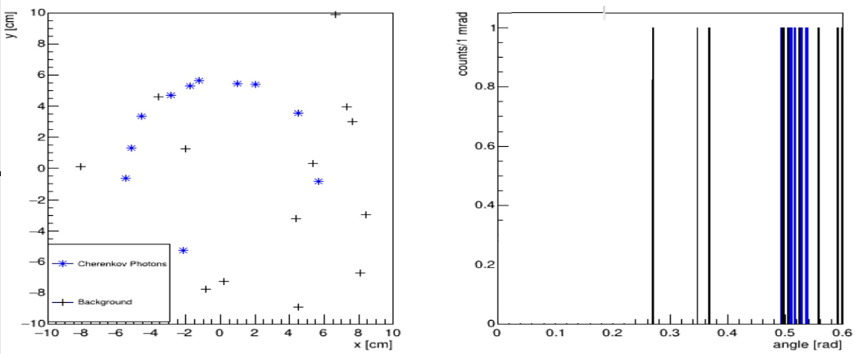
Current PID algorithm in the HMPID
Hough Transform Method
Mapping to one-dimensional space
Photon-cluster hit map
Photon Cherenkov angles
n_{clusters} entries in cluster map
n_{clusters} entries
(x,y) → ((x_{p},y_{p},θ_{p},ϕ_{p}), η_{c})
η_{c, track}
cluster coordinate
“Hough counting space”
“Cherenkov angle space”
Notes:
This figure is just meant to mimic the pattern of an orthogonal track and the mapping to the Hough Counting space
It does not come from real data or from simulation

Slide 29
Current PID algorithm in the HMPID
Hough Transform Method
Hough counting space
The reconstruction of η_{c} for all clusters within a chamber for a given track is referred to as the 'Cherenkov angle space', or the 'Hough Counting space'.
This distribution is also referred to as a single Cherenkov photon distribution η_{c, track}
The single-photon distribution (η_{c, track}) of many tracks η_{c} with the similar momentum is gaussian, and has standard-deviations (angular resolution) depending on various parameters

Slide 30

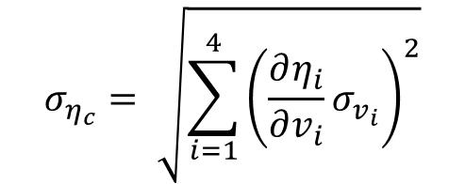
Current PID algorithm in the HMPID
Hough Transform Method
Angular resolution
For a track with inclination angles and momentum, each cluster in the chamber has its distinct angular resolution
The angular resolution varies with the detector status, inclination angles and the position of the MIP and cluster.
Chromatic error (E) : Spread in photon-energy
Geometric error (RW) : Track inclination
Localization error (R) : Cluster position
Track inclination angles (θ_{p})
$$v_{i} :(i∈ \left\{E, RW, R, θ_{p}\right\})$$
The RMS resolution is found by the propagation of each of the variables :
$$σ_{η_{c}}= \sqrt{\sum_{i=1}^{4}{{\left(\frac{∂η_{i}}{∂v_{i}}σ_{v_{i}}\right)}^{2}}}$$

Slide 31
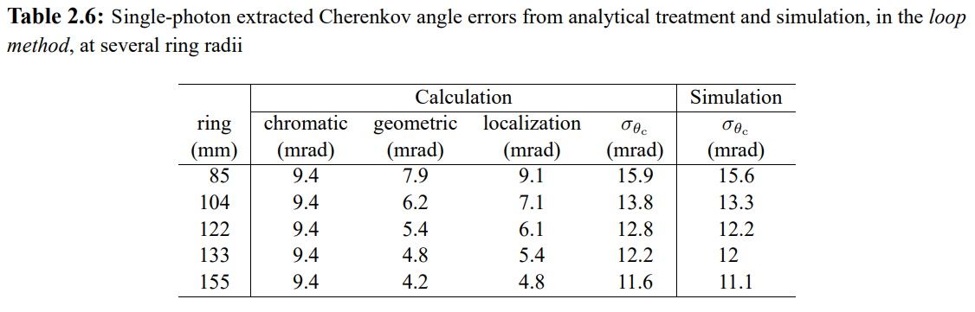
Current PID algorithm in the HMPID
Hough Transform Method
Angular resolution :
Typical values
From HMPID TDR
Notes:
Dariusz Czerwinski et al. “Alice Technical Design Report of the High Momentum Particle Identification Detector.” In: Sept. 1998. isbn: ISBN 92-9083-134-0.

Slide 32
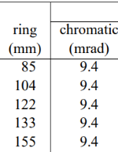
Current PID algorithm in the HMPID
Hough Transform Method
Angular resolution :
Chromatic error (1/2)
The spread of the photon energy in the radiator leads to the spread in the refractive index and subsequently Cherenkov angle per photon.
The distribution can be modelled as a gaussian distribution:
$$X_{E} \sim N (σ_{E},μ_{E})$$
The detector is calibrated; the mean value of the photon energy for a given run is known.
Notes:
More is explained later under Angular resolution : Chromatic error (E) : Detector status

Slide 33
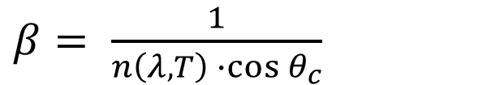
Current PID algorithm in the HMPID
Hough Transform Method
Angular resolution :
Chromatic error (2/2)
η_{c}
$β$ $= \frac{1}{n\left(λ,T\right)∙cos{θ_{c}}}$
For photons in same ring :
𝛽 (track velocity) is constant
radiator temperature T is constant
photon energy (through wavelength λ) differs
  → n is different
Spread in η_{c} around θ_{c}
Notes:
More is explained later under Angular resolution : Chromatic error (E) : Detector status

Slide 34



Current PID algorithm in the HMPID
Hough Transform Method
Angular resolution :
Geometric Error
Unknown emission point of Cherenkov photons in the radiator, assumed to happen in the middle of the radiator width.
Uniform distribution of emission point
$$σ_{RW}= \frac{rW}{\sqrt{12} \cos{θ_{p}}}$$
$$X_{RW} \sim U (0,rW)$$

Slide 35
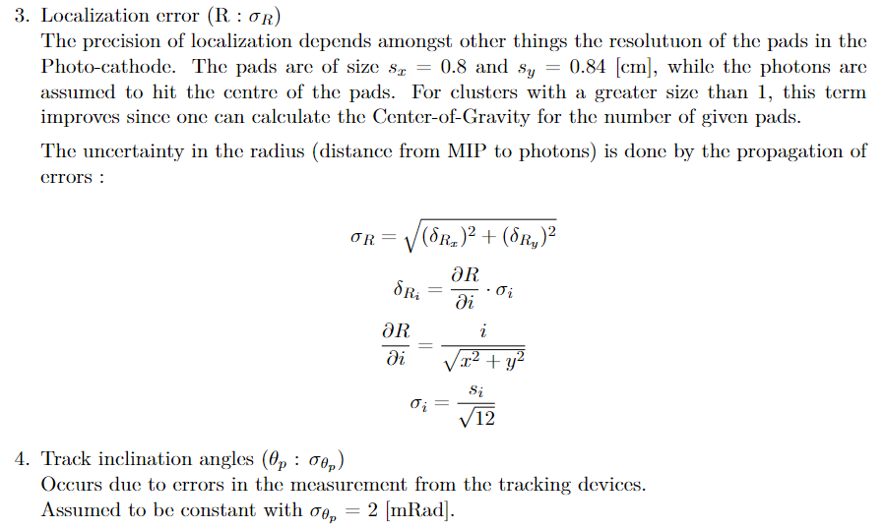
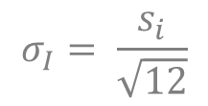
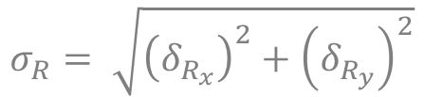
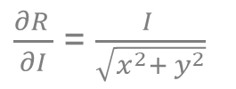

Current PID algorithm in the HMPID
Hough Transform Method
Angular resolution :
Localization error
$$σ_{R}= \sqrt{{\left(δ_{R_{x}}\right)}^{2}+{\left(δ_{R_{y}}\right)}^{2}}$$
$$δ_{R_{I}}= \frac{{∂R}_{ }}{∂I}σ_{I}$$
$\frac{{∂R}_{ }}{∂I}$ = $\frac{I }{\sqrt{x^{2}+ y^{2}}}$
$$σ_{I}= \frac{s_{i}}{\sqrt{12}}$$

Slide 36

Current PID algorithm in the HMPID
Hough Transform Method
Angular resolution :
Track inclination errors
Occurs due to errors in the measurement from the tracking devices.
Assumed to be constant with $σ_{θ_{p}}=2 [mRad]$

Slide 37
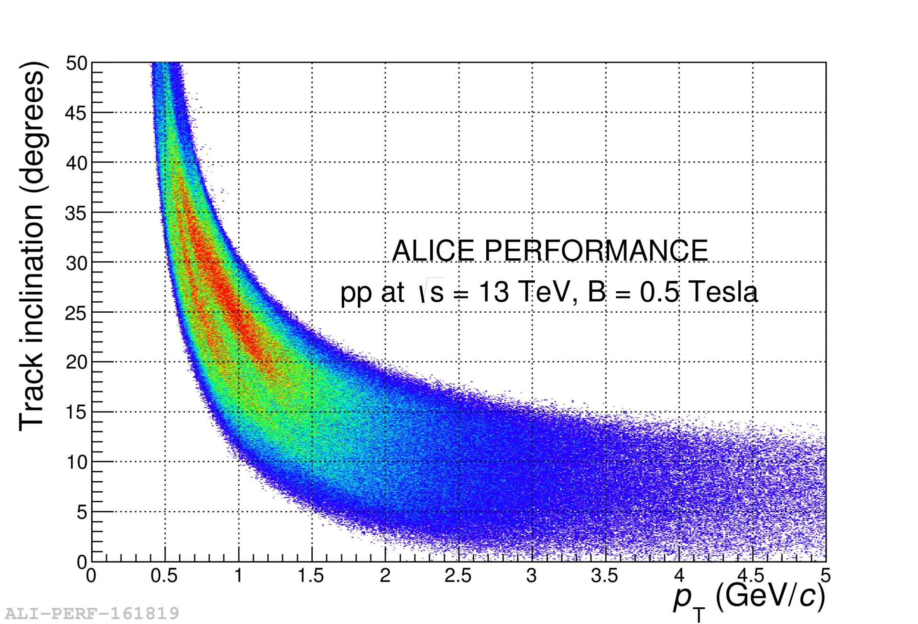
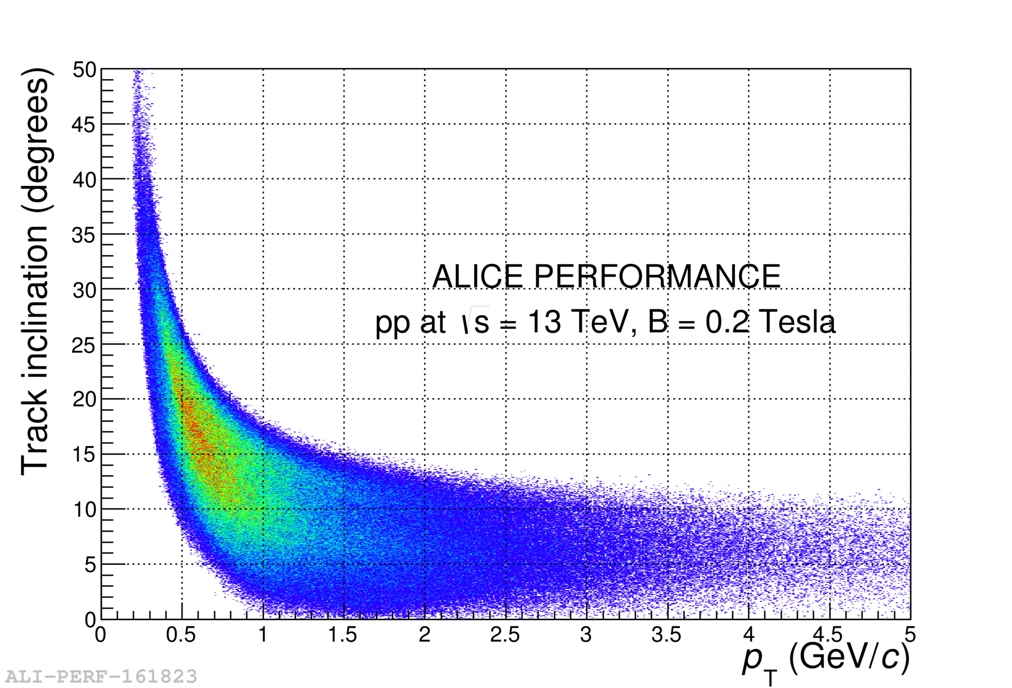
Current PID algorithm in the HMPID
Hough Transform Method
Angular resolution with field strength
Track inclination, 0.5 Tesla
Track inclination, 0.2 Tesla
σ_{θ, 0.5 T} ≈ 10 mrad
σ_{θ, 0.2 T} ≈ 7 mrad
Notes:
Credits to Giacomo Volpe for figure on bottom https://indico.cern.ch/event/1246704/?view=nicecompact

Slide 38
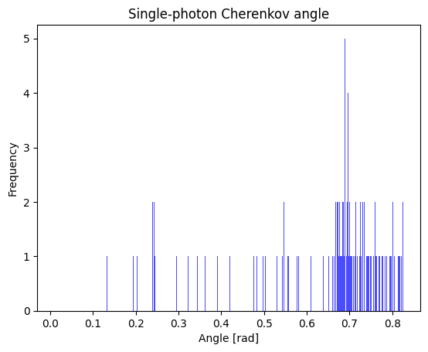
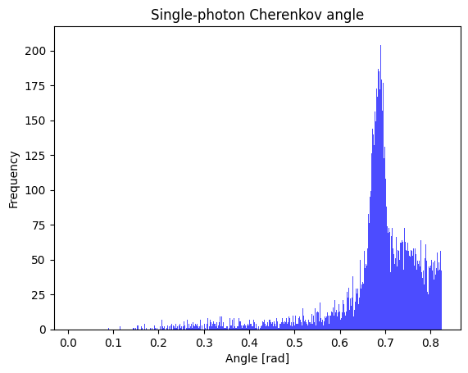
Current PID algorithm in the HMPID
Hough Transform Method
Single Cherenkov-photon distributions
n_{clusters} entries in map
η_{c, track}
Collect for many tracks
η_{c}
Single photon distribution for one track
Single photon distribution for many tracks in same momentum range
Note that both are single-photon distributions
Monte Carlo (MC) simulated events by Pion-gun
Tracks per chamber on average around 5
Fixed momentum 2.7..2.8 [GeV/c]
Notes:
Monte Carlo simulated events by Pion-gun
Tracks per chamber on average around 5
Fixed momentum 2.7..2.8 [GeV/c]

Slide 39




Current PID algorithm in the HMPID
Hough Transform Method
Single Cherenkov-photon distributions
Mean value
$\cos{{θ_{ }}_{c,π}^{theoretical}= \left(\frac{\sqrt{p^{2}+ {m_{π}}^{2}}}{p∙ n}\right)}$
η_{c}
$${θ_{ }}_{c,π}^{theoretical}=\cos^{−1}\left(\frac{\sqrt{p^{2}+ {m_{π}}^{2}}}{p∙ n}\right)$$
p = 2.7-2.8 [GeV/c]
m_{π}= 0.1396 [GeV/c] # mass of pion
n = 1.291 [-]*
$${θ_{ }}_{c,π}^{theoretical}=0.682 [rad]$$
Peak (μ) of η_{c} distribution approximately equivalent to ${θ_{ }}_{c,π}^{theoretical}$
*For the given run. Depends on temperature, photon energy
Notes:
Monte Carlo simulated events by Pion-gun
Tracks per chamber on average around 5
Fixed momentum 2.7..2.8 [GeV/c]

Slide 40
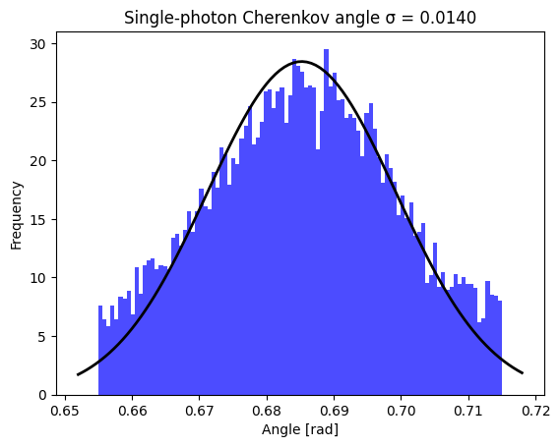
Current PID algorithm in the HMPID
Hough Transform Method
Single Cherenkov-photon distributions
Standard deviation
$$σ_{{singleθ}_{C}}=0.014$$
η_{c}
The distribution has a tail, which can be attributed to the background signal
  The configuration from the plot above is a MC simulated Pion-gun with very high track-multiplicity (on average around 5 per chamber)
If one establishes a certain range around the calculated Cherenkov angle, one can analyze the symmetry of the distribution to distinguish the signal from the background
Notes:
Monte Carlo simulated events by Pion-gun
Tracks per chamber on average around 5
Fixed momentum 2.7..2.8 [GeV/c]
* The particle Gun is configured with 40-70 tracks in the acceptance
o2-sim -n"$nev" -e TGeant3 -g boxgen --configKeyValues "BoxGun.pdg=211; BoxGun.phirange[0]=-5; BoxGun.phirange[1]=60; BoxGun.number=45; BoxGun.eta[0]=-0.5 ; BoxGun.eta[1]=0.5; BoxGun.prange[0]=2.7; BoxGun.prange[1]=2.8;" $simWorker --run ${runNumber}

Slide 41
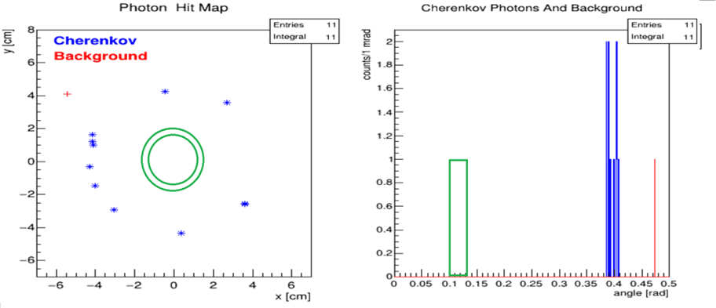
Current PID algorithm in the HMPID
Hough Transform Method
HTM : Width of sliding window
The width of the window is chosen to allow the majority of the signal to be included
Currently 45 mRad is used : HMPIDReconstruction/Recon.h#L61
45 mRad corresponds to 3-4 sigma of the single photon angular resolution
η_{c, track}
Notes:
The above is not coming from real data or MC simulations, it is only meant for illustrative purposes
This is just for illustration purposes and does not match 45 mRad

Slide 42
Current PID algorithm in the HMPID
Hough Transform Method
HTM : Sliding window iteration
η_{c, track}
Bins of 1 mRad is applied to the histogram [/Recon.h#L60C28-L60C28]
The sliding window is iterated with 1 mrad in the Cherenkov angle space
The iteration is done from 0 rad to 0.75 Rad [Recon.cxx#L531-L537]
The histogram will have k = 750 bins
Notes:
The above is not coming from real data or MC simulations, it is only meant for illustrative purposes
This is just for illustration purposes and does not match 45 mRad

Slide 43




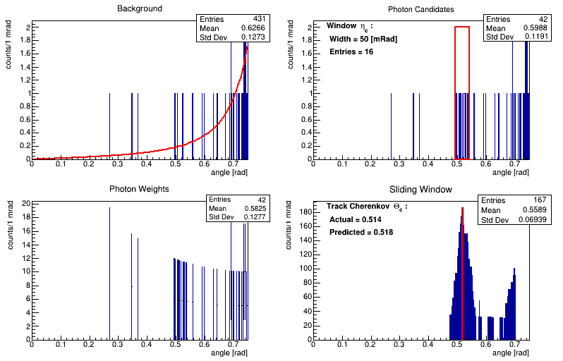
Current PID algorithm in the HMPID
Hough Transform Method
HTM : Weighting procedure
A weighting procedure for the selection of photons is applied
The weighting applied to each bin k is inversely proportional to the corresponding ring area for the bin
The weighted histogram is the number of photons in the given bin multiplied with the weight of the bin
Single photon distribution
Weights of photons
η_{c, track}
_{Fit of background}
Recon.cxx#L539-L561
Notes:
The above is not coming from real data or MC simulations, it is only meant for illustrative purposes

Slide 44
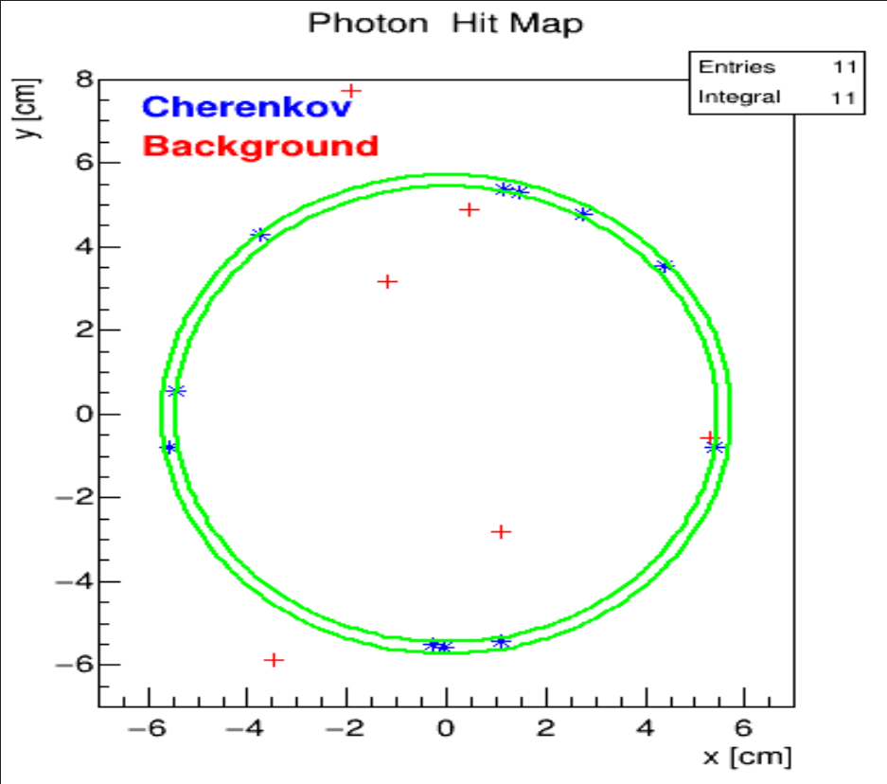
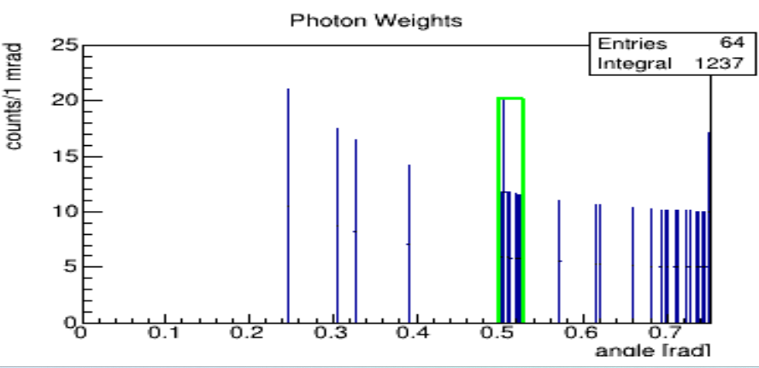
Current PID algorithm in the HMPID
Hough Transform Method
HTM workflow 1/3
Weighting
Recon.cxx#L563-L581
Notes:
The above is not coming from real data or MC simulations, it is only meant for illustrative purposes
This is just for illustration purposes and does not match 45 mRad

Slide 45
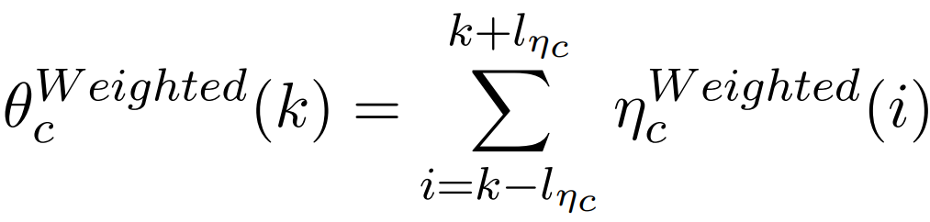
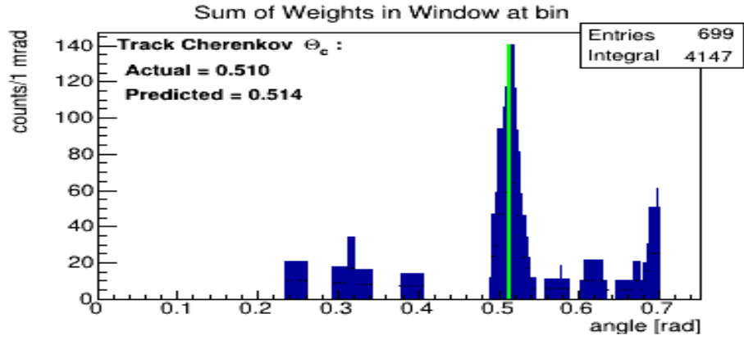
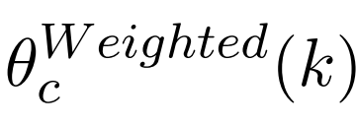
Current PID algorithm in the HMPID
Hough Transform Method
HTM workflow 2/3
The sum of the weighted photons $η_{c}^{Weighted}$ in the window :
The width of the sliding window is$2 ∙ l_{η_{c}}$
Sum of weights
In window
Bin K with highest
Find the bin K in $θ_{c}^{Weighted}$which is the highest weighted sum in the window
The photons in the window at this bin is called the “Hough selected photons” η_{c, selected}
The number of photons in the window is$N_{ph}^{Hough}$
Recon.cxx#L582-L589
Notes:
The above is not coming from real data or MC simulations, it is only meant for illustrative purposes
This is just for illustration purposes and does not match 45 mRad

Slide 46
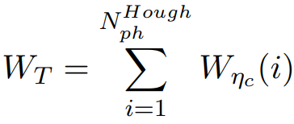
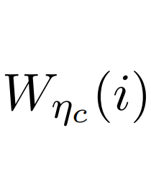
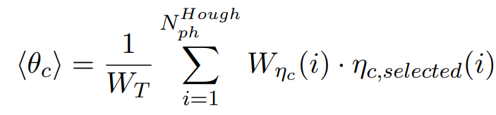
Current PID algorithm in the HMPID
Hough Transform Method
HTM workflow 3/3
The Cherenkov angle ⟨θ_{c}⟩ of the track is provided by the weighted average of η_{c, selected, track}
→ ⟨θ_{c}⟩ is the ring average of the Hough selected photons
is the weight for the photon i in bin k
Notes:
The above is not coming from real data or MC simulations, it is only meant for illustrative purposes
This is just for illustration purposes and does not match 45 mRad

Slide 47
Current PID algorithm in the HMPID
Current PID algorithm in the HMPID :
Single photon and ring-average Cherenkov photon distributions

Slide 48
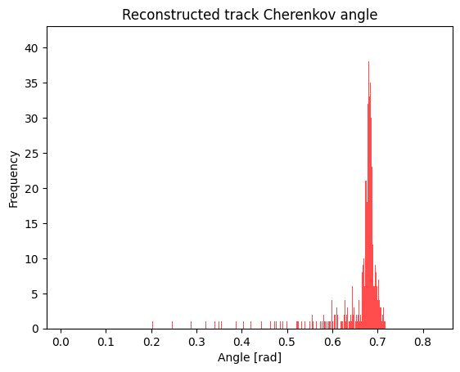
Current PID algorithm in the HMPID
Hough Transform Method
Single photon and ring-average distributions
η_{c}
θ_{c}
$$σ_{{singleθ}_{C}}=0.014$$
$$σ_{{ringθ}_{C}}=0.0056$$
Single Cherenkov photon distribution
Ring average / Track Cherenkov angle distribution
The improved standard deviation from the single-photon to the ring-average distribution can be attributed to :
The width of the window of the HTM; which will discard outliers
The θ_{c} being the weighted average of the ring-selected photons
Notes:
Monte Carlo simulated events by Pion-gun
Tracks per chamber on average around 5
Fixed momentum 2.7..2.8 [GeV/c]

Slide 49
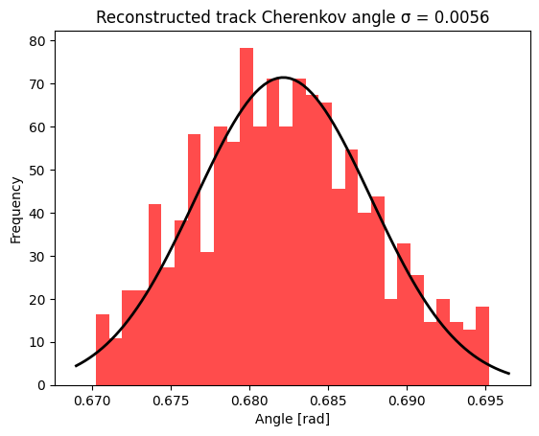
Current PID algorithm in the HMPID
Hough Transform Method
Relation between single Cherenkov photon and track Cherenkov distributions
Single photon distribution
Ring average / Track distribution
η_{c}
θ_{c}
$$σ_{{singleθ}_{C}}=0.014$$
$$σ_{{ringθ}_{C}}=0.0056$$
The ring-average distribution stems from selecting a certain set of photon Cherenkov angles values using the sliding window (The Hough selected photons) for each track to be reconstructed.
The mean values of the single-photon and ring-average Cherenkov angle distributions will be more or less the same
Notes:
Monte Carlo simulated events by Pion-gun
Tracks per chamber on average around 5
Fixed momentum 2.7..2.8 [GeV/c]

Slide 50
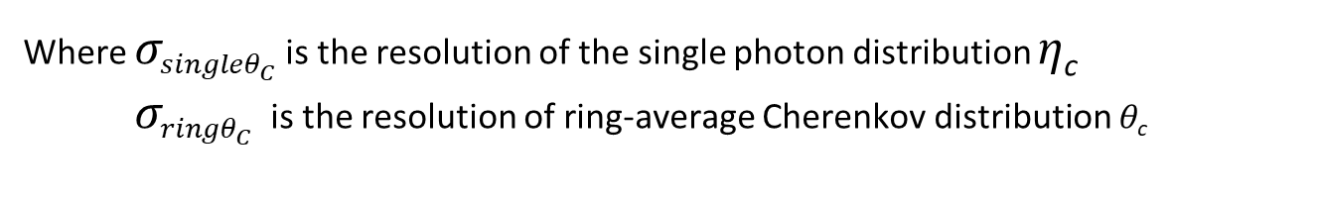
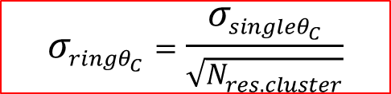
Current PID algorithm in the HMPID
Hough Transform Method
Relation between photon distributions
$$σ_{{singleθ}_{C}}=0.014$$
$$σ_{{ringθ}_{C}}=0.0056$$
η_{c}
θ_{c}
The ring-average Cherenkov angle distribution will have a resolution 𝝈_{ring θc} depending
on the average number of Hough selected photons per track ( Nres.cluster) :
$$σ_{{ringθ}_{C}}=\frac{σ_{{singleθ}_{C}}}{\sqrt{N_{res.cluster}}}$$
Where $σ_{{singleθ}_{C}}$ is the resolution of the single photon distribution η_{c}
${ σ}_{{ringθ}_{C}}$ is the resolution of ring-average Cherenkov distribution θ_{c}
Notes:
Monte Carlo simulated events by Pion-gun
Tracks per chamber on average around 5
Fixed momentum 2.7..2.8 [GeV/c]

Slide 51
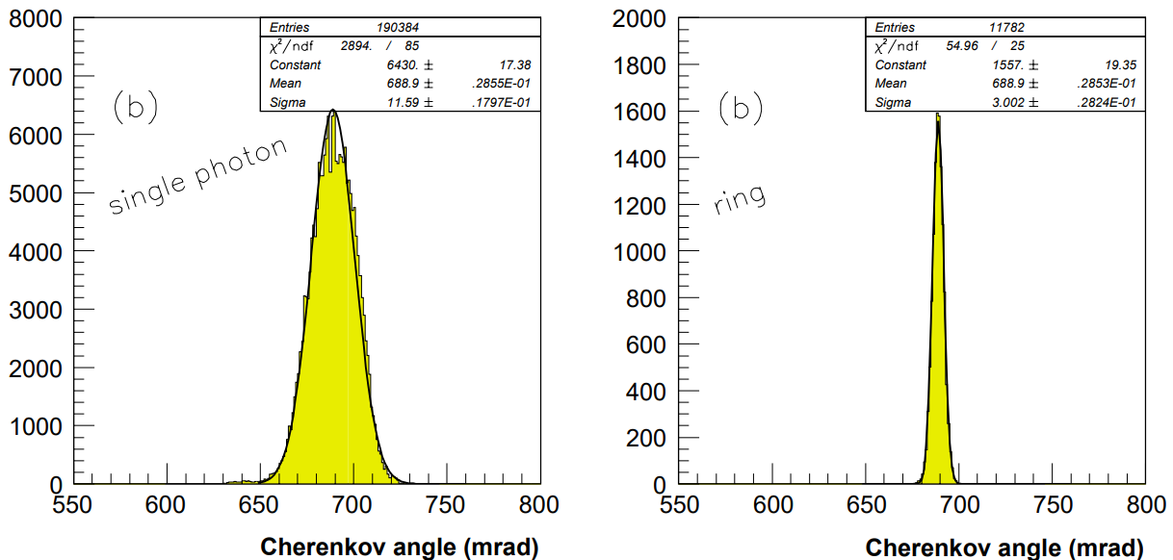
Current PID algorithm in the HMPID
Hough Transform Method
Relation between photon distributions
From HMPID TDR
Notes:
Monte Carlo simulated events by Pion-gun
Tracks per chamber on average around 5
Fixed momentum 2.7..2.8 [GeV/c]

Slide 52



Current PID algorithm in the HMPID
Hough Transform Method
Average number of selected photons
$$σ_{{singleθ}_{C}}=0.014$$
$$σ_{{ringθ}_{C}}=0.0056$$
η_{c}
θ_{c}
One can calculate the average number of Hough selected photons by the equation :
$$σ_{{ringθ}_{C}}=\frac{σ_{{singleθ}_{C}}}{\sqrt{\text{N}\text{res}\text{.}\text{cluster}}}$$
$${\text{N}}^{avg, estimate}= {\left(\frac{σ_{{singleθ}_{C}}}{σ_{{ringθ}_{C}}}\right)}^{2}={\left(\frac{0.014}{0.0056}\right)}^{2}=6.25$$
For the data above :
Just a crude estimate
Notes:
Monte Carlo simulated events by Pion-gun
Tracks per chamber on average around 5
Fixed momentum 2.7..2.8 [GeV/c]

Slide 53
Current PID algorithm in the HMPID
Current PID algorithm in the HMPID :
Evaluation of performance

Slide 54
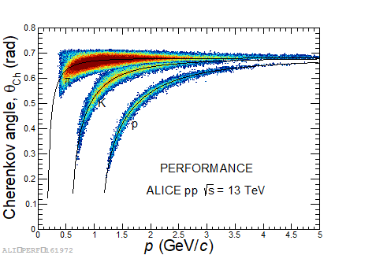
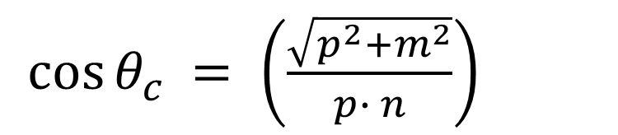
Current PID algorithm in the HMPID
Evaluation of performance
Reconstructed Cherenkov angles for multitude of tracks
n constant
p from other detectors measured by the HMPID : θ_{c}
$\cos{{θ_{c}}_{ }= \left(\frac{\sqrt{p^{2}+m^{2}}}{p∙ n}\right)}$
PID using the HTM in the HMPID on Run 2 data : Scatterplot of Cherenkov angle versus momentum
Each point in the scatter plot represents a reconstructed track
Notes:
Credits to Giacomo Volpe https://indico.cern.ch/event/1246704/?view=nicecompact

Slide 55
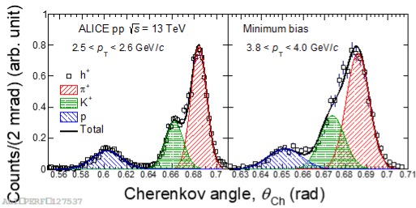
Current PID algorithm in the HMPID
Evaluation of performance
Distributions at fixed momentums
The distribution per specie is evaluated for a fixed range of momentum
The ring-average angular resolution
[3-5 mRad in previous examples] inherently limits the ability to distinguish species at higher momentums
Efficient discrimination of all species is possible in 2.5..2.6 GeV/c range
Overlap between pions and kaons occurs in the 3.8..4.0 GeV/c range
Run 2 data
Notes:
Hadron separation on Run 2 data
Credits to Giacomo Volpe https://indico.cern.ch/event/1246704/?view=nicecompact

Slide 56

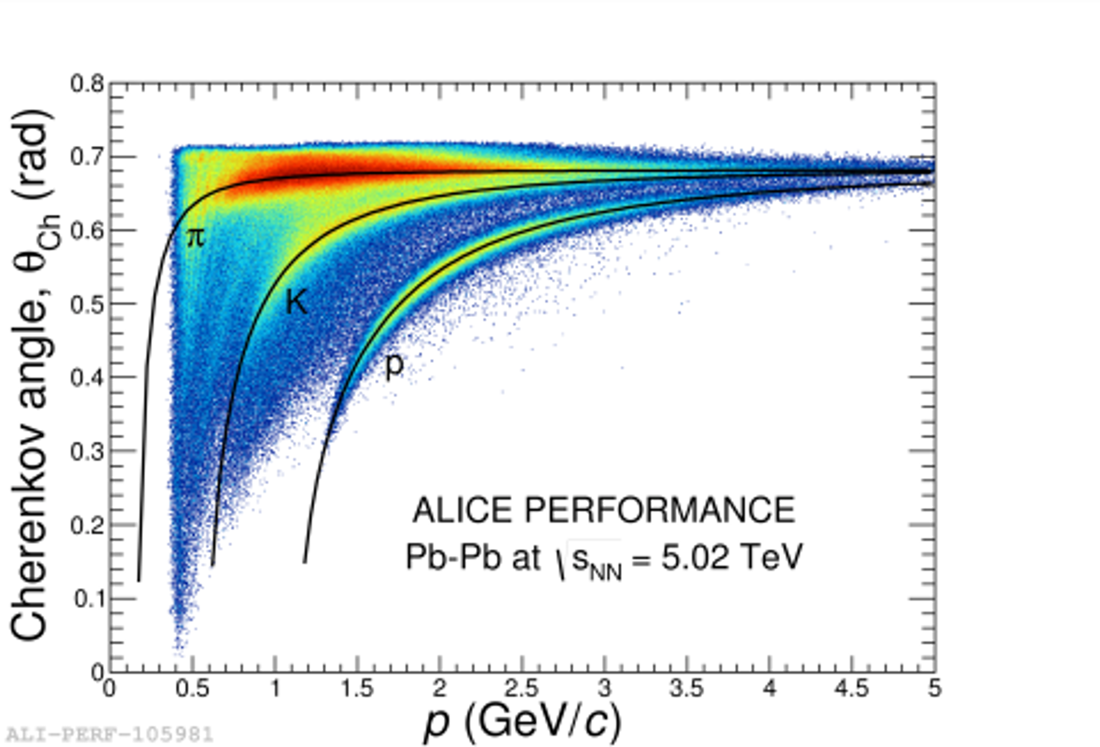
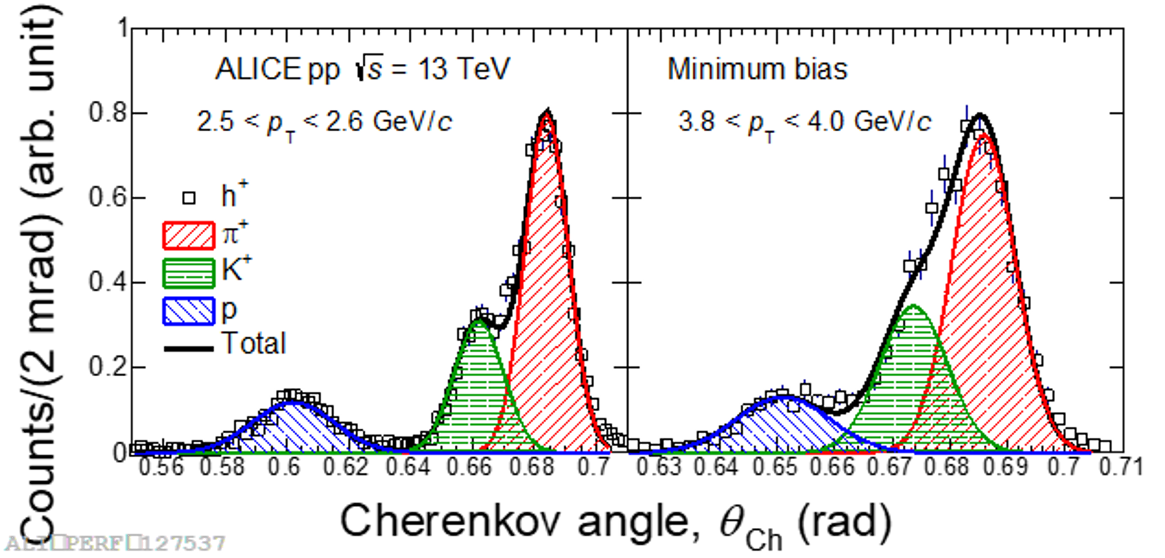
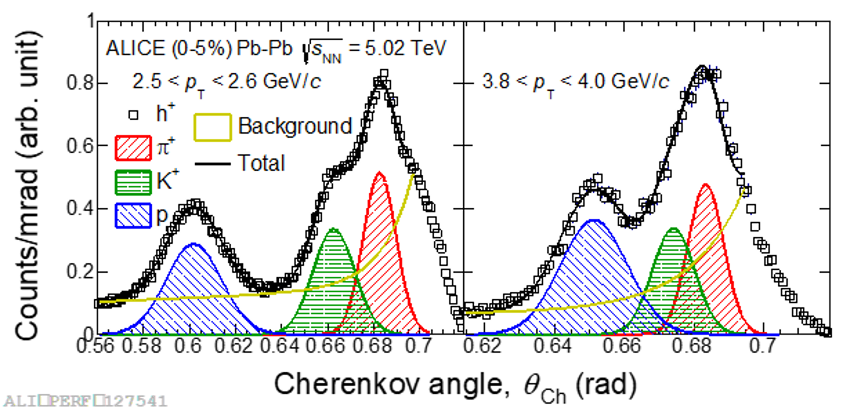
Current PID algorithm in the HMPID
Evaluation of performance
Comparing pp vs Pb-Pb for fixed momentums
Notes:
Hadron separation on Run 2 data
Good separation is seen in the Proton-Proton events, whereas overlapping is seen in the lead-lead events
Credits to Giacomo Volpe https://indico.cern.ch/event/1246704/?view=nicecompact

Slide 57


Current PID algorithm in the HMPID
Evaluation of performance
High multiplicity events: B = 0.2 and 0.5 Tesla comparison
MC data
PID efficiency
0.2 Tesla
0.5 Tesla
Higher momentum
+ more Cherenkov photons emitted
+ Better track inclination (smaller θ_{p} )
Better angular resolution per photon-cluster
Less skewed Cherenkov ring patterns
Theoretical values θ_{c,i} comes closer to each other
Notes:
Pion IDentificaiton accuracy distributed over momentums using the HTM on MC data
Credits to Giacomo Volpe https://indico.cern.ch/event/1246704/?view=nicecompact

Slide 58

Current PID algorithm in the HMPID
ALICE charged hadrons yields evaluation strategy
To measure the production of pions, kaons and protons over a wide p_{T} range, results from five different independent PID techniques/detectors, namely ITS, TPC, TOF, HMPID and kink-topology (for kaons), are combined.
In their overlap p_{T} regions the spectra from the different PID techniques are consistent within uncertainties:
  the results are combined in the overlapping ranges using a weighted mean with the independent systematic uncertainties as weights.
The HMPID constrains the uncertainty of the measurements in the transition region between the TOF and TPC relativistic rise methods (around p_{T} = 3 GeV/c). It both improves the precision of the measurement and validates the other methods in the region where they have the worst PID separation.
HMPID separation power in σ unit as a function of p_{T}
Notes:
Credits to Giacomo Volpe :
https://indico.cern.ch/event/1246704/?view=nicecompact

