Slide 1

Update on BSM issues and new SIGFPEs
Andrea Valassi (CERN)
4th June 2024
(attached to Madgraph on GPU development meeting, 11th June 2024)
https://indico.cern.ch/event/1355154
(previous update was on May 28 – only mentioning changes since then)

Slide 2
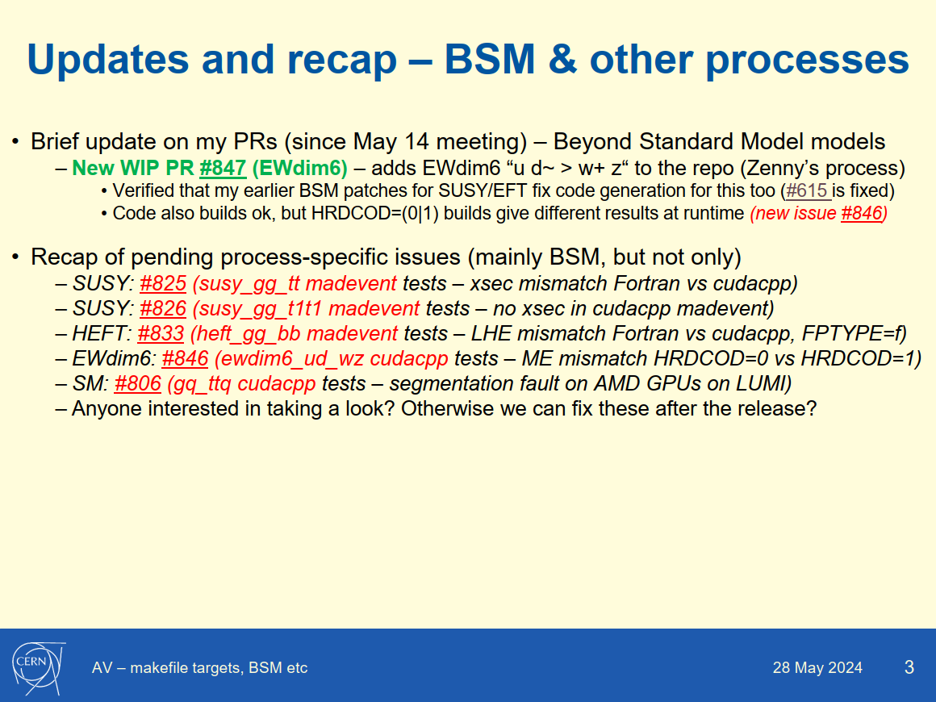
From systematic tests of all processes and all FPTYPE combinations using ‘tput’ and ‘tmad’ scripts
Today I report on investigations about this in collaboration with Olivier

Slide 3
Some “easy” bits
SUSY: #825 (susy_gg_tt madevent tests – xsec mismatch Fortran vs cudacpp)
  Fixed by Olivier in PR #850 – missing “Ccoeff” in some code (CODEGEN)
  Completed by AV in PR #860 – update runTest reference files (mg4gpu) for susy processes
Minor enhancements by AV (mg4gpu only, no CODEGEN)
  PR #851 – add back bin/madevent script for all processes
  PR #854 – add matrix1.pdf (from matris1.ps) for all processes to debug channel issues

Slide 4
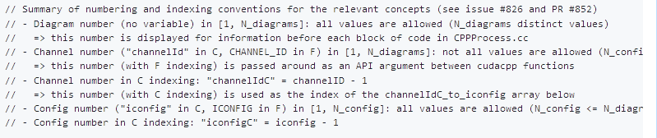
A much more complex bit
Olivier’s draft PR #852 investigating the zero xsec issue 826 opened a Pandora box
  I tested Olivier’s patch and other related issues in PR #853
  Main finding by OM: in cudacpp we miss a mapping of “iconfig” and “channel” (e.g. for colors)
Note: all issues on my first slide come from my ‘tput’ or ‘tmad’ test suite
  tmad test suite runs “madevent < input.txt” for Fortran/C++/CUDA, compares xsec and LHE
  But... so far I have always only been running these for “iconfig=1”
    Some nasty problems seem to be lurking only at iconfig>1 (including SIGFPE crashes)
Just for reference: there are many different entities and variables involved
  And the fact that Fortran (1 to N) and C (0 to N-1) indexes differ does not help
  This is my proposal how to reference them in the code

Slide 5
SIGFPE crash in rotxxx
There is a SIGFPE crash #855 in Fortran function rotxxx (aloha_functions.f)
  Only in optimized –O3 code: relevant variables in gdb show up as <optimized out>
  Disabling optimization (IIRC –O1 is enough?) makes the crash disappear
  My proposed workaround #857: add the volatile keyword for a few Fortran variables
    Disable optimizations of very specific lines of code (related to Fortran SIMD?)
    This technique is extensively used in cudacpp SIMD ixx/oxx: volatile prevents many crashes
  Issue and fix are fully reproducible (crashes without, does not crash with volatile)
  Not clear why it appears only for some iconfig – but I would fix this independently
    And fixing this issue then makes it possible to see further issues down the line...

Slide 6
A snapshot of other issues
There is a different SIGFPE crash #845 in cudacpp function sigmakin
  Intermittent: same binary executable sometimes crashes and sometimes does not...
  This seems most likely related to the wrong/missing iconfig-ichannel map for colors?
There is a color mismatch #856 in LHE files
  This is clearly related to the wrong/missing iconfig-ichannel map for colors
There is still the zero cross section I reported in #826
  Olivier’s patch does not fix this for me
Olivier mentioned a few issues he identified in tests with Stefan
  Can you provide a detailed reproducer please?
  Some of these may be related to what I described, some may not
Last point: IMO it is imperative that we have QUICK systematic tests of “launch”
  See discussion in #711: allow generate_events with lower precision i.e. fewer events
  We did not agree on this last year – I think the issues we see now are a consequence of that
  This would have tested systematically all iconfig for all processes
My opinion: we need tests, tests, tests...

