Slide 1

Quick update on crashes and valgrind
Andrea Valassi (CERN)
Madgraph on GPU development meeting, 25th June 2024
https://indico.cern.ch/event/1355155
(previous update was on June 04 before my holidays – only mentioning changes since then)

Slide 2
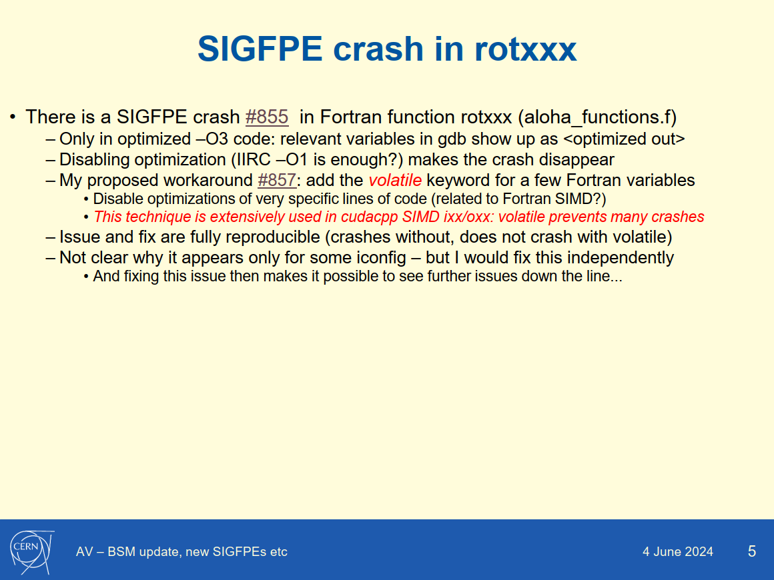
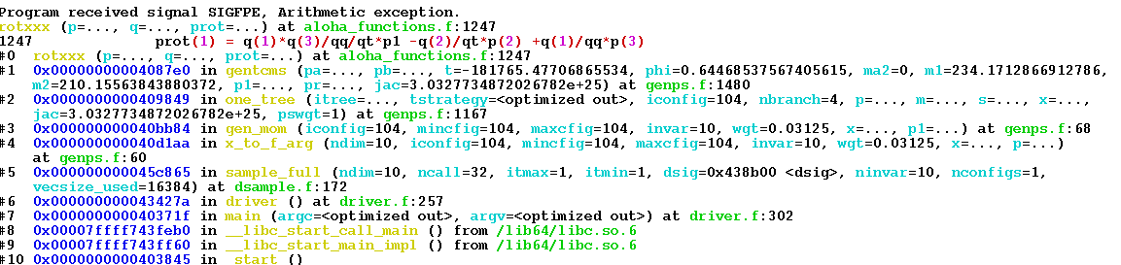
One crash I see
NB: this is not an “intermittent” crash that may sometimes be reproduced and sometimes may not: it is a crash I see all the time...
Olivier (thanks!) tried to reproduce it on my machine itscrd90 but was unable to
  Can you please try again? I gave step-by-step instructions on github...
I understand that adding volatile is controversial: hence I do more tests with valgrind
Note: I have no evidence at all that this may be related to iconfig-ichannel mapping

Slide 3
Some results from valgrind
First I tested the pure Fortran madevent_fortran through valgrind: found two issues
  A minor leak in driver.f (file opened and not closed)
    Issue https://github.com/mg5amcnlo/mg5amcnlo/issues/109
    Fix https://github.com/mg5amcnlo/mg5amcnlo/pull/110 - for review OM
  An uninitialized variable goodjet in reweight.f (possible undefined behaviour)
    Issue https://github.com/mg5amcnlo/mg5amcnlo/issues/111
    Workaround https://github.com/mg5amcnlo/mg5amcnlo/pull/112 - for review OM
    Not a fix! A real fix is needed... the code is accessing a variable that was not properly defined!
  After adding the patches for these two issues, valgrind is happy on madevent_fortran
    HOWEVER: madevent_cpp is still crashing in rotxxx, no progress in this respect
Now running valgrind on madevent_cpp
  This is taking forever (40 minutes and not over yet)... hangs??? is there an infinite loop?
Note: I also considered address sanitizer as suggested long ago by StephanH
  On Fortran code, however, I do not get any useful results (from gfortran)
    We do not support flang yet for Fortran...
  On C++ code, I need to fix some issues with clang build options
    Surprise however: with clang and without address sanitizer, the code also seems to hang???

Slide 4
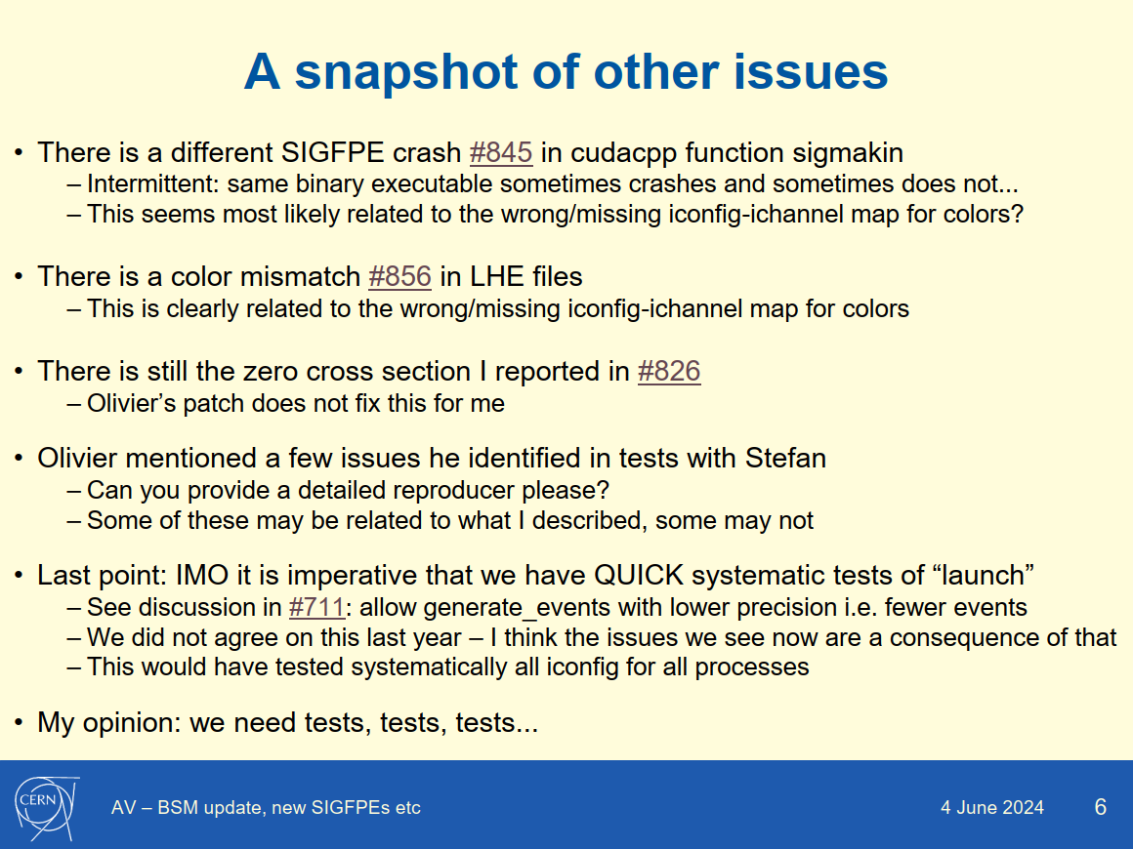
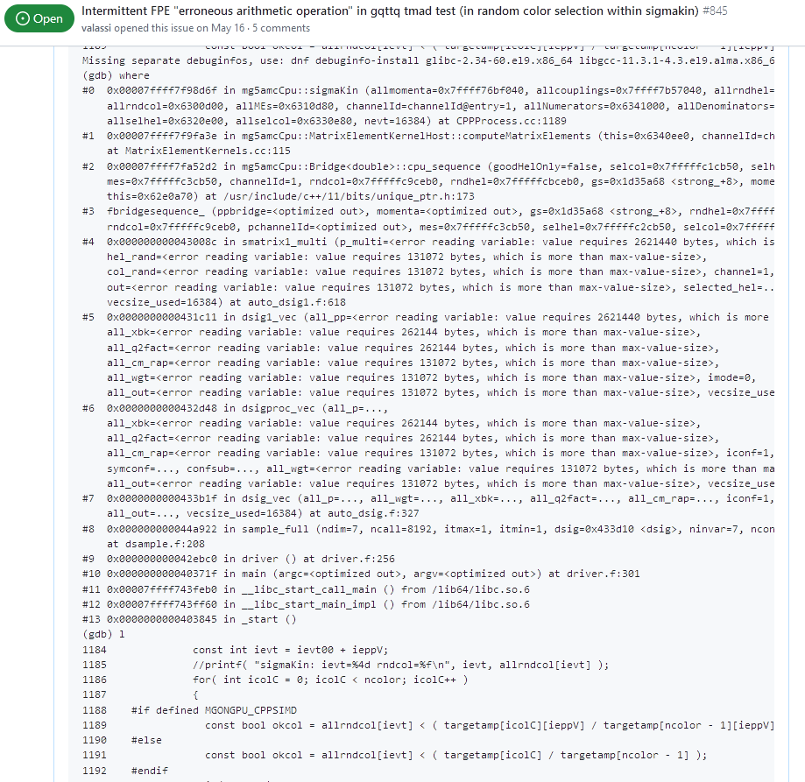
Another crash I see
NB: this is an “intermittent” crash: it sometimes crashes and sometimes does not...
For the moment I assume this is a DIFFERENT ISSUE (in gq_ttq) from the rotxxx crash (in gg_ttgg)...
Note: unlike the rotxxx crash, this is clearly related to iconfig-ichannel mapping

Slide 5


A crash others see
Can we have a reproducer for this please?
Which process, which commands...
(In GENERAL: can we have reproducers please before committing fixes?...)
Anyway: I assume it is related to my #845 crash and will test this against it...
And maybe it might fix the rotxxx crash too, but I would not bet on it...

