Slide 1

Progress report in the master branch
Initial analysis of the master_june24 branch
Andrea Valassi (CERN)
Madgraph on GPU development meeting, 08th July 2024
https://indico.cern.ch/event/1355156
(previous update was on June 25 – only mentioning changes since then)

Slide 2
Outline
Progress in madgraph4gpu master (and mg5amcnlo gpucpp)
  Our default branch, where I have shown all results in previous meetings
  Fixes and improvements from myself and Olivier, with mutual reviews/help (thanks!)
Progress in madgraph4gpu master_june24
  A new parallel branch created by Stefan and Olivier for channelid #830 and warps #756
  Associated to mg5amcnlo gpucpp_june24 and gpucpp_wrap branches (and lone commits)
  Olivier asked me to look at this with high priority, towards a merge into master
    (I used github fragments and reverse engineering – was this described in this meeting?)

Slide 3
master branch

Slide 4
Follow up on valgrind (see #868)
Followed up the two issues I identified two weeks ago in testing madevent_fortran
  (1) Minor leak in driver.f (file opened and not closed) mg5amcnlo#109
    Fix by AV (reviewed by OM) merged on Wed 26 Jun in PR mg5amcnlo#110
  (2) Uninitialized variable goodjet in reweight.f (possible undefined behavior) mg5amcnlo#111
    Workaround by AV (reviewed by OM) merged on Wed 26 Jun in PR mg5amcnlo#112
    Not a fix! Just ‘randomly’ initialize the uninitialized variables. A proper fix was also needed.
  Update MG5AMC in madgraph4gpu accordingly (and regenerate code)
    Fix by AV (reviewed by OM) merged on Thu 27 Jun in PR #869
  After adding the patches for these two issues, valgrind is happy on madevent_fortran
    HOWEVER: madevent_cpp was still crashing in rotxxx, no progress in this respect
  (2’) Proper fix for goodjet by OM on Tue 2 Jul in mg5amcnlo commit 1e2aa4bc3
    Update MG5AMC in madgraph4gpu by AV on Wed 3 Jul as part of the color PR #877
Tested madevent_cpp for ‘segfault on Haswell’ or ‘out of bounds’ reported by OM
  I did not find any evidence of such issues (different input files? never mind...)

Slide 5
Major improvements in the CI
Test coverage improvements
  Add my ‘tmad’ tests to the CI (cross section and LHE file comparison Fortran-cudacpp)
  Execute the full codegen-build-tput-tmad test chain for all FPTYPE=d,f,m
  These tests were ALREADY available to everyone through my scripts, but a CI is better
    Specific example/motivation: expose the rotxxx crash to everyone (no need for local reproducers)
Test infrastructure improvements
  Three separate jobs for FPTYE=d,f,m, reusing cached codegen from single codegen step
  Separate build caches for the different FPTYPE’s
  Use the PR number in codegen and build cache lookup (separate caches of different PRs)
Patch by AV (reviewed by OM) on Thu 27 Jun in PR #794

Slide 6
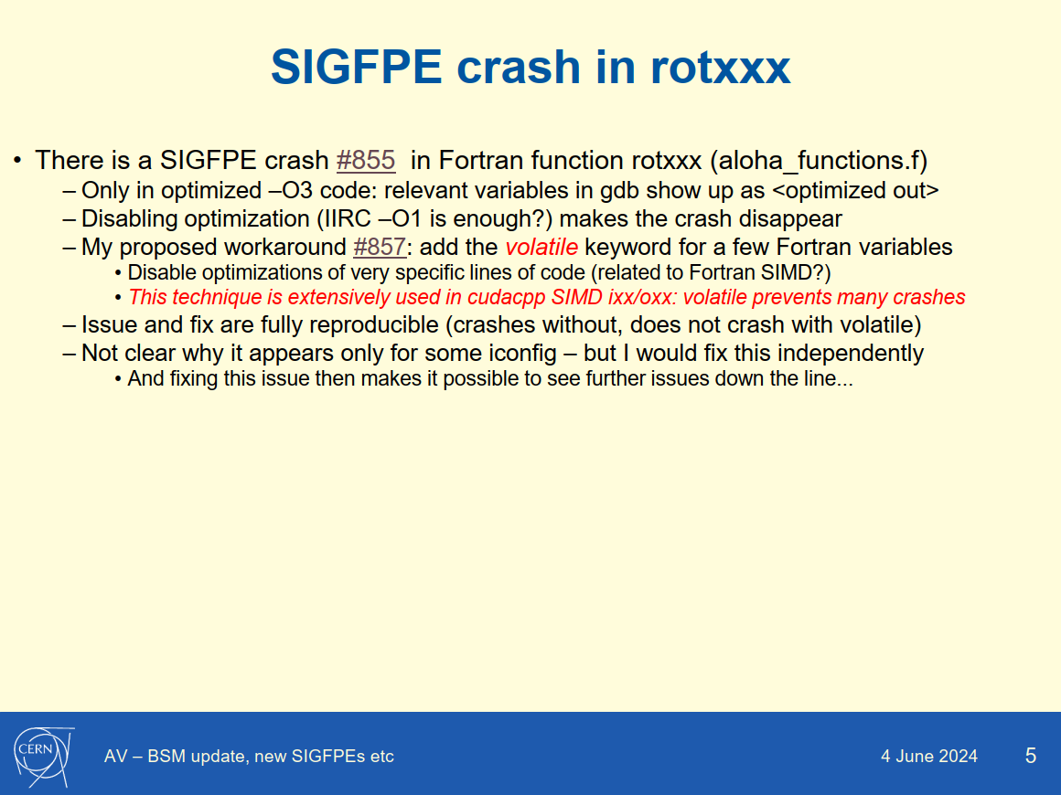
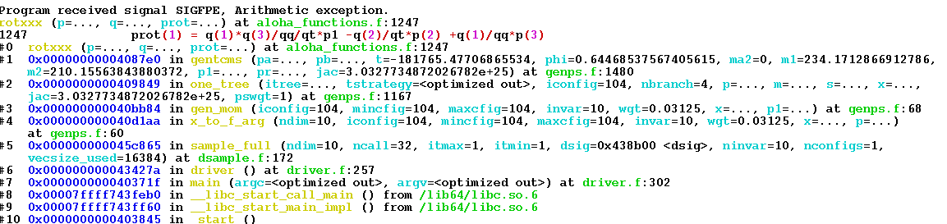
rotxxx crash #855 in gg_ttgg
Fixes by AV (reviewed by OM) merged on Thu 27 Jun
  Add volatile keyword in aloha_functions.f in PR mg5amcnlo#113
  MG5AMC update in PR #857

Slide 7
Haswell segfault and LHE color mismatch
Two related problems (wrong channel2iconfig mapping in coloramps.h impacts both)
  OM reported a Haswell out-of-bound access segfault [AV could not reproduce this]
  Color mismatch #856 in gg_ttggg for iconfig=104
  (NB: zero cross section in susy #826 is NOT related, even if a PR branch is fix_826...)
Two successive patches applied (after long useful discussion between AV and OM)
  Fixes by OM (reviewed by AV) merged on Wed 3 Jul in “fix_826” PR #852
  Further patch by AV (reviewed by OM) merged on Wed 3 Jul in PR #877
    Replacing two older PRs #853 and #873 by AV as suggested by OM
    Eventually stripping away AV’s icolamp patch mg5amcnlo#116 for #856 as suggested by OM
  These two patches fix channel2iconfig mapping in coloramps.h, but NOT yet icolamp
    Consequence: #856 color mismatch is not yet fixed after these two patches
A better fix for icolamp was eventually developed by OM (thanks Olivier!)
  Using the findings of AV’s icolamp patch mg5amcnlo#116, but much more robust
  Fix by OM (reviewed by AV) merged on Thu 4 Jul in PR #880
  Further patch by AV (reviewed by OM) on Thu 4 Jul in PR #881
  These patches finally fix the LHE color mismatch #856

Slide 8
Disable gtest from launch
Olivier’s suggestion: disable googletest download/build/use from ‘launch’ #878
  i.e. do not build cudacpp runTest.exe in ‘user interface mode’, also in generate_events
  Fix by AV (reviewed by OM) merged on Thu 4 Jul in PR #879

Slide 9
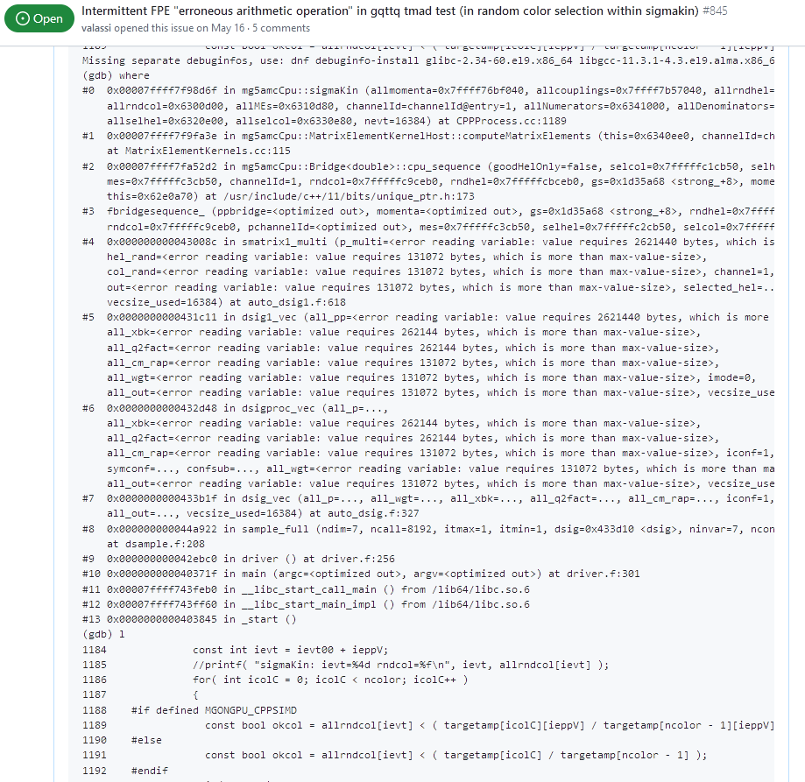
AVX512 crash in gq_ttq color choice #845
Clearly related to SIMD optimizations (only happens for 512z and FPTYPE=f)
  Fixed again with a ‘volatile’ keyword...
  Fixes by AV (reviewed by OM) merged on Thu 4 Jul in PR #874
Fully reproducible with OpenMP disabled (was ‘intermittent’ with OpenMP enabled)
  PR 874 also implements the option to disable OpenMP builds if ‘export OMPFLAGS=‘
  Addresses suggestion by OM in #758
    TODO: switch off OMP by default?

Slide 10
Pending physics issues in master
No cross section in susy gg_t1t1 #826
  OM/SR investigating if coupling ordering is responsible #862
Cross section mismatch in pp_tt012j #872
Much better than two weeks ago!!! Many crashes and complex issues fixed
Both issues are now visible in the CI (6 failures: two times three FPTYPE’s)
  Note: the new CI has an option to bypass/ignore these two issues, check if enabled...
There is also WIP by OM on another CI extension, and some issues found there
  Apologies, I did not have time to look at that yet...

Slide 11
master_june24 branch

Slide 12
Merging master and master_june24
Olivier asked me to look into the merge of master and master_june24
I created my branch ‘june24’ in WIP PR #882
  starting at master_june24
  with the idea of progressively merging master into it
To start with, I looked at master_june24 as-is, or with minimal modifications
  I regenerated all processes with master_june24 codegen (so that the old CI can test them)
    Processes had not been regenerated with the latest codegen, unlike what we had agreed long ago
  I included the new CI tmad tests (so that any issues there immediately show up)
    NB: tmad tests (cross section and LHE comparisons) were ALREADY available via manual scripts
Many issues showed up, including trivial build errors, and crashes (see next slide)
  My opinion: channelid PR #830 was not sufficiently tested upfront
    Some issues may also arise because ‘warp’ modifications in mg5amcnlo for #765 are incomplete
  We should agree on a procedure to avoid this happening again in the future...
    (at the very least: regenerate the code and ensure all CI tests pass...)
In the meantime, I am working on fixing these issues, so that we can move on...
  I will come back to Stefan or Olivier when/if I have questions (I already asked some...)

Slide 13
Some of the issues in master_june24
Builds fail for MAC/clang SIMD #883 (now fixed)
Builds fail for FPTYPE=m #884 (now fixed)
Crash in dsig1_vec if VECSIZE_USED < VECSIZE_MEMMAX #885
Clarify gpucpp branches (master_june24 does not use gpucpp_june24) #886
Fix documentation of NB_WARP and WARP_SIZE etc #887
Fortran runtime error: index of array ‘symconf’ above upper bound #888
Cross section mismatch for gg_ttggg FPTYPE=f #889 (now fixed, higher tolerance)
Replace hack in counters.cc by a proper fix #891
No-multichannel should be null array pointer, not channelid=0 #892
__CUDACC__ macros prevent HIP support #893
Wrong handling of SIMD numerators and denominators #894
Channelid memory accessor should be called only once for all diagrams #895
Add tests for two warps with different channelid’s #896

Slide 14
Is the warp functionality complete?
Do I understand correctly that eventually one “Gn” job will handle many iconfigs?
Is this functionality complete in Fortran? Is the new input.txt format decided?
In the meantime: I would at least test two warps with different channelids #896
If warps are NOT complete, I would wait before merging master_june24 into master
  My opinion: we should make sure we are able to fully test the functionality
In the meantime, the work on merging master into master_june24 can continue
  And the work on master (cross sections, couplings, plugin...) should continue too

