Slide 1

Status of PRs towards a release
(and a few other things)
Andrea Valassi (CERN)
(THANKS to Olivier for the team work on all these PRs!)
Madgraph on GPU development meeting, 3rd September 2024
https://indico.cern.ch/event/1355160
(previous update was last week on August 27 – only mentioning changes since then)

Slide 2
(1) Towards the release

Slide 3
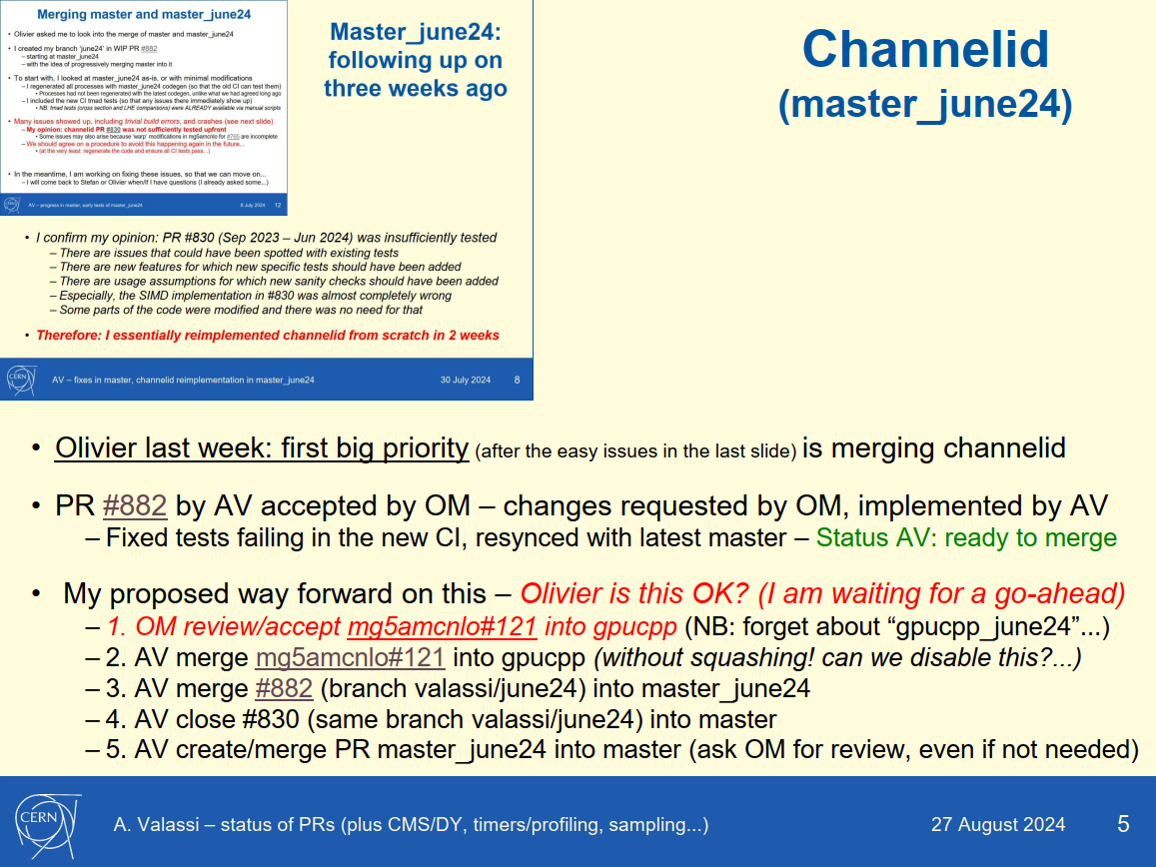
Channelid
(master_june24)
MERGED!
Olivier two weeks ago: first big priority is merging channelid
Status: FINALLY MERGED! – In detail
  1. Merged mg5amcnlo#121 (branch valassi_gpucpp_june24) into gpucpp
  2. Merged #882 (branch valassi/june24) into master_june24
  2. Merged #985 (branch master_june24) into master
And now... must merge/rebase everything else with the gpucpp+master baseline
  This is where some conflicts and issues start to appear...

Slide 4
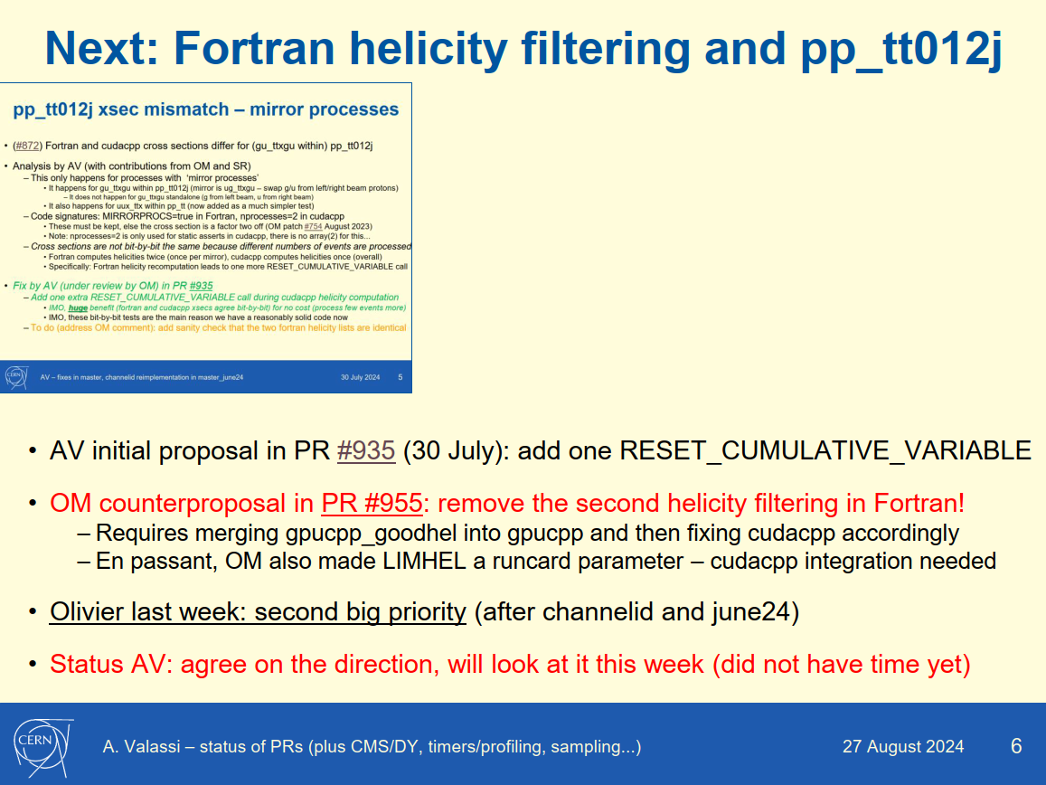
Next: Fortran helicity filtering and pp_tt012j
Olivier two weeks ago: second big priority (after channelid/june24)
Status AV: PR #986 (branch goodhel) based on Olivier’s 955 is ready and tested
  With its mg5amcnlo counterpart #137 (branch valassi_goodhel)
  Note: this includes many bits of the upgrade to 3.6.0 (but Olivier has more... next slide)
WIP now: update this to the latest gpucpp/master including june24
  First issue: merge conflicts (maybe better solved by Olivier’s gpuccp_for360, next slide)
  Second issue: with my WIP version, I get a 0.1% cross-section mismatch #991

Slide 5
Next: Olivier’s gpucpp_for360
Olivier this week: third big priority (after channelid/june24 and goodhel)
  Our cudacpp release is meant to be in v3.6.0...
This is a series of patches that are needed on top of june24 and goodhel
  They fix issues resulting from the update to 3.6.0 (in goodhel) and the interplay with the rest
Status: WIP WIP
  Done AV/OM: merged gpucpp_goodhel #138 into gpucpp_for360
  To do: more conflict resolution, on the mg5amcnlo side
  To do: and then, the integration with the cudacpp side

Slide 6
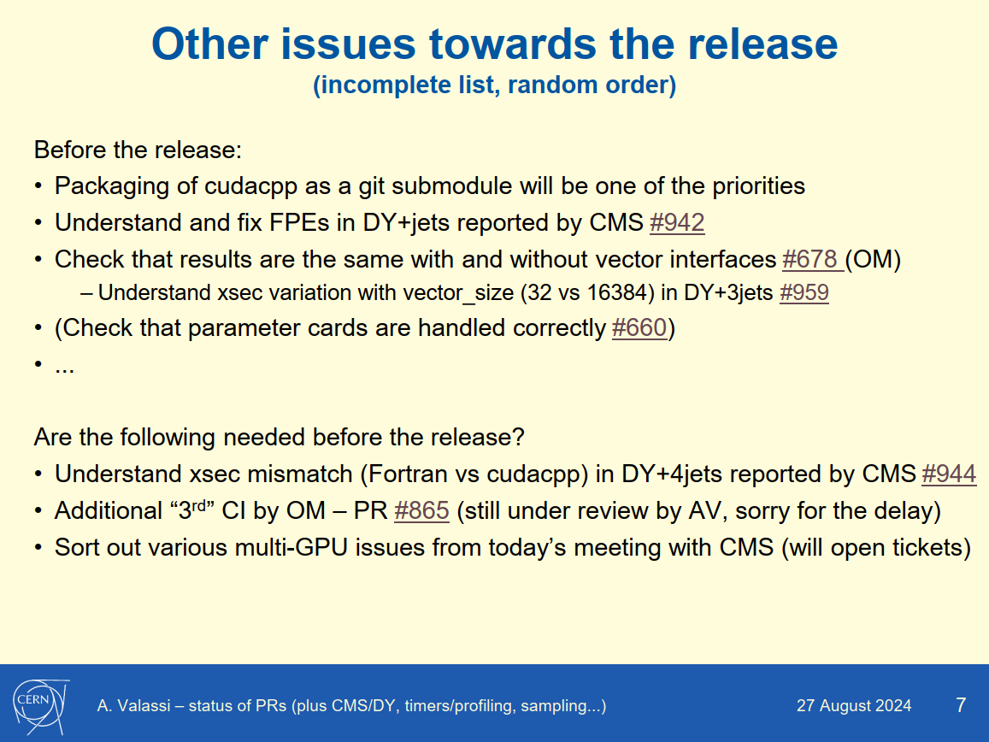
Other issues towards the release
Daniele’s talk
done, three issues
done
(fixci branch, not 865)

Slide 7
(2) Miscellanea

Slide 8
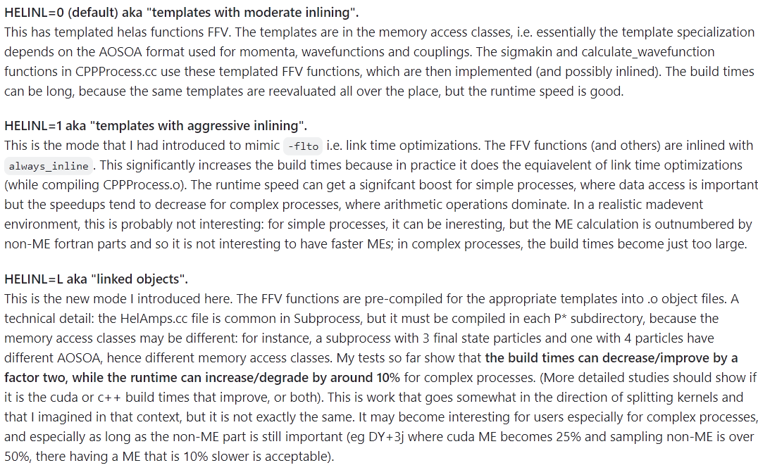
Build times: from templates to linked objects
Just some quick tests after a discussion at the meeting last week
  WIP PR #978 – reusing bits and pieces of previous work for splitting kernels
To do: test build times separately for cuda and each SIMD mode
Quick test using HELINL=L mode: does gg to ttggg (2 to 6) become more manageable?
Preliminary answer: NO unfortunately

