Slide 1
Persistent Current Effects in EuroCirCol 16 T cos-theta design using state of the art conductor
Susana Izquierdo Bermudez
08-02-2023
Acknowledgements: Ezio Todesco

Slide 2
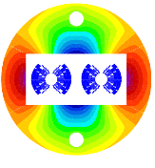
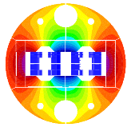
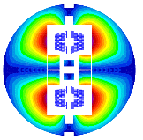
Introduction
Within EuroCirCol Program, WP5, three different magnet design options were explored [1].
16 T operating field, different coil configuration:
  Cos-theta (INFN), [2]
  Block (CEA), [3]
  Common-coil (CIEMAT), [4]
In 2018, the persistent currents effects at injection for the different coil configurations were explored EDMS 2036614. The outcome form this study was presented in the 4th FCC-hh design meeting (April 2023, https://indico.cern.ch/event/1267008/)
Magnetic cross section of the cosθ [2], block [3] and common-coil [4] designs.
[1] Tommasini, Status of the 16 T Dipole Development Program for a Future Hadron Collider, IEEE Transactions on Applied Superconductivity ( Volume: 28, Issue: 3, April 2018 )
[2] V. Marinozzi et al. "Conceptual design of a 16 T cosθ bending dipole for the future circular collider" IEEE Transactions on Applied Superconductivity ( Volume: 28, Issue: 3, April 2018)
[3] C. Lorin M. Durante H. Felice M. Segreti " Design of a Nb 3 Sn 16 T block dipole for the future circular collider " IEEE Transactions on Applied Superconductivity ( Volume: 28, Issue: 3, April 2018 )
[4] 10. F. Toral J. Munilla "Magnetic and mechanical design of a 16 T common coil dipole for FCC" IEEE Transactions on Applied Superconductivity (Volume: 28, Issue: 3, April 2018 )

Slide 3
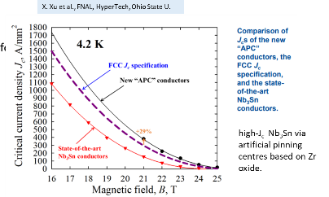
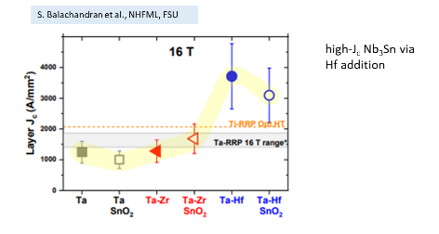
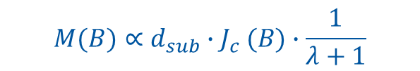
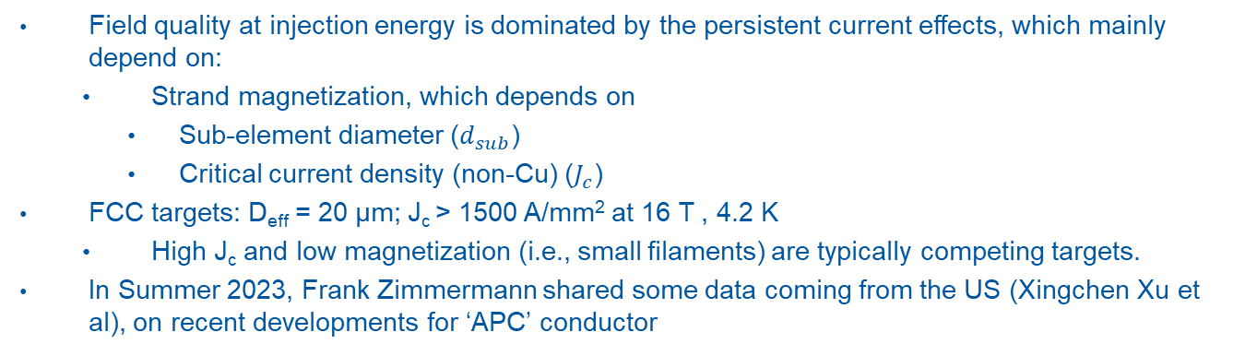
Field quality at injection
Field quality at injection energy is dominated by the persistent current effects, which mainly depend on:
  Strand magnetization, which depends on
    Sub-element diameter ($d_{sub}$)
    Critical current density (non-Cu) ($J_{c}$)
FCC targets: D_{eff} = 20 μm; J_{c} > 1500 A/mm² at 16 T , 4.2 K
  High J_{c} and low magnetization (i.e., small filaments) are typically competing targets.
In Summer 2023, Frank Zimmermann shared some data coming from the US (Xingchen Xu et al), on recent developments for ‘APC’ conductor
$$M(B)∝d_{sub}{∙J}_{c}(B)∙\frac{1}{λ+1}$$
[5] S. C. Hopkins, et al., "Design Optimization, Cabling and Stability of Large-Diameter High Jc Nb3Sn Wires," in IEEE Transactions on Applied Superconductivity, vol. 33, no. 5, pp. 1-9, Aug. 2023, Art no. 6000609, doi: 10.1109/TASC.2023.3254497.
[6] Xingchen Xu, et al., "High critical current density in internally-oxidized Nb3Sn superconductors and its origin ," Scripta Materialia,Volume 186,2020,Pages 317-320,
ISSN 1359-6462, https://doi.org/10.1016/j.scriptamat.2020.05.043.

Slide 4
Conductor assumptions in 2017
Cases considered for strand magnetization:
  D_{eff} = 50 μm, grain boundary pinning (state of the art technology)
  D_{eff} = 20 μm, grain boundary pinning
  D_{eff} = 20 μm, artificial pinning to reduce magnetization at low field
    Remark: today this is an ‘academic case’, and we are reducing the current margin at low field
  D_{eff} = 20 μm, half of the artificial pinning efficiency
Pinning method | Grain Boundary | Grain Boundary | Point Pinning | Half Pinning
Effective filament diameter, D_{eff} [µm] | 50 | 20 | 20 | 20
p [--] | 0.5 | 0.5 | 1 | 0.75
q [--] | 2 | 2 | 2 | 2
T_{c0} [K] | 16 | 16 | 16 | 16
B_{c20}[T] | 29.38 | 29.38 | 29.38 | 29.38
α | 0.96 | 0.96 | 0.96 | 0.96
C₀[A/mm²T] | 1.03*267845 | 1.03*267845 | 1.03*338485 | 1.03*312260
Cabling degradation [%] | 3 | 3 | 3 | 3
Remark: at the time, small magnetization was considered critical not only for the field quality at injection but also for the cryogenic load

Slide 5
Data shared in summer 2023
Xingchen Xu, from FNAL, kindly shared data from different wires under development. In particular, we got:
  Critical current density for 70 µm effective filament diameter, using two different heat treatments:
    High Critical Current: 63 hours at 700 ̊ C
    Low Critical Current: 540 hours at 625 ̊ C
  Critical current density for HL-LHC wire 0.85 mm, 55 µm effective filament diameter (not nominal reaction cycle)
  Magnetization measurements for 35 µm effective filament diameter, reacted 63 hours at 700 ̊ C

Slide 6
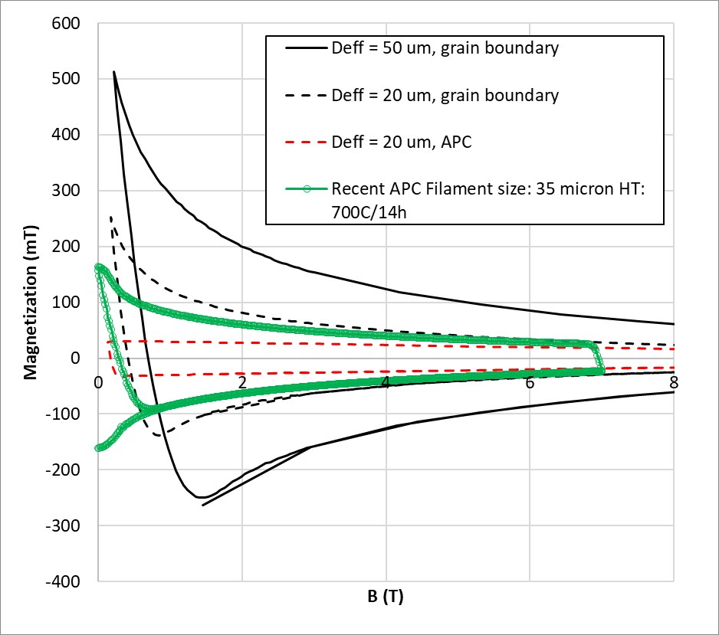
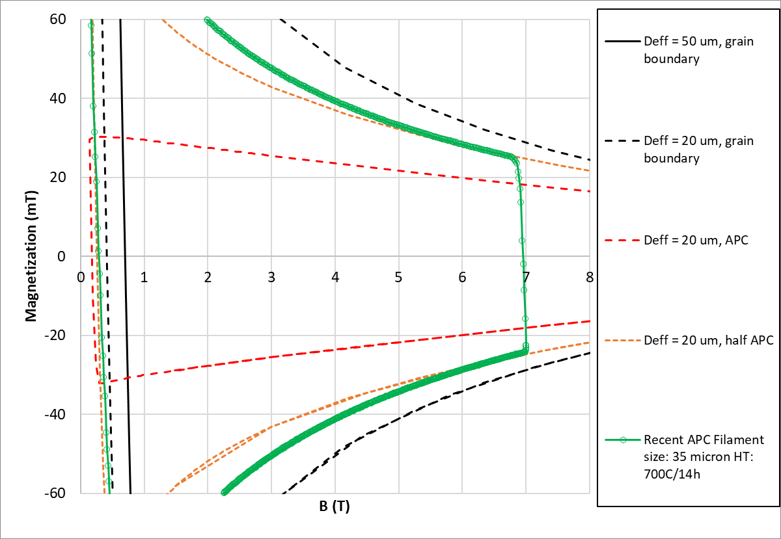
Magnetization – now vs assumptions in 2017
Only data for the 35 µm wire is given (Cu/non-Cu ratio 1.25)
  Probably it has rather low Jc this wire (only magnetization data was given)
Compared with the assumed magnetization in 2017 we are not far from the assumed magnetization for 20 µm/half APC

Slide 7
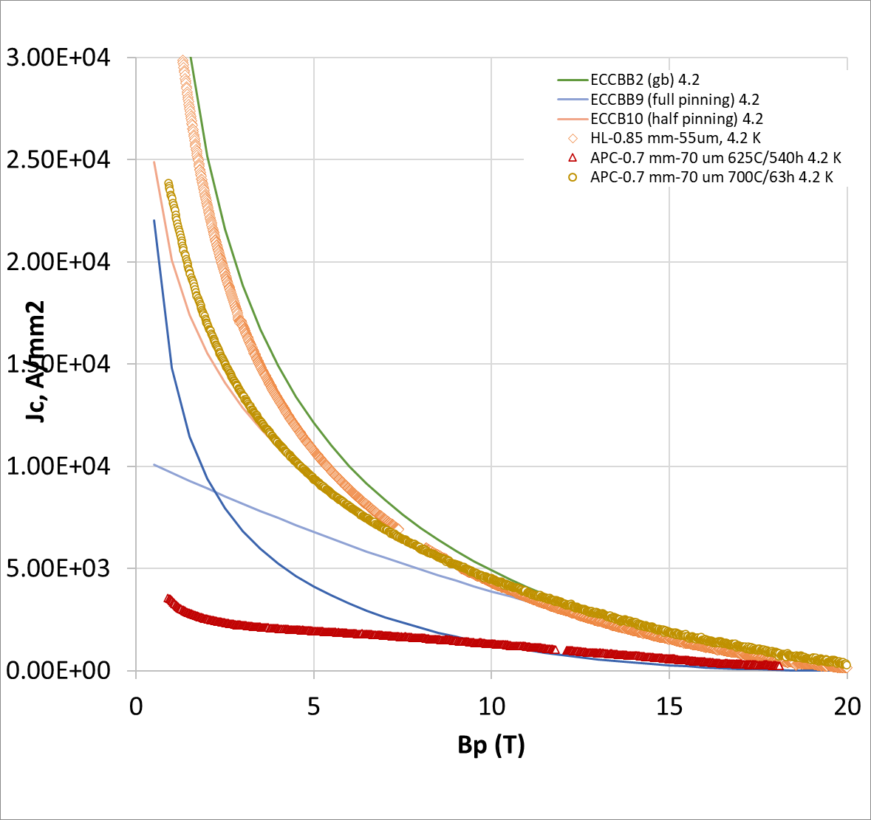
J_{c} – now vs assumptions in 2017
The 700 C 63 h is not so far from what we were assuming ‘half pinning’
The very long reaction wire has very low Jc, but also at high field is low
We don’t have a full set of data, i.e, current density and magnetization. Maybe the small filament (magnetization data provided) is still not there in terms of current density (only Jc for 70 um given), but let’s be optimistic and assume that at some point they will get both so we can take the case 20 µm half pinning efficiency as reference
Assumed in 2017 study

Slide 8
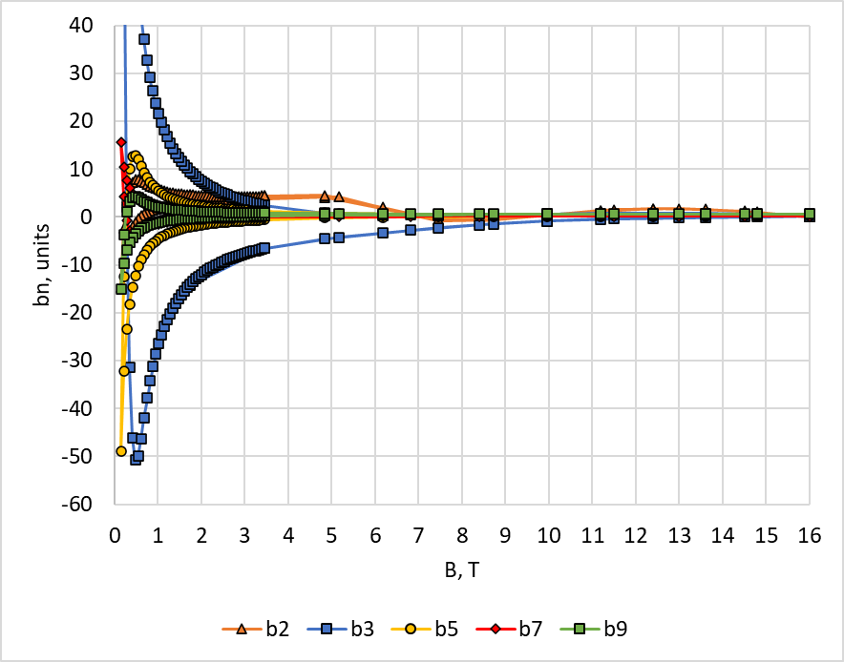
Field errors
Cos-theta 16 T design from EuroCirCol
20 µm/half APC

Slide 9
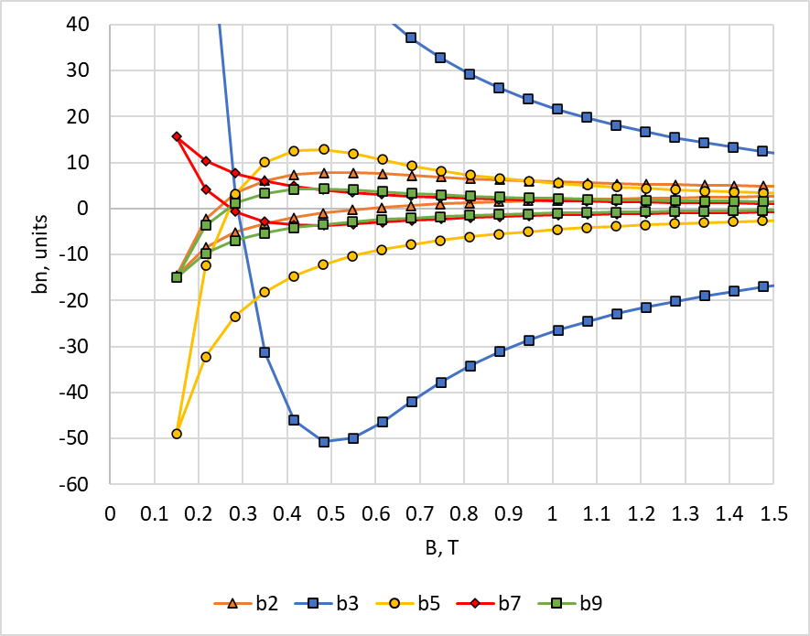
Field errors at low field
LHC modified (3.3 TeV)
sc HEB in LHC (3.3 TeV)
sf HEB in LHC (1.7 TeV)
scSPS (1.3 TeV)
Cos-theta 16 T design from EuroCirCol
16*1.7/50
16*1.3/50
16*3.3/50
20 µm/half APC
Injection energies form https://indico.cern.ch/event/1343931/contributions/5673200/

Slide 10
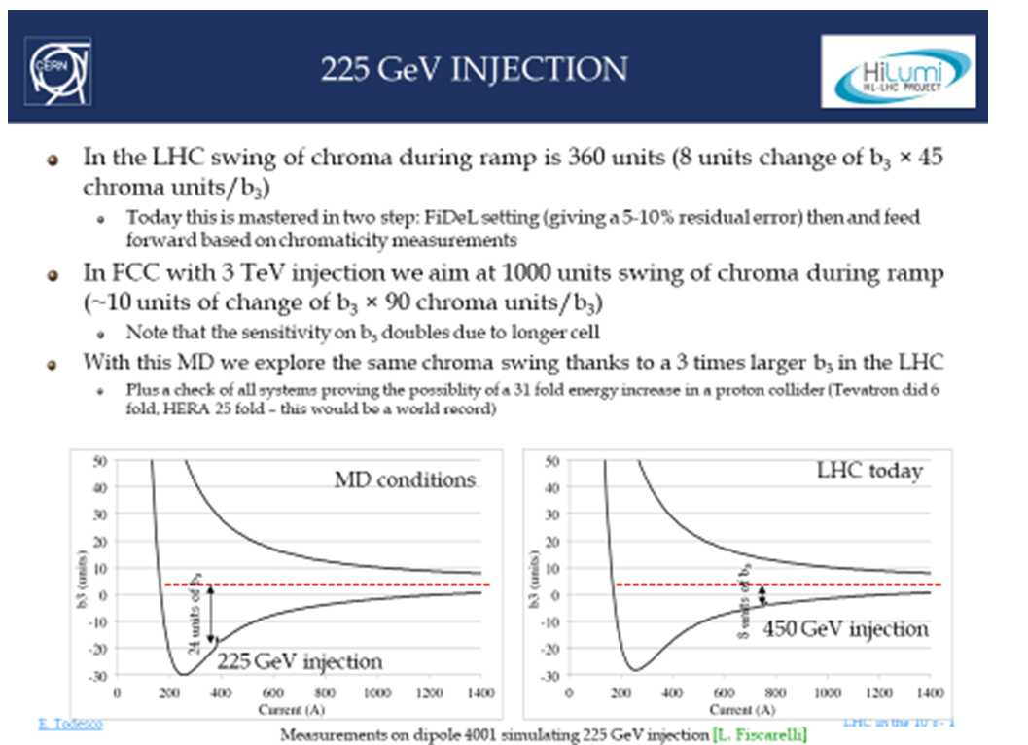
Additional remarks
Large swing of chroma during ramp compared with LHC, an MD was proposed in 2018 to inject in the LHC at 225 GeV
If injection is below or around the penetration field, the issue is not only the swing but also reproducibility
See talk from Ezio, FCC-hh design meeting (March 16, 2023) · Indico (cern.ch)

Slide 11
Summary
Recent magnetization and J_{c} measurements on Nb₃Sn magnets indicate progress towards APC
  We have only a partial set of data (J_{c} and magnetization for different types of strands and heat treatments), but being optimistic, from the cases studied in the past, we are close to the D_{eff} = 20 µm and half pinning efficiency.
Today we are far from the design of the arc magnet for fcc-hh, and the coil layout will have an impact on the field errors at injection, we do not have elements today to prove that a 1.3 TeV injection is viable
All computations shown here are based on the cos-theta 16 T magnet EuroCirCol design study
[1] S. Izquierdo Bermudez, L. Bottura and E. Todesco, "Persistent-Current Magnetization Effects in High-Field Superconducting Accelerator Magnets," in IEEE Transactions on Applied Superconductivity, vol. 26, no. 4, pp. 1-5, June 2016, Art no. 4003905, doi: 10.1109/TASC.2016.2519006.

Slide 12
Additional slides

Slide 13
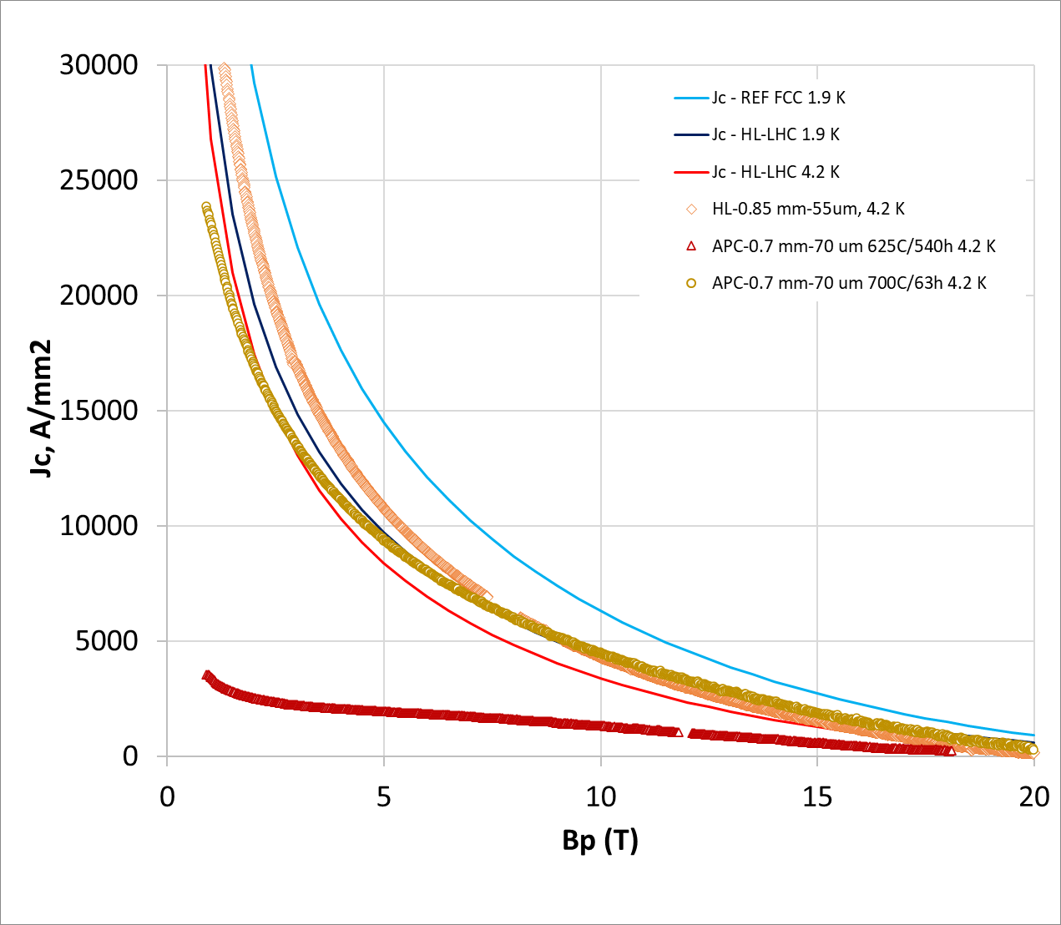
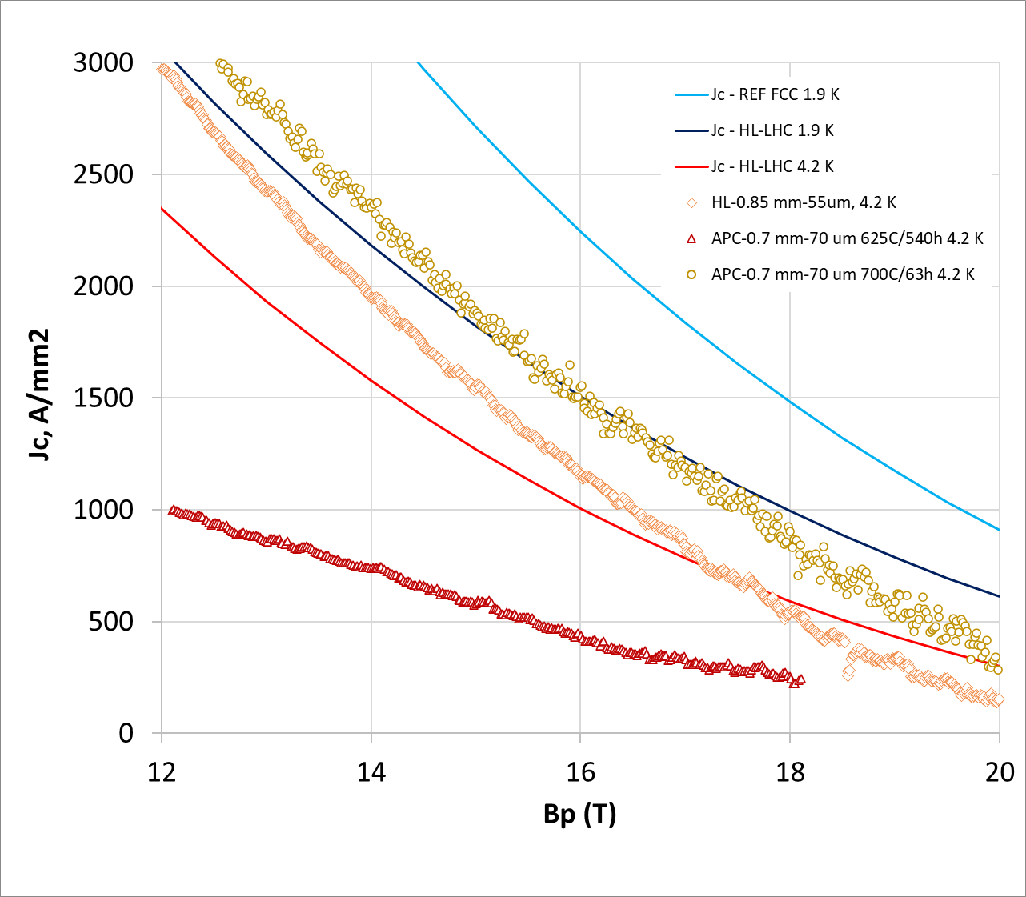
Critical current density
Comments on the critical current:
  The J_{c} for the HL-LHC wire, is quite high (3000 A/mm² vs 2400 A/mm² (ref) at 12 T. Typically we get 10 % more than the reference J_{c}, this wire is 25 % more.
  The curve becomes very flat when you react for very long, but even with that you lose a lot of Jc at high field (wire is not fully reacted)
  When comparing HL-LHC wire with the APC wire (high temperature/short cycle), critical current density at 0.9 T is 36 % less, which is a nice reduction at low field, with a Jc@17.5 T of 1045 A/mm² for APC vs 676 A/mm2 for RRP wire(+50 %)

