Slide 1







Update on $J/ψJ/ψ$ Structures using Run III Data $$J/ψJ/ψ→4μ$$
Gerry Bauer, Liangliang Chen, Yufei Chen, Meng Guo, Zhen Hu, Bolin Li, Zhengchen Liang, Zhijun Li, Yasar Onel, Chengping Shen, Xining Wang, Kai Yi, Zhengyun You, Jingqing Zhang, Yilin Zhou, Feng Zhu
+ Nikita Petrov, Ruslan Chistov
Thailand-China CMS Workshop 2024, Chulalongkorn University,
Jan 19, 2024

Slide 2
Outline
Motivation
Datasets, MC simulation & Event selection
Trigger modification & Preliminary results [blinded]
Background study
Run III Projection from Run II
Summary

Slide 3
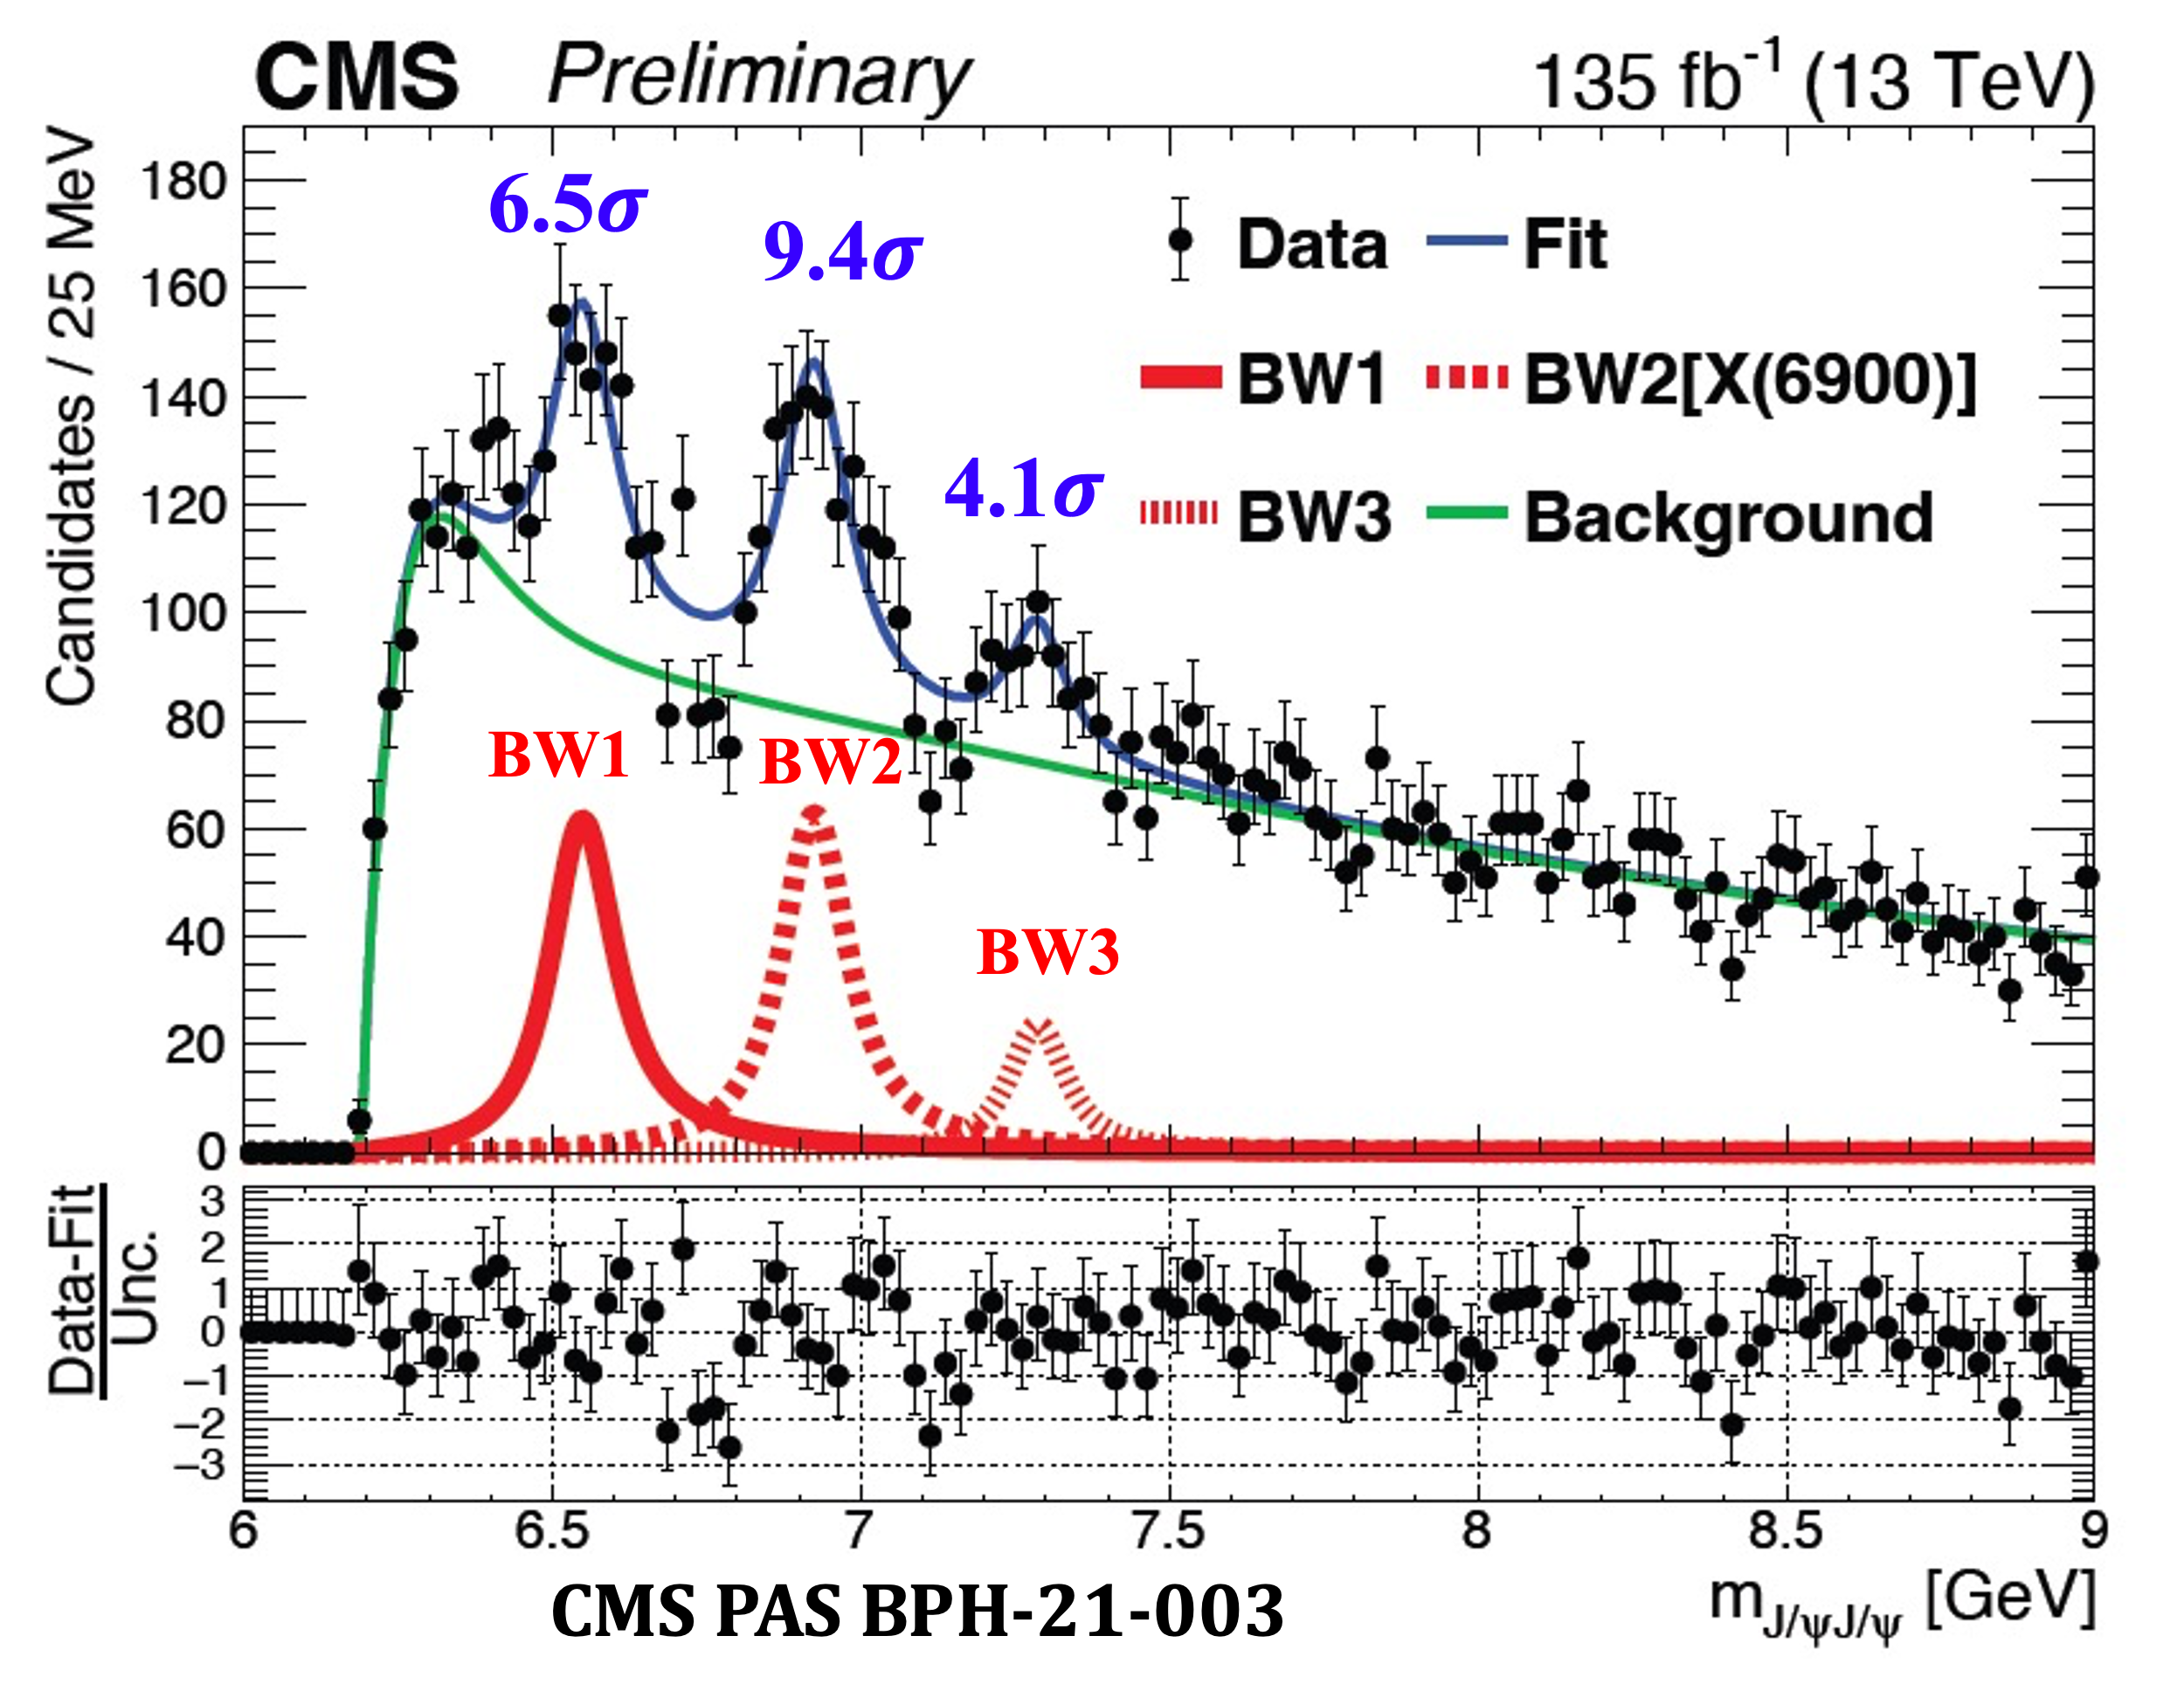
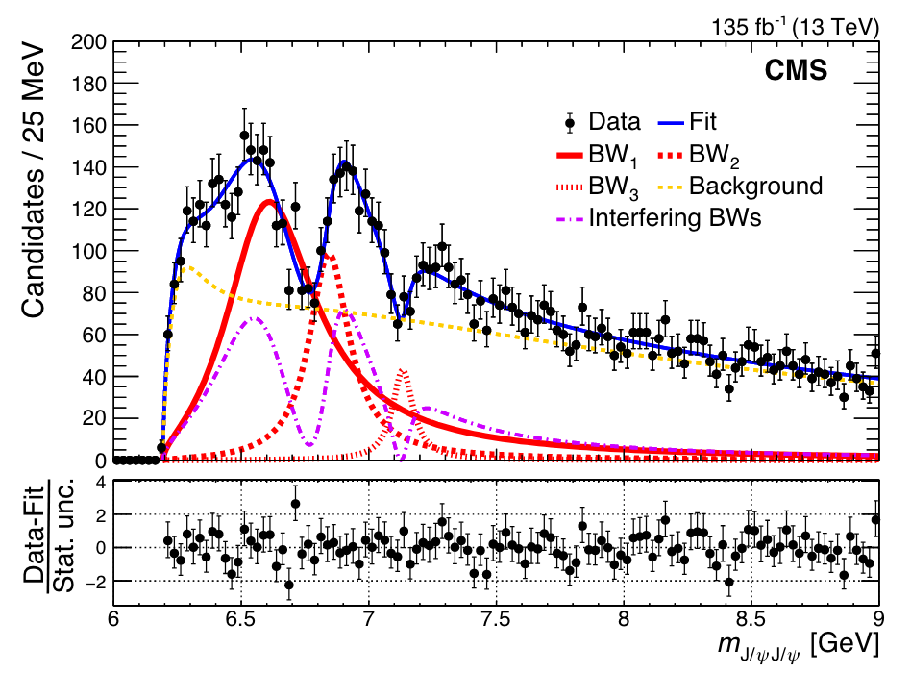
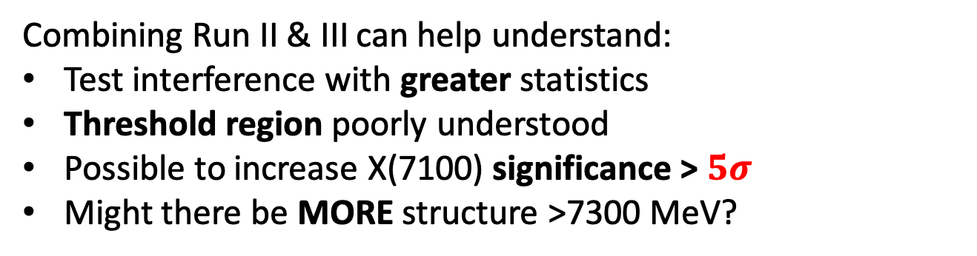
Motivation
Non_inter
Inter
Non_interference fit model
arXiv:2306.07164
interference fit model
CMS PAS BPH-21-003
Combining Run II & III can help understand:
Test interference with greater statistics
Threshold region poorly understood
Possible to increase X(7100) significance > $5σ$
Might there be MORE structure >7300 MeV?
Notes:
More than one point: around threshold range , interf model,
Combining Run II & III:Test interference with greater statistics

Slide 4
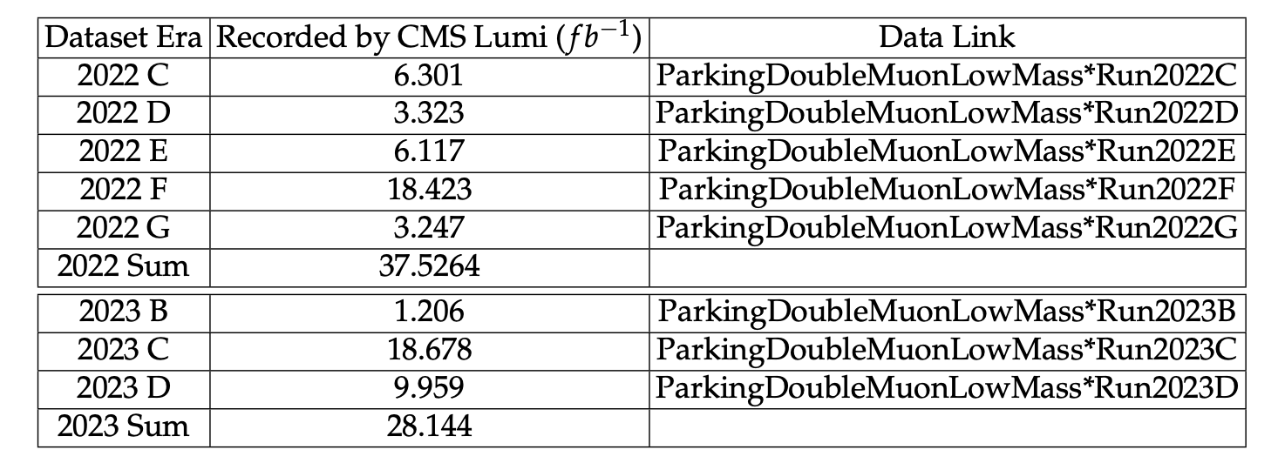
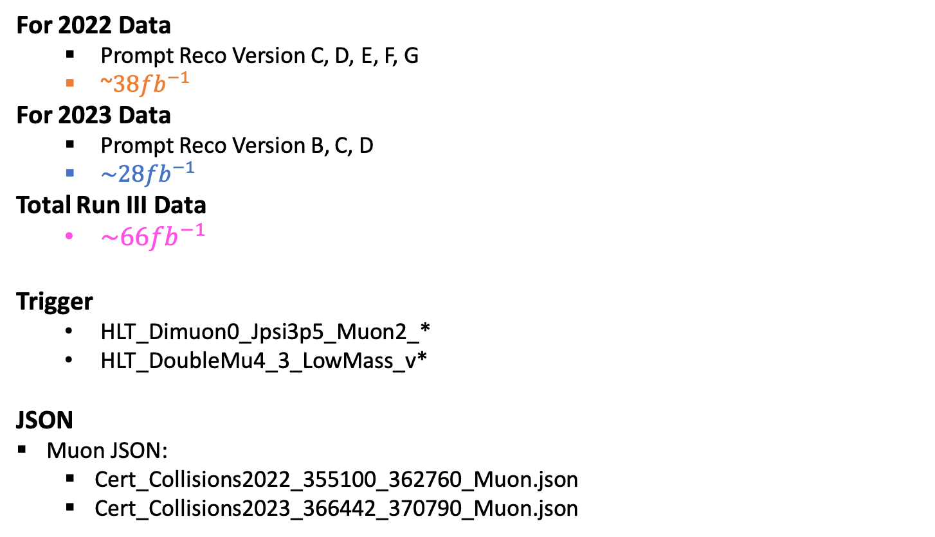
Run III Dataset
For 2022 Data
Prompt Reco Version C, D, E, F, G
~${\text{3}8fb}^{−1}$
For 2023 Data
Prompt Reco Version B, C, D
${\text{\sim 28}fb}^{−1}$
Total Run III Data
${\text{\sim 66}fb}^{−1}$
Trigger
HLT_Dimuon0_Jpsi3p5_Muon2_*
HLT_DoubleMu4_3_LowMass_v*
JSON
Muon JSON:
Cert_Collisions2022_355100_362760_Muon.json
Cert_Collisions2023_366442_370790_Muon.json

Slide 5
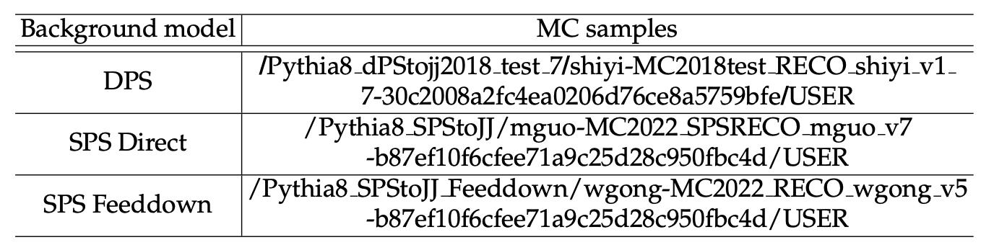
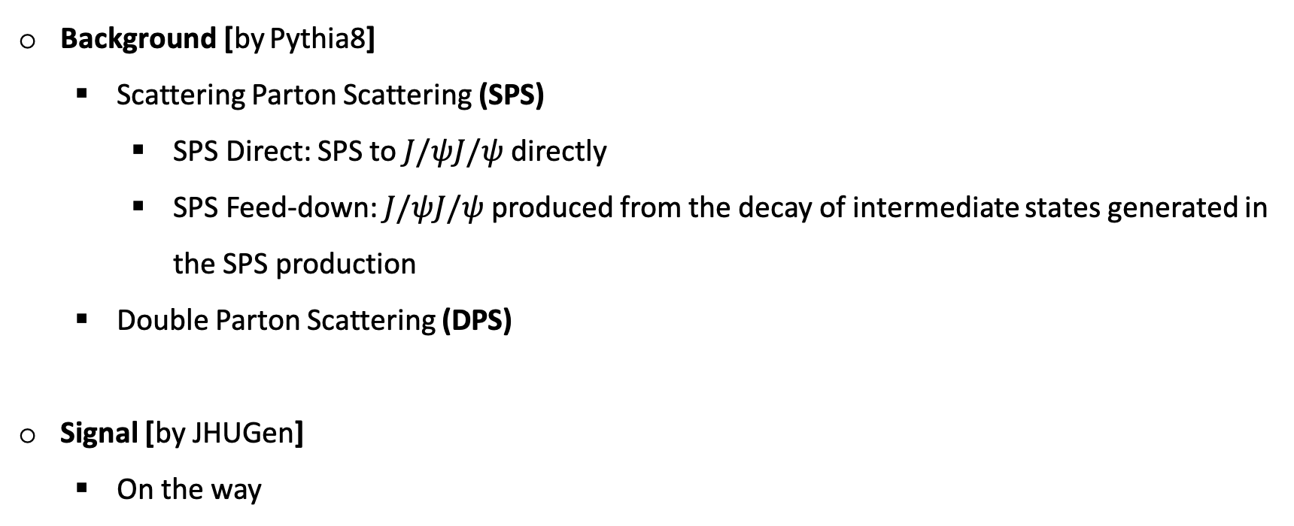
Monte Carlo simulation
Background [by Pythia8]
Scattering Parton Scattering (SPS)
SPS Direct: SPS to $J/ψJ/ψ$ directly
SPS Feed-down: $J/ψJ/ψ$ produced from the decay of intermediate states generated in the SPS production
Double Parton Scattering (DPS)
Signal [by JHUGen]
On the way

Slide 6
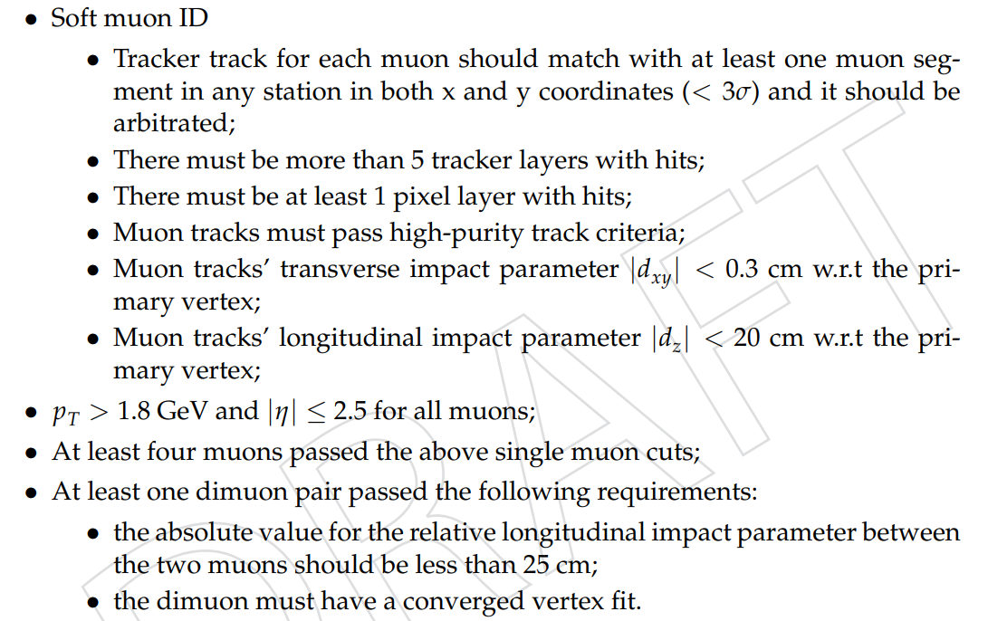
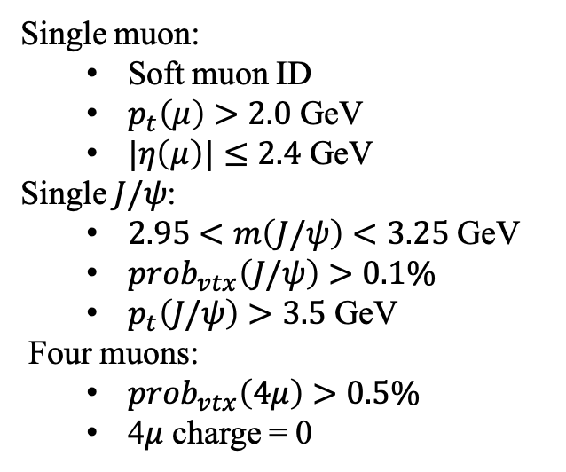
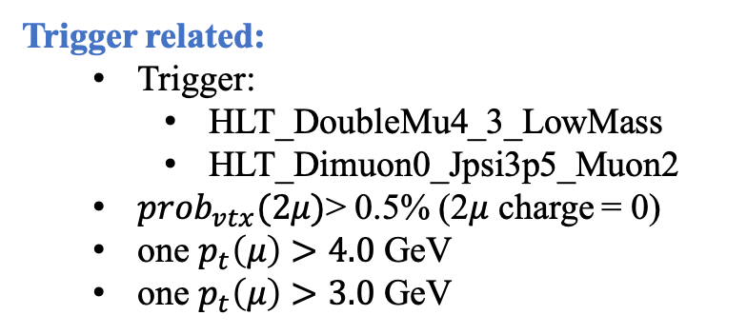
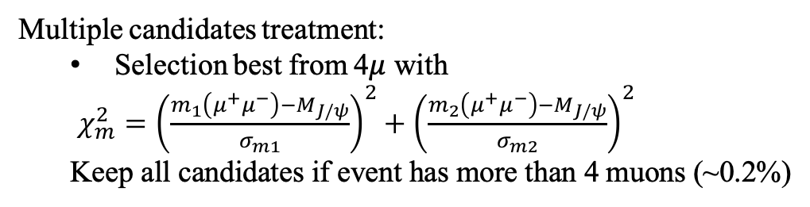
Event selection
Skim cuts:
Event selection:
The same cuts as Run II.
Trigger related:
Trigger:
HLT_DoubleMu4_3_LowMass
HLT_Dimuon0_Jpsi3p5_Muon2
$prob_{vtx}(2μ)$> 0.5% (2$μ$ charge = 0)
one $p_{t}\left(μ\right)>4.0$ GeV
one $p_{t}\left(μ\right)>3.0$ GeV
Single muon:
Soft muon ID
$p_{t}\left(μ\right)>2.0$ GeV
$|η\left(μ\right)|≤2.4$ GeV
Single $J/ψ$:
$2.95<m\left(J/ψ\right)<3.25$ GeV
$prob_{vtx}\left(J/ψ\right)>0.1\%$
$p_{t}\left(J/ψ\right)>3.5$ GeV
Four muons:
$prob_{vtx}\left(4μ\right)>0.5\%$
4$μ$ charge = 0
Multiple candidates treatment:
Selection best from 4$μ$ with
$χ_{m}^{2}={\left(\frac{m_{1}\left(μ^{+}μ^{−}\right)−M_{J/ψ}}{σ_{m1}}\right)}^{2}+{\left(\frac{m_{2}\left(μ^{+}μ^{−}\right)−M_{J/ψ}}{σ_{m2}}\right)}^{2}$
Keep all candidates if event has more than 4 muons (~0.2%)

Slide 7
Trigger modification
Comparison strategy:
With 2022 data set
Trigger information
[old] HLT_Dimuon0_Jpsi3p5_Muon2_* ➔ applicable for Run II and Run III data sets
[new] HLT_DoubleMu4_3_LowMass_v* ➔ exclusive to Run III data set
Three scenarios:
using only the HLT_Dimuon0_Jpsi3p5_Muon2 trigger,
using only the HLT_DoubleMu4_3_LowMass trigger,
combining both triggers, where data selected by either trigger were included.
7
Notes:
In this slide we show the 2d fit result of 2022 data for each trigger.
The plots above are from the new trigger, and the below plots are from previous trigger.
From these 2d fit plots we can see that despite that the background increased a lot, especially for the mu+mu- with low pt, the amount of signal improved remarkably.

Slide 8
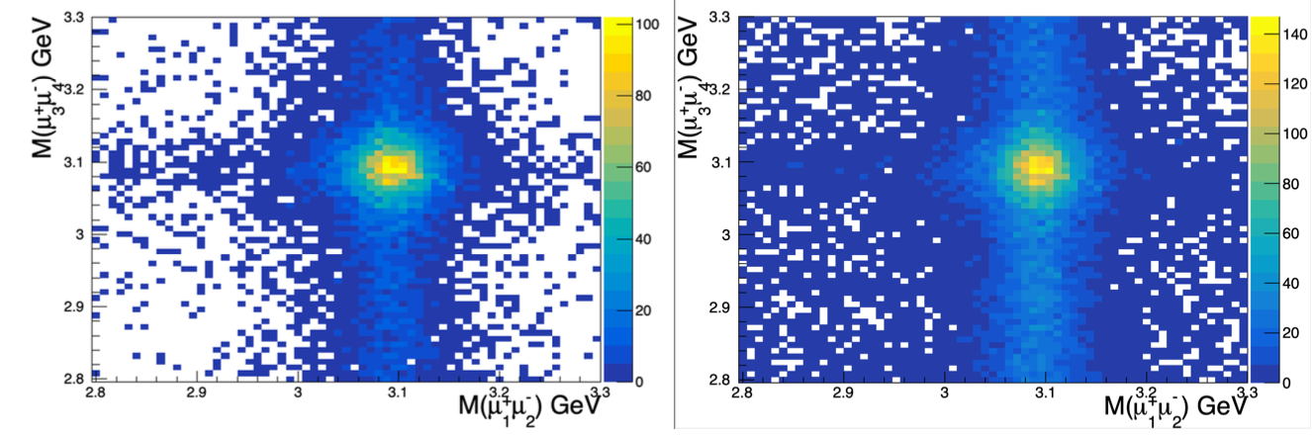
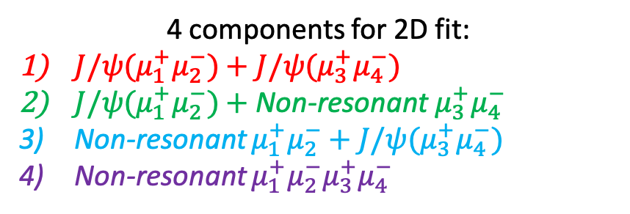
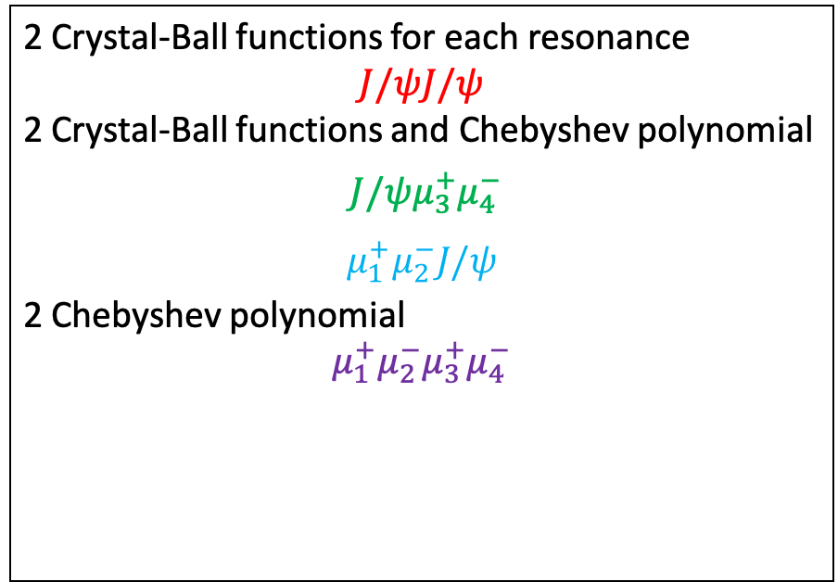
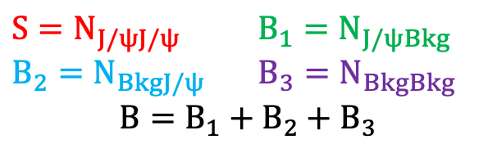
Comparison of two triggers [2022 data]
Old Trigger
4 components for 2D fit:
$J/ψ(μ_{1}^{+}μ_{2}^{−})+J/ψ(μ_{3}^{+}μ_{4}^{−})$
$J/ψ(μ_{1}^{+}μ_{2}^{−})+$ Non-resonant${ μ}_{3}^{+}μ_{4}^{−}$
Non-resonant $μ_{1}^{+}μ_{2}^{−}+J/ψ(μ_{3}^{+}μ_{4}^{−})$
Non-resonant $μ_{1}^{+}μ_{2}^{−}μ_{3}^{+}μ_{4}^{−}$
4mu
Jpsi
mumu
4mu
Mumu
Jpsi
Jpsi
Jpsi
Mumu
Jpsi
4mu
4mu
2 Crystal-Ball functions for each resonance
$$J/ψJ/ψ$$
2 Crystal-Ball functions and Chebyshev polynomial
$J/ψμ_{3}^{+}μ_{4}^{−}$
$$μ_{1}^{+}μ_{2}^{−}J/ψ$$
2 Chebyshev polynomial
$$μ_{1}^{+}μ_{2}^{−}μ_{3}^{+}μ_{4}^{−}$$
Jpsi
mumu
New Trigger
$S=N_{J/ψJ/ψ}$ ${B_{1}=N}_{J/ψBkg}$
${B_{2}=N}_{BkgJ/ψ}$ ${B_{3}=N}_{BkgBkg}$
$$B=B_{1}+B_{2}+B_{3}$$
Notes:
In this slide we show the 2d fit result of 2022 data for each trigger.
The plots above are from the new trigger, and the below plots are from previous trigger.
From these 2d fit plots we can see that despite that the background increased a lot, especially for the mu+mu- with low pt, the amount of signal improved remarkably.

Slide 9
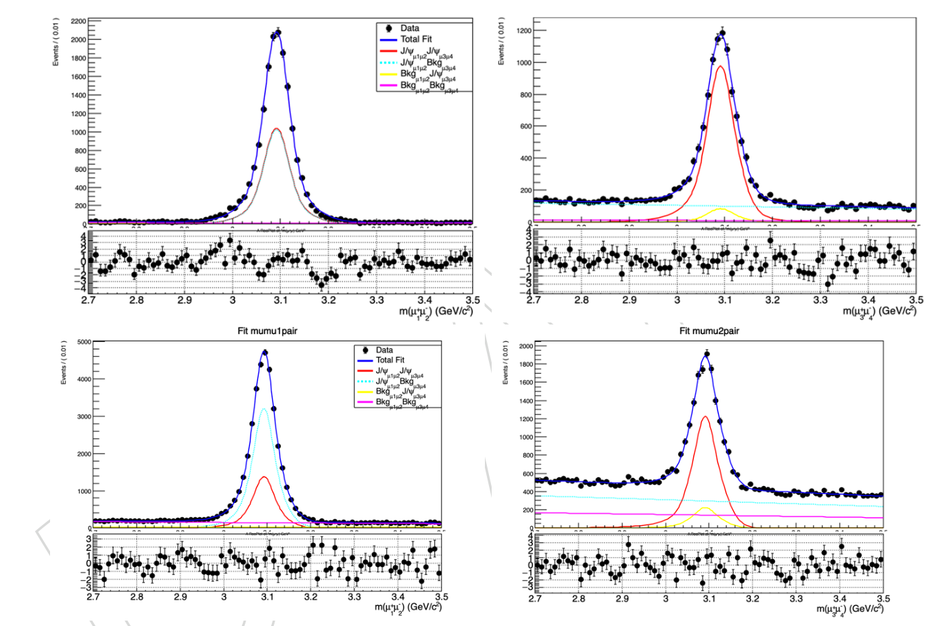
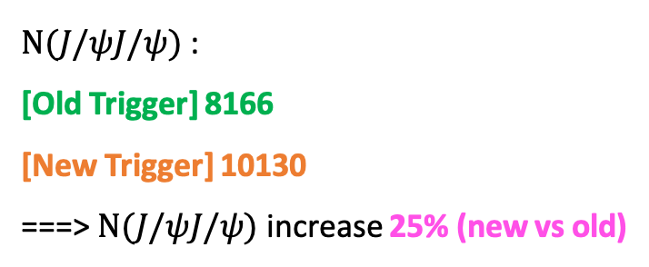
Comparison of two triggers [2022 data]
Old Trigger
$N(J/ψJ/ψ)$ :
[Old Trigger] 8166
[New Trigger] 10130
===> $N(J/ψJ/ψ)$ increase 25% (new vs old)
New Trigger
The results from the third case are similar to those of the second
Use a combination of
New trigger and Old trigger
Notes:
In this slide we show the 2d fit result of 2022 data for each trigger.
The plots above are from the new trigger, and the below plots are from previous trigger.
From these 2d fit plots we can see that despite that the background increased a lot, especially for the mu+mu- with low pt, the amount of signal improved remarkably.

Slide 10
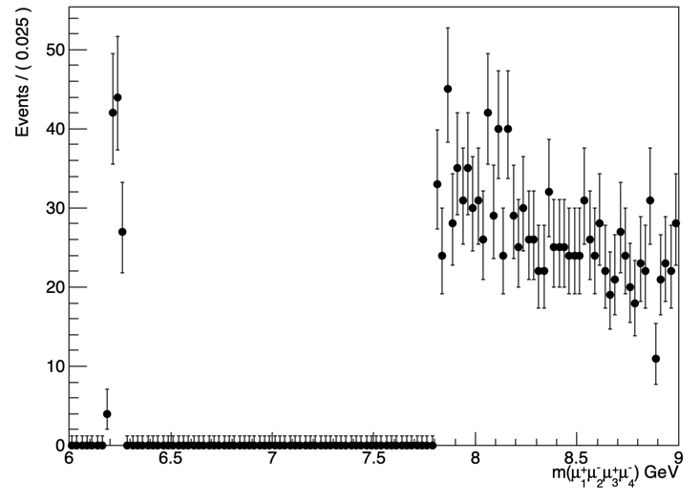
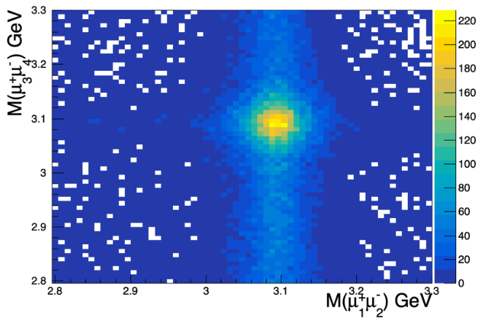
Preliminary results in Run III data
Run III data [blinded]
Scatter plot in Run III data
Blinded region
[6.26~7.8GeV]
Notes:
在sideband的数据相当于之前的百分之多少, with the same requirement as we applied to Run II data. 做一些比较
为了更深入的对比，we remvoed mass window related cuts and then invetst 2d scattering p an fit how many
Can we unblind the region window which region want blind and unblind
Take the run II redifinite which region want blind and unblind
Run II 6.9可以亮出来

Slide 11
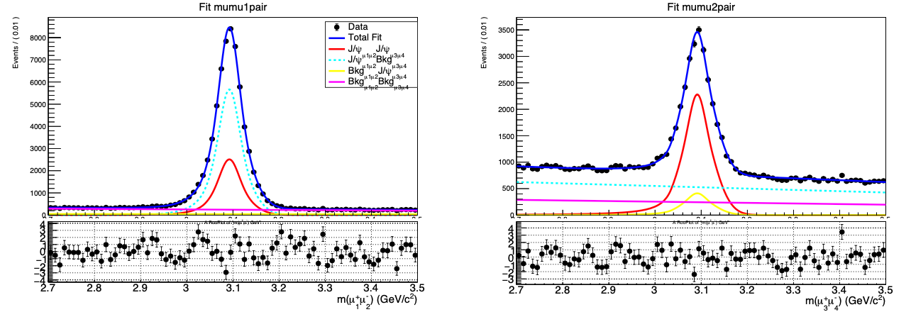
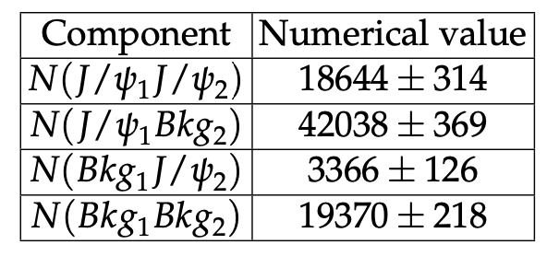
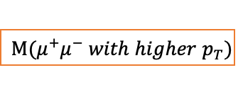
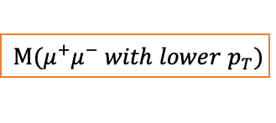
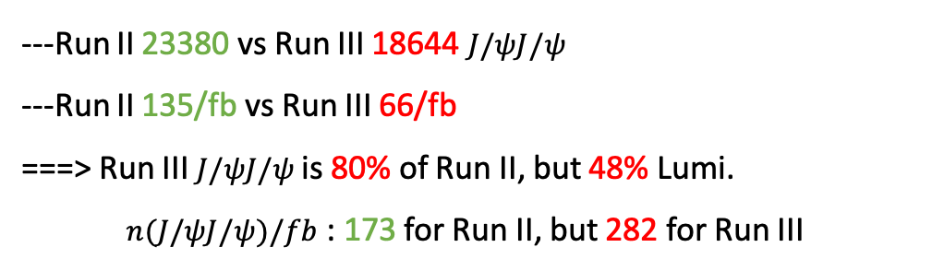
2D fit of dimuon mass in Run III data
$$M(μ^{+}μ^{−} with higher p_{T})$$
$$M(μ^{+}μ^{−} with lower p_{T})$$
---Run II 23380 vs Run III 18644 $J/ψJ/ψ$
---Run II 135/fb vs Run III 66/fb
===> Run III $J/ψJ/ψ$ is 80% of Run II, but 48% Lumi.
$n(J/ψJ/ψ)/fb$ : 173 for Run II, but 282 for Run III
A rise in combinatorial background events
～Tenfold compared to the original amount
Notes:
The projection plot of X-axis distribution with full Run II data
Higher pt muons
Change bin

Slide 12
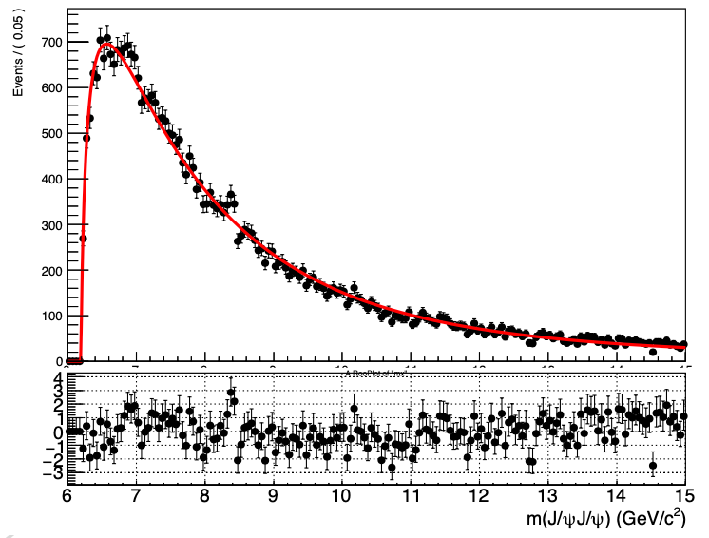
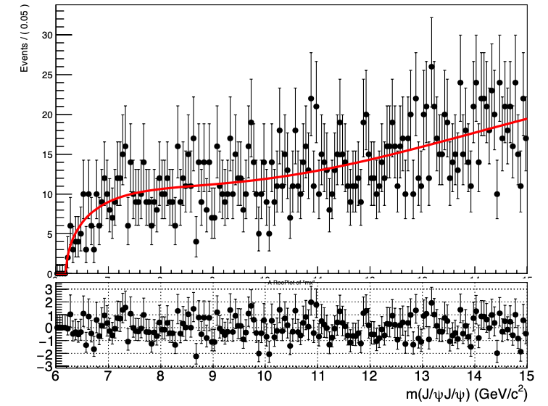

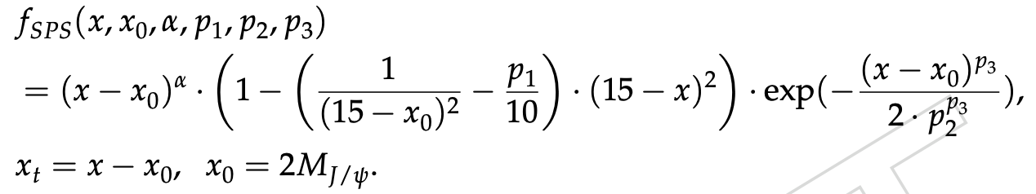
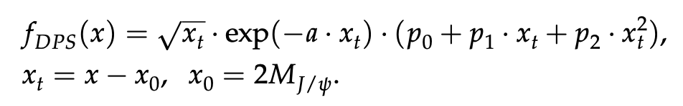
Background study---SPS & DPS
Use the same fitting formula in Run II
Fitting results of MC demonstrate consistency with Run II analysis
SPS MC
Fit model
DPS MC
Fit model
Notes:
Renew the second and third forth plot
Using the same scale

Slide 13
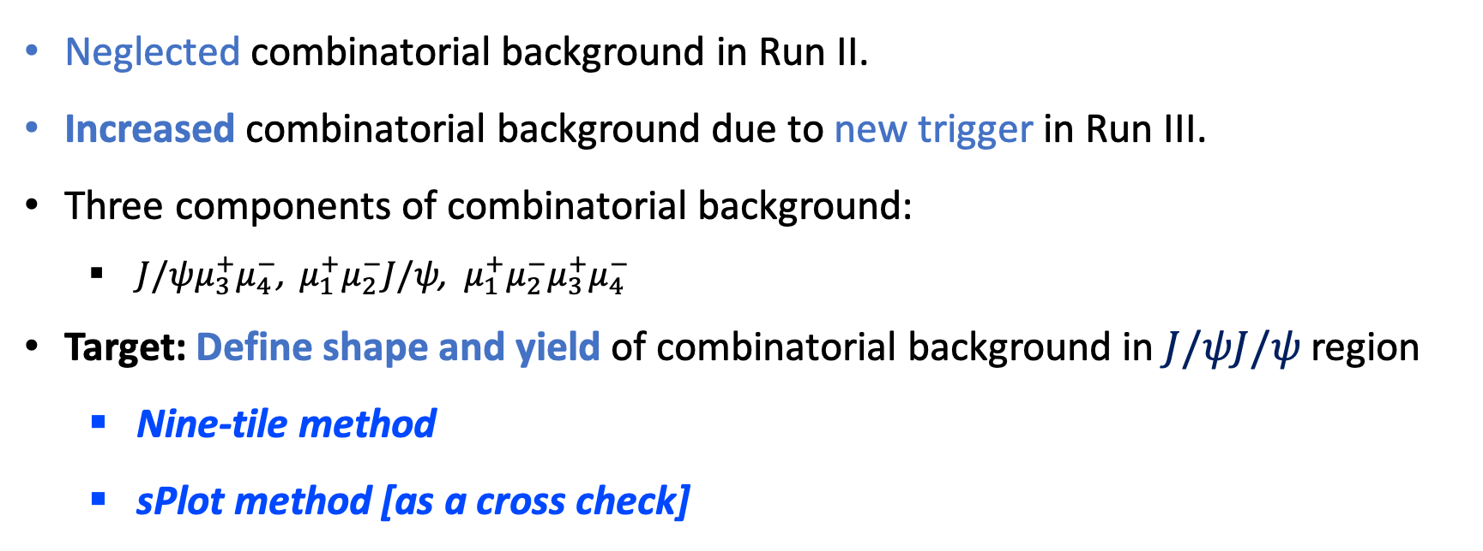
Background study --- Combinatorial background
Neglected combinatorial background in Run II.
Increased combinatorial background due to new trigger in Run III.
Three components of combinatorial background:
$J/ψμ_{3}^{+}μ_{4}^{−}$, $μ_{1}^{+}μ_{2}^{−}J/ψ$, $μ_{1}^{+}μ_{2}^{−}μ_{3}^{+}μ_{4}^{−}$
Target: Define shape and yield of combinatorial background in $J/ψJ/ψ$ region
Nine-tile method
sPlot method [as a cross check]
Notes:
Renew the second and third forth plot
Using the same scale

Slide 14
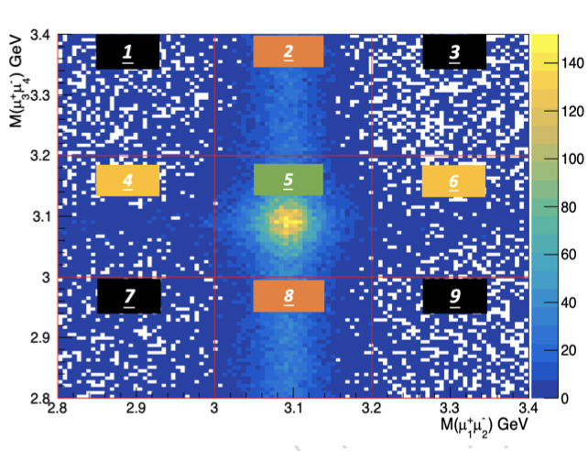
Combinatorial background study --- Nine-tile
Assumed three components of combinatorial background linear
Dimuon Mass Regions:
[2.8, 3.0], [3.0, 3.2], [3.2, 3.4] GeV
Tile Weights:
Tiles 1, 3, 7, 9 [μ+μ−μ+μ−], a weight of - 0.25;
Tiles 2 and 8 [J/ψμ+μ−], a weight of 0.5;
Tiles 4 and 6 [μ+μ−J/ψ], a weight of 0.5;
Tile 5, the signal region of J/ψ J/ψ
Estimate contributions in the J/ψ J/ψ signal region using assigned tile weights.
Notes:
Renew the second and third forth plot
Using the same scale

Slide 15
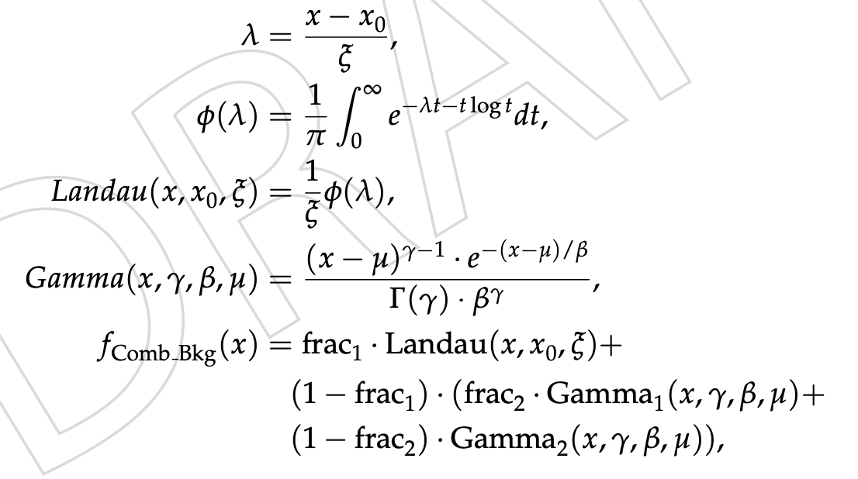
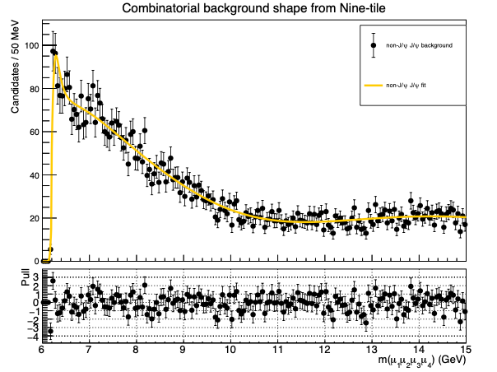
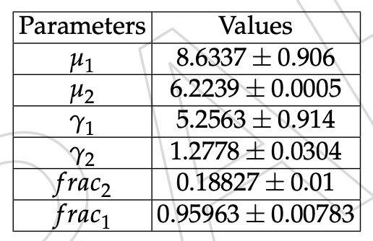
Combinatorial background study --- Nine-tile
Data
Fit
Notes:
Renew the second and third forth plot
Using the same scale

Slide 16
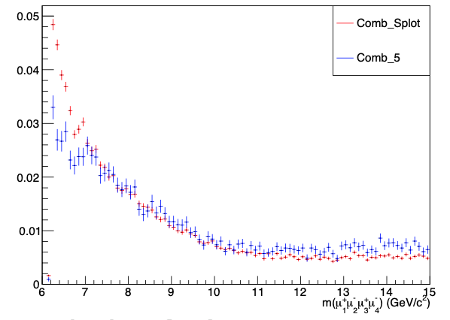
Combinatorial background study --- sPlot
Data
sPlot
Fit
Nine-tile
sPlot broader range [2.7, 3.5] GeV, Nine-tile zoom in [3.0, 3.2] GeV, causing variations
Both methods align on combinatorial background shape.
Nine-tile chosen as default for its focus on the J/ψ region.
The estimated yield of non-J/ψ pairs is 10744 ± 84.
Notes:
Renew the second and third forth plot
Using the same scale

Slide 17
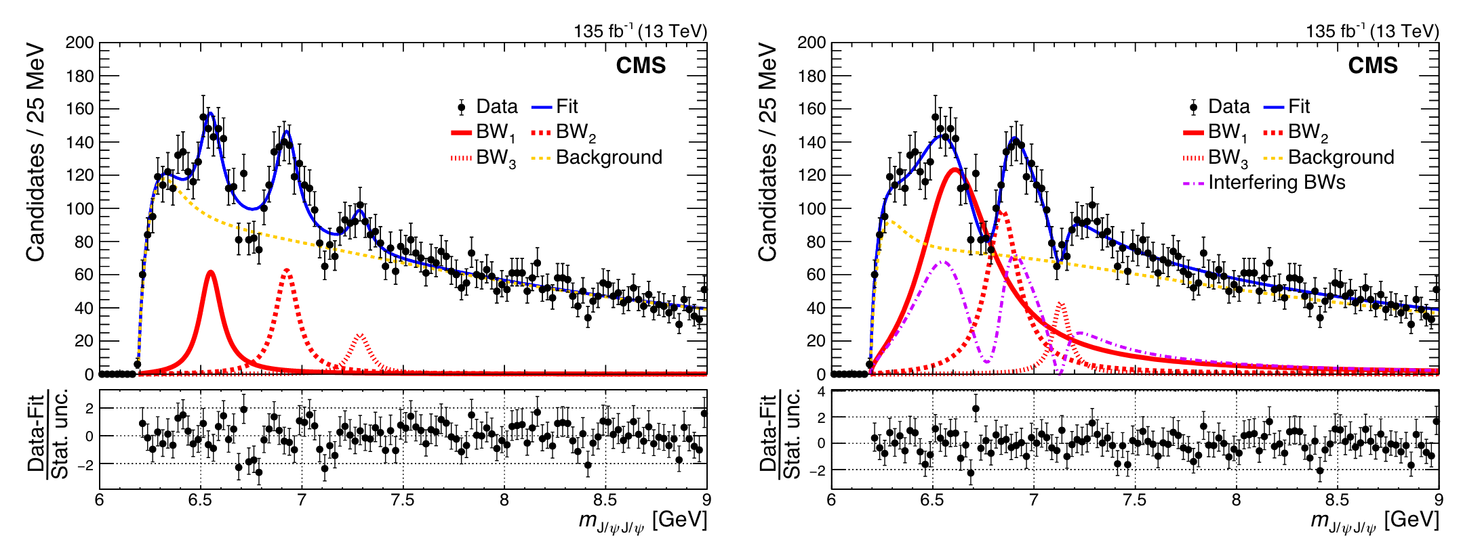
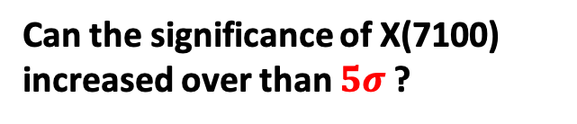
Projecting Current Run III from Run II
The J/ψJ/ψ mass spectrum with two fits model in Run II
Non_interference fit model
interference fit model
Can the significance of X(7100) increased over than $5σ$ ?

Slide 18
Projecting Current Run III from Run II
Toy MC Simulation Strategy :
Based on the ”three-way” interference model [derived from the Run II analysis]
Produce 80% SPS, DPS, BW0, interference of BW1, BW2, and BW3.
Combinatorial background [shape fixed from Nine-tile]
Determine yield numbers with a Gaussian constraint at 10744 ± 84
Toy MC Fitting Model:
The ”three-way” interference model
SPS, DPS, BW0, interference of BW1, BW2, and BW3.
+ Combinatorial background [shape fixed and yield float in 10744 ± 84]
+ Feed-down background [shape fixed]

Slide 19
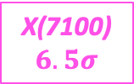
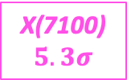
Interf fit of Run II + Run III toy data
X(7100)
$$5.3σ$$
X(7100)
$$6.5σ$$
Significance of X(7100) is expected to exceed over $5σ$
Notes:
Add words
Change 15->9GeV

Slide 20
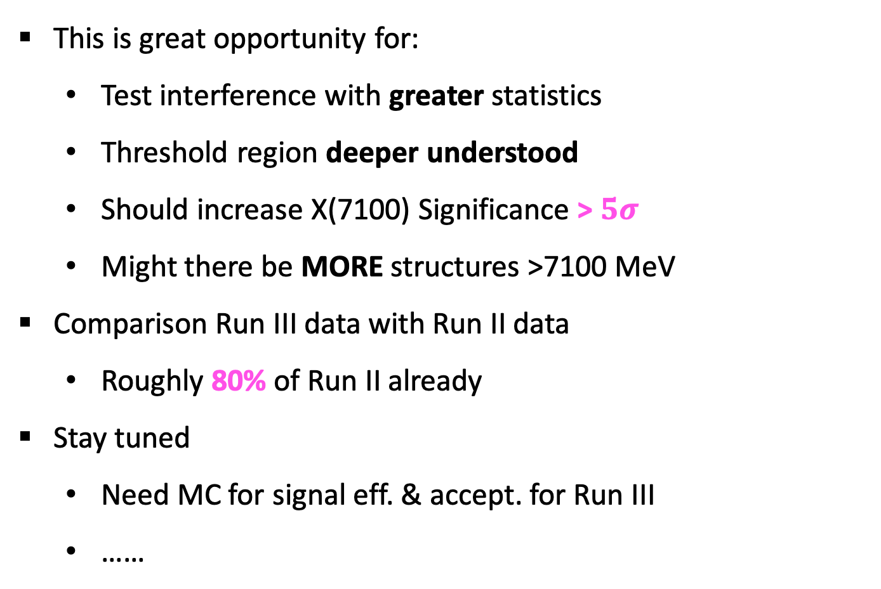
Summary
This is great opportunity for:
Test interference with greater statistics
Threshold region deeper understood
Should increase X(7100) Significance > $5σ$
Might there be MORE structures >7100 MeV
Comparison Run III data with Run II data
Roughly 80% of Run II already
Stay tuned
Need MC for signal eff. & accept. for Run III
……
Thank you!
Notes:
Remake shape of background
Make ntuple for 2023
Resolution efficiency

Slide 21
Back up

Slide 22
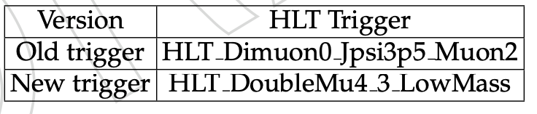
Event selection
Skim cuts:
The same cuts as Run II.
The triggers: Some new change here

Slide 23
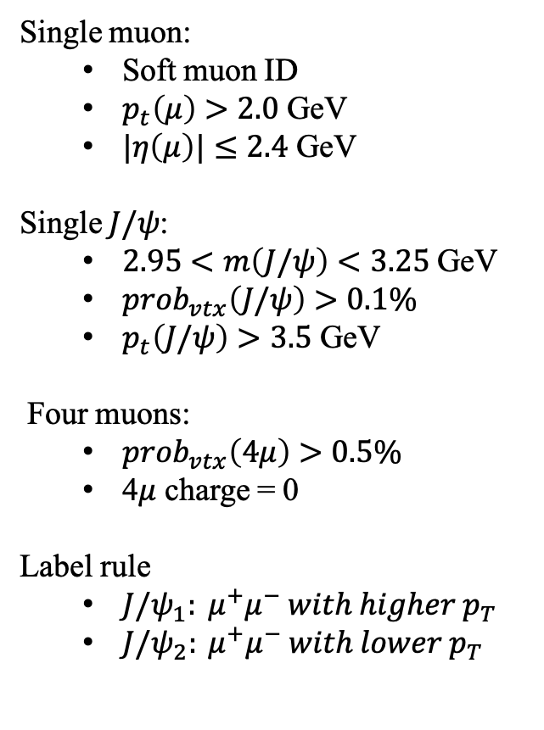
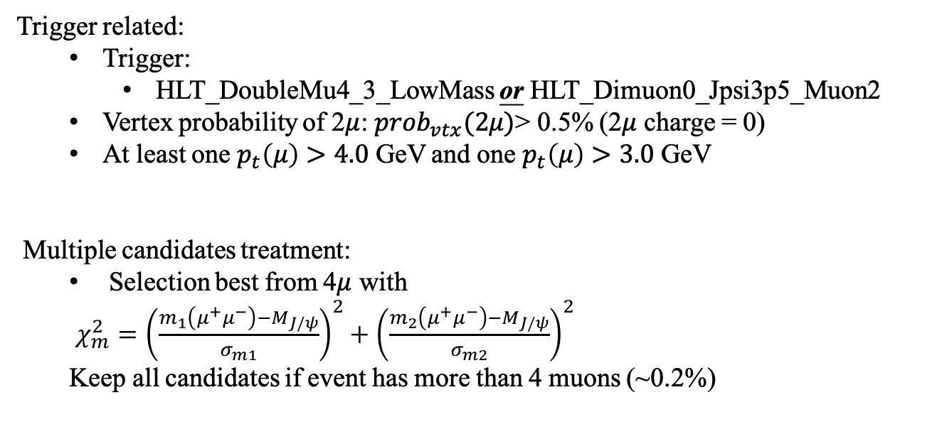
Event selection
Single muon:
Soft muon ID
$p_{t}\left(μ\right)>2.0$ GeV
$|η\left(μ\right)|≤2.4$ GeV
Single $J/ψ$:
$2.95<m\left(J/ψ\right)<3.25$ GeV
$prob_{vtx}\left(J/ψ\right)>0.1\%$
$p_{t}\left(J/ψ\right)>3.5$ GeV
Four muons:
$prob_{vtx}\left(4μ\right)>0.5\%$
4$μ$ charge = 0
Label rule
${J/ψ}_{1}: μ^{+}μ^{−} with higher p_{T}$
${J/ψ}_{2}: μ^{+}μ^{−} with lower p_{T}$
Trigger related:
Trigger:
HLT_DoubleMu4_3_LowMass or HLT_Dimuon0_Jpsi3p5_Muon2
Vertex probability of 2$μ$: $prob_{vtx}(2μ)$> 0.5% (2$μ$ charge = 0)
At least one $p_{t}\left(μ\right)>4.0$ GeV and one $p_{t}\left(μ\right)>3.0$ GeV
Multiple candidates treatment:
Selection best from 4$μ$ with
$χ_{m}^{2}={\left(\frac{m_{1}\left(μ^{+}μ^{−}\right)−M_{J/ψ}}{σ_{m1}}\right)}^{2}+{\left(\frac{m_{2}\left(μ^{+}μ^{−}\right)−M_{J/ψ}}{σ_{m2}}\right)}^{2}$
Keep all candidates if event has more than 4 muons (~0.2%)

Slide 24
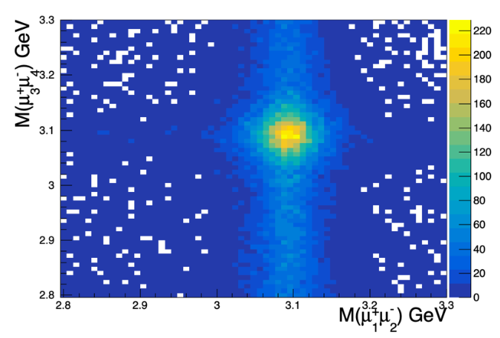


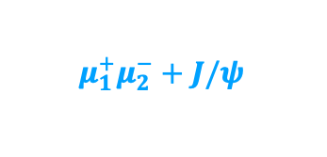

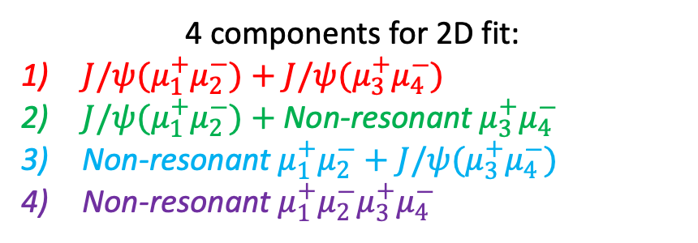
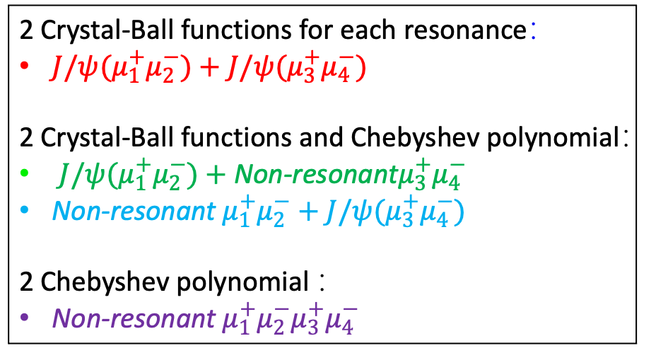
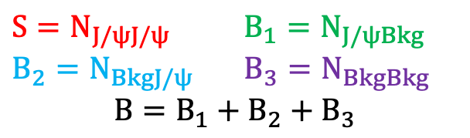
The scattering plot in RunIII data
4 components for 2D fit:
$J/ψ(μ_{1}^{+}μ_{2}^{−})+J/ψ(μ_{3}^{+}μ_{4}^{−})$
$J/ψ(μ_{1}^{+}μ_{2}^{−})+$ Non-resonant${ μ}_{3}^{+}μ_{4}^{−}$
Non-resonant $μ_{1}^{+}μ_{2}^{−}+J/ψ(μ_{3}^{+}μ_{4}^{−})$
Non-resonant $μ_{1}^{+}μ_{2}^{−}μ_{3}^{+}μ_{4}^{−}$
$${ μ}_{1}^{+}μ_{2}^{−}+J/ψ$$
$$J/ψ+J/ψ$$
2 Crystal-Ball functions for each resonance：
$J/ψ(μ_{1}^{+}μ_{2}^{−})+J/ψ(μ_{3}^{+}μ_{4}^{−})$
2 Crystal-Ball functions and Chebyshev polynomial：
$J/ψ(μ_{1}^{+}μ_{2}^{−})+$ Non-resonant$μ_{3}^{+}μ_{4}^{−}$
Non-resonant $μ_{1}^{+}μ_{2}^{−}+J/ψ(μ_{3}^{+}μ_{4}^{−})$
2 Chebyshev polynomial ：
Non-resonant $μ_{1}^{+}μ_{2}^{−}μ_{3}^{+}μ_{4}^{−}$
$${ μ}_{1}^{+}μ_{2}^{−}μ_{3}^{+}μ_{4}^{−}$$
$$J/ψ+μ_{3}^{+}μ_{4}^{−}$$
$S=N_{J/ψJ/ψ}$ ${B_{1}=N}_{J/ψBkg}$
${B_{2}=N}_{BkgJ/ψ}$ ${B_{3}=N}_{BkgBkg}$
$$B=B_{1}+B_{2}+B_{3}$$
Notes:
fonts

Slide 25
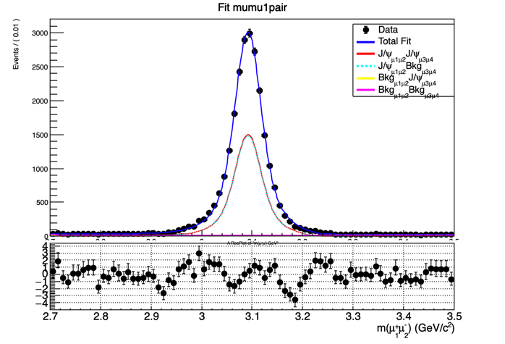
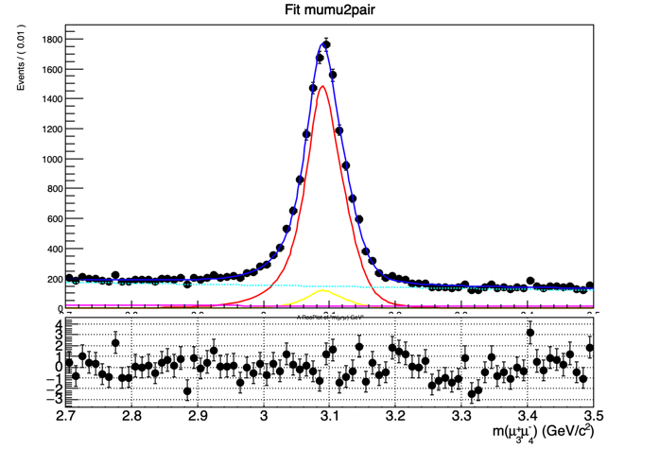
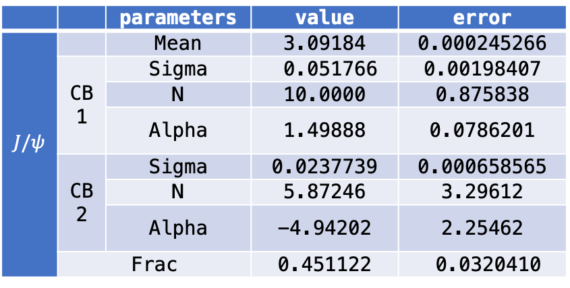



2D fit of dimuon mass in Run III data
$$M(μ^{+}μ^{−} with higher p_{T})$$
$$M(μ^{+}μ^{−} with lower p_{T})$$
 |  | parameters | value | error
$$J/ψ$$ |  | Mean | 3.09184 | 0.000245266
 | CB1 | Sigma | 0.051766 | 0.00198407
 |  | N | 10.0000 | 0.875838
 |  | Alpha | 1.49888 | 0.0786201
 | CB2 | Sigma | 0.0237739 | 0.000658565
 |  | N | 5.87246 | 3.29612
 |  | Alpha | -4.94202 | 2.25462
 | Frac |  | 0.451122 | 0.0320410
 |  | parameters | value | error
$$J/ψ$$ |  | Mean | 3.0895 | 0.000753
 | CB1 | Sigma | 0.033666 | 0.00129
 |  | N | 4.9765 | 0.739
 |  | Alpha | 1.2281 | 0.076
 | CB2 | Sigma | 0.015074 | 0.00268
 |  | N | 9.99999 | 1.89
 |  | Alpha | -0.49534 | 0.145
 | Frac |  | 0.78421 | 0.0364
Notes:
The projection plot of X-axis distribution with full Run II data
Higher pt muons
Change bin

Slide 26


Background study --- Estimation of X(6900) feed-down
Relative Branching Fraction
Notes:
Renew the second and third forth plot
Using the same scale

Slide 27









Kinematic distributions
$$p_{T}(J/ψ)$$
$$p_{T}(μ)$$
$$η(J/ψ)$$
Run III
Run III
Run III
Run II
Run II
Run II
Notes:
Renew the second and third forth plot
Using the same scale

