Slide 1

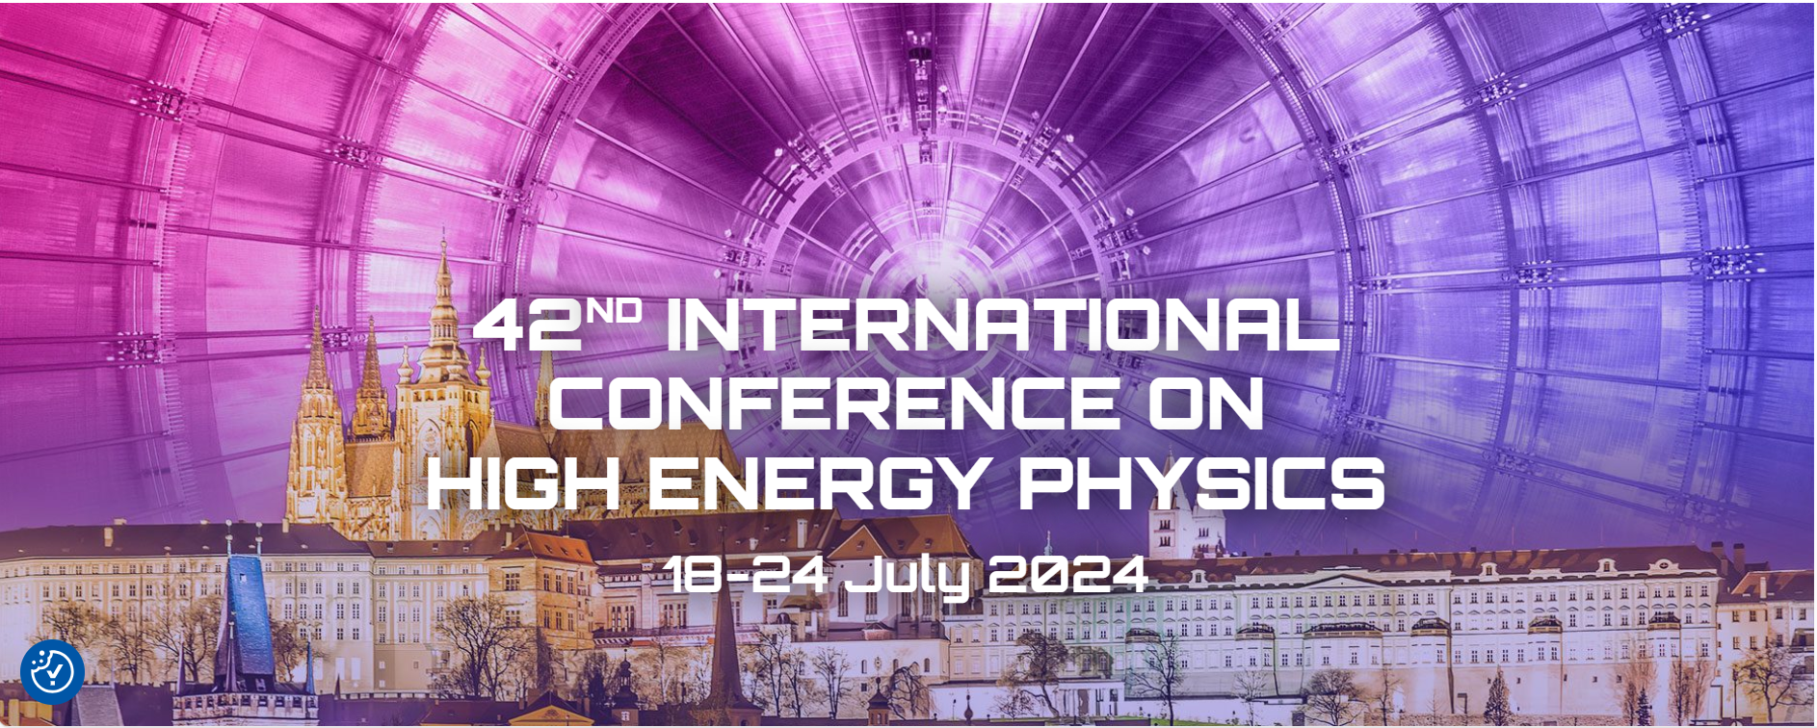
Green use of fluorocarbons in Cherenkov detectors and silicon tracker cooling systems:
challenges and opportunities.
G. D. Hallewell
Aix Marseille Université, CNRS/IN2P3, CPPM, Marseille, France
G. Hallewell: Green FCs for Cherenkov detectors and Si tracker cooling: Sustainability session ICHEP2024 Praque 18-24 July 2024
.
1
Notes:
1

Slide 2
“Green” fluorocarbons for Cherenkov detectors & silicon tracker cooling systems: challenges and opportunities
Saturated fluorocarbons (PFCs, SFCs: C_{n}F_{(2n+2)}) chosen for optical properties as Cherenkov radiators: C₄F₁₀ & CF₄ in COMPASS & LHCb RICH1&2.
Non-conductivity, non-flammability, non-toxicity & radiation resistance
➔ ideal coolants
- C₆F₁₄ used in all LHC experiments,
- C₃F₈ evaporatively cools ATLAS silicon tracker, TOTEM;
These fluids however have high GWPs (GWP₂₀ > 5000*CO₂);
Fluoro-ketones (C_{n}F_{2n}O), while not industrialised over a wide C_{n}F_{2n}O range,
can offer similar performance at very low, or 0 GWP;
Radiation tolerance & thermal performance of 3M NOVEC 649 (lin-C₆F₁₂O) sufficiently promising to be considered by CERN to replace C₆F₁₄ for cooling,
but acid production and materials compatibility issues to resolve;
G. Hallewell: Green FCs for Cherenkov detectors & Si tracker cooling Sustainability session: ICHEP2024 Prague 18-24 July 2024

Slide 3
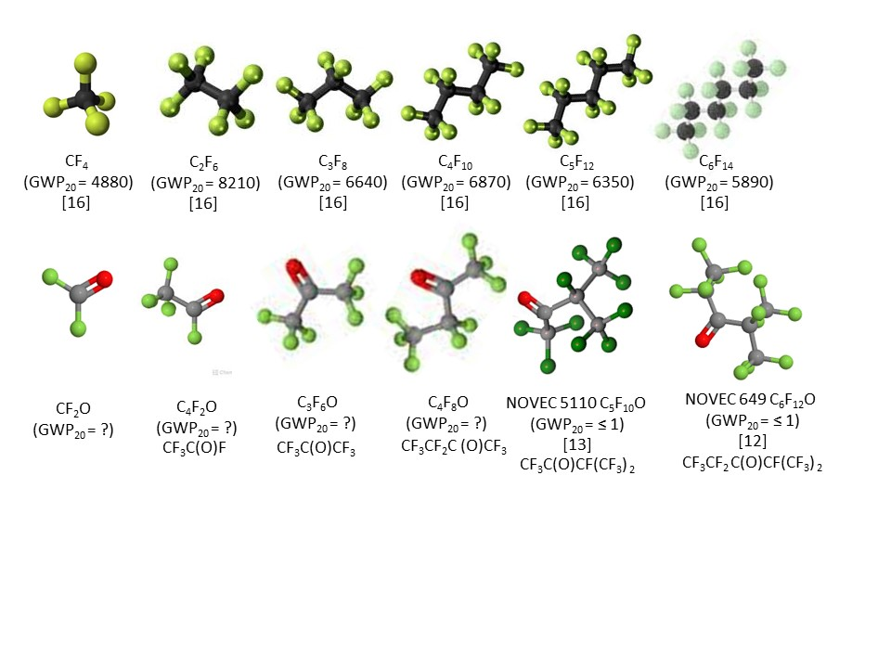
Molecular shapes and GWP (1)
SATURATED FLUOROCARBONS (C_{n}F_{(2n+2)}) with current uses at CERN
RICH (Gas)
Si COOLING (Evap.)
RICH (Gas)
COOLING (Liq.)
Current
uses
at CERN
Ex-DELPHI
RICH (Gas)
FLUOROKETONES (C_{n}F_{2n}O)
Toxic
Toxic
H330
RICH
(Gas)
RICH
(Gas (blend))
COOLING (Liq.)
Probable
Uses
(if/when
available)
C₂F₄O
Upper: molecular shapes of SFCs, including common gaseous Cherenkov radiators
Lower: shapes of some non-cyclic C_{n}F_{2n}O analogues
(20-year GWPs noted where known – refs: https://link.springer.com/article/10.1140/epjp/s13360-023-04703-w)
G. Hallewell: Green FCs for Cherenkov detectors & Si tracker cooling Sustainability session: ICHEP2024 Prague 18-24 July 2024

Slide 4
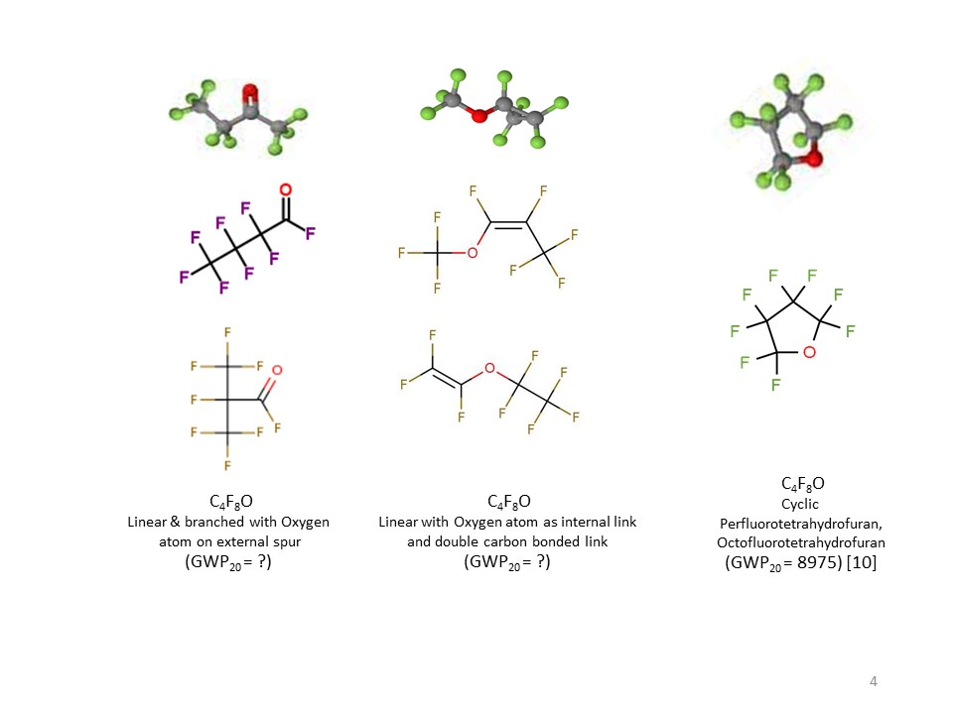
Molecular shapes and GWP (2)
☺
ALICE VHMPID,
BTeV studies:
Refractive index,
UV transparancy OK
(similar to C₄F₁₀), but…
?
?
High GWP!!
?
Cyclic, non-cyclic & non-cyclic double carbon-bonded C₄F₈O isomers: refs at end.
Placement of oxygen atom can also determine flammability & toxicity­
G. Hallewell: Green FCs for Cherenkov detectors & Si tracker cooling Sustainability session: ICHEP2024 Prague 18-24 July 2024

Slide 5

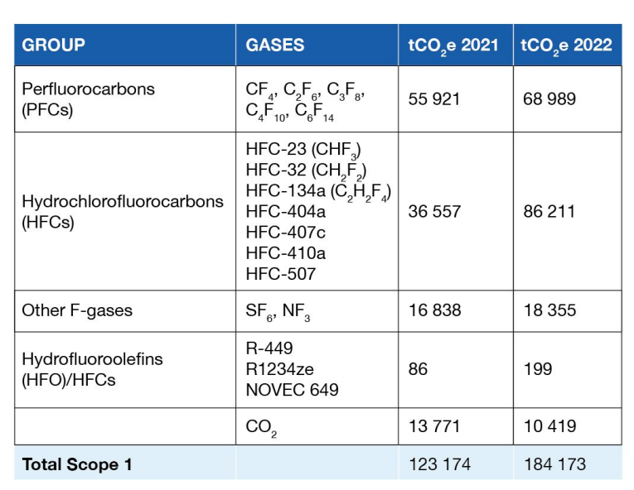
From: 2021-22 CERN environmental Report report https://doi.org/10.25325/CERN-Environment-2023-003
PFC Loss around 10-12 tonnes
(particle detection and detector cooling)
GWP 23000
R449: (CFH blend) GWP=1397
R1234 (HFO): GWP = 7
NOVEC 649 (C₆F₁₂O): GWP=0
GWP 0
G. Hallewell: Green FCs for Cherenkov detectors & Si tracker cooling Sustainability session: ICHEP2024 Prague 18-24 July 2024

Slide 6
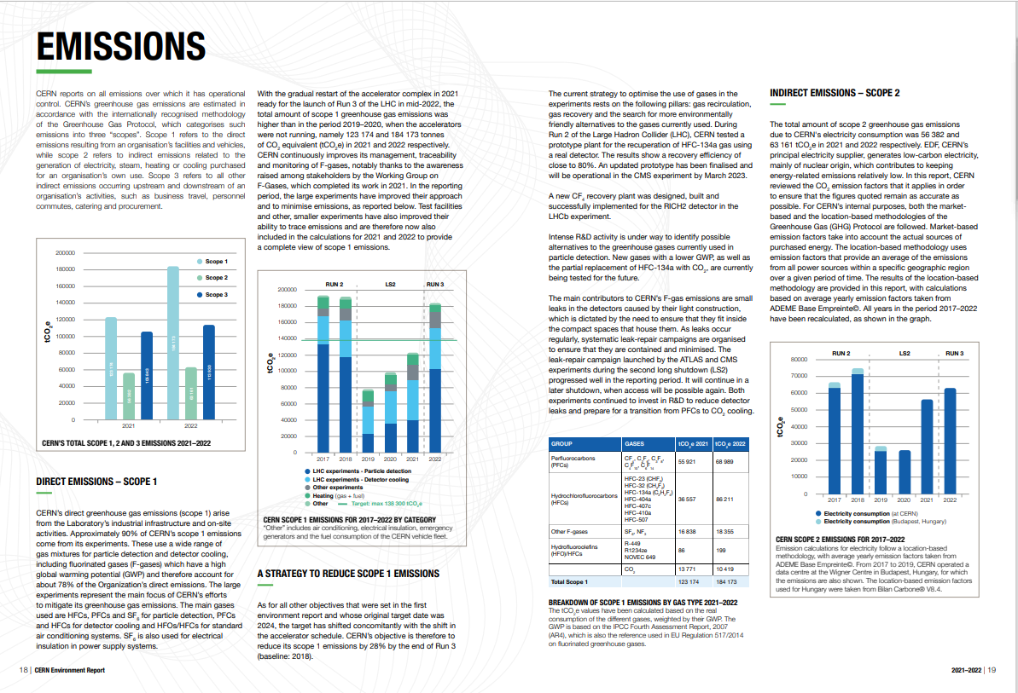
https://doi.org/10.25325/CERN-Environment-2023-003
But no mention at all of the ATLAS ultrasonic fluorocarbon leak monitor system !
G. Hallewell: Green FCs for Cherenkov detectors & Si tracker cooling Sustainability session: ICHEP2024 Prague 18-24 July 2024

Slide 7
Adding some conclusion here, in case I run out of time:
“Green” fluorocarbons for Cherenkov detectors & silicon tracker cooling systems: challenges & opportunities
Saturated fluorocarbons (SFCs: C_{n}F_{(2n+2)}) chosen for optical properties as Cherenkov radiators: C₄F₁₀ & CF₄ used in COMPASS & LHCb RICH1&2.
Non-conductivity, non-flammability & radiation resistance ➔ ideal coolants
- C₆F₁₄ used in all LHC experiments,
- C₃F₈ evaporatively cools ATLAS silicon tracker, TOTEM.
These fluids however have high GWPs (GWP₂₀ > 5000*CO₂).
While not industrialised over a wide C_{n}F_{2n}O range fluoro-ketones can offer similar performance at very low, or 0 GWP;
Radiation tolerance & thermal performance of 3M NOVEC 649 (lin-C₆F₁₂O) sufficiently promising to be considered by CERN to replace C₆F₁₄ for cooling;
Cherenkov detectors: subject to optical testing, lin-C₄F₈O could replace C₄F₁₀ while lin-C₄F₈O or lin-C₅F₁₀O blended with N₂ and monitored in real time by sound velocity gas analysis - could replace CF₄
SI tracker COOLING: Lighter molecules (e.g. C₂F₄O, with similar thermodynamics to C₂F₆) - would allow lower temperature, 0GWP operation than evaporative CO₂ in Si trackers operated at high luminosity: low order C_{n}F_{2n}O toxicity a problem…
G. Hallewell: Green FCs for Cherenkov detectors & Si tracker cooling Sustainability session: ICHEP2024 Prague 18-24 July 2024

Slide 8
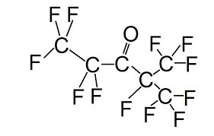
What gives NOVEC 649/1230 (lin C₆F₁₂O: FK-5-1-12) its low GWP?
A: Structure!: a double-bonded oxygen atom on a peripheral spur of the molecule
This fluoro-ketone configuration is:
CF₃CF₂C(O)CF(CF₃)₂
G. Hallewell: Green FCs for Cherenkov detectors & Si tracker cooling Sustainability session: ICHEP2024 Prague 18-24 July 2024
8

Slide 9
What gives NOVEC 649/1230 (lin C₆F₁₂O: FK-5-1-12) its low GWP?
https://www.nist.gov/system/files/documents/el/fire_research/R0301570.pdf
[15]
Scission by UV photons of λ ~300 nm in upper atmosphere (low P, high UV): fragments do not re-associate* into C_{n}F_{(2n+2)} SFCs
*The Environmental Impact of CFC Replacements HFCs and HCFCs
T. WALLINGTON et al Environ.Sci.Technol.1994(28)7 320A https://doi.org/10.1021/es00056a714
G. Hallewell: Green FCs for Cherenkov detectors & Si tracker cooling Sustainability session: ICHEP2024 Prague 18-24 July 2024
9

Slide 10
The Cherenkov detector aspect
G. Hallewell: Green FCs for Cherenkov detectors & Si tracker cooling Sustainability session: ICHEP2024 Prague 18-24 July 2024

Slide 11
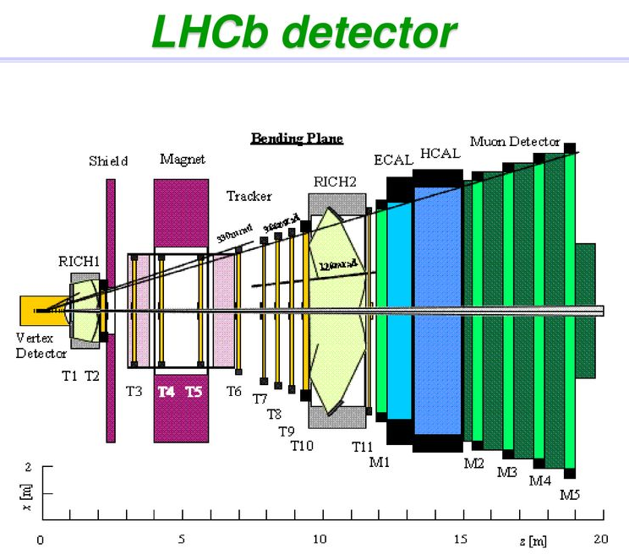
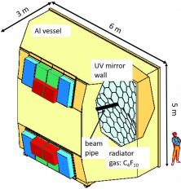
The big SFC-using Ring Imaging CHerenkov Detectors at CERN
Ideally… replace SFCs with same-order GWP₀ FKs with good UV transparency, refractivity…
LHCb RICH 1
(4m³ C₄F₁₀)
GWP eqv CO₂: 274 tonnes
LHCb RICH 2
(100 m³: CF₄ + ~5% CO₂)
GWP eqv. CO₂: 1737 t
LHCb RICH 1
(4m³ lin-C₄F₈O)
GWP eqv. CO₂: 0 tonnes
LHCb RICH 2
(100 m³: CF₂O + ?)
GWP eqv. CO₂: 0 t
COMPASS RICH
(100 m³ lin- C₄F₈O)
GWP eqv. CO₂: 0 tonnes
COMPASS RICH
(100 m³ C₄F₁₀)
GWP eqv CO₂: 6849 tonnes
No! CF₂O TOXIC ☹
G. Hallewell: Green FCs for Cherenkov detectors & Si tracker cooling Sustainability session: ICHEP2024 Prague 18-24 July 2024

Slide 12
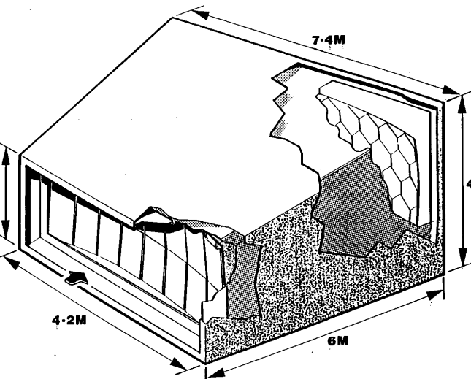
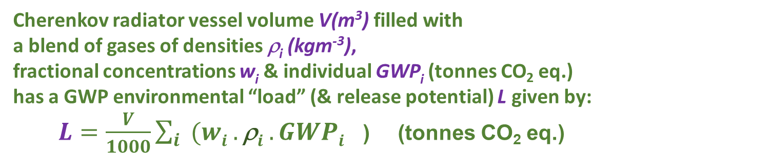
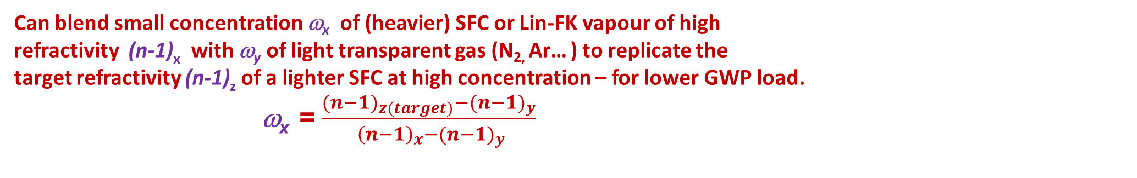
Refractive index & GWP ’load’ in a Cherenkov Gas Radiator (vessel only, not including tankage & piping)
C₄F₁₀ (COMPASS: 100m³, LHCb RICH 1: 4m³): GWP₂₀ = 4880,
CF₄ (LHCb RICH 2: 100m³): GWP₂₀ = 6870
V,ρ
Cherenkov radiator vessel volume V(m³) filled with
a blend of gases of densities ρ_{i} (kgm⁻³),
fractional concentrations w_{i} & individual GWP_{i} (tonnes CO₂ eq.)
has a GWP environmental “load” (& release potential) L given by:
$L=\frac{V}{1000}\sum_{i}{{(wi .\text{r}i .GWPi}^{}}$) (tonnes CO₂ eq.)
Corresponding radiator gas mixture refractivity given by :
$\text{(}\text{n}\text{−1)}rad =\sum_{i}{{(wi.\text{(}\text{n}\text{−1)}i}^{}}$)
Can blend small concentration ω_{x} of (heavier) SFC or Lin-FK vapour of high
refractivity (n-1)_{x} with ω_{y} of light transparent gas (N_{2,} Ar… ) to replicate the
target refractivity (n-1)_{z} of a lighter SFC at high concentration – for lower GWP load.
ω_{x} = $\frac{{{(n−1)}_{z(target)}−(n−1)}_{y}}{{ {\left(n−1\right)}_{x}−(n−1)}_{y}}$
G. Hallewell: Green FCs for Cherenkov detectors & Si tracker cooling Sustainability session: ICHEP2024 Prague 18-24 July 2024

Slide 13
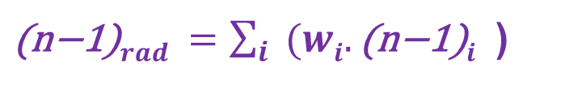
Use real-time speed of sound to get component molar concentrations,ω_{i}
(SoS traditionally also called “c” by acousticians to confuse things)
$\text{(}\text{n}\text{−1)}rad =\sum_{i}{{(wi.\text{(}\text{n}\text{−1)}i}^{}}$)
More details (ATLAS system): https://www.mdpi.com/2410-390X/5/1/6
Then use standard refractivity formula to get from calculated ω_{1,2}
to refractive index of radiator gas blend in real-time,
then standard relativistic expressions to get from n to Cherenkov γ thresholds for different particle species + β = 1 angle
Real-time measurement of speed of sound c takes us via the relative concentrations of the components to the speed of light β and beyond!! in the radiator gas
Eyes on the prize…(focus here on LHCb RICH2 (n-1)…)
(488.10⁻⁶)_{CF4} = (~1750.10⁻⁶)_{C5F10O}*0.12+(300.10⁻⁶)_{N2}*0.88
G. Hallewell: Green FCs for Cherenkov detectors & Si tracker cooling Sustainability session: ICHEP2024 Prague 18-24 July 2024
13

Slide 14
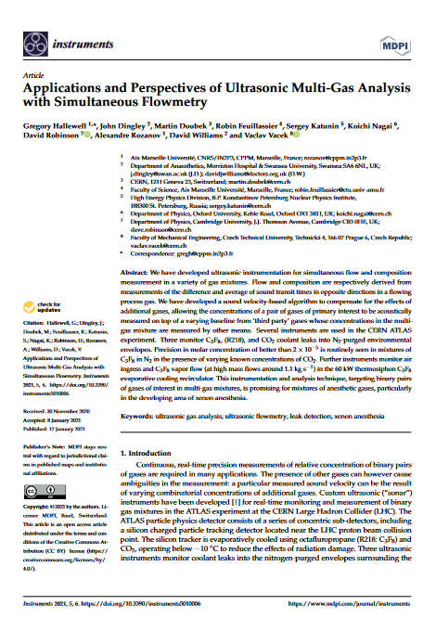
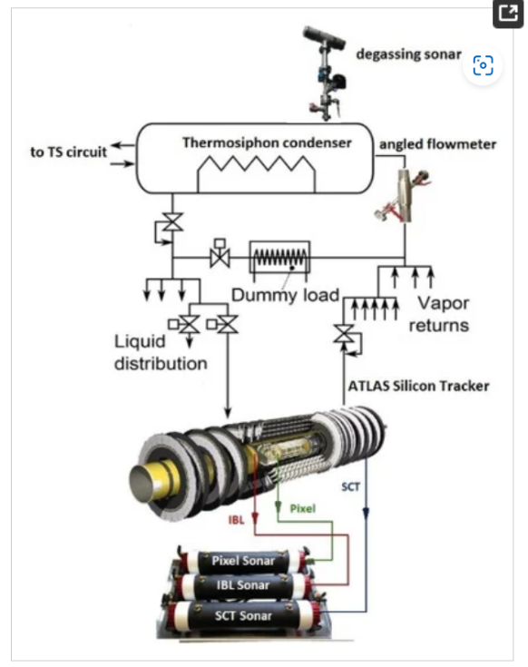
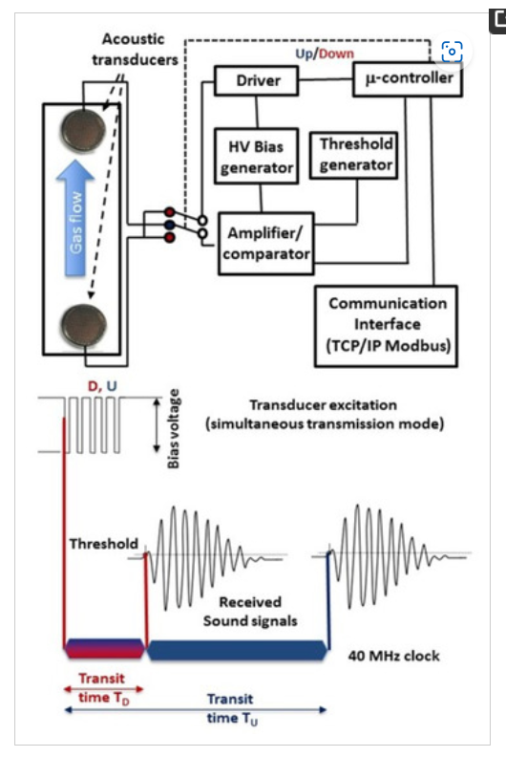
Ultrasonic gas analysis in a process environment with multiple background gases
More details: https://www.mdpi.com/2410-390X/5/1/6
:
Methodology (ATLAS-developed algorithm) for interpolation of fit parameters for SoS vs. composition)
for ultrasonic analysis of a gas pair of primary interest (e.g. FC/N₂) on top of known concentrations of other gases, (e.g. CO₂, H₂O, O₂…)
Precision: 10⁻⁵ C₃F₈ into N₂ at 1 bar
G. Hallewell: Green FCs for Cherenkov detectors & Si tracker cooling Sustainability session: ICHEP2024 Prague 18-24 July 2024
14

Slide 15
Cherenkov threshold: lin-C₅F₁₀O (eg: 3M NOVEC 5110)/N₂
& (heritage) C₅F₁₂/N₂ blend
and GWP load comparison with LHCb RICH2 (CF₄: 100m³)
N₂-NOVEC5110 (C₅F₁₀O) will be very similar (MW 266 vs. 288)
LHCb RICH 2: CF₄ thresholds
GWP load = (0.95 molar*4880*V.ρ)
~ 14% molar Novec 5110 gives a GWP load reduction of 1737 tonnes
(everything in the 100m³ radiator vessel):
Even substituting CF₄ with ~ 13% molar heritage stock C₅F₁₂ SFC (!) reduces GWP load by ~800 tonnes
C₅F₁₂ concentration (%)
LHCb RICH 2 with C₅F₁₀O/N₂
GWP load = (0.13 molar*1*V.ρ)
G. Hallewell: Green FCs for Cherenkov detectors & Si tracker cooling Sustainability session: ICHEP2024 Prague 18-24 July 2024
15

Slide 16
Radiator volume GWP load: 100 m³ gas radiator with different mw gases blended with nitrogen to replace CF₄
(note: blends with Ar very similar: need refractivity data for linear fluoro-ketones, probably similar to SFCs) blends with CO₂ not consdered: high CO₂ triple point temp (-56 C) ➔ thermodynamic recirculation difficulty)
CF₄ (pure) 1737 tonnes
CF₄
C₂F₆
Krypton: (>100% indicates need
for slight pressuisation)
C₄F₁₀
C₃F₈
C₅F₁₂
Xe
G. Hallewell: Green FCs for Cherenkov detectors & Si tracker cooling Sustainability session: ICHEP2024 Prague 18-24 July 2024

Slide 17
GWP load reduction through CF₄ index matching (LHCb RICH2)
Table 1: GWP loads of various SFCs and NOVEC 5110 blended with N₂ ((n-1) = 310.10⁻⁶) to match refractivity of CF₄ and C₄F₁₀
assumed radiator volume: 100 m³
https://link.springer.com/article/10.1140/epjp/s13360-023-04703-w
Base fluid | Base fluid density (1bar,25˚C) kgm⁻³ | Base fluid GWP (20-yr) | Component (n-1) (*10⁶) (@ nm) | % Blend with N₂ to match (n-1) CF₄ | GWP load (t.CO₂) | % Blend with N₂ to match (n-1) C₄F₁₀ | GWP load (t.CO₂)
CF₄ LHCb RICH2 (100m³) | 3.56 [18] | 4880 [16] | 488 (180-310 nm) [19] | 100 | 1737 | not applicable | n/a
CF₂O | - |  |  | ~100 | 1 | n/a | n/a
C₂F₆ | 5.63 [18] | 8210 [16] | 793 (180-310 nm) [19] | 38.1 | 1762 | not applicable | n/a
Lin-C₂F₄O | - |  |  | - |  | n/a | n/a
C₃F₈ | 7.75 [18] | 6640 [16] | 1180 (250 nm) [16] | 21.4 | 1099 | not applicable | n/a
Lin-C₃F₆O | - |  |  | - |  | n/a | n/a
C₄F₁₀ LHCb RICH1 (4m³): COMPASS (100m³) | 9.97 [18] | 6870 [16] | 1450 (250 nm) [16] | 16.3 | 1119 | 100 | 6849
Lin-C₄F₈O (Non-cyclic C₄F₈O)* | 9.5 (est.) | Probably < 1 (NOVEC 5110 Analogy) | 1380 @ 400nm (based on 3M PFG-3480 c-C₄F₈O [7]: linear C₄F₈O not yet measured but assumed similar) | 18.4 | 0.18 | 112.7* (>100% would imply necessity of operating C₄F₈O at slight overpressure) | 1.07
C₅F₁₂ | 11.63 [18] (BP 30 ˚C at 1 bar) | 6350 [16] | 1750 (180-310nm)[19] (40 ˚C, undiluted) | 13.0 | 957 | 79.3 | 5857
NOVEC 5110 C₅F₁₀O | 10.7 [13] (BP 27 ˚C at 1 bar) | <1 [13] | Not yet measured: probably around 1650 by analogy with C₄F₁₀ and C₄F₈O ratio | 13.9 | 0.149 | 85.2 | 0.91
Positions of presently unavailable-in-bulk C_{n}F_{2n}O fluids are shown in italics. Refractivities to match (CF₄ and C₄F₁₀) shown in bold.
GWP loads and refractivities calculated using eqs. (1)-(3): assumed radiator volume: 100 m³
*Made in research quantities by Synquest Inc. as isomers Heptafluorobutyryl fluoride PN: 2116-2-07 CAS: 335-42-2
Octafluoro-2-butanone PN: 2117-2-10 CAS: 337-20-2 & Heptafluoroisobutyryl fluoride PN: 2116-2-0A CAS: 677-84-9
G. Hallewell: Green FCs for Cherenkov detectors & Si tracker cooling Sustainability session: ICHEP2024 Prague 18-24 July 2024

Slide 18
Even bigger GWP load reduction through C₄F₁₀ index matching
(eg here: COMPASS RICH)
Table 1: GWP loads of various SFCs and NOVEC 5110 blended with N₂ ((n-1) = 310.10⁻⁶) to match refractivity of CF₄ and C₄F₁₀
assumed radiator volume: 100 m³
Base fluid | Base fluid density (1bar,25˚C) kgm⁻³ | Base fluid GWP (20-yr) | Component (n-1) (*10⁶) (@ nm) | % Blend with N₂ to match (n-1) CF₄ | GWP load (t.CO₂) | % Blend with N₂ to match (n-1) C₄F₁₀ | GWP load (t.CO₂)
CF₄ LHCb RICH2 (100m³) | 3.56 [18] | 4880 [16] | 488 (180-310 nm) [19] | 100 | 1737 | not applicable | n/a
CF₂O | - |  |  | ~100 | 0 | n/a | n/a
C₂F₆ | 5.63 [18] | 8210 [16] | 793 (180-310 nm) [19] | 38.1 | 1762 | not applicable | n/a
Lin-C₂F₄O | - |  |  | - |  | n/a | n/a
C₃F₈ | 7.75 [18] | 6640 [16] | 1180 (250 nm) [16] | 21.4 | 1099 | not applicable | n/a
Lin-C₃F₆O | - |  |  | - |  | n/a | n/a
C₄F₁₀ LHCb RICH1 (4m³): COMPASS (100m³) | 9.97 [18] | 6870 [16] | 1450 (250 nm) [16] | 16.3 | 1119 | 100 | 6849
Lin-C₄F₈O (Non-cyclic C₄F₈O)* | 9.5 (est.) | Probably < 1 (NOVEC 5110 Analogy) | 1380 @ 400nm (based on 3M PFG-3480 c-C₄F₈O [7]: linear C₄F₈O not yet measured but assumed similar) | 18.4 | 0.18 | 112.7* (>100% would imply necessity of operating C₄F₈O at slight overpressure) | 1.07
C₅F₁₂ | 11.63 [18] (BP 30 ˚C at 1 bar) | 6350 [16] | 1750 (180-310nm)[19] (40 ˚C, undiluted) | 13.0 | 957 | 79.3 | 5857
NOVEC 5110 C₅F₁₀O | 10.7 [13] (BP 27 ˚C at 1 bar) | <1 [13] | Not yet measured: probably around 1650 by analogy with C₄F₁₀ and C₄F₈O ratio | 13.9 | 0.149 | 85.2 | 0.91
G. Hallewell: DRD4 WG 2 Low GWP FC radiator gases: June 19 2024

Slide 19
C_{n}F_{2n}O fluid selection search criteria
Bibliographic
Materials tests
Optotests
Start(ed)
Next C_{n}F_{2n}O fluid
(order & isomer)
to evaluate
Y
Non-
Flammable
(MSDS)
?
Y
Non-
Oxone-
depleting
?
Y
Non-toxic
(MSDS)
?
N
N
N
N
Low GWP!
?
Y
N
N
N
Acid
formation
with H₂O
?
Y
Y
Rad.
Tolerant
(more for
cooling)
?
Y
N
Y
Materials/
purifier
Compatible
?
Dielectric
?
Y
N
Recirc.
Thermo-
dynamics
OK
?
Y
UV-Vis
transparency
OK
?
Y
(n-1) &
Chrom. Disp.
OK
?
Y
Accept
fluid
N
N
N
G. Hallewell: Green FCs for Cherenkov detectors & Si tracker cooling Sustainability session: ICHEP2024 Prague 18-24 July 2024

Slide 20
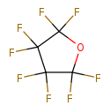
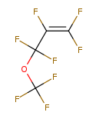
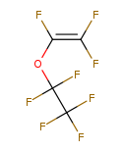
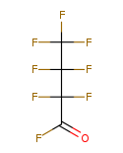
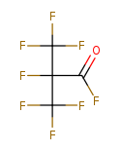
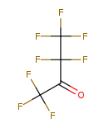
Some molecular shapes to study (or eliminate) for UVT, GWP, radiation stability & materials compatibility: example: C₄F₈O isomers,
Octafluorotetrahydrofuran
CAS: 773-14-8
H332 asphyxiant hazard
Pentafluoroethyl trifluorovinyl ether CAS: 10493-43-3
Flammable,
H332 Inhalation toxicity Cat 4
Octafluoro-3-methoxyprop-1-ene
CAS: 67641-44-5
H332 Inhalation toxicity Cat. 4
BTeV, ALICE VHMPID evaluated; good properties but high GWP
Source: https://www.synquestlabs.com
Octafluoro-2-butanone
CAS: 337-20-2
Inhalation toxicity H335:
may cause resp. irritation
2,2,3,3,4,4,4-Heptafluorobutanoyl
Fluoride CAS: 335-42-2
H331 Inhalation toxicity Cat. 3
Heptafluoroisobutyryl
Fluoride CAS: 677-84-9
H331 Inhalation toxicity Cat. 3
Most promising candidate?
analogy with NOVEC 5110,
649 structures…
G. Hallewell: Green FCs for Cherenkov detectors & Si tracker cooling Sustainability session: ICHEP2024 Prague 18-24 July 2024

Slide 21
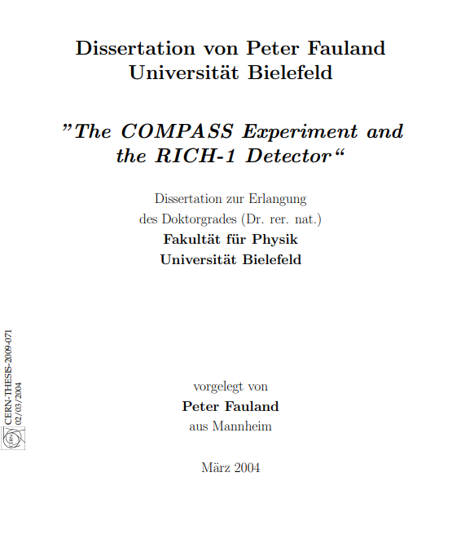
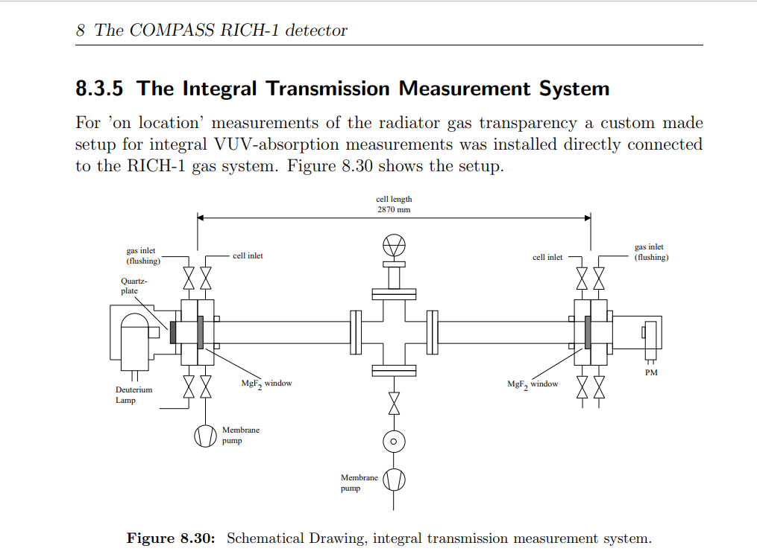
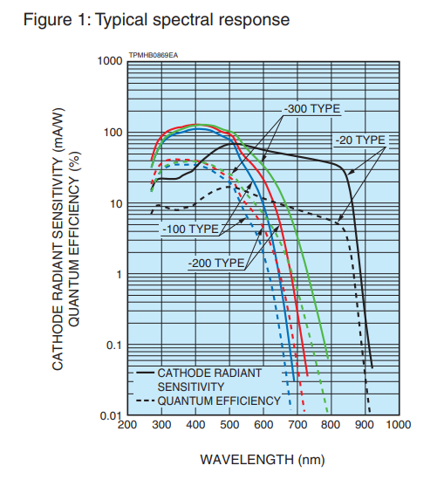
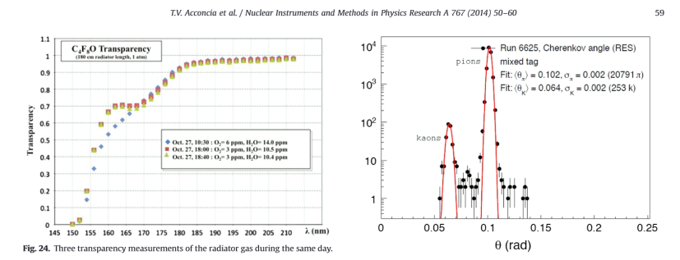
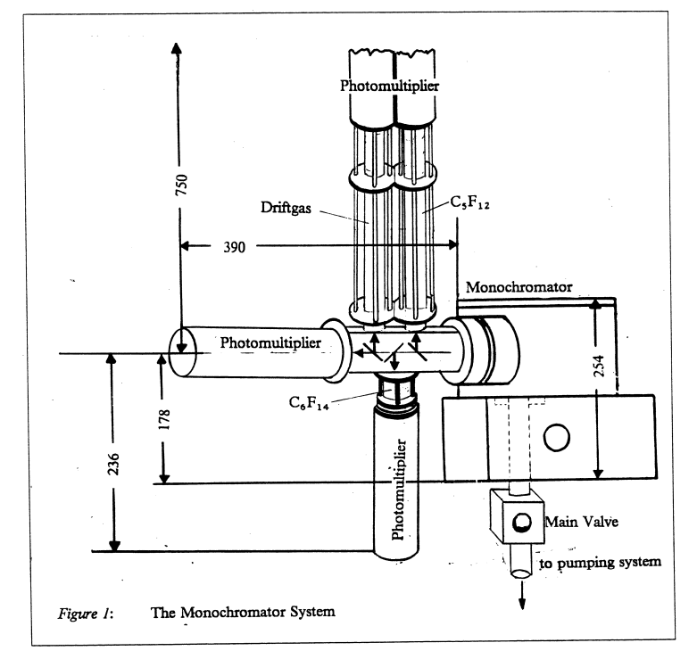
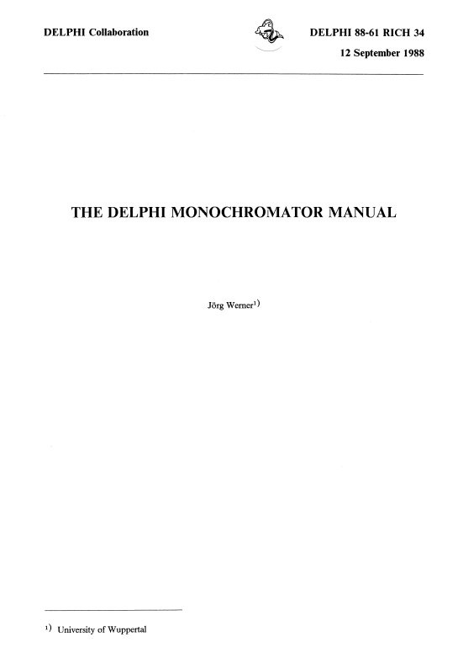
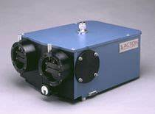
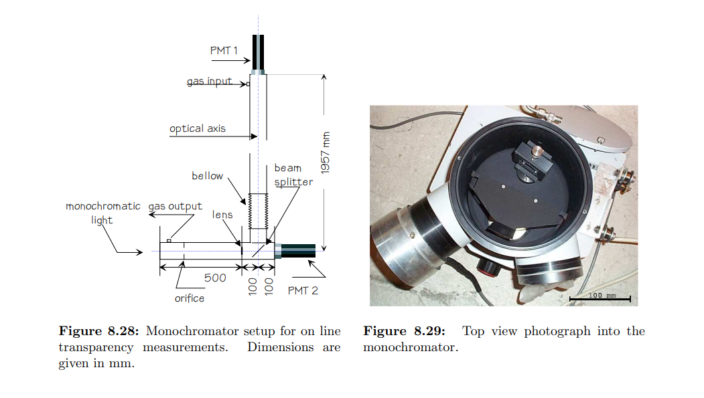
UV transparency, refractivity, cmhemical stability & compatibility studies needed
for different C_{n}F_{2n}O molecular shapes.
RICH detector community very competent & equipped for detailed UVT & (n-1)
- much ex-DELPHI RICH diagnostic equipment at CERN for example
A
Minuteman Model 302 VM.
ALICE VHMPID: transparancy
measurements in c-C₄F₈O
Octafluorotetrahydrofuran
CAS: 773-14-8
Synquest Inc. FL, USA
Most probable PC spectral range
in new build gas RICH detectors
G. Hallewell: Green FCs for Cherenkov detectors & Si tracker cooling Sustainability session: ICHEP2024 Prague 18-24 July 2024

Slide 22
On the turning away…
The uncertain ECHA (European Chemicals Agency) route to fluorocarbon (PFC, PFAS…) prohibition
(Other people here will talk about this...Path paved with impracticalities?)
Au revoir 3M… need to clarify manufacturers’ attitudes (Dehon Co. (Fr), Synquest (USA), F2 (UK), various companies in China)…
on future lin-fluoroketone (C_{n}F_{2n}O) production
Electronics industry is the driver: we just ride the coat-tails!
.
[51] ECHA/NR/23/04;
https://echa.europa.eu/-/echa-publishes-pfas-restriction-proposal]
[52] ECHA Candidate List of substances of very high concern for Authorisation;
https://echa.europa.eu/candidate-list-table
[53] Annex to the Annex XV restriction report proposal for restriction: Per- & polyfluoroalkyl substances (PFASs); ECHA; 22/03/2023
https://echa.europa.eu/documents/10162/d2f7fce1-b089-c4fd-1101-2601f53a07d1
[54] Per- and polyfluoroalkyl substances (PFAS); ECHA
https://echa.europa.eu/hot-topics/perfluoroalkyl-chemicals-pfas
G. Hallewell: Green FCs for Cherenkov detectors & Si tracker cooling Sustainability session: ICHEP2024 Prague 18-24 July 2024

Slide 23
The Silicon tracker cooling aspect
See also https://link.springer.com/article/10.1140/epjp/s13360-023-04703-w
G. Hallewell: Green FCs for Cherenkov detectors & Si tracker cooling Sustainability session: ICHEP2024 Prague 18-24 July 2024

Slide 24
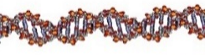
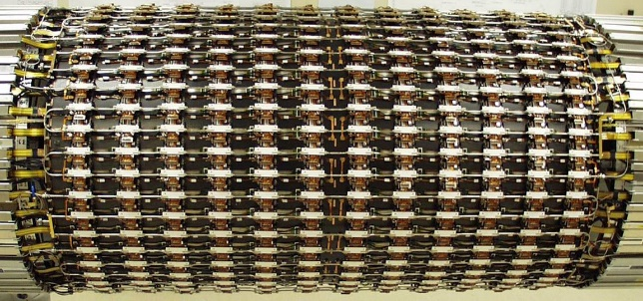
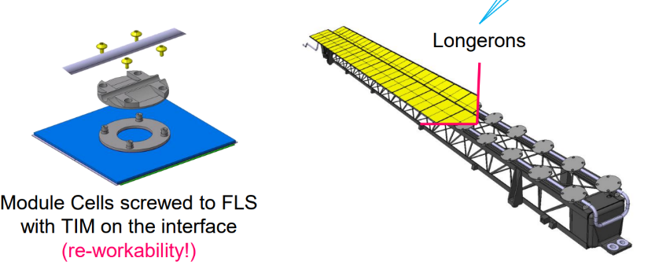
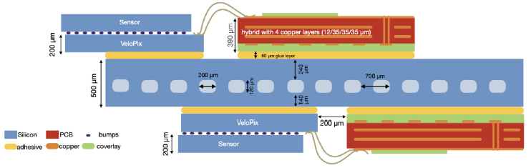
Examples from cooling particle physics Si trackers (ATLAS, CMS, LHCb)
Two distinct types of detector cooling geometry at HL-LHC:
Tube and block ‘DNA’
ATLAS barrel SCT (present) ATLAS ITK Barrel longerons and Si module
block attachment (future HL-LHC)
Disadvantages: long(er) heat conduction path (more interfaces) Si➔ cold(er) coolant: lower Thermal figures of merit NEED COLDER COOLANT!
Thermal Figure of Merit (TFM):
  Expressed in terms of temperature difference between Si
  modules & coolant at given power density (units: °C cm² W⁻¹)
  TFM = ((T_{(Si module)} −T_{(Coolant)}) / (Si module power/cm²)).
  Lower numeric value ➔ better thermal performance.
  TFMs < 4 typical in microchannel devices,
  ~ 20+ in some tube & block geometries.
(2) Micro-channel cooling
LHCb VELO upgrade
Advantages: shortest heat conduction path to coolant: coolant can be warmer:
Disadvantages: fraglity issues: channels etched in silicon and cover plate attached
G. Hallewell: Green FCs for Cherenkov detectors & Si tracker cooling Sustainability session: ICHEP2024 Prague 18-24 July 2024

Slide 25
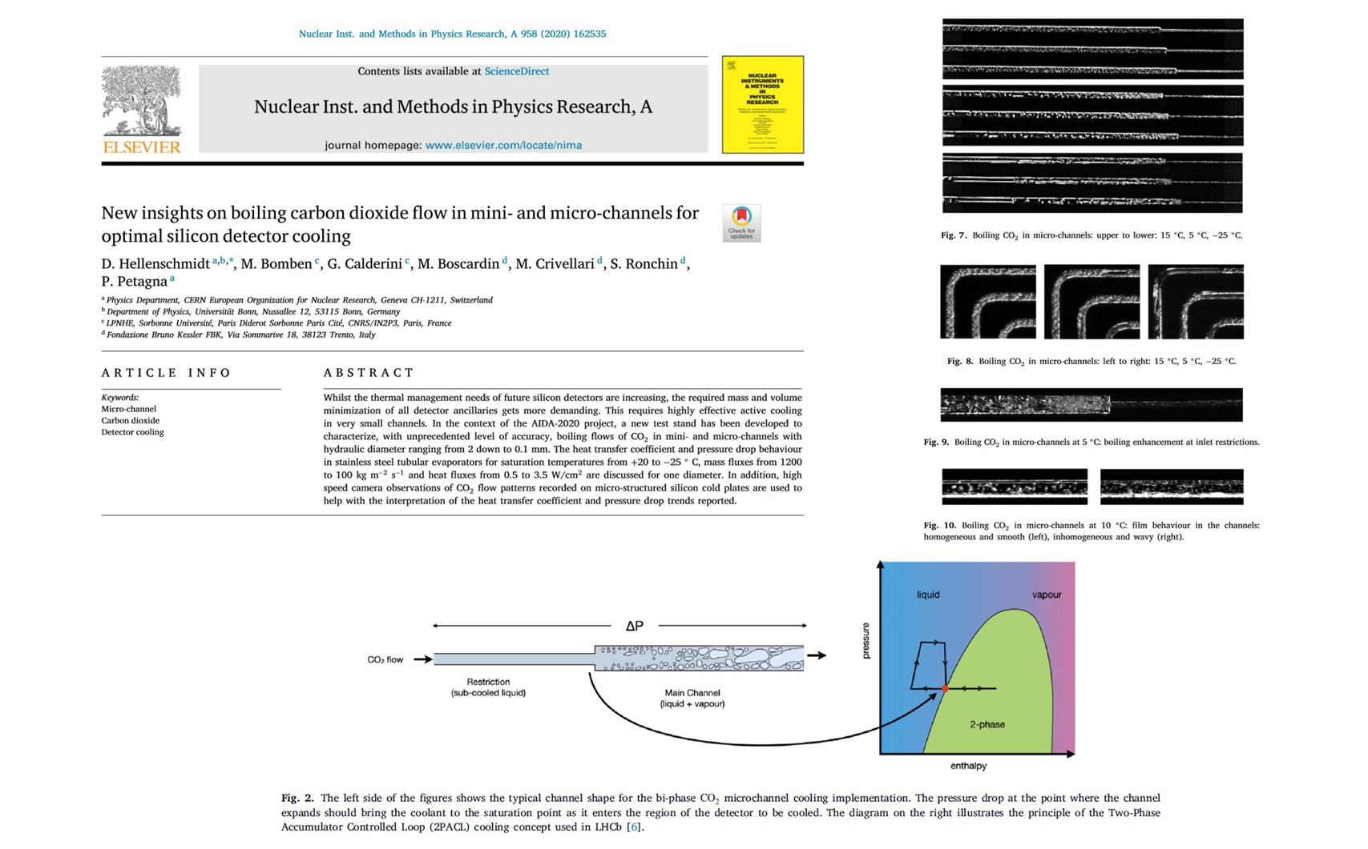
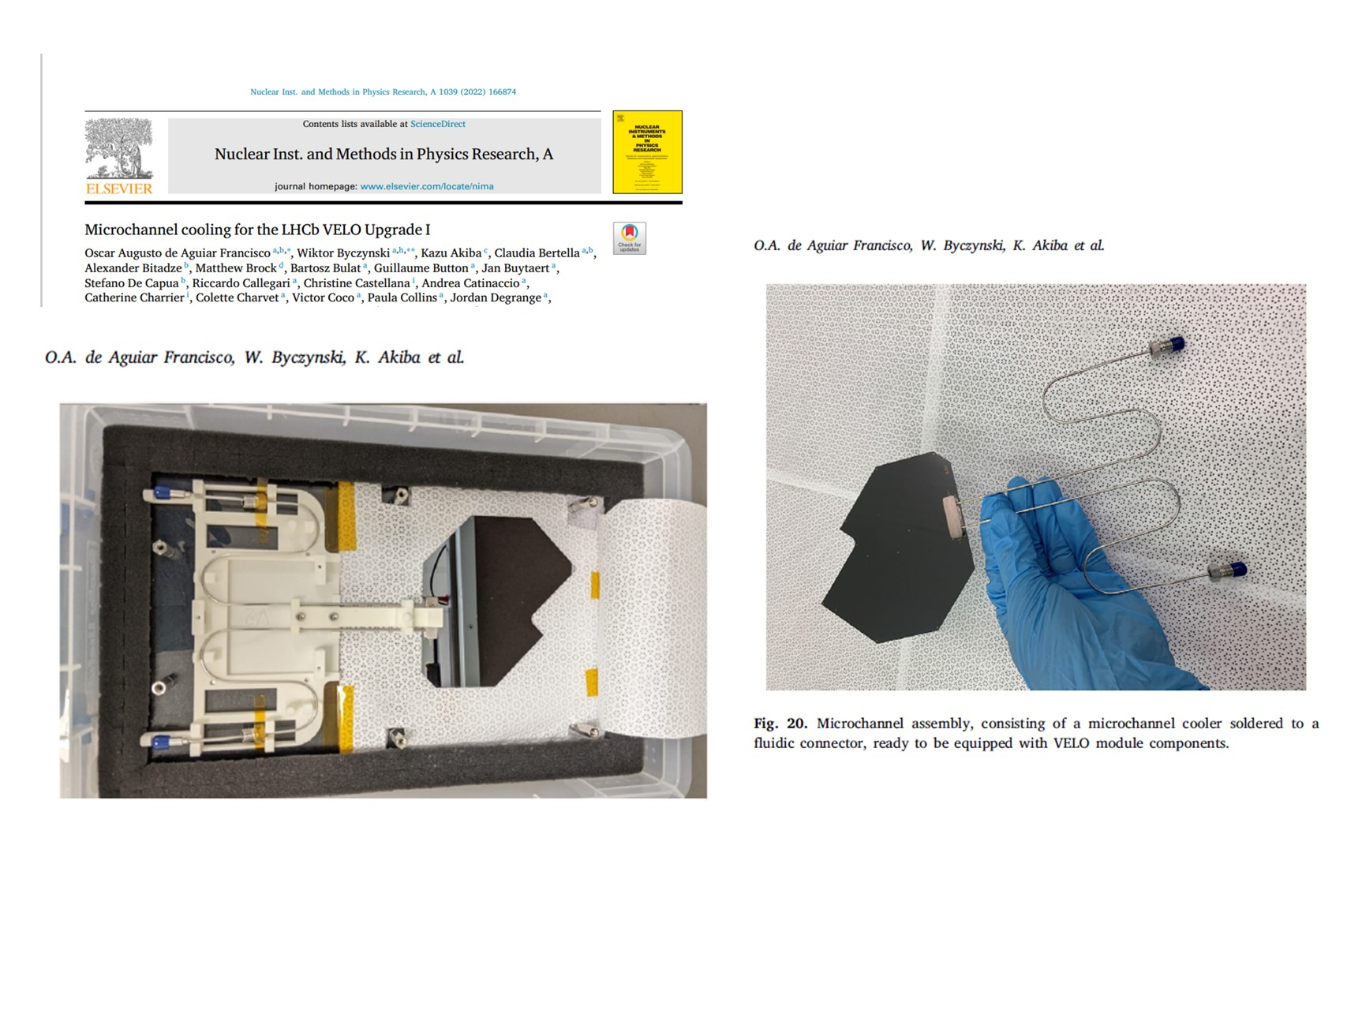
Micro-channel cooling: the LHCb VELO upgrade
Recent mastery of evaporative CO₂ cooling in microchannels
G. Hallewell: Green FCs for Cherenkov detectors & Si tracker cooling Sustainability session: ICHEP2024 Prague 18-24 July 2024

Slide 26
CO₂ Evaportive cooling problems:
High triple point temperature of -56 °C
CO₂ cooling already known to be inefficient at coolant temperatures below -40 °C:
limits the lowest temperature attainable in the tubes of a tube & block cooling system: CO₂ cooling now admitted to be insufficient for protection against
radiation damage and protection against leakage current-generated
thermal runaway over the whole HL-LHC envelope (2029-41):
ATLAS plans to change its inner pixel detector half way through…
A very complicated alternative trans-critical krypton evaporative cycle has been proposed
see: L. Contiero et al; Cold Krypton system for the Phase III Upgrade of the LHC,
Forum on Tracking Detector Mechanics 2023, Tuebingen Germany May 31-June 2 2023
G. Hallewell: Green FCs for Cherenkov detectors & Si tracker cooling Sustainability session: ICHEP2024 Prague 18-24 July 2024

Slide 27
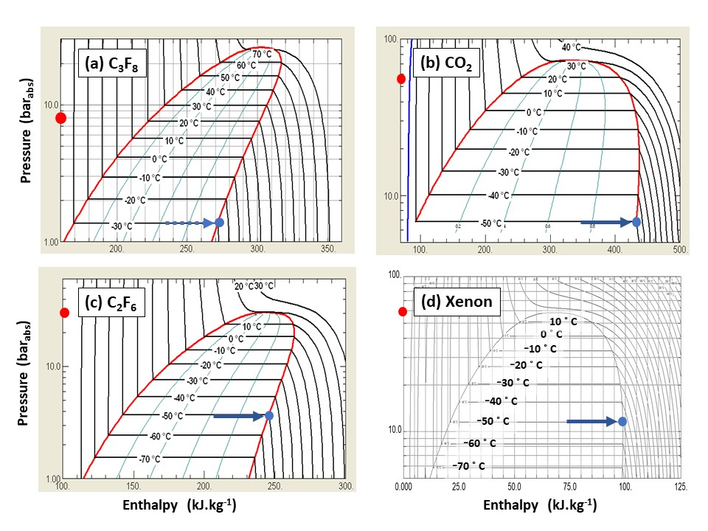
Si tracker evaporative coolingome Thermodynamic comparisons: SFCs, CO₂, Xe
(F-K thermodynamics would be similar to same carbon order SFCs)
C₃F₈ won’t go cold enough for HL-LHC operation, particularly in tube & block trackers
https://link.springer.com/article/10.1140/epjp/s13360-023-04703-w
C₂F₄O would have been the ideal fluid: much cheaper than Xe, but toxic…
blend C₂F₆ with C₃F₆O?? (C₂F₆ / C₃F₈ zeotropic blends already demonstrated…)
R. Bates et al; 2015 JINST 10 P03027
G. Hallewell: Green FCs for Cherenkov detectors & Si tracker cooling Sustainability session: ICHEP2024 Prague 18-24 July 2024

Slide 28
On the turning away…
The uncertain ECHA (European Chemicals Agency) route to fluorocarbon (PFC, PFAS…) prohibition
(Other people here will talk about this...Path paved with impracticalities?)
Au revoir 3M… need to clarify manufacturers’ attitudes (Dehon Co. (Fr), Synquest (USA), F2 (UK), various companies in China)…
on future lin-fluoroketone (C_{n}F_{2n}O) production
Electronics industry is the driver: we just ride the coat-tails!
.
[51] ECHA/NR/23/04;
https://echa.europa.eu/-/echa-publishes-pfas-restriction-proposal]
[52] ECHA Candidate List of substances of very high concern for Authorisation;
https://echa.europa.eu/candidate-list-table
[53] Annex to the Annex XV restriction report proposal for restriction: Per- & polyfluoroalkyl substances (PFASs); ECHA; 22/03/2023
https://echa.europa.eu/documents/10162/d2f7fce1-b089-c4fd-1101-2601f53a07d1
[54] Per- and polyfluoroalkyl substances (PFAS); ECHA
https://echa.europa.eu/hot-topics/perfluoroalkyl-chemicals-pfas
G. Hallewell: Green FCs for Cherenkov detectors & Si tracker cooling Sustainability session: ICHEP2024 Prague 18-24 July 2024

Slide 29
Conclusion
(Also at beginning as I didn’t think I’d get this far…)
Anyway… thanks for watching and listening:
(some references and back-up material follow
for those interested in this subject)
Also see: https://link.springer.com/article/10.1140/epjp/s13360-023-04703-w
G. Hallewell: Green FCs for Cherenkov detectors & Si tracker cooling Sustainability session: ICHEP2024 Prague 18-24 July 2024

Slide 30
Conclusion
Saturated fluorocarbons (SFCs: C_{n}F_{(2n+2)}) are chosen for their optical properties as Cherenkov radiators, with C₄F₁₀ and CF₄ used in COMPASS & LHCb RICH1&2.
Non-conductivity, non-flammability & radiation resistance ➔ ideal coolants with C₆F₁₄ used in all LHC experiments, while C₃F₈ evaporatively cools the ATLAS silicon tracker and TOTEM.
These fluids however have high GWPs (GWP₂₀ > 5000*CO₂).
While not industrialised over a wide C_{n}F_{2n}O range fluoro-ketones can offer similar performance at very low, or 0 GWP;
Radiation tolerance & thermal performance of 3M NOVEC 649 (lin-C₆F₁₂O) sufficiently promising to be considered by CERN to replace C₆F₁₄ for cooling;
Cherenkov detectors: subject to optical testing, lin-C₄F₈O could replace C₄F₁₀ while lin-C₄F₈O or lin-C₅F₁₀O blended with N₂ and monitored in real time by sound velocity gas analysis - could replace CF₄ in RICH radiators;
SI tracker COOLING: Lighter molecules (e.g. C₂F₄O, with similar thermodynamics to C₂F₆) - would allow lower temperature, 0GWP operation than evaporative CO₂ in Si trackers operated at high luminosity: low order C_{n}F_{2n}O toxicity a problem…
G. Hallewell: Green FCs for Cherenkov detectors & Si tracker cooling Sustainability session: ICHEP2024 Prague 18-24 July 2024

Slide 31
References and back-up material
G. Hallewell: Green FCs for Cherenkov detectors & Si tracker cooling Sustainability session: ICHEP2024 Prague 18-24 July 2024

Slide 32
Approaches to low-GWP fluorocarbon RICH radiator gases
.
See also:
https://link.springer.com/article/10.1140/epjp/s13360-023-04703-w (paper: EuroPhysics J. Plus, Dec 2023)
https://indico.cern.ch/event/1263731/contributions/5398511/attachments/2648319/4584649
/G_Hallewell_DRD4%20Rad%20Gas%20GWP%20with%20annexes%20May%2016%202023.pdf
https://indico.cern.ch/event/1410802/ (DRD4 WG2 meeting 17 May 2024)
https://indico.cern.ch/event/1420840/ (DRD4 WP_3.1 meeting 28 May 2024)
“From the Speed of Sound to the Speed of Light: and beyond!”
G. Hallewell: Green FCs for Cherenkov detectors & Si tracker cooling Sustainability session: ICHEP2024 Prague 18-24 July 2024
32
Notes:
32

Slide 33
Cherenkov radiator and related general references (1 of 2) from
https://link.springer.com/article/10.1140/epjp/s13360-023-04703-w
[1] CERN Environment Report 2017–2018 https://doi.org/10.25325/CERN-Environment-2020-001
[2] B. Mandelli; Eco-gas mixtures and mitigation procedures for Green-house Gases (GHGs);
ECFA Detector R&D Road-map Symposium: T.F. 1 Gaseous Detectors, 29/4/2021
https://indico.cern.ch/event/999799/contributions/4204191/attachments/2236047/3789965/BMandelli_ECFA.pdf,
[3] B. Mandelli; R&D for the optimization of the use of greenhouse gases in particle detector systems;
Mini workshop on gas transport parameters for present and future generation of experiments: CERN April 22, 2021
https://indico.cern.ch/event/1022051/contributions/4325947/
[4] G. Rigoletti; Studies to reduce greenhouse gas emissions from detectors at the LHC; EP-DT Seminar May 4, 2022.pdf (cern.ch)
[5] S. Dalla Torre et al; Long term experience with C₄F₁₀ in COMPASS RICH-1; Presentation 11th Intl. Workshop on Ring Imaging Cherenkov detectors, Edinburgh, Scotland, Sept 12-16 2022. https://indico.cern.ch/event/1094055/contributions/4932286/attachments/2508724/4311387/RICH2022_C4F10_dallatorre.pdf
[6] 3M PFG-3480: c-octofluorotetrahydrofuran (C₄F₈O). Note: fluid out of production : product reference now used for a non-fluidic product. For historic product data sheet mentioning its high GWP see (for example): http://static6.arrow.com/aropdfconversion/a7116f41dfdd5b79d2eb7b40afd687f8af23d8ef/mediawebserver(563).pdf
[7] M. Artuso et al; Nucl. Instr & Meth. A Volume 558, (2006), 373-387
[8] Product #2H07-2-08 Synonyms: 2,2,3,3,4,4,5,5-octafluorotetrahydrofuran, Perfluorotetrahydrofuran; CAS No: 773-14-8, MDL No. MFCD00465561: SynQuest Labs Inc., 13201 Rachael Boulevard, Alachua, FL 32615, USA https://www.synquestlabs.com/Home/ProductDetail?SearchText=Octafluorotetrahydrofuran
[9] T. Acconcia et al ; Nucl. Instr & Meth A 767 (2014) 50–60
[10] M. Vollmer et al; Abundances, emissions, and loss processes of the long-lived and potent greenhouse gas octafluorooxolane (octafluorotetrahydrofuran, c-C4F8O) in the atmosphere; Atmos. Chem. Phys., 19, 3481–3492, 2019
[11] 3M Novec® range of fluorinated fluids; https://www.3m.com/3M/en_US/p/c/b/novec/?Ntt=novec
[12] 3M Novec 649/1230 fluid (C₆F₁₂O); https://multimedia.3m.com/mws/media/569865O/3m-novec-engineered-fluid-649.pdf,
https://multimedia.3m.com/mws/media/124688O/3m-novec-1230-fire-protection-fluid.pdf]
[13] 3M Novec 5110 fluid (C₅F₁₀O); https://multimedia.3m.com/mws/media/1132123O/3m-novec-5110-insulating-gas.pdf
[14] CERN report EN-CV 22/12/2017, EDMS 1751219 2017-334 rev 1.0: Technical Note NOVEC Fluids Qualification Report: Report on the study executed for the qualification of the NOVEC Fluid for Detector Cooling applications.
[15] J. Owens, Understanding the stability and environmental characteristics of a sustainable Halon alternative.
3M Performance Materials 3M Center, St. Paul, MN 55144
G. Hallewell: Green FCs for Cherenkov detectors & Si tracker cooling Sustainability session: ICHEP2024 Prague 18-24 July 2024

Slide 34
Cherenkov radiator and related general references (2 of 2) from
https://link.springer.com/article/10.1140/epjp/s13360-023-04703-w
[16] CERN Mini-workshop on gas transport parameters for present and future generation of experiments 20/04/2021;
S. Easo; LHCb-RICH detectors and their gas radiators
https://indico.cern.ch/event/1022051/contributions/4333562/attachments/2231064/3780374/LHCb-RICH-Current-GasRadiators-April-2021.pdf,
Options for alternate radiators in LHCb-RICH system (including calculations by O. Ullaland); S. Easo,
https://indico.cern.ch/event/1022051/contributions/4319538/attachments/2231436/3781060/LHCb-RICH-Future-Radiators.pdf
[17] S.Easo; Nucl.Inst.& Meth. A 876 (2017) 168-173
[18] E. Lemmon, M. Huber, & M. McLinden; REFPROP Standard reference database 23, version 9.0 (2010)
U.S. National Institute of Standards & Technology.
[19] E. Nappi and J. Seguinot Rivista del Nuovo Cimento Vol. 28, N. 8-9 2005 DOI 10.1393/ncr/i2006-10004-6
[20] K. Abe et al. ; IEEE Trans. Nucl. Sci. 45 (1998) 648 SLAC-PUB-7705 DOI: 10.1109/23.6826
[21] G. Hallewell et al; Nucl. Instr. & Meth A264 (1988) 219-234
[22] G. Hallewell; Nucl. Instr & Meth A 876, (2017) 50-53
[23] G. Hallewell et al; MDPI Instruments (2021) 5(1), 6;
[24] P. Stassi et al; Ultrasonic Gas mixture analysis system in the Forward RICH of DELPHI,
DELPHI Internal Note 95-124 RICH73, 25 July 1995
[25] M.Sannino; Nucl. Instr. and Methods in Physics Research A 595 (2008) 208–211
[26] C. D'Ambrosio et al; Monitoring, Alignment and Control of the RICH Detectors;
LHCb-Memo-2000-80 RICH 6 September 2000.
[27] P. Fauland, PhD thesis; (COMPASS experiment) University of Bielefeld March 2004.
[28] Now marketed as SensComp model 600 transducer, http://www.senscomp.com/ultrasonic-sensors/
[29] T. Blake et al; Nucl. Instr. Meth A791 (2015) 27-31
[30] A. Papanestis; Nucl. Instr. Meth. A766 (2014) 14–18
[31] R. Calabrese et al; 2022 JINST 17 P07013
[32] J. Vavra (SLAC National Laboratory); private communication.
G. Hallewell: Green FCs for Cherenkov detectors & Si tracker cooling Sustainability session: ICHEP2024 Prague 18-24 July 2024

Slide 35
Silicon tracker cooling and related general references FROM
https://link.springer.com/article/10.1140/epjp/s13360-023-04703-w
[33] P. Tropea; The CMS tracker fluorocarbon cooling system,
Engineering Forum: experiences from cooling systems for LHC detectors Oct 30 2008
[34] G. Aglieri Rinella et al, 2019 JINST 14 P07010
[35] G. Anelli et al ; 2008 JINST 3 S08007
[36] D. Attree et al, 2008 JINST 3 P07003
[37] W. Adam et al ; 2021JINST16P02027 CMS Technical Design Report; Pixel Detector Upgrade CMS-TDR-011, CERN-LHCC-2012-016 07/09/2012
[38] ATLAS Insertable B-Layer Technical Design Report; CERN-LHCC-2010-013 ATLAS TDR 19 15/09/2010
[39] O. de Aguiar Francisco et al; Nucl. Instr. Meth A. 1039 (2022) 166874
https://www.sciencedirect.com/science/article/pii/S0168900222003394
[40] Fluoroketone C₂F₅C(O)CF(CF₃)₂ as a Heat Transfer Fluid for Passive and Pumped 2-Phase Applications;
P. Tuma, 3M Co., 3M Center, 236-2B-01St. Paul, MN 55144, USA, Proc. 2008 IEEE 24th IEEE Semiconductor Thermal
Measurement and Management Symposium, San Jose CA, March 16-20 DOI: 10.1109/STHERM.2008.4509386
also accessible via: https://twiki.cern.ch/twiki/pub/LHCb/SciFiDemoCooling/F.Tuma_c6K_as.....pdf
[41] L. Gruber et al; Nucl. Instr. & Meth. 958 (2020) 162025 https://www.sciencedirect.com/science/article/abs/pii/S016890021930422X?via%3Dihub
[42] ”Building the future of LHCb”; C. Frei, S. Gambetta, B. Leverington; CERN Courier, September 2021 (2 September 2021)
https://cerncourier.com/a/building-the-future-of-lhcb
[43] M. Battistin et al; Int. J. Chemical Reactor Engineering 2015; 13(4): 511–521
[44] R. Bates et al; 2015 JINST 10 P03027
[45] https://lhc-commissioning.web.cern.ch/schedule/LHC-long-term.htm
[46] L. Contiero et al; Cold Krypton system for the Phase III Upgrade of the LHC,
Forum on Tracking Detector Mechanics 2023, Tuebingen Germany May 31-June 2 2023
[47] L. Contiero et al; Krypton, applied as refrigerant for cooling of silicon detector trackers;
GL 2022: 15th IIR-Gustav Lorentzen Conference on Natural Refrigerants, Trondheim, Norway, June 13-15 2023
[48] D. Alvarez et al: Thermo-Mechanical Performance of the Local Supports for the ATLAS ITk Pixel Outer Barrel:
Experimental and FEA Studies; Forum on Tracking Detector Mechanics 2023, Tuebingen Germany May 31-June 2 2023
[49] B. Verlaat; CO₂ cooling experiences in the LHCb Velo Thermal Control System
Engineering Forum: experiences from cooling systems for LHC detectors Oct 30 2008
[50] R. Bates et al; 2013 JINST 8 P02006
[51] ECHA/NR/23/04; https://echa.europa.eu/-/echa-publishes-pfas-restriction-proposal]
[52] ECHA Candidate List of substances of very high concern for Authorisation; https://echa.europa.eu/candidate-list-table
[53] Annex to the Annex XV restriction report proposal for restriction: Per- & polyfluoroalkyl substances (PFASs);
ECHA; 22/03/2023 https://echa.europa.eu/documents/10162/d2f7fce1-b089-c4fd-1101-2601f53a07d1
[54] Per- and polyfluoroalkyl substances (PFAS); ECHA https://echa.europa.eu/hot-topics/perfluoroalkyl-chemicals-pfas
G. Hallewell: Green FCs for Cherenkov detectors & Si tracker cooling Sustainability session: ICHEP2024 Prague 18-24 July 2024

Slide 36
(5.7) SWOT analysis of cooling fluids HL-LHC
Strengths CO₂ Non-flammable, non-toxic, electrical insulator, non-ozone-depleting, radiation resistant, GWP=1 | Weaknesses CO₂ High pressure circulation (60 bar) at ambient temp before cooldown to operating temp High triple point ( -56°C)
Threats CO₂ High triple point may make Si tracker operation problematic: less thermal ‘headroom’ after heavy irradiaton (‘thermal runaway’ phenomenon) | Opportunities CO₂ Extensive R&D program at CERN Evaporative coolant of choice for ATLAS, CMS for start of HL-LHC program
Strengths C₂F₆ Non-flammable, non-toxic, electrical insulator, non-ozone-depleting, radiation resistant | Weaknesses C₂F₆ Very high GWP (around 6000 x CO₂)
Threats C₂F₆ Production will be phased out unless a strong motivation from semiconductor manufacture industry | Opportunities C₂F₆ Proved to decrease the operating temp of an ATLAS SCT thermal model in blend with 75% C₃F₈
Strengths C_{n}F_{2n}O Non-flammable, non-toxic, electrical insulator, non-ozone-depleting, radiation resistant, GWP=0 | Weaknesses C_{n}F_{2n}O
Threats C_{n}F_{2n}O Large scale industrial production may depend on the phasing-out of SFCs, needs of semiconductor manufacture industry: Material compatibility needs further study. | Opportunities C_{n}F_{2n}O Expertise in particle physics community for 3M NOVEC 649 (C₆F₁₂O)
Strengths xenon Non-flammable, non-toxic, electrical insulator, non-ozone-depleting, radiation resistant, GWP=0 | Weaknesses xenon High pressure circulation (50 bar) at ambient temp before cooldown to operating temp (amost transcritical) Extremely expensive
Threats xenon Very difficult future procurement (war in Ukraine) (10⁻⁸ atmospheric content.) | Opportunities xenon Could find expertise In particle physics community for fabrication of circulators: already used in dark matter experiments
G. Hallewell: Green FCs for Cherenkov detectors & Si tracker cooling Sustainability session: ICHEP2024 Prague 18-24 July 2024

Slide 37
The uncertain ECHA path to prohibition
(a path paved with impracticalities?)
G. Hallewell: Green FCs for Cherenkov detectors & Si tracker cooling Sustainability session: ICHEP2024 Prague 18-24 July 2024

Slide 38
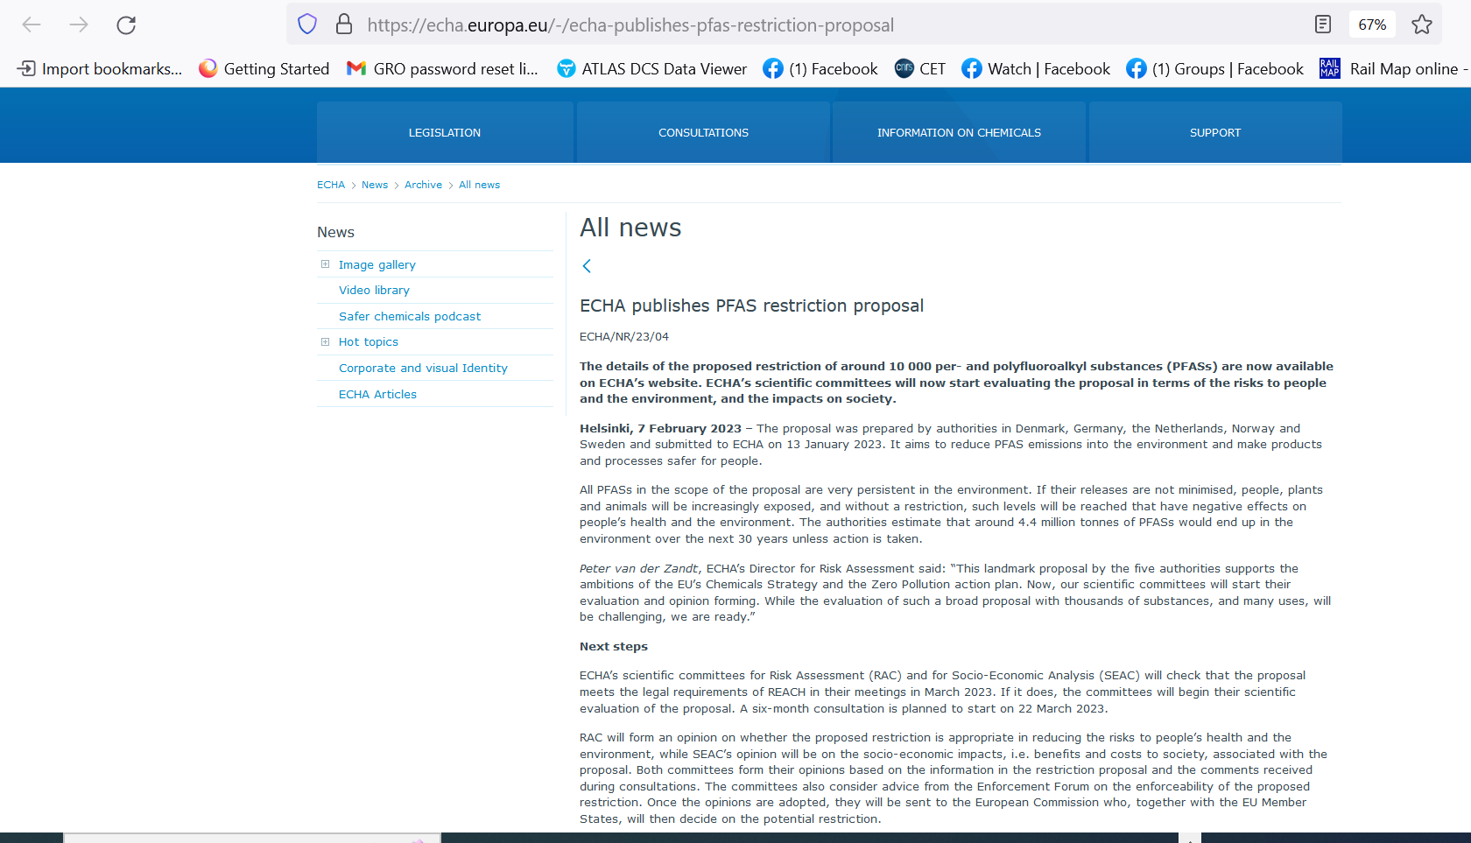
G. Hallewell: Green FCs for Cherenkov detectors & Si tracker cooling Sustainability session: ICHEP2024 Prague 18-24 July 2024

Slide 39
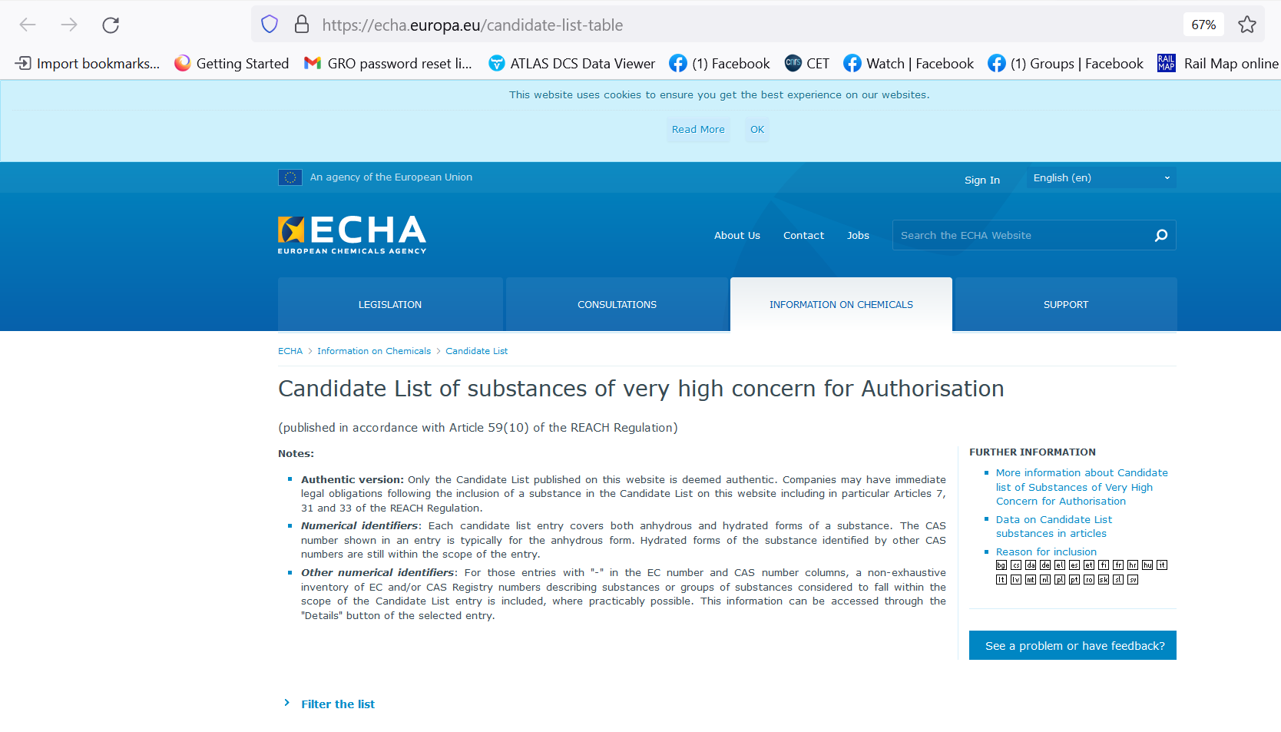
G. Hallewell: Green FCs for Cherenkov detectors & Si tracker cooling Sustainability session: ICHEP2024 Prague 18-24 July 2024

Slide 40
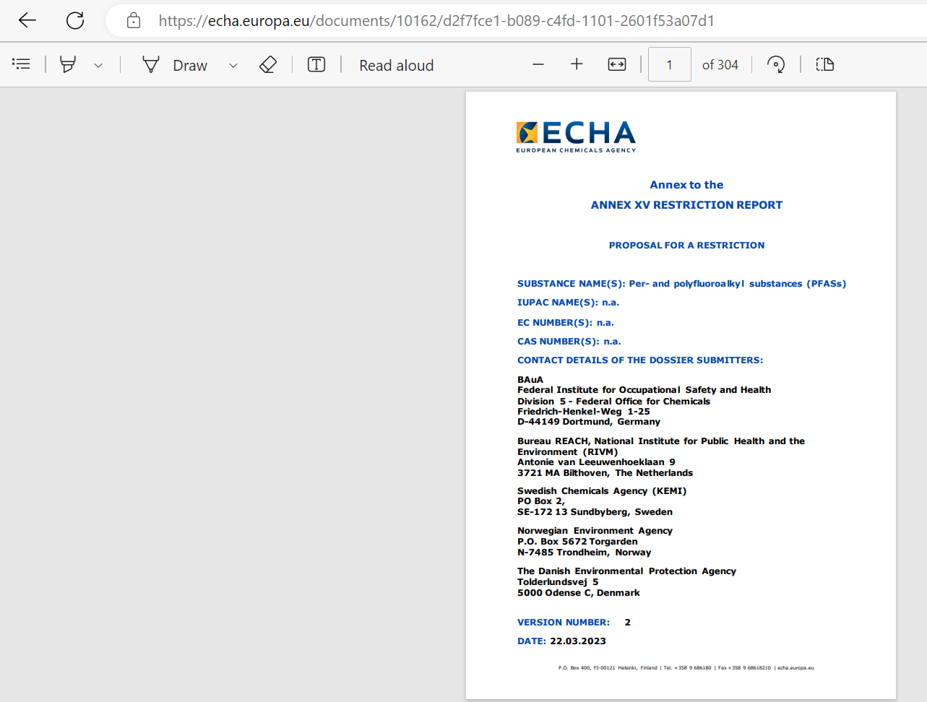
G. Hallewell: Green FCs for Cherenkov detectors & Si tracker cooling Sustainability session: ICHEP2024 Prague 18-24 July 2024

Slide 41
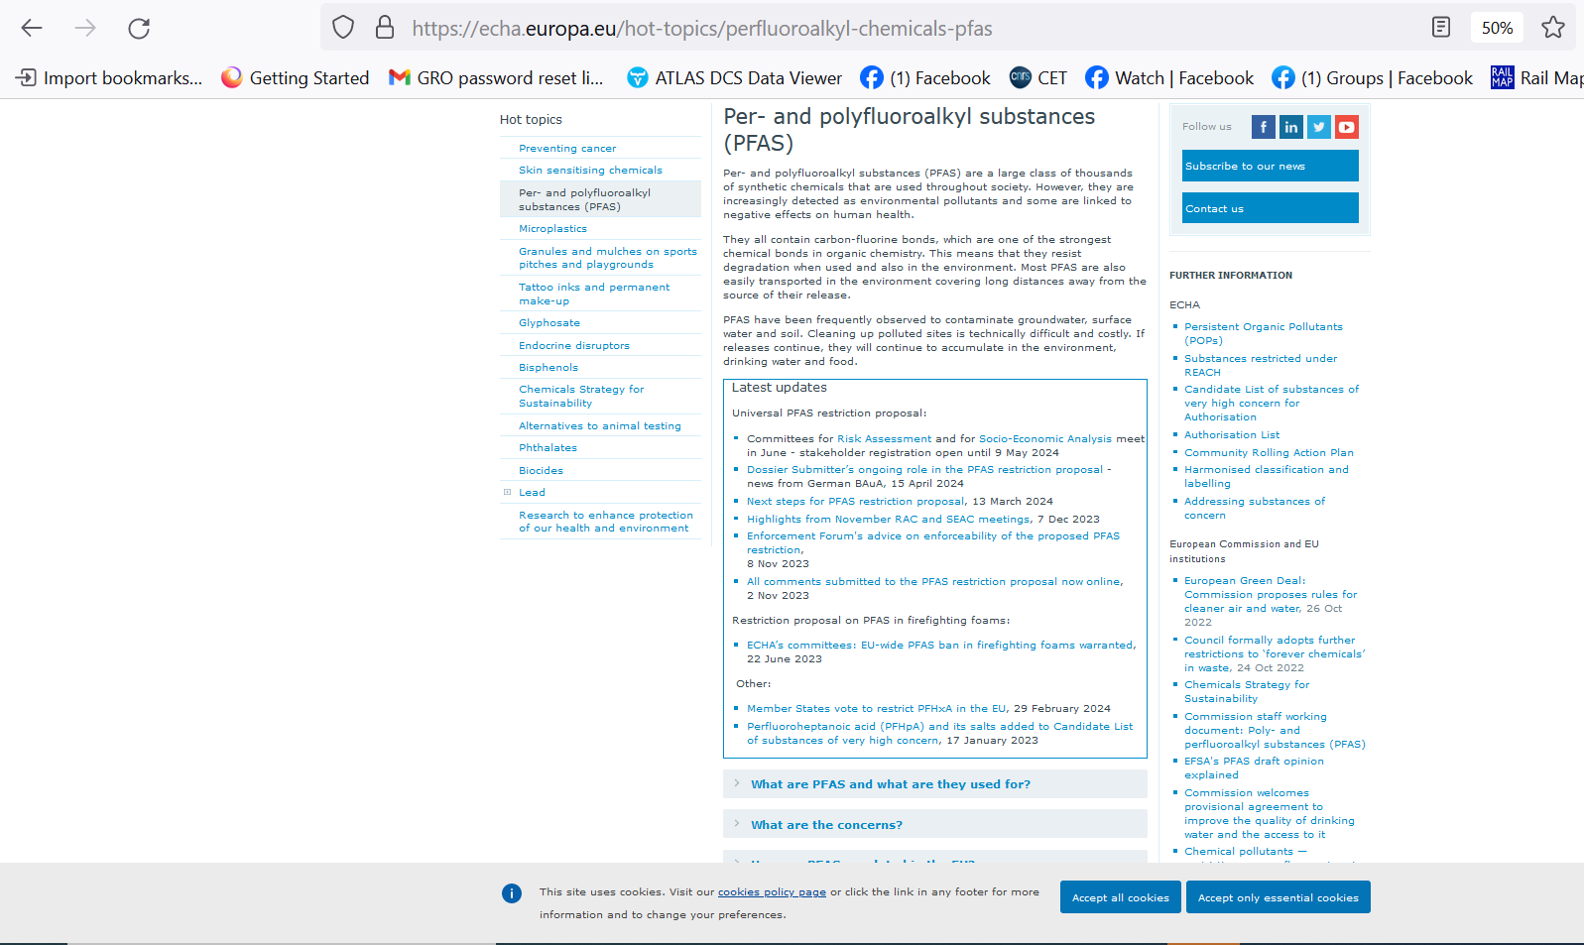
G. Hallewell: Green FCs for Cherenkov detectors & Si tracker cooling Sustainability session: ICHEP2024 Prague 18-24 July 2024

