Slide 1
Beam pipe rope support from YE1
Ali Karaki - CMS Engineering and Integration Office
In collaboration with:
Josef Sestak and Orlando Santos - TE-VSC-BVO
Tristan Loic Loiseau - CMS Technical Coordination
10/12/2023

Slide 2
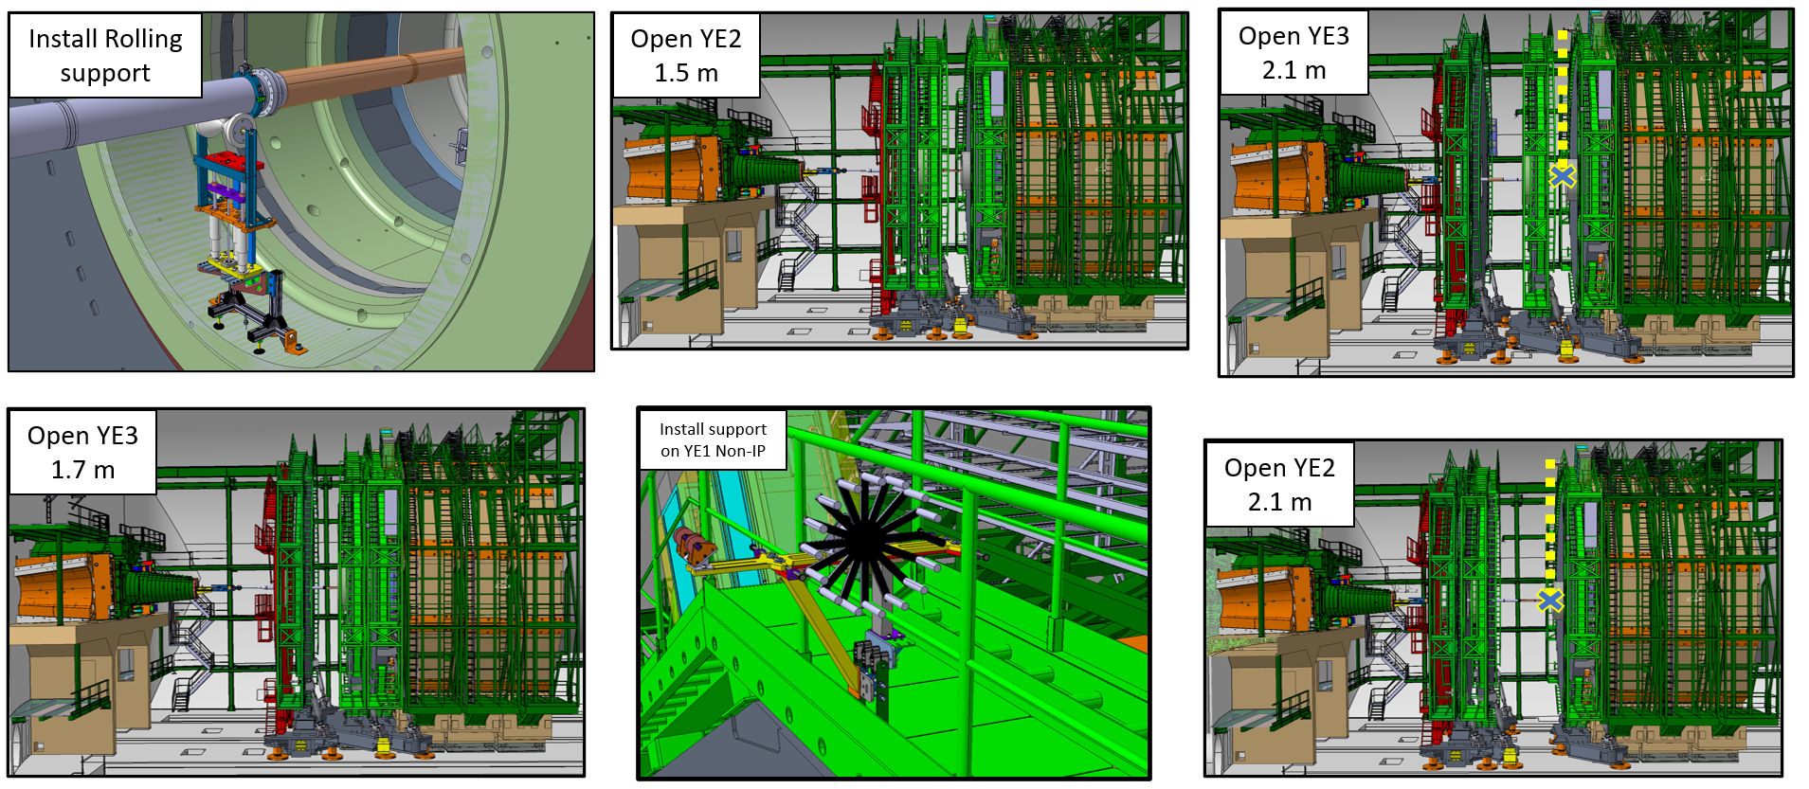
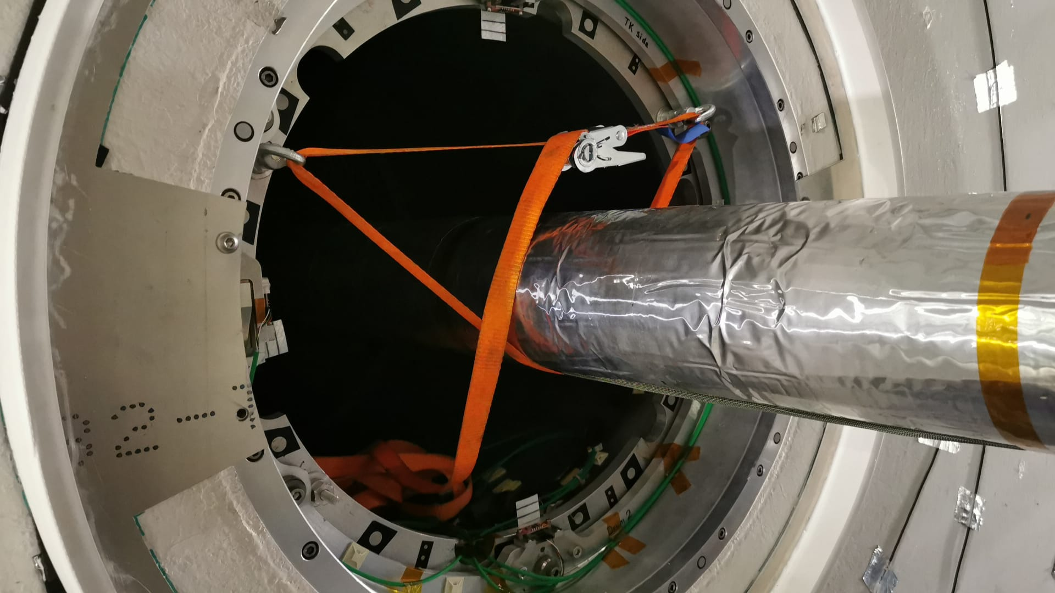
Motivation
Comparison:
Steps to open YE3 and YE2 one full stroke with and without the ‘rope’ support
Simplifying the opening\closing sequence of the endcaps by the reduction of the number of strokes to fully open\close the detector from 14 to 11.
No more need for the YE3 rolling support. Less risk for the BP and for personnel
(radiological). Less time for the installation.
Install rolling support
Open YE3 1.7 m
Open YE2 1.5 m
Install support on YE1 non IP
Swap supports
Survey
Open YE3 2.1m
Open YE2 2.1 m
Engage the rope support from YE1
Survey
Open YE3 3.8 m
Open YE2 3.6 m
No more need for the sling from the ES cone.
1
3
5
2
4
6

Slide 3
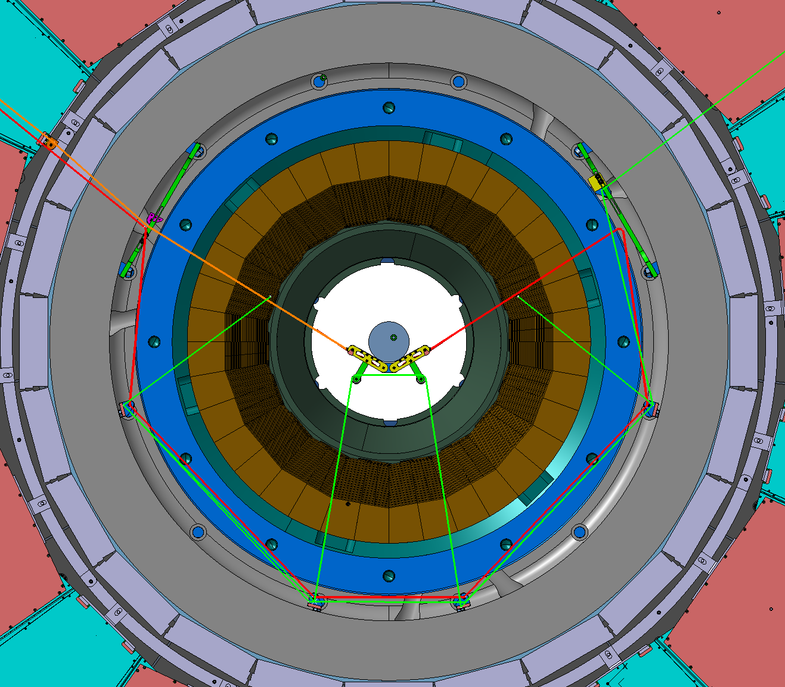
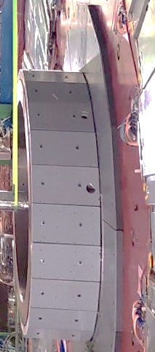
Support design overview
Wire ropes passing through the obsolete alignment holes of YE1 spacer ring.
Control the installation\removal of the support remotely from the tower by pulling the ropes.
Rope 1 is the main rope that takes the load, while rope 2 is used to retract rope 1 and keep it in the shadow of the spacer ring.
To be used when the endcaps are in closed configuration (no gap between YE1 and YE2), or in any position of YE1 at |z|<12.3m.
Rope 1
Rope 2
Beam pipe
YE1 spacer ring
YE1 Non-Ip side

Slide 4
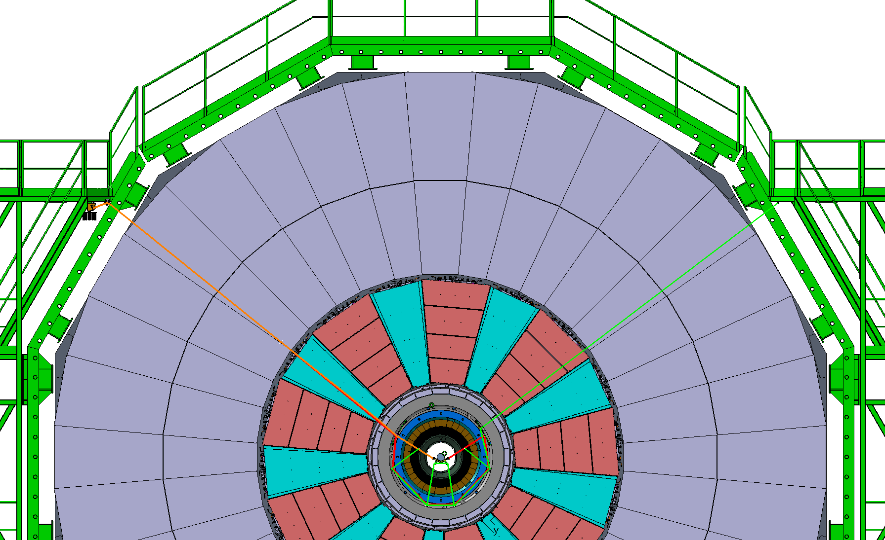
Support design overview
Control points (winches)
Guide point on RE2
Guide points on GE21
BP interface
Pulley system

Slide 5
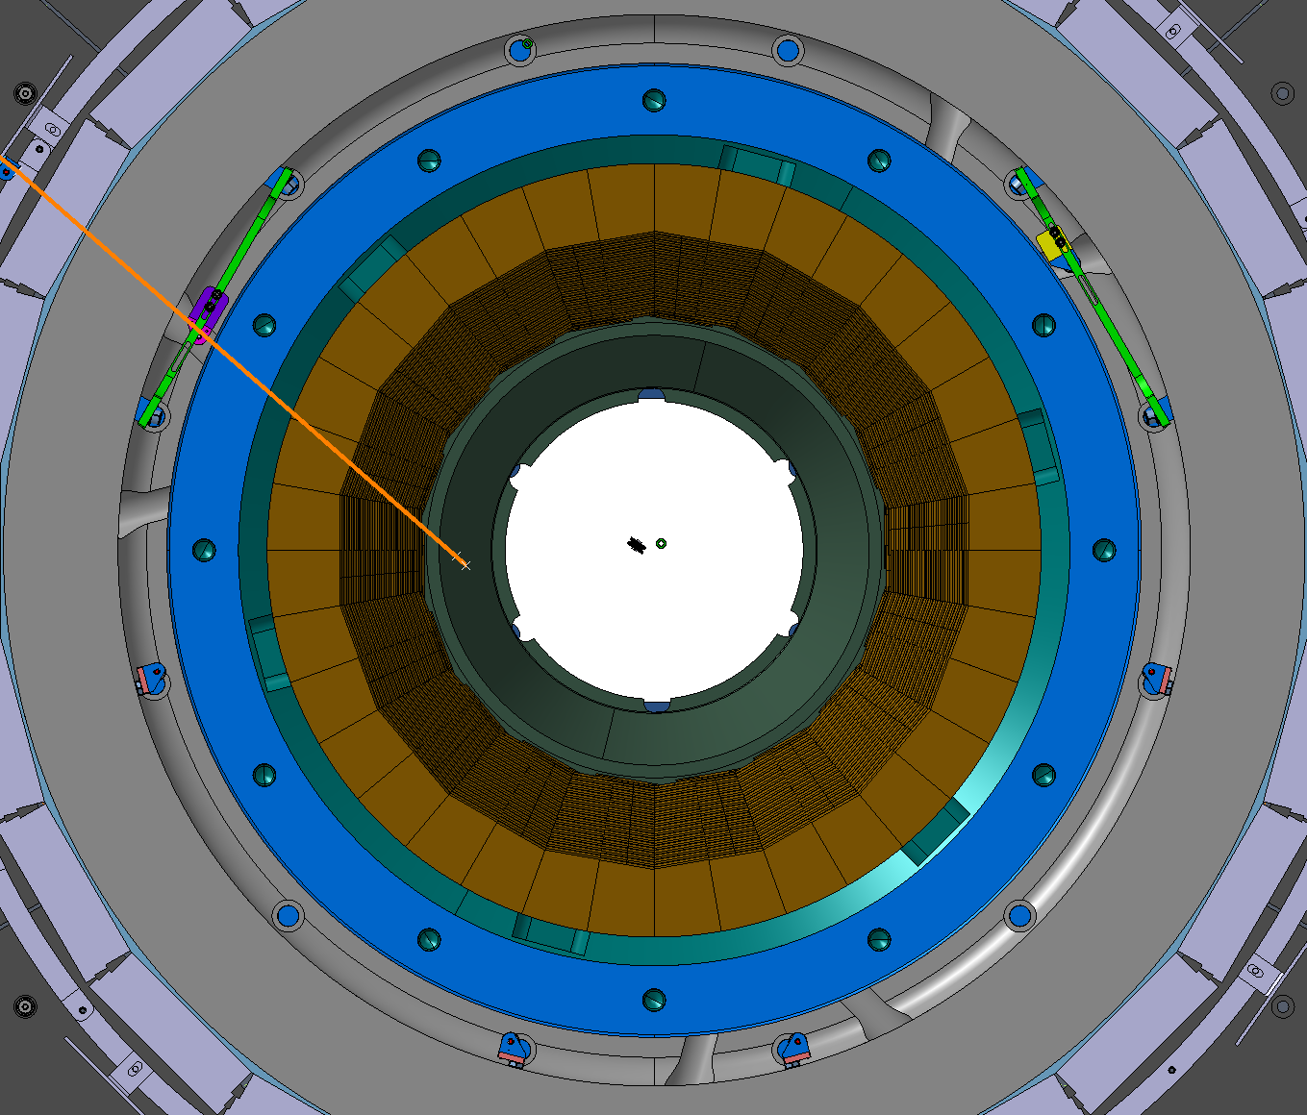
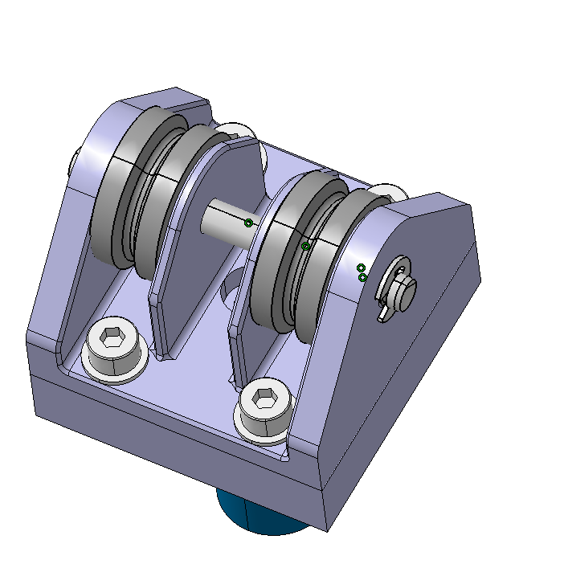
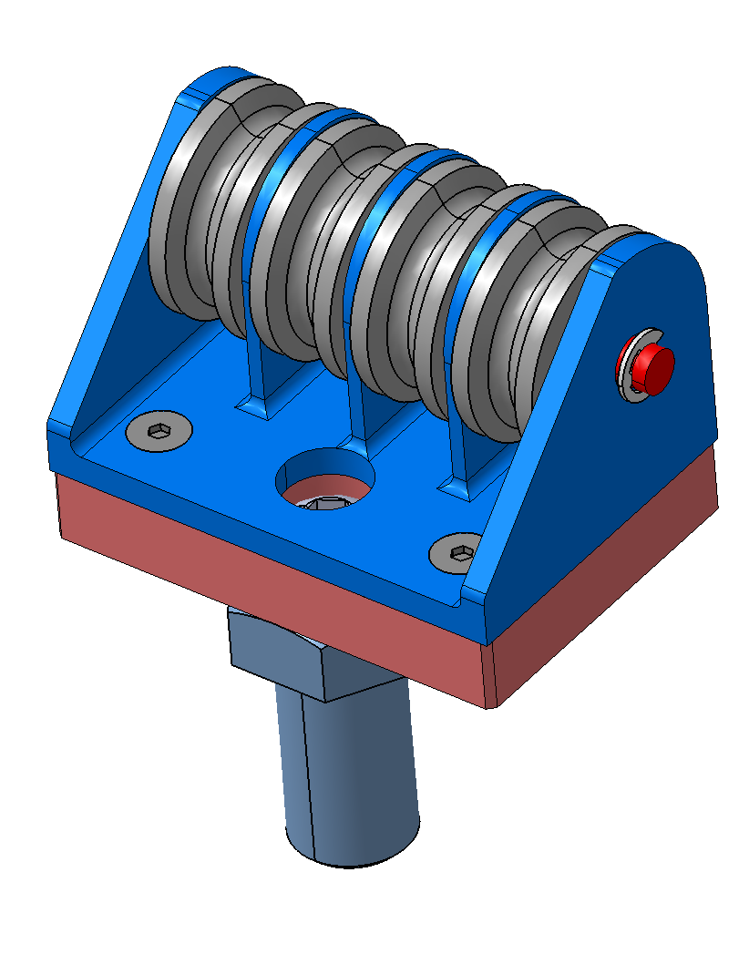
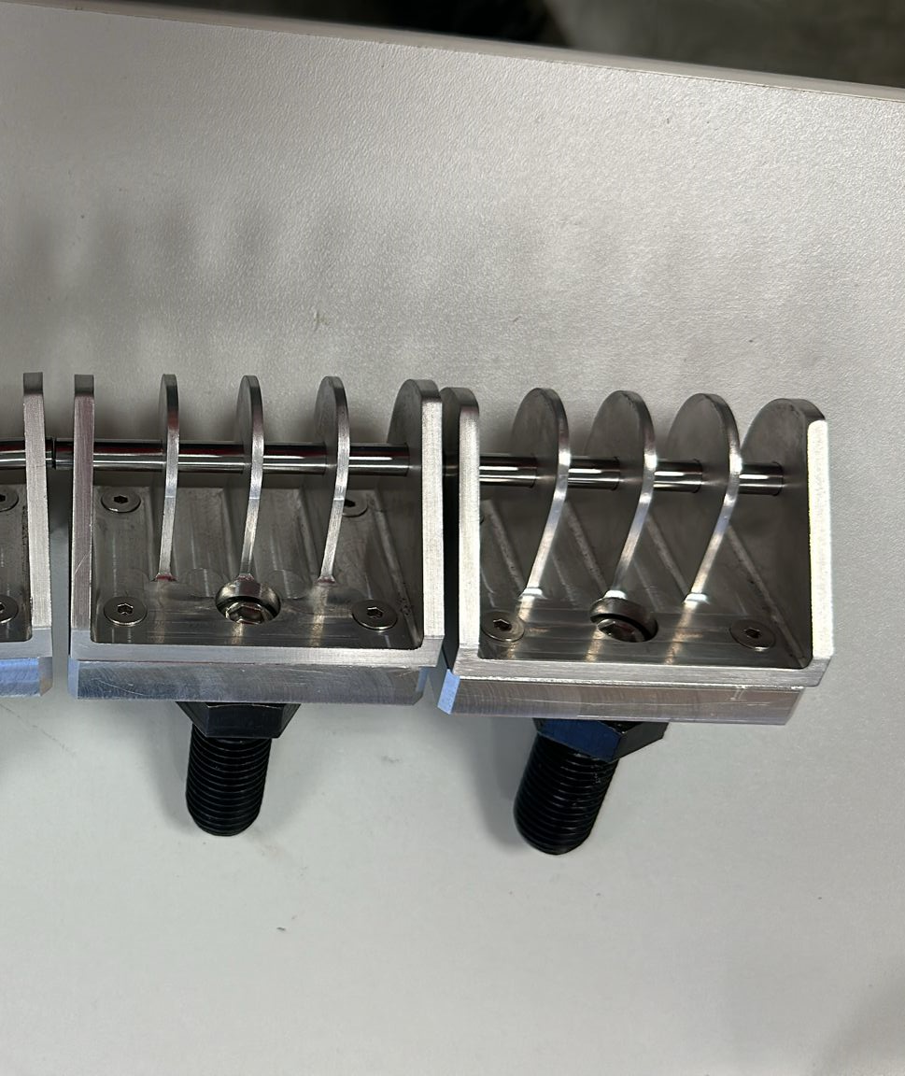
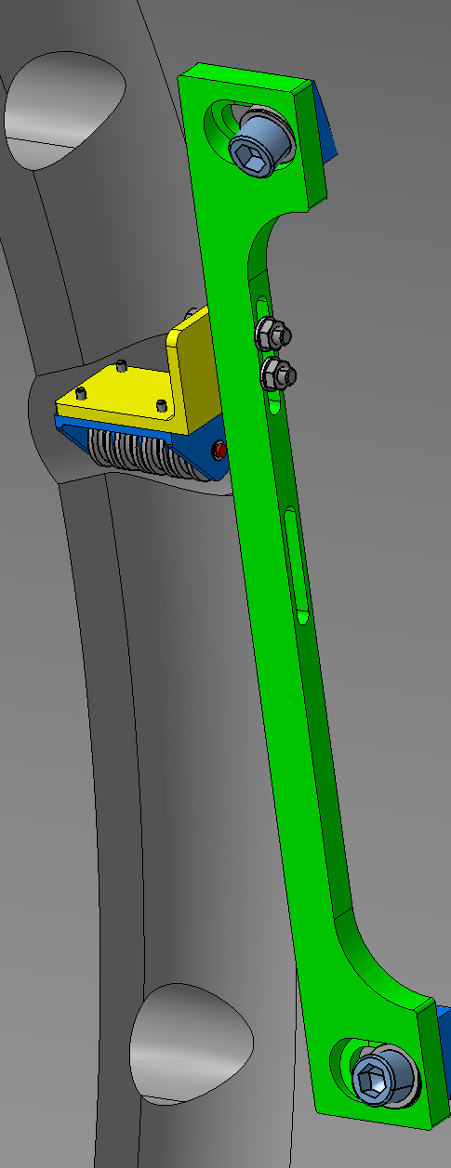
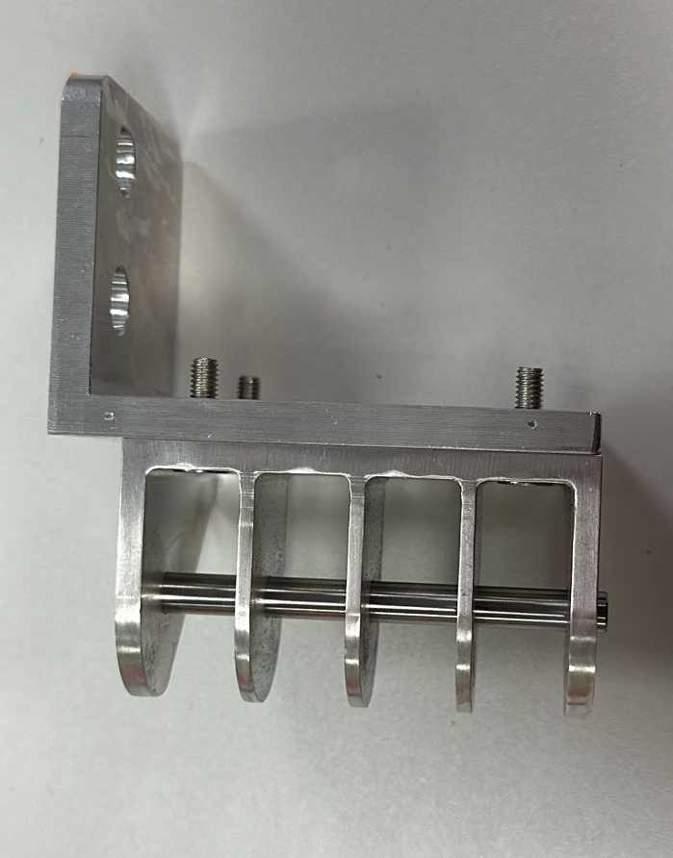
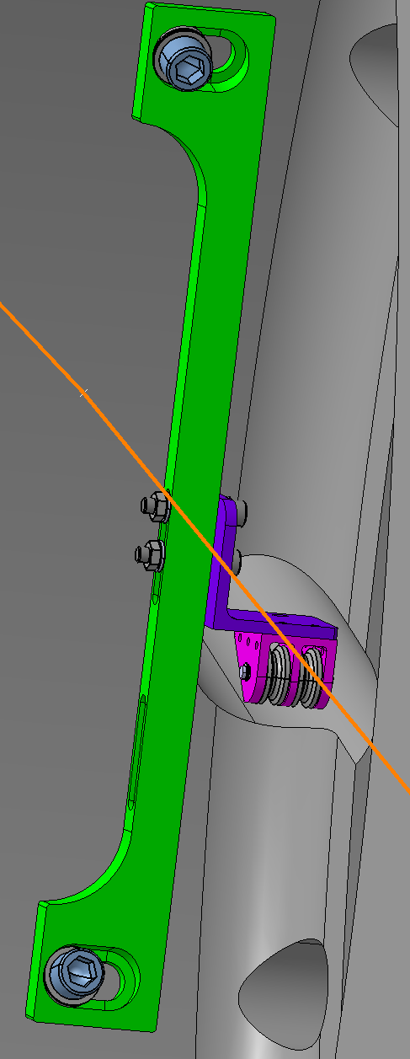
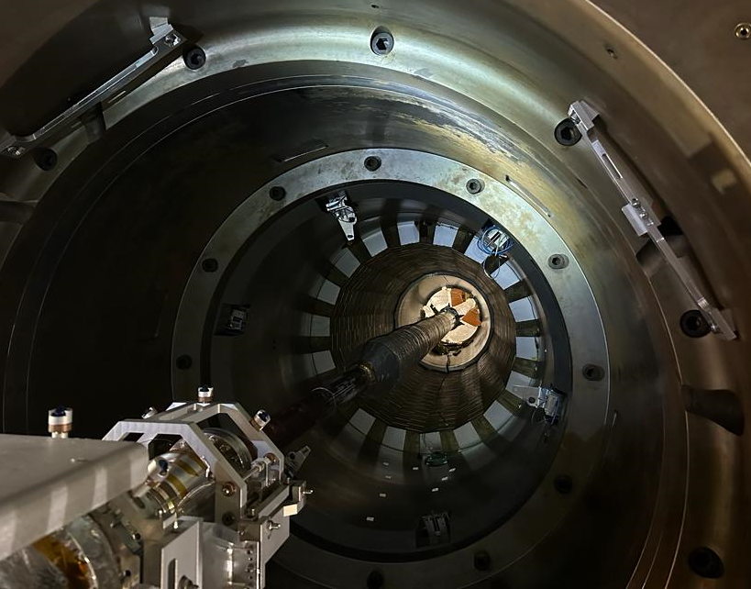
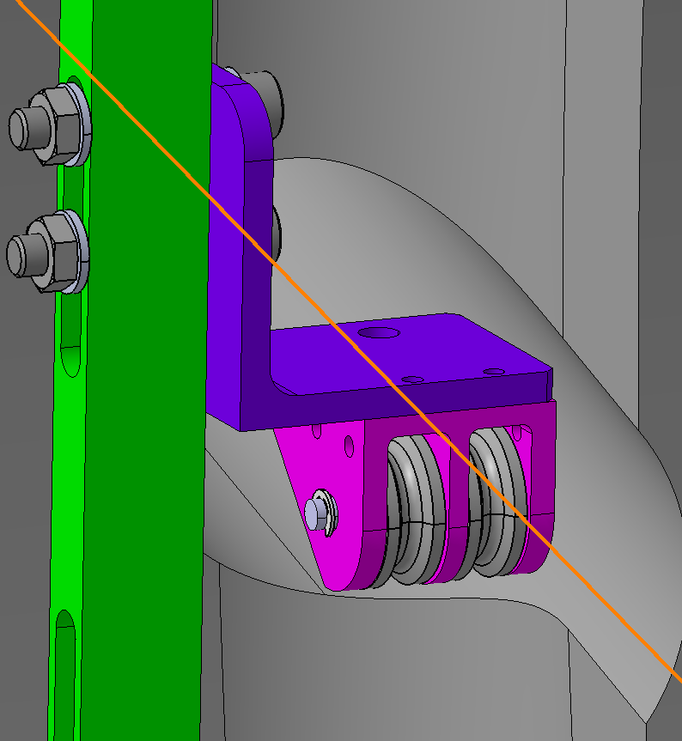
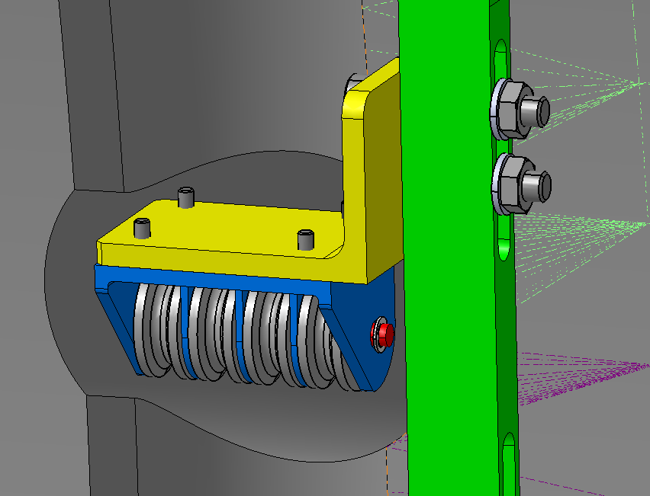
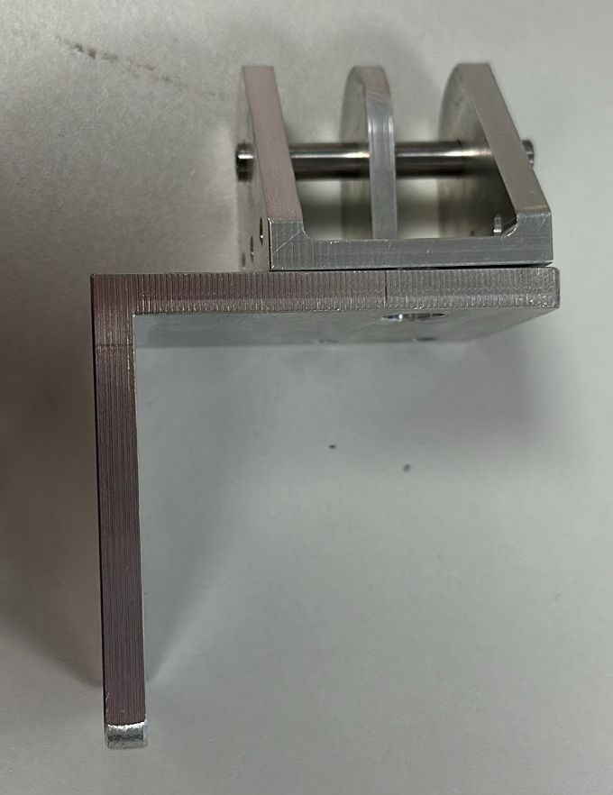
Pulley system - Permanently installed
2
1
Machining of the block done
Waiting the delivery of the pulleys
Concept design
by TE-VSC
Machining of the brackets done
Installation of the interfaces done on YE-1
1
2
2 pulleys block
4 pulleys block

Slide 6
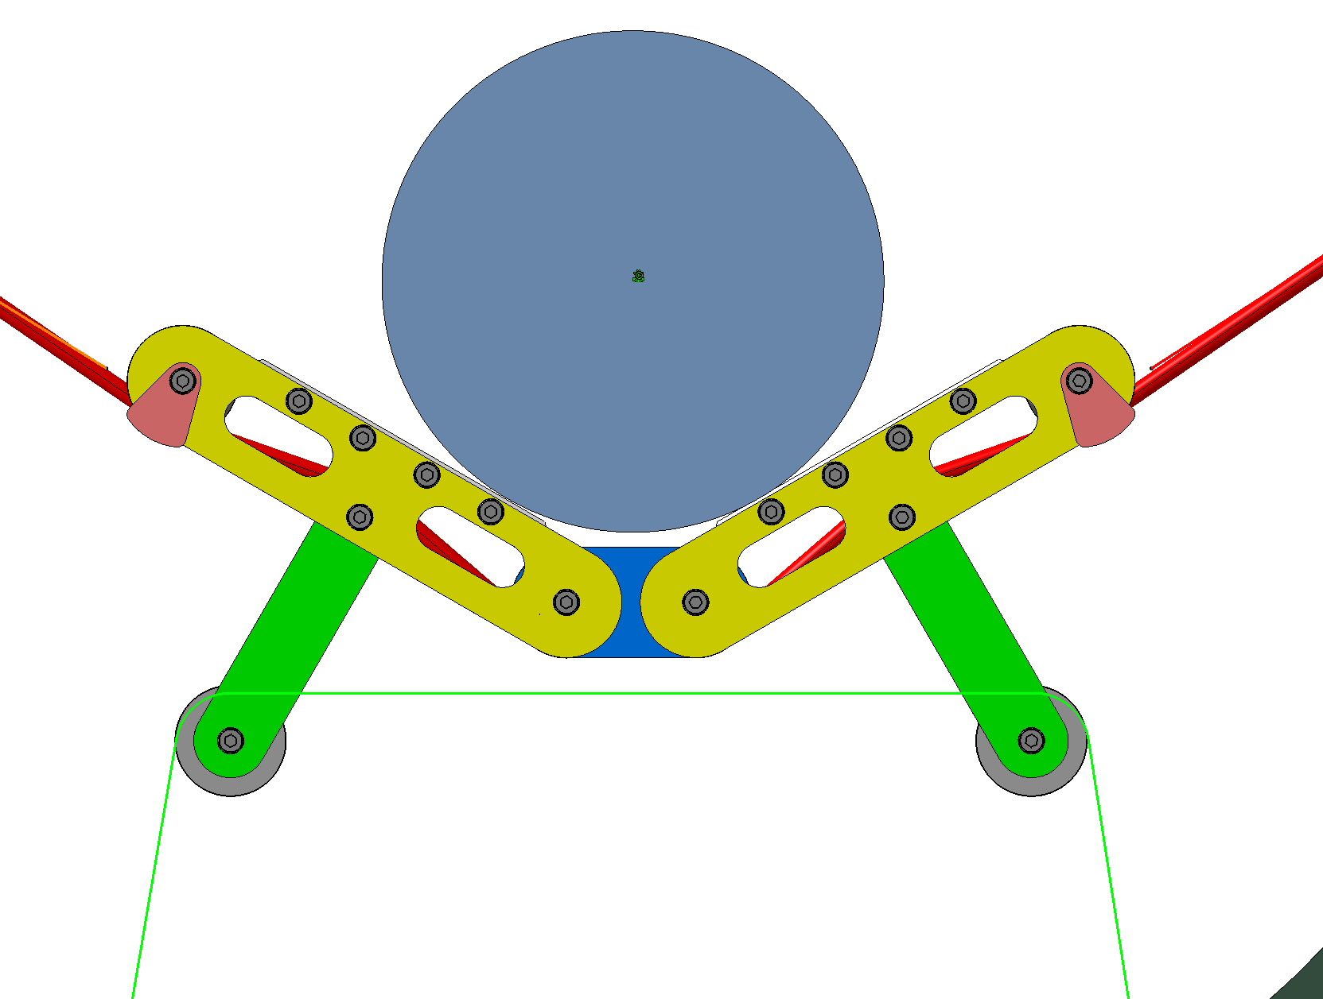
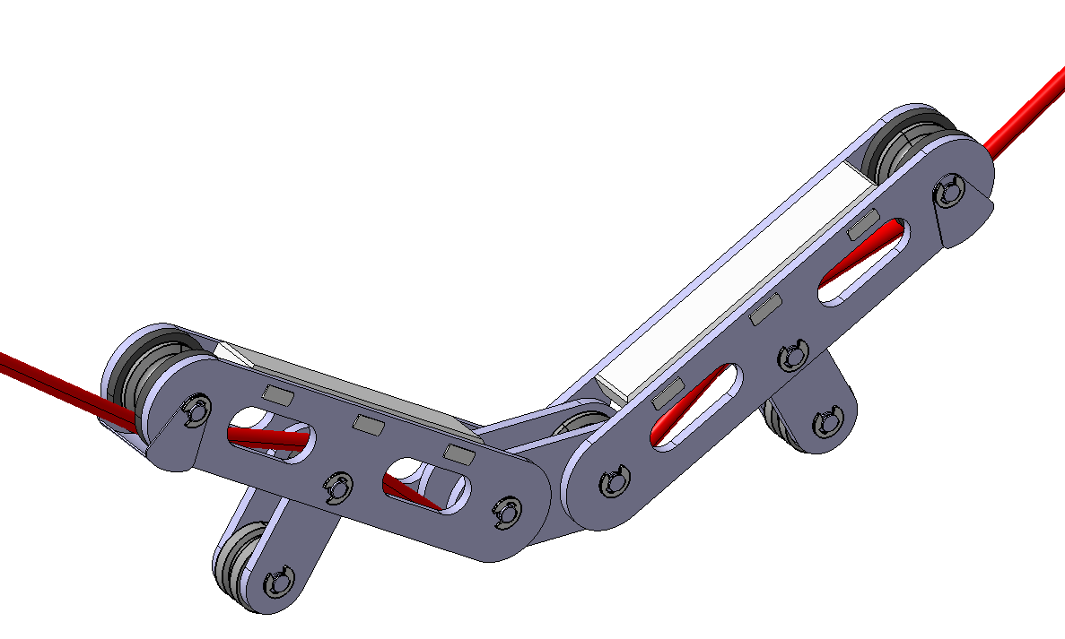
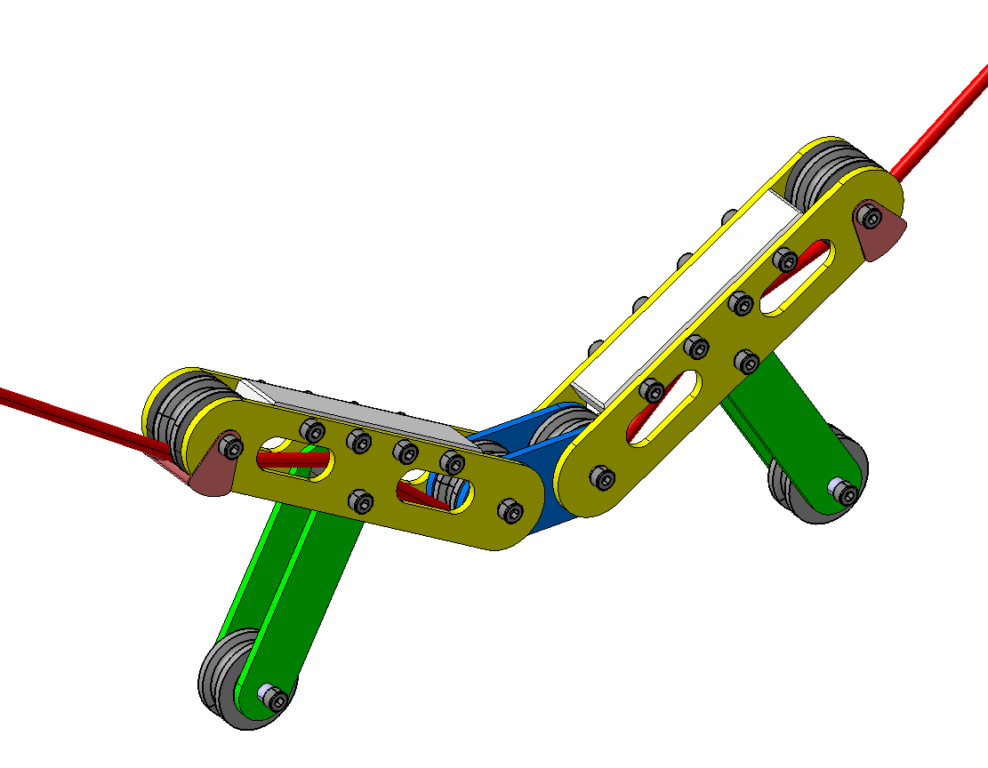
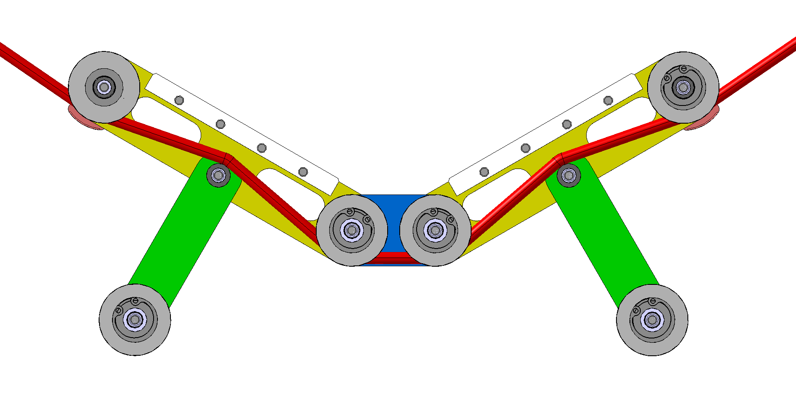
Beam pipe interface
Concept design
by TE-VSC
Support rope
Dyneema D5mm
Beam pipe
Design is complete
Needs to be machined
Modified version
Retraction rope
Dyneema D5mm
20
Derlin support blocks
Aluminium plates
Pulleys

Slide 7
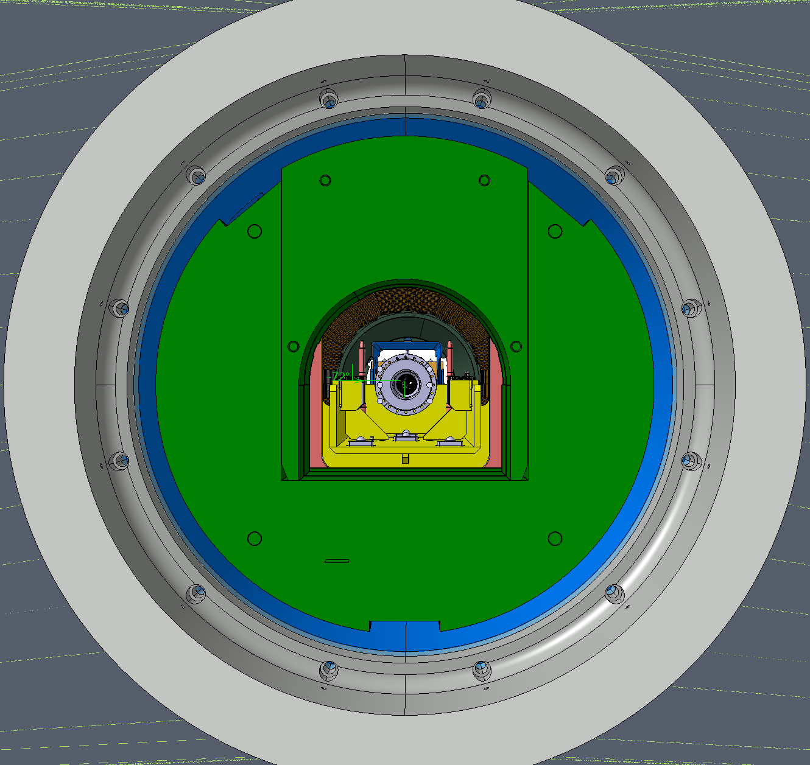
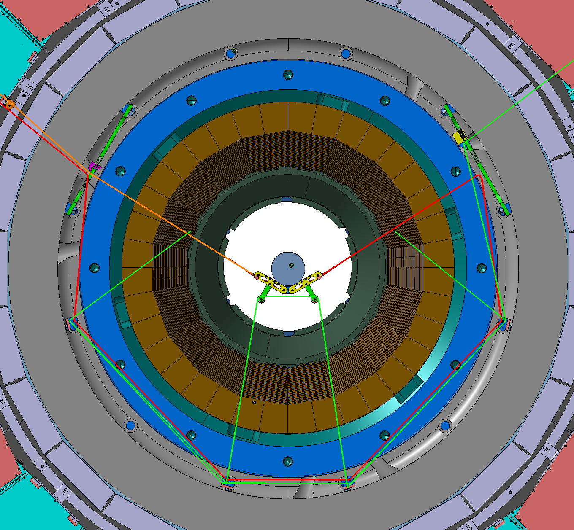
Support Envelope
When YE1 is fully open (10.4 m), the support must be retracted sufficiently to avoid any conflict with the FIN.
YE1 Inner ring
FIN
R705
R790

Slide 8
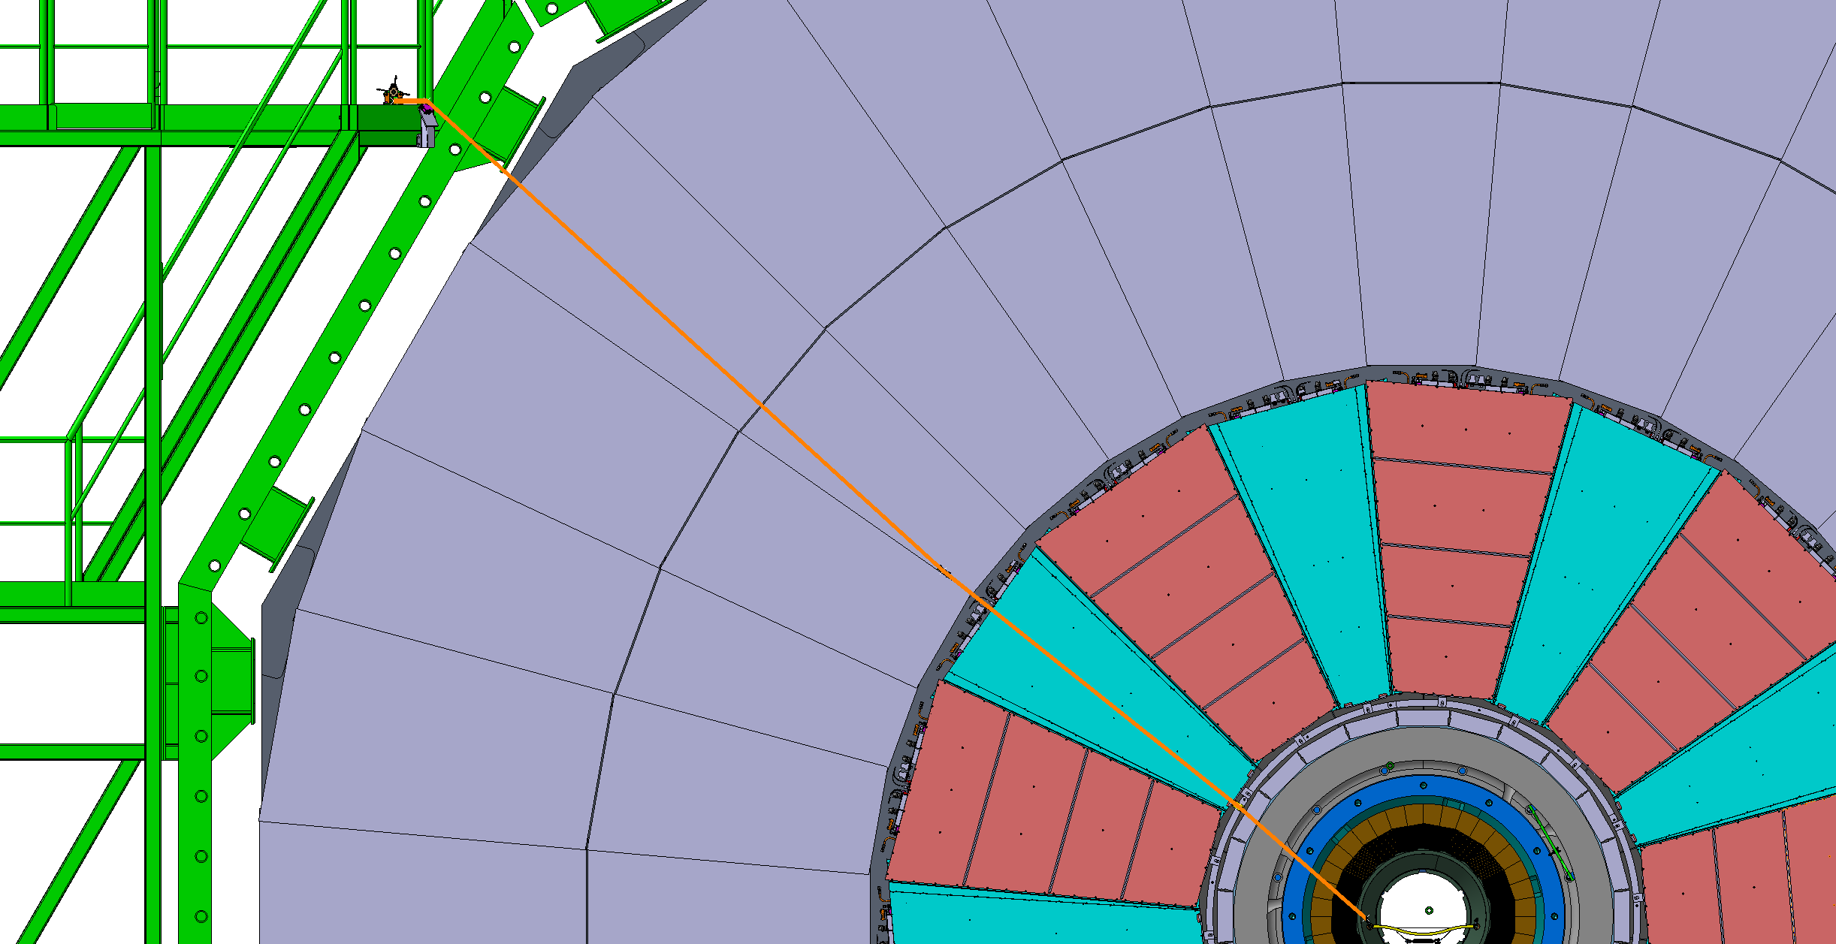
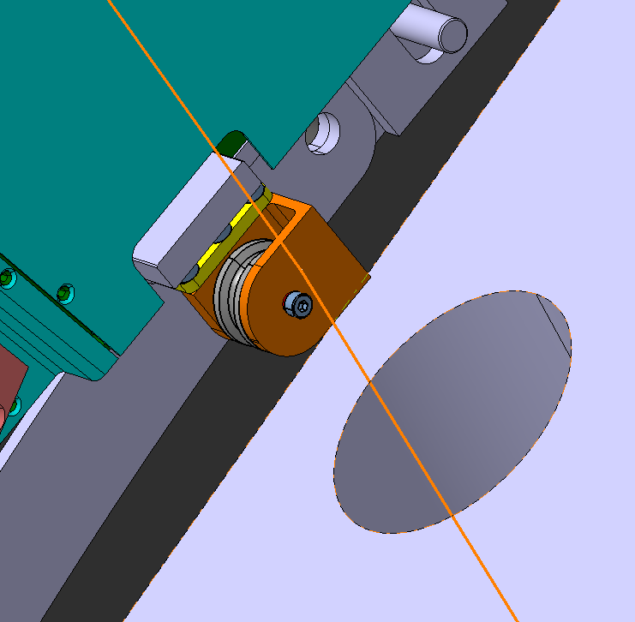
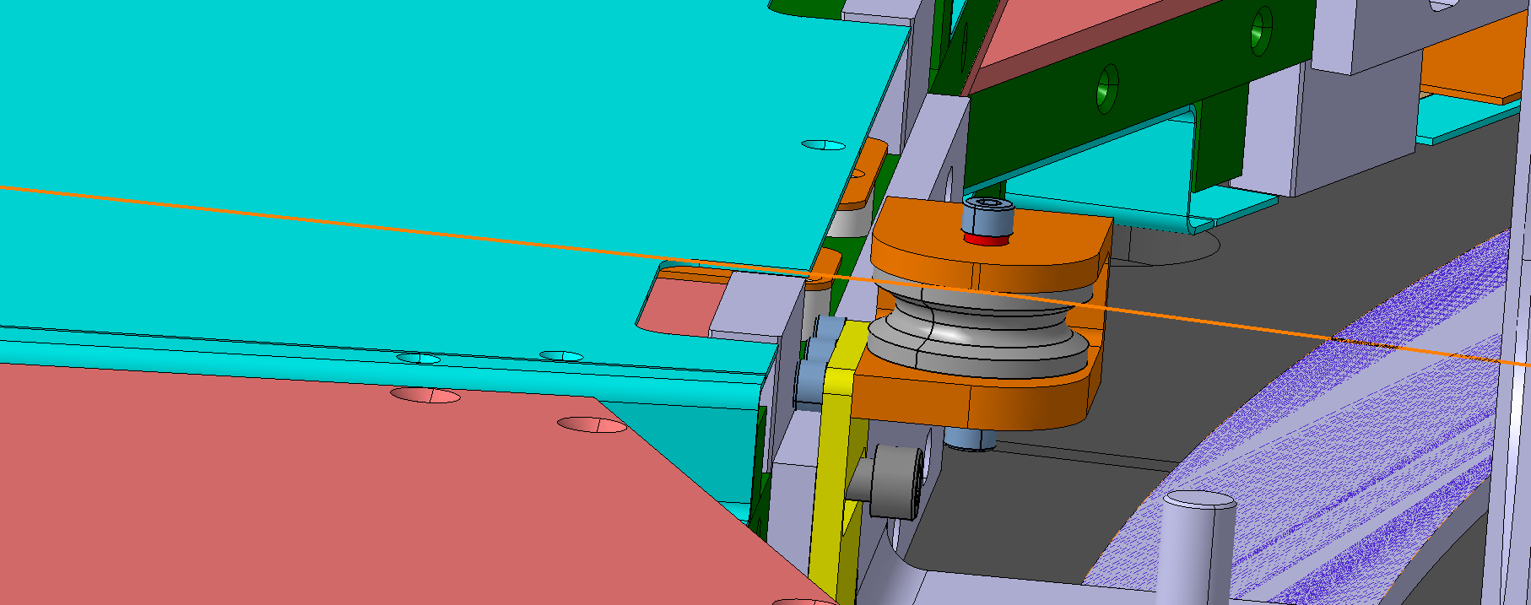
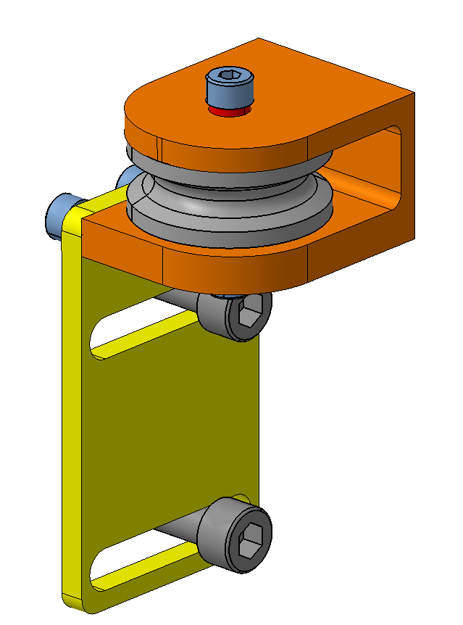
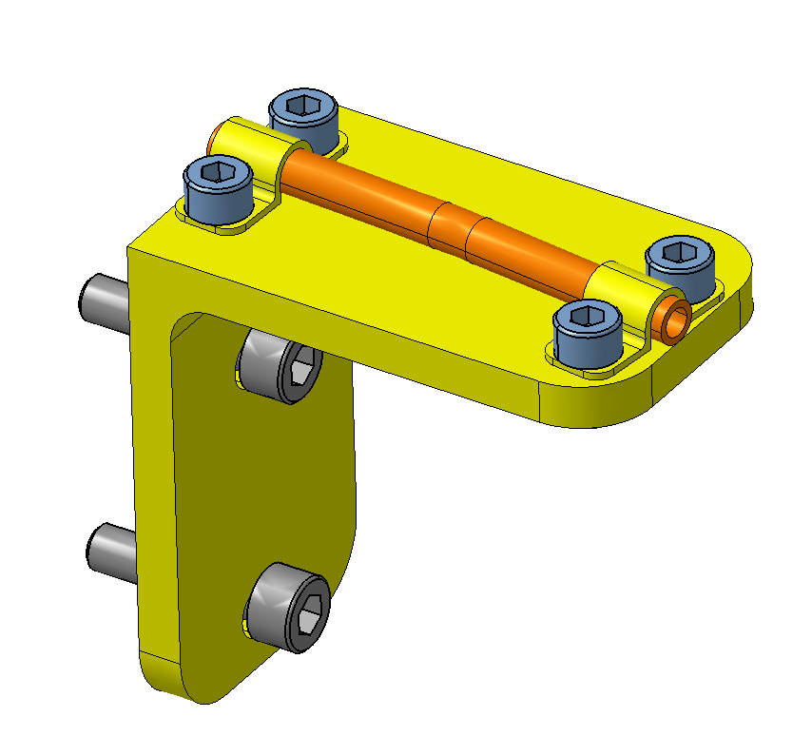
Guide point on GE2/1
One pulley with a support plate.
The pulley is fixed to the GE2/1 support bracket.
The support is designed in a way to keep minimum distance between the rope and the GE2/1 chamber and to have the rope concentric with the alignment hole in YE1.
The connection must withstand the forces of R1=11.5 N radially and R2=3.5 N in Z.
Another pulley next to the first one needs to be added to close the rope loop.
R2= 11.5 N
Alignment hole D80
V1
V2
GE2/1
Dyneema Rope
D 5mm
R2= 3.5 N
GE2/1
Bracket

Slide 9
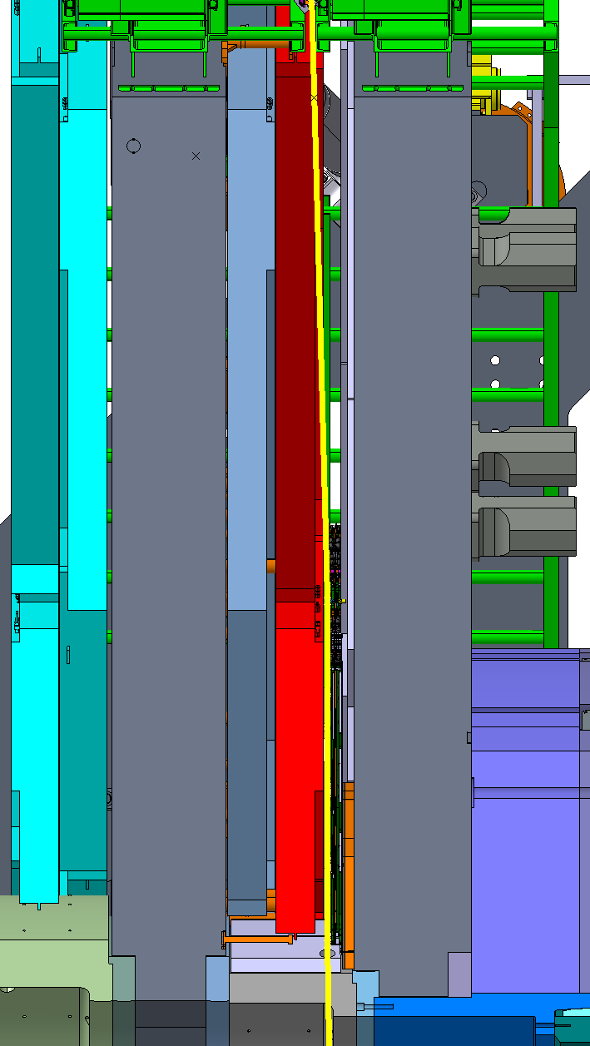
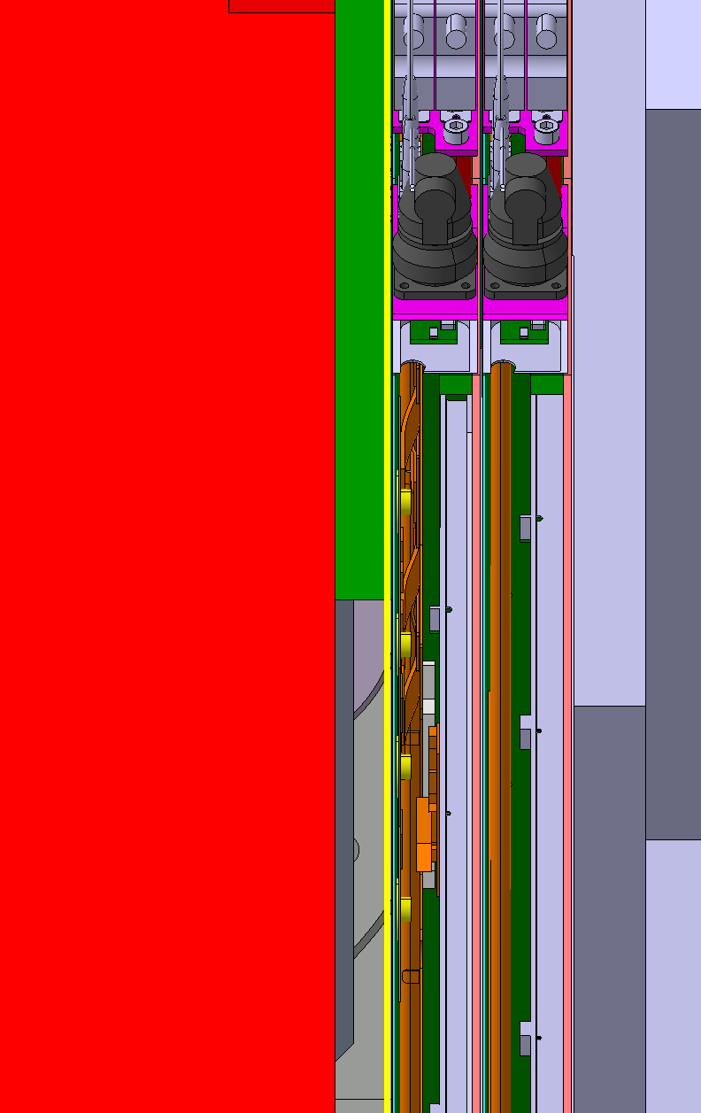
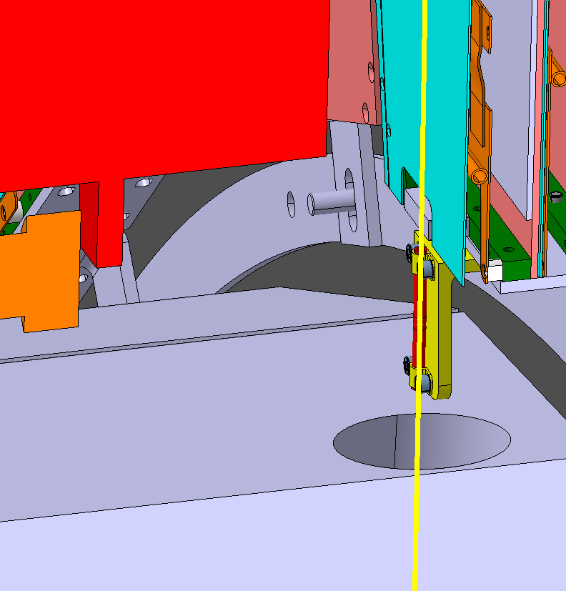
Gap with YE2 (GE2)
The minimum nominal gap between GE2/1 and ME2/1 is 23 mm.
The rope diameter is 5 mm
Therefore, the minimum clearance between the rope and ME/2 is 18 mm.
GE+2/1
ME+2/1/9
GE+2/1
ME+2/1/9
62 mm
YE+2
YE+1
18 mm
YE1 Alignment hole

Slide 10
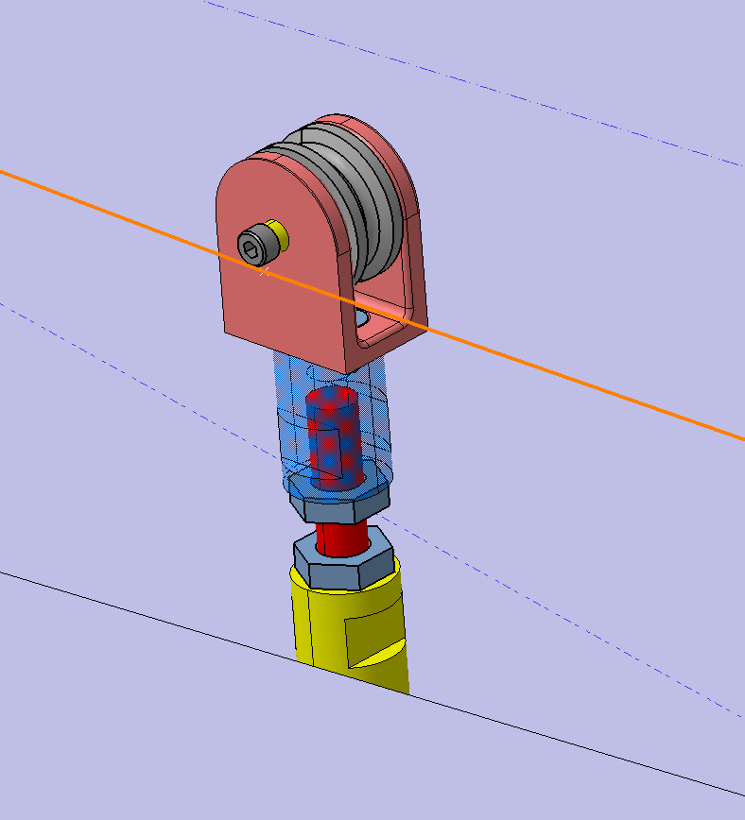
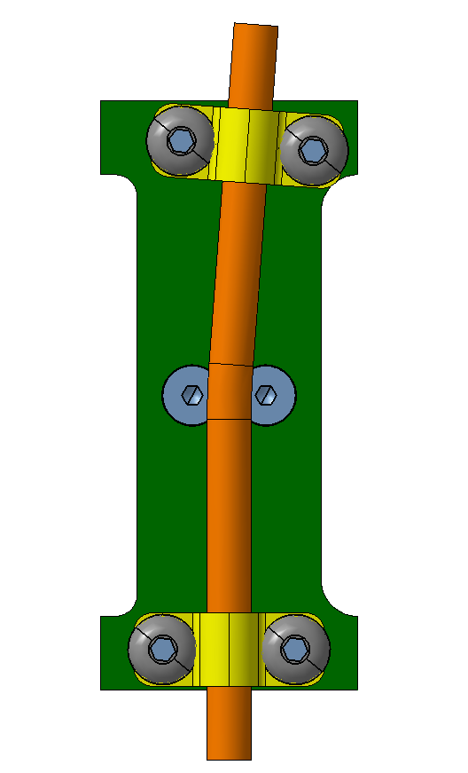
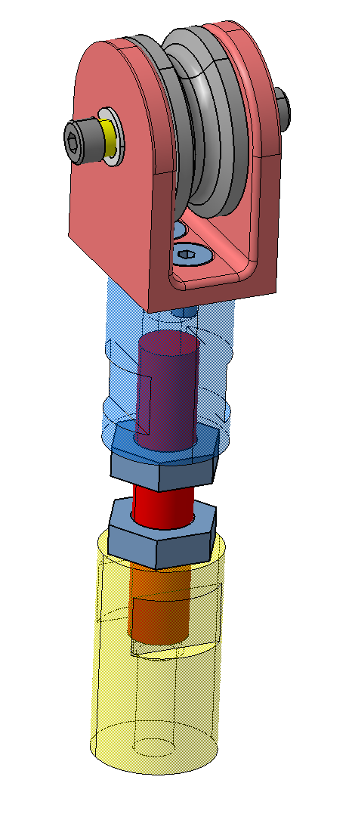
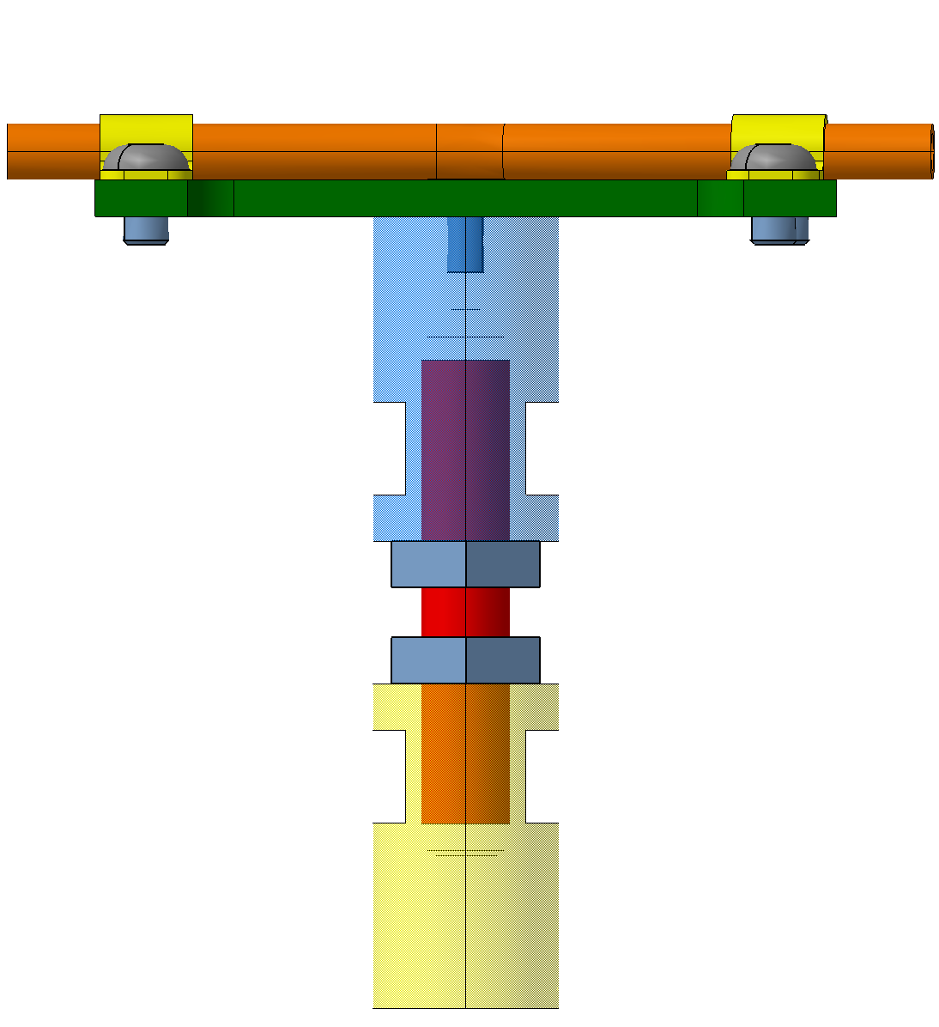
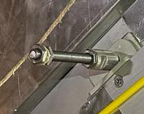
Guide point on RE2/2
One pulley guiding the rope.
The pulley is fixed to a set of two adjustable rods (in Z)
The whole assembly is fixed to the RE2/2 bracket.
The connection must withstand the forces of R1=13.5 N radially and R2=5.1 N in Z.
RE+2/2/18
RE+2/2/19
V1
V2
RE2/2 bracket
R2= 5.1 N
90
M10
( For Z Adjustment)
D20

Slide 11
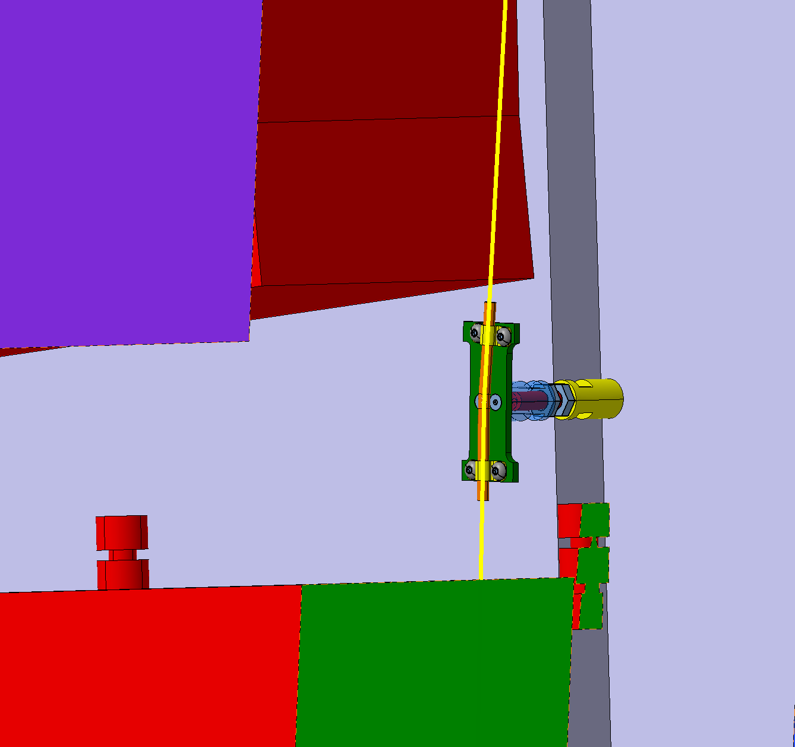
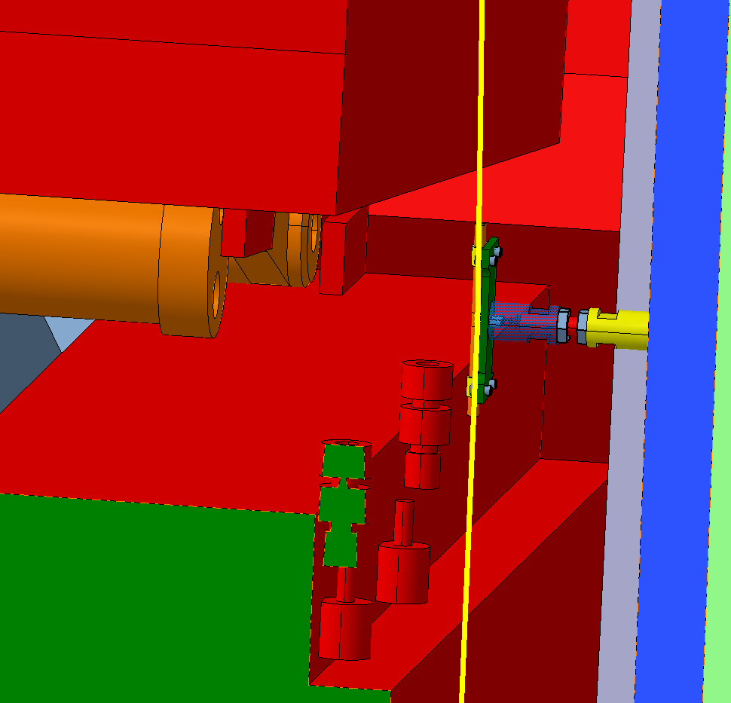
Gap with YE2 (RE2)
The guide point on RE2 is at the level of the gap between ME2/1 and ME2/2
The minimum clearance between the rope and YE2 at this level is 60 mm.
ME+2/2/18
ME+2/2/18
60 mm
YE+2
YE+1
RE+2/2/18
RE+2/2/18
192 mm
110 mm
ME+2/1/9
ME+2/1/9

Slide 12
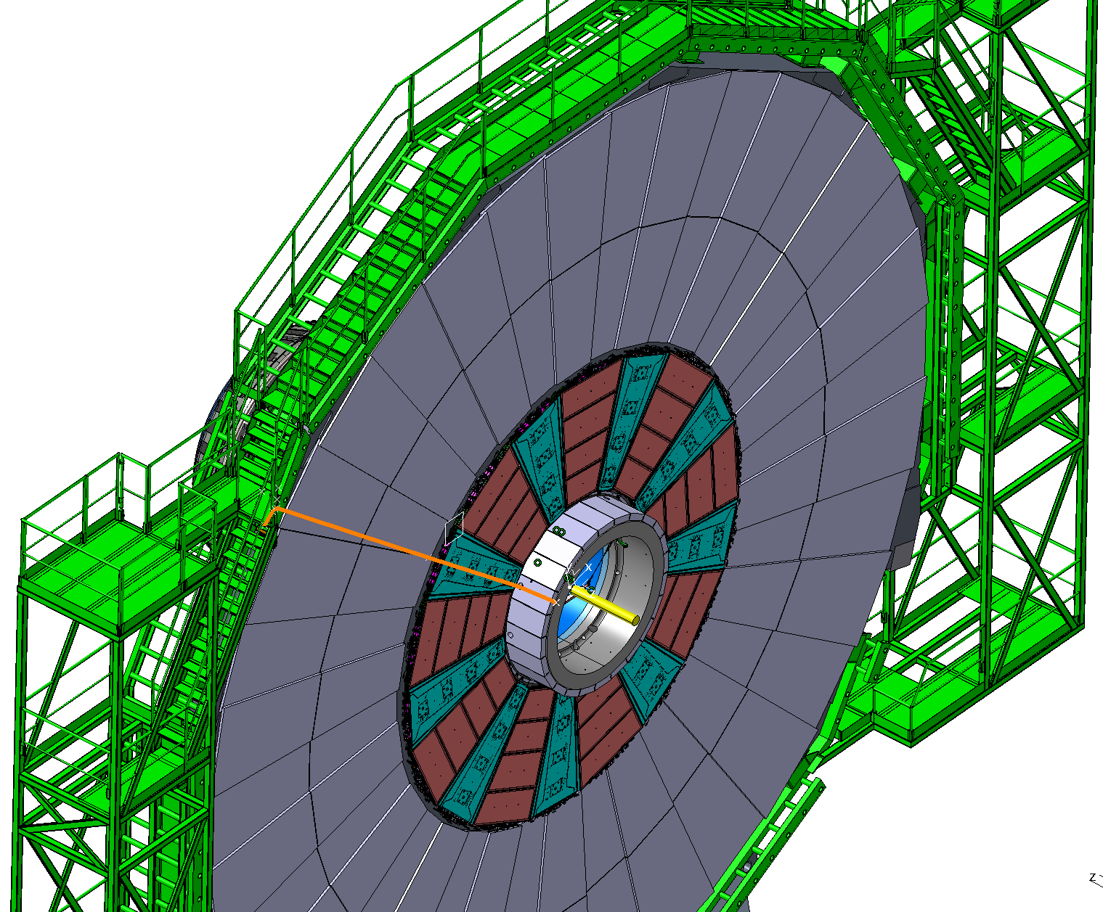
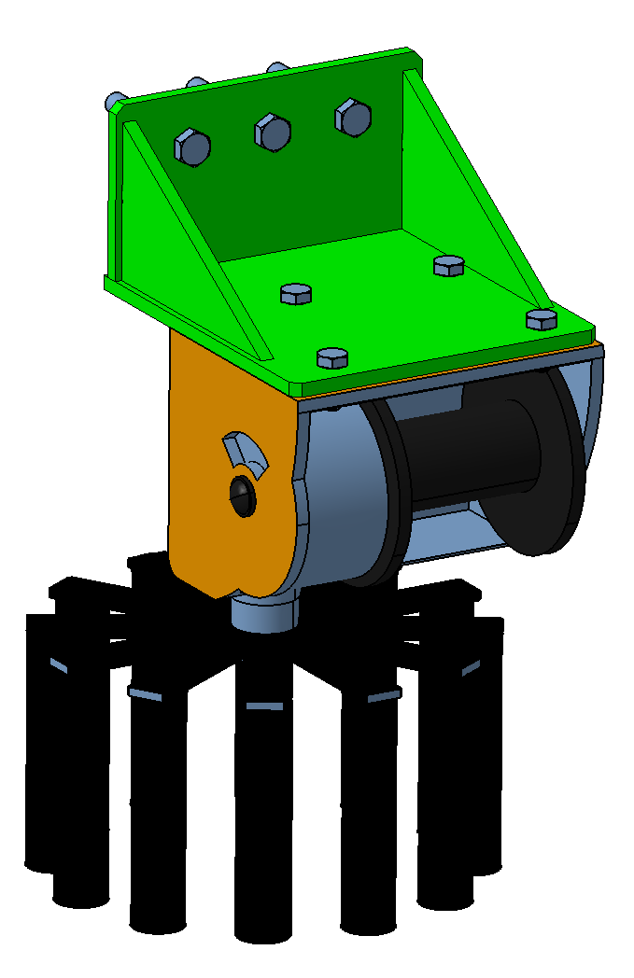
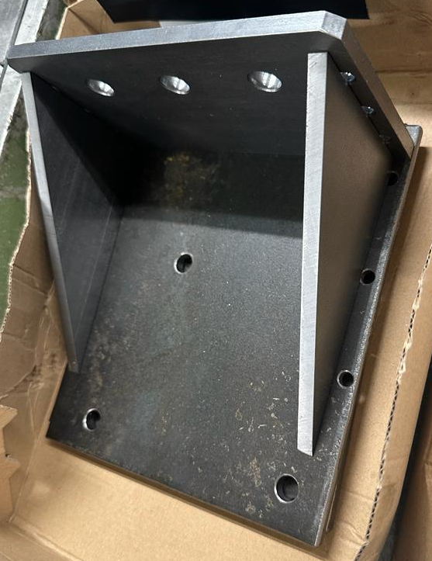
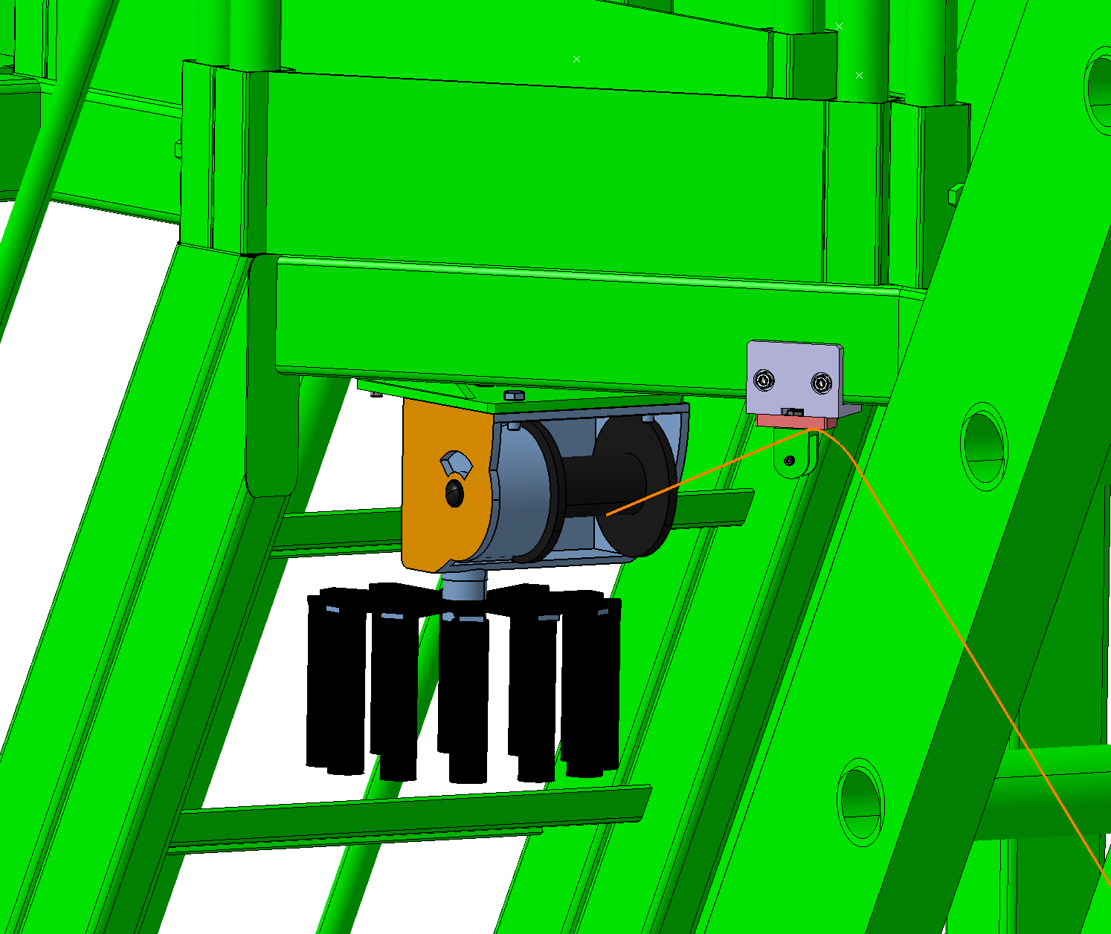
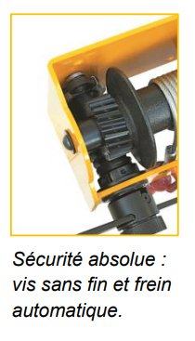
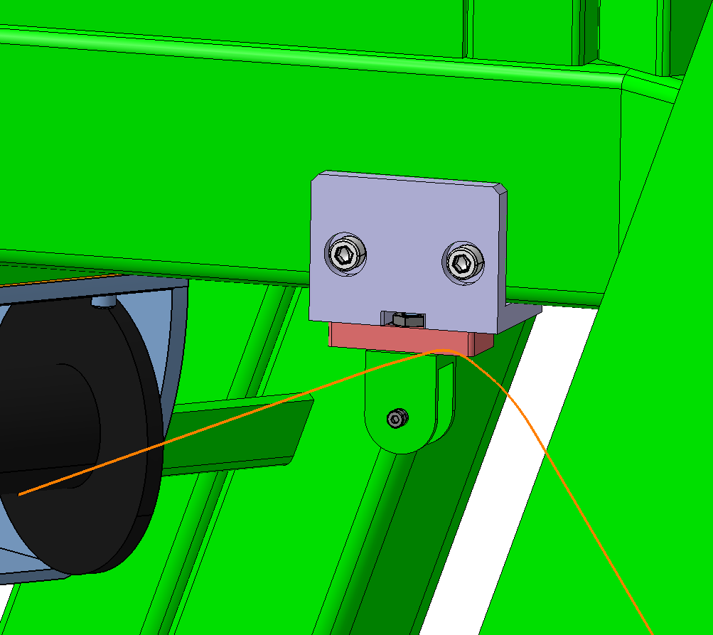
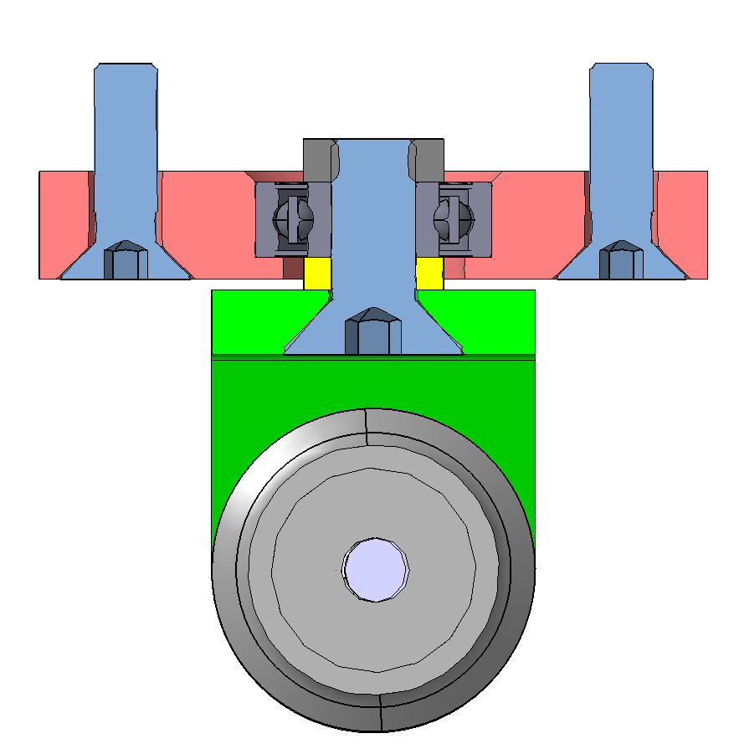
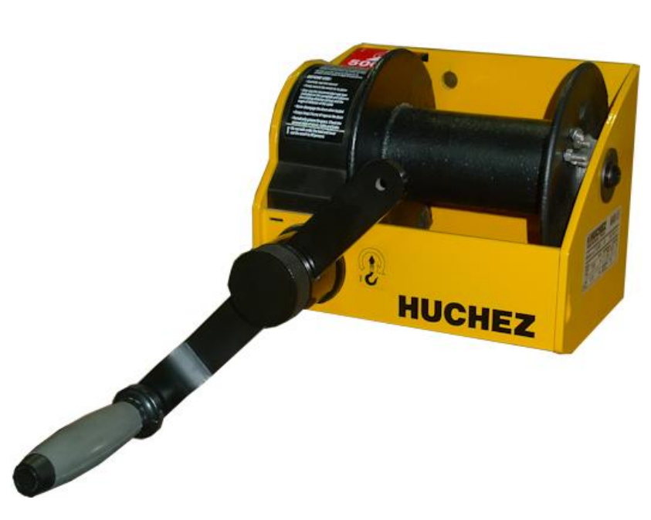
Winches on YE1 tower
Steel bracket bolted to the YE1 tower
Support machined
Winches delivered
Permanently installed.
Accessible from the stairs.
Machining done
Manual rope winch-Worm gear mechanism
Self-braking. Adjustable handle.
Aluminium bracket bolted to the YE1 tower
Free rotation around the vertical axis. Self adjustment

Slide 13
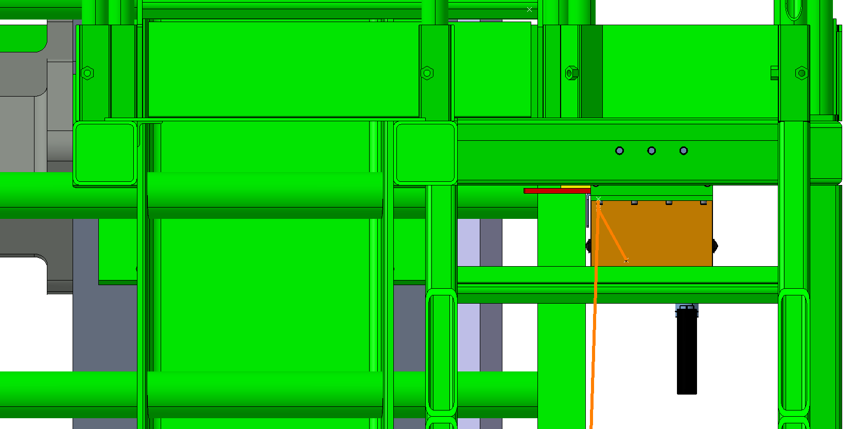
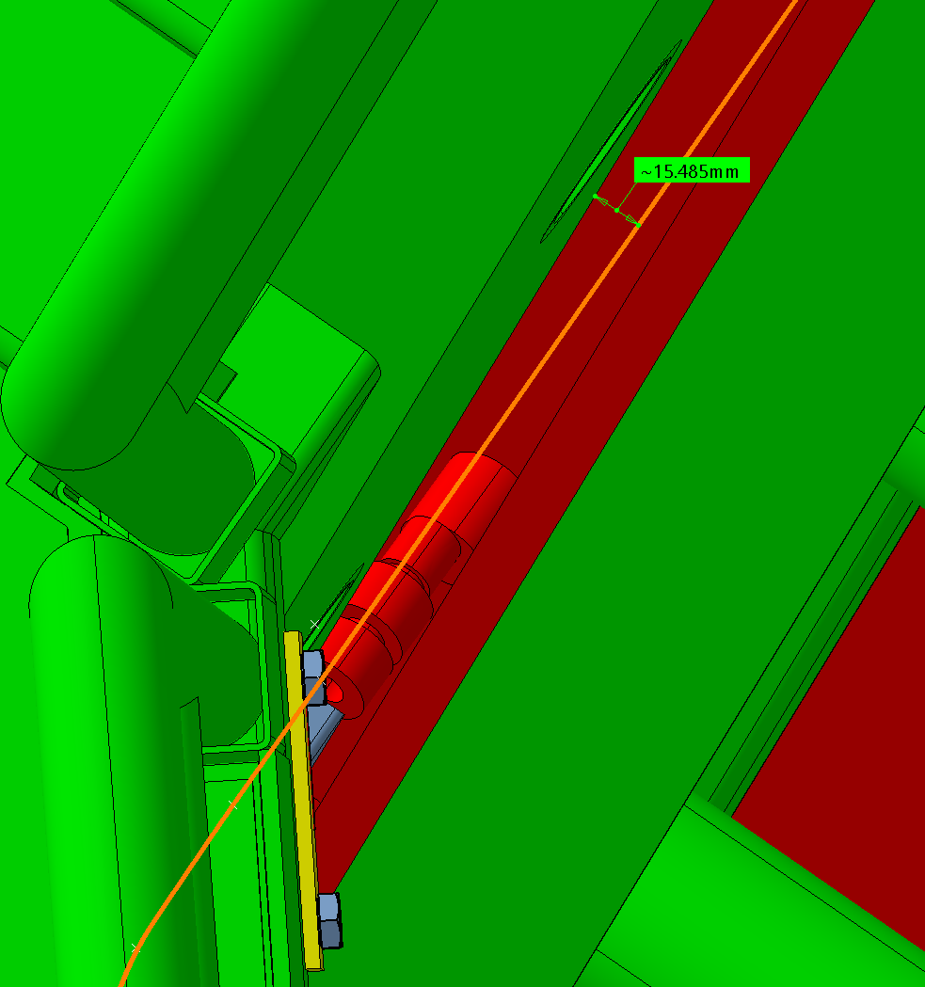
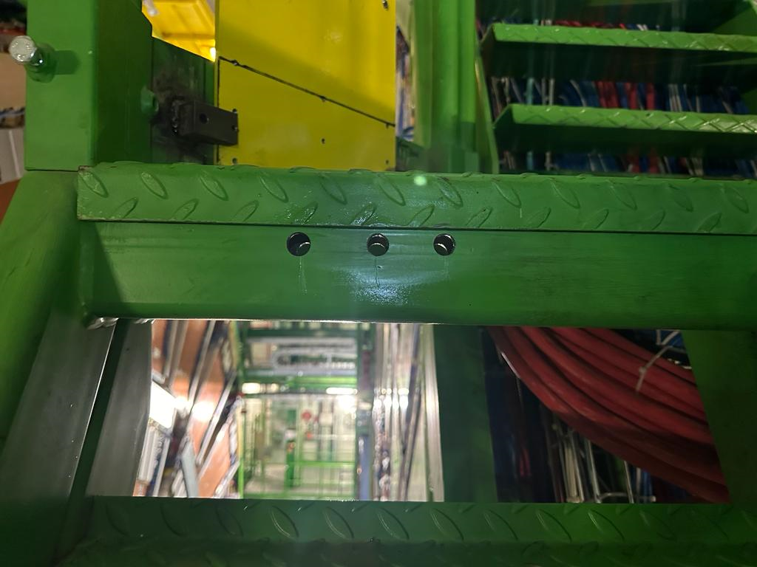
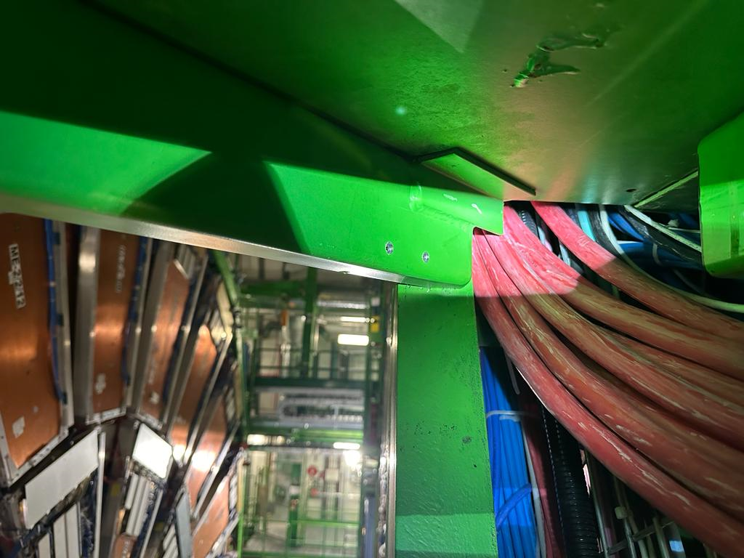
Winches on YE1 tower
Gap between the rope and the towers in closed configuration
YE1
Winch
YE2
View from the balcony
Destructive work done last week

Slide 14
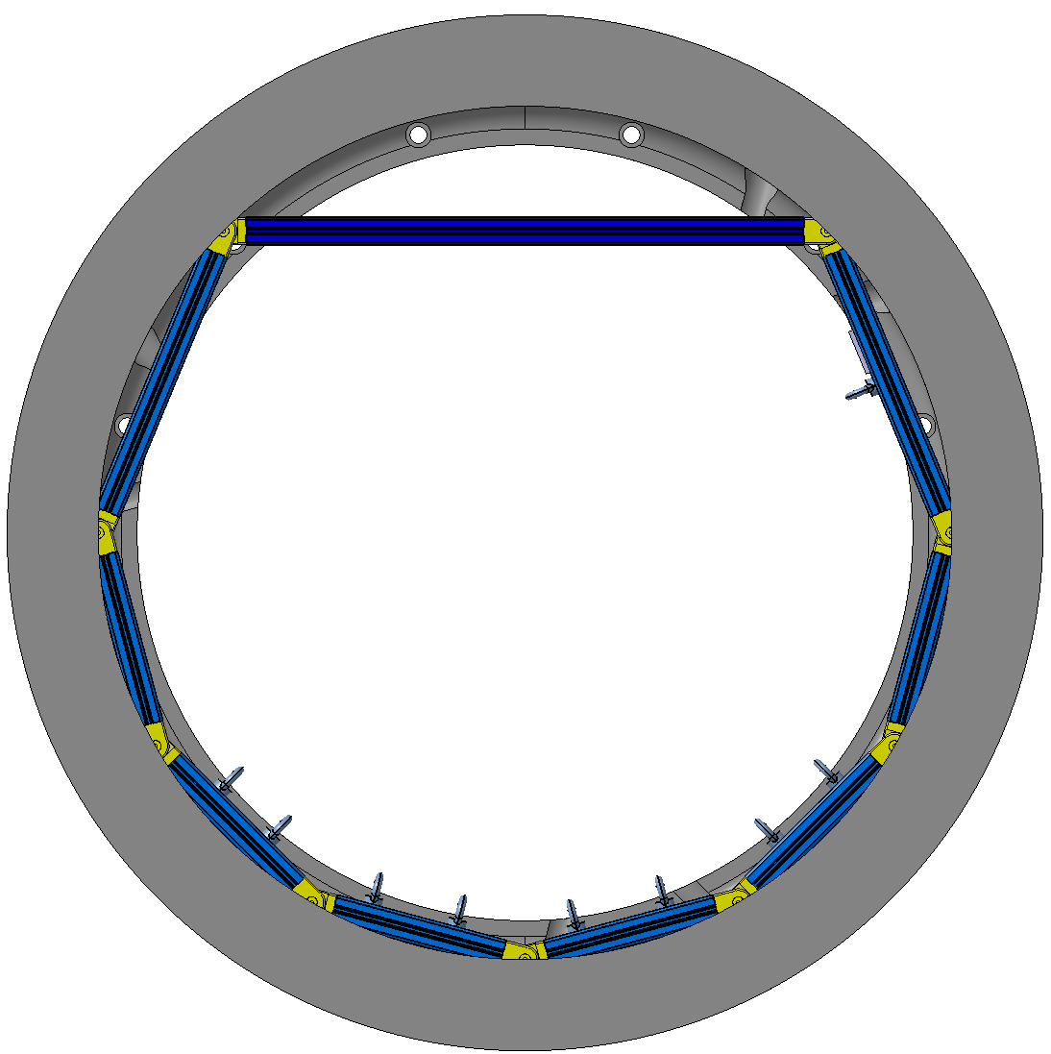


Mock up
A scaled-down prototype of the inner ring of YE1 was constructed at a 1:2 scale with bosch profiles.
The objective is to experiment with various rope configurations to identify the most effective one for symmetrically raising/lowering the beam pipe.
The configuration below has been identified. However, there was a significant amount of friction caused by the pulleys. Further testing is needed with the appropriate pulleys to address this issue.
YE1 inner ring
Bosch frame

Slide 15
Conclusion
The new YE1 rope support will significantly simplify the opening/closing procedure of CMS.
A gap was found between YE1 and YE2 to pass the rope. The guiding points are identified, designed, and partially manufactured.
The fix points on the towers were identified and designed. Destructive work done.
Further tests are required on the mock-up with the proper pulleys to decide on the final rope's configuration.
Start the machining of the beam pipe interface, if agreed on the design.
Providing the test goes well, the aim is to install the support by the end of the YETS.

Slide 16
Back-up

Slide 17





Dyneema rope – 3 mm
210 DaN
Fixed interface inside YE1 inner ring
Aluminium interface
Turnbuckle
Adjustment 1
M16 screws
Adjustment 3
Adjustment 2
4 mm SS cable
Eye bolt-
Adjustable position
BP
YE1 inner ring- View from TAS side

Slide 18



Interface with the Beam Pipe
60 mm
Silicon foam layer
3mm
Eye bolt and shackle (SS)
48 deg
48 deg
PEEK bar
CNC machined

Slide 19


Position during the run

Slide 20


Fixed interface inside YE1 inner ring
Fixed aluminium interface inside the YE1 inner ring, permanently.
Eye bolt with adjustable position to control the angle of the rope.
M16 screws
Aluminium interface
48 deg
48 deg
Eye bolt-
Adjustable position

Slide 21


Gap with YE2 (Tower)
YE+1
YE+1
Rope
YE+2
YE+2

Slide 22

Interface with the Beam Pipe
The BP is in contact with a 15 mm wide sling with adjustable tension.
The sling is flat; therefore, no transversal forces are transmitted due to the BP during the installation/removal of the support.
It is kept permanently inside YE1 but not touching the BP, except when the support is needed.
BP
Al bar
Sling
Tensioner

Slide 23



Fb2=183.6 cos(4.24)
= 183 N
Projection on XY Plan
Fb1=183.6 sin(4.24)
= 13.57 N
B
Fc2=184 cos(3.58)
= 183.6 N
C
Fc1=184 sin(3.58)
= 11.5 N
F 184 N

Slide 24




Projection on YZ Plan
Fb3=184 sin (1.59)
= 5.1 N
B
Fc3=184 sin(1.131)
= 3.55 N
C
F 184 N

