Slide 1

COMPUTING FOR ALICE IN THE CZECH REPUBLIC
2022-2024
D. Adamova (NPI ASCR)
J. Chudoba, A. Mikula, L. Míča, M. Svatoš , P. Šesták , J. Uhlířová , P. Vokáč (all FZU ASCR), J. Hampl (NPI ASCR)
Seoul, 18.04.2024

Slide 2
HEP Computing in Prague: WLCG site praguelcg2
(a.k.a. the farm GOLIAS)
A national computing center for processing data from various HEP experiments
Distributed resources with all central services and most of hardware at the central site: FZU ASCR
Basic infrastructure already in 2002.
One of the 13 sites participating in the first LCG campaign in 2003
April 2008, WLCG MoU signed by Czech Republic (ALICE+ATLAS)
Certified as a Tier2 center of LHC Computing Grid (praguelcg2)
Collaboration with various other Grid projects
Very good network connectivity provided by CESNET / e-INFRA CZ.
Multiple dedicated 10 – 100 Gb/s connections to collaborating institutions, 100 Gb/s connection to LHCONE.
Provides computing services for ATLAS + ALICE, Auger, NOVA, Fermilab, Astrophysics ...

Slide 3
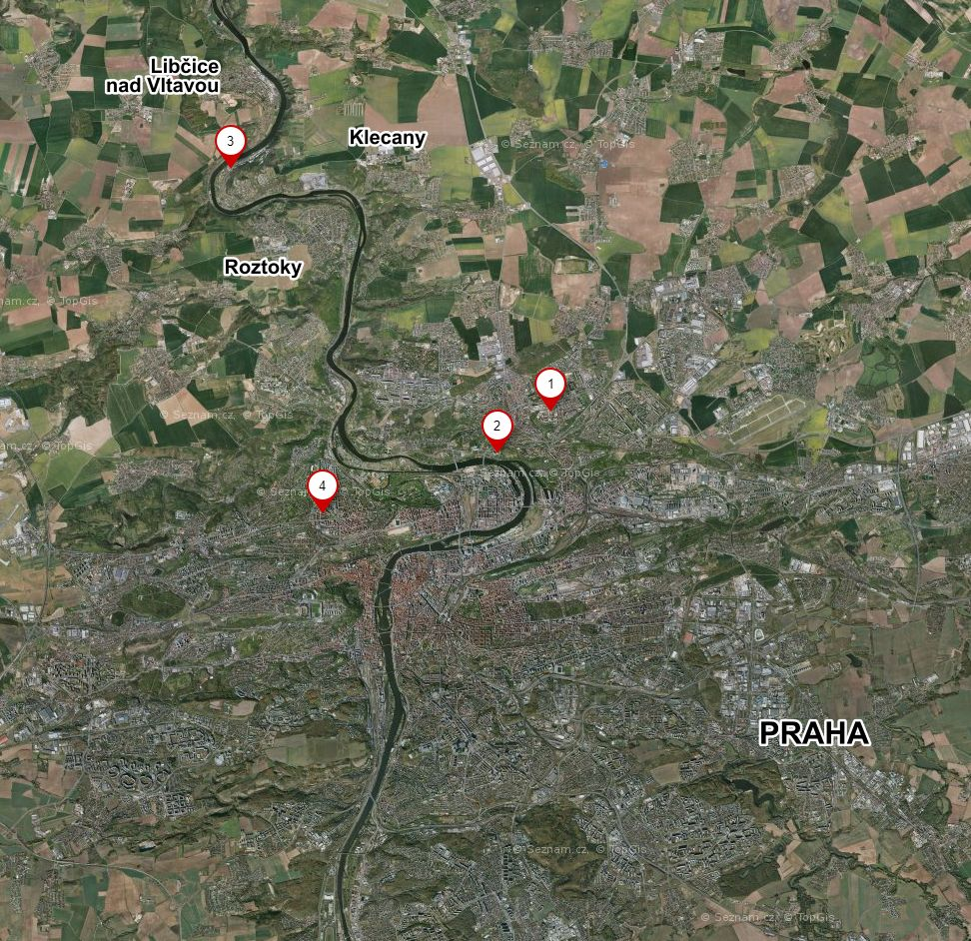
Czech republic Tier-2 center - geographical layout
Distributed resources
Several clusters under one HTCondor LRMS: 10000
jobslots (5000 physical cores)
  4 types of hardware, oldest from 2017 (Intel Xeon E5-2650 v4)
  1 cluster (from 2016) switched off in June 2023 (15 kHS06, 1440 jobslots) and moved to MFF UK
  Plus 1240 jobslots at MFF UK, 16 kHS06
NPI REZ
FZU
CESNET
MFF UK

Slide 4
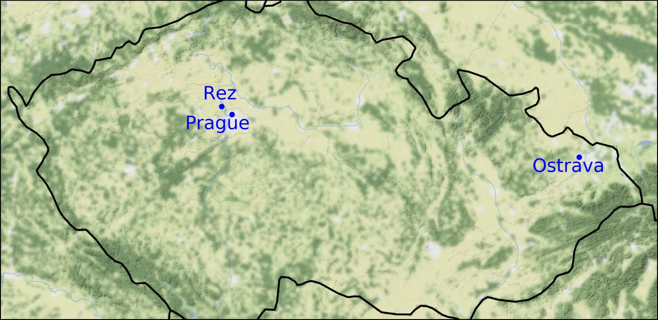
Extended geographical layout
Other participating institutions – in Prague
Charles University (UK), Faculty of Mathematics and Physics
Czech Technical University (CTU)
CESNET MetaCentrum
The Exascale HPC center IT4I in Ostrava. Currently hosting a cluster Karolina, acquired as a part of the EuroHPC Joint Undertaking. Installed in 2021. Used by praguelcg2 as an external resource for the ATLAS experiment.
IT4I is also involved in the LUMI consortium, thus providing access to the LUMI supercomputer (2022).

Slide 5
Current resources
- Dedicated server room 62 m² (2015)
- 1 batch system (HTCondor)
2 main WLCG VOs: ALICE, ATLAS
~ 10900 cores (~149kHS)
~ 10.3 PB in total on disk grid storage on site and at NPI (dCache, XRootD)
~ 1PB on NFS servers
OS: WN on Centos7, services mostly on AL9
planned: update of AliceBox
Monitoring: Grafana and icinga
Configuration management by Puppet
Provisioning and SW management by Foreman
ALICE XRootD storage at NPI – 3.33 PB of disk space
Dedicated optical connection between NPI and FZU: throughput 100 Gb/s.

Slide 6
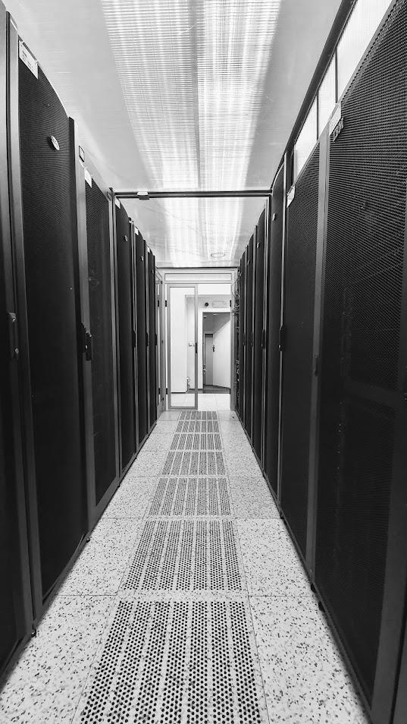
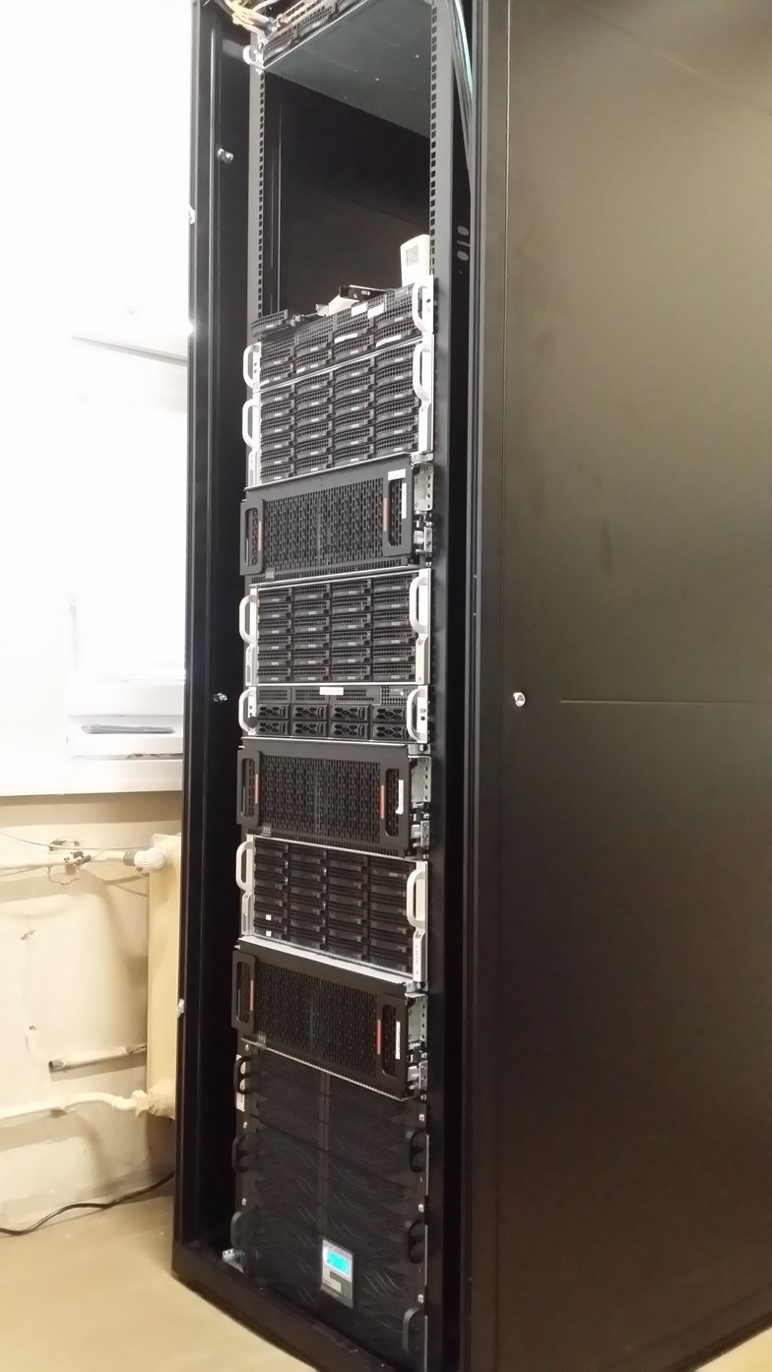

Slide 7
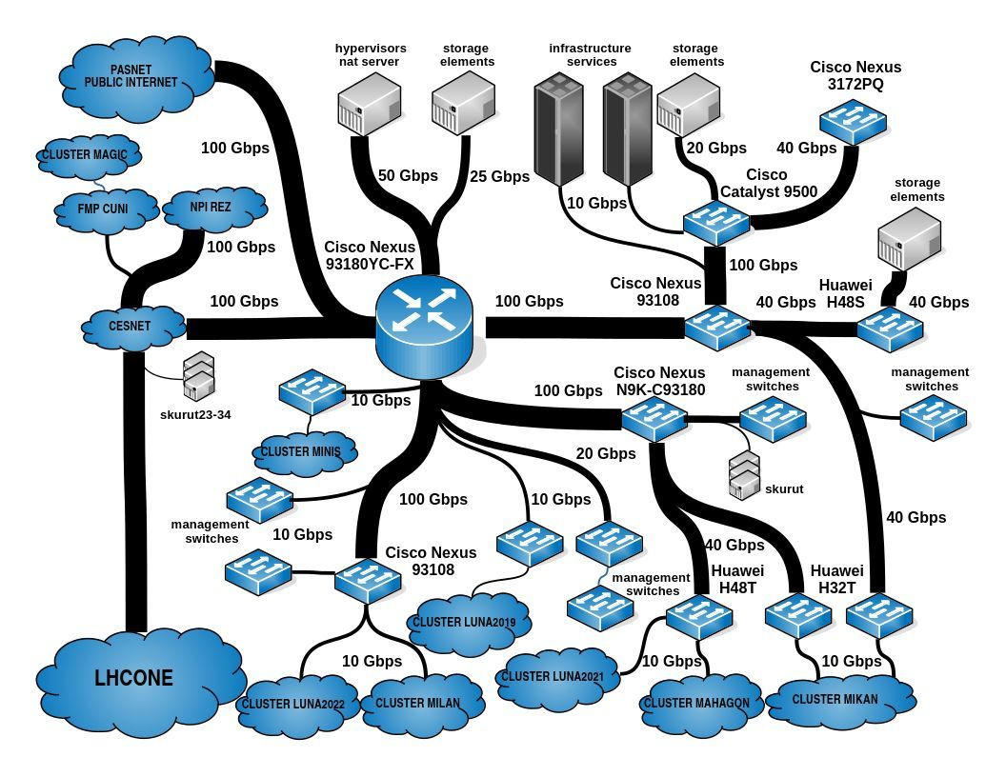

Slide 8
Recent upgrades, new hardware
Recent : 2022 - 2023
2022 NPI : new server rack cabinets installed + new UPS units with bigger capacity
2023 NPI : new air conditioning of the NPI server room
In 2023 applied for ASCR investment for disk server, capacity ~ 1.32 PB. The approval process took 1 year, currently the purchase finished, installation and tests ongoing.
November 2023 : increase of capacity of the link NPI – FZU to 100 Gb/s.
Current perspectives for 2023 - 2026
Min. of Education investments project OPJAK (2023-2026)
In it for ALICE: Disk storage: 0.9 PB & CPU: 12.5 kHS23
Additional support needed for sufficient disk storage capacity by 2026
CPU remains to be largely dependent on opportunistic resources

Slide 9
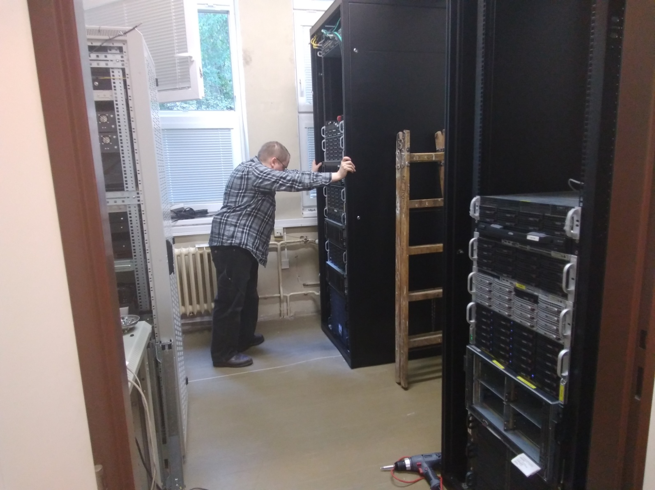
New server rack cabinets at NPI

Slide 10
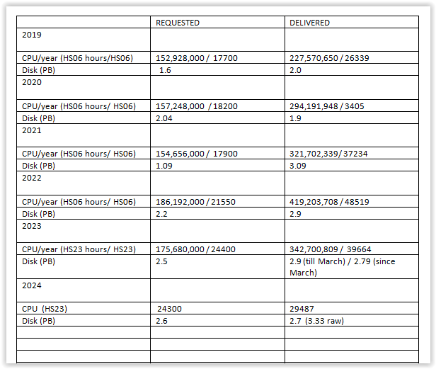
Delivery of Czech computing resources during 2019 - 2024
All pledges fulfilled, only 1 exception

Slide 11
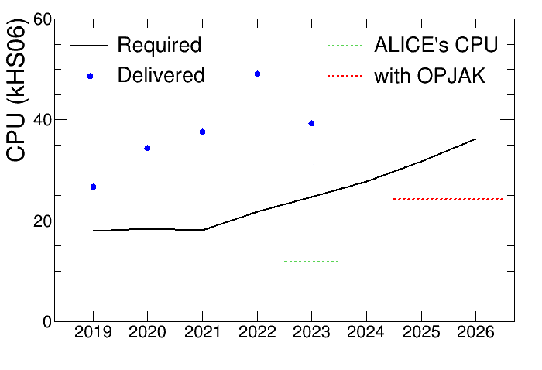
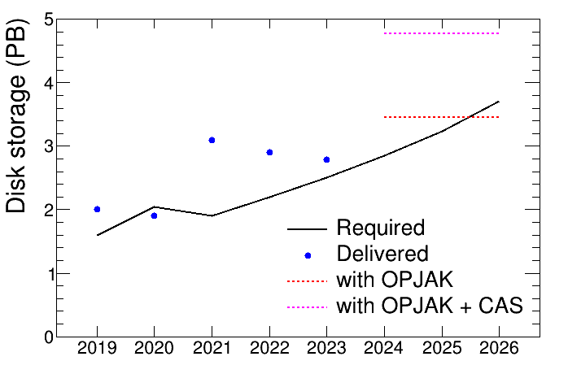
Pledged vs delivered: 2019 - 2026
Based on earlier estimates of pledges for 2025 and 2026

Slide 12
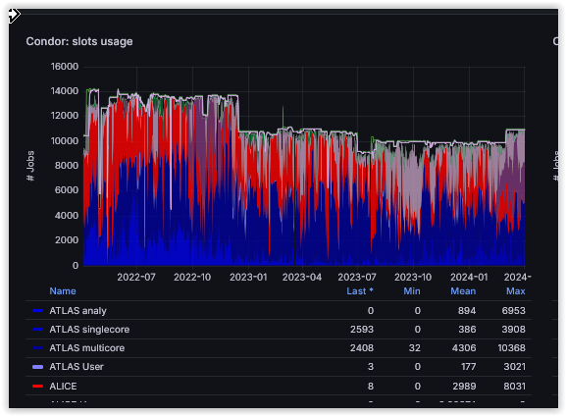
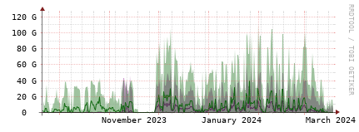
Running jobs profile during last 2 years, by the local monitoring at the central site in Prague. Main CPU consumers are ALICE and ATLAS.
ALICE
ATLAS
ATLAS
multicore
Network traffic between the main site of praguelcg2 and NPI storage cluster during last 6 months. In November, the link was elevated to
100 Gb/s.

Slide 13
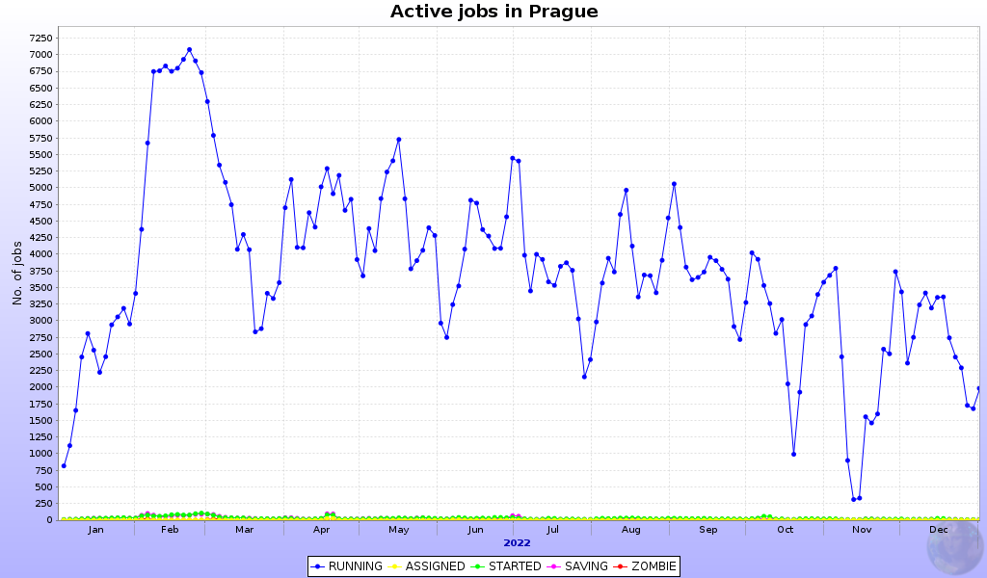
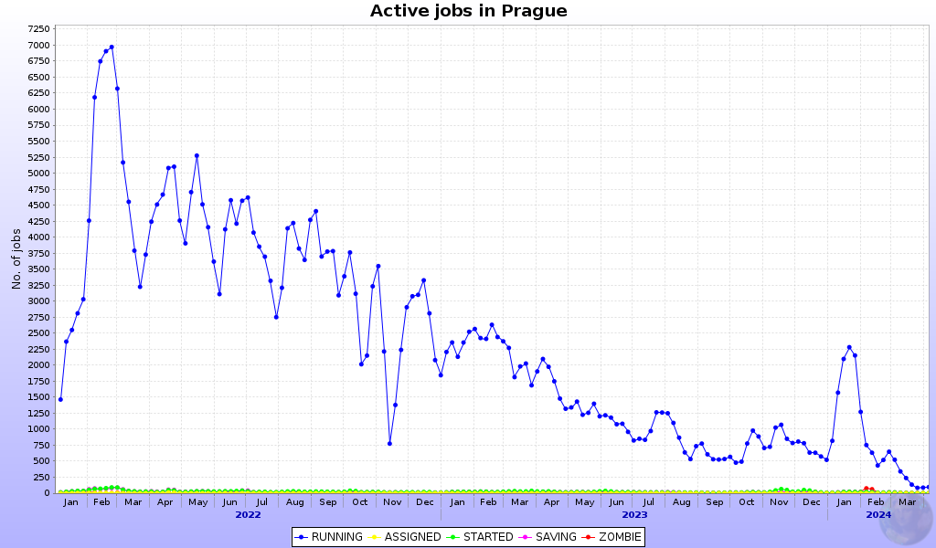
Running jobs profile in MonaLisa in 2022.
Avg. 3756, Max. 8913
Running jobs profile in MonaLisa,
01/2022-03/2024.
Avg. 2325, Max. 8913
For 01/2023-03/2024
Avg.1215, Max. 7670

Slide 14
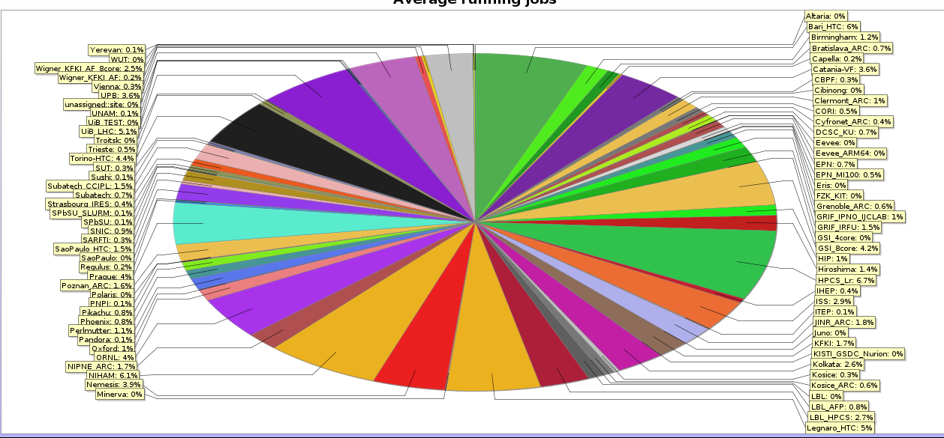
CPU delivery - ALICE Tier-2 share: 01/2023 – 03/2024
praguelcg2: 4%
Czech republic share in 01/2023 – 03/2024 was 4% (In 2022 it was 7%)

Slide 15
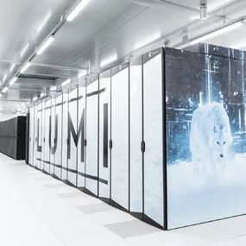
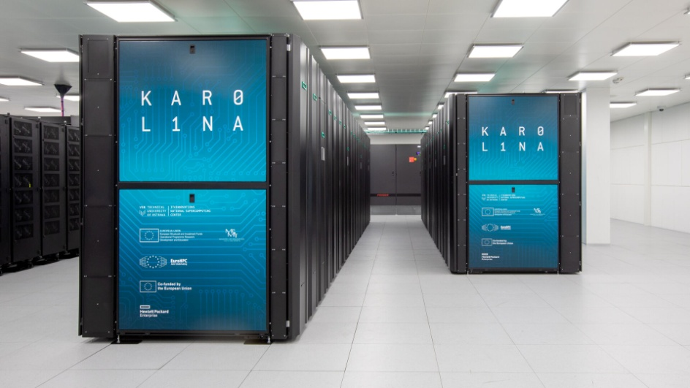
More CPUs for praguelcg2 – IT4I
National Supercomputing Center
IT4Innovation in Ostrava
  200 000 node hours in the project OPEN-27-57 (end 2023).
    153 % used (100 % with a full priority, 50 % reduced, the rest in preemption queue)
  new project since September 2023: OPEN-29-6
    multiyear
    2x (150 000 + 50 000) node hours (Karolina + Barbora, 2023 + 2024)
    test access to LUMI
LUMI: Supercomputer in Finland (2022). Joint venture EuroHPC and the LUMI consortium. Access of the Czech republic thanks to the involvement of the IT4I in the LUMI consortium.

Slide 16
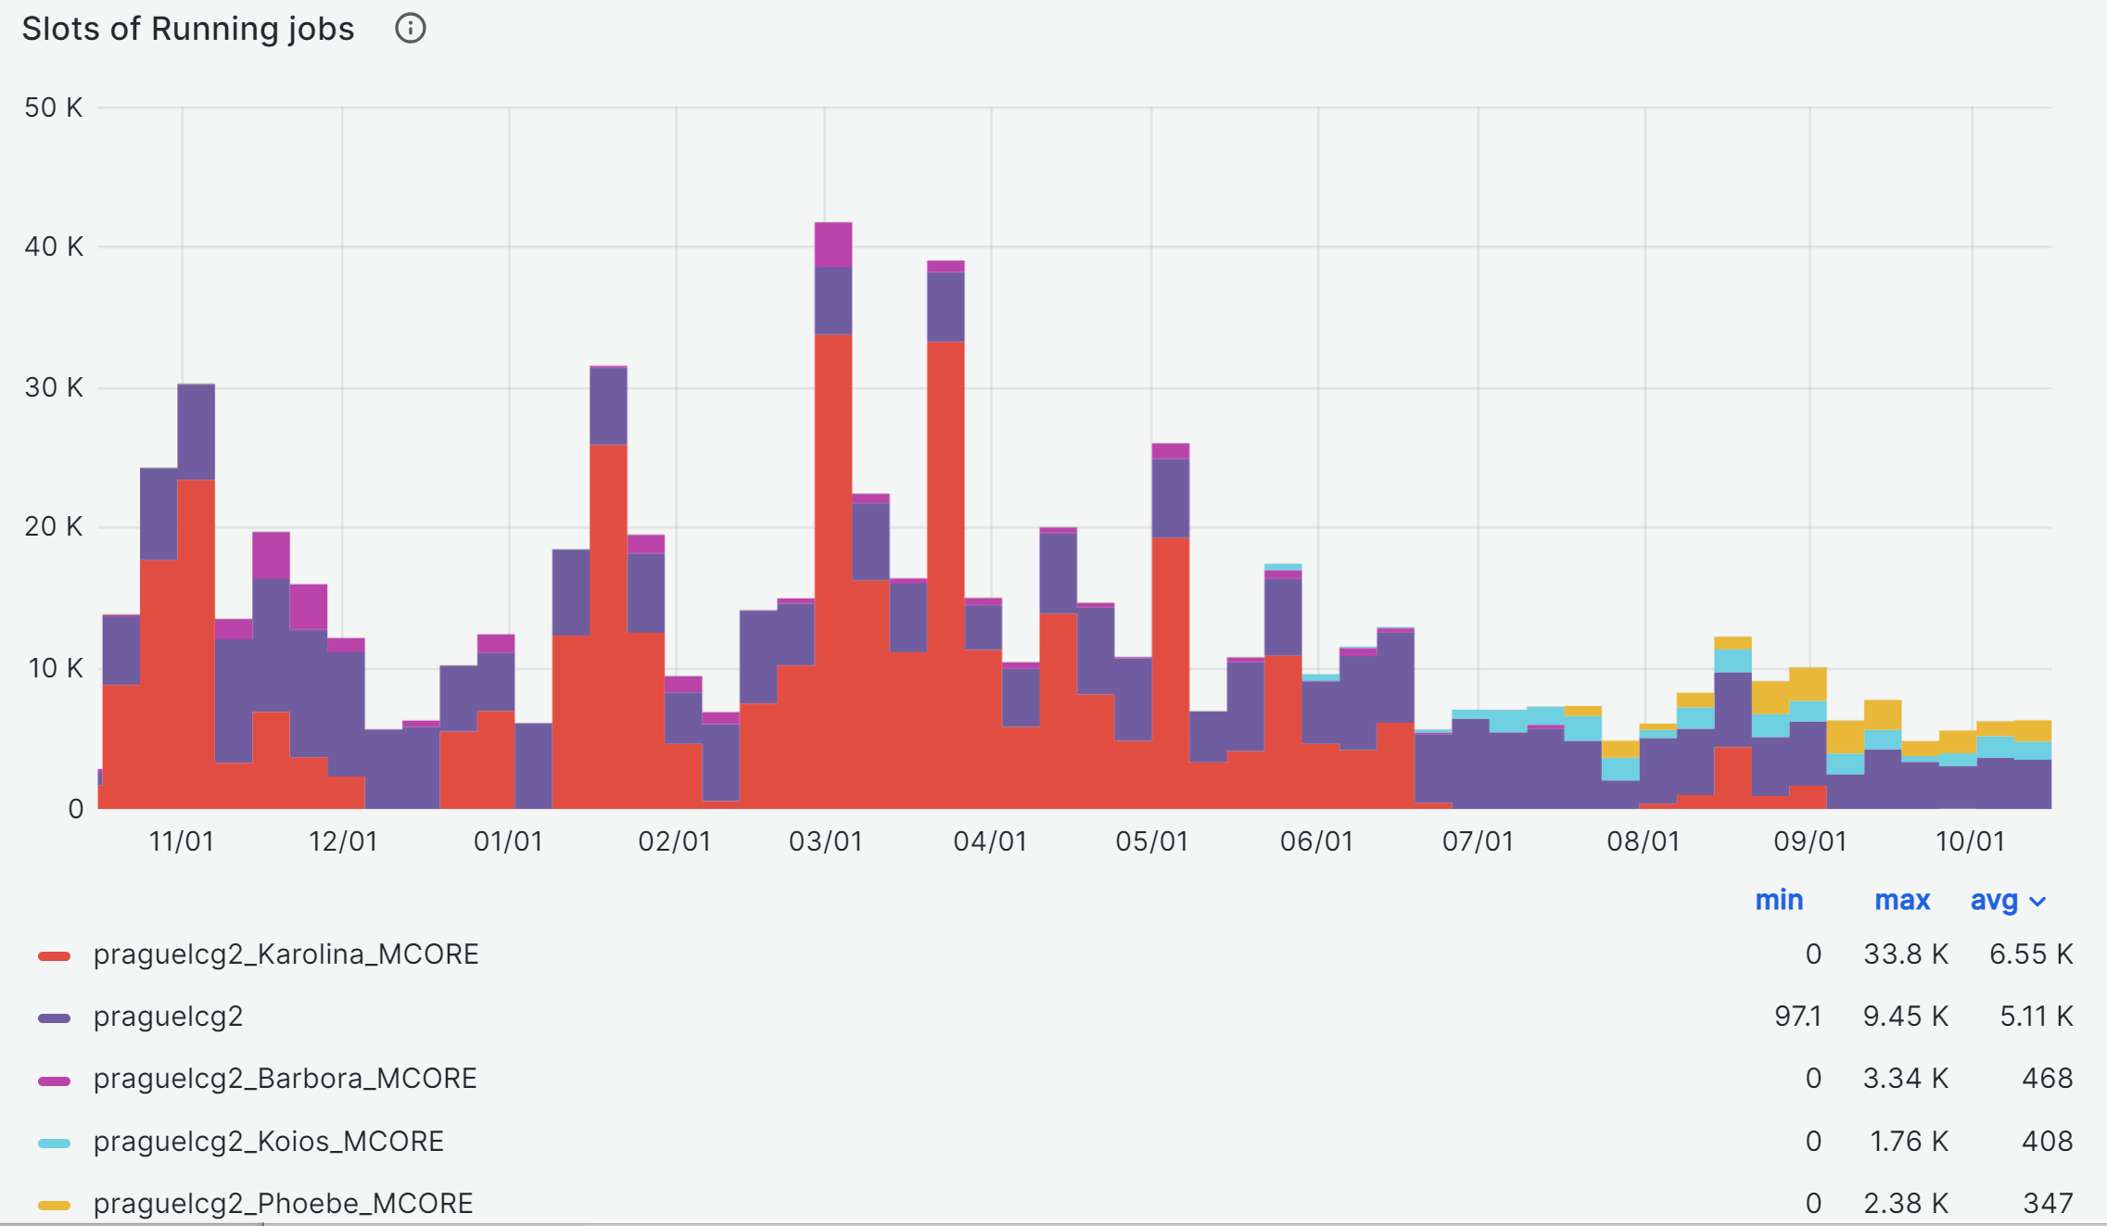
IT4I: ATLAS running jobs slots. 11/2022 – 10/2023

Slide 17
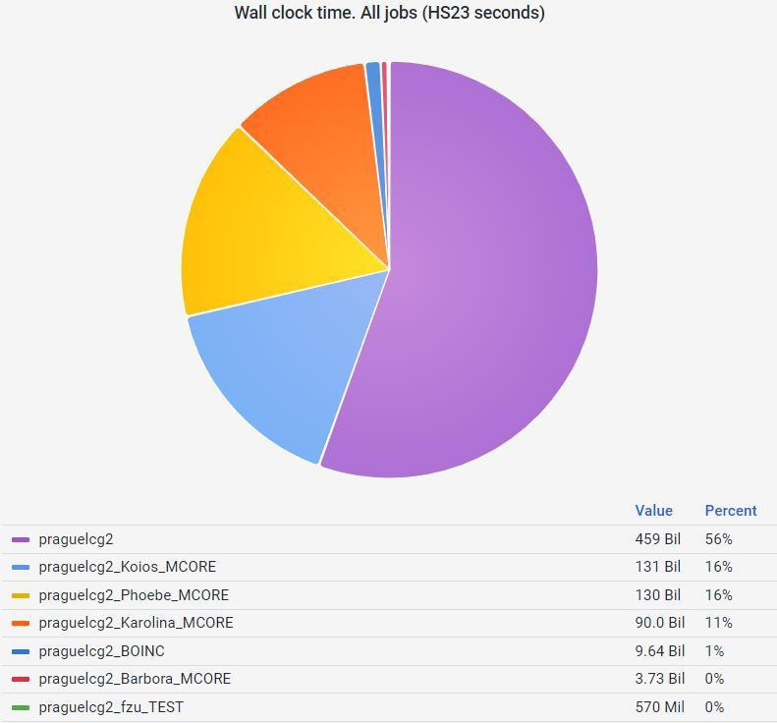
ATLAS jobs wall time distribution. 11/2022 – 10/2023
ATLAS: almost 50% of computing resources delivered from external resource.
Good for ALICE: more opportunistic resources at the main site.

Slide 18
Summary
Decommissioned older CPU servers compensated by non-dedicated resources
New project for WLCG dedicated hardware accepted (2023-2026).
Czech Tier-2 center is successfully delivering CPU and storage resources to the Grid and local users with minimal outage.
Receiving only 8-core jobs for ALICE limits unfortunately the extensity of appropriate opportunistic resources.
We are prepared to make sure we deliver resources for ALICE as requested in the coming years.

Slide 19
BACKUP

Slide 20
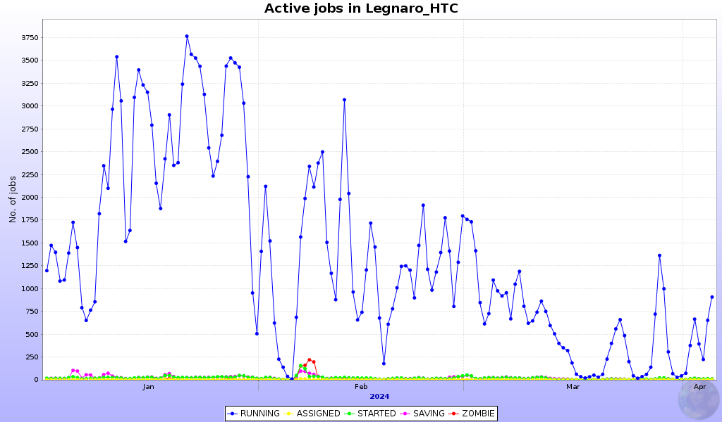
Running jobs Legnaro_HTC 01.2024 – 03.2024

Slide 21
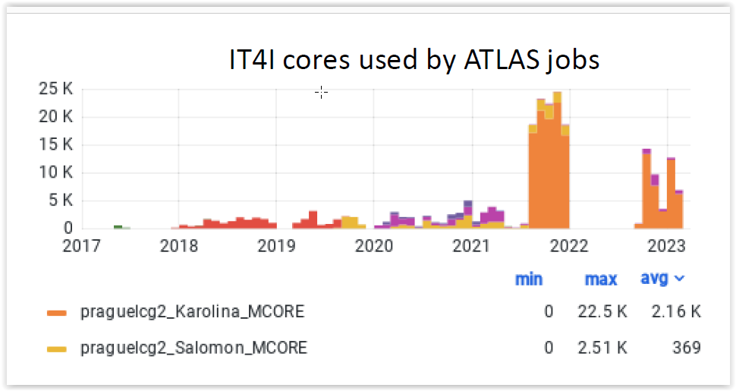
Use of the resources of IT4I, current status, by ATLAS
2023: Standard project with highest allocation this year
25.6M corehours
- allocation almost used up already within 2 months
- equivalent to 66000 FZU cores used for 2 months

