Slide 1
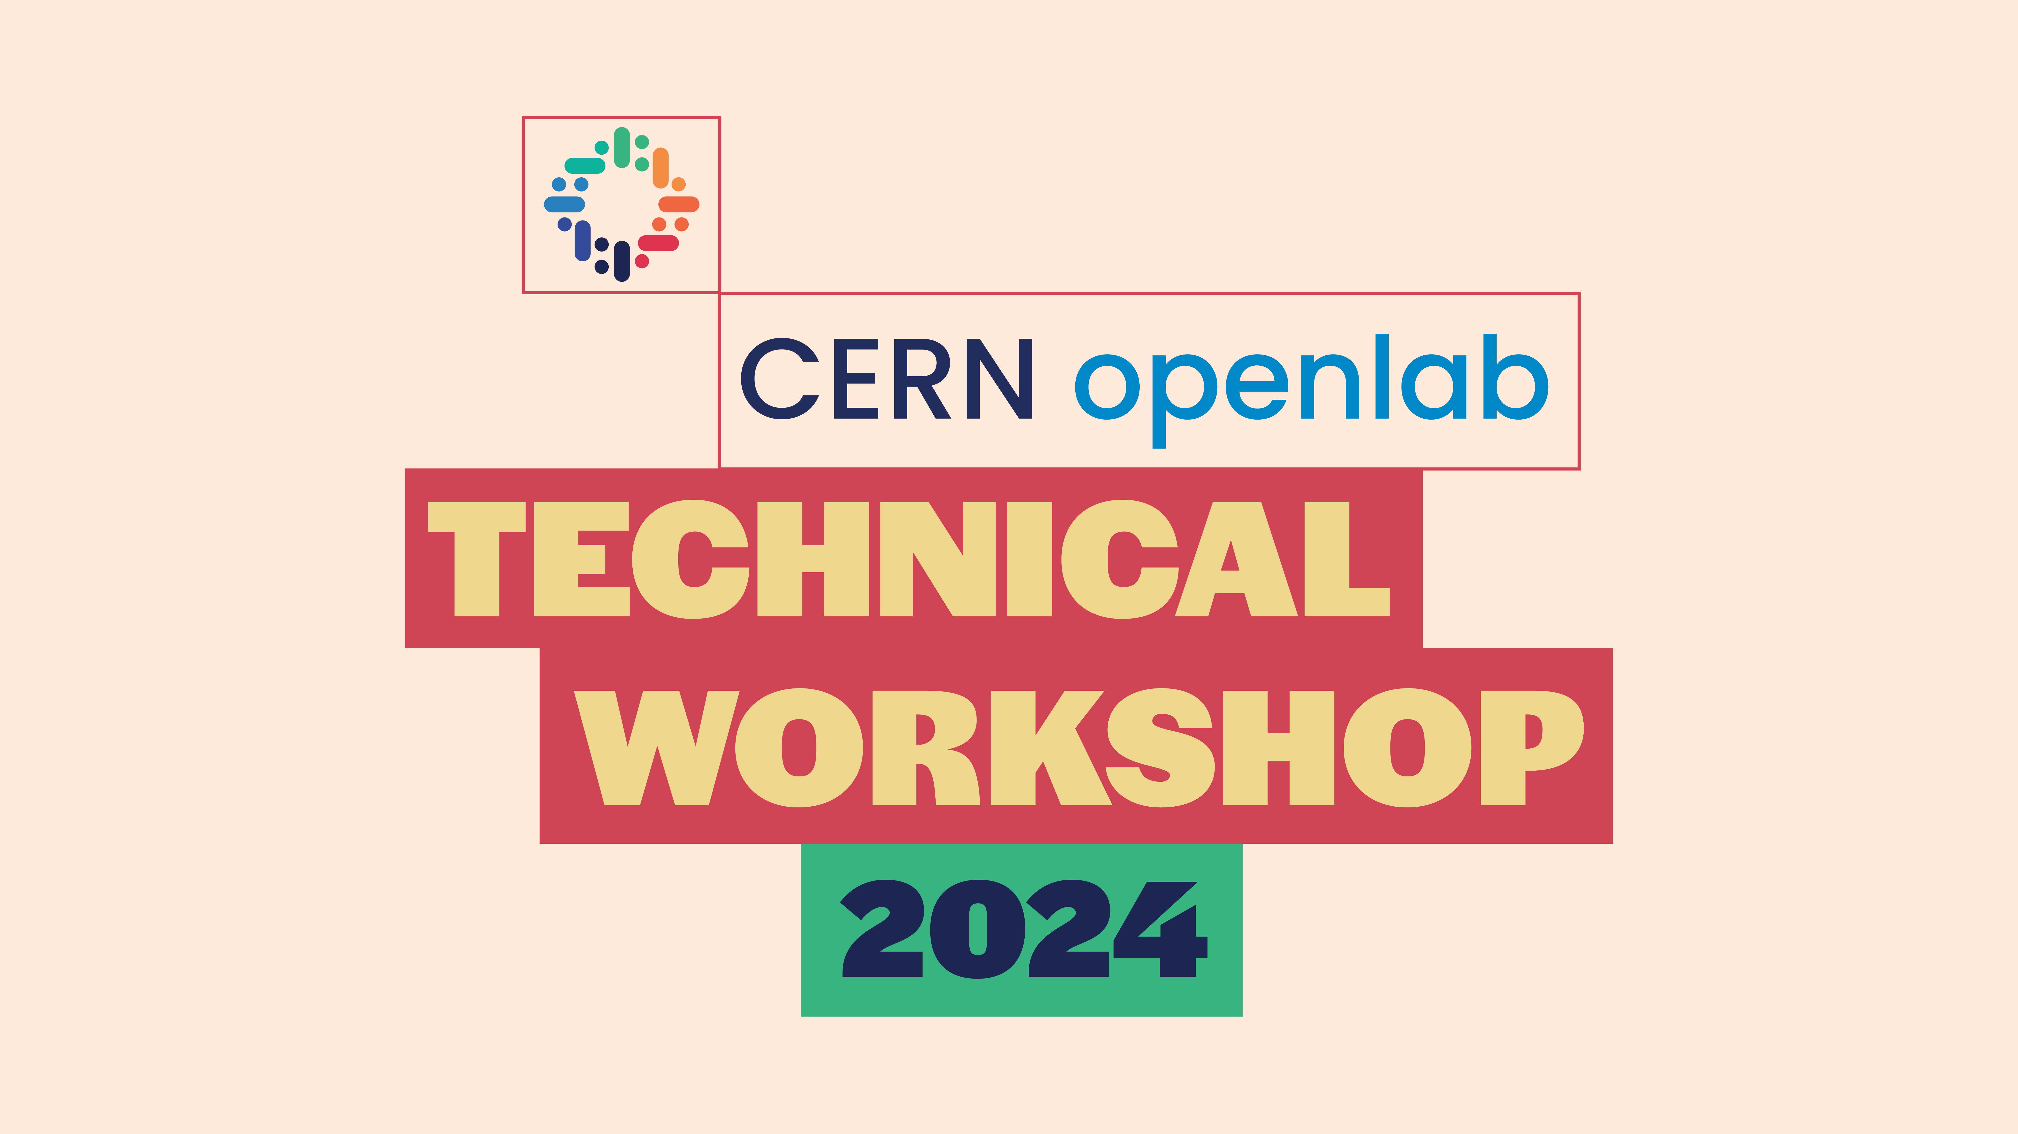

Slide 2
WELCOME!!

Slide 3

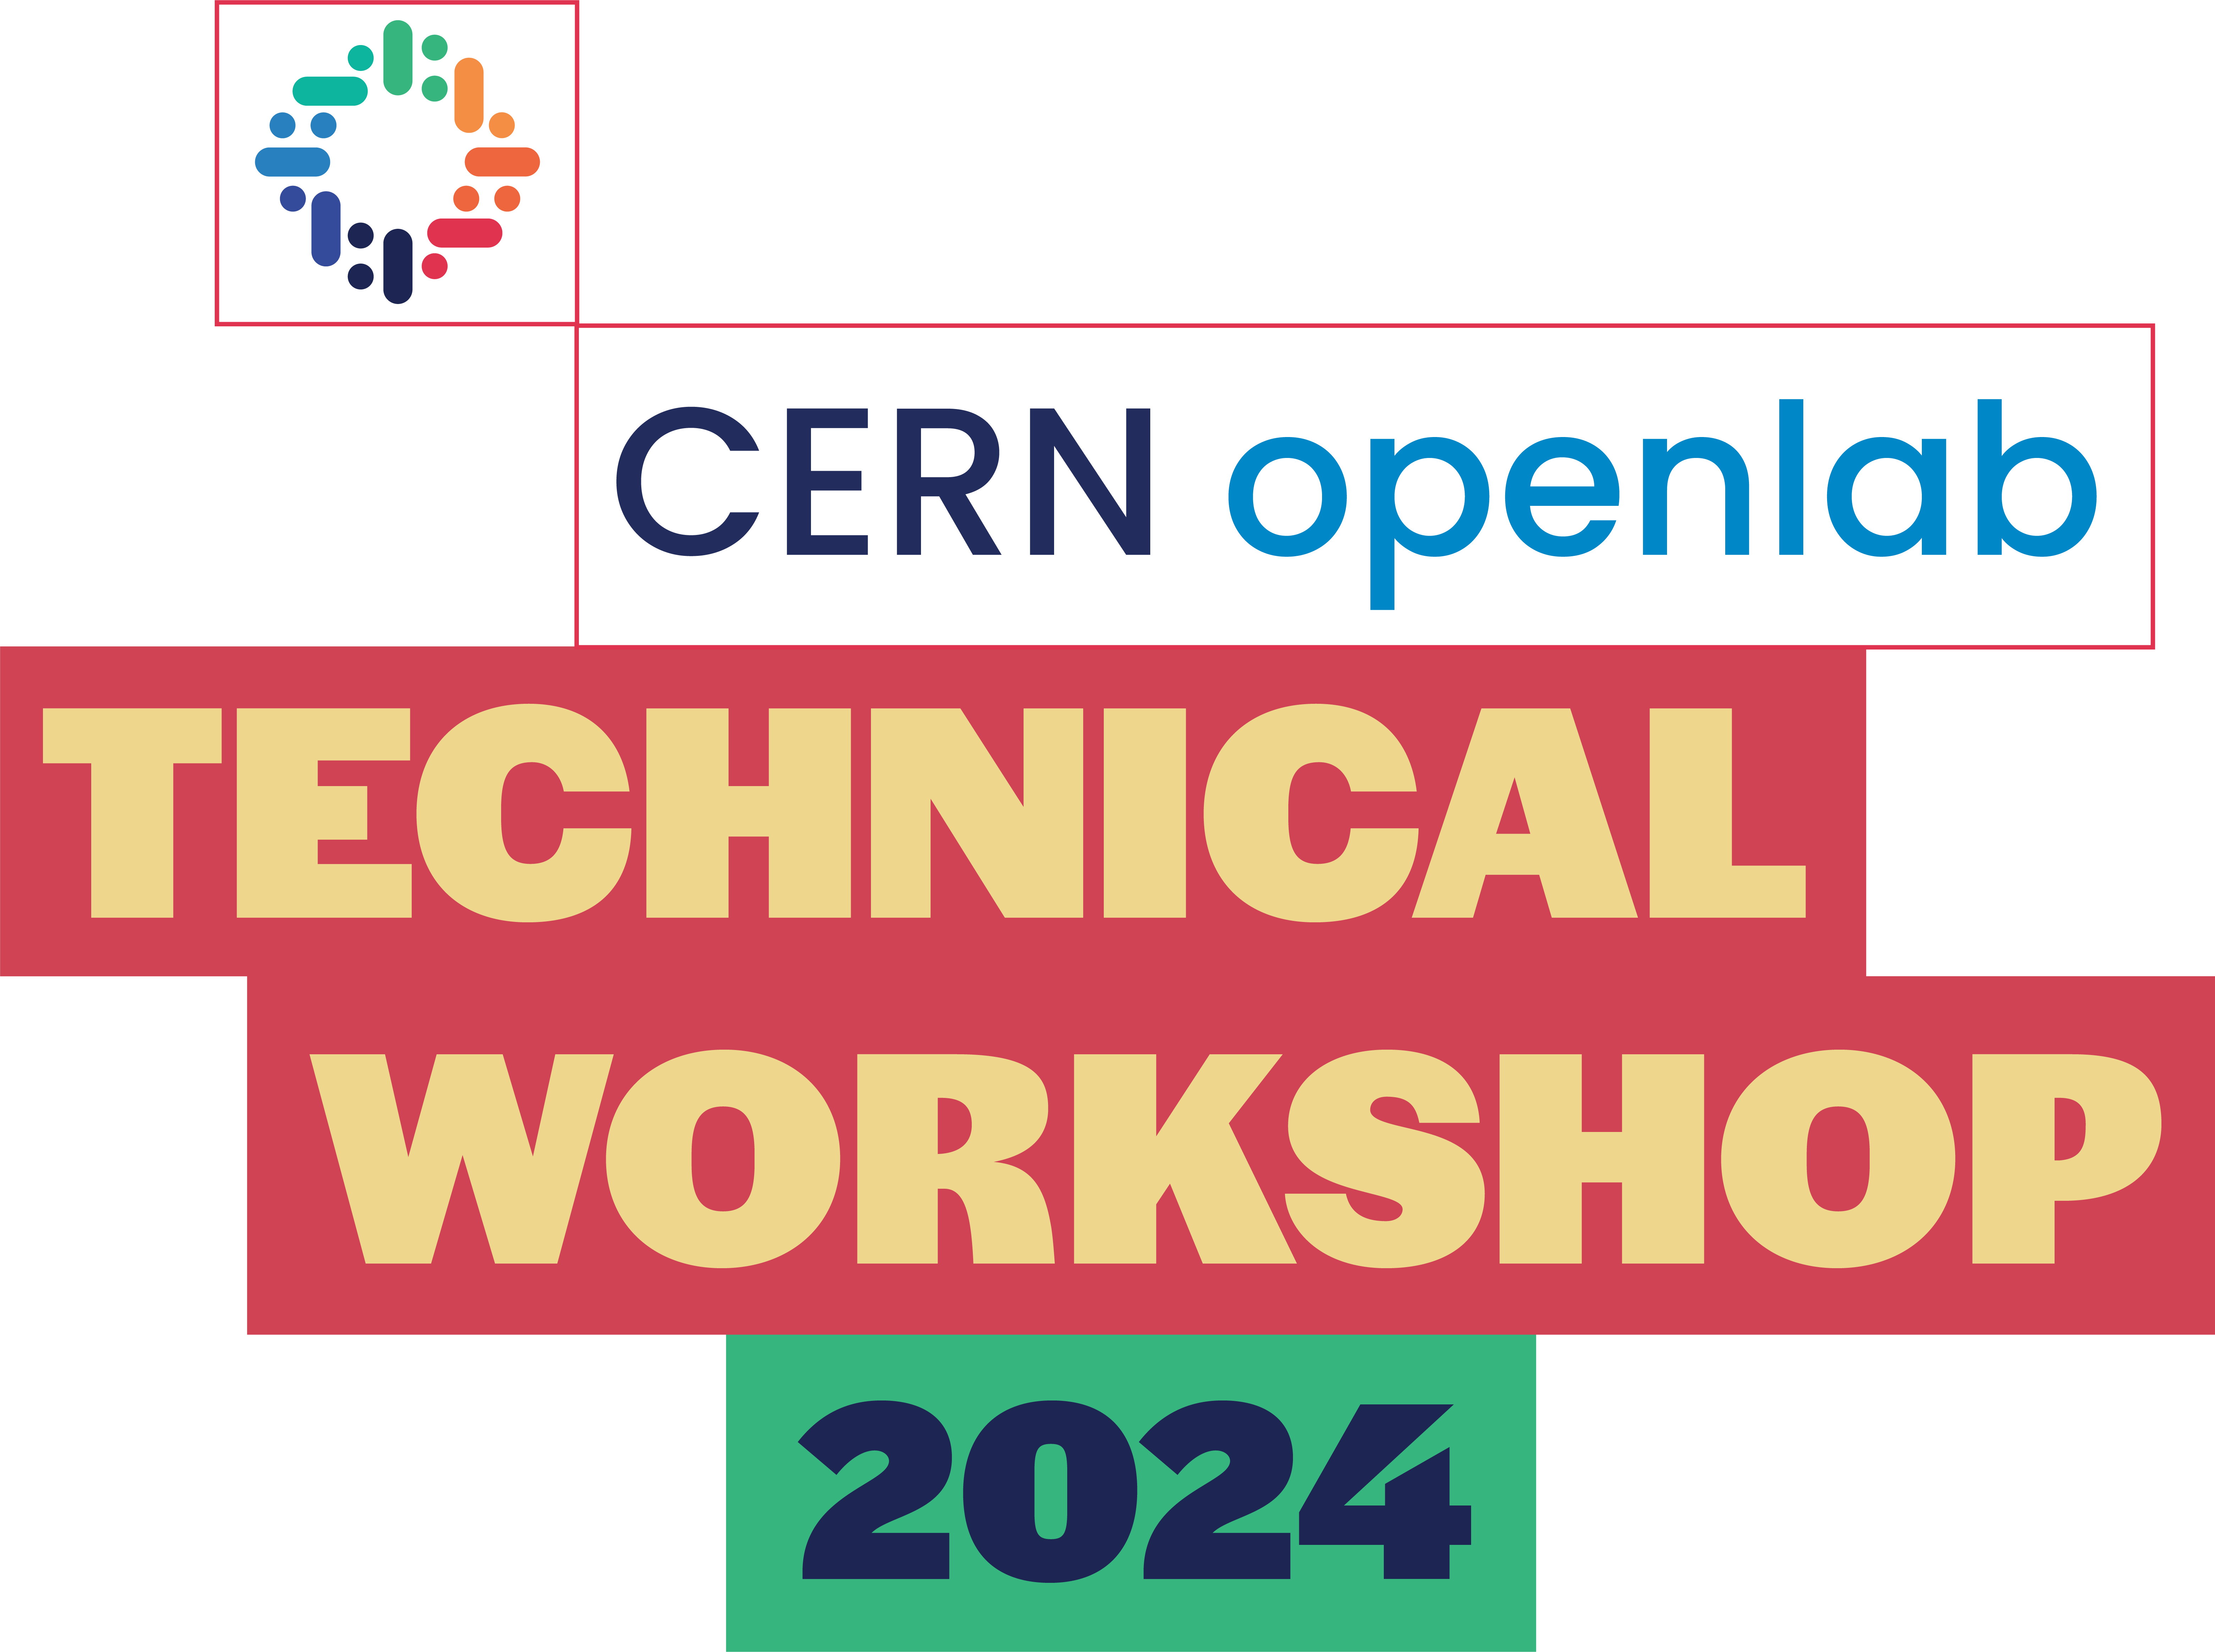
Reception (09h00-10h10)
09h00 |  Welcome Session
Speakers: Maria Girone (Head of CERN openlab) and Bob Jones (Leader of CERN IT Strategy and Executive Governance)
09h10 | Future CERN accelerator programme and its technological challenges
Speaker: Mike Lamont (CERN’s Director for Accelerators and Technology)
09h40 | CERN openlab Phase VIII
Speaker: Maria Girone (Head of CERN openlab)
09h55 | Innovation at CERN IT department
Speaker: Alberto Di Meglio (Leader of CERN IT Innovation)
10h10 – 10h40 | Coffee Break and Poster Session

Slide 4
Heterogeneous Computing Platforms and Infrastructures (10h40 – 12h20)
10h40 | Real-time data processing for level 1 trigger using CXL memory-Lake architecture
Speaker: Giovanna Lazzari Miotto
10h55 | Solving HPC challenges with Micron CXL attached memory products
Speaker: Andrey Kudryavtsev, Micron
11h15 | Accelerating the HEP software
Speaker: Attila Krasznahorkay
11h30 | Diving into NVIDIA Grace Hopper and NVIDIA Grace CPU Superchips: capabilities and performance
Speaker: Filippo Spiga, NVIDIA
11h50 | Heterogeneous Architectures Testbed @ CERN and E4 project
Speaker: Joaquim Santos
12h20 – 13h30 | Lunch and Poster Session

Slide 5
Heterogeneous Computing Platforms and Infrastructures (13h30 – 14h50)
13h30 | Benchmarking Heterogeneous Architectures with HEPScore
Speaker: David Southwick
13h45 | The New Prévessin Data Centre at CERN
Speaker: Luca Atzori
14h00 | IT carbon-aware computing programme
Speaker: João Fernandes
14h25 | GROUP PHOTO
14h35 – 15h05 | Coffee Break and Poster Session
15h05 | Intel AMX: Xeon built-in acceleration for AI
Speaker: Walter Riviera, Intel

Slide 6
AI applications and HPC Convergence (15h20 – 17h20)
15h20 | Overview of AI activities at CERN
Speaker: Lorenzo Moneta
15h35 | AI in low-latency environments
Speaker: Thomas Owen James
15h50 | Generative Models for Simulation
Speaker: Kristina Jaruskova
16h05 | AI model registry in the Cloud
Speaker: Renato da Costa Cardoso
16h20 | Distributed Training and HPO at Centre of Excellence on AI and Simulation-Based Engineering at Exascale (CoE RAISE)
Speaker: Eric Wulff
16h35 | interTwin - an Interdisciplinary Digital Twin Engine for Science
Speaker: Matteo Bunino
16h50 | LHC Digital Twin
Speaker: Jurgen De Jonghe
17h05 | Data Analytics for Industrial Control Systems Speaker: Abhit Patil
17h20 – 19h00 | Science Gateway Visit and Networking Cocktail
Notes:
Private visit!!!!

Slide 7

Applications for Society and Environment (09h00 – 10h15)
09h00 | The programme of CERN KT for society and environment
Speaker: Giovanni Anelli
09h15 | BioDynamo
Speaker: Tobias Duswald
09h30 | EMP2 - Environmental Modelling and Prediction Platform using Foundation Models
Speaker: Ilaria Luise
09h45 | Intertwin use cases - Virgo and CMCC
Speaker: Alexander Zoechbauer
10h00 | Reinforcement learning for causal discovery and data quality monitoring
Speaker: Olivia Jullian Parra
10h15 - 10h45 | Coffee Break and Poster Session

Slide 8
Cloud and Storage (10h45 – 12h40)
10h45 | On data storage technologies - past, present, future
Speaker: Luca Mascetti
11h00 | Oracle: Bringing developers, DBAs, and Gen AI together
Speaker: Cristobal Pedregal-Martin, John Lathouwers, Oracle
11h20 | Integration of Oracle Cloud Resources into CERN IT BC&DR
Speakers: Miroslav Potocky and Alexandros Stoumpis
11h35 | AI and Kubernetes @ CERN – Challenges
Speakers: Antonio Nappi and Ricardo Rocha
11h50 | Kubediff - Facilitate and automatize Kubernetes operations
Speakers: Adrian Karasinski
12h05 | Next Generation Archiver for WinCC OA
Speaker: Pedro Agostinho
12h20 | Siemens - Connectivity and Edge
Speaker: Christian Kern, Siemens
Quantum Computing (12h40 – 13h10)
12h40 | Quantum Databases for Dynamic Data Storage (Intel)
Speaker: Carla Sophie Rieger
12h55 | Noisy Gates for Simulating Quantum Computers
Speaker: Michele Grossi

Slide 9
LET’S GET STARTED!!!

