Slide 1

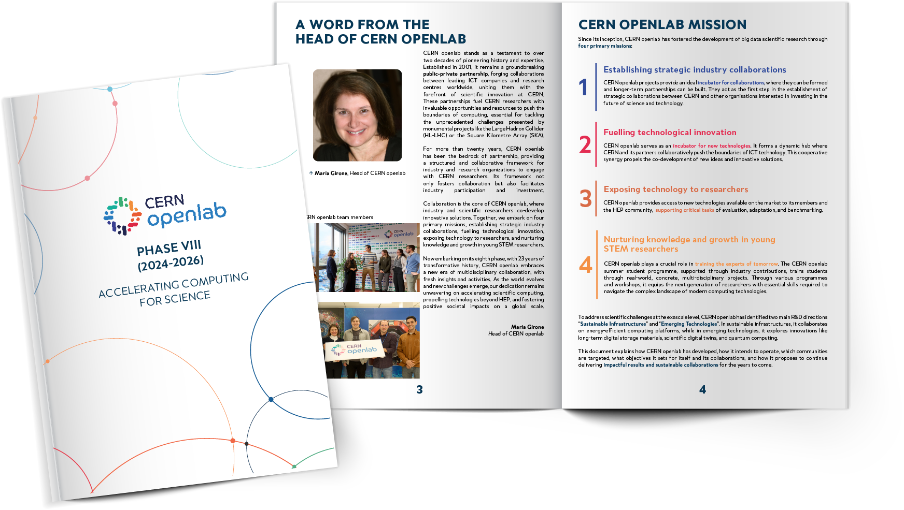
PHASE VIII
ACCELERATING COMPUTING FOR SCIENCE
Notes:
Public-private partnership, forging collaborations between leading ICT companies and research centres worldwide, uniting them with the forefront of scientific innovation at CERN.
These partnerships fuel CERN researchers with invaluable opportunities and resources to push the boundaries of computing, essential for tackling the unprecedented challenges presented by monumental projects like the Large Hadron Collider (HL-LHC) or the Square Kilometre Array (SKA).

Slide 2
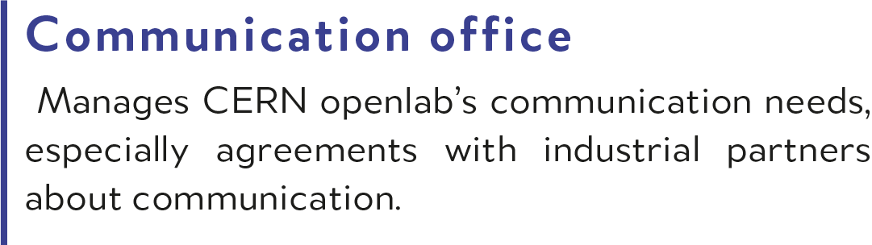
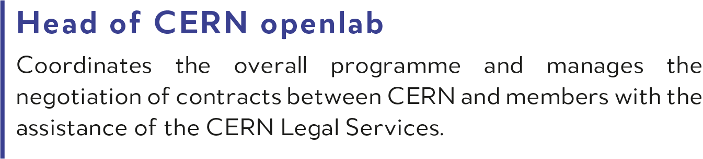
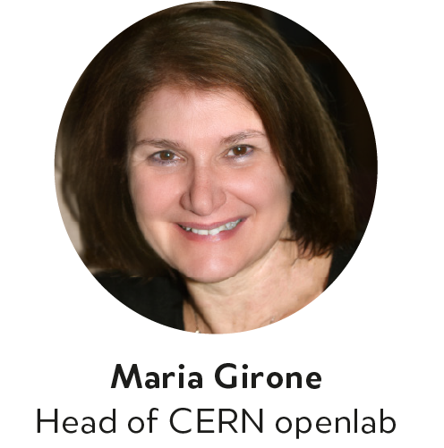
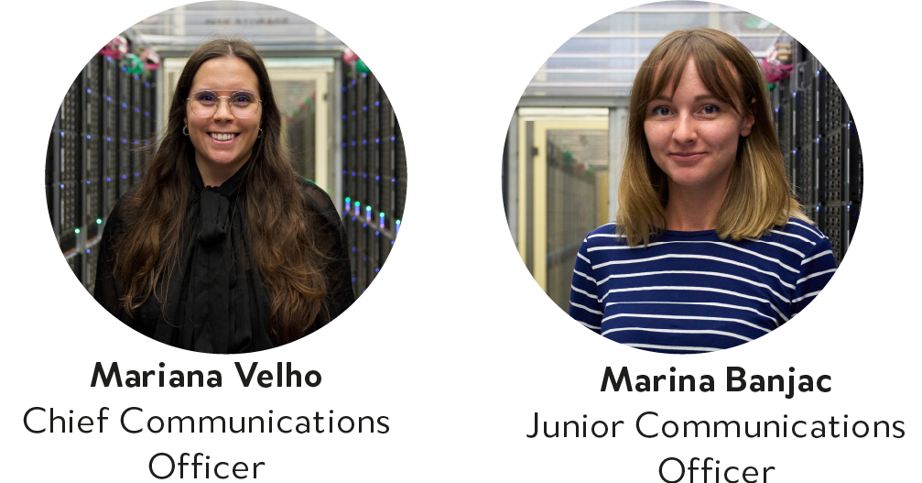
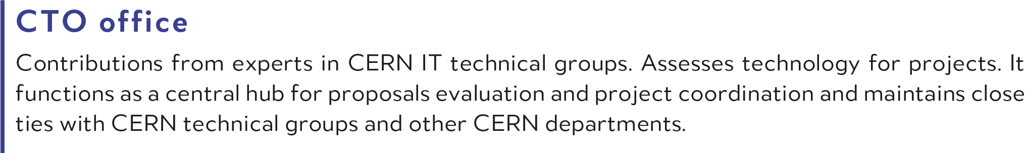
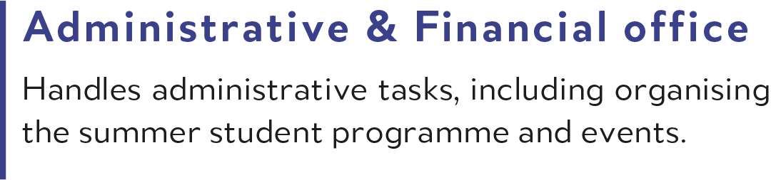
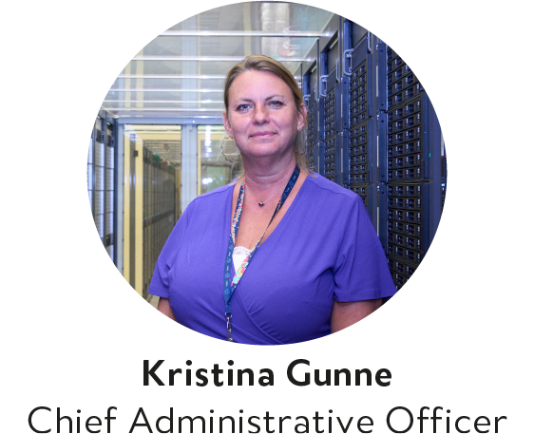

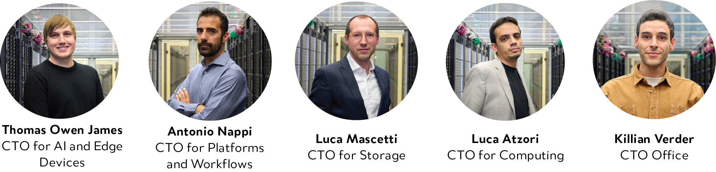
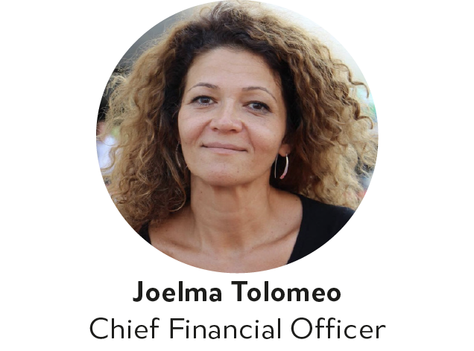
THE TEAM

Slide 3
CERN OPENLAB
Since its inception, CERN openlab has fostered the development of big data scientific research through four primary missions.
Four primary missions:
1
2
3
4
Establishing strategic industry collaborations
Fuelling technological innovation
Exposing technology to scientists
Nurturing knowledge and growth in young STEM researchers

Slide 4
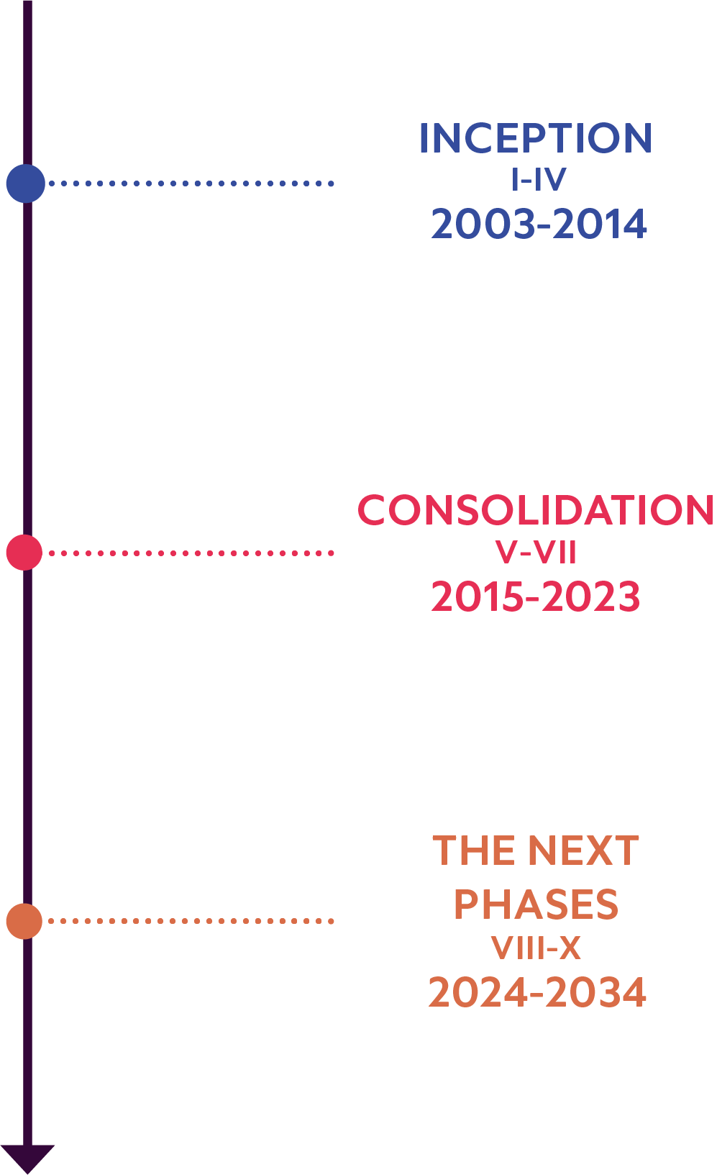
COLLABORATION MODEL
LHC START
Large industrial partners
x86 64-bit processors, multi-core devices,
high-performance networking, peta-byte storage, highly-available databases
CERN openlab operates within structured three-year phase cycles designed to systematically assess technological evolution, anticipate future needs, and delineate overarching thematic priorities.
LHC STEADY OPERATIONS
Broader portfolio of companies, dynamic market
Multi-core devices, accelerated hardware, specialized architectures, fast disk storage, cloud infrastructures
PREPARING FOR HL-LHC
Focussed and agile projects, strategic partnership incubator
Sustainable infrastructures, heterogeneous architectures, energy-efficient computing, advanced storage, AI applications and algorithms, emerging technologies

Slide 5
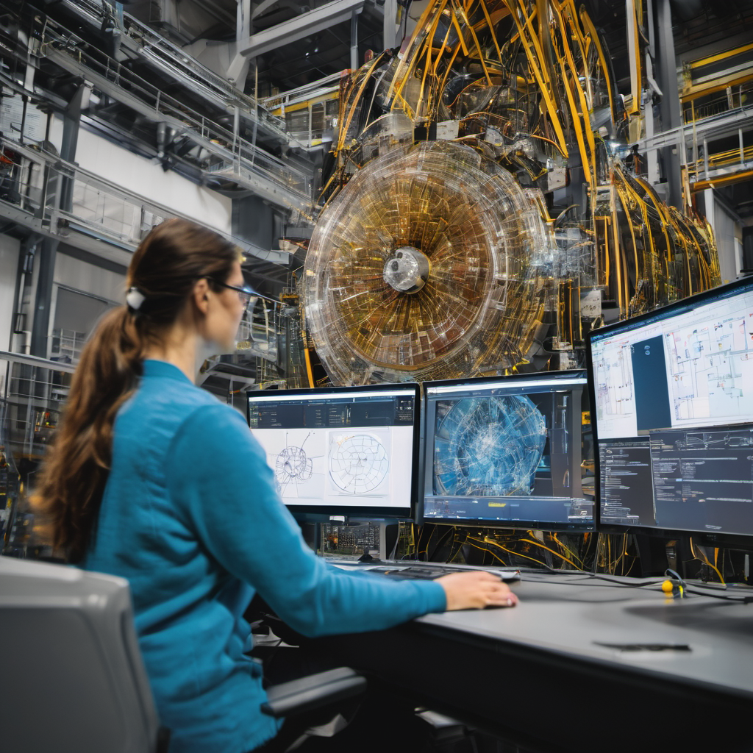
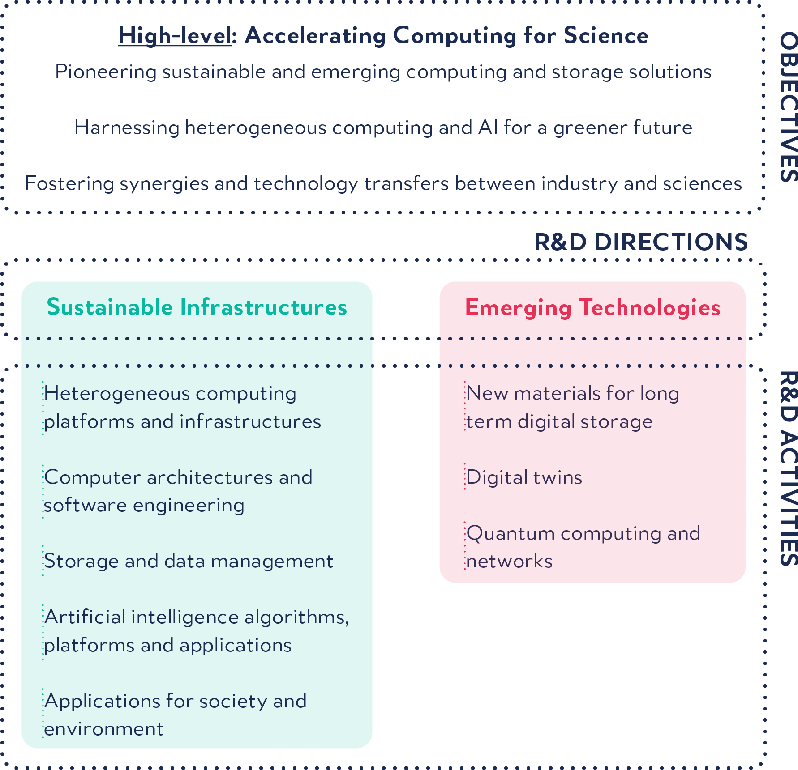

CERN OPENLAB PHASE VIII
Objectives, R&D Directions and Activities
To address scientific challenges at the exascale level, CERN openlab has identified two main R&D directions “Sustainable Infrastructures” and “Emerging Technologies”.
Notes:
Investigating
Exploiting

Slide 6
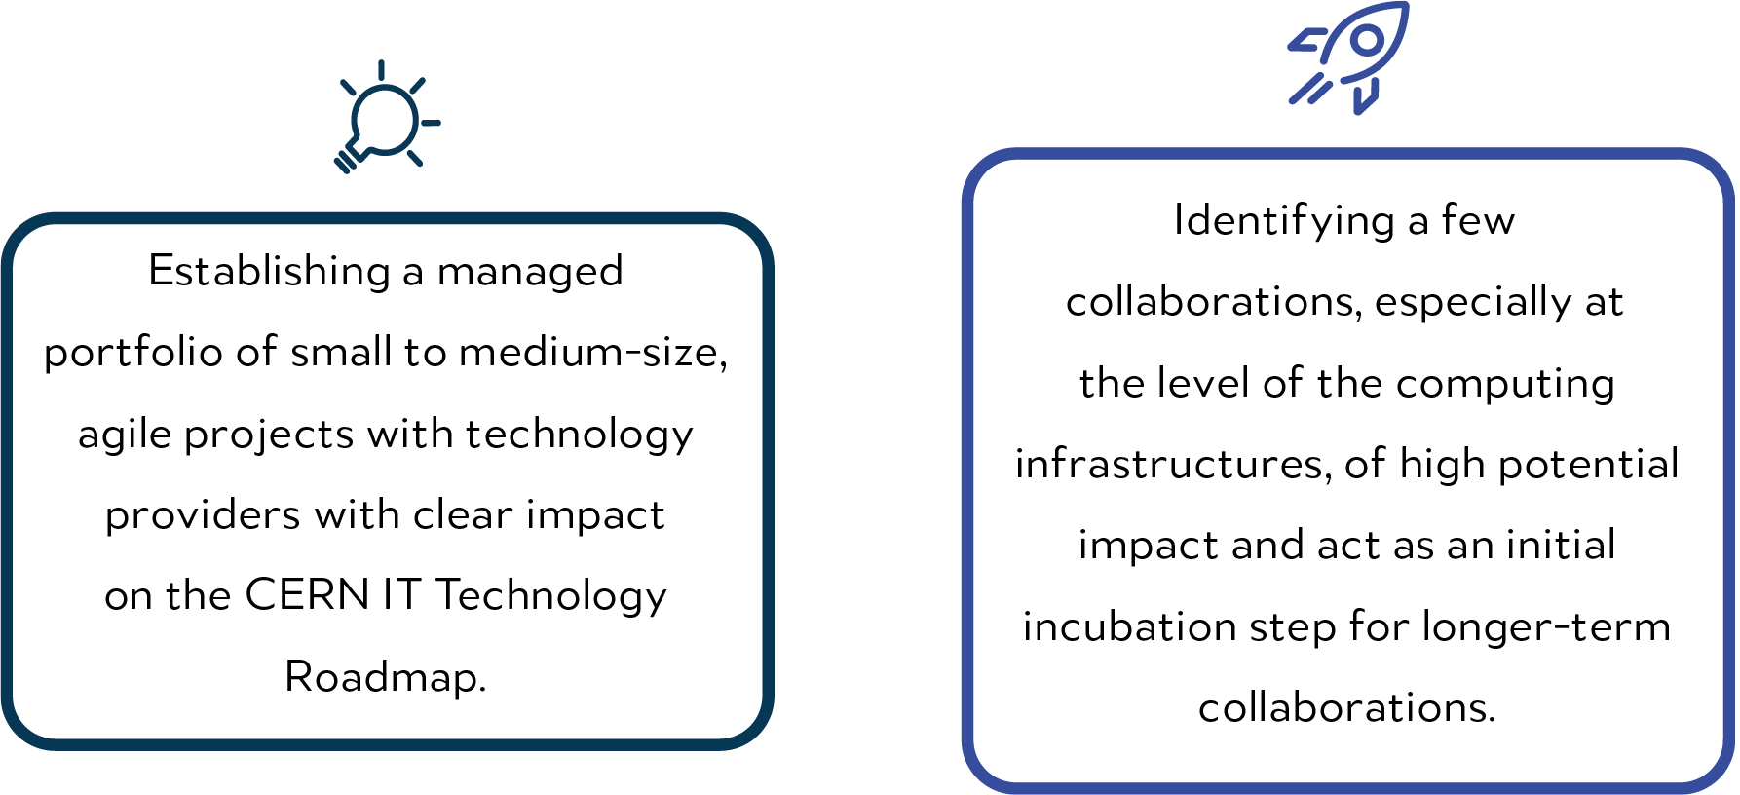
IMPLEMENTATION MODEL
Foster strategic industry-science partnerships
The CERN openlab implementation model relies on two main approaches:
Maximise technical impact
Harness the potential of innovative technologies
Amplify CERN openlab core strengths

Slide 7
R&D ACTIVITIES PLAN
Focussed, agile projects Strategic partnership incubator
Heterogeneous architectures testbed (x86, Arm, GPUs, FPGAs, AI accelerators)
Analysis facilities on the cloud
Digital Twins of accelerators and detectors
New materials for long-term storage
Hybrid HPC and QCS integration
AI workflow optimization on HPC
Foundation models
Generative AI
AI applications in low latency environments
Low-latency interconnects
Real–time data processing on CXL architectures
Data compression acceleration
Advanced storage solutions
AI on edge devices and SoCs

Slide 8
STAKEHOLDERS
CERN openlab’s primary role is to act as conduit and facilitator for collaboration in computing science and technology between two categories of stakeholders:
The science communities
(CERN departments and groups; R&D teams at CERN; Research centres)
Technology
Providers
(industry)

Slide 9















CURRENT INDUSTRY AND RESEARCH MEMBERS
INDUSTRY AND RESEARCH MEMBERS IN PRE-AGREEMENT STAGE

Slide 10
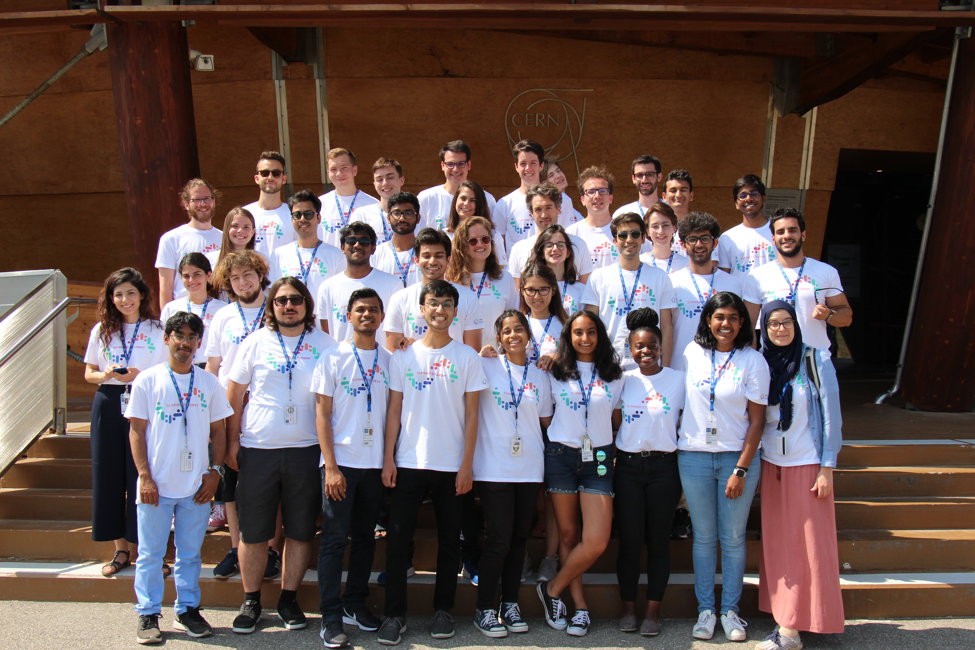
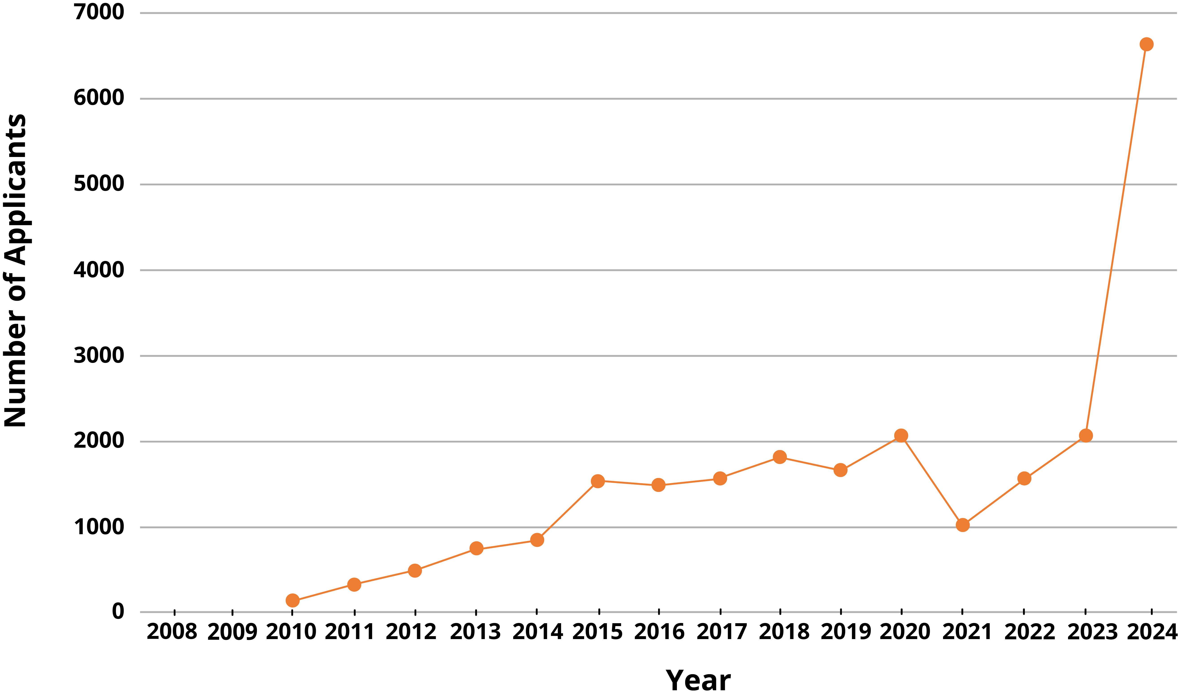
COMMUNICATION, EDUCATION & OUTREACH
As a part of the education and training programme, CERN openlab runs various initiatives that support participation of young scientists and other research organisations
Number of CERN openlab Summer Student Programme applicants throughout the years
Provides undergraduate and master’s level students with an opportunity to work on one of the R&D projects for nine weeks under experts' supervision
This year there was a record of more than 6600 applicants!
Summer Student Programme

Slide 11
COMMUNICATION, EDUCATION & OUTREACH
As a part of the education and training programme, CERN openlab runs various initiatives that support participation of young scientists and other research organisations
Provides undergraduate and master’s level students with an opportunity to work on one of the R&D projects for nine weeks under experts' supervision
This year there was a record of more than 6600 applicants!
Summer Student Programme
Throughout the year, CERN openlab summer student program had more than 20,000 applicants and received more than 400 students.
Year | 2008 | 2009 | 2010 | 2011 | 2012 | 2013 | 2014 | 2015 | 2016 | 2017 | 2018 | 2019 | 2020 | 2021 | 2022 | 2023 | 2024 | Total
Applicants | NI* | NI* | 92 | 330 | 490 | 750 | 850 | 1540 | 1479 | 1580 | 1820 | 1658 | 2074 | 1022 | 1568 | 2067 | 6626 | 23946
Selected | 13 | 15 | 15 | 15 | 15 | 22 | 23 | 40 | 39 | 37 | 41 | 40 | 39 | 27 | 32 | 30 | 30 | 473
NI* - No Information

Slide 12
COMMUNICATION, EDUCATION & OUTREACH
As a part of the education and training programme, CERN openlab runs various initiatives that support participation of young scientists and other research organisations
TODAY!!
Provides undergraduate and master’s level students with an opportunity to work on one of the R&D projects for nine weeks under experts' supervision
This year there was a record of more than 6600 applicants!
Annual workshop to review the R&D projects carried out during the last year and discuss future plans. The event features technical talks, a poster session and a technology track dedicated to our industrial partners
Summer Student Programme
Technical
Workshop
Open access to CERN openlab lectures that cover a wide range of computing topics, from AI to exascale computing and quantum technologies. Regular specialised technical training to members of the scientific community
CERN openlab relies on Communication, Education & Outreach actions
Lectures & Training

Slide 13
THANK YOU!!!!!
Notes:
LOOKIN FORWARD TO THE NEXT THREE YEARS OF PHASE VIIII

