Slide 2
Benchmarking Heterogeneous Architectures with HEPScore
Openlab Technical Workshop 2024
David Southwick

Slide 3
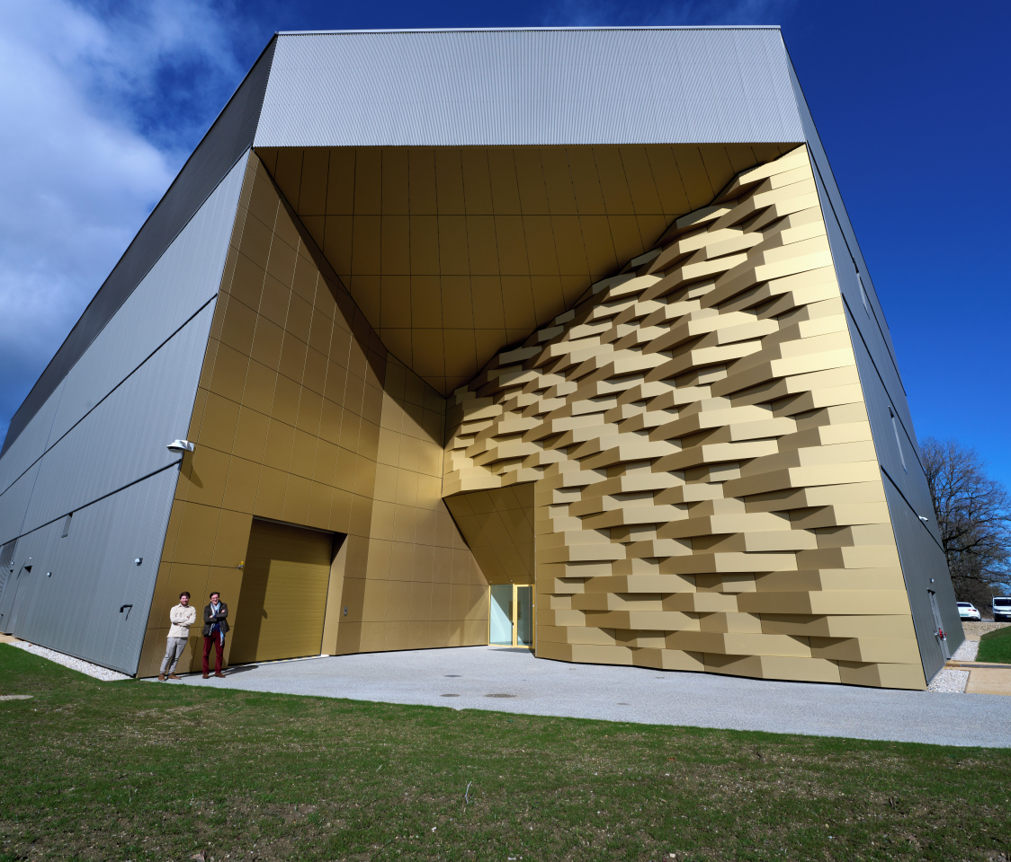
Benchmarking and Heterogeneous hardware
Computing at CERN has been dominated by x86 CPU operations for most of its history, but this environment is rapidly changing:
Specialized compute devices (accelerators)
Specialized architectures (registers, memory, extensions)
Necessitating a paradigm shift in software models to leverage aggressive offloading to the most efficient device
To understand this complex environment, new tooling was required to provide the flexibility to account many diverse devices in this increasingly fragmented and rapidly changing field
CERN Prévessin Data Center

Slide 4
HEP Benchmarking
HEPscore: The next generation of benchmarking for the WLCG
Intentional “single score” result
Composable/updateable containerized workload array
Extensible to any hardware that can run python
HEPscore ratified in April 2023 by the WLCG HEPscore Deployment Task Force as a replacement for HEPspec06
Now progressively replacing HS06
Reference HEP applications from multiple experiments
HEPscore
Uses workloads from HEP experiments
Produce single score (à la HS06)
HEP Benchmark Suite
Orchestrator of multiple benchmarks (HS06, HEPscore, SPEC, etc)
Central collector & Reporter
OCI Containers
HEP workloads
Instructions & public results: https://w3.hepix.org/benchmarking.html

Slide 5
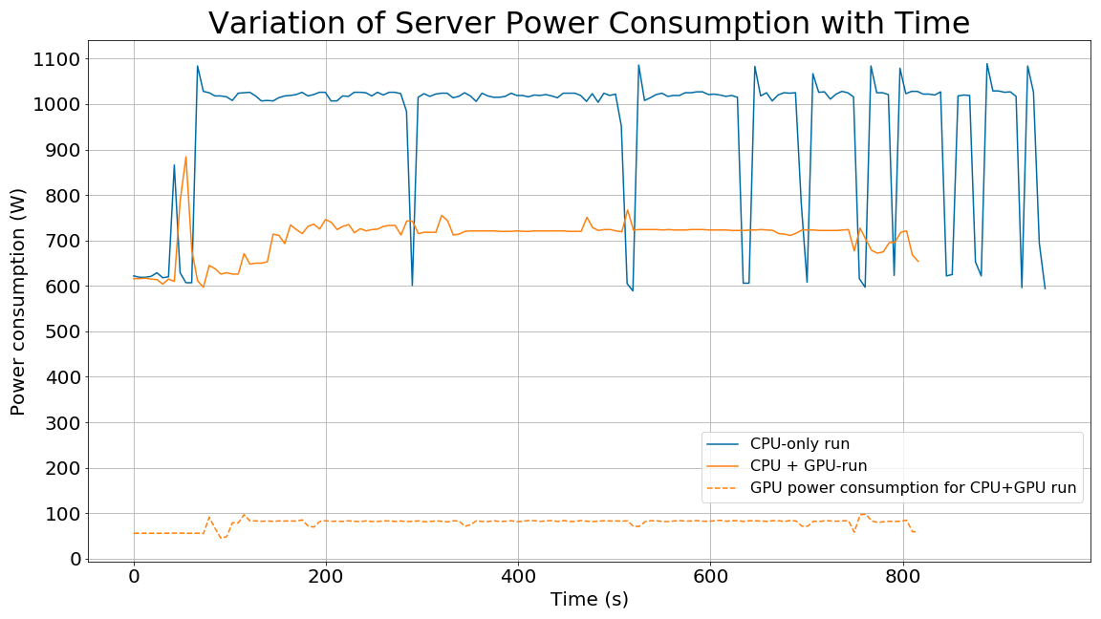
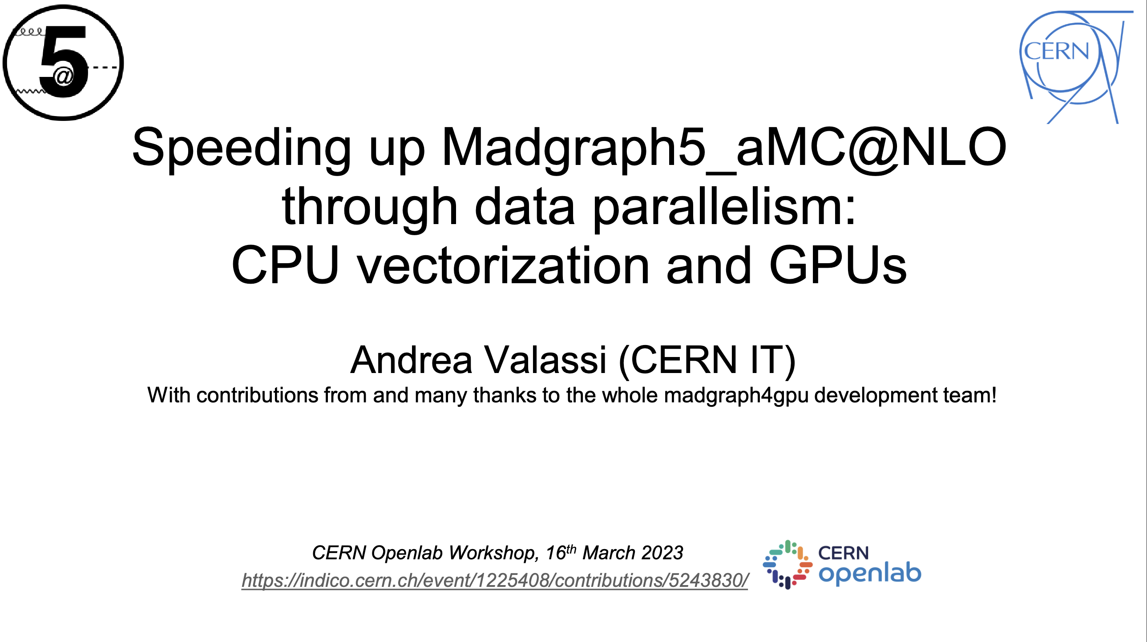
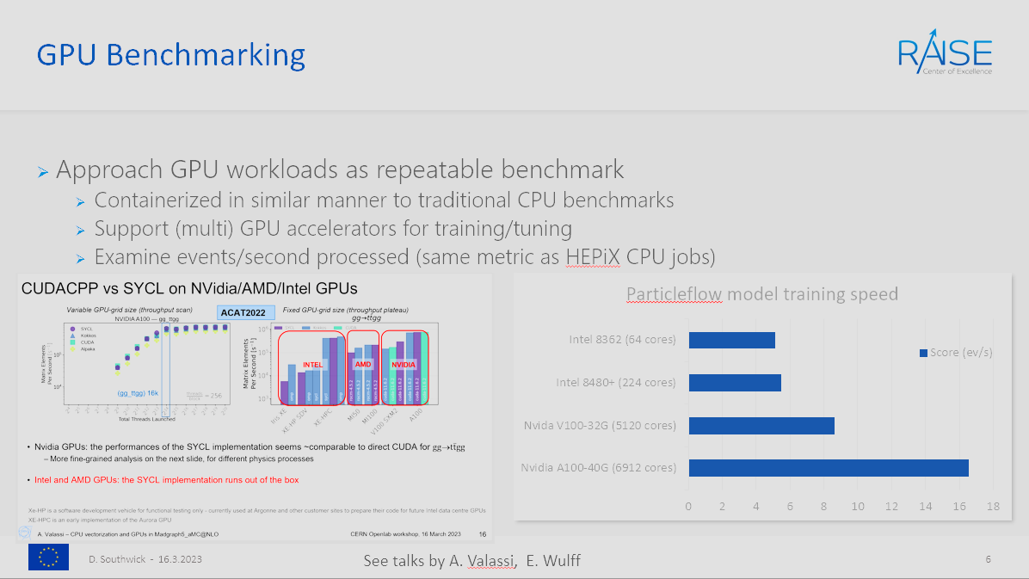
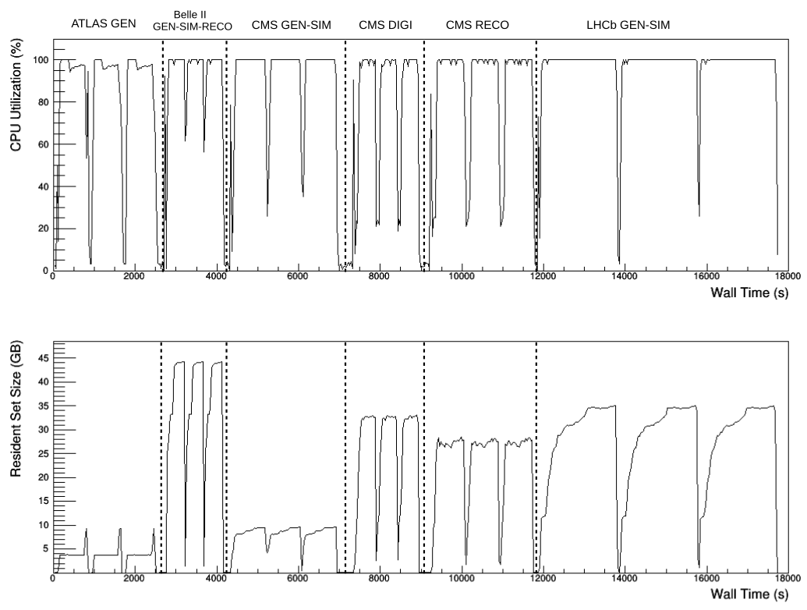
Heterogeneous execution… and more
“HEPscore23” comprises a set of 7 production workloads:
Available for x86_64 and aarch64
Additional (bonus!) workloads leveraging compute accelerators:
MadGraph5 Event Generator (CPU vectorization, GPUs)
CMS HLT (GPUs)
MLPF (CPU vectorization, GPUs)
HEP Benchmark Suite includes plugins to measure energy consumption, load, CPU frequency; enabling heterogenous efficiency studies

Slide 6
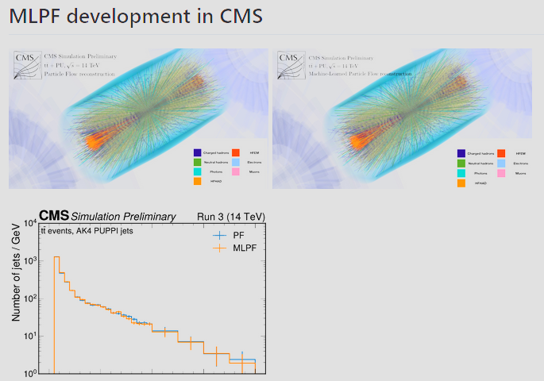
Machine Learned Particle Flow (MLPF)
An early example of a new generation of ML workloads being developed across all experiments
Containerized and available as an optional benchmark in HEPscore
Executes on any hardware supporting ML frameworks
Aggressively leverages accelerator offloading
ML workloads such as this will take time before they replace their traditional deterministic (x86) counterparts, but this process has already begun in many experiments
See talk by E. Wulff later today!

Slide 7
Recent heterogeneous accelerators
Understanding production ML performance (inference) critical as ML development matures in experiments.
Leverage heterogenous testbed to study performance, efficiency (next talk!)
Study modern GPU and CPU vector capabilities
Inform procurement, pledging, accounting
…Still complex & difficult!
Selection of current-gen accelerator performance

Slide 8
Outlook
Many developments in benchmarking to cover heterogeneous architectures:
Workloads supporting multiple compile targets
Leveraging multiple types of compute accelerators and frameworks
Major infrastructure tooling effort to support HEPscore rollout
Focus on energy and compute efficiency across many devices
Preparing for upcoming heterogeneous workloads from experiments!

Slide 10
Energy Efficiency

