Slide 1
The new Prévessin Data Centre (PDC) at CERN
2024 CERN openlab Technical Workshop
L. Atzori, W. Salter, O. Barring & E. Bonfillou – March 26th, 2024

Slide 2
Agenda
Project goal and timelines
Organization and roles
Architecture overview
IT rooms
Cooling and heat recovery
Monitoring dashboard of one IT room
Conclusion

Slide 3
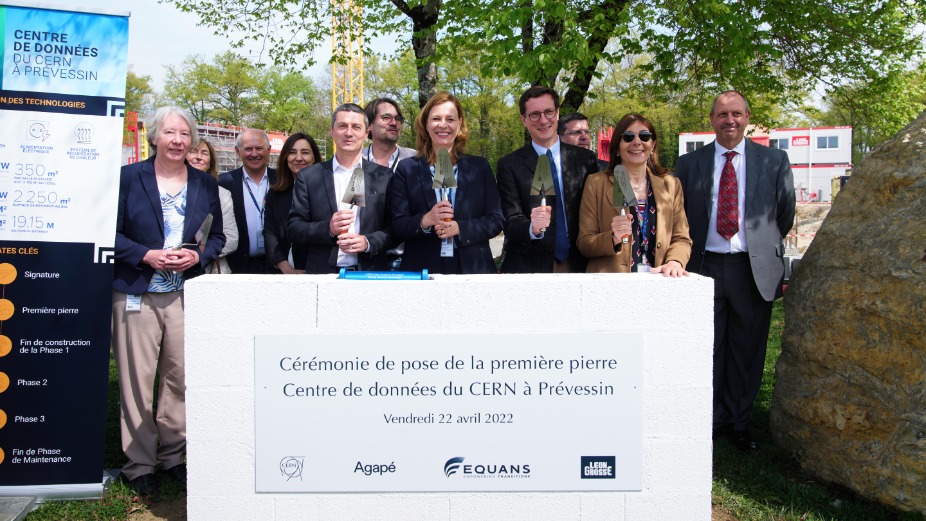
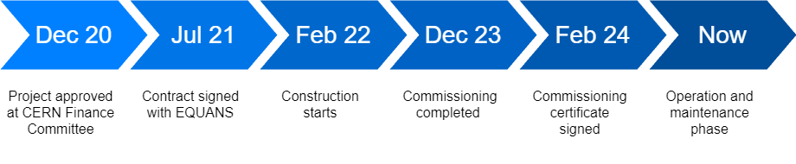
Project goal and timelines
PDC needed to provide computing needs of HL-LHC, which are expected to be ten times higher than today
PDC hosts servers for physics data processing and “business continuity / disaster recovery” infrastructure
MDC (Meyrin Data Centre) will continue to run in parallel, with a particular focus on data storage

Slide 4
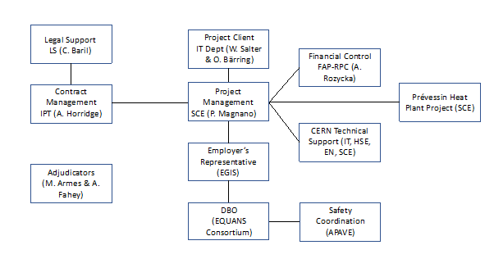
Organization and roles
The approach has been for a turn-key DC solution:
→ Based on functional specifications
→ Including 10-years operation and maintenance
The project follows the FIDIC Gold Book standard for project design, build and operation
CERN specific exceptions to the above:
→ EN-EL is responsible for the provision and maintenance of the HV systems
→ EN-AA is responsible for the operation and maintenance of the safety systems (smoke detection and evacuation, video surveillance and access control)

Slide 5
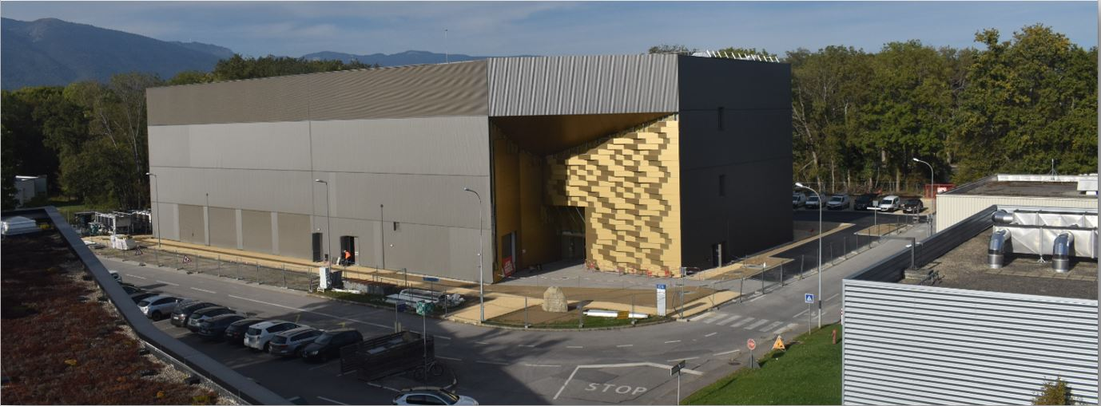
Architecture overview
Total power of 12 MW:
→ 4 MW per floor
→ 1st phase (now) has 2nd floor only
→ 2nd phase (HL-LHC) will add 1st floor
→ 3rd phase will add ground floor
Total of 6 IT rooms:
→ 2 per floor
→ 2 MW per room
90 racks per IT room:
→ 78 server racks
→ 12 network racks
Ground print of 2,250 m²:
→ 70m * 37m * 19m
Total surface of 6,400 m²:
→ 2,100 m² for IT rooms
Located in front of the CERN Control Centre (CCC)

Slide 6
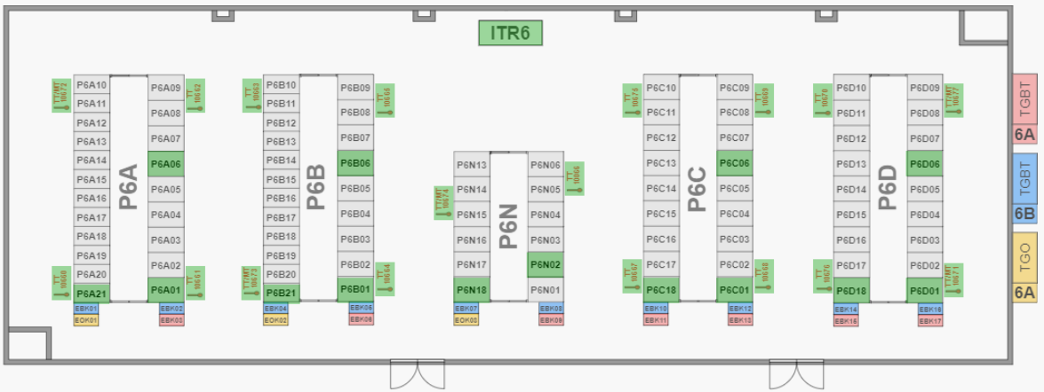
IT rooms (1)
Each room contains:
→ 1 network pod (center)
→ 4 server pods
Pods are powered by two separate feeds:
→ 1 without UPS
(25kW/rack)
→ 1 with partial UPS coverage
(20%, 12kW/rack)
Non-UPS racks are for batch workers
UPS racks are for BCDR and services
UPS covers for micro-cuts ( <~ 15 seconds)
After that, covers only for clean automated shutdown of connected capacity
→ UPS is not designed to cover for extended outages! ←

Slide 7
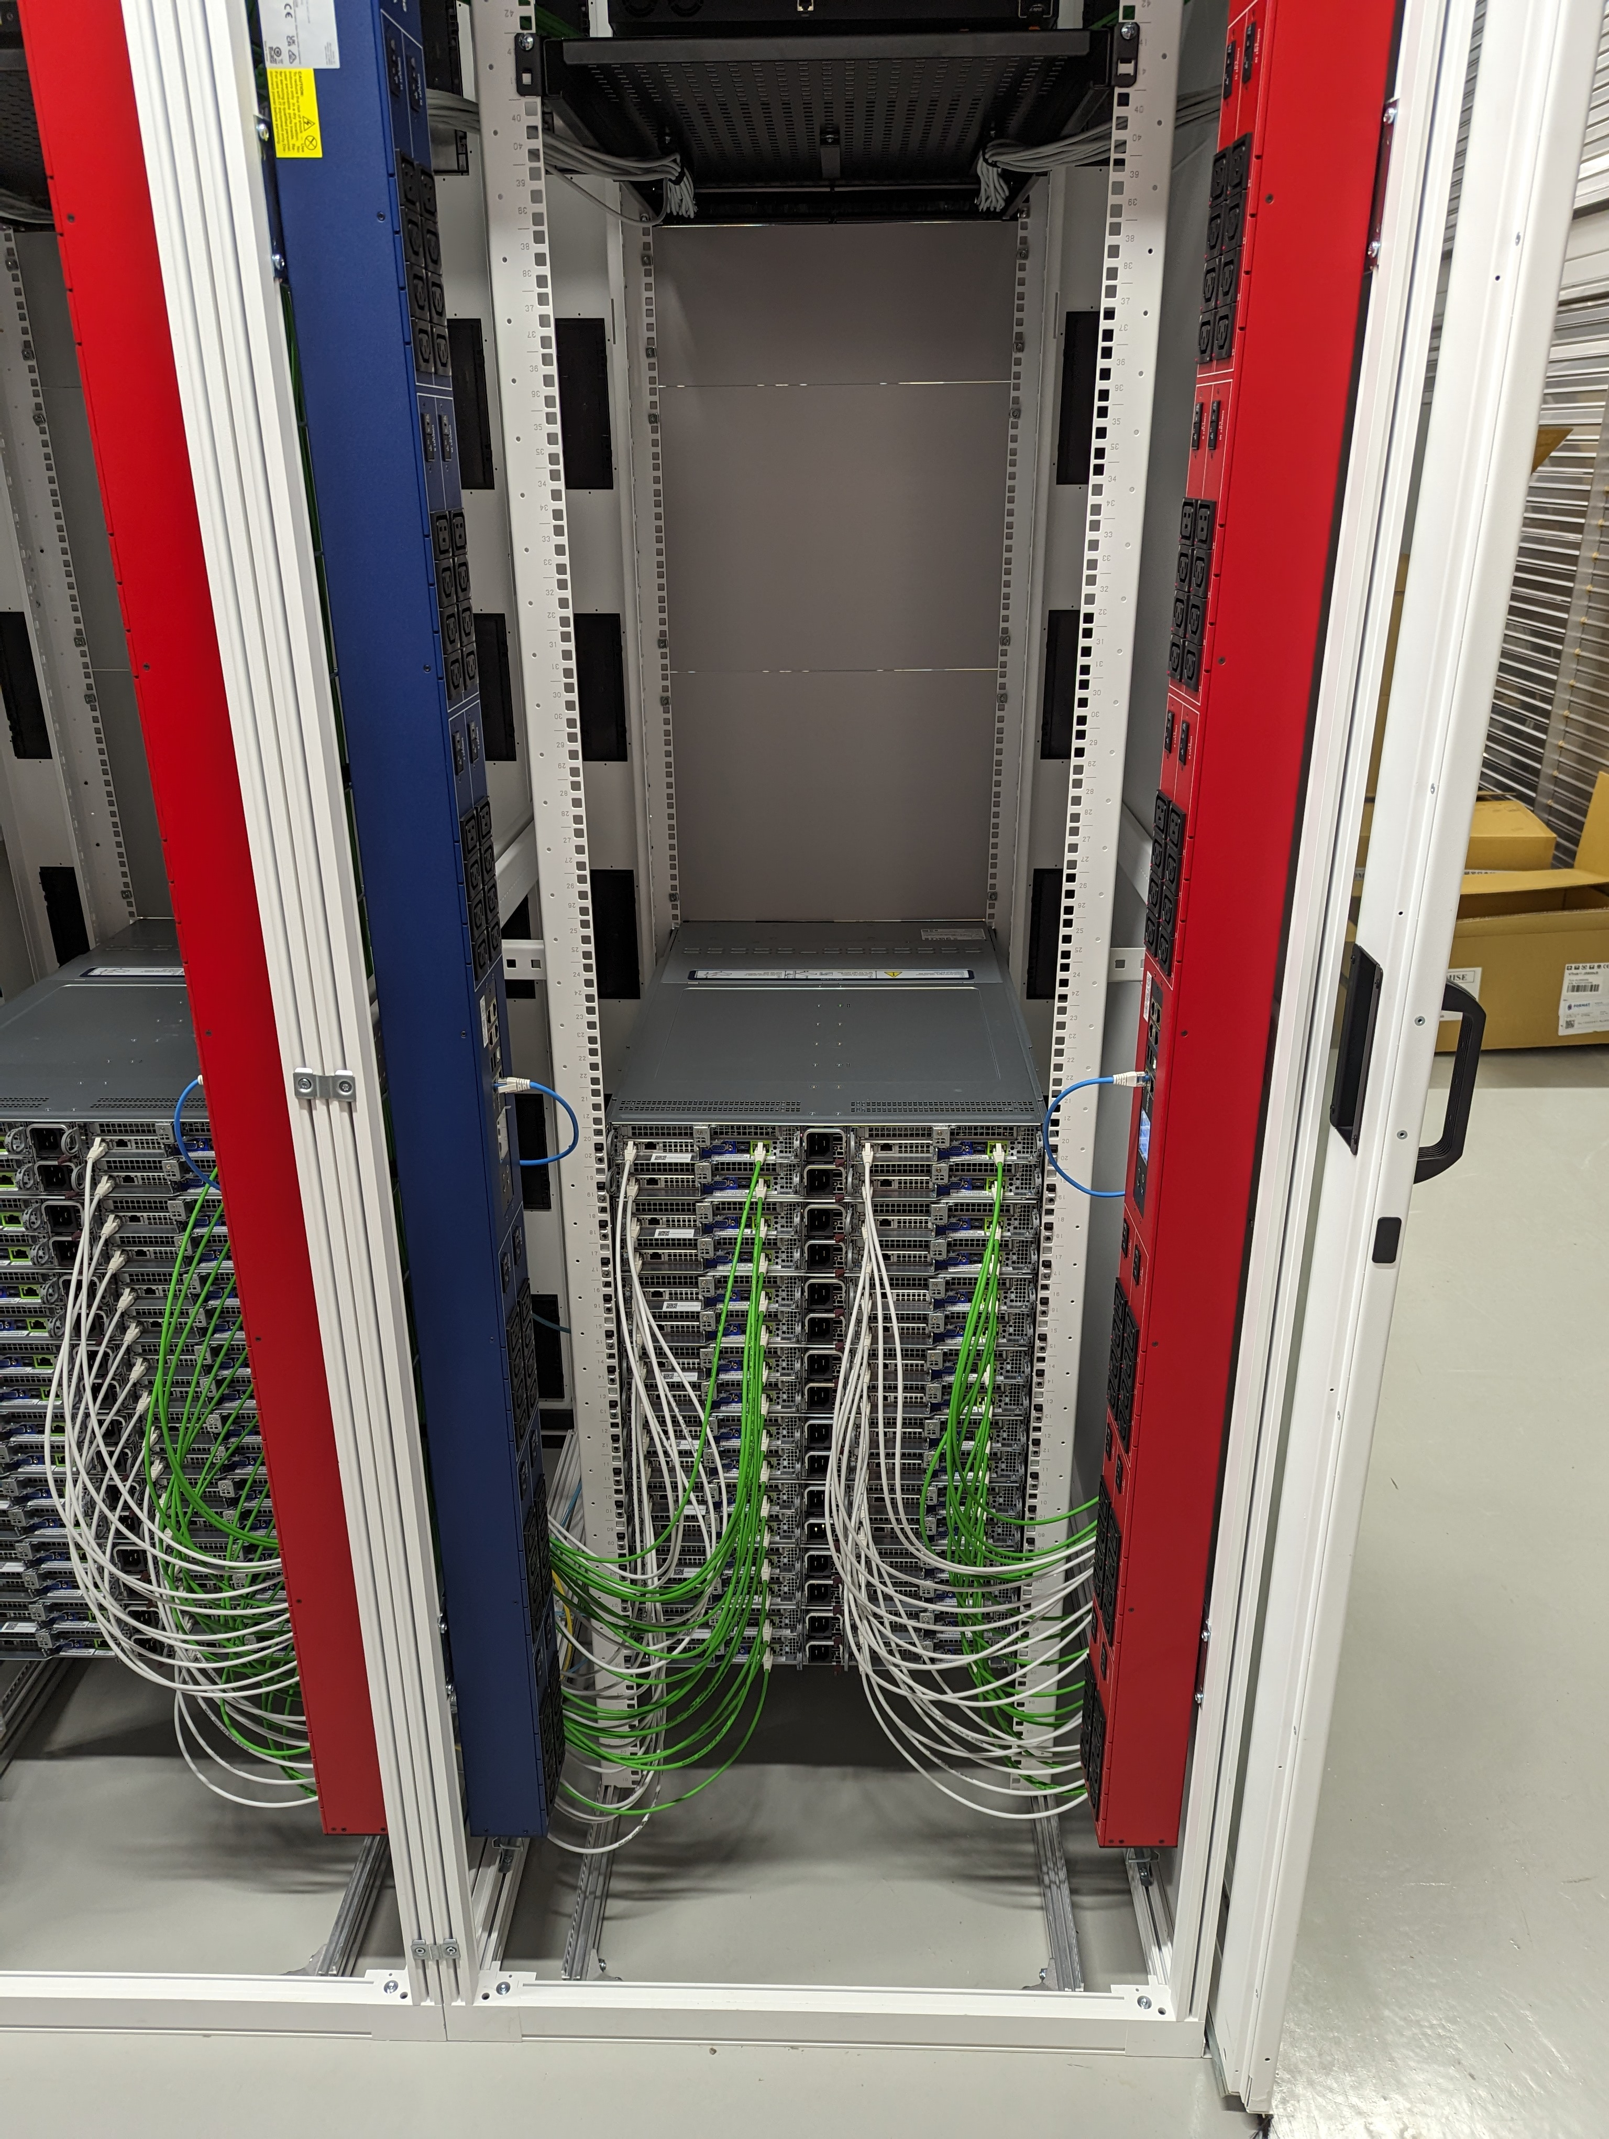
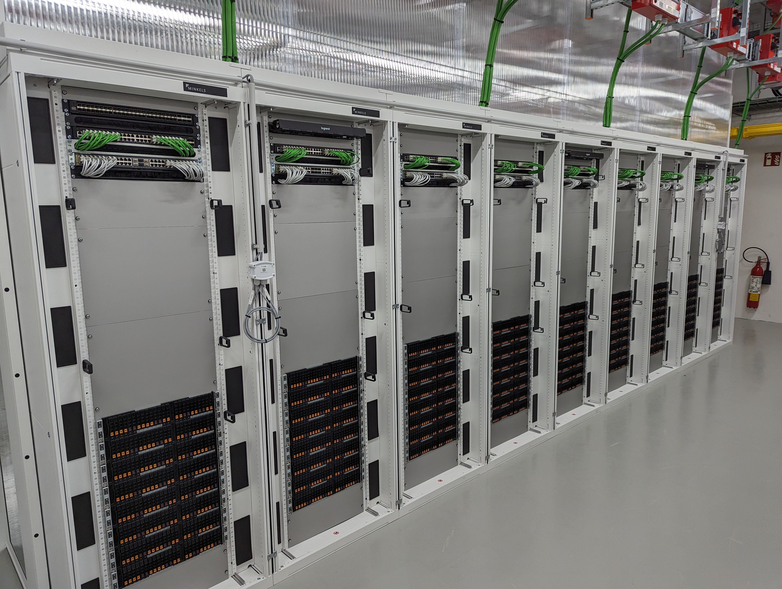
IT rooms (2)
Rear view of a rack:
→ Hot air inside pod
→ 1 PDU per feed
→ IPMI (green)
→ Data (white)
Front of servers facing outside pod

Slide 8
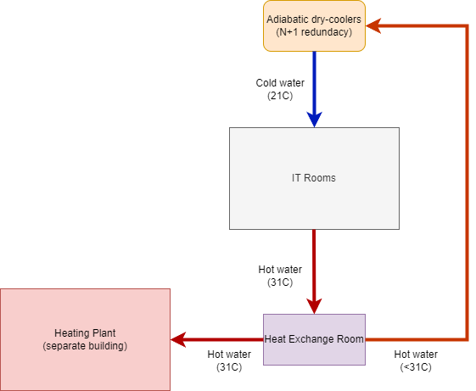
Cooling and heat recovery (1)
For 1st phase: 4 * 2 MW Jaeggi dry coolers on the roof
→ N+1 redundancy
→ 1 for technical areas (non-IT rooms)
For each new phase:
→ 2 * 2 MW additional dry coolers to be installed
→ All piping work already done
Starting from 20ºC outside temperature:
→ Dry coolers in adiabatic mode with water recycling
to improve WUE
→ PDC designed for a PUE target of 1.1 (max 1.15 contractually) ←

Slide 9
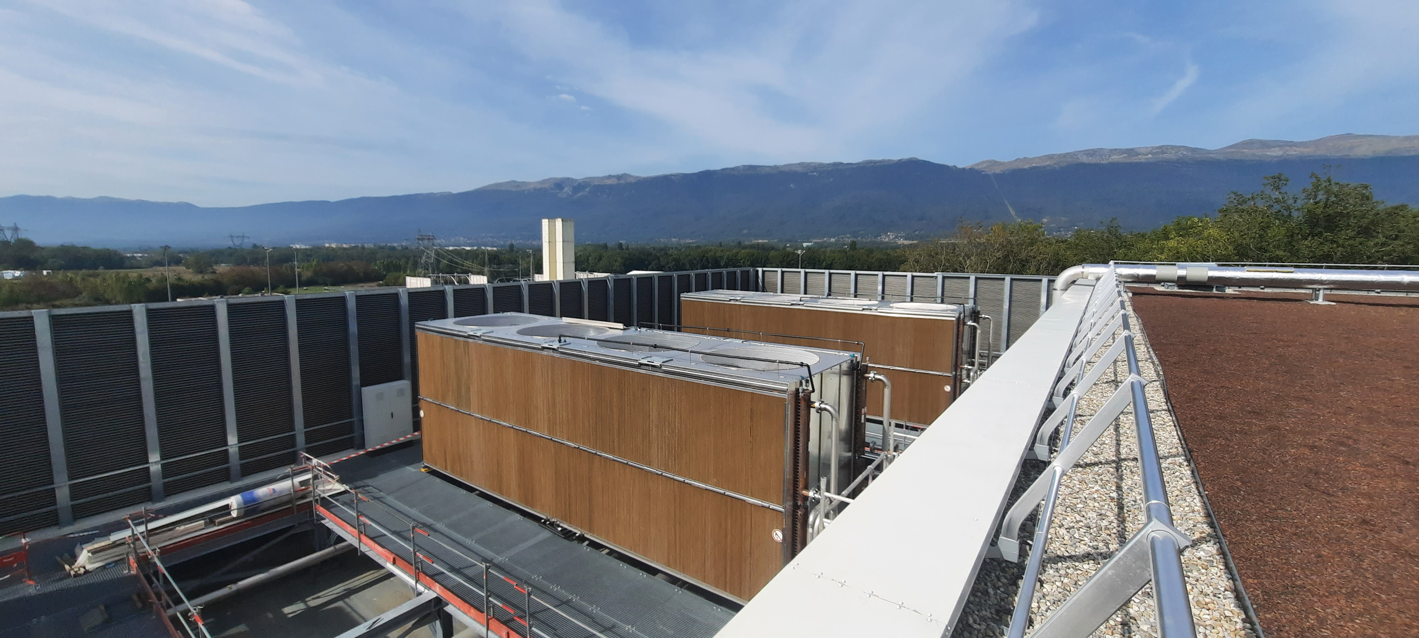
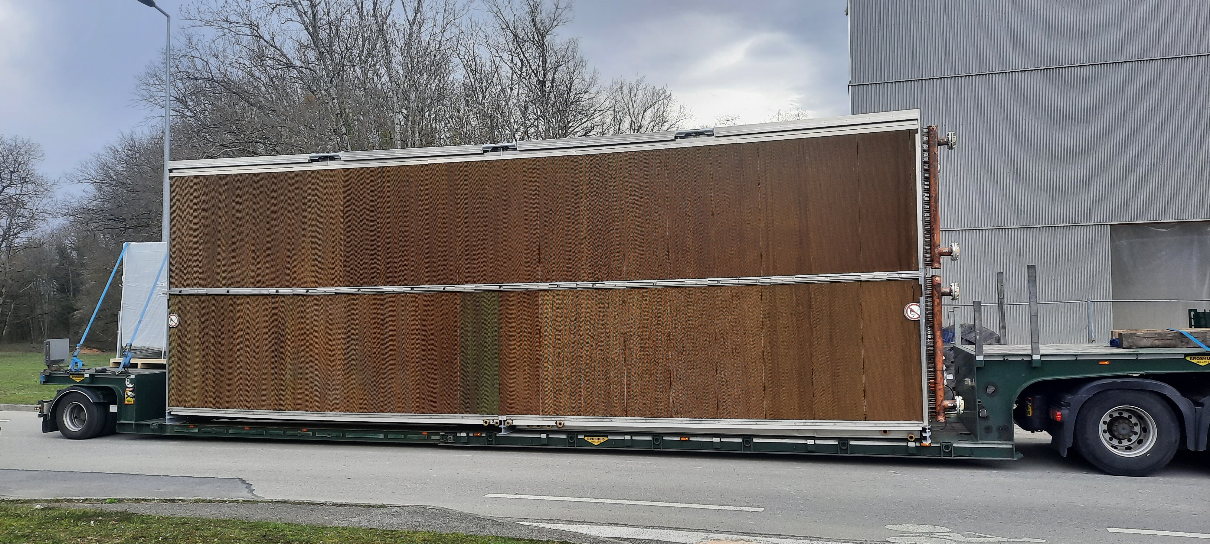
Cooling and heat recovery (2)
One 2MW dry-cooler on a truck
Two 2MW dry-coolers on the roof

Slide 10
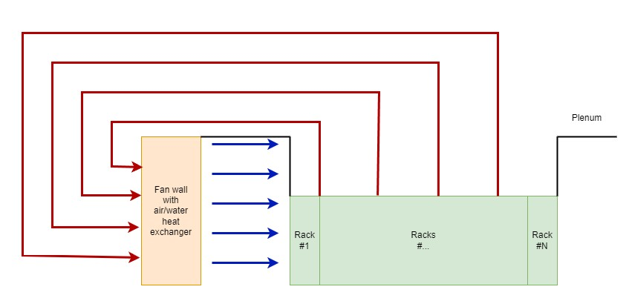
Cooling and heat recovery (3)
Each IT room is equipped with large fan-walls:
→ 5 * 500kW fan-walls made by Schneider
→ fan-walls operate in N+1 redundancy mode
→ largest fan-walls in Europe
Air circulates in a closed loop
Inlet temperature:
→ 25ºC on average
→ can go up to 32ºC in hot periods
Air-flow in the IT rooms (lateral view)

Slide 11
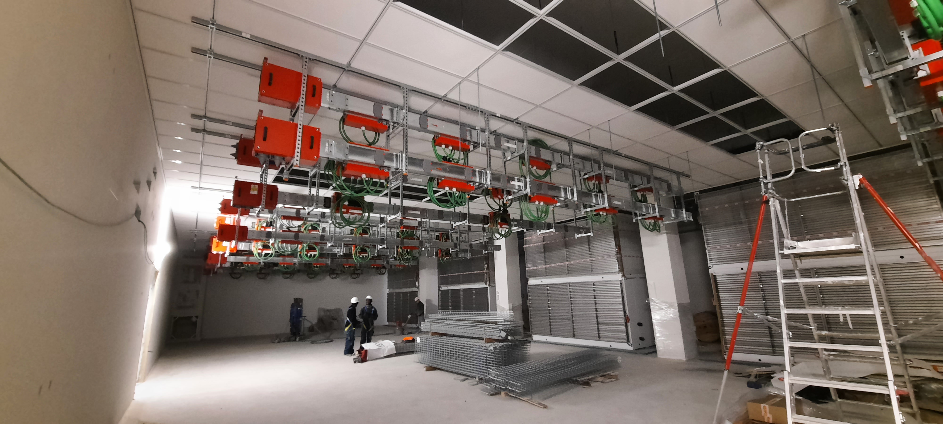
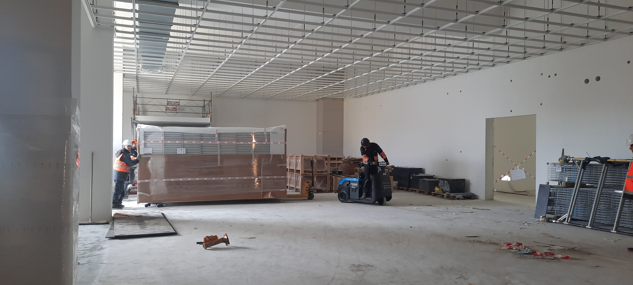
Cooling and heat recovery (4)
One half-fan module being moved
Fan walls being installed

Slide 12
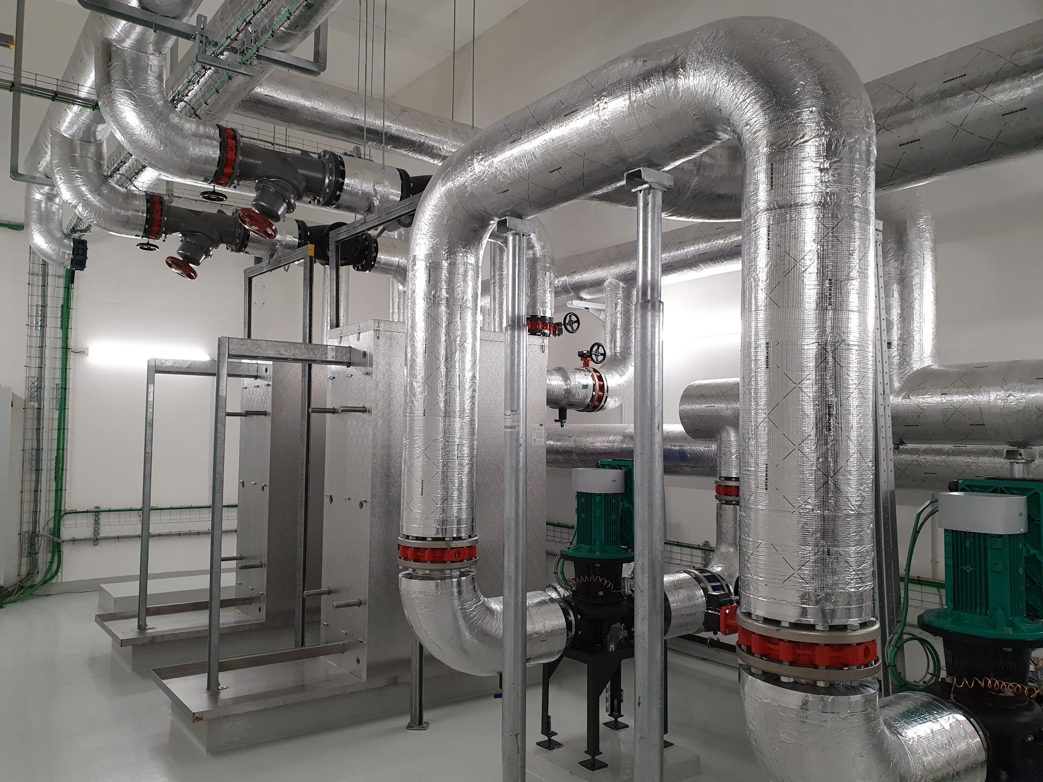
Cooling and heat recovery (5)
Hot water from IT rooms arrive in the heat recovery room
For 1st phase, 3MW will be transferred to the heating plant via 2 * 1.5 MW water/water heat exchangers
For 2nd phase, 4MW in total will be transferred to the heating plant via one additional water/water heat exchanger of 1MW
This recuperated energy will heat the buildings on the CERN Prévessin site

Slide 13
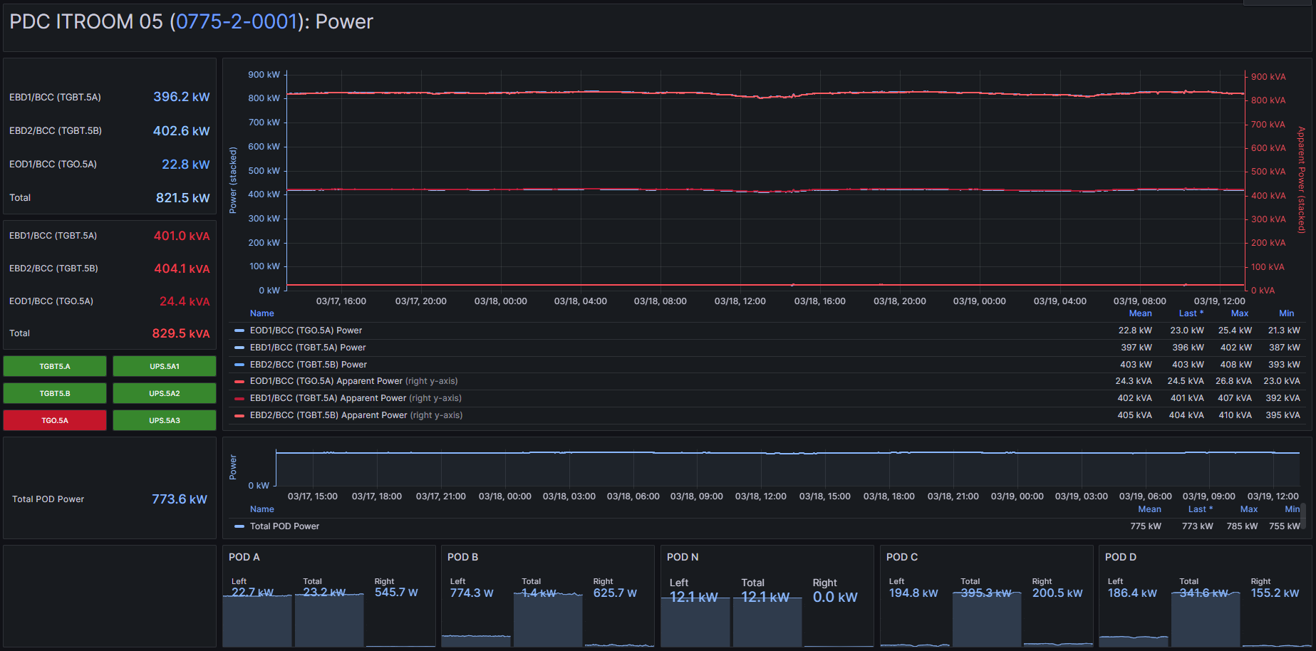
Monitoring dashboard of one IT room

Slide 14
Conclusion
PDC to provide computing capacity for HL-LHC:
→ 1st phase is 4 MW, 2nd phase is 8 MW and 3rd phase is 12 MW
→ Turn-key solution with a 10-years operations and maintenance included
Project carried out on-time with a particular focus on energy efficiency (1.1 < PUE < 1.15)
4MW of energy recuperated to heat CERN buildings on the Prévessin site
PDC powered by two separate power feeds
→ One without UPS
→ One with 20% on UPS coverage
→Technical building, unfortunately no visits are possible←

