Slide 1
Distributed Training and HPO at the
Centre of Excellence on AI- and Simulation-based Engineering at Exascale
Eric Wulff ^{1,2}, Maria Girone^{1,2},
Juan Pablo García Amboage^{1,2}, Joosep Pata³
¹CERN, ²CoE RAISE WP4
³NICPB
With material from the CMS Collaboration

Slide 2
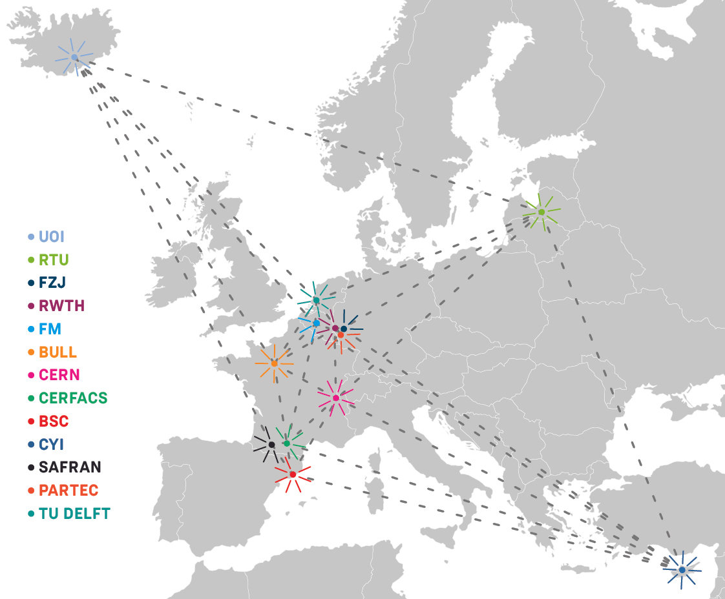
CoE RAISE
CoE RAISE [1]: Center of Excellence for Research on AI- and Simulation-based Engineering at Exascale
  Develop novel, scalable Artificial Intelligence technologies
CERN (Dr. M. Girone) leads WP4: Data-Driven Use-Cases towards Exascale [2]
  Including Task 4.1 (E. Wulff): Event reconstruction and classification at the CERN HL-LHC, which we’ll see more details on later
UOI (Prof. M. Riedel) leads WP2: AI- and HPC-Cross Methods at Exascale [3]
  Provides expert support on HPC and AI methods to use cases in WP4
CoE RAISE Partners
[1] https://www.coe-raise.eu [2] https://www.coe-raise.eu/wp4 [3] https://www.coe-raise.eu/wp2

Slide 3
RAISE example use-case:
Event reconstruction and classification at the
CERN HL-LHC

Slide 4
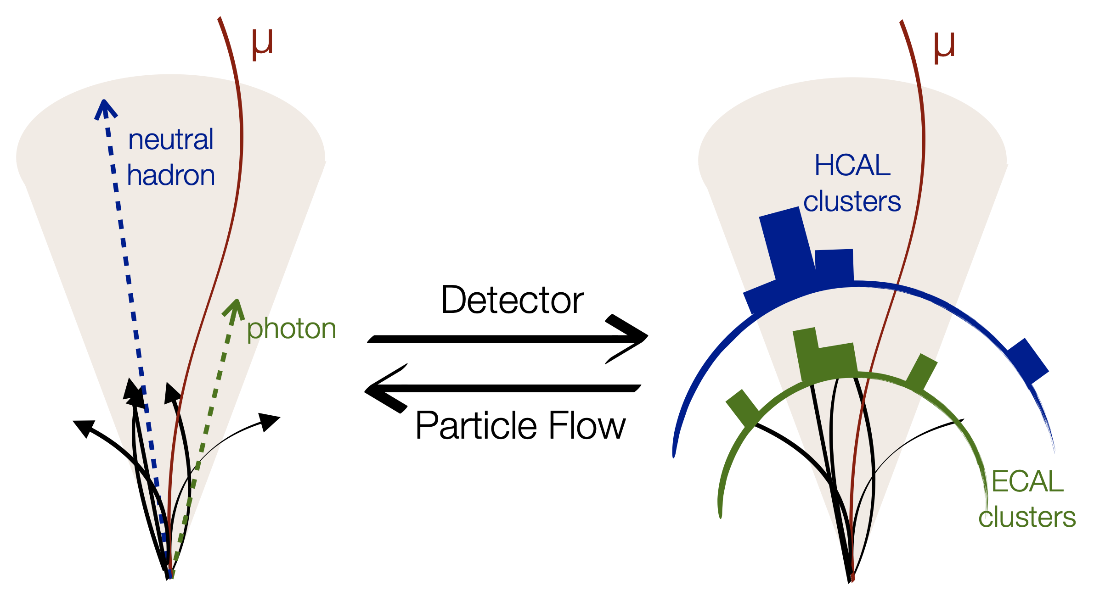
Event reconstruction
Event reconstruction attempts to solve the inverse problem of particle-detector interactions, i.e., going from detector signals back to the particles that gave rise to them
Particle-flow (PF) reconstruction takes tracks and clusters of energy deposits as input and gives particle types and momenta as output

Slide 5


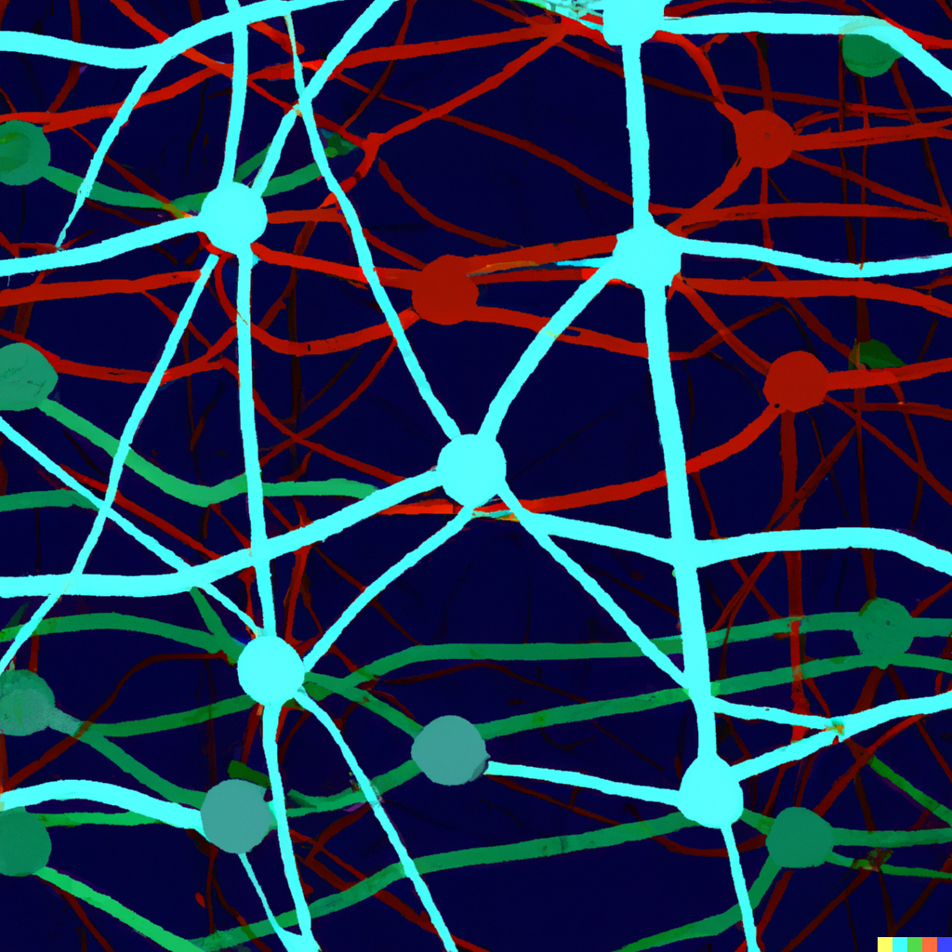
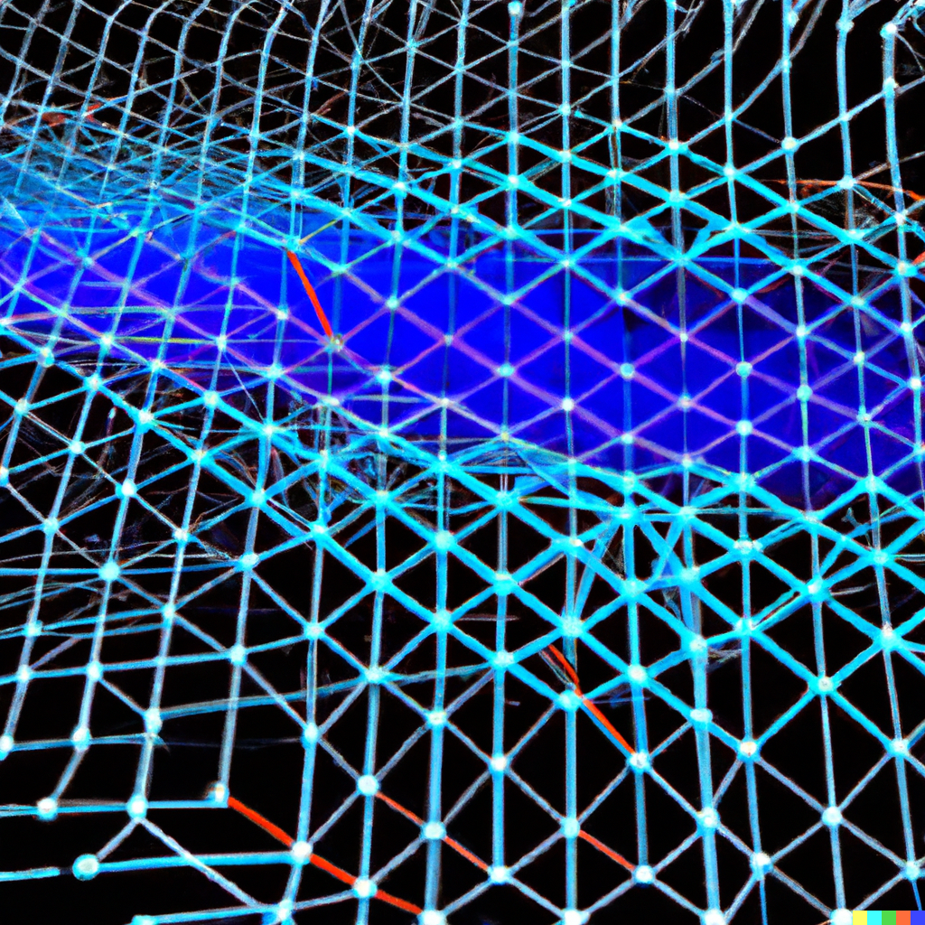
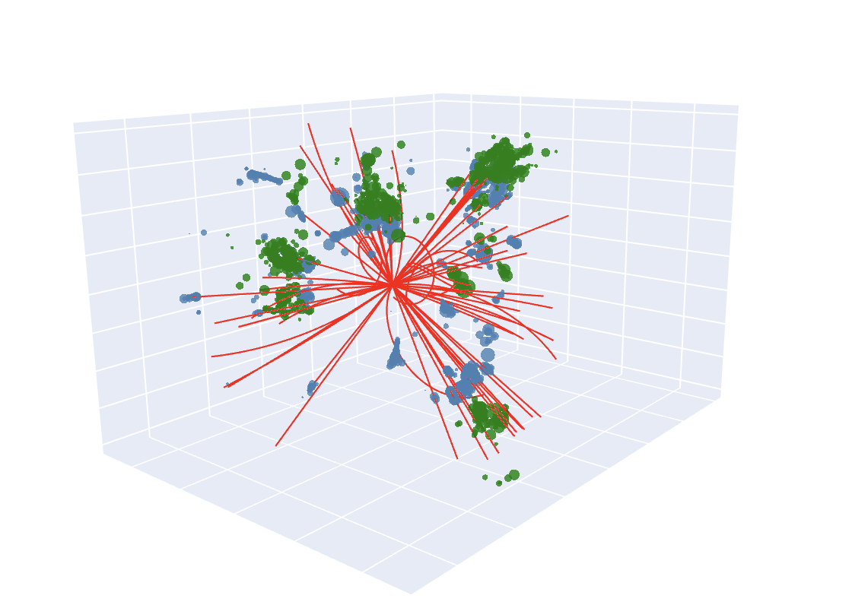
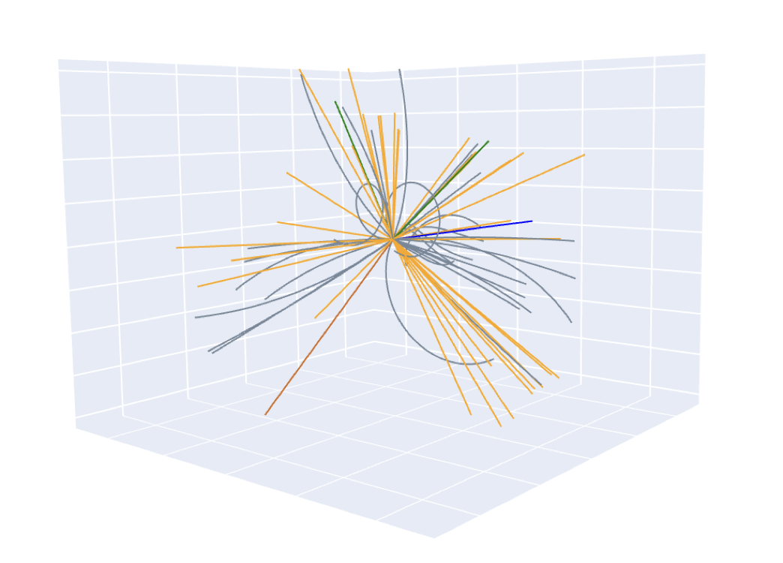
AI-based particle flow reconstruction workflow
Physics simulation
Dataset creation
ML training
Trained model
Data selection
Data pre-processing
Model export
Event reconstruction
Tracks and calorimetry
Reconstructed particles

Slide 6
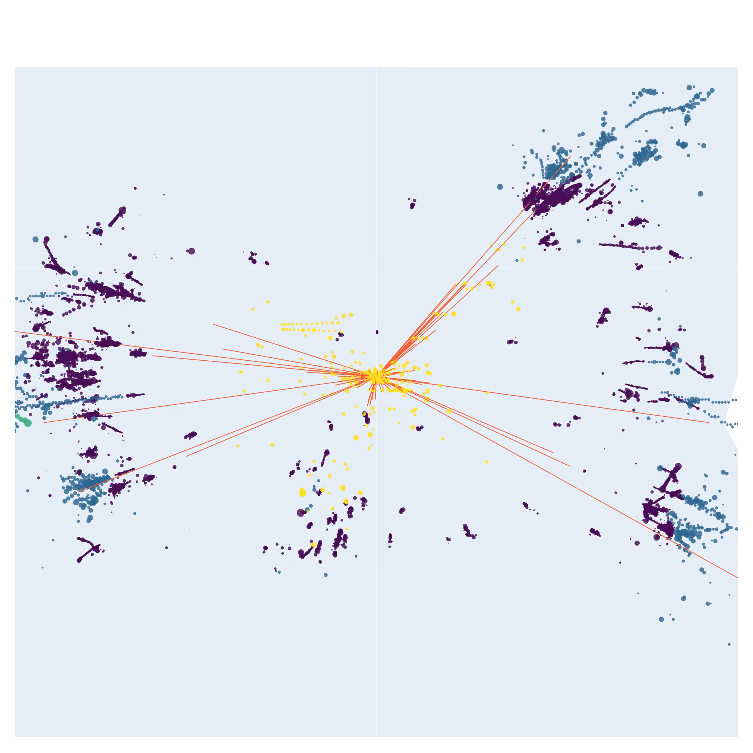
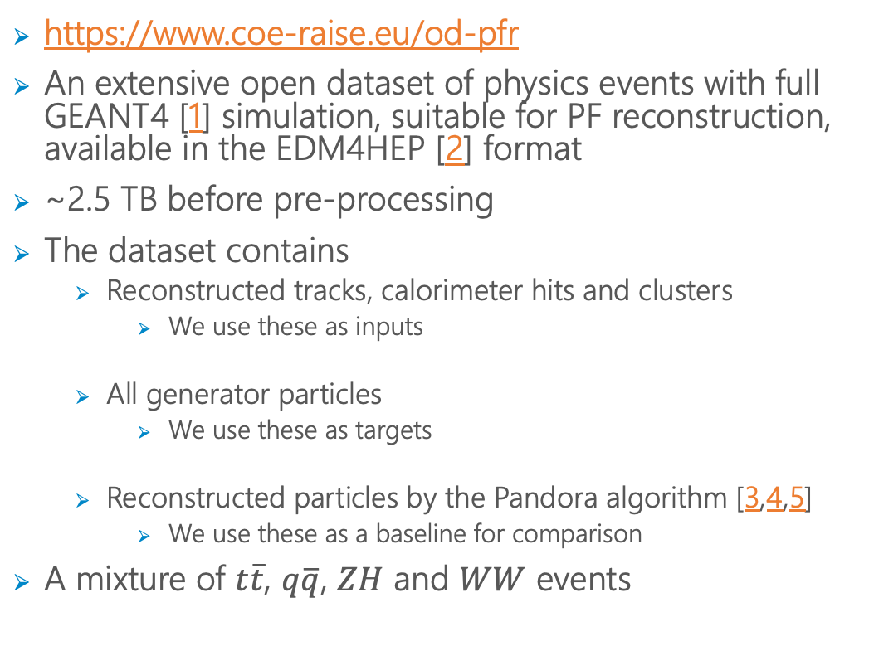
New CoE RAISE open data
https://www.coe-raise.eu/od-pfr
An extensive open dataset of physics events with full GEANT4 [1] simulation, suitable for PF reconstruction, available in the EDM4HEP [2] format
~2.5 TB before pre-processing
The dataset contains
  Reconstructed tracks, calorimeter hits and clusters
    We use these as inputs
  All generator particles
    We use these as targets
  Reconstructed particles by the Pandora algorithm [3,4,5]
    We use these as a baseline for comparison
A mixture of $t\overline{t}$, $q\overline{q}$, $ZH$ and $WW$ events
3D visualization of a single event

Slide 7
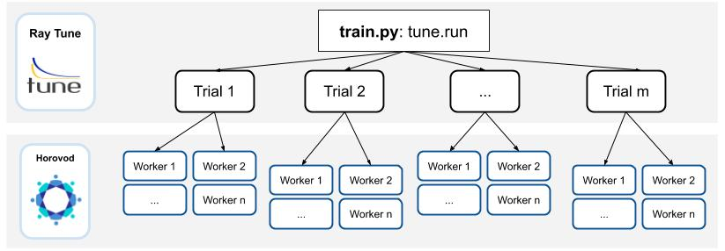
Improvements from large-scale distributed hyperparameter optimization (HPO)
Distributed HPO
Hyperparameter tuning results
Two levels of parallelization
Using ASHA + Bayesian Optimization for HPO
Final validation loss decreased by ~34% giving a significant performance improvement from HPO
Hypertuning

Slide 8
Improvements over the baseline: Jet resolution
Using data never seen in training
Almost 50% improvement in jet response width over the baseline
Consistent improvement over the entire p_{T} spectrum
[1]
[1]
[1] Joosep Pata, Eric Wulff, Farouk Mokhtar, David Southwick, Mengke Zhang, Maria Girone, Javier Duarte. Improved particle-flow event reconstruction with scalable neural networks for current and future particle detectors, (in press) Commun Phys, (2024) https://arxiv.org/abs/2309.06782

Slide 9
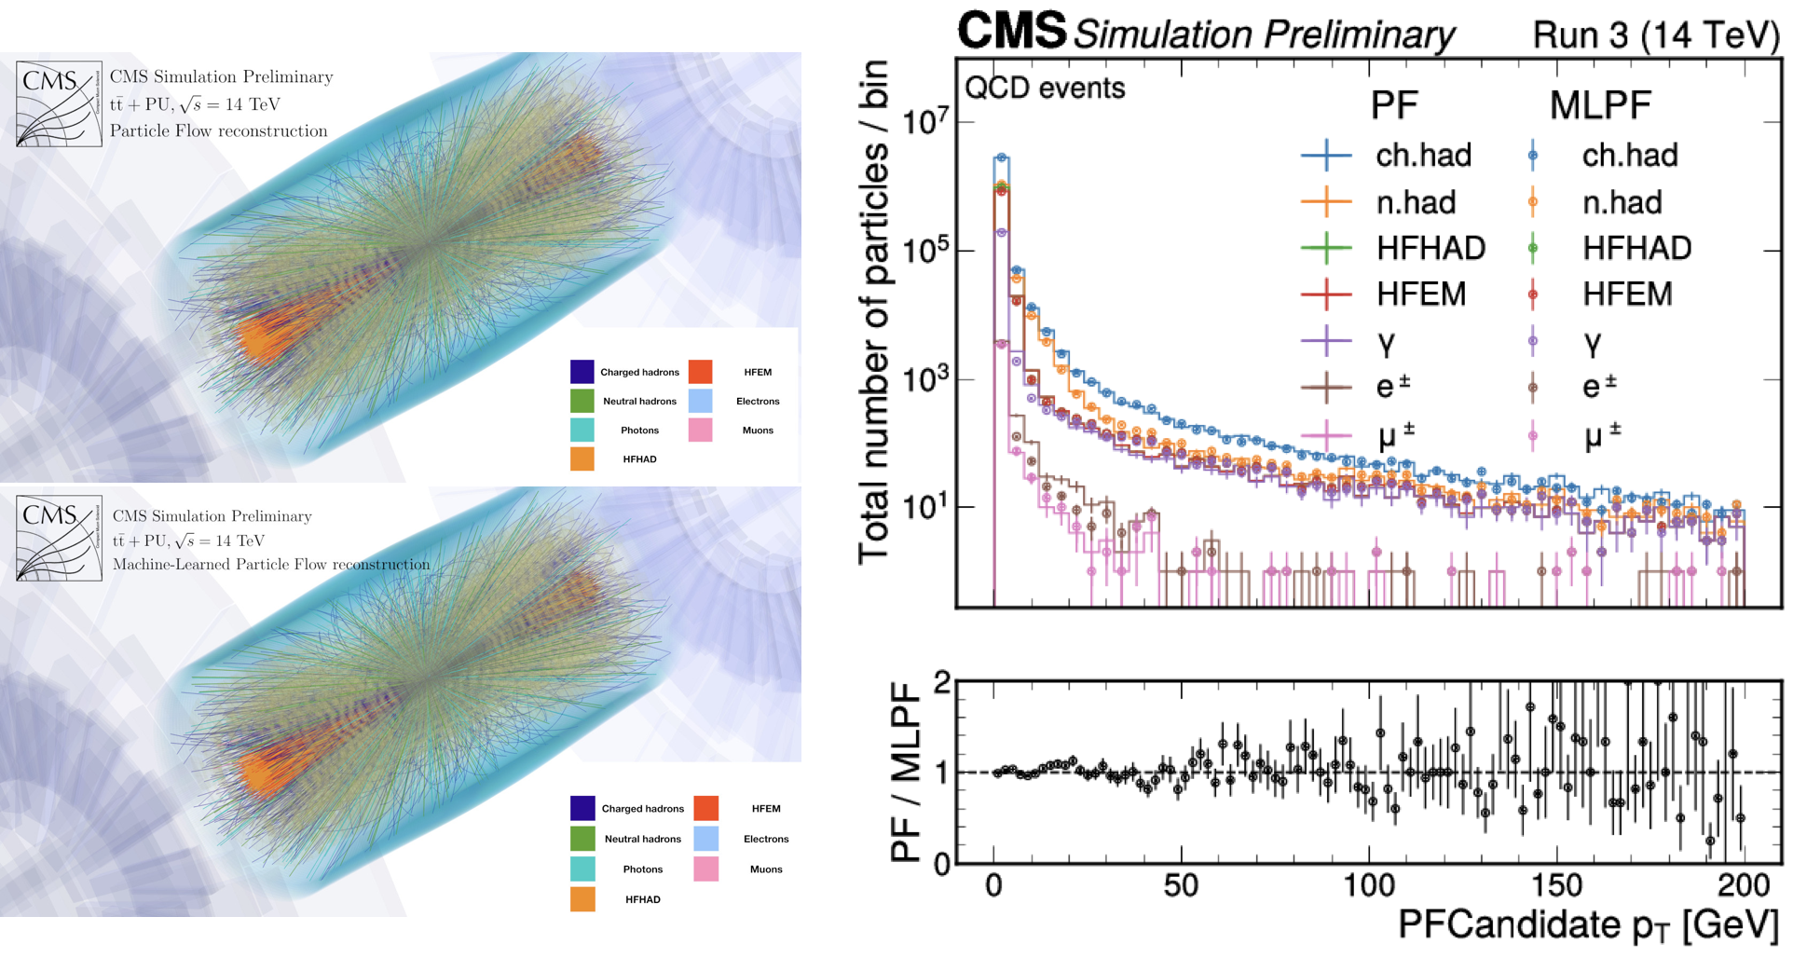
Tested in a real detector
This approach was also tested in a real detector (CMS) in 2022
We plan to update the model for CMS in 2024
JP, Javier Duarte, Farouk Mokhtar, Eric Wulff, Jieun Yoo, Jean-Roch Vlimant, Maurizio Pierini, Maria Girone.
Machine Learning for Particle Flow Reconstruction at CMS. ACAT 2021.
https://doi.org/10.48550/arXiv.2203.00330, http://cds.cern.ch/record/2792320

Slide 10
Quantum-SVR for model performance prediction in HPO

Slide 11
The hyperparameter optimization process
Define HPs search space
Select HPs to optimize and their ranges
Human responsibility
Select trials from the search space
Random search
Grid search
Bayesian opt.
Automated
Evaluate the trials
⚠️ Expensive!
All trials are often not fully evaluated
Automated
Select best trial
Automated
step to be accelerated using performance prediction

Slide 12
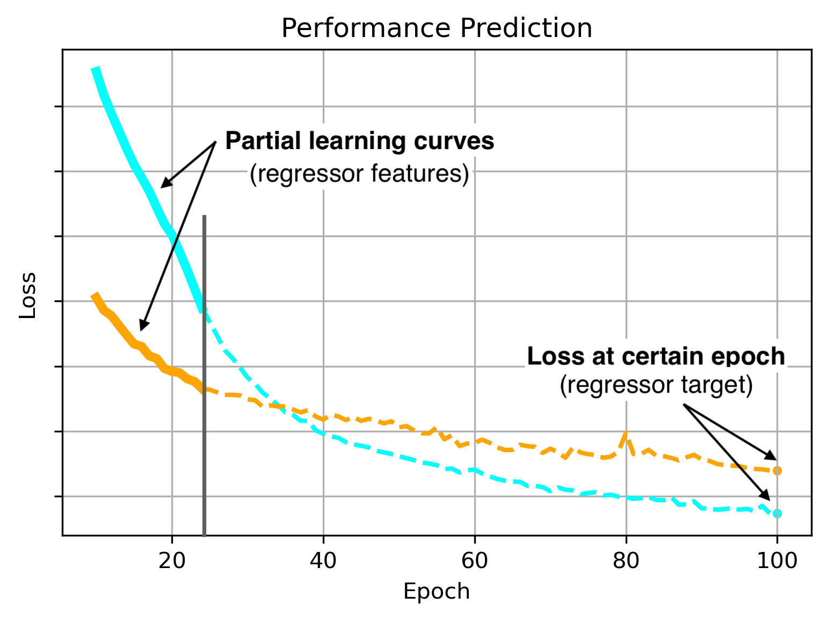
Model performance prediction
Using performance prediction can accelerate the evaluation step in HPO.
  Use a meta-model which provides a cheap approximated evaluation of the target model
The performance predictor
  Must be fast to train
  The training samples come from previously fully trained trials
We use a Quantum Annealer to train a Q-SVR as out model performance predictor
Saved 75 epochs of the target model!

Slide 13
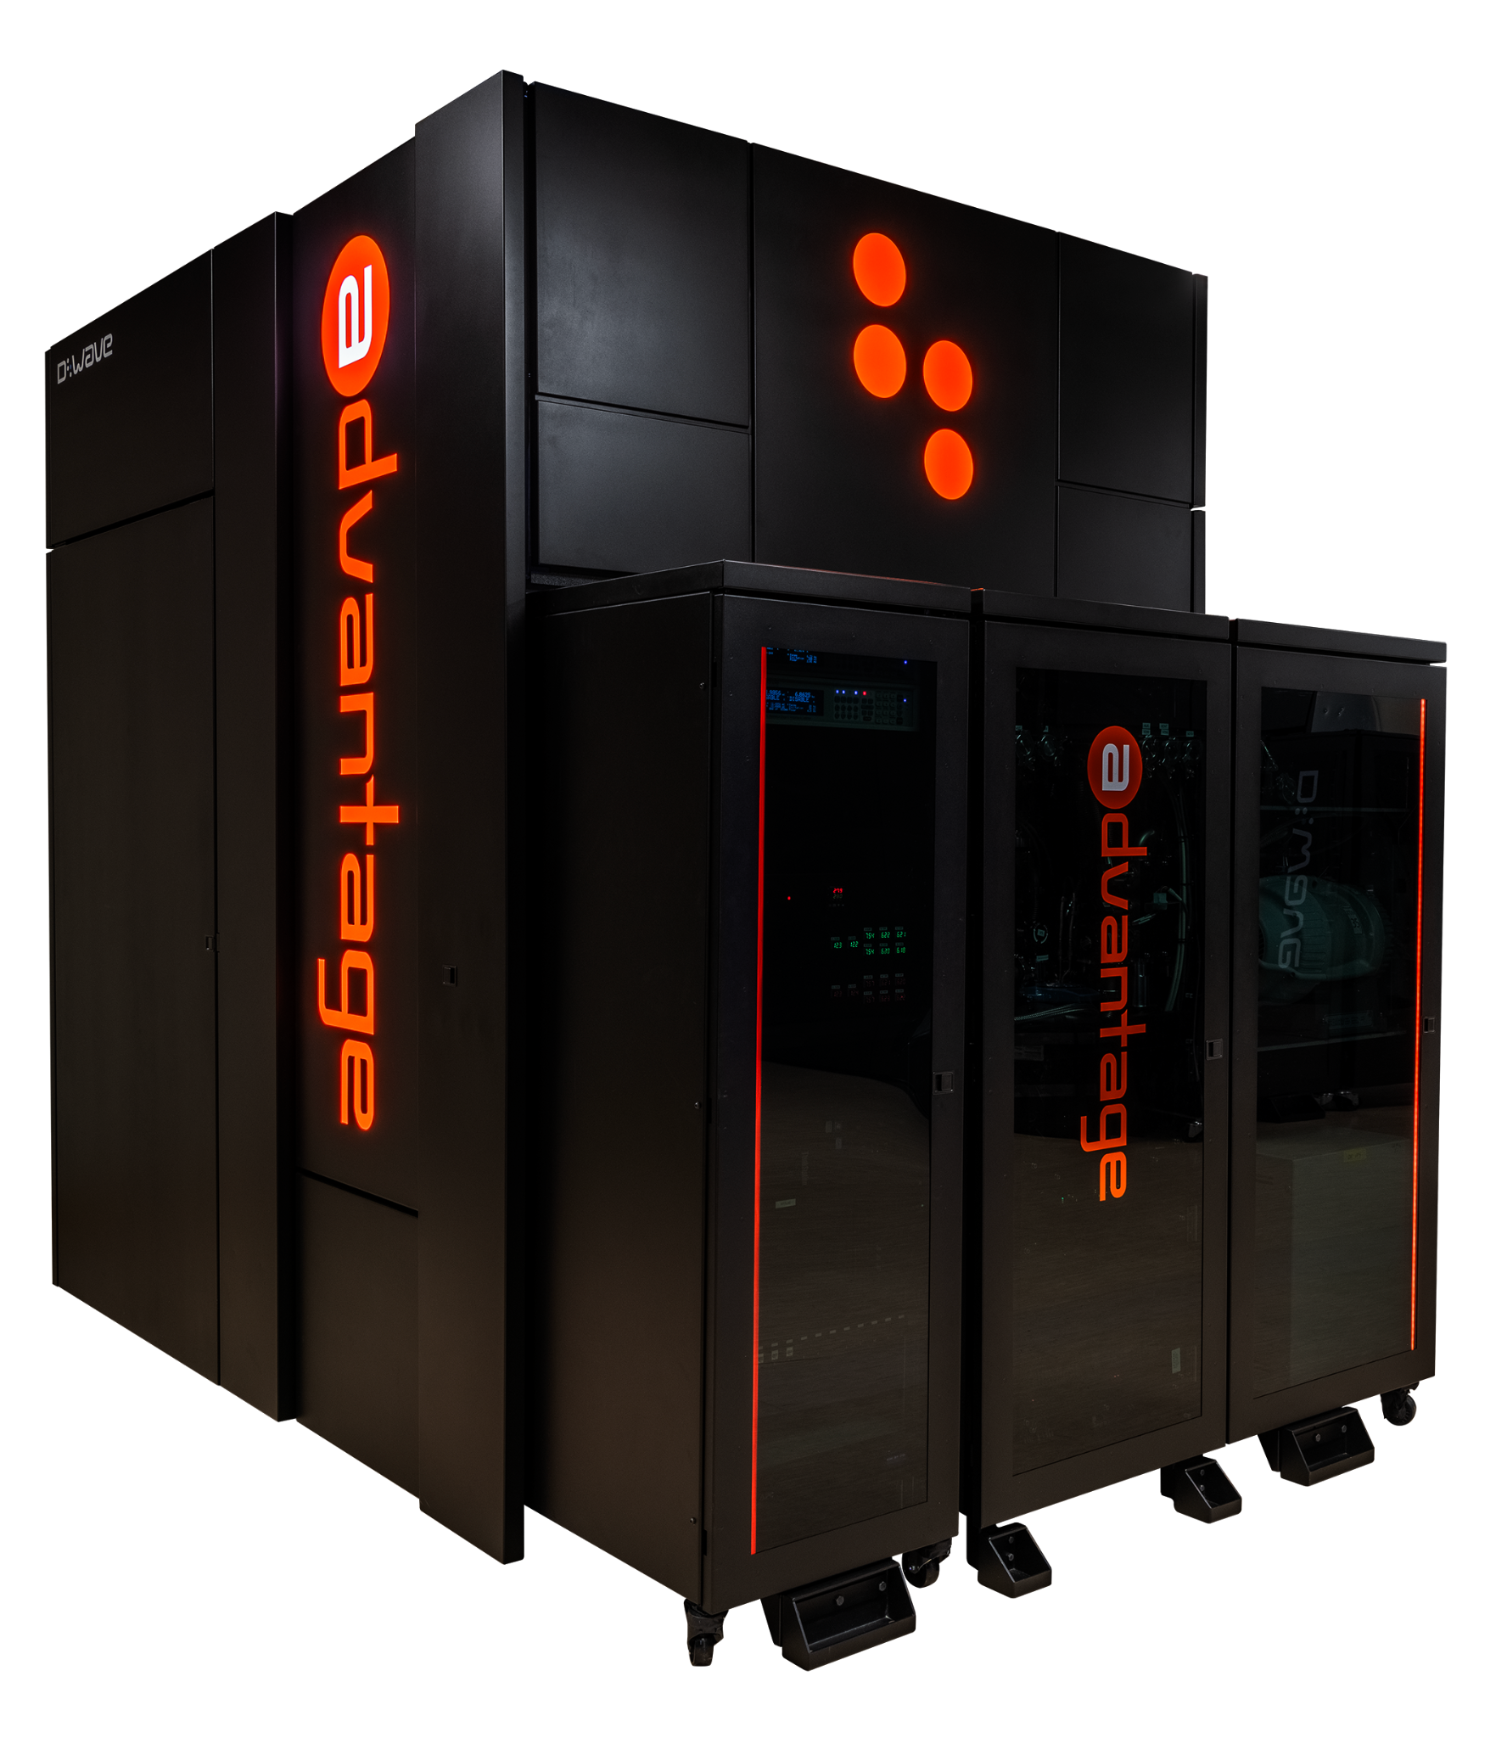
Quantum SVR
Q-SVR: re-formulation of SVR model that can be trained in a Quantum Annealer. (Pasetto et al.)
In theory: Q-SVR training is O(N) and SVR is O(N³), N=#training samples. (Date et al.)
In practice:
  Currently no time advantage from Q-SVR.
  Limited training size: ~20 samples.
Classical computer
Classical computer
SVR
not trained
trained
Q-SVR
QUBO
problem
QUBO
solutions
training samples
Quantum Annealer
We used the D-Wave AdvantageTM system JUPSI at the Jülich Supercomputer Centre

Slide 14
Swift-Hyperband
Fast-Hyperband: not suitable for integration with Q-SVRs.
Swift-Hyperband: new approach to combine performance prediction with Hyperband.
Fast-Hyperband
Swift-Hyperband
Multiple decision points inside each round
Only 1 decision point inside each round
Trains few SVRs
Trains many SVRs
Estimates σ for every SVR
No need to estimate σ
Not suitable for Q-SVRs
Suitable for Q-SVRs
Sequential
Easily parallelizable

Slide 15
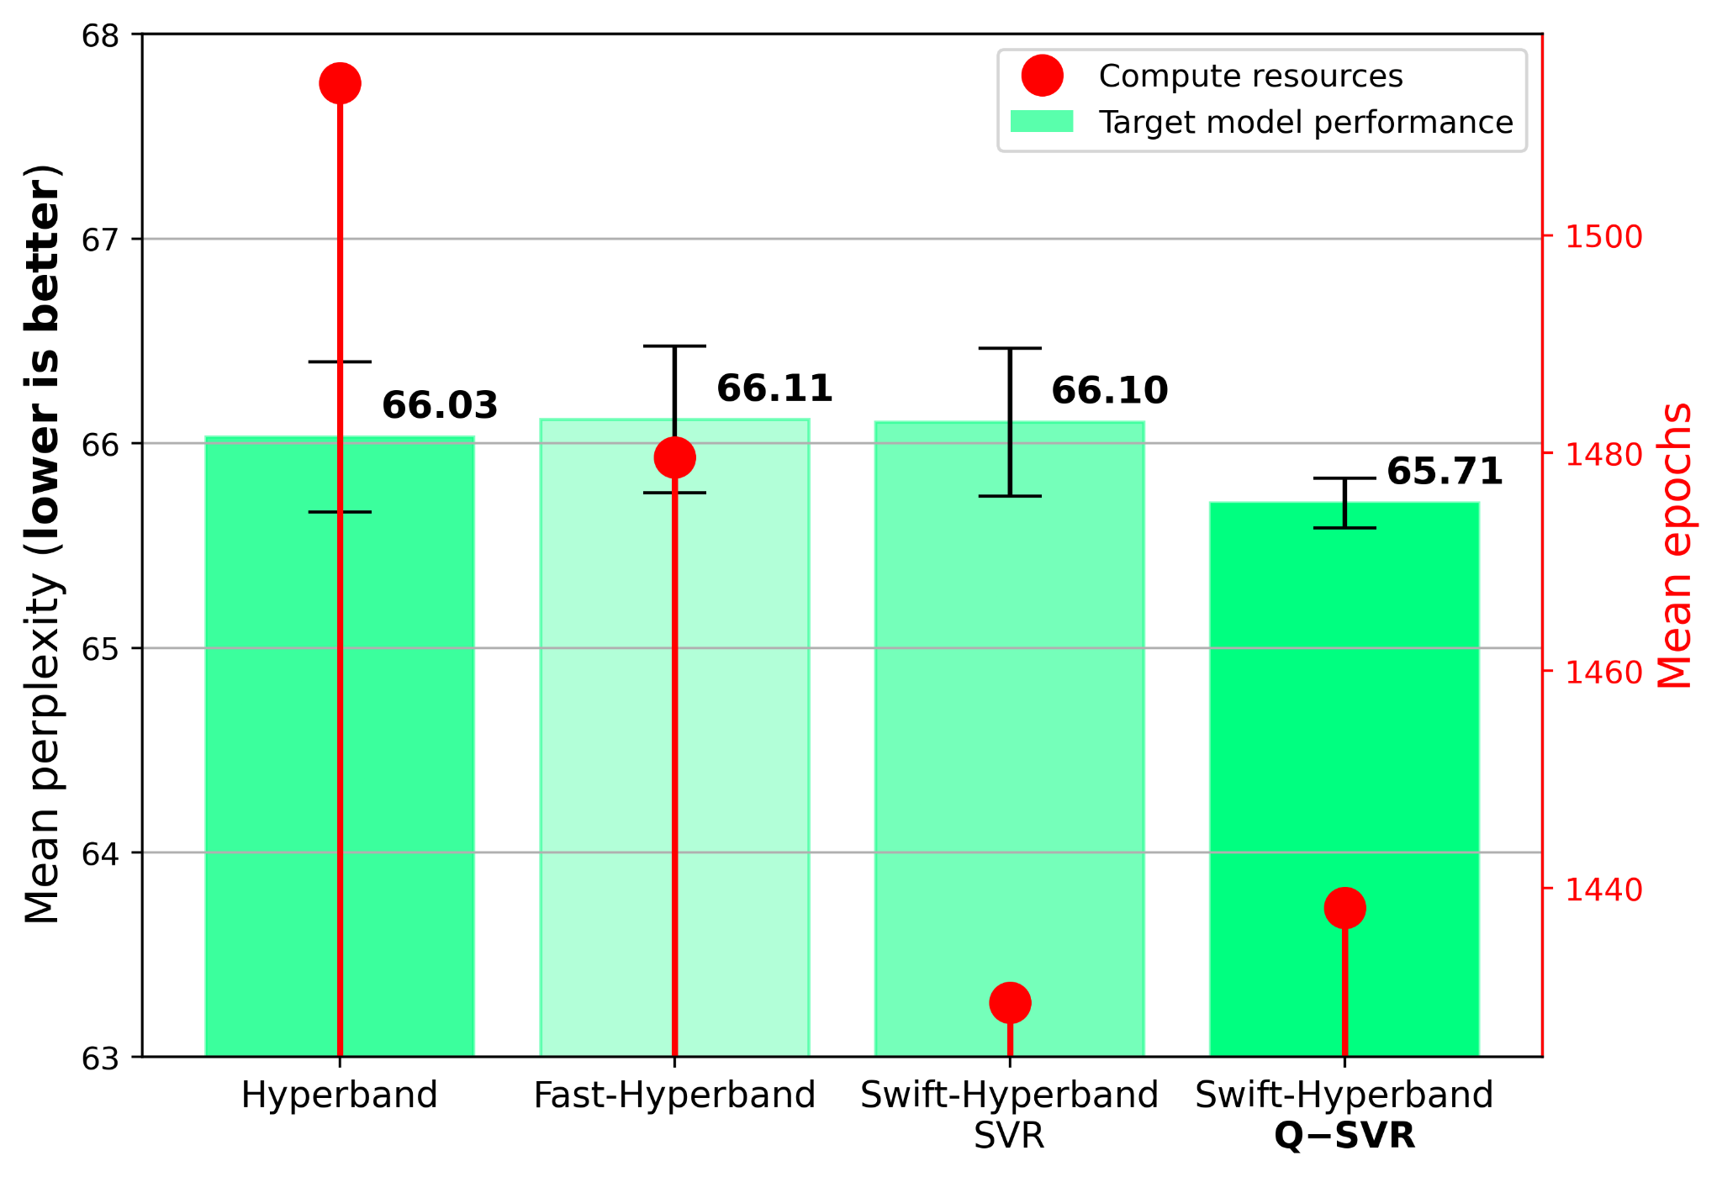
HPO algorithm comparison
LSTM for PTB - 2 HPs
Green bars show performance of the best found trial on the validation set
Red markings show consumed compute resources
Lower is better in both cases

Slide 16
Summary

Slide 17
Summary
CoE RAISE develops novel, scalable AI methods towards Exascale
  Use-cases from a wide range of sciences and industry
New open dataset available on the CoE RAISE website
Large-scale distributed HPO significantly increased model performance in the example use-case of Machine-Learned Particle Flow (MLPF)
Swift-Hyperband integrates performance prediction with Hyperband and runs in a hybrid Quantum-Classical manner

Slide 19
Backup

Slide 20
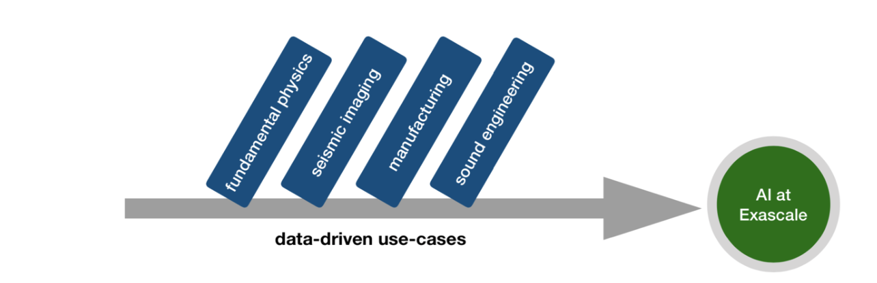
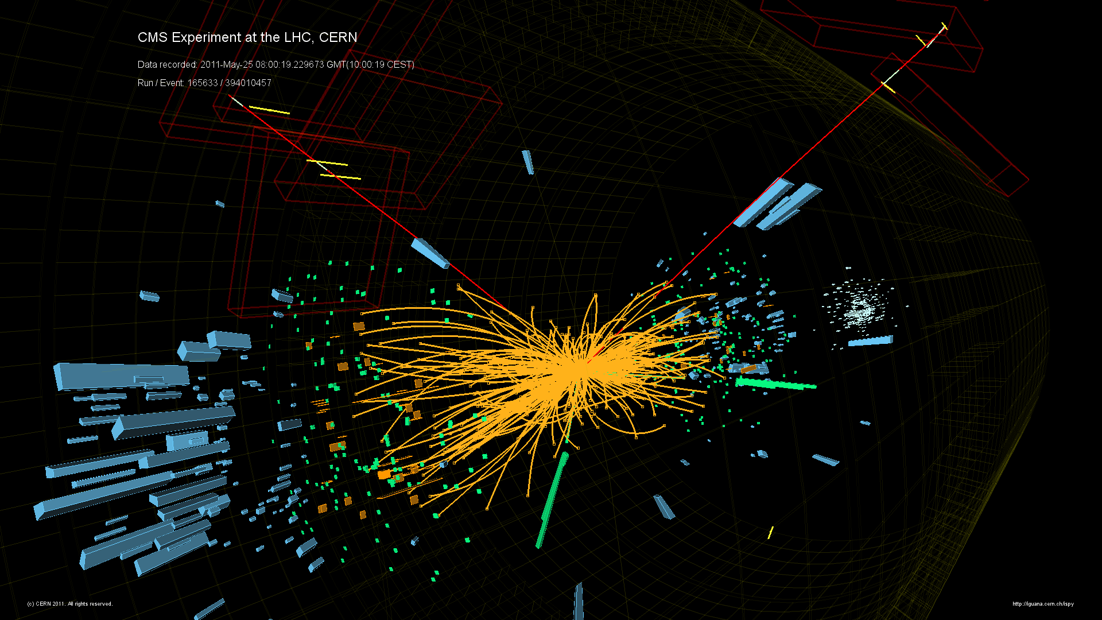
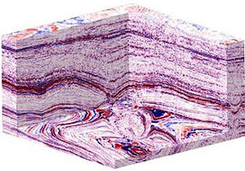
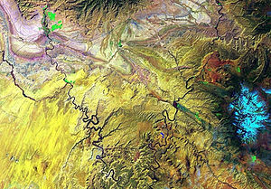
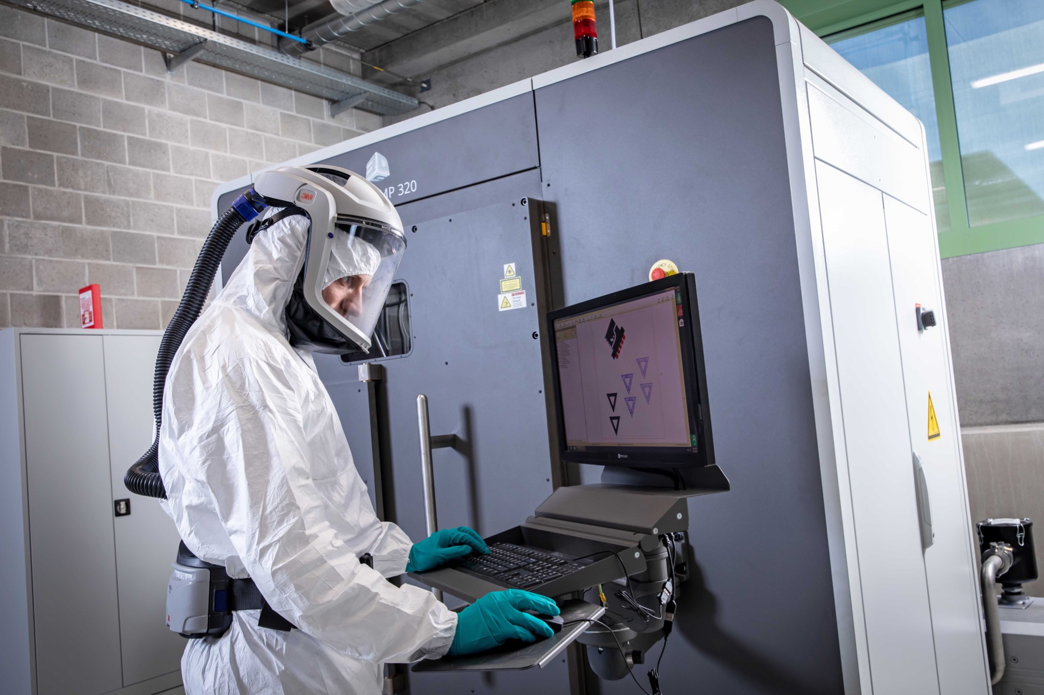
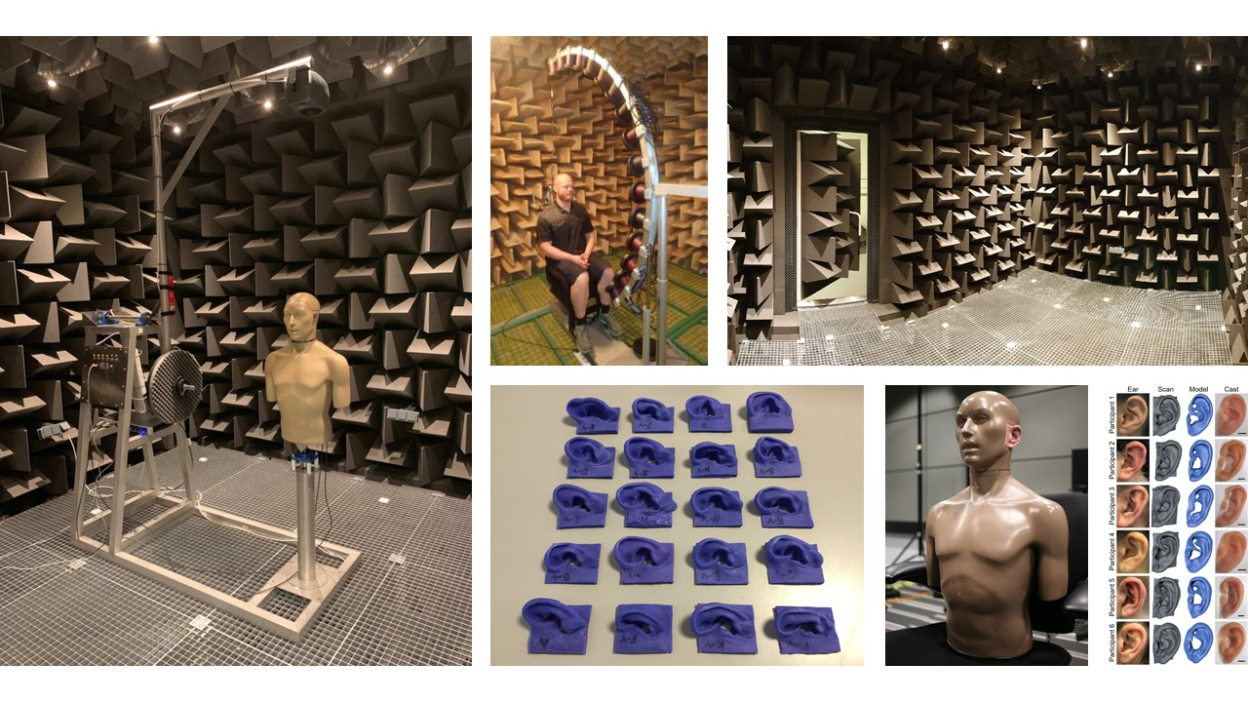
Data-driven use-cases
Representative use-cases from research and industry/SMEs, which have a strong focus on data-driven technologies, i.e., analyzing data-rich descriptions of physical phenomena
  Event reconstruction and classification at the CERN HL-LHC (CERN, RTU)
    develop novel approaches for HL-LHC collision event reconstruction replacing traditional algorithms with AI-driven techniques towards HPC-to-Exascale
  Seismic imaging with remote sensing for energy applications (FZJ, UOI, CYI)
    optimize seismic imaging and remote sensing, enabling AI approaches, combining satellite and airborne data with seismic imaging
  Defect-free metal additive manufacturing (UOI, FM)
    develop prediction models that detect porosity inside metal parts such that the information is exploited to improve the product quality in additive manufacturing
  Sound engineering (FZJ, UOI)
    develop a deep-learning-based algorithm that associates individual anatomy to a head-related transfer function (HRTF), for use in spatial audio systems

Slide 21
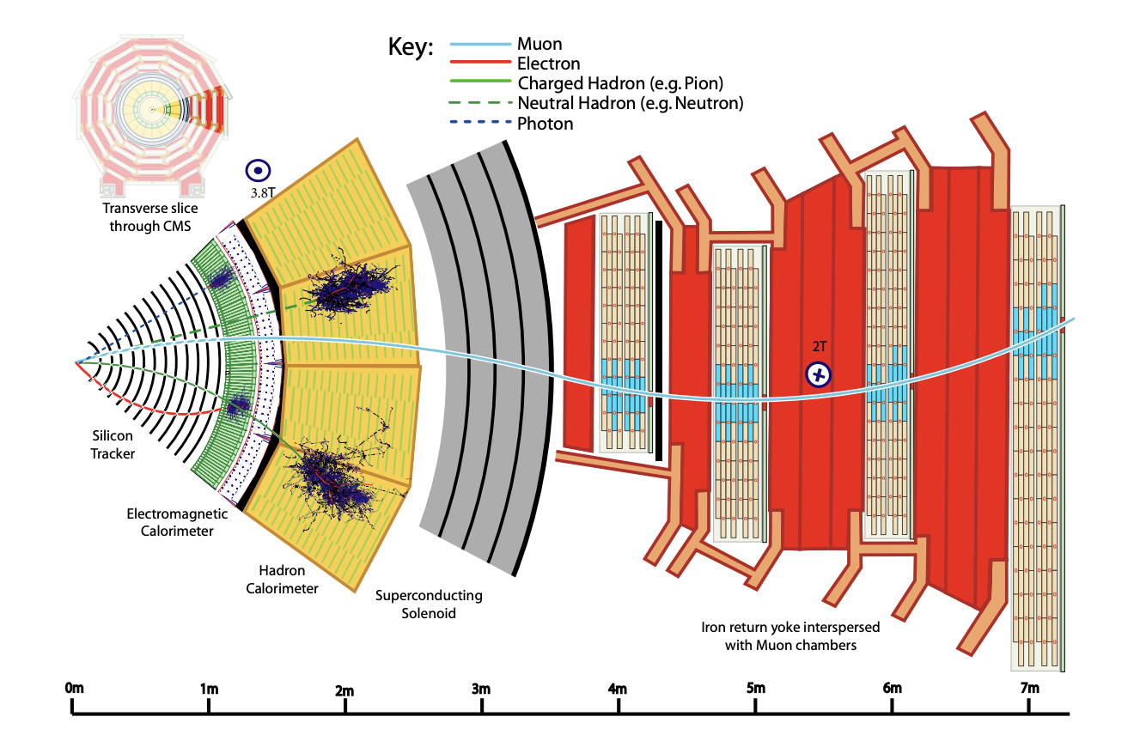
Event reconstruction at the LHC
Particle detectors at the LHC are extremely complex, with many subdetectors
Particles interact with the detectors and leave tracks and energy deposits
Information from subdetectors are combined to produce a particle-level interpretation of the event
Event reconstruction is the process of inferring higher-level physics objects from detector signals
Transverse slice through the CMS detector
JINST 12 (2017) P10003

Slide 22
New open dataset for supervised learning
~10k elements/event
Full detector simulation using GEANT4
Electron-positron collision in CLIC detector geometry
Dataset contains
  Calorimeter and tracker hits
  Tracks and calorimeter clusters
  Generator-level particles (ground truth for supervised learning)
  Baseline reconstructed particles (from a non-ML PF algo)
~100-300 elements/event
~300-500 elements/event
Joosep Pata, Eric Wulff, Farouk Mokhtar, David Southwick, Mengke Zhang, Maria Girone, Javier Duarte. Improved particle-flow event reconstruction with scalable neural networks for current and future particle detectors, (in press) Commun Phys, (2024) https://arxiv.org/abs/2309.06782

Slide 23

New open dataset for supervised learning
~10k elements/event
Full detector simulation using GEANT4
Electron-positron collision in CLIC detector geometry
Dataset contains
  Calorimeter and tracker hits
  Tracks and calorimeter clusters
  Generator-level particles (ground truth for supervised learning)
  Baseline reconstructed particles (from a non-ML PF algo)
~100-300 elements/event
Let’s focus on this part
~300-500 elements/event
Joosep Pata, Eric Wulff, Farouk Mokhtar, David Southwick, Mengke Zhang, Maria Girone, Javier Duarte. Improved particle-flow event reconstruction with scalable neural networks for current and future particle detectors, (in press) Commun Phys, (2024) https://arxiv.org/abs/2309.06782

Slide 24
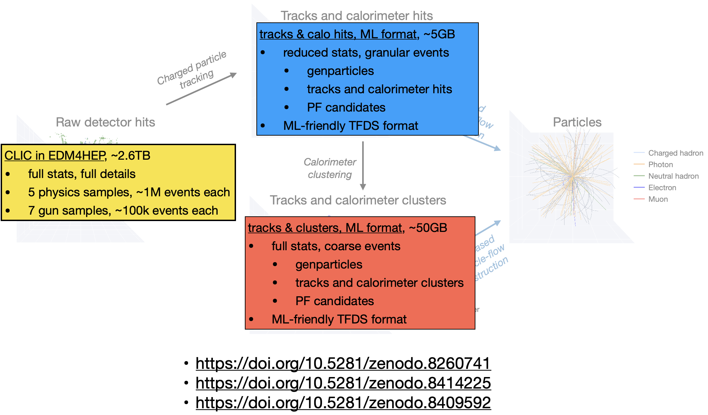
Open datasets

Slide 25
Improvement in training from HPO
HPO significantly improved model performance for both the GNN-based and the transformer-based MLPF models
GNN outperforms transformer
Validation loss
Jet resolution
MET resolution
Hypertuning
Hypertuning
Hypertuning
[1]
[1]
[1]
[1] Joosep Pata, Eric Wulff, Farouk Mokhtar, David Southwick, Mengke Zhang, Maria Girone, Javier Duarte. Improved particle-flow event reconstruction with scalable neural networks for current and future particle detectors, (in press) Commun Phys, (2024) https://arxiv.org/abs/2309.06782

Slide 26
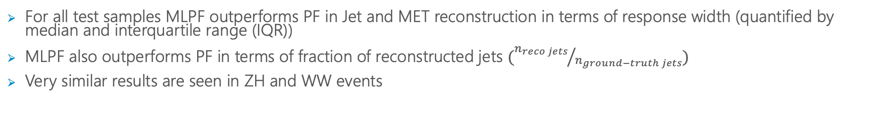
Jet and MET in ttbar + PU10 test data
For all test samples MLPF outperforms PF in Jet and MET reconstruction in terms of response width (quantified by median and interquartile range (IQR))
MLPF also outperforms PF in terms of fraction of reconstructed jets $({n_{reco jets}}/{n_{ground−truth jets}})$
Very similar results are seen in ZH and WW events
Jets resolution
MET resolution

Slide 27
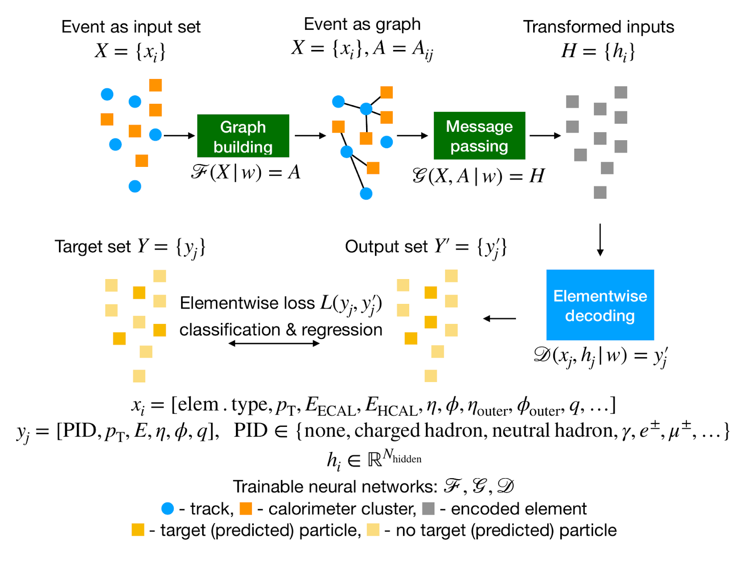
Machine-Learned Particle-Flow (MLPF)
The MLPF model
The Particle Flow (PF) Algorithm [1]
  Tries to identify and reconstruct all stable individual particles from collision events by combining information from different subdetectors (tracks, calorimeter clusters)
Machine-Learned Particle-Flow (MLPF) [2]
  GPU accelerated, GNN-based algorithm for PF
  Code available on GitHub
  See ACAT2021 talk by J. Pata (and proceedings) for more MLPF model details and ACAT 2021 talk by E. Wulff (and proceedings) for more details on the hypertuning of MLPF
  ACAT2022 poster
Based on Eur. Phys. J. C 81, 381 (2021)
https://arxiv.org/abs/2101.08578
[1] CMS Collaboration https://cds.cern.ch/record/1194487?ln=en
[2] Pata, J., Duarte, J., Vlimant, JR. et al. MLPF: efficient machine-learned particle-flow reconstruction using graph neural networks. Eur. Phys. J. C 81, 381 (2021). https://doi.org/10.1140/epjc/s10052-021-09158-w

Slide 28
Graph Neural Network (GNN) with Locality Sensitive Hashing (LSH)

Slide 29
Kernel-based self-attention Transformer

Slide 30
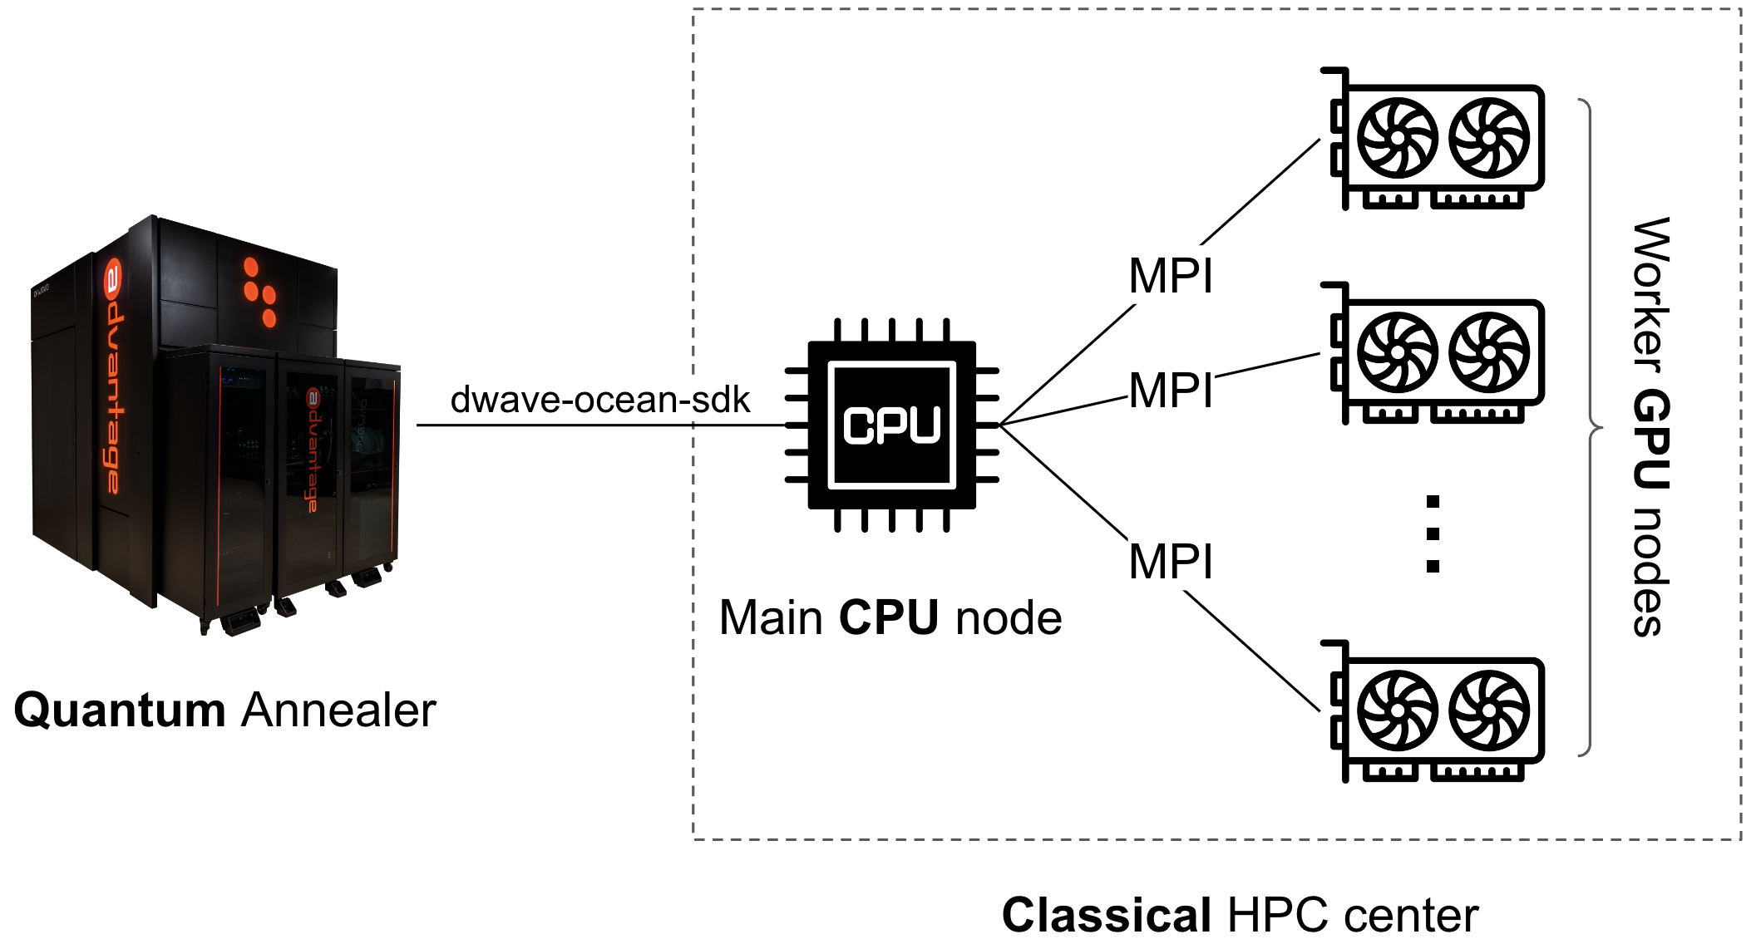
A Hybrid Quantum-Classical workflow for HPO
Hybrid Quantum-Classical Workflow
Distributed Hybrid Quantum-Classical Model Performance Prediction for Hyperparameter Optimization (HPO) of Deep Learning (DL) Models
Quantum Annealer (QA) aids classical GPU-accelerated HPC cluster in performing HPO
GPU cluster trains DL models
QA trains Quantum-SVR (QSVR) used to aid the HPO process
Promising results
Train DL
models
in parallel
Trains
QSVR
This work was shown at QTML at CERN 19th-24th November 2023 and continues the effort based on the following previous works:
  ACAT 2022, E. Wulff, J.P García Amboage, David Southwick, Maria Girone, Eduard Cuba
  CHEP 2023, E. Wulff, J.P García Amboage, David Southwick, Maria Girone, Eduard Cuba
  ISC 2023, M. Aach, E. Wulff, E. Pasetto, A. Delilbasic, R. Sarma, E. Inanc, M. Girone, M. Riedel, A. Lintermann
Quantum-SVR training workflow
SVR
not trained
Classical computer
Classical computer
trained
Q-SVR
QUBO
problem
QUBO
solutions
training samples
Quantum Annealer

Slide 31
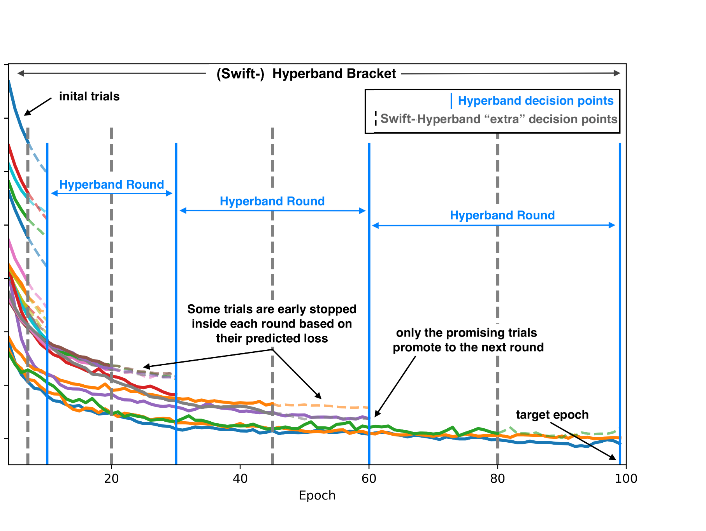
Swift-Hyperband
One extra decision point inside each round
At the beginning of the round some trials are fully trained to define a threshold.
The other trials are partially trained
If their predicted loss is lower than the threshold the trials are stopped before completing the round.
Loss
Trainings are done in parallel

Slide 32
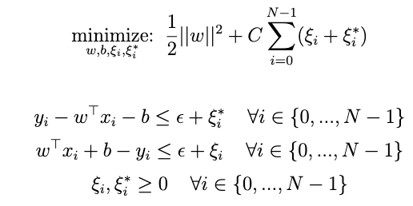
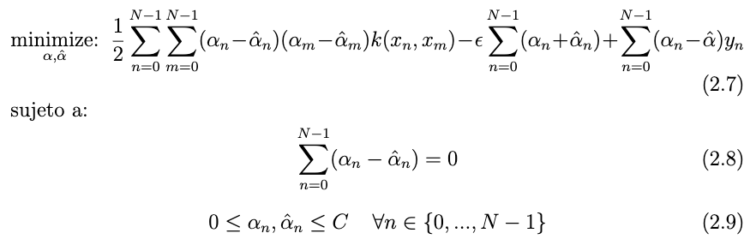



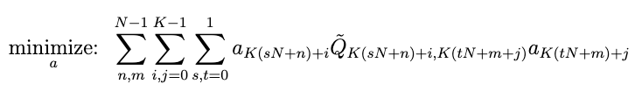
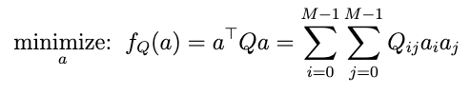

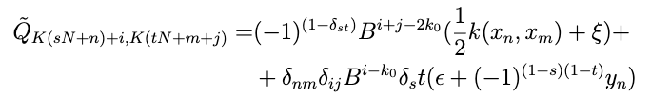
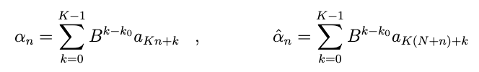

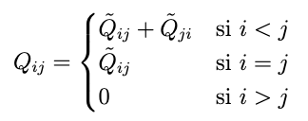
From SVR to Q-SVR formulation (Pasetto et al.)
Classical SVR primal formulation
Classical SVR dual formulation
1
2
predictions:
calculate b:
predictions:
Resulting problem with binary variables and without restrictions ✅
QUBO formulation
4
3
Add restriction as penalty term
Encode SVR variables using binary variables
“Ignore” the 2nd restriction
QUBO matrix for the canonical formulation:

Slide 33
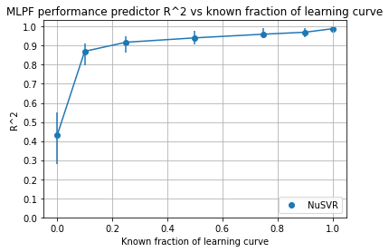
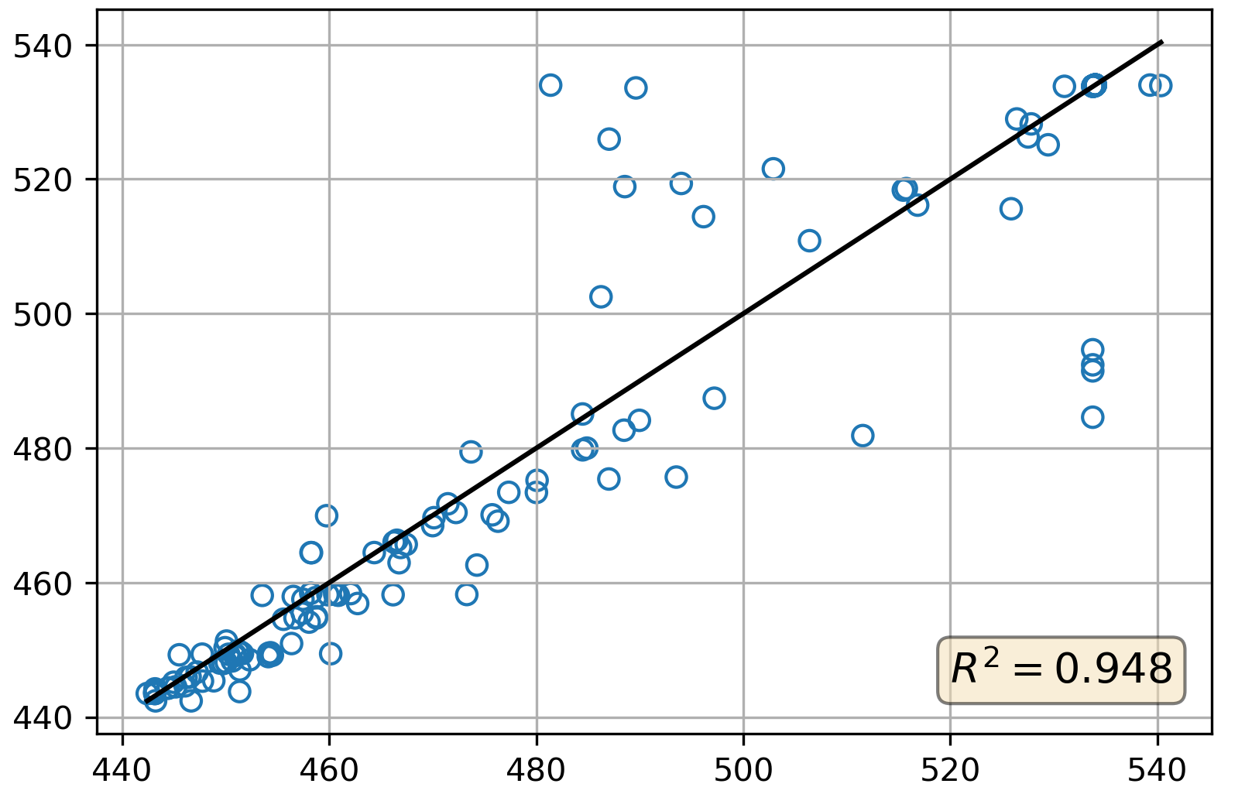
Performance prediction of MLPF
Very promising results for Q-SVR and SVR.
Best Q-SVR true vs predicted test values
train size = 20, known fraction of lc = 0.25
MLPF predicted loss
MLPF true loss

Slide 34
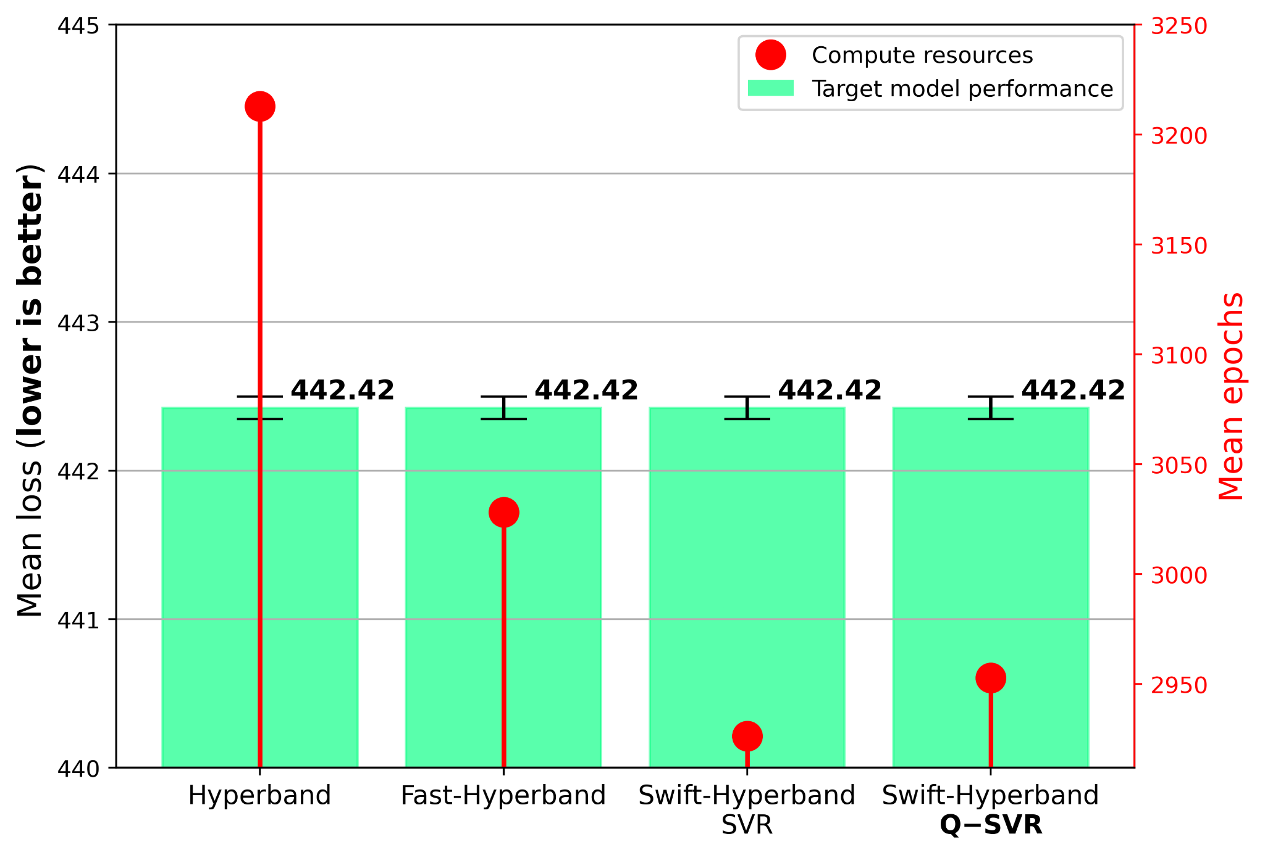
Algorithm Comparison
Simulated results using learning curve datasets
MLPF for Delphes - 7 HPs
LSTM for PTB - 2 HPs

Slide 35
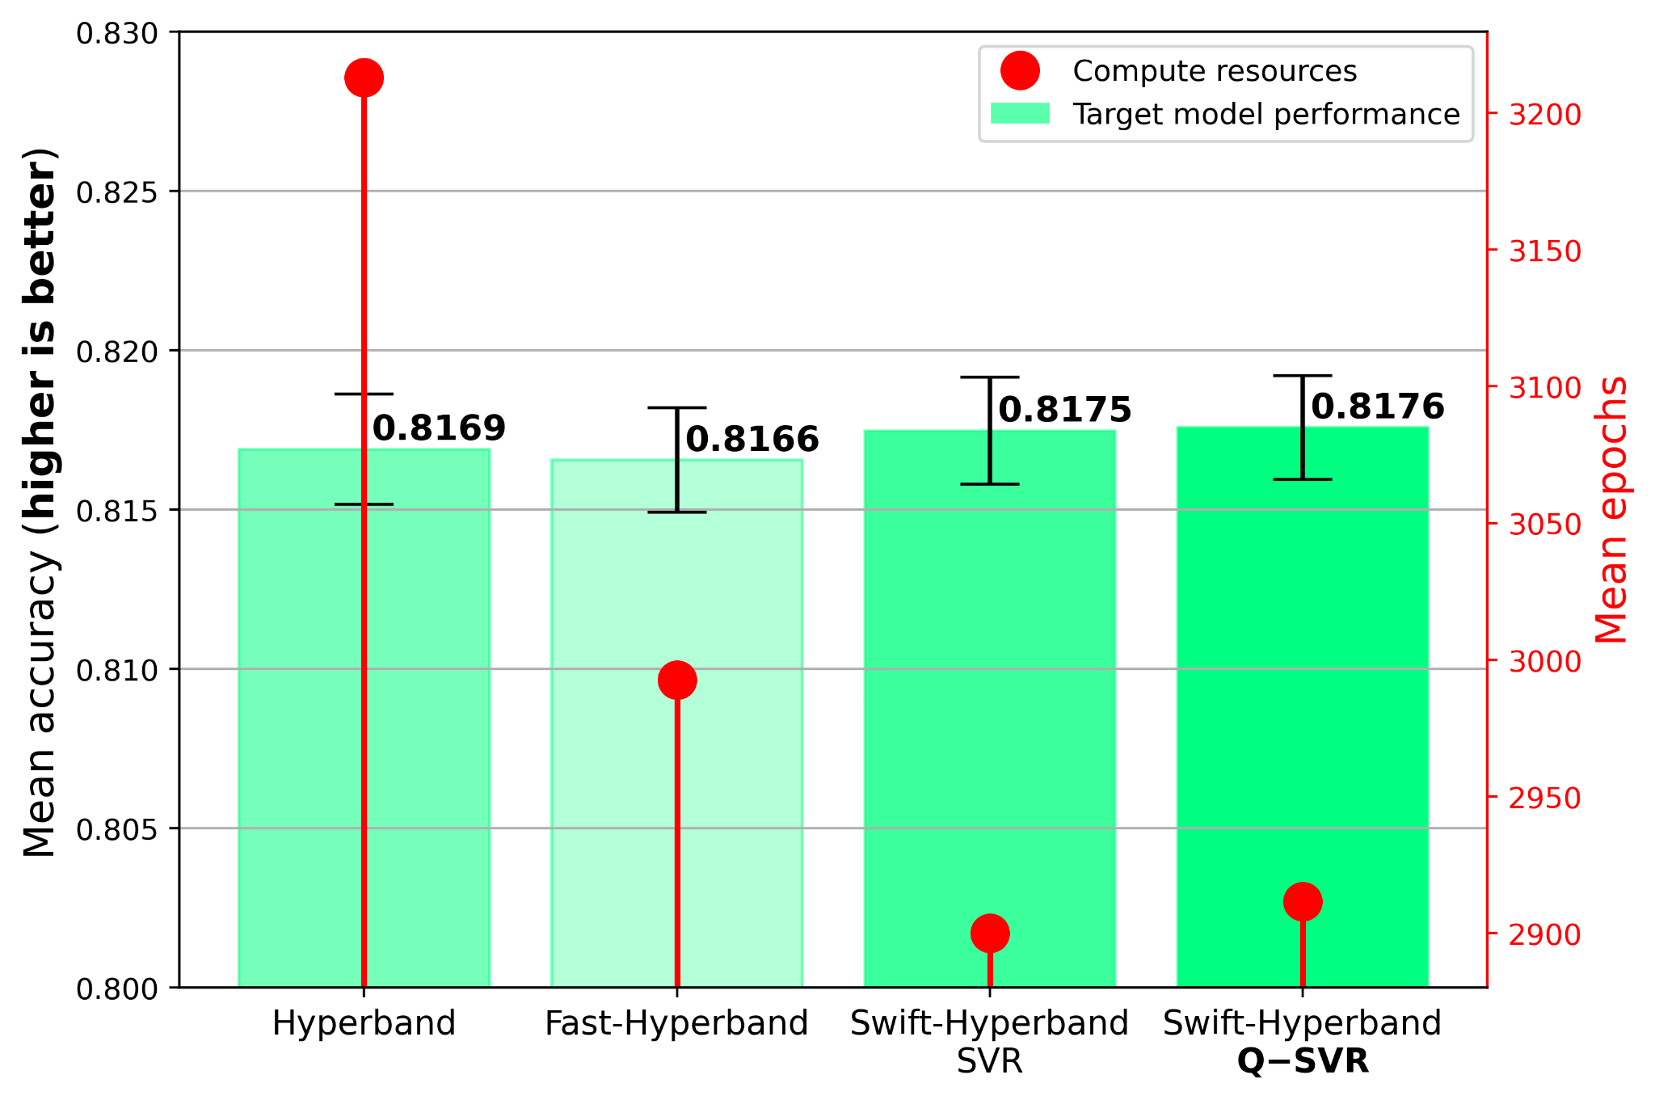
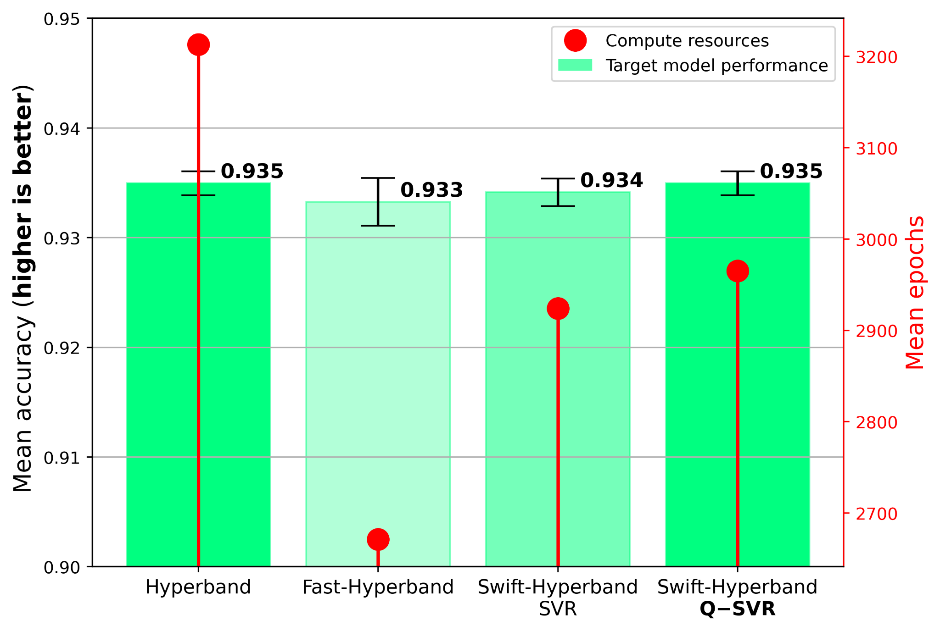
Algorithm Comparison
Simulated results using learning curve datasets
CNN for CIFAR-10 - 5 HPs
CNN for SVHN - 9 HPs

