Slide 1
Reinforcement learning for causal discovery and data quality monitoring
Funded by Hoffman la Roche
CERN OpenLab technical Workshop
?
?
Olivia Jullian Parra (CERN, Geneva)
Sara Zoccheddu (University of Zurich, Zurich)
Shah Rukh Qasim (University of Zurich, Zurich)
Julián García Pardiñas (CERN, Geneva)
Nicola Serra (University of Zurich/CERN, Geneva)
Milo Alan Puhan (University of Zurich, Zurich)
Henock Yebyo (University of Zurich, Zurich)
Maximilian Janisch, (University of Zurich, Zurich)
Thomas Lehéricy,(University of Zurich, Zurich)

Slide 2
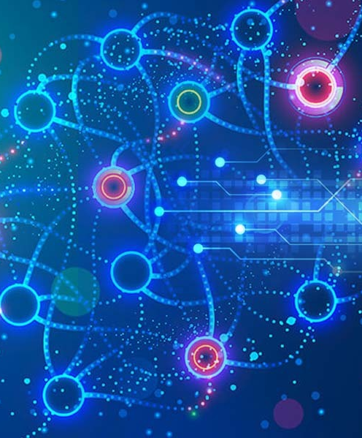
Index
1
Causal Inference Challenge
2
Understanding causal inference: causal discovery
3
Reinforcement Learning for causal discovery
4
4
Similarities between causal discovery and data quality monitoring techniques
5
Reinforcement Learning for data quality monitoring in HEP experiments
6
5
5
Conclusions and future steps

Slide 3
Causal inference challenge

Slide 4



When studying a treatment for a disease…
Treatment taken
Sufficient to accept the treatment effect
Treatment non taken

Slide 5
Causal inference challenge
Confounders
X
Patient variables that affect the outcome and treatment decision
Y
t
Outcome
Treatment
Treatment effect on patient variables
Treatment whose effect is under study

Slide 6
Machine Learning for causal inference
X
P(Z)
[N(0,1)]
X
Y
P(X,Y,t)
Q(X,Y/Z)
Y
t
P(Z)=Q(Z/X,Y,t)
What CVAE offers
Extract Z from X,Y,t (p(Z/X,Y,t)): acquire all the data responsible for the outcome Y
Predict Y (q(Y/Z,X,t)): have counterfactual data to understand how t affects the outcome Y
https://indico.cern.ch/event/1225408/contributions/5249322/

Slide 7
Proof of concept: statins treatment effect
Confounders
X
30 patient variables, some of them categorical
Y
t
Outcome
Treatment
Cardiovascular diseases
Statins to lower the cholesterol

Slide 8
Results on treatment effect prediction
CVAE
0.79
RCT
Target trial
0.74
0.78
Yebyo HG, Aschmann HE, Kaufmann M, Puhan MA. Comparative effectiveness and safety of statins as a class and of specific statins for primary prevention of cardiovascular disease: A systematic review, meta-analysis, and network meta-analysis of randomized trials with 94,283 participants. Am Heart J. 2019 Apr;210:18-28. doi: 10.1016/j.ahj.2018.12.007. Epub 2019 Jan 10. PMID: 30716508.
Yebyo, H. G., Günthard, H. F., Rehfuess, E. A., Serra, N., Haile, S. R., Senn, O., ... & Puhan, M. A. Statins for Primary Prevention of Cardiovascular Events in People Living with HIV: A Target Trial and Benefit Harm Balance Modelling Study. Available at SSRN 4427462.

Slide 9
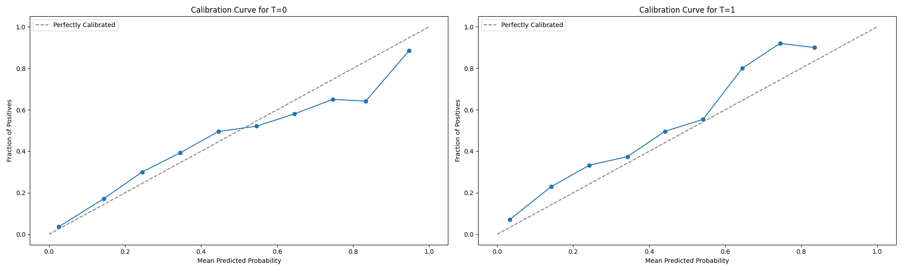
CVAE calibration
Calibration when treatment is not taken
Calibration when treatment is taken
Fraction of positives
Predicted probability
Predicted probability
Small overestimation of the risk when the treatment is taken

Slide 10
Limitations
Unobserved confounders: what is the real X?
Benefit-Harm treatment study
Y
What if there are new variables to consider for the treatment effect?
X
X
X
X
t
X
Y
t
X
X
Multiple interactions
X
t
What if there are multiple treatments in place to test?
X
Y
t
What if the treatment also affects other X variables?
Y

Slide 11
Causal discovery
?
?

Slide 12

Causal Discovery pipeline
We have observational data
We find causal relationships
X
X
t
X
Y
t
Y
We use a Reinforcement Learning (RL) algorithm

Slide 13
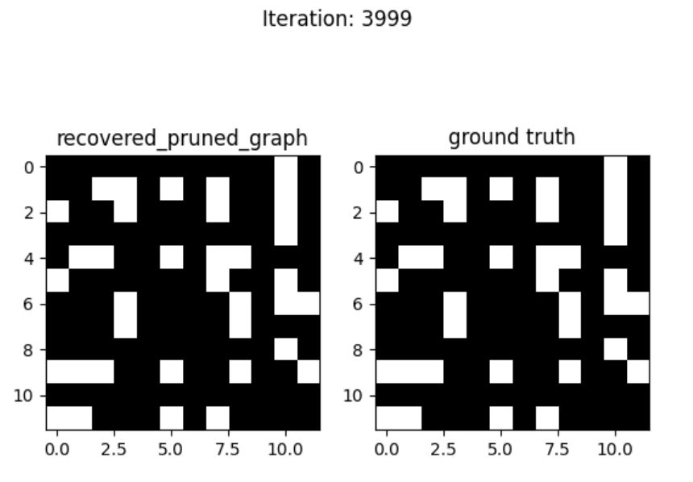
Experiments
Toy dataset
Variables have linear-gaussian dependencies
The variance of the values is the same for all of them
    Node i
    Node j
Zhu, S., Ng, I., & Chen, Z. (2019). Causal discovery with reinforcement learning. arXiv preprint arXiv:1906.04477.

Slide 14
Actor-Critic model for RL
Reward
Reward
Based on the Bayesian Information Criterion for the best graph selection
Adds penalties to include expert knowledge
Used to update the algorithm
Generates
Critic
Environment
Observational data
Evaluates
Actor
Action taken by the actor
Actor
Critic
Environment
Takes a state derived from all the observational data
Works under a policy
Proposes a causal graph candidate
Evaluates the graphs proposed by the actor
Predicts again the obs. data using the graph proposed (needs optimization)
Representation of the observational data collection
Represents all the possible patient variables, treatments and outcomes

Slide 15
Data quality monitoring
Reduce bias in the data
Systems are imperfect and may bias the collected data.
Detect and correct system errors
When the system status is incorrectly classified as good, measurements are biased.
Goal
When the system status is incorrectly classified as bad, data collection efficiency reduces.
Improve data collection efficiency

Slide 16
Actor-Critic model with human feedback
Reward
Reward
Used to update the algorithm
Generates
Scheme reward based to allow the correctness and confidence level of the actor
The human will provide the reward
Critic
Environment
Observational data
Evaluates
Actor
Action taken by the actor
Actor
Environment
Proposes an action for the system status and tries to integrate the human feedback to its policy
Representation of the system monitoring
The state is a collected histogram of the system status
https://indico.cern.ch/event/1297159/contributions/5729221/

Slide 17
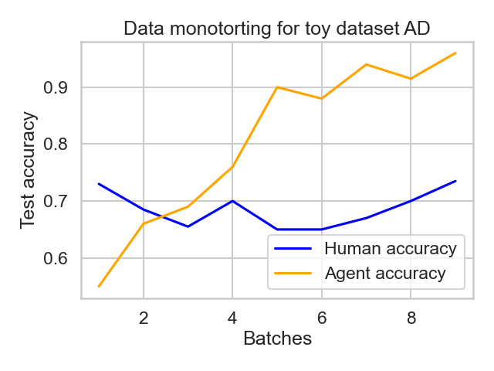

Results
We can achieve superhuman condition for the offline regime
How do we know when to rely on the machine? We are currently performing studies on the detection of superhuman condition during training, without having access to the ground truth$1$
Probability of human failure: 0.3
¹ Bar, O., Drory, A., & Giryes, R. (2022, May). A spectral perspective of DNN robustness to label noise. In International Conference on Artificial Intelligence and Statistics (pp. 3732-3752). PMLR.

Slide 18


Conclusions
Causal inference achieve. We can use them for more complex use cases to complement RCTs
First steps done towards causal discovery. Able to abstract the algorithm and adapted it to new use cases
Ability to assist the shifter decisions without necessity of their constant feedback and automatize some system’s checks
Causal Inference
Causal discovery
Data monitoring

Slide 19
Thanks
for your attention

Slide 20
Q&A
olivia.jullian.parra@cern.ch

Slide 21


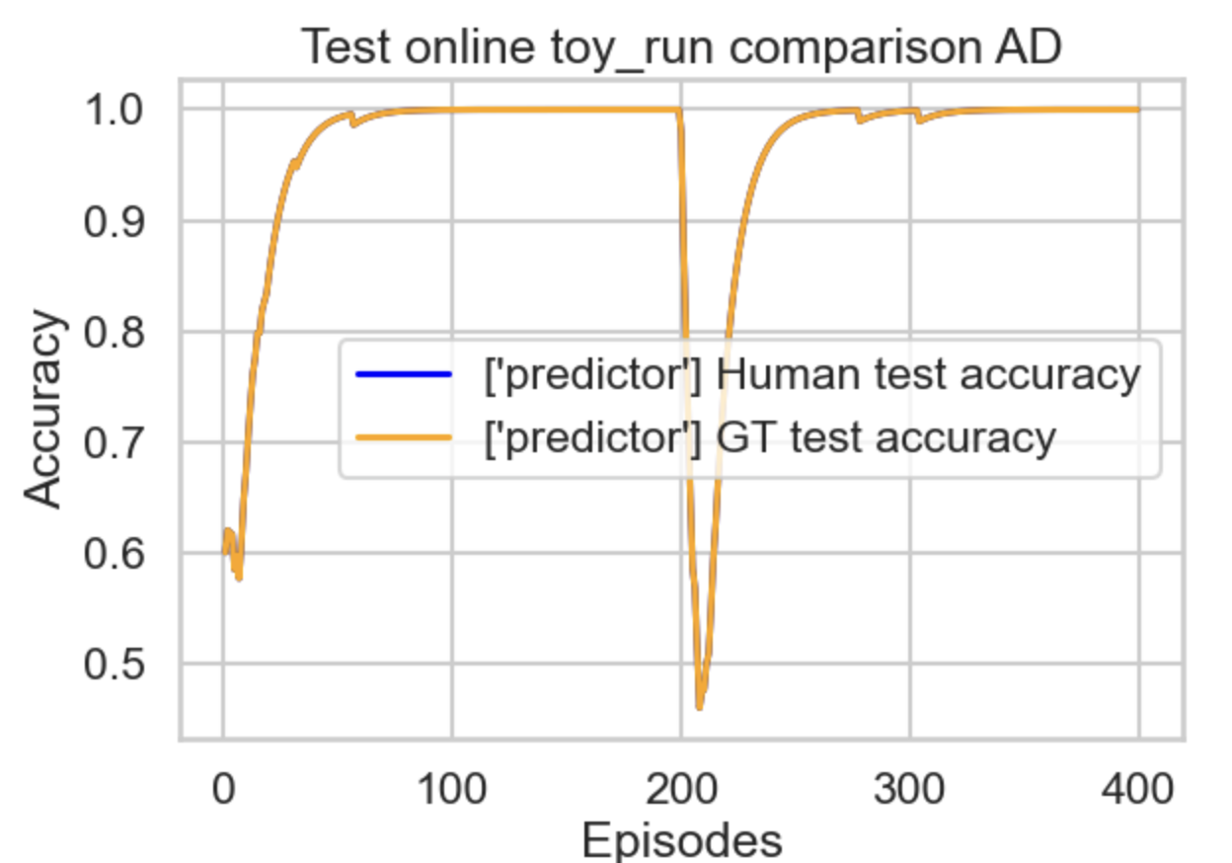
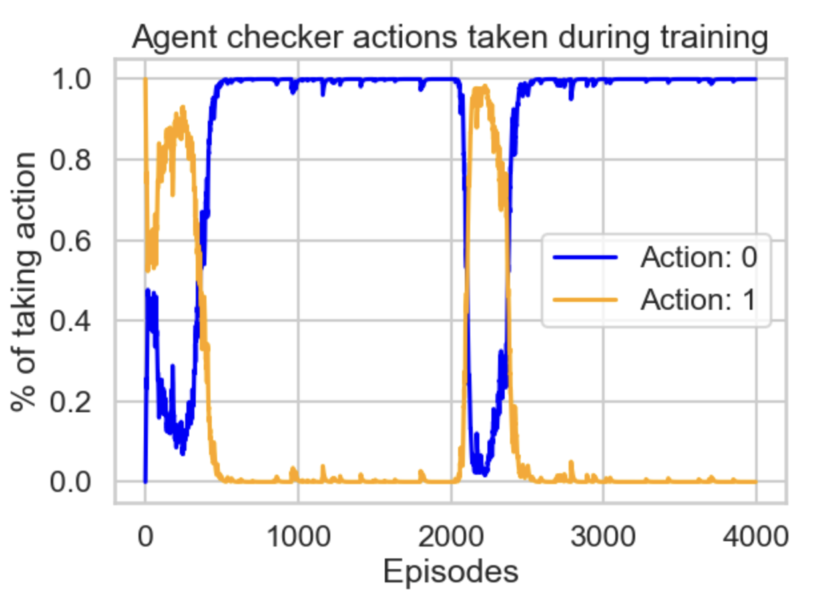

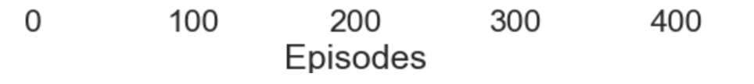
Results for changing conditions
    Anomalies changing over the time
    Integration of human feedback

