Slide 1
Bringing Devs, DBAs, and GenAI
Together
Cris Pedregal-Martin | John Lathouwers
Member Technical Staff | Developer Evangelist
http://bit.ly/oraclespringboot

Slide 2


Cris Pedregal-Martin
Member Technical Staff
Mission Critical Technologies

Slide 3
Top 3 Areas
Kubernetes as a vehicle to bring DBAs, Developers and Gen AI together
Design of Backend as a Self-Service (BaaS) multi-cloud platforms
      Cloud-agnostic and on-premises stack components
Delivering value from Gen AI – on structured and unstructured data
      Starting with knowledge assistants (copilots) for
        Support teams – root cause analysis
        Generating SQL to chat with data
        Developer documentation

Slide 4
Top 2 Themes
Simple
Collaborate
Notes:
Simple
Apps, data, workflows, deployment, cloud environments, Kuberbetes, DevOps, Observability
Collaborate
Share best practices, innovation in Gen AI, models, data, vectors,

Slide 5

John Lathouwers
ex-DBA at UBS and Credit Suisse
Designed the Hands on Workshop to help Oracle DBA’s understand and support Microservices Architecture and Kubernetes Infrastructure
https://bit.ly/KubernetesForDBAs
Built the automation for Oracle Backend for Spring Boot and Microservices Platform:
https://bit.ly/oraclespringboot
Developer Evangelist
Oracle Database

Slide 6

Who Are We?
Developer Evangelists
Real World Experience
Ask Questions
Listen
Translators?!?
Goal:
Make Developers Life Easier

Slide 7
Education and Innovation
Contribute our Knowledge and Expertise

Slide 8
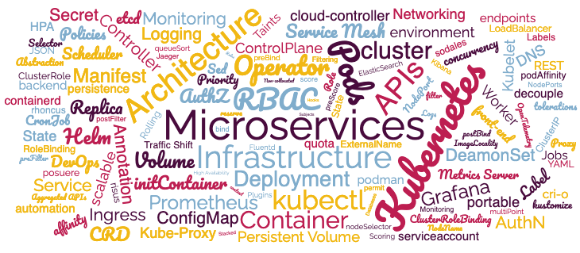
Microservices & Kubernetes

Slide 9
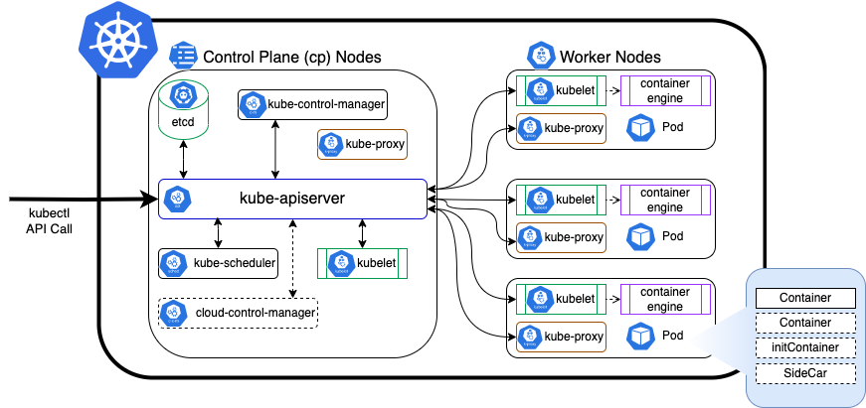
Kubernetes Cluster
A loose comparison with a RAC cluster
kubectl (srvctl)
Control Plane (Grid Infrastructure)
  API Server (crsd – sort of)
  etcd (OCR)
Worker Nodes (Cluster Nodes)
Pods (DB Instances)
Containers (Schema)
kube-proxy (Listeners)

Slide 10
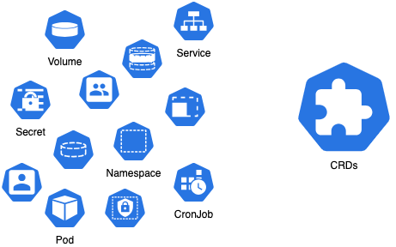
Custom Resource Definitions
CRDs provide a means to extend the types of resources that can be managed in a Kubernetes Cluster.
Oracle Autonomous Database
Oracle Autonomous Container Database
Containerized Oracle Single Instance Database and Data Guard
Containerized Oracle Sharded Database
Oracle Multitenant Database
Oracle Base Database Cloud Service (BDBCS)
Out-of-the-Box

Slide 11
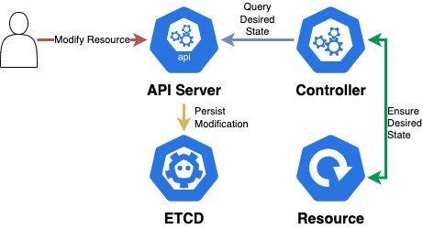
Controllers
Kubernetes comes with a set of built-in Controllers that run inside the kube-control-manager:
Operate in a continuous loop
Monitor Current State of Resources
Compare Current State with Desired State
Send Instructions to ensure Current State is Desired State

Slide 12
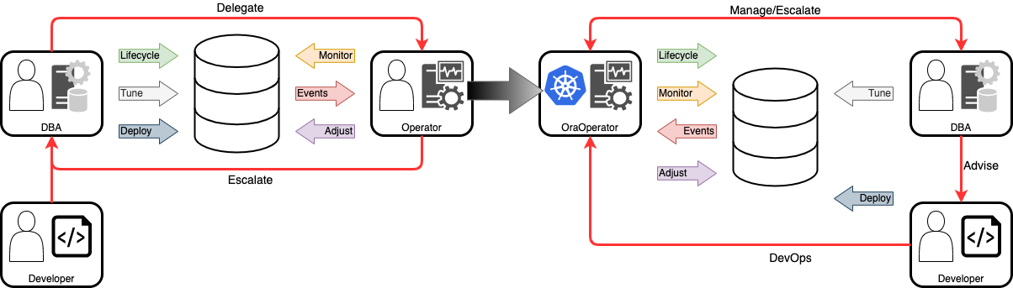
Oracle Database Operator for Kubernetes
aka OraOperator
CRDs
Controller
Non-Native
Kubernetes-Native

Slide 13
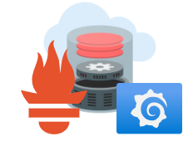
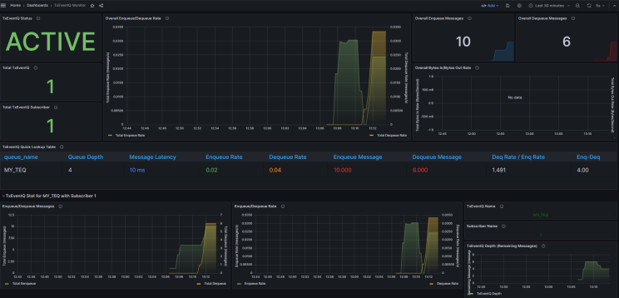
Oracle Database Observability Exporter
Oracle Database
Prometheus/Loki
Grafana
Standard Metrics
Availability
Session Activity
Wait Events
Tablespace
Processes
Session

Slide 14
Experience into a Platform
Understand the Challenges, by Experiencing Them

Slide 15
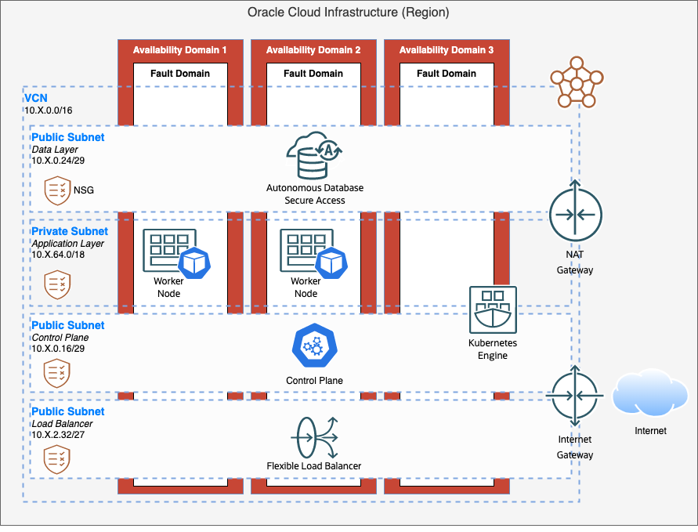

Infrastructure as Code
Autonomous Database
Networking
  NAT Gateway
  Internet Gateway
  Security Groups
Worker Nodes
Control Plane
Load Balancer (Service)

Slide 16
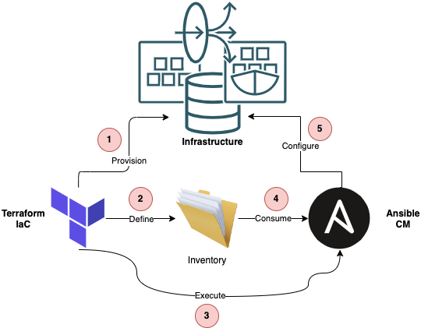
Infrastructure as Code meets Configuration Management
Process
Provision Infrastructure as Code
Define Infrastructure Inventory
Run Ansible Configuration Management
Ansible Consumes Inventory
Configure Infrastructure
Benefits
Declarative
Easily Extendable
Isolated IaC vs CM
  Multiplatform
  Testing optimisation
Parallelisation
  Configure as Infrastructure is available

Slide 17
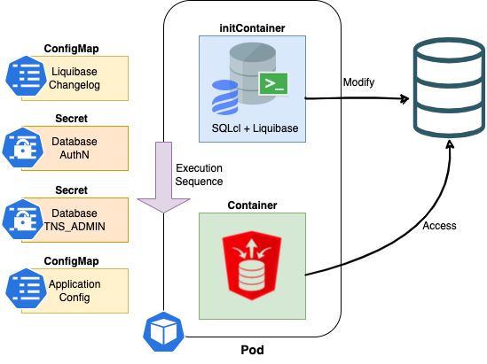
SQLcl + Liquibase
An initContainer is perfect for ensuring the database has the correct users, permissions, and objects present for the application container to use.
Liquibase is an open-source tool that enables you to define, manage, and version control your database schema.

Slide 18





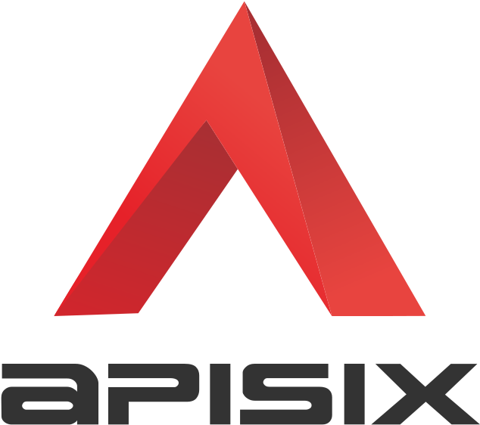


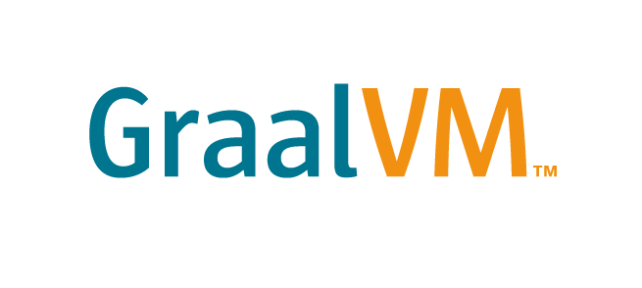

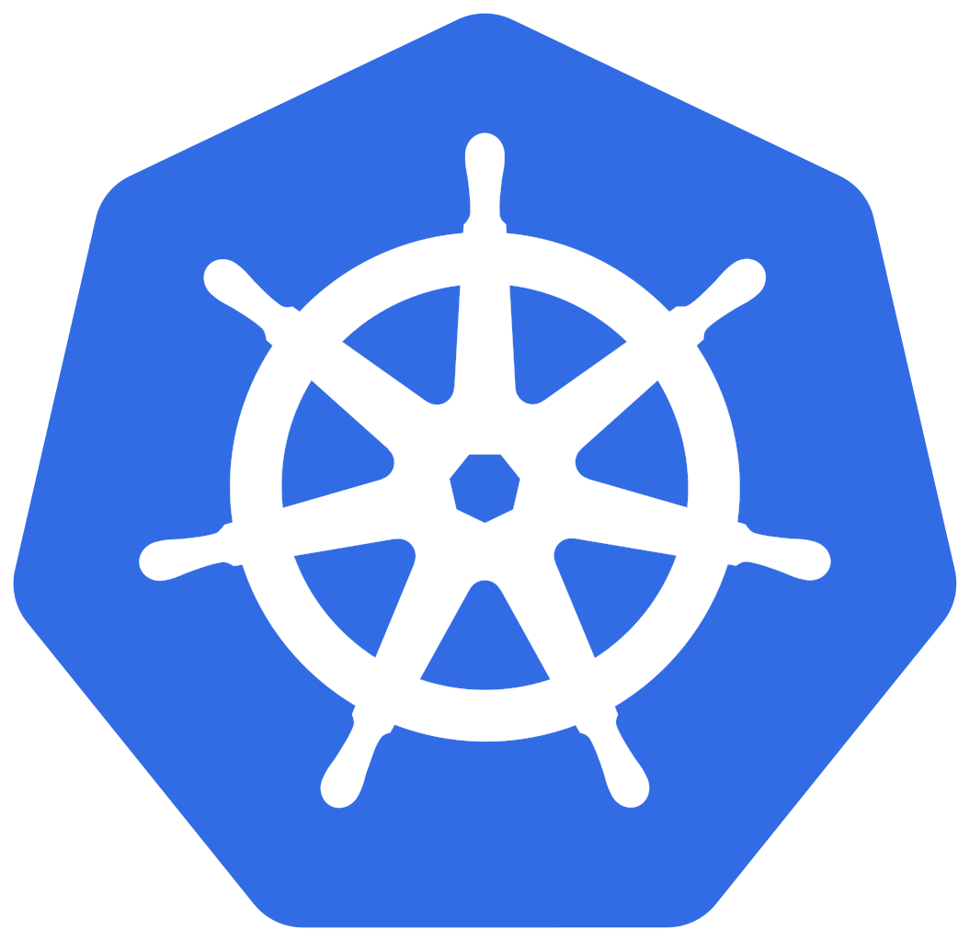


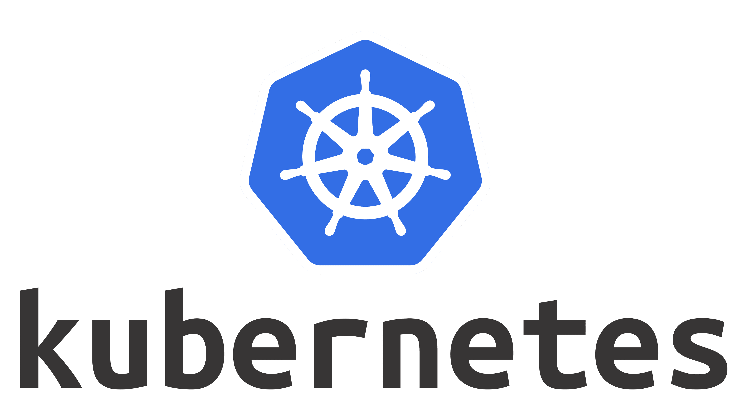
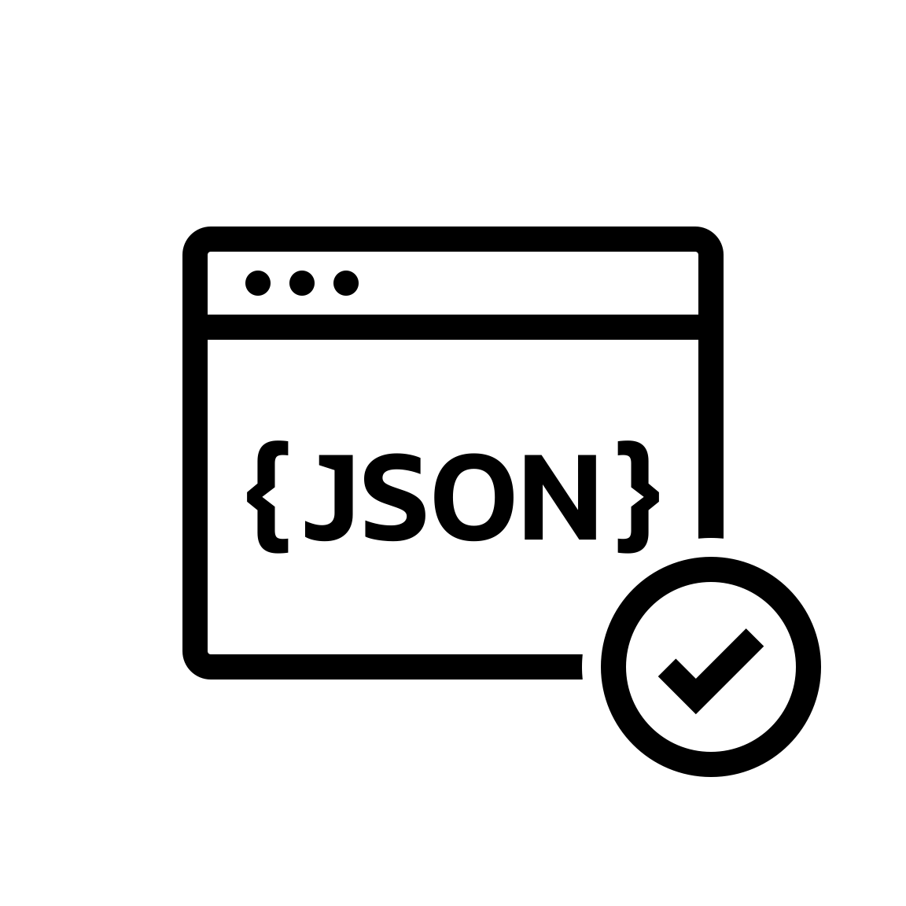


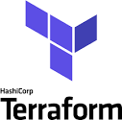


A Production Platform
OBaaS CLI
Spring Ops Center
Service Discovery
Workflows
Apps Dashboard
Security
Auth &
Access Networking
Extensible
Components
(e.g. SAP, Cosmos)
API Gateway
Dashboard
Parse Oracle Database Adapter
Spring Apps
App Container
App Container
App Container
App Container
Circuit breakers, client-side load balancing, fault tolerance
Resilience4J, OpenFeign, Spring Config
Relational
Documents
Mobile SDKs
Events
iOS, Android, Unity,
React Native, Flutter Node.js, .Net, PHP, C, Arduino
Oracle Database
Spatial
Graph
Multitenant architecture for microservices
Text Search
Oracle Backend for SpringBoot and Microservices

Slide 19

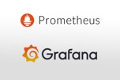
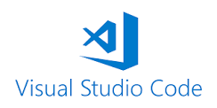

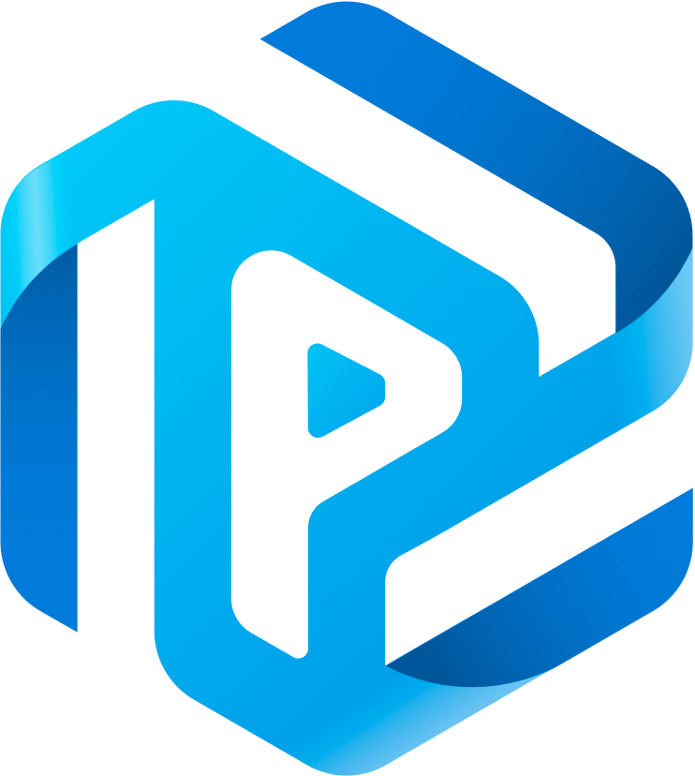


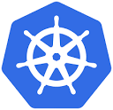


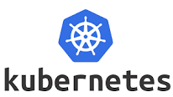

What’s Next… Docs for Devs
AI and Retrieval Augmented Generation (RAG)
Platform Control Center
LLM
Llama2
Prompt
flow
Prompt
flow
Apps Dashboard
Security
Auth and
Access +
Responsible
AI
Prompt
Flow
Responsible
AI
Filters
Vector
Similarity
Search
Prompt +
Metadata
To LLM
Vectorize
Data
GPUs
External
LLMs
Cohere, OpenAI, Anthropic
APIs
CRM
Chatbot
Container
Security
Chatbot
Container
Other
AI
Apps
Other
AI
Apps
Enterprise
Data
Sources
Documents
AI Vector
Oracle Database
Relational

Slide 20
Resources
LiveLabs and More

Slide 21









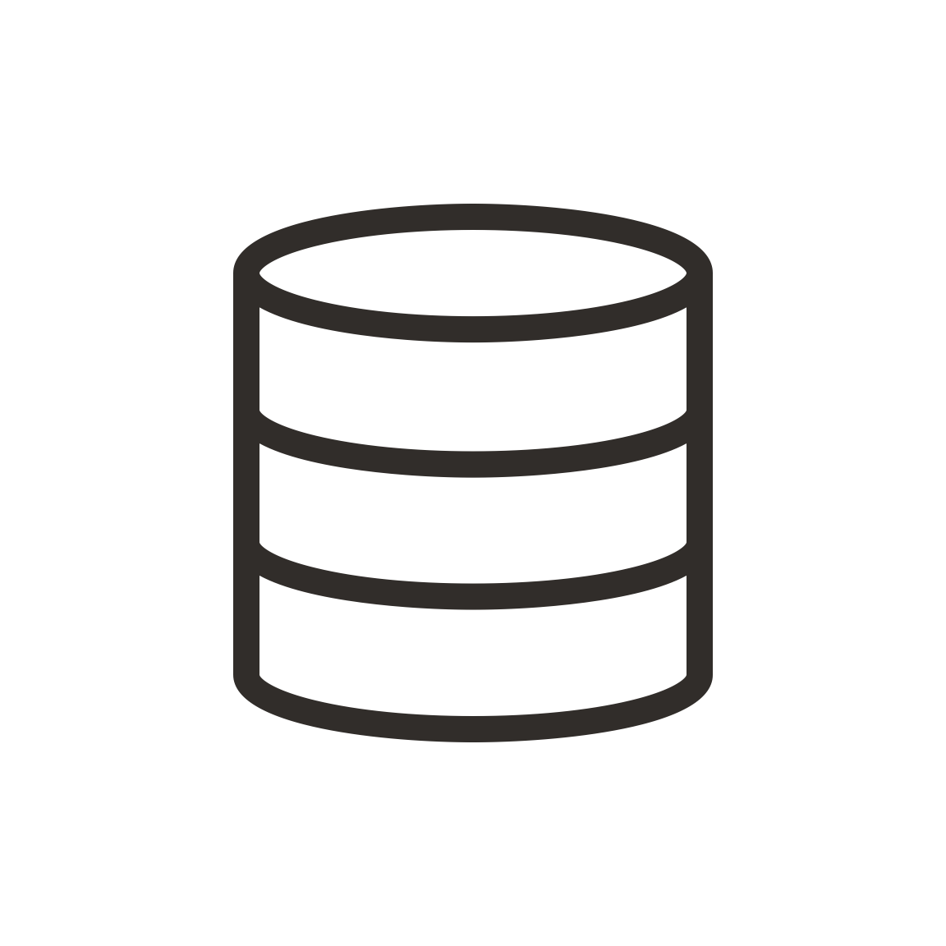

Oracle LiveLabs
developer.oracle.com/livelabs
Showcasing how Oracle’s solutions solve your business problems — available 24/7 for free!
700+
free workshops, available or in development
1000+
events run using LiveLabs
workshops
7 million
people have already visited LiveLabs

Slide 22
Discover More
Kubernetes for DBAs
http://bit.ly/KubernetesForDBAs
Cloudbank – An Oracle Backend for SpringBoot and Microservices Example
https://bit.ly/CloudBankOnOBaaS
Oracle Databases for Containers and Kubernetes
https://www.oracle.com/uk/database/kubernetes-for-container-database/
Getting started with Microservices
https://developer.oracle.com/technologies/microservices.html

Slide 23
Thank You
cris.pedregal@oracle.com
john.lathouwers@oracle.com

