Slide 1
Integration of Oracle Cloud Resources into CERN IT BC&DR
Miroslav Potocky, CERN IT Database Services

Slide 2
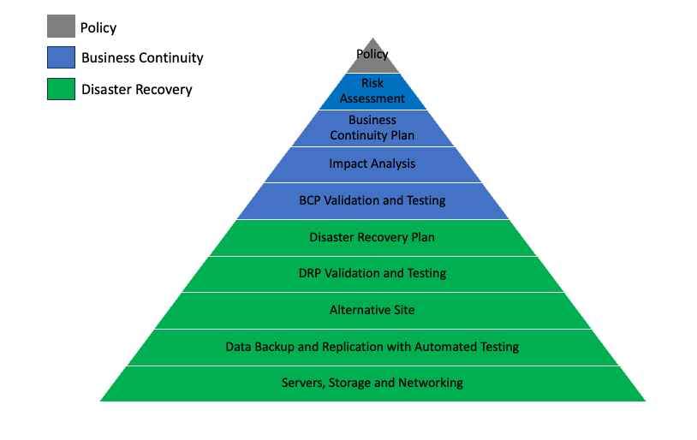
CERN BC & DR Framework
Notes:
Disaster Recovery - ability to restore services within a defined timeframe, with no or very limited data loss, in the event of a major incident, e.g. the complete loss of the DC for an extended period.
For a major incident impacting one of the CERN data centres leading to major capacity being unavailable for an extended period of time, it will be necessary to have a strategy for where to build back the services

Slide 3
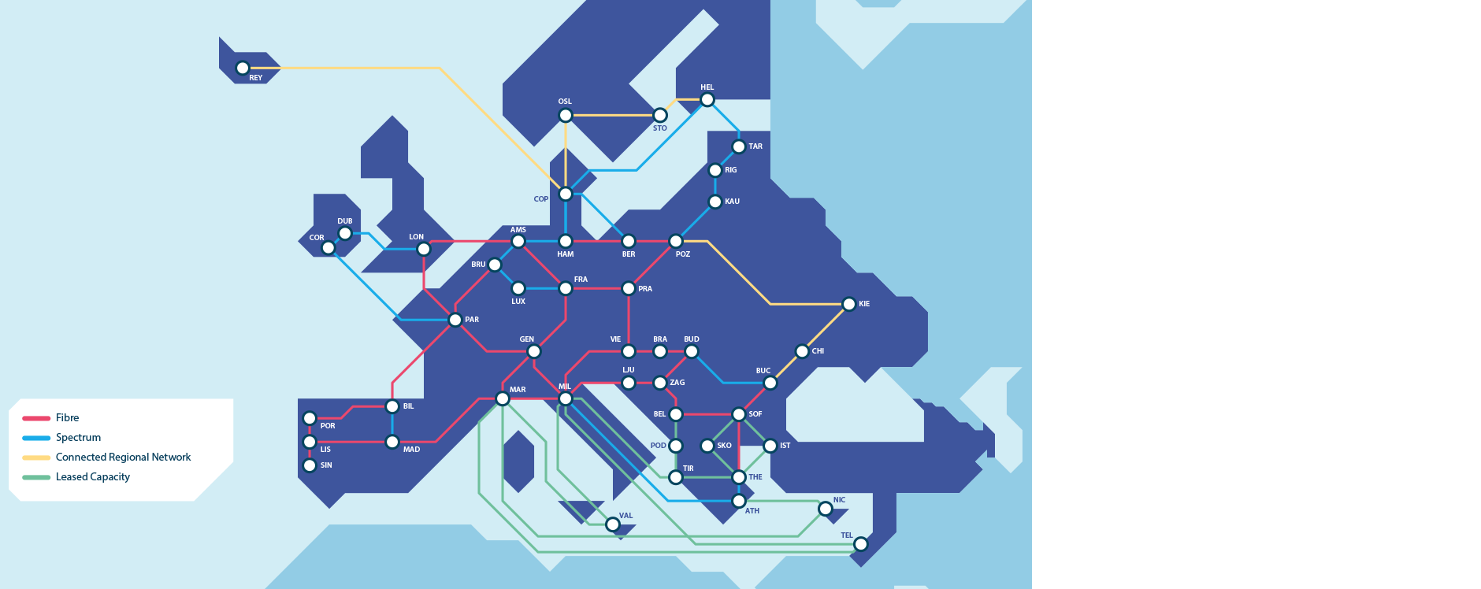

External prerequisites
CERN – GÉANT
  2 x 100Gbps
GÉANT – OCI
  2 x 10Gbps
Oracle
Cloud infrastructure
CERN
Notes:
GÉANT interconnects Europe's national research and education networks (NRENs) with the high bandwidth, high speed and highly resilient pan-European backbone – together connecting Europe's researchers, academics and students to each other, and linking them to over half the countries in the world

Slide 4
Resources mapping
CERN DC
External router
OpenStack Ironic Host
IP Services / Networks
Subnet
Router
Firewall
Oracle Database
Oracle Cloud Infrastructure
FastConnect + DRG
Oracle Base Database Node
Virtual Cloud Network
Subnet
Routing table
Security list
Oracle Database
Notes:
What constitutes the equivalent of on-premise resources
Mapping and configuring resources to mimic On-premise infrastructure as much as possible
This is just a subset of services directly necessary to configure in order to provide DG replication
Most of services we see on CERN DC side have domain experts supporting them – OCI infrastructure is supported vertically by Database services team – knowledge required across all layers

Slide 5
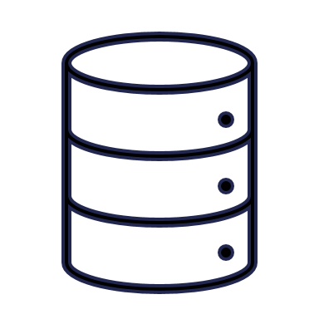


Tenancy Setup
FRANKFURT REGION
CERN TENANCY
GPN/DC VCN
PROTECTED VCN
CERN DATACENTER
GENERAL PURPOSE SUBNET
TECHNICAL SUBNET
TECHNICAL NETWORK
DNS
Database Systems
Route Table
Database Systems
Route Table
FastConnect
Security Lists
Security Lists
DC SUBNET
Dynamic Routing Gateway
EXPERIMENT SUBNET
GPN / ITS NETWORK
EXPERIMENT NETWORK
Database Systems
Route Table
Database Systems
Route Table
Security Lists
Security Lists
Notes:
Following the mapping
Setup mimcs the on-premise infrastructure
Special attention is given to “protected” network segments and related access
Firewall / security list configuration is crucial.
Owners of trusted sets in CERN are still in control of access- no bypassing

Slide 6
Setup challenges
Repeatability
    Several complete tear-downs and rebuilds
    Automation of API calls
    No API for on-premise counterpart
Completeness
    On-premise landscape evolution
    Requirement to “catch and incorporate” changes
Verification
    Database level connectivity
    Limited application vertical test
Notes:
It’s a learning curve – some early mistakes can not be easily changed later
Strong dependencies between resources requires careful choices in the beginning
Infrastructure on premise is never static
Updates are necessary as we go – for example Database hosts migration / Oracle version upgrades, etc.
Database access via TNS is the deciding factor
Application failover capability as part of complete DR test – possibly during LS3

Slide 7
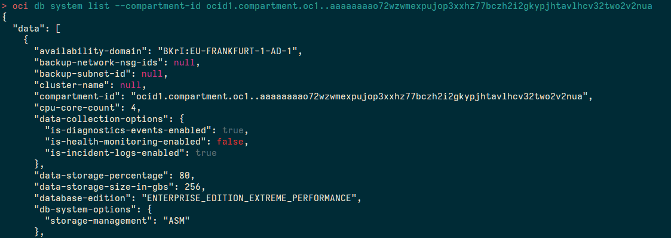
Repeatability
OCI CLI
    Essential for repeated and scripted deployment
    Basically, a nice wrapper for API calls
    Quick access via Shell scripting
  REST API
    Next step in automation
    Higher-level language use (e.g. Python)
    Integration with automation software (e.g. Rundeck)
  Manual actions
    Preferably to be avoided

Slide 8
Completeness
Not a technical challenge
    Policy and housekeeping
    Everyone on-board
Infrastructure as a code
    Always up-to-date view
    Simple state dump
    Version change control
$ cat system_repository.json | \
> jq '.entities | .[] | select(.sc_entity==“test_entity") ' | \
> jq '{
> db_name: .sc_db_database_name,
> db_unique_name: .sc_db_unique_name,
> domain:.sc_domain,
> project:.sc_project
> }'
{
"db_name": “TESTDB",
"db_unique_name": “TESTDB_OCI",
"domain": “GPDB",
"project": “CLOUDDB"
}

Slide 9
Verification
Notes:
Once we are fairly certain with setup
This is not a one time move – we’ve done the move to testing several times – there’s been several teardowns and rebuilds to make the testing and validation run more smoothly

Slide 10
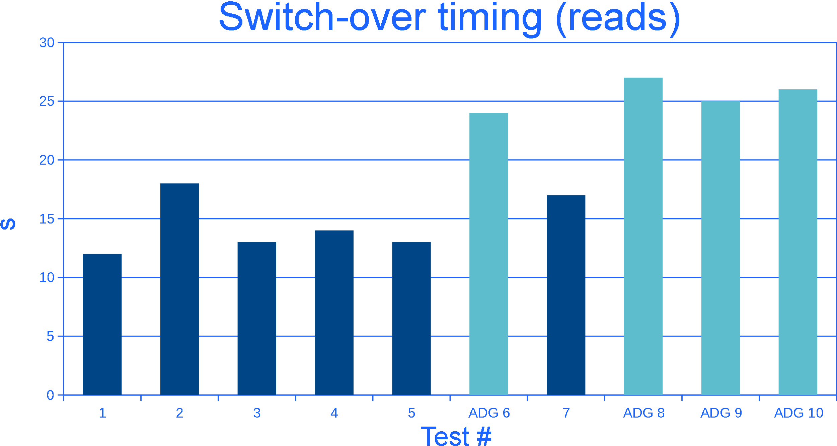
Verification
  Rebuild time
  Response latency
  Switch-over delay
Possible to run up to
4 full speed replica rebuilds
Latency on-par with off-site expectation (sub 10ms)
ADG adds 10s on average
Notes:
Additional bandwidth might be necessary for a full-scale DR test – it is more than enough for redo transport to existing replicas, however the full rebuild can take couple weeks
Latency is acceptable for a DR temporary test/run. Longer duration BC exercise would however require a closer datacenter (perhaps OCI in Geneva?)
Active Data guard us is definitely discouraged in DR scenario – read offload already happens on-premise – it only adds switchover delay

Slide 11
Conclusions
BC & DR is a process
  Never really completed and finalized
  Cloud resources add much needed flexibility
Considerable amount of work already done
  Transparent network access to OCI resources
  Quick provisioning of database replicas in OCI
  Oracle Database service DR at COBIT Level 4 – Predictable process
DR test trade-offs
  Complexity of disaster recovery solution vs. Cost
  Verified disaster recovery plan vs. Production downtime

Slide 12
Future strategy
Notes:
BC is actually just DR with consideration to long term run
Impact analysis should decide what scenarios of BCP are worth implementing and including in the final plan

Slide 13
Outlook
BC scale / cost estimation
  Where to draw the line between resiliency and cost?
Security hardening
  Central Key Management implementation
  Dynamic security lists
  Immutable backups
Observability improvement
  Security policies auditing
  Usage monitoring
Notes:
As usual, it all comes down to how much money is our resiliency worh
Can we quantify it? Is protecting against an 747 surprise landing on Meyrin DC feasible?
Further points still required for DR “finetuning”
Key management can be done even now – but something integrated and out of box is preferrable
Dynamic Access control synchronization is necessary for BC preparation
Immutable backups against ransomware of less fortunate (read non-oracle and non DB) data
Last but not least
Central view of the whole shebang to know who internally we should ask for more money, err… support

Slide 14
Credits
CERN
Stoumpis, Alexandros
Dafonte Perez, Eva
Oracle
Chardonnereau, Şengül
Hurel, Sebastien
Jung, Stefan
Designe, Jérôme
Poulin, Audrey
Pedregal-Martin, Cristobal

Slide 15
Q & A

