Slide 1
The Spectrum Project

Slide 2
But first, uncorrelated: the HENP CoE
You may remember it was discussed at last MB (link)
It seems the EuroHPC Governing Board members expressed their opinions, but the final votation has been moved to Feb 28th-29th
  We should know next week
I got (positive) feedback about informing GB members from
  Italy (“preferential”), Germany, Spain, Slovenia, Cyprus, France
  (I might have forgotten a few)
So… we just stand still and see what happens next week …

Slide 3

The SPECTRUM Project
CORDIS link: here
Call “HORIZON_HORIZON-INFRA-2023-DEV-01-05”: Preparation of common strategies for future development of RI technologies and services within broad RI communities … and … Developing, consolidating and optimising the European research infrastructures landscape, maintaining global leadership
It is NOT a R&D project: the expected outcomes are
  The preparation of a common strategy between some Scientific Domains with the EuroHPC
  The realization of a “Community of Practice” of people discussing common items
  Technically, it is a CSA: Coordination and Support Action
OUR specific outcome, if you want, is about discussing with (Euro)HPC centers in view of the next generations, in order to make sure they are suitable for our use

Slide 4
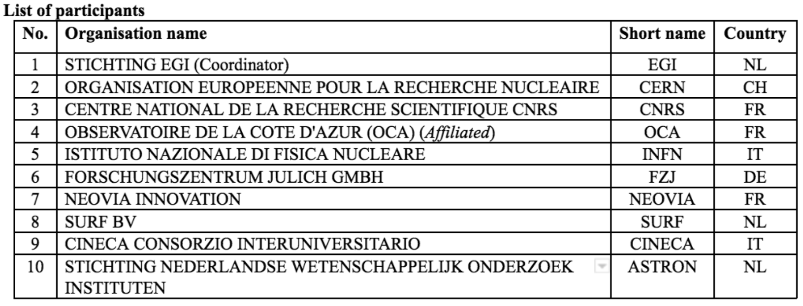
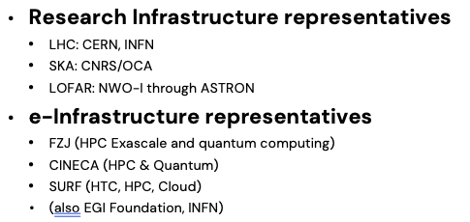
A little history
Call opened ~ jan 2023
Initial selection of scientific domains: HEP + RadioAstronomy (SKA+LOFAR)
Initial work thanks to Maria Girone (HEP) and Chiara Ferrari (SKA)
  I was involved only later as INFN
We thank the HEP community for the support: we received support letters from CMS, ATLAS, LHCb, ALICE, SKA-O, CERN, UK, INAF, JIVE, ILT, RADIONET

Slide 5
What now – and why this presentation
overall 199.3 funded PMs
  43 CERN+INFN for HEP
The first step (Months 1-15) is dedicated to the
  Collection of existing documentation about future plans / needs
  Establishment of working groups
    To present use cases
    To prepare a community wide consultation to be used as input for the realization of 2 documents (in the second phase of the project, M15-M30 →
A Technical Blueprint which collects in a systematic way the needs from the two scientific communities and the way these can be covered by (Euro)HPC systems
A Strategic Research, Innovation and Deployment Agenda (SRIDA) to suggest how to implement the Roadmap via future (2025) EU INFRA calls

Slide 6
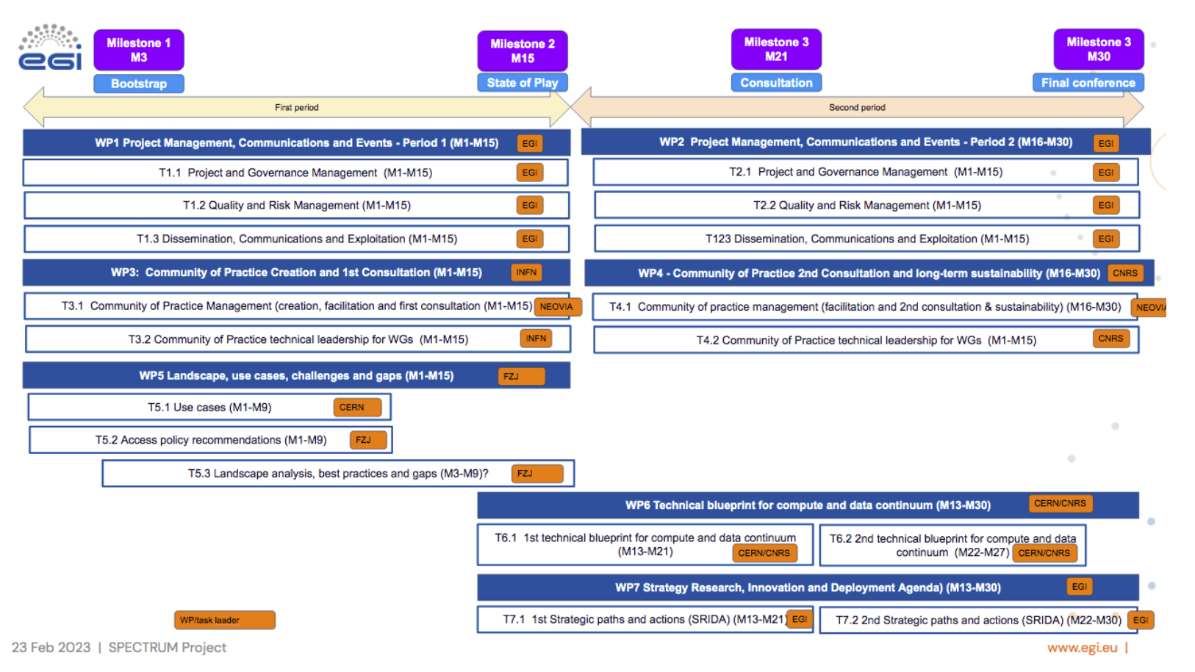
“HEP” WP/Tasks

Slide 7
We will contact you briefly …
We would like to have a good participation in the WGs (still deciding the granularity)
Most importantly:
  Help in collecting existing material describing needs and solutions
  Collect well described use cases to be used to evaluate challenges and gaps
Target is by the summer, to have a version of the community consultation which reaches all the actors
A side note: in the end we focus on HEP + RA, but no other “scientific project” was granted; we are thinking to widen the interest to closeby domains, like GW

Slide 8
Contact points …
Maria.Girone@cern.ch
Tommaso.Boccali@cern.ch

