Slide 1
Update on the European HPC Strategy meeting
Maria Girone (CERN)
Tommaso Boccali (INFN Pisa)

Slide 2
Outline
The process is a bottom-up attempt (yes, experiments are “bottom=users” for HPC centers) for an HPC/HEP strategy
This talk is mostly a
  Recap from US meeting (early 2024)
  A small report from Lubljana EU meeting (Sept 5th+6th)
  How to go on and some ideas

Slide 3
What is happening?
Granting process, long term support, technical support, …
It was decided that we (==HEP) would have profited from a more direct link with the HPC world
  At the political (==funders) and technical (==sysadmin) levels
  For current systems (==how to get access to, and how to implement our needs) and future systems (==how to design future systems)
How to (best) execute our workflows on system X?
Explain our (future needs) and try to negotiate systems able to satisfy them

Slide 4
How to implement this?
Small groups meeting: no formal agenda (not a conference), as open as possible discussion
  Which is risky, it needs to find persons in the proper mood – on both sides
    ~ 1 person per Experiment
    ~ 1 person per HPC center
    + CERN and WLCG
  Going more technical or more political: depends on the people, last second steering of discussion
Know each other:
  Who we are, what we do, what we (will) need
  What we can gain from collaboration

Slide 5
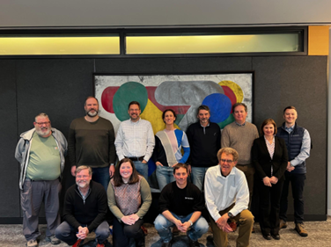

US meeting - a reminder
(thanks to M. Girone,
report @ JENA)
Held in in January 2024; present in 13
  CMS, ATLAS, WLCG, CERN, Argonne,
  Berkeley, SDSC
Discussions focused on
  Provisioning
  Interfaces
  Software
  Data Management
  Workflows
There is already a report available

Slide 6

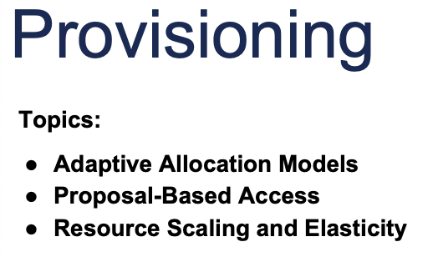
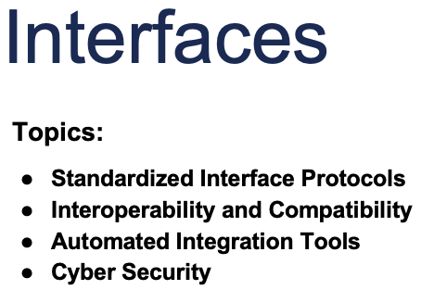
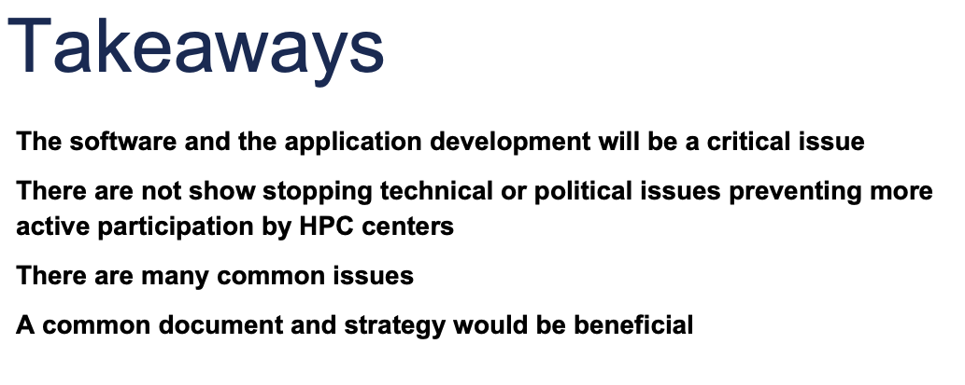


Summary of Summaries (from I.Fisk’s summary)

Slide 7
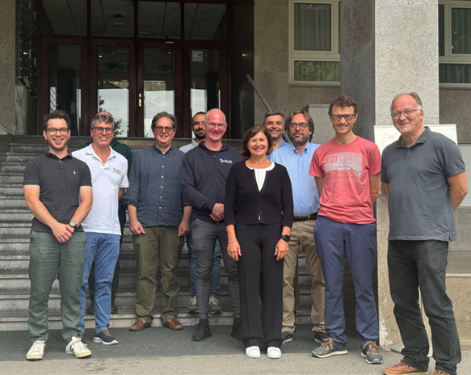
Europe September 5th-6th
Lubljana
(agenda)
+ remote attendance
Present:
  CMS, ALICE, ATLAS, LHCb, WLCG, CERN
  VEGA, LUMI, CSCS, GENCI/SURJF, Juelich, Deucalion, Karolina, Flatiron for US, JENA HPC working group
Agenda only includes
  “know each other” - my center, my experiment
  Open technical discussion on “items”
Wrap up of the 1st day discussion written during the night, and further elaborated on the second day
Report in preparation
Items:
  Allocation policies and opportunities
  Edge nodes and AAI
  Type of workflows
  Networking
  SW
  Storage handling
  Strategy

Slide 8
Some points from the summaries
Allocation policies and opportunities
We can go one by one, or try to have an umbrella request handled for example by CERN; suggestion is to go the “national path” if there are links.
Fast proposals, 100% success rate if “reasonable”
Review of EuroHPC allocation policies
  Nearly all systems (but CSCS) are 50% owned by EuroHPC, 50% by the hosting state; hence two paths to obtain grants
  In both cases, at least 3 types of calls
    R&D: show that your code can be executed on the machine (possibly after some negotiations / changes with local admins)
      Only technical evaluation
    Benchmarking: show that your code can scale 1 → N nodes
      Only technical evaluation
    Regular Access: production level, after having shown the readiness of the codes (via the previous two); tens-hundred millions CoreH
      Technical + scientific evaluation
    (Strategic access: top-down, decided by EC or the EuroHPC governing board; up to 10% of the full EuroHPC capacity)
      Political evaluation (+ do we want it?)
Previously via PRACE; now handled completely within EuroHPC. Needs a full proposal, and passing scientific evaluation.
Success rate well below 100%
Less known; up to now “strategic access status” granted only to Destination Earth (climate) and Human Brain Project (brain simulation)

Slide 9
Edge nodes and AAI
Possibility to deploy edge services (no root access needed as an assumption) from the user point of view (VM, container, …)
  Ask for the functionality, not the virtualization technology!
Have a look at IRI proposals (CHEP 2023) – if not code, as directions (blueprint)
Is a federated AAI possible (for example, eduGAIN profiles or similar) or even existing?
  Expected by 2024 – in principle should be adopted by all HPC sites
  Already now, LUMI supports eduGAIN
Possible uses of edge nodes: storage, bridging between Condor/Dirac/Panda and SLURM, routing, SQUIDs, …

Slide 10
Type of workflows
Production only jobs vs also user jobs
  Fewer users to consider / enable + more tested workflows
Which is the lowest GPU utilization you tolerate?
  One answer was as low as 10%
  Focus on minimum speedup requested? (looking at the cost)

Slide 11
Networking
LAN not a problem: these sites exceed what we need by factors (current standard is > 200 Gbps per node; AI specialized machines can exceed 1 Tbps per node)
WAN: more a political problem than anything else; situation very diverse
  LUMI: all is open (outgoing connections from compute nodes)
  Juelich: all is closed
Possible intermediate solutions
  Networking opened towards some trusted subnets
  (solution at CINECA)
  Allow to open (user level) VPNs
Upcoming EuroHyperConn strategy: how to connect EuroHPC centers between them, and with everyone else
Proxy and fan-out….

Slide 12
Software
Is CVMFS usage increasing outside HEP so that we can assume it will be available sooner or later?
  Alternatively: is userland CVMFS (via aFuse or cvmfsexec) an acceptable option?
    Alternatively: other solutions? An incremental CVMFS dump?
      Is that available? Is that a reasonable feature to ask to CVMFS?
Is there a site-preferred high level framework (kokkos vs sycl vs alpaka…)?
  Not really, for them is an application problem

Slide 13
Storage handling
Edge services as nodes to deploy data management (for example via services which then use internal centre large POSIX)
The need to deploy caches: again as edge services? How else?
Some sites have “datamovers” (globus, Fenix, Simpl, …)
  Evaluate enabling them to FTS

Slide 14
Strategy
(my personal view): the centers consider us as “technical parties” they would like to work with
  Much better than usual approach from other domains “we send you a tar file please find a way to execute it”
  But what about the political level?
  We probably need 2 different types of channels
A possible strategy (TBC/D!)
  Form a domain-wide portfolio of successful “Project Access”-like granted projects
  Use high level opportunities to inform EuroHPC (or above) about us/our needs
    The annual EC visit to CERN and similar FA-EC meetings
    The upcoming European Particle Physics Strategy Update; via the WS and the Briefing Book
    Initiatives like JENA and SPECTRUM
    EuroHPC User Forum (Maria deputy-chair)

Slide 15
A few possible “actions” from the meeting
(to be validated by the MB)
Write a report like that written by the US colleagues (but independent at this point)
Have a global meeting, including US, EU and Asia
  Now defined: @ CERN Jan 30th-31st (used to be 13th-14th but changed by popular demand)
  At that point, aim for a global document
Prepare a DB of existing (successful) grants
Discuss at the level of WLCG MB a common strategy between experiments towards EuroHPC, in synergy with CERN efforts
  Divide and conquer? Common projects?
Continuously monitor new opportunities from the centers (early access, new systems coming online, …)
  We have a list from the meeting!
Prepare a description of main WLCG use cases and inform HPC centers
Monitor the possibility for a HEP (or more) EuroHPC CoE approval path
  Submitted in early 2024; not discussed since EuroHPC had a change of plan. Possibly to be reconsidered in early 2025
Monitor the submission of inputs about HPC utilization to the ESPP

