Slide 1

MuSR study on the quantum magnetism of 2D frustrated compounds
Workshop on Muon Physics at the Intensity and Precision Frontiers (MIP 2024)
Jie Ma
Shanghai Jiao Tong University
2024.04.21.

Slide 2

Outline
Geometrically Frustrated Magnet
2. Quantum effect in triangular lattice
3. Disorder state of Honeycomb lattice
4. Conclusion and outlook
2

Slide 3
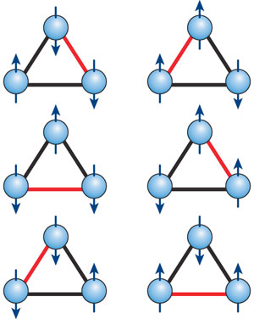
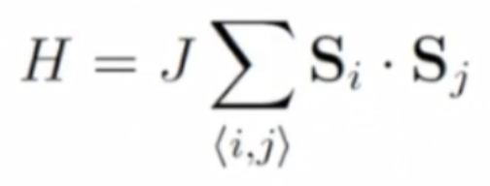
Geometrically Frustrated Magnet
Competing or contradictory constraints on a large fraction of the magnetic sites ─ geometric magnetic frustration
?
?
?
Fig. 2D frustrated model.
Fig. 3D model.
J < 0
J > 0
RuCl3

Slide 4
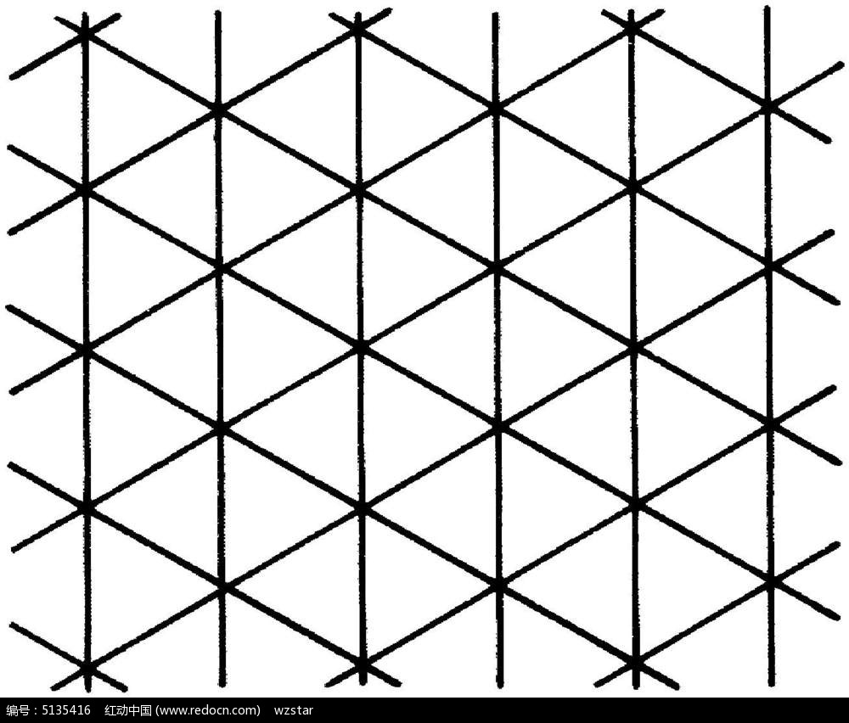
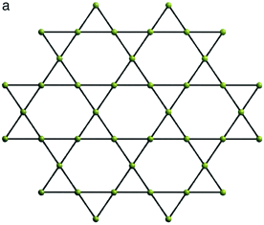
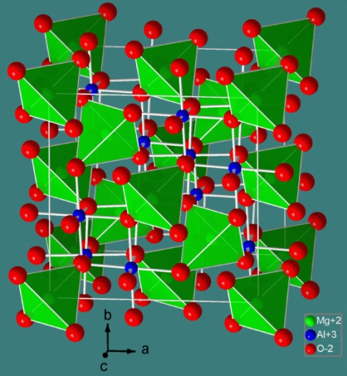
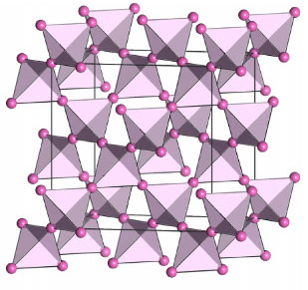
Geometrically Frustrated Magnet
Competing or contradictory constraints on a large fraction of the magnetic sites ─ geometric magnetic frustration
Examples of frustrated lattice
?
─ Edge/corner sharing triangles
triangular/kagome lattices (2D)
─ Corner sharing tetrahedra
Spinel/Pyrochlore lattices (3D)
?
?
Fig. Frustrated model of 2D and 3D system.
Fig. Triangular lattice.
Fig. Kagome lattice.
Fig. Spinel lattice AB₂O₄.
Fig. Pyrochlore lattice A₂B₂O₇.
4

Slide 5

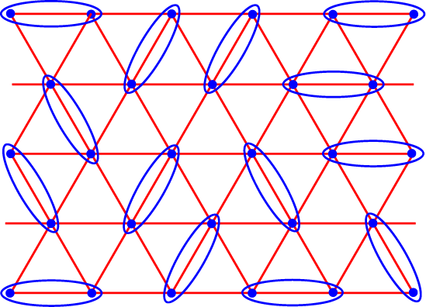
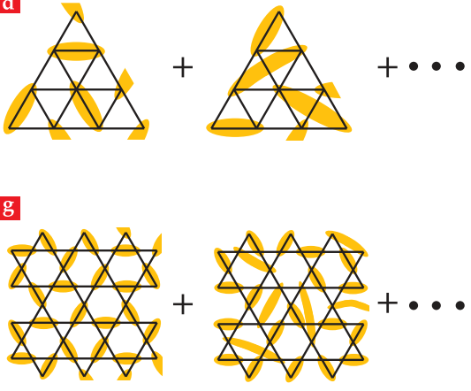
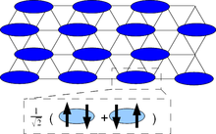
Geometrically Frustrated Magnet
Competing or contradictory constraints on a large fraction of the magnetic sites ─ geometric magnetic frustration
Examples of frustrated lattice
?
─ Edge/corner sharing triangles
triangular/kagome lattices (2D)
─ Corner sharing tetrahedra
Spinel/Pyrochlore lattices (3D)
?
?
Fig. Frustrated model of 2D and 3D system.
Superconductor
P.W. Anderson 1973、1987
Physics Today 69, 30 (2016).
5

Slide 6

Quantum Spin Liquid
Competing or contradictory constraints on a large fraction of the magnetic sites ─ geometric magnetic frustration
Quantum Spin Liquid
─ No magnetic long-range ordering
─ No symmetry broken
─ Fractional excitation: spinon
─ Strong fluctuation at low energy
Examples of quantum-spin-liquid
Material | Lattice | Θ_{cw} (K) | J (K)
κ-(BEDT-TTF)₂Cu₂(CN)₃ | anisotropic triangular | -375 | 250
EtMe₃Sb[Pd(dmit)₂]₂ | anisotropic triangular | -375~-325 | 220-250
YbMgGaO₄ | Triangular | -4 | 1.5
Na₄Ir₃O₈ | Hyperkagome | -650 | 430
PbCuTe₂O₆ |  | -22 | 15
ZnCu₃(OH)₆Cl₂ (herbertsmithite) | Kagome | -314 | 170
Cu₂Zn(OH)₆FBr (barlowite) | Kagome | -200 | 170
Rb₂Cu₃SnF₁₂ | Kagome | -100 | 154.4
Ca₃Cr₇O₂₈ | Distorted Kagome |  | -9
PRL 91, 107001 (2003); PRL 100, 087202 (2008); PRL 95, 177001 (2005); JACS 130, 2922 (2008); Nature Phys. 6, 865 (2010); Nature 464, 199 (2010); npj Quant. Mater. 4, 12 (2019); npj Comp. Mater. 8, 10 (2022).
6

Slide 7
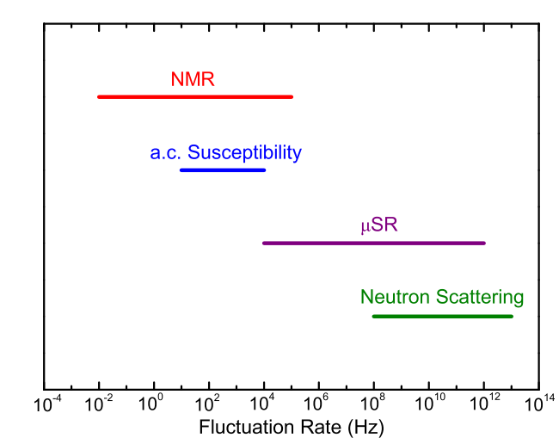

Quantum Spin Liquid
Competing or contradictory constraints on a large fraction of the magnetic sites ─ geometric magnetic frustration
Quantum Spin Liquid
─ No magnetic long-range ordering
─ No symmetry broken
─ Fractional excitation: spinon
─ Strong fluctuation at low energy
Identification of quantum-spin-liquid
Specific heat measurements: the low-energy density of states;
Thermal transport measurements: localized or itinerant excitations;
Neutron scattering/Nuclear-magnetic resonance: excitations and correlations;
Reflectance measurements: power-law optical conductivity
Frustration
Spin-orbital (Wilson Ratio)
R = [4π²k_{B}²χ₀] / [3(gμ_{B})²γ]
7

Slide 8
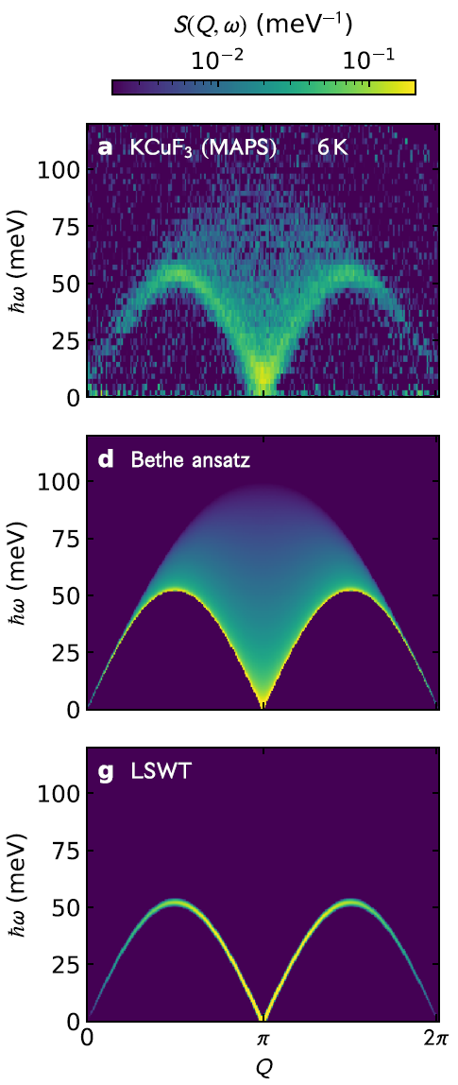
Geometrically Frustrated Magnet
Competing or contradictory constraints on a large fraction of the magnetic sites ─ geometric magnetic frustration
Examples of frustrated lattice
Nature 540 22 (2016); Nat. Phys. 17, 726 (2021); Nat. Commn. 13, 5796 (2022)

Slide 9
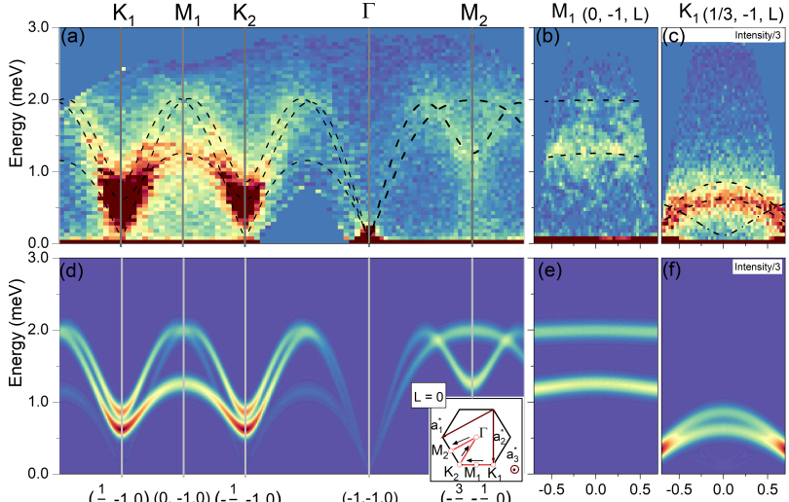
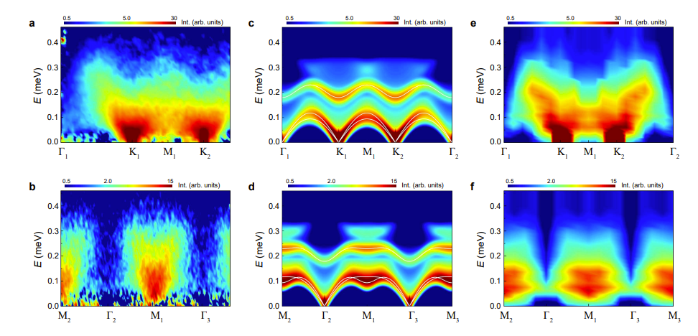
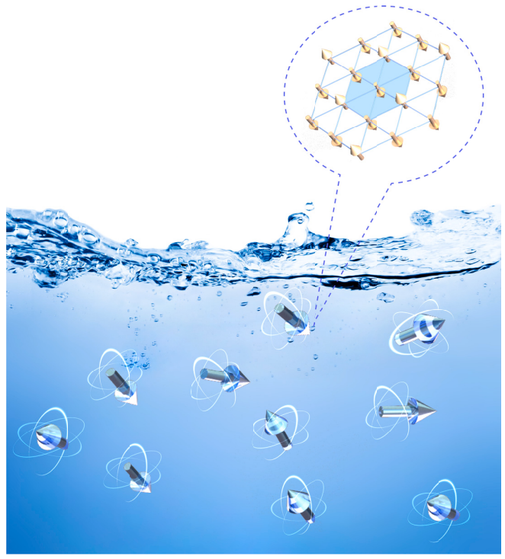
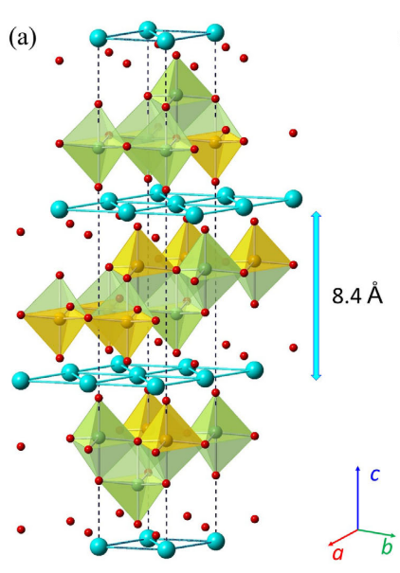
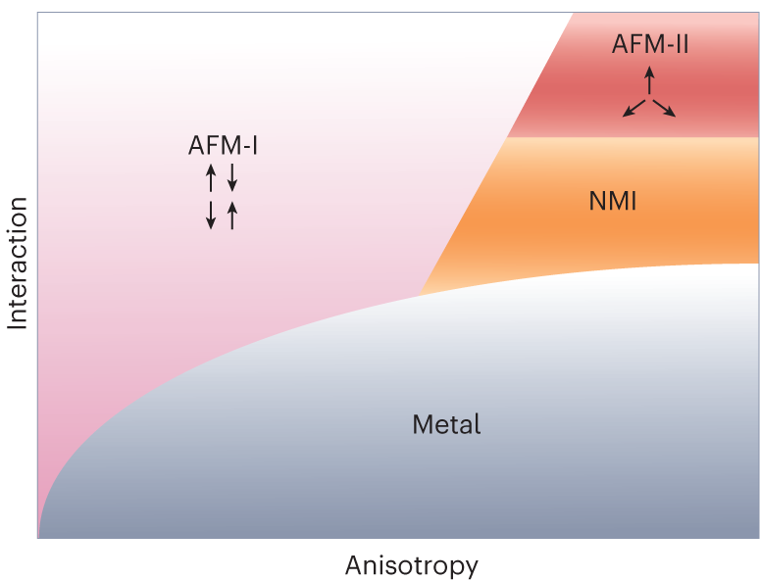
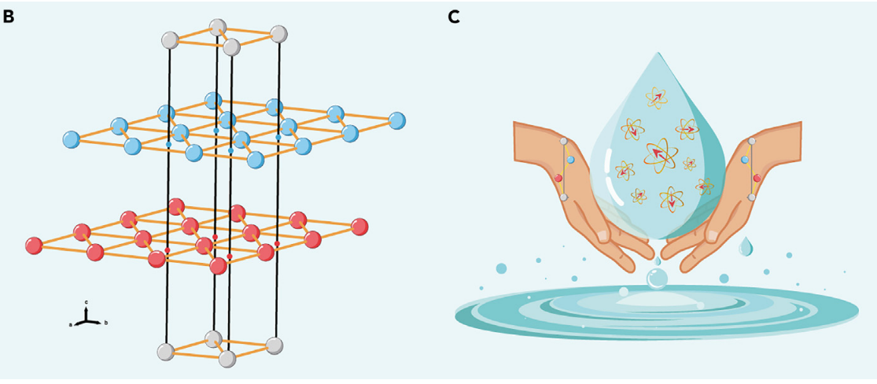
Is there a pure QSL?
Ba₃MnSb₂O₉
Na₂BaCo(PO₄)₂
PRB 108, 174424 (2023); arxiv 2402.07730 (2024)
Adv. Quant. Technol., 1900089 (2019); The Innov. 4, 100484, (2023); Nat. Phys. 19, 922 (2023).
9

Slide 10
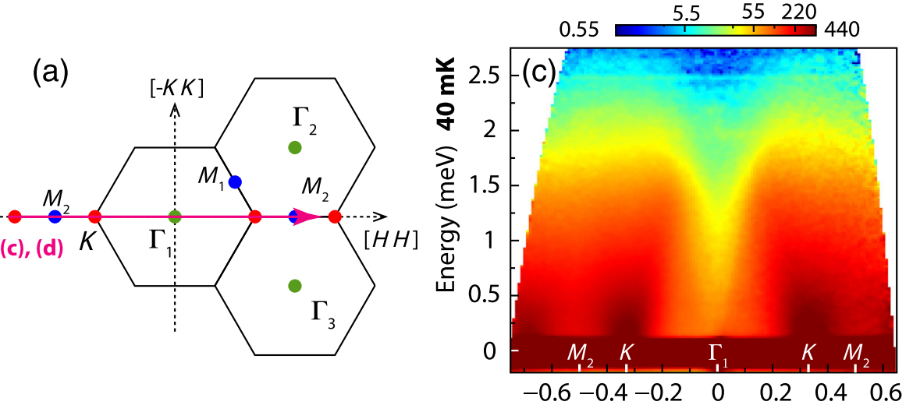
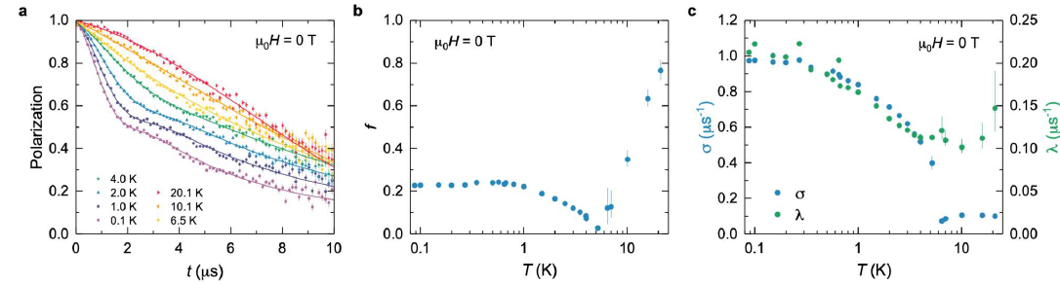
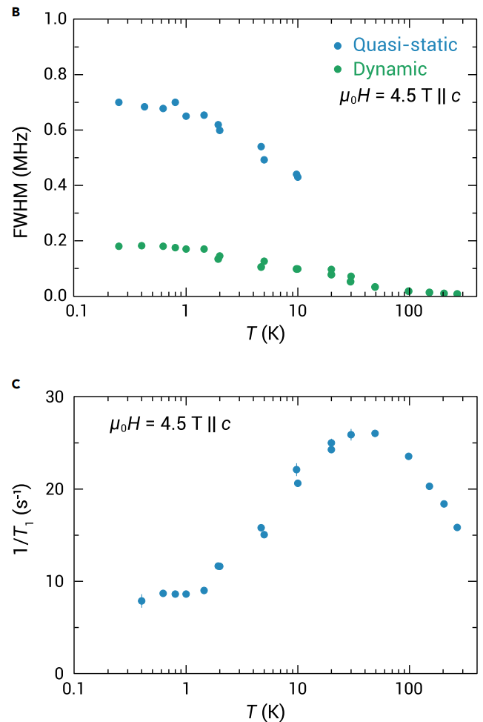
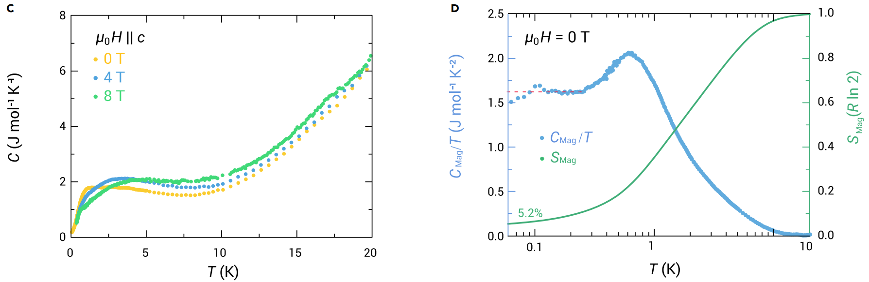
NaYbSe₂
P. Dai, et al., PRX 11, 021044 (2021); Z. Zhu et al., The Innov. 4, 100459 (2023).
(a) QSL’s evidences:
C_{m}/T (<0.5 K) is almost a constant, indicating the spinon Fermi surface spin liquid;
the 𝜇SR spectra show no spin freezing with robust dynamics and strong quantum fluctuations;
Continuous spin excitations by INS.
NMR indicates the coexistence of short-range magnetic order and QSL
10

Slide 11
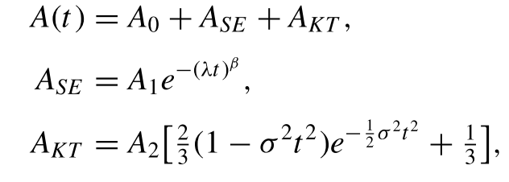
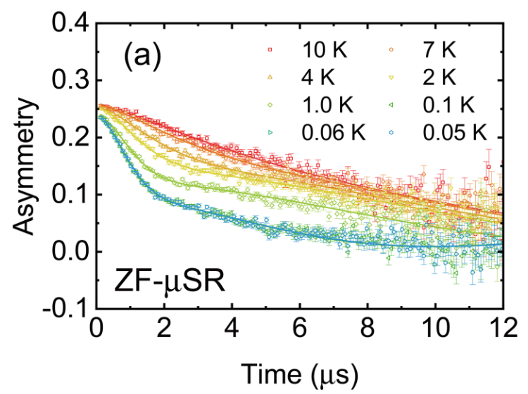
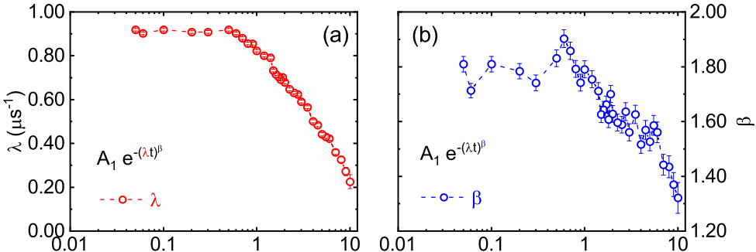
μSR study of NaYbSe₂
Z. Zhang, et al., PRB 106, 085115 (2022
No oscillation is seen in the ZF-μSR spectra down to 50mK;
No spin-glass-like freezing
Both λ and β go up to a plateau below 0.3 K, indicating the emergence of a stable magnetically disordered QSL ground state.
11

Slide 12
Outline
Geometrically Frustrated Magnet
2. Quantum effect in triangular lattice
3. Disorder state of Honeycomb lattice
4. Conclusion and outlook
12

Slide 13
Kitaev model
  Anyons in an exactly solved model
arXiv: cond-mat/0506438v3
  Energy gaps: local excitations
  Topological Quantum Numbers: excitations stable
  Topological Order

Slide 14
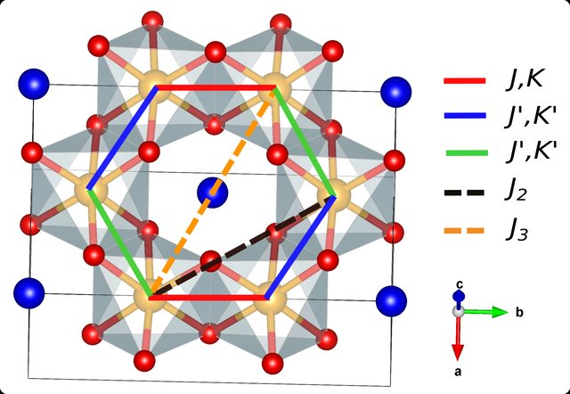
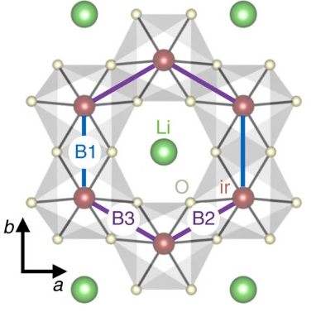
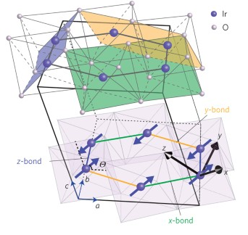
Honeycomb-Kitaev
4d/5d transition mental
  H₃LiIr₂O₆
  α-Li₂IrO₃
  α-Na₂IrO₃
R. Yadav, et. al., PRL 121, 197203 (2018); S. Nishimoto, et. al., Nat. Comm. 7, 10273 (2016); S. Hwan Chun, et al., Nat. Phys. 11, 462 (2015).
The Kitaev model extended to a Heisenberg-Kitaev model:
Kitaev term K,
off-diagonal symmetric exchange term Γ and Γ′,
J (J_{NN}), and the third NN coupling J₃
14

Slide 15
α-RuCl₃
  α-RuCl₃
Dominant Kitaev term K
Magnetic ordered at 0 T while disordered at 7 T (potential QSL)
Quantum spin liquid behavior
A. Banerjee et al. Nat. Mater. 15, 733 (2016)
15

Slide 16
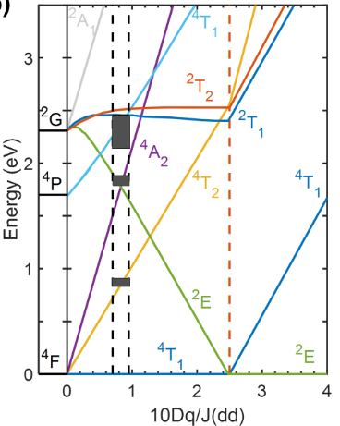
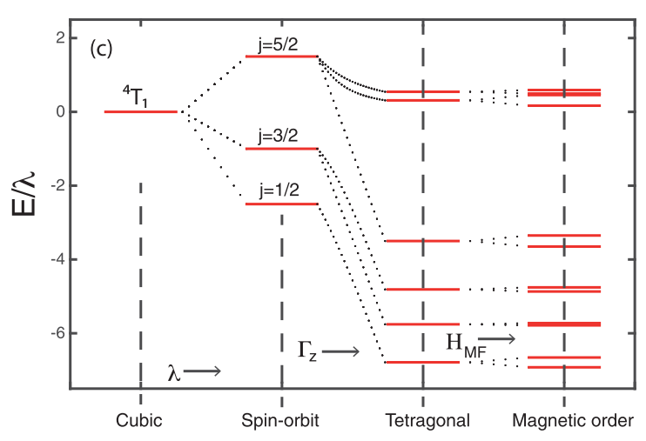
3d transition metal
  Co²⁺ 3d⁷
Splitting of the degenerate d⁷ states
Octahedral and Trigonal crystal field in a single-electron picture
Spin-orbit coupling in a multi-electron picture
16
A. K. Bera, et al. Phys. Rev. B 95, 094424 (2017); C. Kim et al., arXiv:2012.06167 (2020).

Slide 17
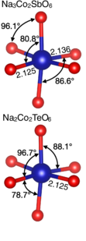
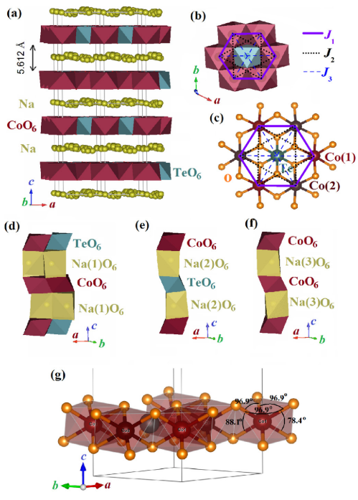
Na₂Co₂TeO₆ and Na₃Co₂SbO₆
  Na₂Co₂TeO₆
  Na₃Co₂SbO₆
Na₃Co₂SbO₆ and Na₂Co₂TeO₆ have the similar structure
Distortions of Na₂Co₂TeO₆ and Na₃Co₂SbO₆ are different
M. Songvilay et al., PRB 102, 224429 (2020); A. K. Bera, et al., PRB 95, 094424 (2017); J. Yan, et al., PRM 3, 074405 (2019)

Slide 18
Heat capacity & Magnetic susceptibility
CV
CV
CV
  With the field,
  1) Long-range ordering disappeared;
  2) Anisotropy between ab-plane and c-axis;
  3) All susceptibilities crossed at around 11.5 T.
18

Slide 19
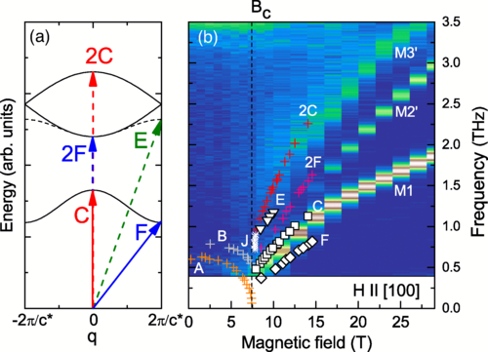
High-field electron spin resonance
A. Ponomaryov, et. al., PRL 125, 037202 (2020)
  Four modes are observed:
  1) A and B modes almost overplot on each other, g_{ab}~4.13;
  2) C mode is gapped with g_{c}~2.25;
  3) D mode is broad and weak, between A/B and C lines.
19

Slide 20
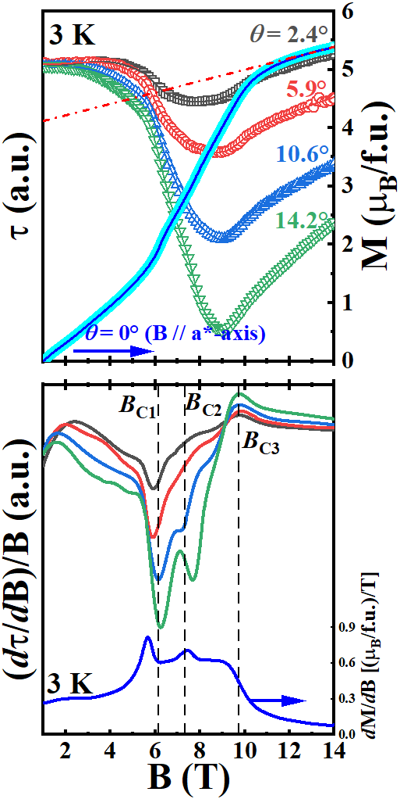
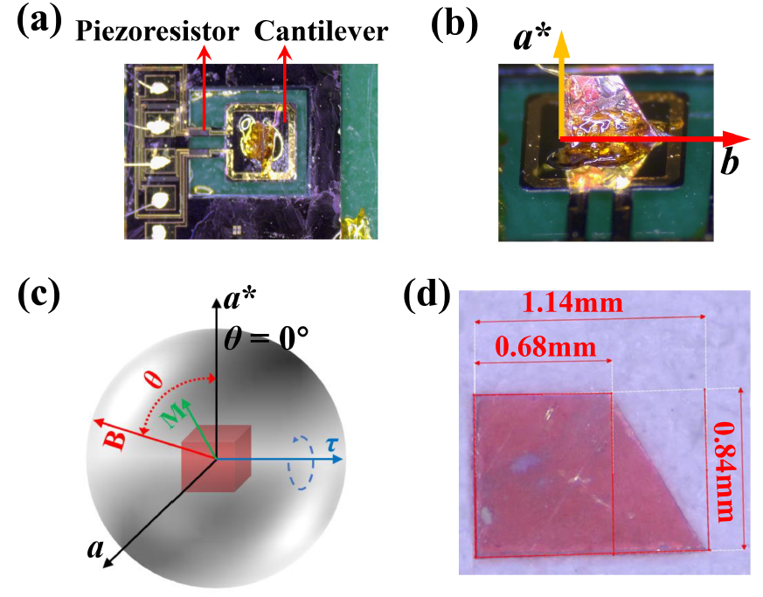
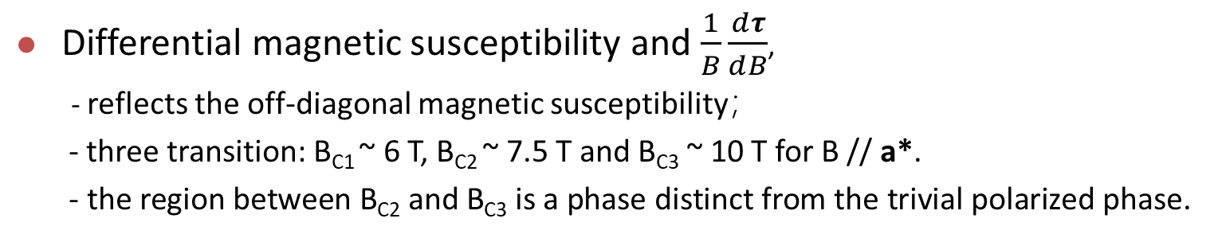
Magnetic torque measurements
  Differential magnetic susceptibility and $\frac{1}{B}\frac{ⅆτ}{ⅆB}$,
  - reflects the off-diagonal magnetic susceptibility；
  - three transition: B_{C1} ~ 6 T, B_{C2} ~ 7.5 T and B_{C3} ~ 10 T for B // a*.
  - the region between B_{C2} and B_{C3} is a phase distinct from the trivial polarized phase.
20

Slide 21
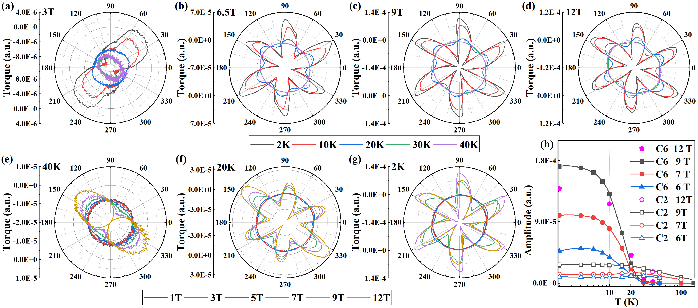
Temperature- and field-dependence of torque
Between B_{C2} and B_{C3}, perfect 6-fold symmetry and the amplitude of the torque is larger than the polarized phase above B_{C3}, indicating a disordered ground state with obvious quantum fluctuations ;
21

Slide 22
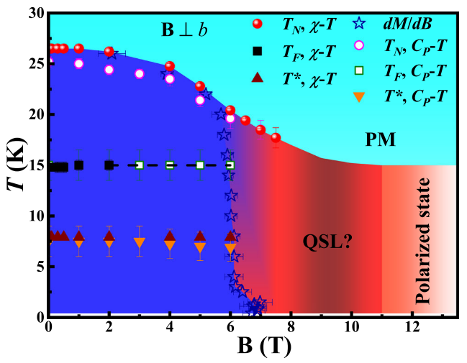
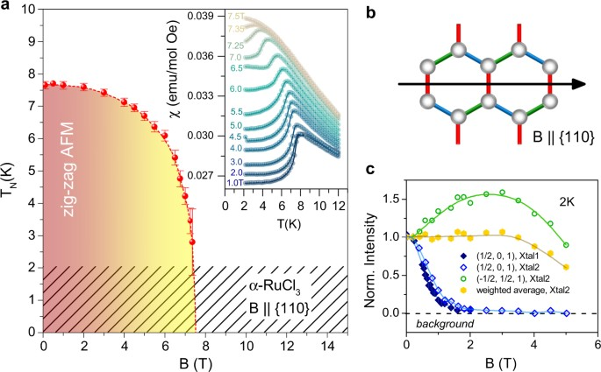
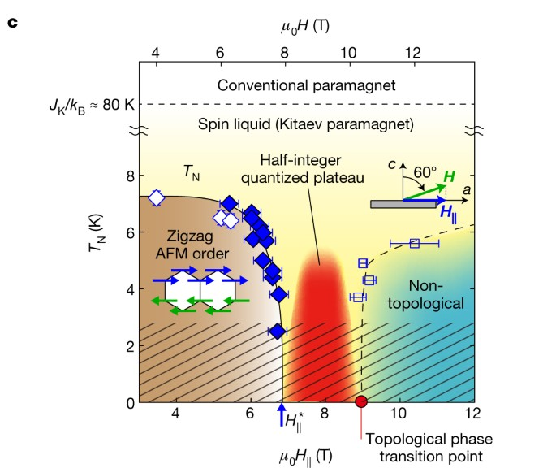
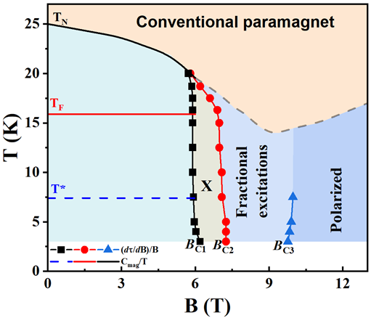
H vs T phase diagram, B // a*-axis
  Phases are complicated
  1) QSL-like phase is observed
  2) No plateau is observed, only spin flip
npj Quantum Materials 3, 8 (2018)
22

Slide 23
Spin-dynamics
23

Slide 24
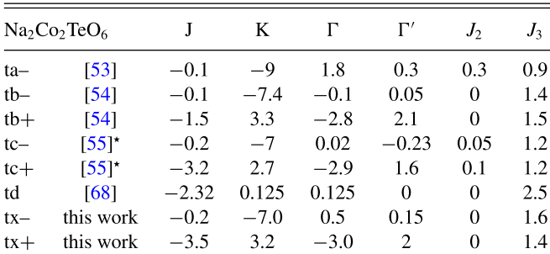
Comparisons
Low-energy dynamics can be dictated by the J₃-Δ model, indicating the J₃ is important.
PRB 103, L180404 (2021); PRB 102, 224429 (2020); JPCM 34, 045802(2021); PRL 129, 147202 (2022); PRB 106, 014413 (2022).
24

Slide 25
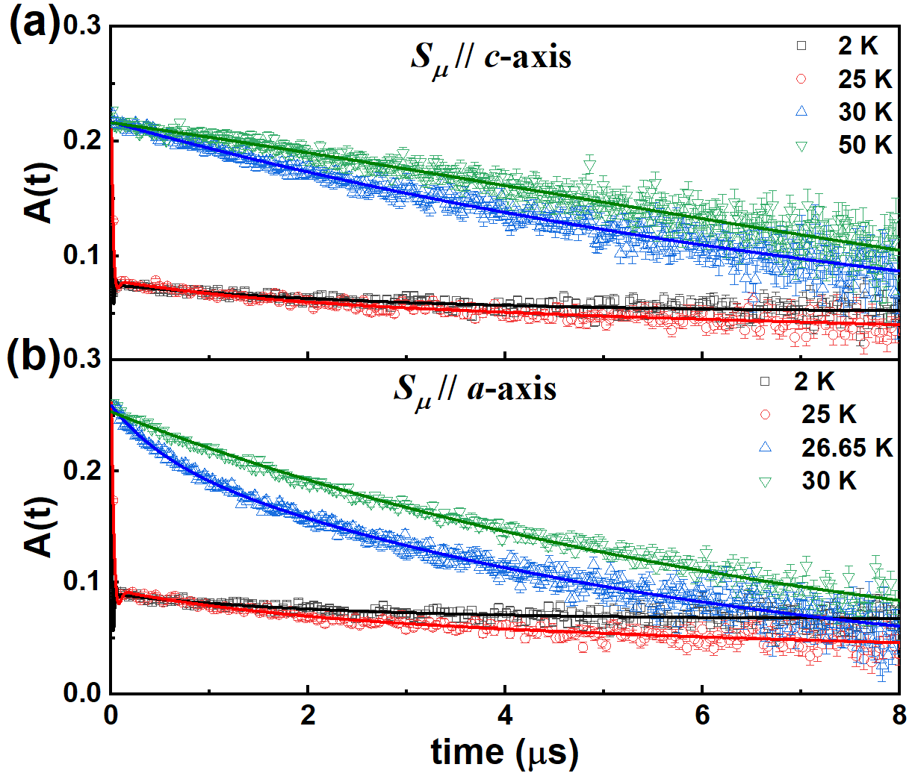
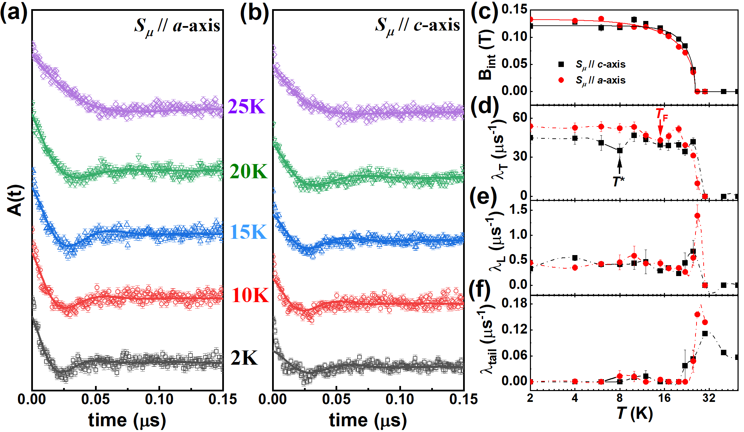
μSR by M20D at TRIUMF
LF=0.1T
  ZF-μSR : very fast depolarization and superimposed oscillations within 50 ns below T_{N}, strong quasistatic internal field;
  λ_{T} reflects the width of static magnetic field distribution.
  T_{F} and T* present anomalies.
25

Slide 26
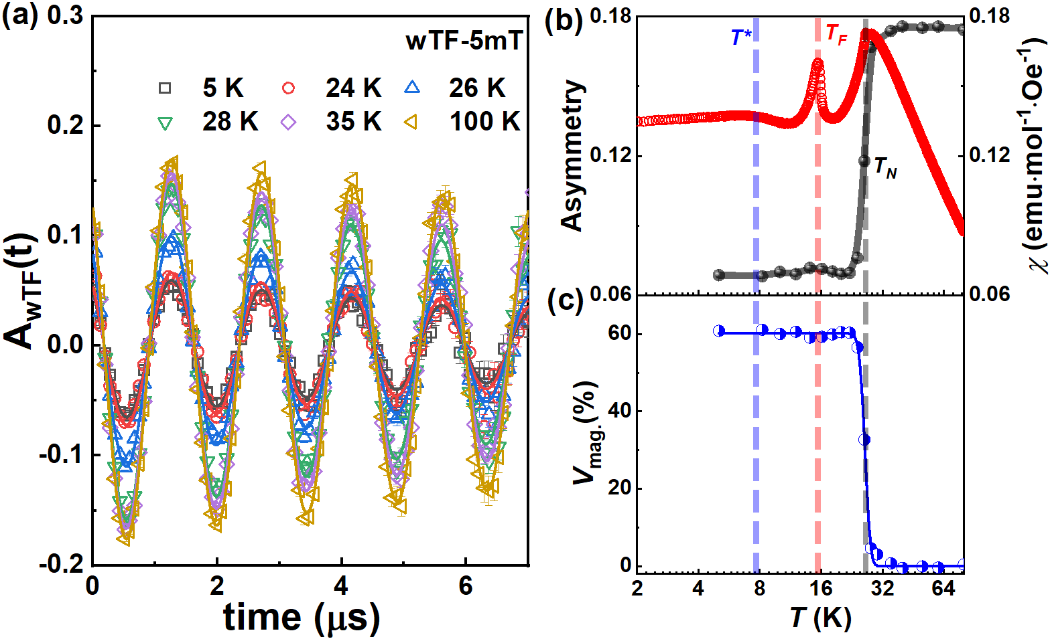
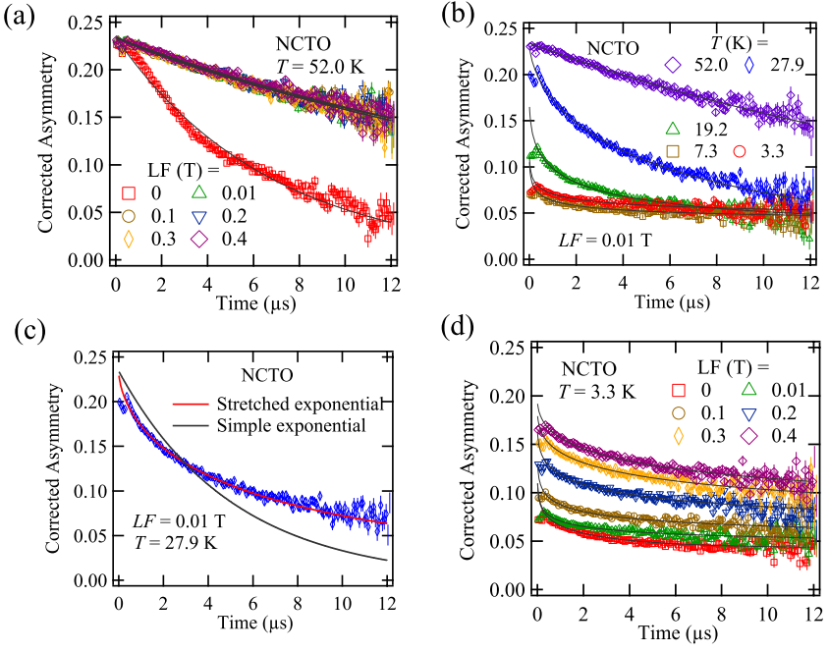
μSR by GPS at PSI
arXiv:2307.16451v1 (2023)
  V_{mag}(0K) = 60 % suggests the bond-dependent anisotropic frustrations (Kitaev interactions) and quantum fluctuations；
  Strong spin dynamics at low temperature.
26

Slide 27
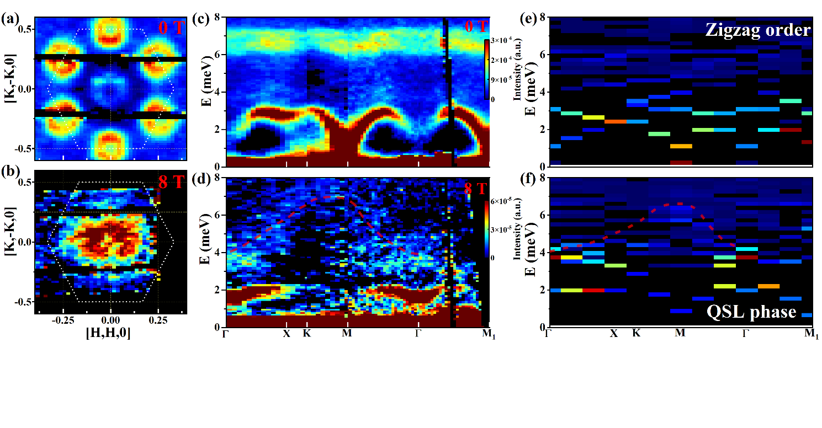
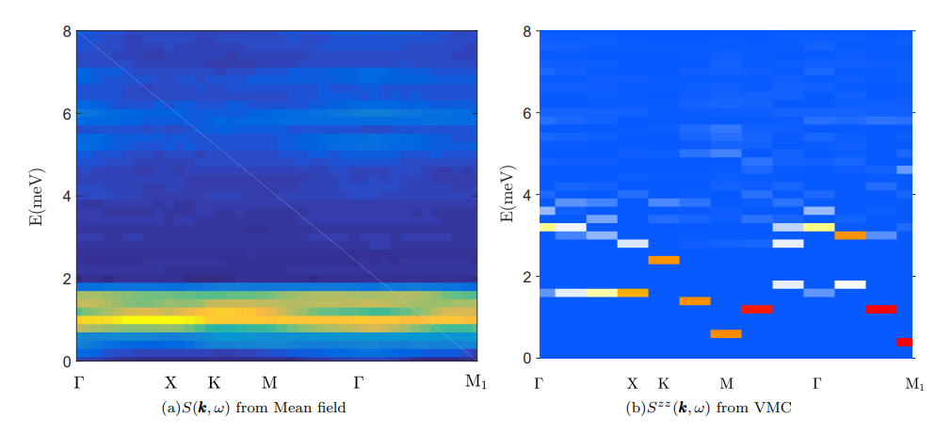
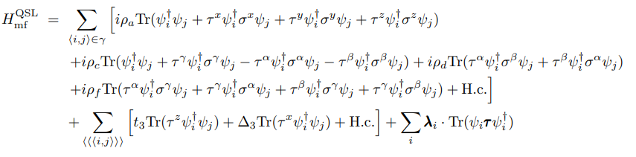
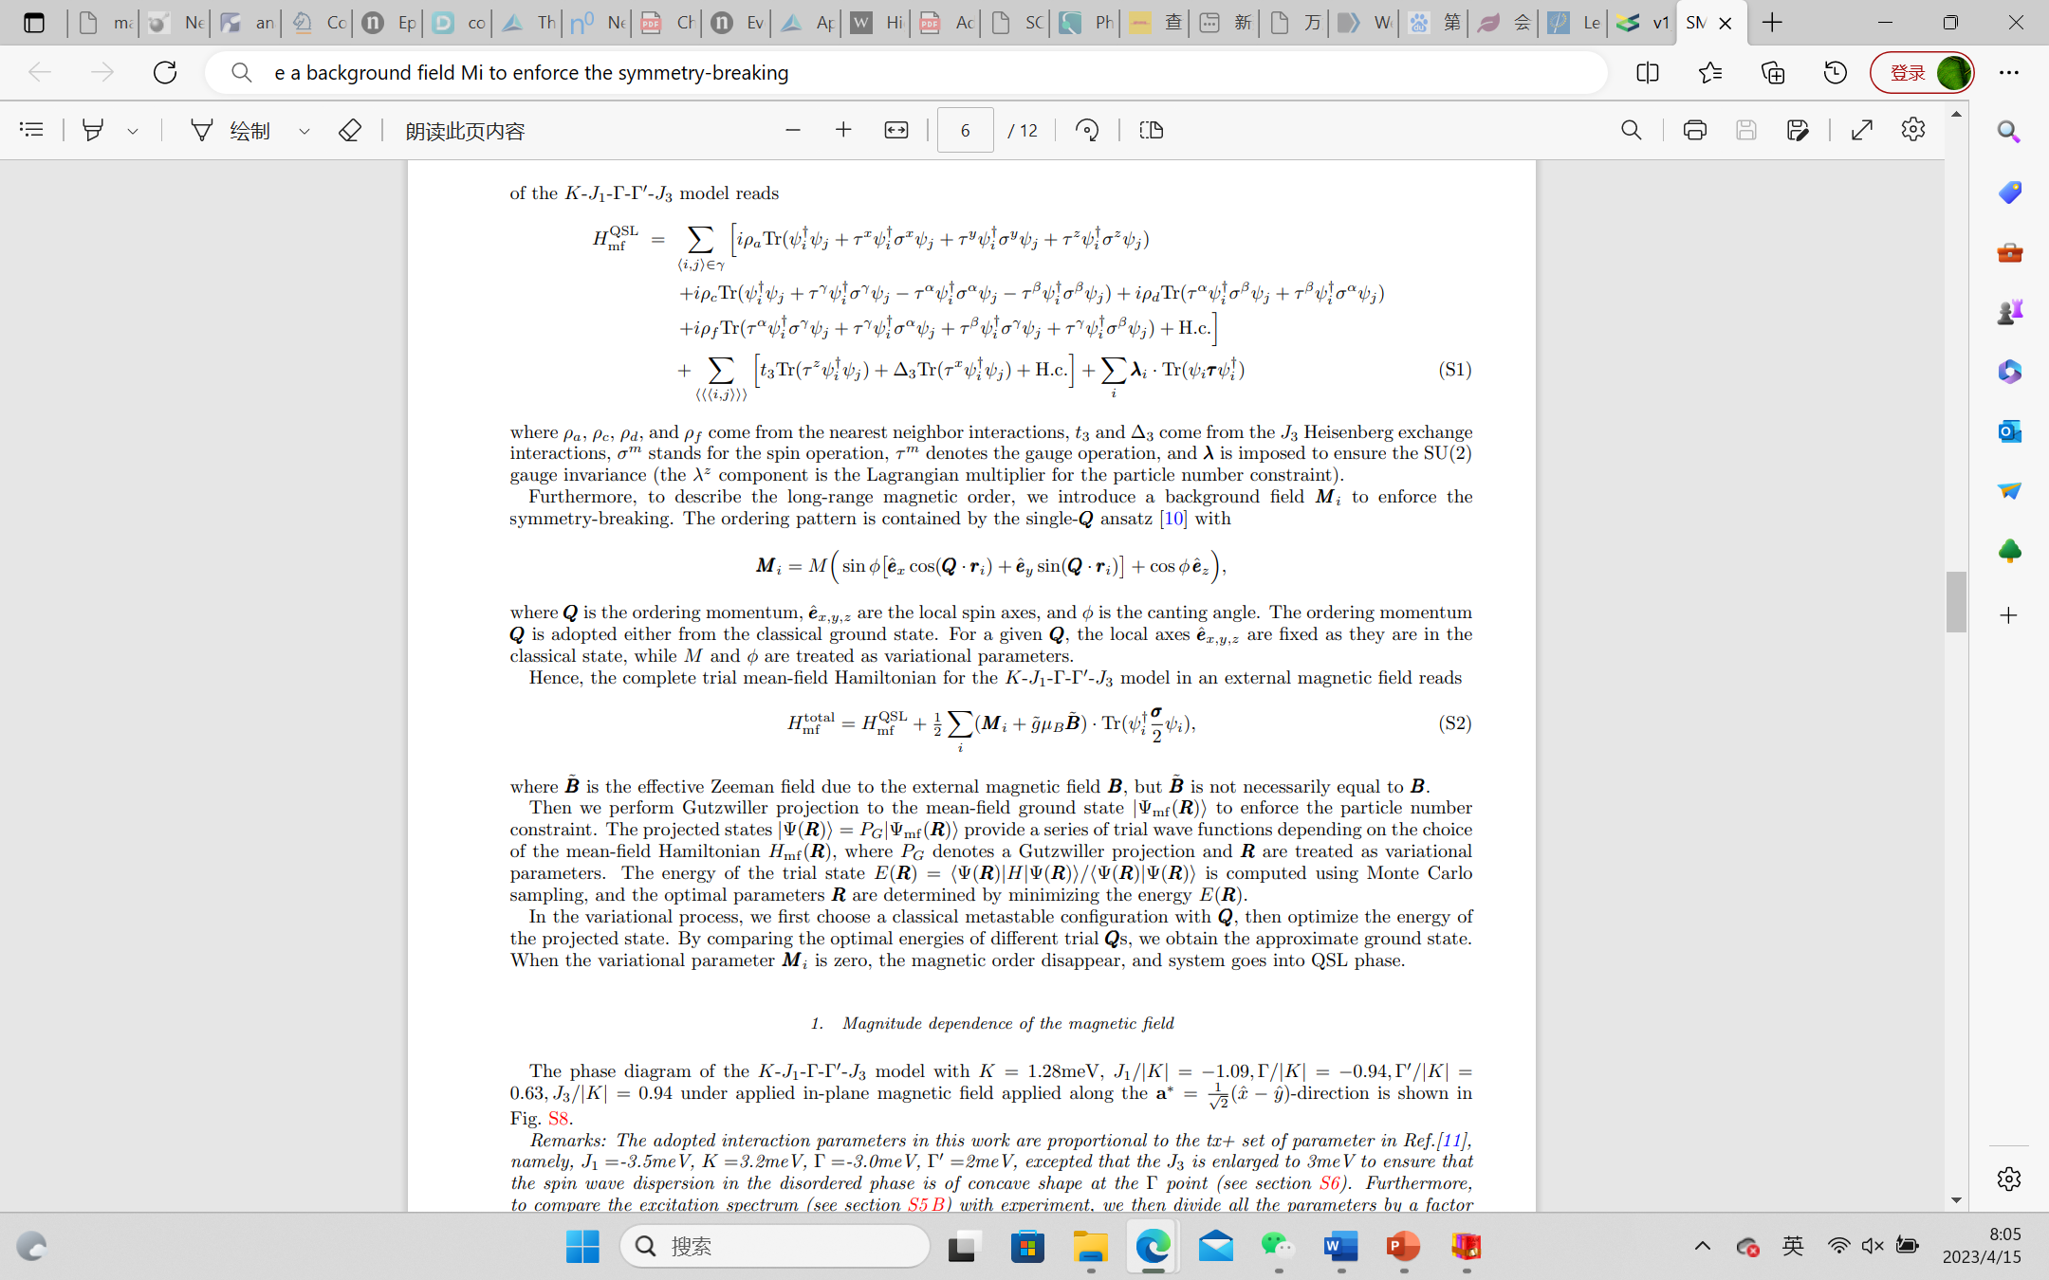
Inelastic Neutron Scattering
QSL mean-field K-J₁-Γ-Γ′-J₃ model
Background field to enforce the symmetry-breaking
27

Slide 28
Inelastic Neutron Scattering
J₁ = −1.54 meV, J₃ = 1.32 meV, K = 1.408 meV, Γ = −1.32 meV, and Γ′ = 0.88 meV,
J₁ = 0.066 meV, J₃ = 1.32 meV, K = −3.399 meV, Γ = 0.286 meV, and Γ′ = 0.077 meV.
28

Slide 29
Conclusions
  Quantum effect in 2D triangular/honeycomb lattices could very strong
  New physical properties could be introduced with the complicated interactions of the quantum fluctuation and spin/orbital
  Spinons of RVB? or Vortex fermion excitations?
  muSR has a strong contribution to the proof of QSL
29

Slide 30
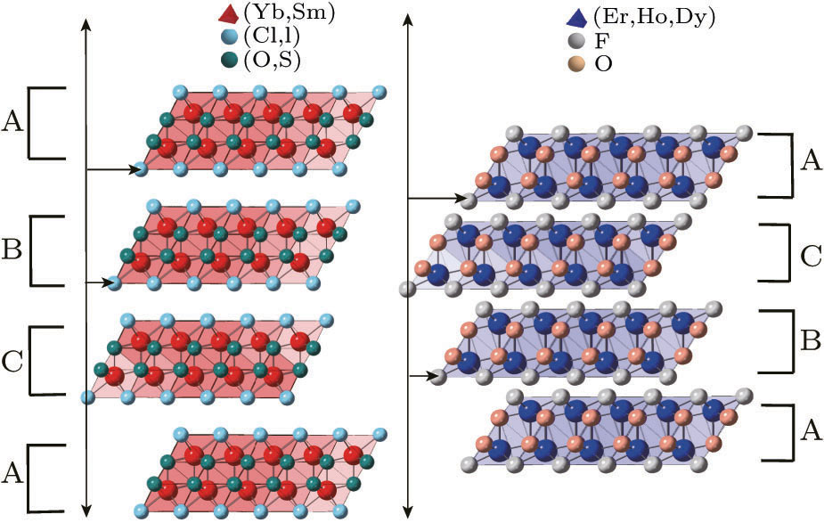


Quantum Spin Liquid Candidate
REChX (RE = rare earth; Ch = O, S, Se, Te; X = F, Cl, Br, I)
Chin. Phys. Lett. 38， 047502 (2021)

Slide 31



YbOCl
3.51 Å
3.72 Å
Yb³⁺
J_{eff}=1/2
Triangular lattice in a single layer and the neighbor layers form a stacked honeycomb lattice.
An AFM transition was detected at about 1.3 K.
Strong anisotropy in M-H curves.

Slide 32






Thermodynamic measurements of YbOCl
The AFM transition moves toward high temperature with increasing field.
A spin disordered state was detected.
The anisotropic spin Hamiltonian was constructed.
Notes:
From the magnetic dependent heat capacities and magnetic susceptibilities, the phase transition peak shows exotic behavior. Firstly, the peak should move to lower temperature with increasing magnetic field for a traditional AFM phase, because the magnetic field could suppress the magnetic fluctuation, while in this material, the peak shows a distinct magnetic-field dependence. Secondly, the sharp peak that represents phase transition becomes broad and smooth when magnetic field is up to 0.2 T, suggesting the system enters a disordered region with strong fluctuation. This character is also captured by alternating current magnetic susceptibility measurements. AC susceptibility measures the ability of a spin to respond or flip with a change in the external magnetic field, allowing it to be related to the magnetization or spin fluctuations in the system. In the magnetic field from 0.1-3.5 T range, the AC magnetic susceptibility is nearly constant at a plateau, this is a fascinating finding closely related to the spin disorder. This magnetic field driving spin disorder state is related to the special magnetic structure confined in ab-plane, thus the magnetic field along the c-axis is a transverse field, which can enhance the quantum fluctuation. Additionally, we executed single crystal inelastic neutron scattering experiment at TASP, and the extra magnetic peaks separated from nuclear peaks those can be indexed by propagation vector (0 0 1.5) were detected below 1.3 K. This is consistent with the heat capacity and magnetic susceptibility measurements and verify the AFM transition. Interestingly, from the magnetic field dependence of the magnetic peak (001.5), we find the magnetic Bragg peak is almost undetectable under 0.3 T, suggesting that a relatively small magnetic field can suppress the magnetic phase transition and push the spin system into a disordered state.
In order to reveal the abundant physics in YbOCl, we and our theoretical collaborators construct the Hamiltonian and the full diagonalization method was applied to simulate the magnetization and heat capacity data to derive various parameters in the Hamiltonian. Considering the strong SOC of Yb3+ and the distorted octahedral
structure, the off-diagonal terms of the anisotropic spin interaction will play an important role. Therefore, the anisotropic spin Hamiltonian is represented as follows: where HHoneycomb is the NN spin Hamiltonian, Htriangular is the NNN spin Hamiltonian, and HZeeman is the splitting term. For the NN spin Hamiltonian

Slide 33



FD simulation results of YbOCl
Derived parameters
NPD and INS results
J_{zz}=1.05K, J±=-0.6K
J_{zz}′=0.26K, J±′=-0.42K
J±±=0.39K, J_{z±}=0
J±± ′=0.13K, J_{z±}′=0
J₁=-0.71K, K₁=0.78K
Γ₁=1.27K, Γ₁′=0.49K
J₂=-0.11K, K₂=-0.26K
Γ₂=0.05K, Γ₂′=0.07K
Notes:
In order to obtain the diagonal terms firstly, we choose to simulate the data at high temperature and high field, where the spins are essentially aligned with the direction of the external magnetic field and the off-diagonal terms can be ignored. Through the fitting and simulation calculations of the M/H-T data, we found an optimal set of parameters, namely Jzz = 1.05 K, J′zz = 0.26 K, J± = -0.6K, and J′± = -0.42 K. This set of parameters can well reproduce both the MH and MT experimental results. Then the off-diagonal terms can be derived by fitting heat-capacity data at polarization region. And J±±=0.39K, J±±’=0.13K, Jz±=0, Jz±’=0 were obtained. It should be pointed out that the spin Hamiltonian in YbOCl is strictly equivalent to the J-K-Γ-Γ’ model, which allows a mutual conversion of spin-exchange interactions between the two models, resulting in J1 ∼ -0.71 K, K1 ∼ 0.78K, Γ1 ∼ 1.27 K, and Γ′1 ∼ 0.49 K for the honeycomb lattice, and J2 ∼ -0.11 K, K2 ∼ -0.26 K, Γ2 ∼ 0.05 K, and Γ′2 ∼ 0.07 K for the triangular lattice. Apparently, the NNN spin interactions are smaller than the NN spin interactions in the representation of J −K −Γ−Γ′ model, which suggests that the spin interactions in the honeycomb lattice play a major role in the magnetism of YbOCl. We also performed powder inelastic neutron scattering on Pelican, ANSTO and the data of elastic part were extracted to analyze the magnetic structure at ground state of YbOCl. Three distinct magnetic peaks indexed by (001.5) (007.5) (102.5) were observed with a propagation vector (001.5). Although the resolution is not good enough to do the Rietveld refinement, we can use the relative intensity of these different magnetic peaks and nuclear peaks combined with the thermodynamics data to rule out some spin configurations. Firstly, the magnetic moments should lie in ab plane mainly. Secondly, the magnetic structure is more likely to be a collinear one because the spin system can be polarized so easily when the magnetic field is applied in ab-plane. The magnetic structure is determined by iterating through the possible magnetic space group (MSG) solutions, which were derived from the k-SUBGROUPSMAG program of the Bilbao Crystallographic server. Through total 14 possibilities, the magnetic structure of magnetic moments align parallel in ab-plane and antiparallel along c-axis coincides with our experimental data best. This ground state is also verified by DMRG calculation based on the spin Hamiltonian above. The in-plane ferromagnetic and interlayer AFM ordered state in YbOCl is distinct from the observations in some other Kitaev compounds. For instance, the ground-state magnetic structure in α-RuCl3 and Na2IrO3 is a zigzag ordered state, and the ground state of YbCl3 is a Neel state. This may be closely related to the fact that J± and J′± are ferromagnetic interactions while Jzz and J′zz are antiferromagnetic interactions. Then this magnetic structure and the spin Hamiltonian were used to simulate the powder averaged INS data by SPINW package, and the calculated results highly reproduce the experimental measurements.

Slide 34












Acknowledgements
Sample synthesis and characterization:
H. D. Zhou, Q. Zhang
Theoretical calculation:
Y. Wan, C. Batista, Y. Kamiya, M. Mourigal, J. Wu,
R. Yu, Z. Liu, J. Park
Neutron Beamline Scientists:
ORNL: M. Matsuda, S. Chi, H. Cao, T. Hong, G. Ehlers,
Feng Ye, D. Abernathy, M. Stone, O. Garlea
NCNR: N. Butch, Yiming Qiu
HZB: Z. L. Lu, J. Q. Xu, M. Russina, G. Günther
FRM-II, J-Parc, PSI, ANSTO, etc
μSR Beamline Scientists:
PSI: T. Shiroka, T. Shang; TRIUMF：X. Li, S. Dunsiger
NMR and ESR:
W. Yu, Z. Qu, W. Tong, X. Luo
34

Slide 35
Thanks!

