Slide 1
Simulation Study of Muon Beam CT and Integration of MuDirac and Geant4 for Muonic X-ray Generation
Zhihao Zhou^{1,2,3}, Yang Li^{1,2}, Jingyu Tang⁴
MIP 2024 @ Peking University
April 21, 2024
¹Institute of High Energy Physics, Chinese Academy of Sciences (CAS)
²Spallation Neutron Source Science Center
³University of Chinese Academy of Sciences
⁴University of Science and Technology of China

Slide 2
Contents
Introduction to Experimental Muon Source(EMuS)
Muon Beam Computed Tomography (CT)
  Cosmic-ray muon imaging
  Accelerator-based muon beam CT
    Details of simulation study
    Result, summary, and outlook
Muonic X-ray Elemental Analysis
  Improve the cascade process of negative muons in Geant4 with the use of MuDirac
https://doi.org/10.1002/pssa.202200426

Slide 3

Experimental Muon Source (EMuS)
EMuS was a research proposal for a muon facility at the China Spallation Neutron Source (CSNS) under the NSFC Fund for Research on National Major Research Instruments (2016–2021).
Two schemes have been designed:
Surface muon for μSR applications
Negative cloud muon for muonic X-ray analysis
  Phase-I or the simplified scheme
Surface and decay muons for μSR
High-momentum decay muon for imaging
Negative decay muon for depth-selective muonic X-ray analysis
  Phase-II or the baseline scheme
https://doi.org/10.1002/pssa.202200426

Slide 4
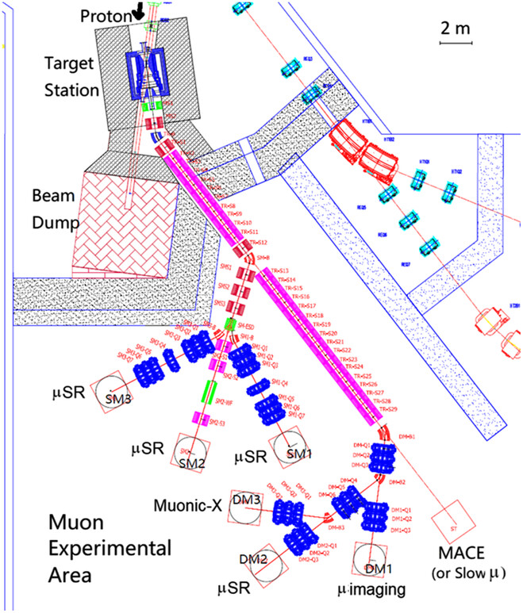
EMuS Baseline Scheme
CSNS accelerator facility provides a proton beam with a kinetic energy of 1.6 GeV, and a repetition rate of 25 Hz. It currently has a beam power of 140 kW, which can be upgraded to 500 kW at Phase-II. EMuS will take about 5% or 25 kW of the total beam power (500 kW) from the CSNS-II accelerator complex.
The high-momentum muon beams for imaging operate at a repetition rate of 2.5 Hz, with a momentum of up to 450 MeV/c and a beam intensity of 7.9×10⁸.
EMuS baseline scheme layout
DM1 endstation: high-momentum muon beam imaging
DM3 endstation: muonic X-ray analysis
https://doi.org/10.1002/pssa.202200426

Slide 5
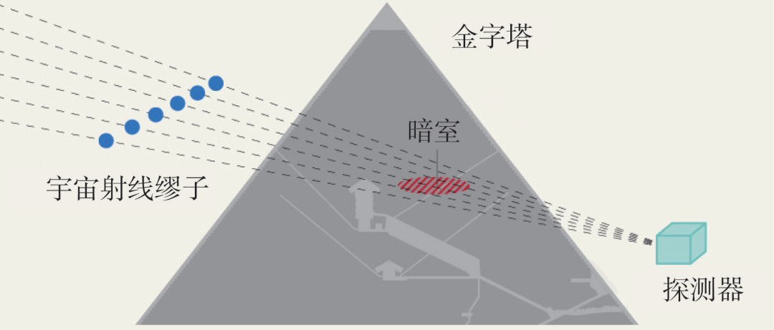
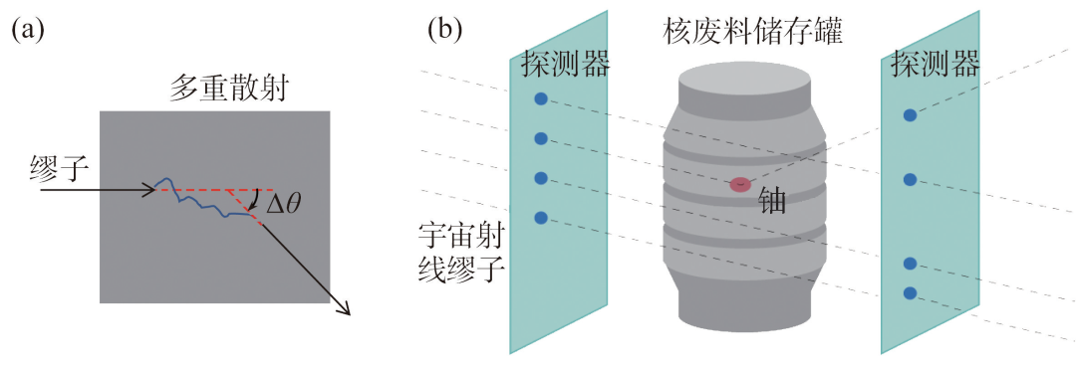
Cosmic-ray Muon Imaging Methods
(i)
Cosmic-ray muons
  Average energy ~4 GeV
  Up to 100 TeV
  ~1/(cm²·s) at sea level
Cosmic-ray muons have been used to image large objects
  Transmission and absorption imaging
  Muon scattering imaging(Muon tomography)
(ii)
Cosmic-ray muon imaging methods:
transmission and absorption
scattering

Slide 6
Muon Beam CT
Accelerator-based muon beam
  Controllable momentum
  High intensity
Penetrating power of 450 MeV/c (360 MeV) muons
  Could be used for imaging macroscopic samples
The baseline scheme of EMuS provides possibility of imaging using high-momentum muon beam
Material | Range [mm]
Aluminum | 718
Iron | 271
Copper | 248
Lead | 238
Tungsten | 137
Corresponding to ranges of 590 MeV proton

Slide 7
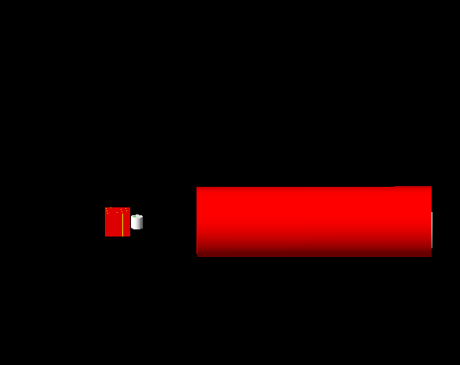
Simulation Study of Muon Beam CT
1. Projection Value Calculation
2. Detector Design
3. Collimator Design
4. Result
Detector
Muon beam
Sample
Collimator
Geant4 simulation

Slide 8
Projection Value
As a tomographic imaging technique, CT images cannot be directly obtained from the detector data. Instead, the data is used to calculate projection values (PVs).
Then, the calculated PVs are used as inputs for the reconstruction algorithm, which is used to produce the final image.
Common CT reconstruction algorithms
  Algebraic Reconstruction Technique (ART, this work)
  Filtered Back Projection (FBP)
  Maximum Likelihood Expectation Maximization (MLEM)
Reconstruction algorithm
Image
Data
Projection Values

Slide 9
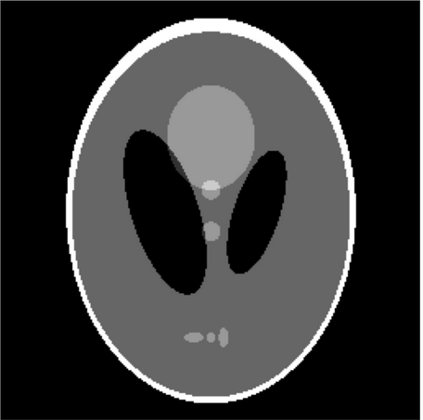
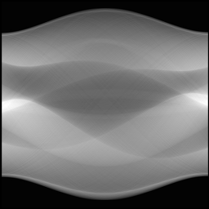
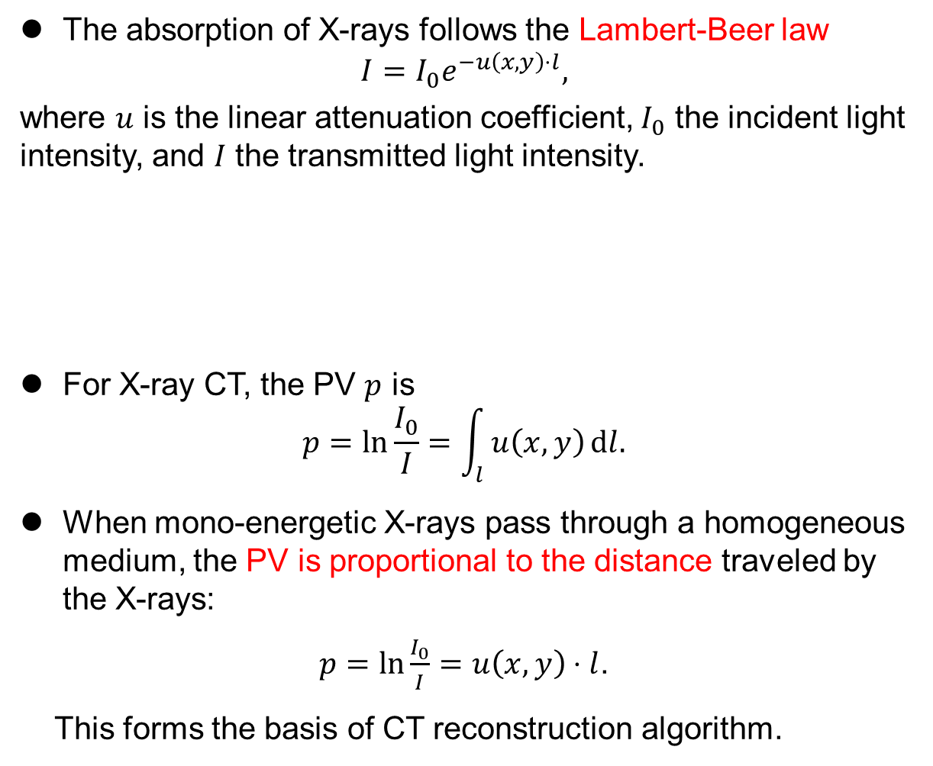
The absorption of X-rays follows the Lambert-Beer law
$$I=I_{0}e^{−u\left(x, y\right)⋅l},$$
where $u$ is the linear attenuation coefficient, $I_{0}$ the incident light intensity, and $I$ the transmitted light intensity.
For X-ray CT, the PV $p$ is
$$p=\ln{\frac{I_{0}}{I}}=\int_{l}^{ }{u\left(x, y\right)}dl.$$
When mono-energetic X-rays pass through a homogeneous medium, the PV is proportional to the distance traveled by the X-rays:
$p=\ln{\frac{I_{0}}{I}}=u\left(x,y\right)⋅l$.
This forms the basis of CT reconstruction algorithm.
Data
Projection Values
Reconstruction algorithm
Image

Slide 10
In early CT scans, the source and detector move at an angle theta to cover the entire cross-section.
The detector and collimator rotate multiple times to collect data from multiple angles.
Nowadays, X-ray CT employs conical beams and detectors with larger areas to achieve multi-layer imaging at once.
source
detector
source
detector

Slide 11
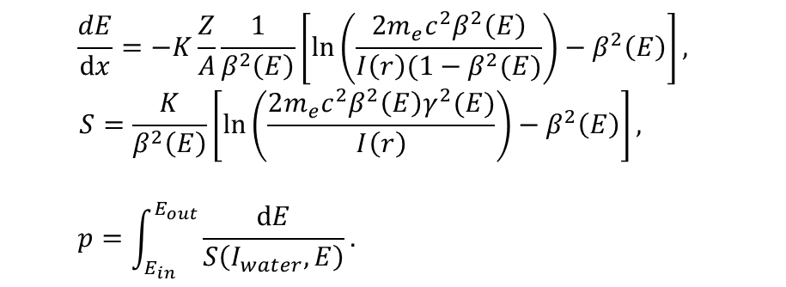
Proton CT (pCT) uses the energy loss of protons for imaging.
  pCT can assist in proton therapy.
  Proton beams usually from a cyclotron.
  The projection value of pCT is:
  $$\frac{dE}{dx}=−K\frac{Z}{A}\frac{1}{β^{2}\left(E\right)}\left[\ln\left(\frac{2m_{e}c^{2}β^{2}\left(E\right)}{I\left(r\right)(1−β^{2}(E)}\right)−β^{2}\left(E\right)\right],$$
  $$S=\frac{K}{β^{2}\left(E\right)}\left[\ln\left(\frac{2m_{e}c^{2}β^{2}\left(E\right)γ^{2}(E)}{I\left(r\right)}\right)−β^{2}\left(E\right)\right],$$
  $$p=\int_{E_{in}}^{E_{out}}{\frac{dE}{S\left(I_{water}, E\right)}}.$$
  Current proton CT uses silicon strip detectors (SSD) and silicon pixel detectors (SPD) to improve imaging efficiency.
    SSD: measure the entry and exit positions and angles of protons
    SPD: measure the energy of exiting protons
    With these measurements, trajectories of protons in the sample can be reconstructed using interpolation algorithms.
  In early proton CT, high-purity germanium detectors were used to measure the energy of outgoing protons.
Silicon strip detectors
Range telescope
HPGe detector
Proton beam
Proton beam
`
···
Sample
Sample
https://doi.org/10.1088/0031-9155/26/6/001
https://doi.org/10.1016/j.ejmp.2018.10.020

Slide 12
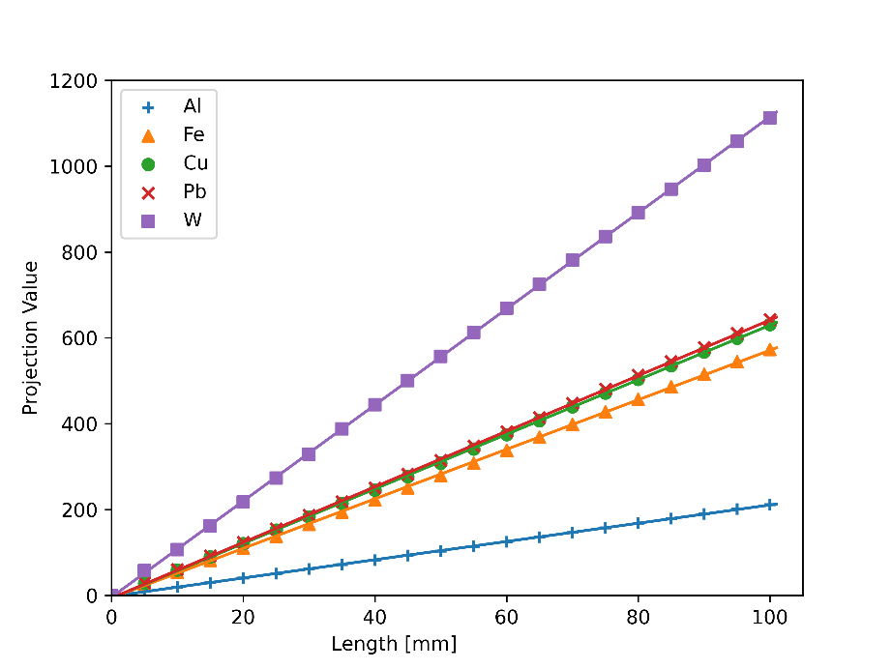
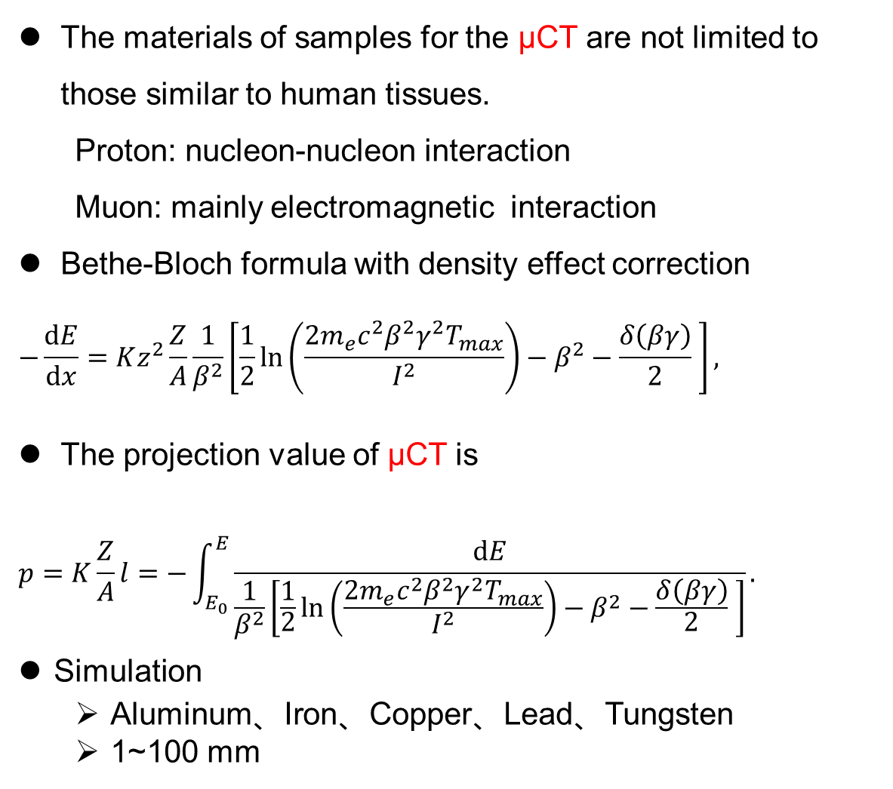
The materials of samples for the μCT are not limited to those similar to human tissues.
  Proton: nucleon-nucleon interaction
  Muon: mainly electromagnetic interaction
Bethe-Bloch formula with density effect correction
$$−\frac{dE}{dx}=Kz^{2}\frac{Z}{A}\frac{1}{β^{2}}\left[\frac{1}{2}\ln\left(\frac{2m_{e}c^{2}β^{2}γ^{2}T_{max}}{I^{2}}\right)−β^{2}−\frac{δ\left(βγ\right)}{2} \right],$$
The projection value of μCT is
$$p=K\frac{Z}{A}l=−\int_{E_{0}}^{E}{\frac{dE}{\frac{1}{β^{2}}\left[\frac{1}{2}\ln\left(\frac{2m_{e}c^{2}β^{2}γ^{2}T_{max}}{I^{2}}\right)−β^{2}−\frac{δ\left(βγ\right)}{2} \right]}}.$$
Simulation
  Aluminum、Iron、Copper、Lead、Tungsten
  1~100 mm
✔️
Relationship between the projection value and the thickness of the material which the muon passes through Good linearity

Slide 13
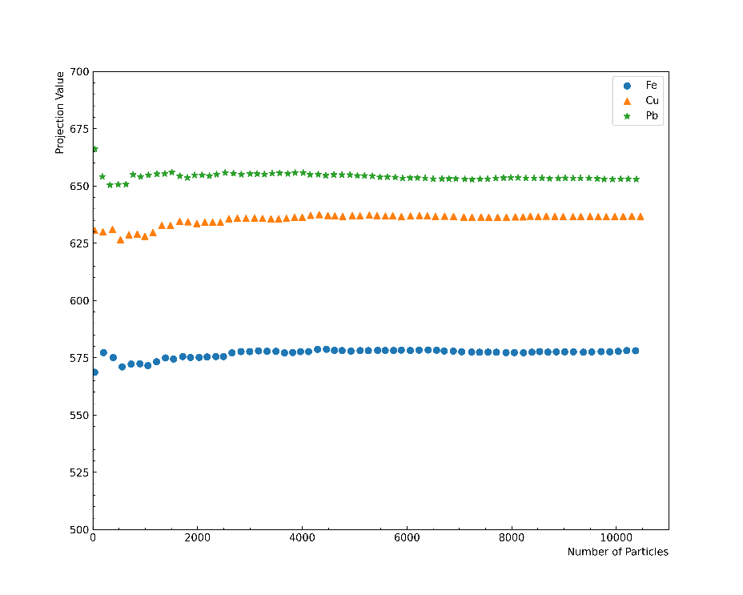
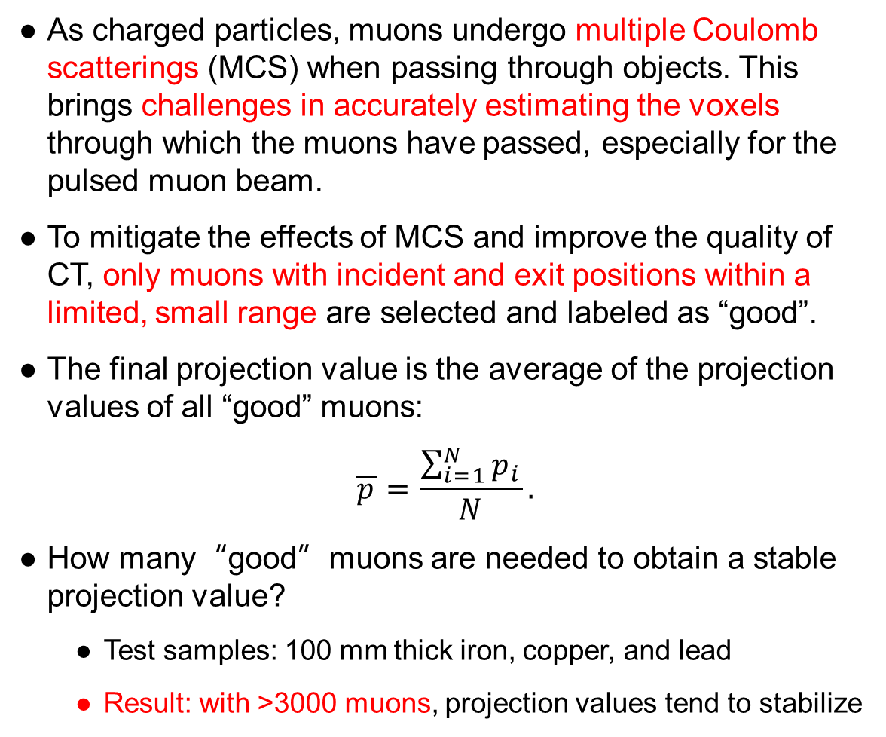
Muon Selection for CT
As charged particles, muons undergo multiple Coulomb scatterings (MCS) when passing through objects. This brings challenges in accurately estimating the voxels through which the muons have passed, especially for the pulsed muon beam.
To mitigate the effects of MCS and improve the quality of CT, only muons with incident and exit positions within a limited, small range are selected and labeled as “good”.
The final projection value is the average of the projection values of all “good” muons:
$$\overline{p}=\frac{\sum_{i=1}^{N}{p_{i}}}{N}.$$
How many“good”muons are needed to obtain a stable projection value?
  Test samples: 100 mm thick iron, copper, and lead
  Result: with >3000 muons, projection values tend to stabilize
✔️
select
reject
Pb
Cu
Fe
Relationship between the projection values of different materials and the number of “good” muons

Slide 14
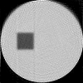
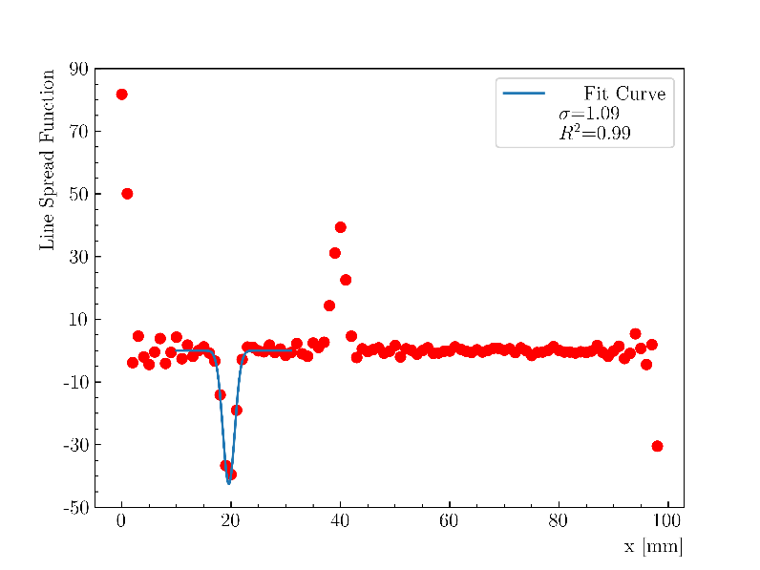
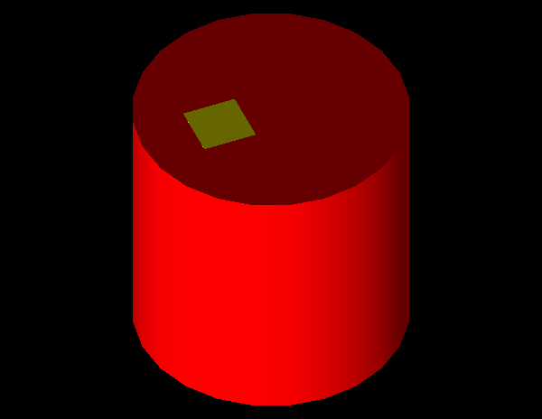
Projection Value Calculation
Reconstructed image
The calculation of projection value was verified with Geant4 simulation.
Simulation settings:
  Small incident beam spot
  Virtual detector
  Sample: aluminum inside iron
  Iron: red cylinder (diameter 100 mm, height 100 mm)
  Aluminum: yellow cuboid (20*100*20 mm³)
Fit to the Line Spread Function of the aluminum edge Resolution ~1.1 mm (σ)

Slide 15
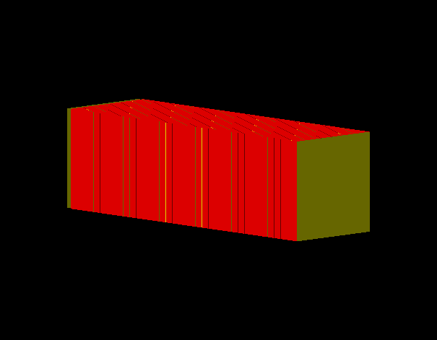
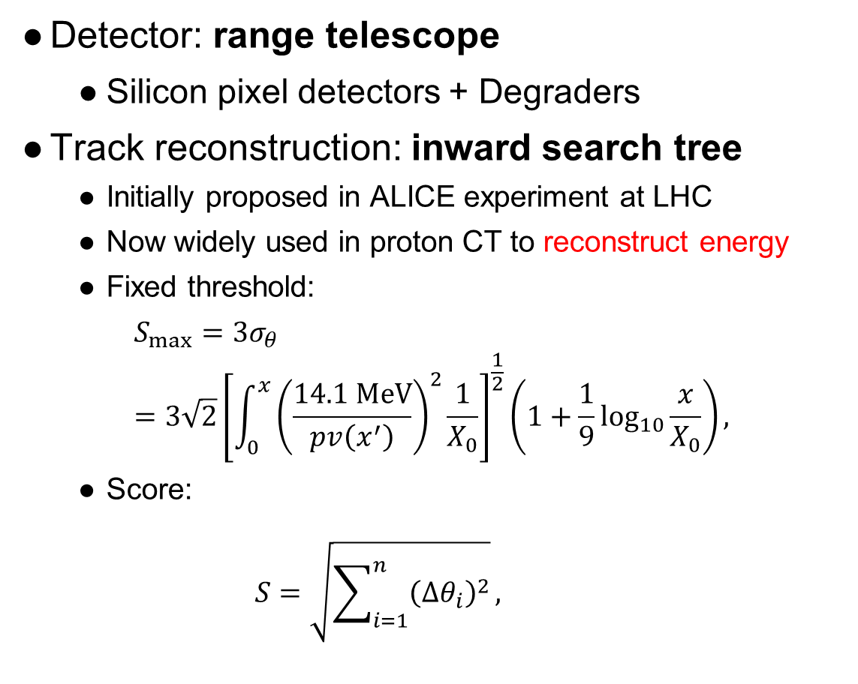


Detector and Track Reconstruction
Detector: range telescope
  Silicon pixel detectors + Degraders
Track reconstruction: inward search tree
  Initially proposed in ALICE experiment at LHC
  Now widely used in proton CT to reconstruct energy
  Fixed threshold:
    $$S_{max}=3σ_{θ}=3\sqrt{2}{\left[{\int_{0}^{x}{\left(\frac{14.1 MeV}{pv\left(x^{′}\right)}\right)}}^{2}\frac{1}{X_{0}}\right]}^{\frac{1}{2}}\left(1+\frac{1}{9}\log_{10}{\frac{x}{X_{0}}}\right),$$
  Score:
    $$S=\sqrt{\sum_{i=1}^{n}{{\left(Δθ_{i}\right)}^{2}}},$$
Range telescope model built with Geant4
Yellow: silicon pixel detector
Red: degrader
$${∆θ}_{2}$$
$${∆θ}_{1}$$
Schematic of track reconstruction algorithm

Slide 16
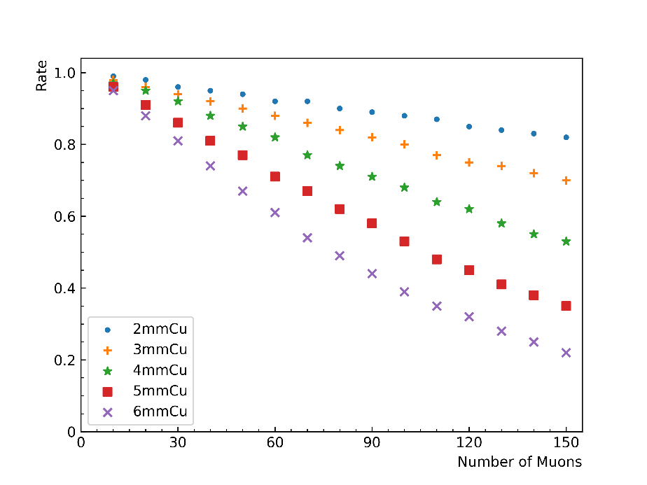
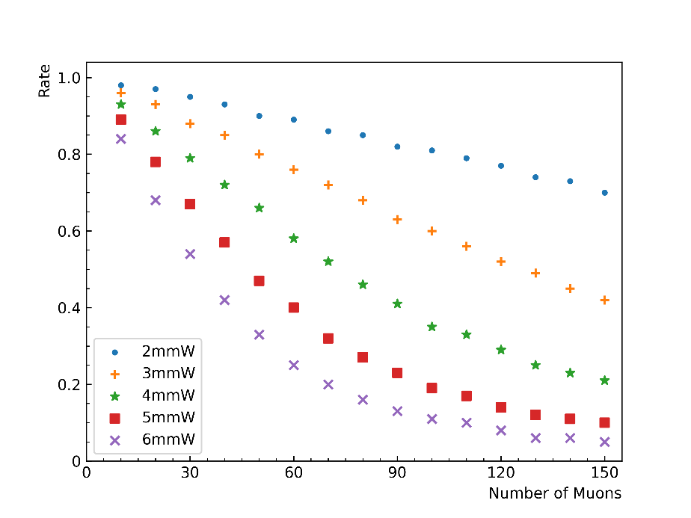
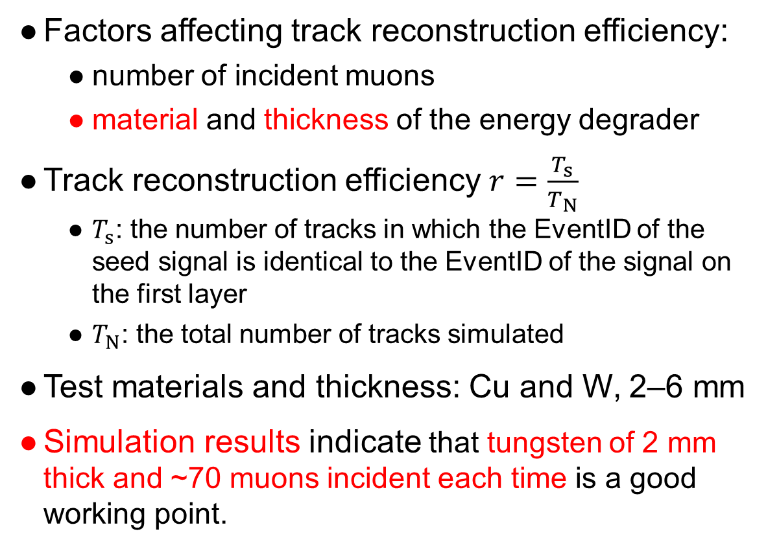
Design of Degrader
Factors affecting track reconstruction efficiency:
  number of incident muons
  material and thickness of the energy degrader
Track reconstruction efficiency $r=\frac{T_{s}}{T_{N}}$
  $T_{s}$: the number of tracks in which the EventID of the seed signal is identical to the EventID of the signal on the first layer
  $T_{N}$: the total number of tracks simulated
Test materials and thickness: Cu and W, 2–6 mm
Simulation results indicate that tungsten of 2 mm thick and ~70 muons incident each time is a good working point.
Efficiency
Copper
Number of muons
Efficiency
Tungsten
Number of muons

Slide 17
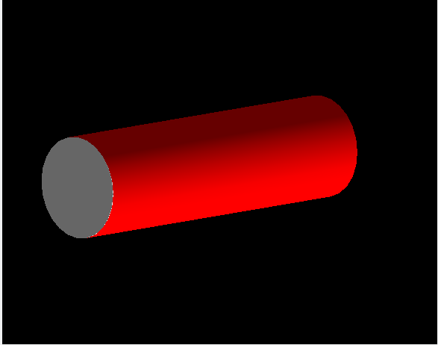
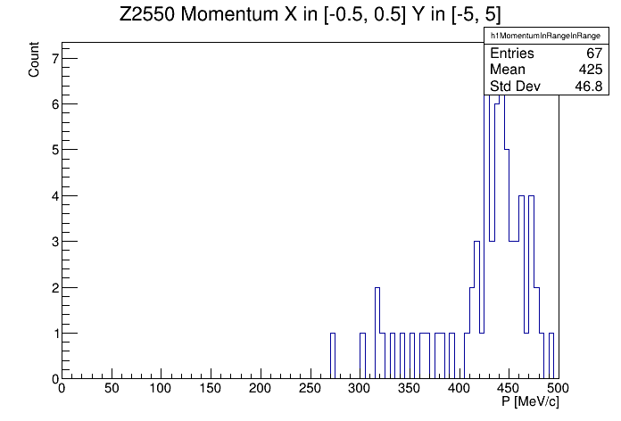
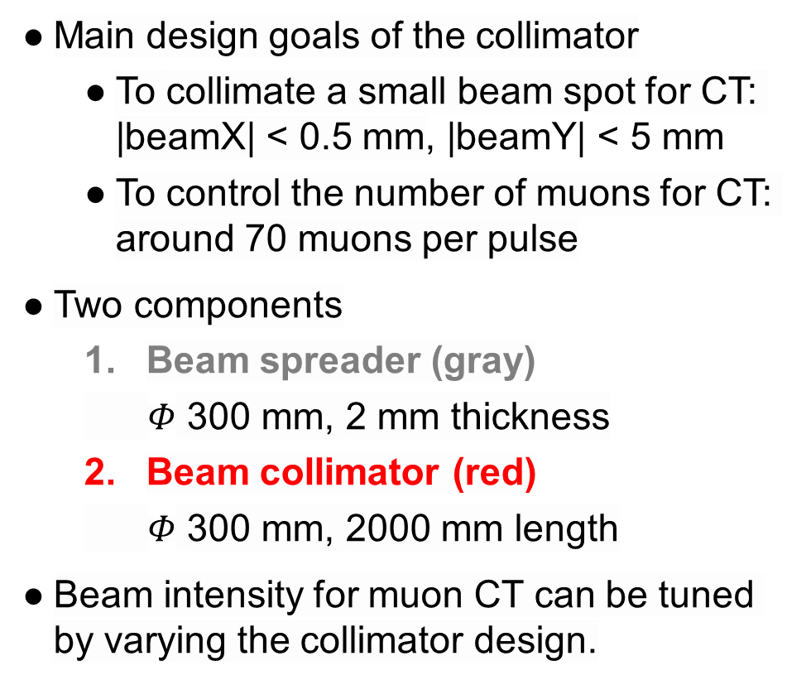
Design of Collimator
Main design goals of the collimator
  To collimate a small beam spot for CT: |beamX| < 0.5 mm, |beamY| < 5 mm
  To control the number of muons for CT: around 70 muons per pulse
Two components
  Beam spreader (gray)
  $Φ$ 300 mm, 2 mm thickness
  Beam collimator (red)
  $Φ$ 300 mm, 2000 mm length
Beam intensity for muon CT can be tuned by varying the collimator design.
Design of the collimator with Geant4 simulation
~70 muons remaining after collimation
Momentum of muons after collimation

Slide 18
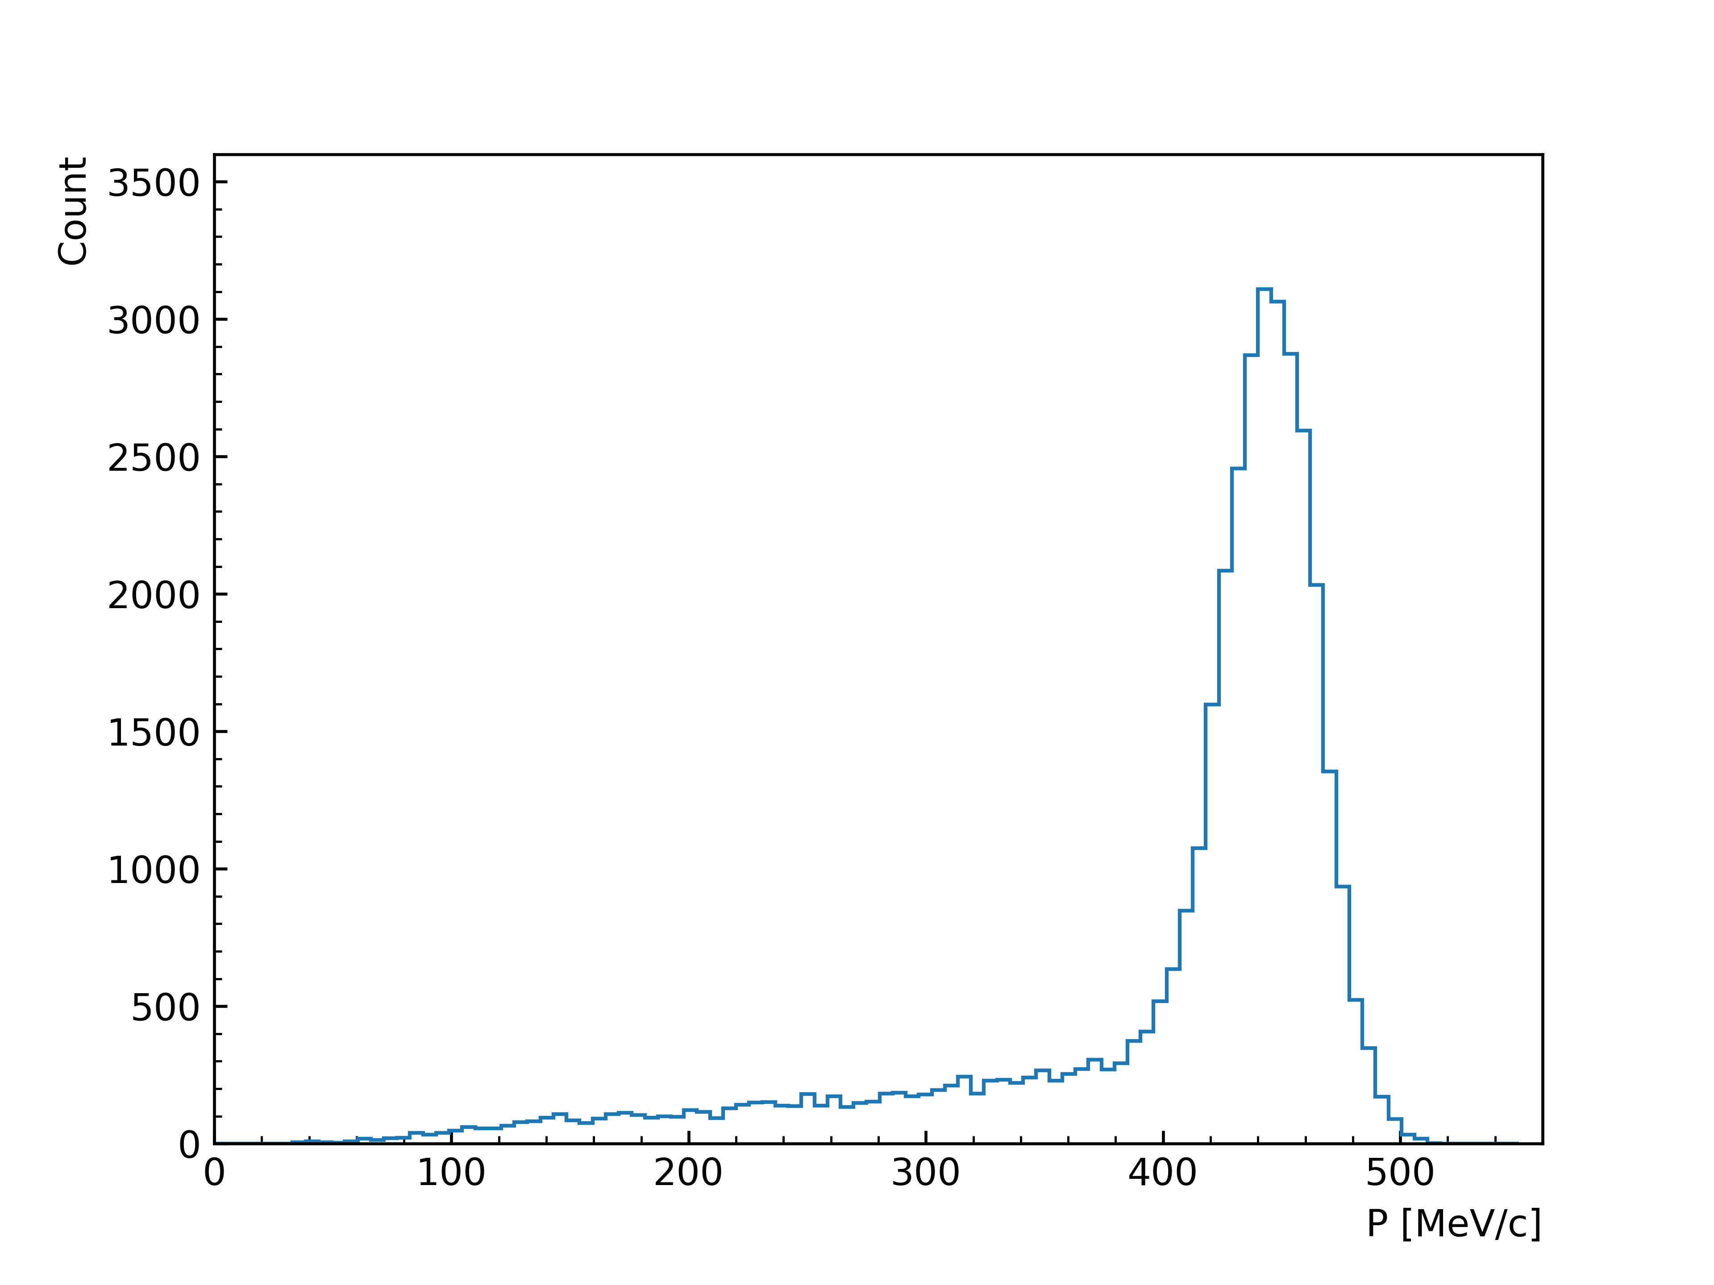
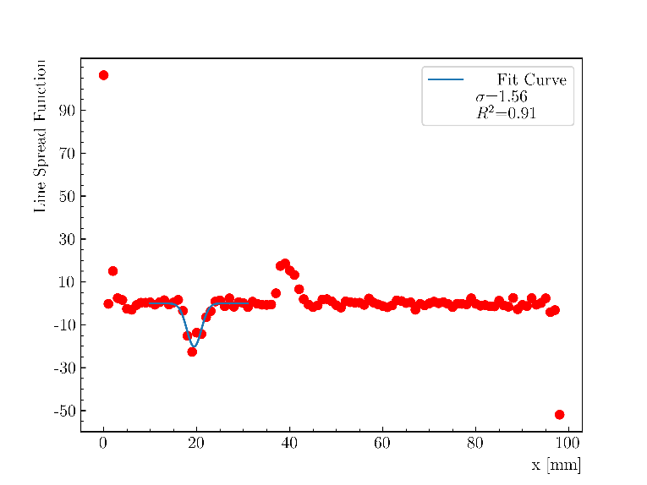
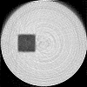
Simulation Result
~38,000 muons after collimation
Full simulation of muon beam CT was conducted, including:
EMuS DM1 beam (~10⁸ muons simulated)
Collimator
Sample
Range telescope
Momentum distribution of muons after passing through the collimator
Fit to the Line Spread Function of the sample edge yields a resolution of ~1.6 mm (σ)
Reconstructed image of muon beam CT

Slide 19
Summary and Outlook
Geant4 simulation and image reconstruction study in the EMuS baseline scheme demonstrate the potential of muon beam CT.
Simulation results suggest that bulk sample imaging with muon CT could be a promising application for muon facilities with high-momentum muon beams.
Current EMuS baseline design would require approximately one week to image a single cross-section of the sample studied in this work.
Improvements:
  Simultaneous irradiation with more beam spots
  Improve the track reconstruction algorithm
Continuous-wave muon beam
  Capability to measure individual muon

Slide 20
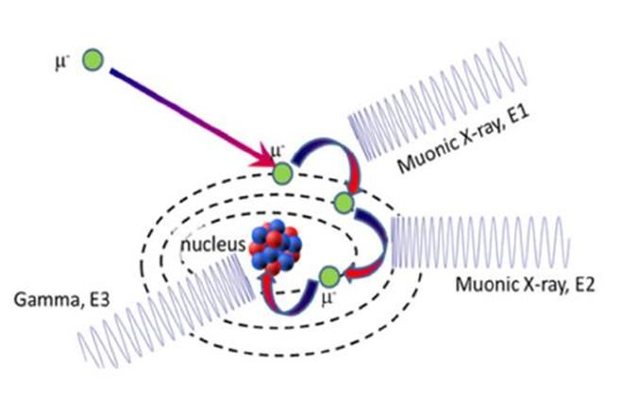
Contents
Muon Beam Computed Tomography (CT)
  Cosmic-ray muon imaging
  Accelerator-based muon beam CT
    Details of simulation study
    Result, summary, and outlook
Muonic X-ray Elemental Analysis
  Improve the cascade process of negative muons in Geant4 with the use of MuDirac
EMuS baseline scheme layout
DM1 endstation: high-momentum muon beam imaging
DM3 endstation: muonic X-ray analysis

Slide 21
Study of Muonic X-ray with Geant4
Background: start-to-end simulation of muonic X-ray analysis on EMuS DM3 is performed with G4beamline (a Geant4-based program)
Problem: muonic X-ray emission lines are incorrectly calculated by Geant4, especially for high-energy transition (e.g., K-shell)
G4MuonMinusCapture
G4EmCaptureCascade
Preliminary solution:
Use MuDirac* to produce muonic X-ray database (energies and probabilities) for all elements
Modify G4EmCaptureCascade to extract the transition energy and probability from database
Create a new messenger class to manage whether to replace the original G4 process (for G4beamline or other Geant4-based program)
Progress:
Developed Python scripts to run MuDirac in multi-process mode (< 1 hour for all nuclides using a 64-core server)
Finished: transition energy extraction
Ongoing: implementation of transition probability
Finished
Git repository
Transition | Kα (2p-1s) [keV]
Element | G4bl before | G4bl now | Exp.
²⁹Cu | 1491 | 1502 | 1507
*MuDirac is a software developed by the ISIS muon group, which calculates the transition energies and probabilities of muon cascade with a precision of a few keV.
https://doi.org/10.1002/xrs.3212
https://doi.org/10.3390/condmat8040101

Slide 22
Future Improvement
Intensities are also important for quantitative elemental analysis.
The intensities of the simulated spectra are not correct (either by MuDirac or Geant4).
  Need to consider the initial muon population on initial energy level, i.e. the angular momentum distribution at capture, L-distribution.
  Try to collaborate with MuDirac team and other groups.

Slide 23
Thank You!

Slide 24
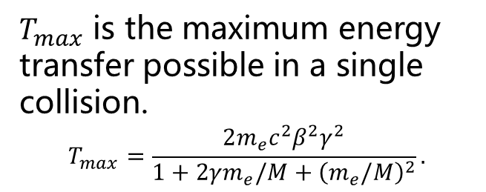
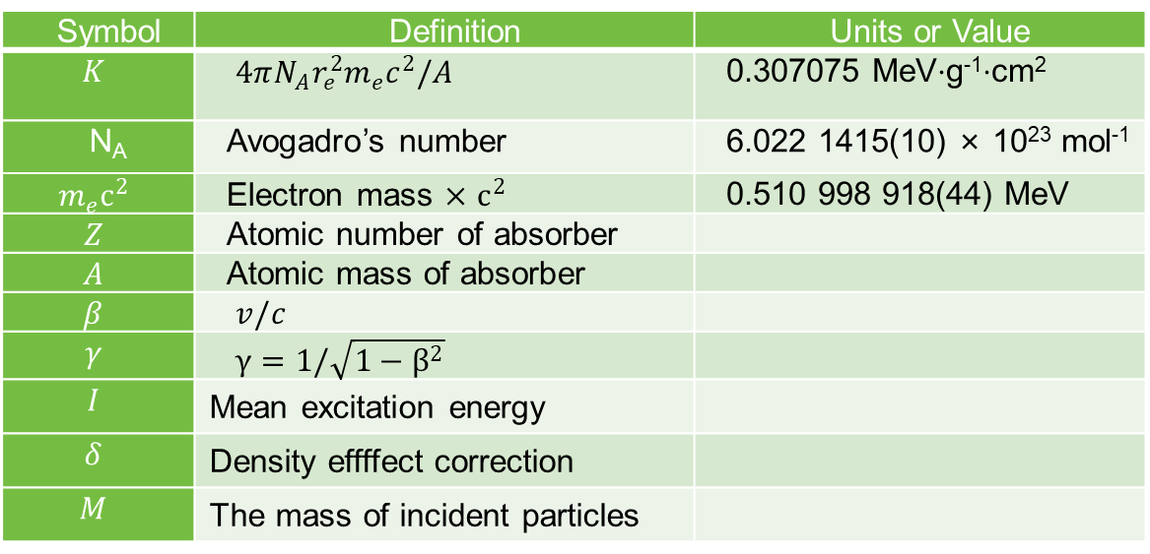
Backup
Summary of variables used in Bethe-Bloch formula.
Symbol | Definition | Units or Value
$$K$$ | $4πN_{A}r_{e}^{2}m_{e}c^{2}/A$ | 0.307075 MeV⋅g⁻¹⋅cm²
N_{A} | Avogadro’s number | 6.022 1415(10) × 10²³ mol⁻¹
$$m_{e}c^{2}$$ | Electron mass $×$ $c^{2}$ | 0.510 998 918(44) MeV
$$Z$$ | Atomic number of absorber
$$A$$ | Atomic mass of absorber
$$β$$ | $v/c$
$$γ$$ | $γ=1/\sqrt{1−β^{2}}$
$$I$$ | Mean excitation energy
$$δ$$ | Density effffect correction
$$M$$ | The mass of incident particles
$T_{max}$ is the maximum energy transfer possible in a single collision.
$$T_{max}=\frac{2m_{e}c^{2}β^{2}γ^{2}}{1+2γm_{e}/M+{\left(m_{e}/M\right)}^{2}}.$$

Slide 25
MyMessenger
Class
G4/My
MuonMinusAtomicCapture
Class
G4/My
EmCaptureCascade
Class
Interact with users and switch between the default process and the customized process.
A class that handles a series of processes following the capture of a muon by an atom, including the formation of muonic atoms, muon cascade processes, and so on.
A class that handles muon cascade processes. This class also handles meson cascade processes, but we only modify the mu- process in the MyMuonMinusAtomicCapture class.

