Slide 1

天然缪子成像技术在文物保护与矿藏勘探中的应用
Application of Muography in Conservation of Cultural Relics and Exploration of Mineral Deposits
Kaiqiang Yao
School of Nuclear Science and Technology, Lanzhou University
Frontier Science Center for Rare Isotopes, Lanzhou University
VMI China/Global
April 21, 2024

Slide 2
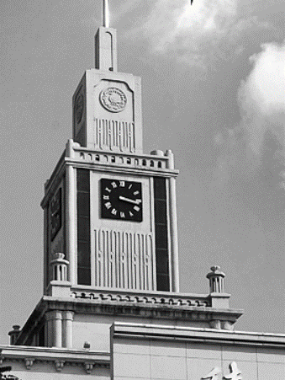
01 / Introduction
02 / Muography System
03 / Cultural relics protection-Xi’an defensive walls
04 / Mineral Exploration-Zaozigou gold mine
05 / Summary and Prospect
Outline
Notes:
2

Slide 3
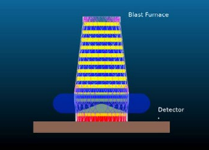
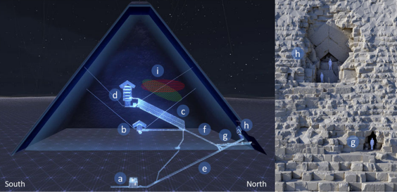
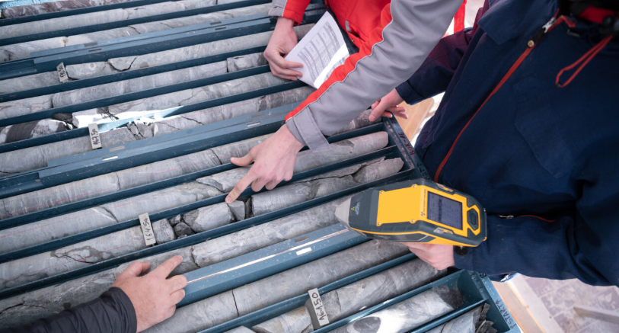
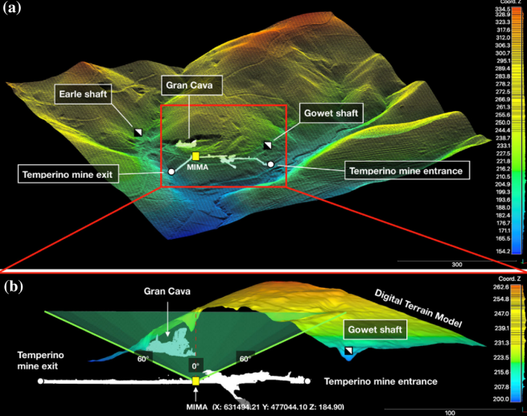
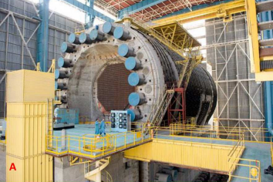
1.1 Research background
Muography is a new green nuclear technology that has been rapidly developed in recent years. It is widely used in materials identification, spent fuel container safety monitoring, ironmaking blast furnace imaging, internal structure monitoring of volcanoes, mineral exploration, archaeology, glacier surveying, nuclear reactor structure monitoring and so on.
Muography
Blast Furnace Imaging
Archaeology
Mineral Exploration
Reactor Imaging
[1] Procureur S, Morishima K, Kuno M, et al. Precise characterization of a corridor-shaped structure in Khufu’s Pyramid by observation of cosmic-ray muons[J]. Nature Communications, 2023, 14(1): 1144.
[2] Beni T, Borselli D, Bonechi L, et al.Transmission-Based Muography for Ore Bodies Prospecting: A Case Study from a Skarn Complex in Italy[J]. Natural Resources Research, 2023: 1-19.
[3] Procureur S, Attié D, Gallego L, et al. 3D imaging of a nuclear reactor using muography measurements[J]. Science Advances, 2023, 9(5): eabq8431.
[4] Lorenzon A, Andreetto P, Checchia P, et al. Application of Muon Radiography to Blast Furnaces: the BLEMAB project[J]. La Metallurgia Italiana, 2022 (10): 62-68.

Slide 4
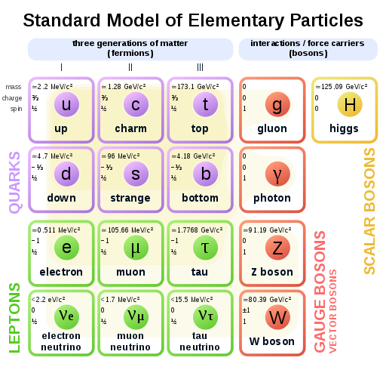
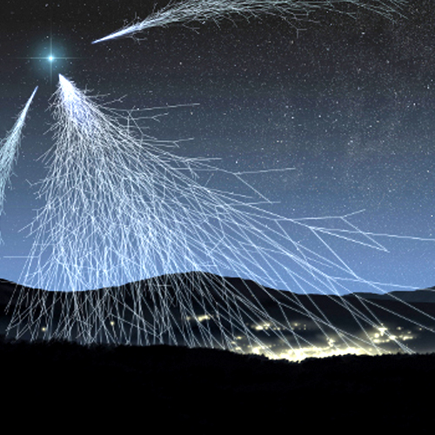








1.2 Cosmic ray muon
Cosmic ray muon production：
30km
$$π^{±}→μ^{±}+ν_{μ}({\overline{ν}}_{μ})$$
$$π^{+}$$
$$K^{±}→μ^{±}+ν_{μ}({\overline{ν}}_{μ})$$
15km
$$π^{−}$$
$$μ^{+}$$
1
2
$$v_{μ}$$
Production：
Secondary particles produced by the cascade reaction of high-energy primary cosmic rays (mainly protons) with the atmosphere
$$v_{μ}$$
Sea level energy and fluxes :
The average energy is 4 GeV, 1 muon per square centimeter per minute.
$$μ^{−}$$
3
4
Solid angle distribution：
cos^{n}θ, n≈2 Changes with energy, elevation, latitude
Flux influences ：
Fluxes are correlated with solar activity cycles, temperature, barometric pressure, altitude, latitude, and other factors
0km
[1] https://nl.wikipedia.org/wiki/Muon.
[2] Griffiths D. Introduction to elementary particles [M]. John Wiley & Sons, 2020.

Slide 5


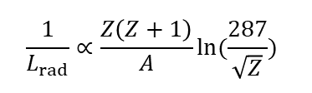
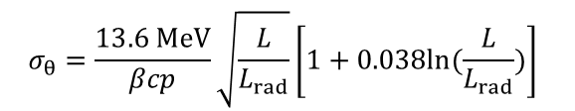
1.3 Principle of Muography
Based on the angular scattering principle
Based on the transmission principle
Counts
stratum
cave
High density
Detector
$$σ_{θ}=\frac{13.6 MeV}{βcp}\sqrt{\frac{L}{L_{rad}}}\left[1+0.038ln⁡(\frac{L}{L_{rad}})\right]$$
$$E_{μ}<500 GeV$$
Ionization losses dominate
Root mean square of scattering angle
Bethe-Bloch equation
Radiation length
$$\frac{1}{L_{rad}}∝\frac{Z\left(Z+1\right)}{A}ln(\frac{287}{\sqrt{Z}})$$
-$\frac{dE}{dX}=Kz^{2}\frac{1}{β^{2}}[\frac{1}{2}ln\frac{2m_{e}c^{2}β^{2}γ^{2}W_{max}}{I^{2}}−β^{2}−\frac{δ(βγ)}{2}]$
[1] Bonomi G, Checchia P, D’Errico M, et al. Applications of cosmic-ray muons[J]. Progress in Particle and Nuclear Physics, 2020, 112: 103768.

Slide 6
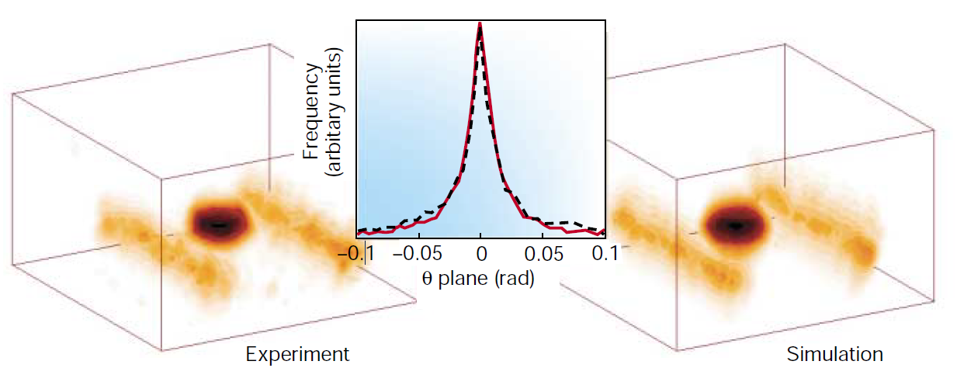
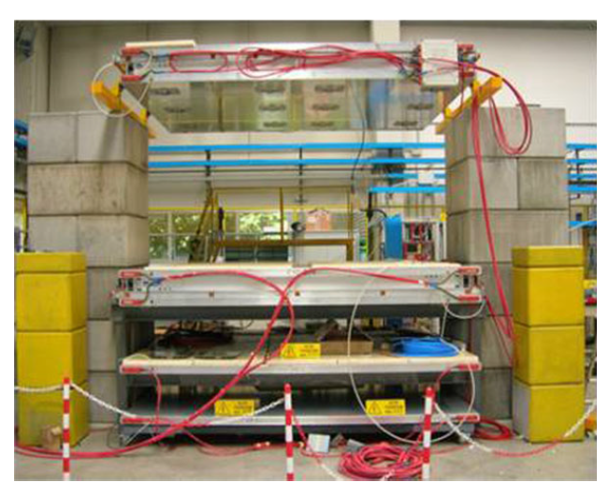
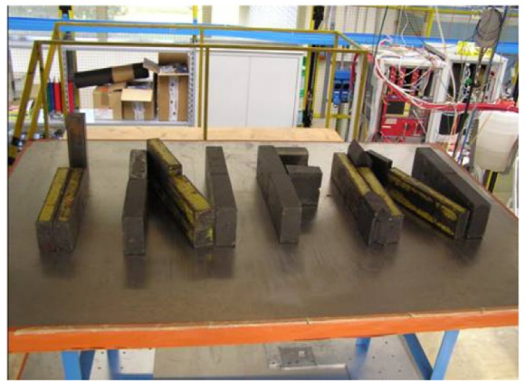
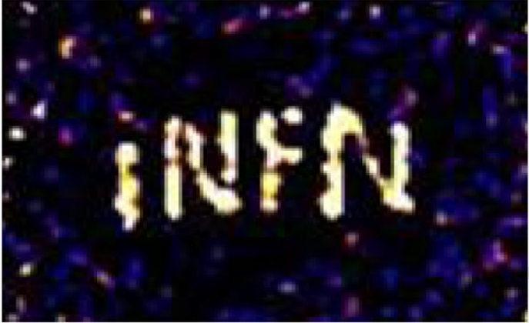
1.4 Application of Muography
2003, Angular scattering principle imaging first proposed(Borozdin, 2003)
2015, Imaging of lead bricks with the TRIUMF system(Anghel, 2015)
2019, Imaging of INFN drift chamber detectors(Checchia, 2019)
[1] Borozdin K N, Hogan G E, Morris C, et al. Radiographic imaging with cosmic-ray muons[J]. Nature, 2003, 422(6929): 277.
[2] Anghel V, Armitage J, Baig F, et al. A plastic scintillator-based muon tomography system with an integrated muon spectrometer[J]. NIMA, 2015, 798: 12-23.
[3] Checchia P, Benettoni M, Bettella G, et al. INFN muon tomography demonstrator: past and recent results with an eye to near-future activities[J]. Philosophical Transactions of the Royal Society A, 2019, 377(2137): 20180065..

Slide 7
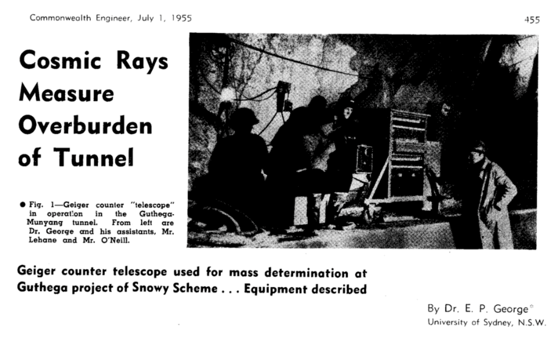
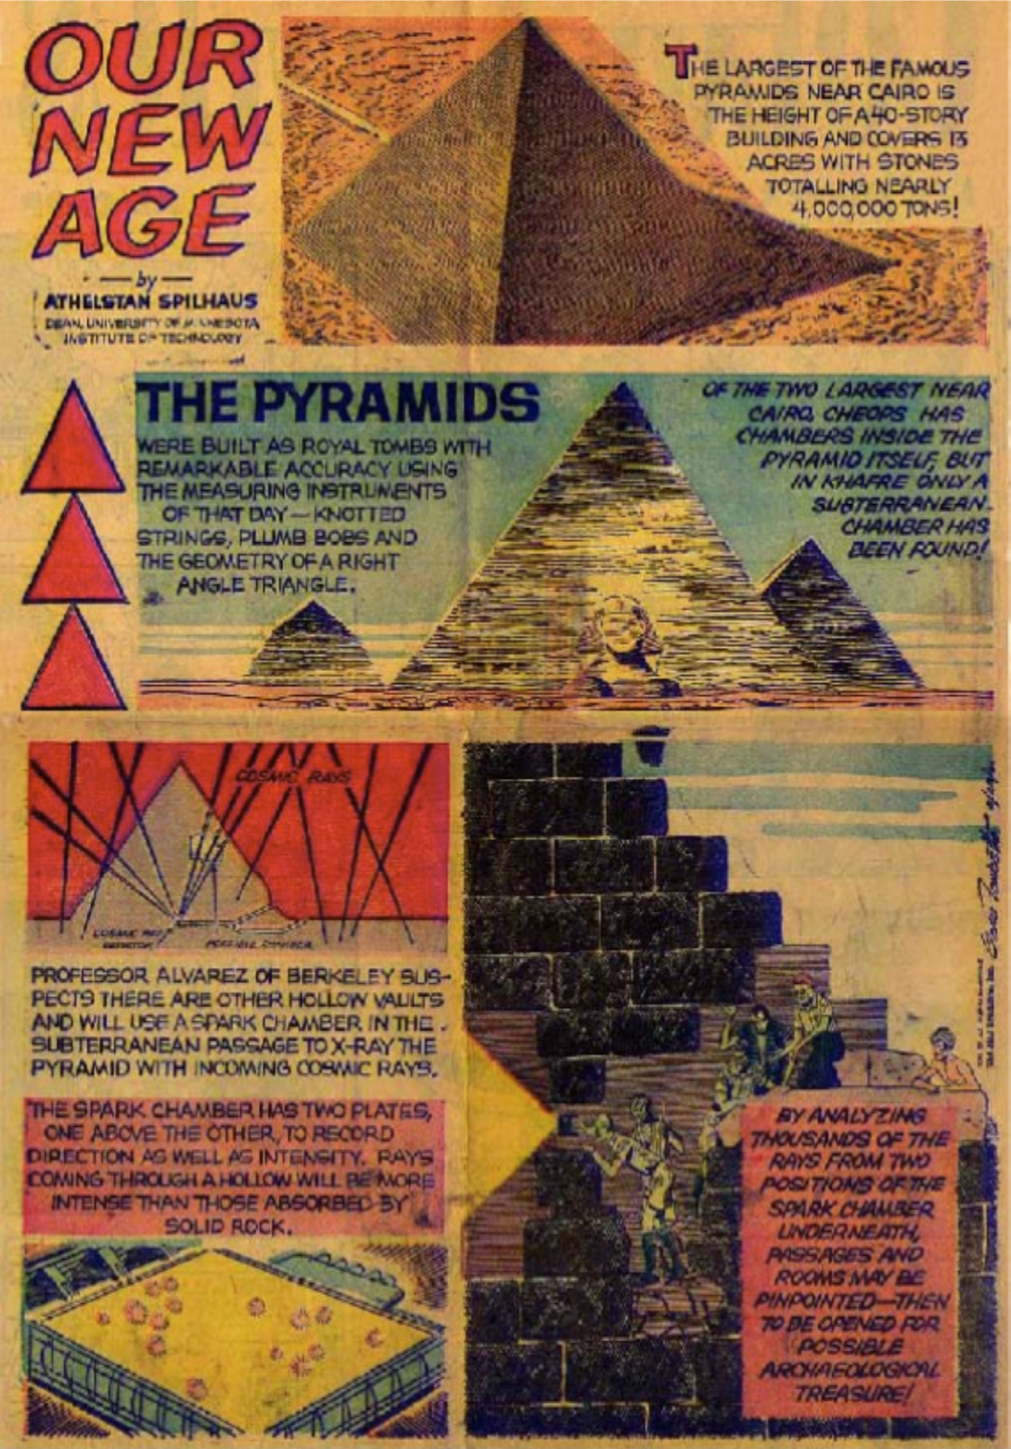
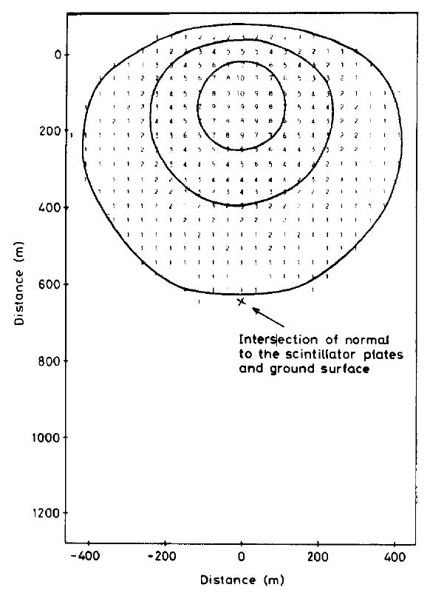
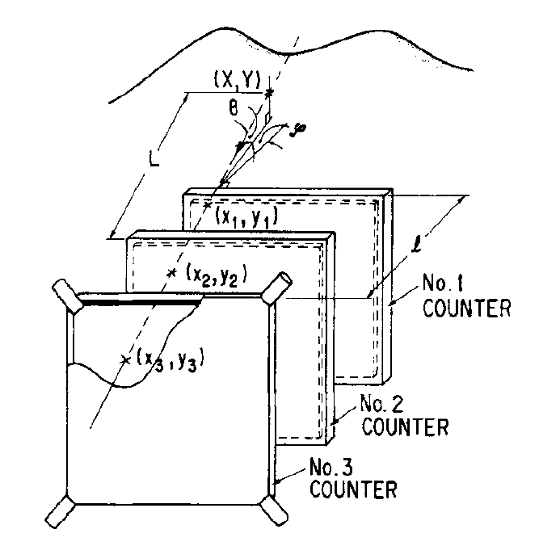
1.4 Application of Muography
1955, First application of muon detection(George)
1995, First application of muon volcano detection(Nagamine)
1970, First archaeological exploration Alvarez)
1979, First proof of principle of muon prospecting(Malmqvist)
[1] George, E. P. (1955). Cosmic rays measure overburden of tunnel. Commonwealth Engineer, 455.
[2] Alvarez L W, Anderson J A, Bedwei F E, et al. Search for Hidden Chambers in the Pyramids: The structure of the Second Pyramid of Giza is determined by cosmic-ray absorption[J]. Science, 1970, 167(3919): 832-839.
[3] Malmqvist L, Jönsson G, Kristiansson K, et al. Theoretical studies of in-situ rock density determinations using underground cosmic-ray muon intensity measurements with application in mining geophysics [J]. Geophysics, 1979, 44(9): 1549-69.
[4] Nagamine, K., Iwasaki, M., Shimomura, K., & Ishida, K. (1995). Method of probing inner-structure of geophysical substance with the horizontal cosmic-ray muons and possible application to volcanic eruption prediction. NIMA, 356(2-3), 585-595.

Slide 8
01 / Introduction
02 / Muography System
03 / Cultural relics protection-Xi’an defensive walls
04 / Mineral Exploration-Zaozigou gold mine
05 / Summary and Prospect
Outline
Notes:
8

Slide 9
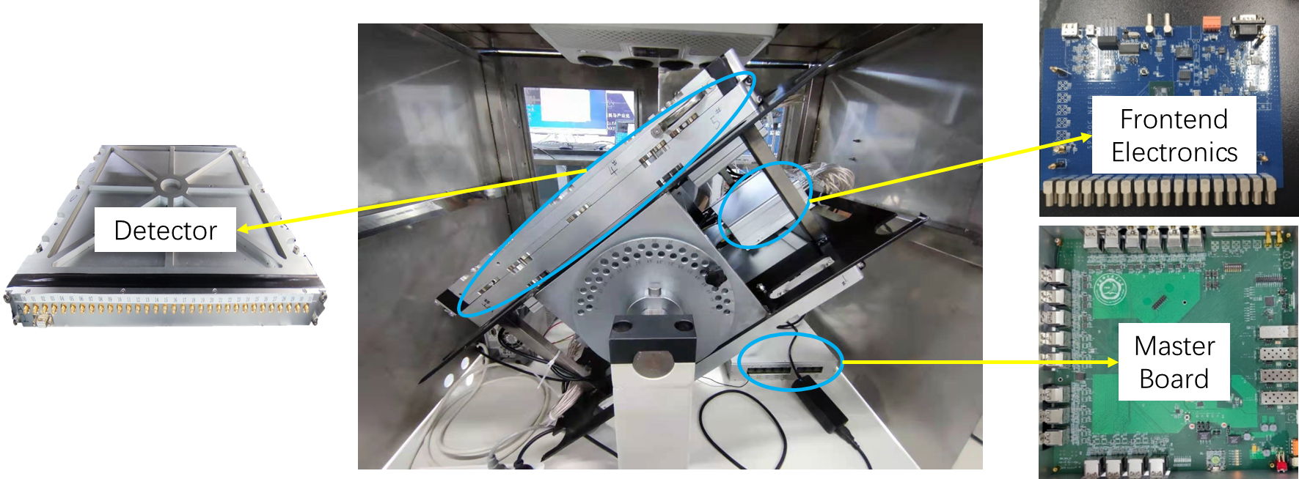
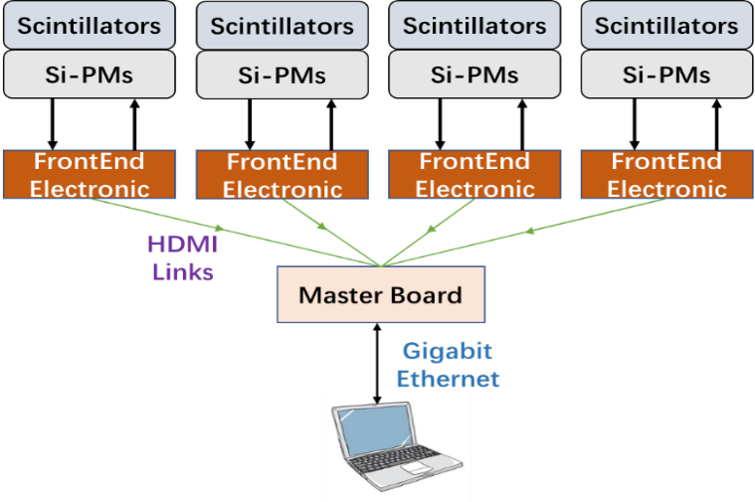
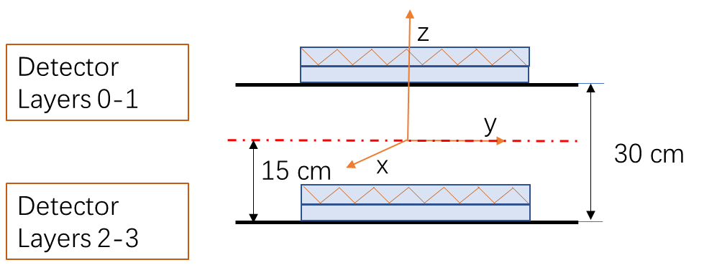
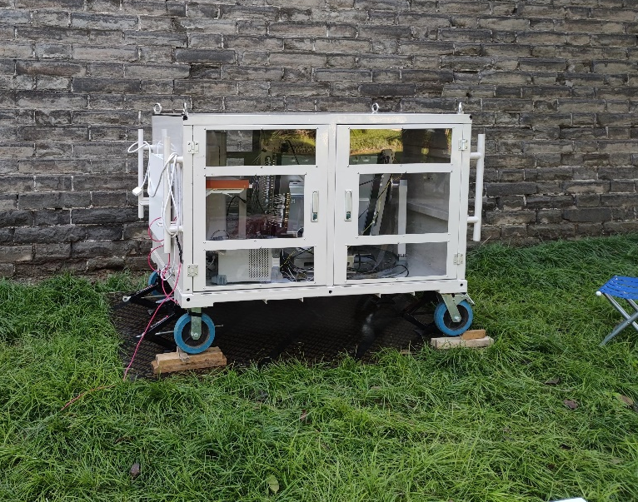
2.1 CORMIS(Cosmic Ray Muon Imaging System)
CORMIS internal structure
connection schematic
CORMIS （COsmic Ray Muon Imaging System）component：
4 layer detectors
Acquisition system
Remote monitoring and control platform
System Stability
Damp proof
Anti-vibration
Temperature control
Angle adjustment

Slide 10
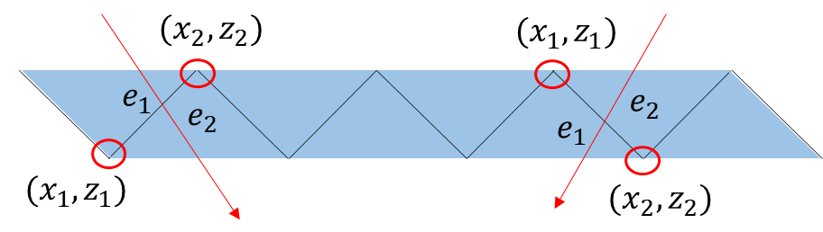
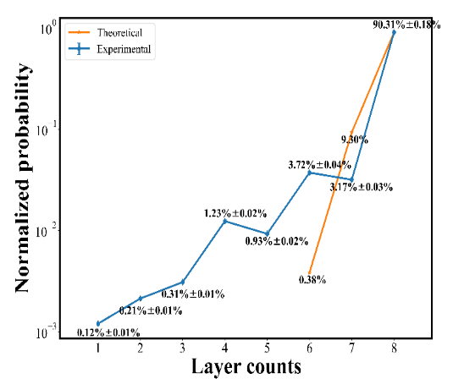
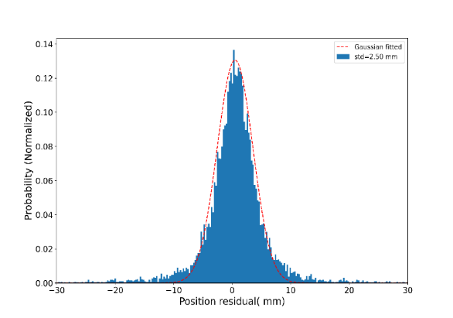
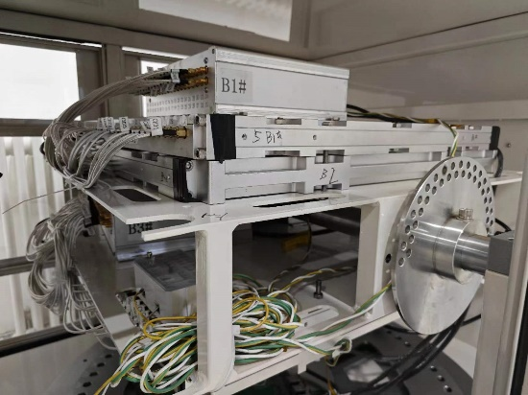
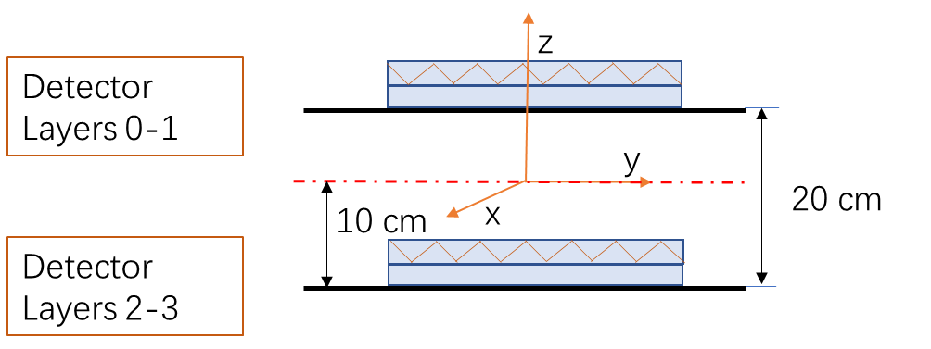


2.2 Plastic Scintillator Detector
2D position calculation
Detector efficiency
Arrangement
Detection efficiency of single-layer ：~97.98%
Equation
$$x=\frac{x_{1}∗e_{1}+x_{2}∗e_{2}}{e_{1}+e_{2}}$$
$$z=\frac{z_{1}∗e_{1}+z_{2}∗e_{2}}{e_{1}+e_{2}}$$
3D track calculation
Positional resolution
A muon track
Std =2.50 mm

Slide 11
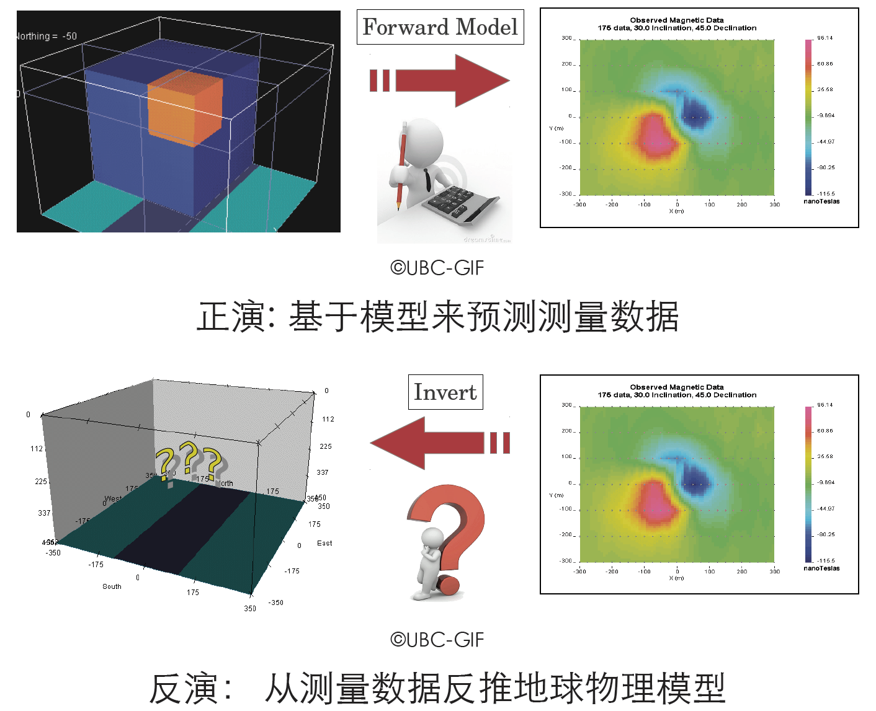
2.3 Forward and Inversion
Forward
1
Geophysical model
Predictive data
Inversion
2
Measurement data
Geophysical model

Slide 12
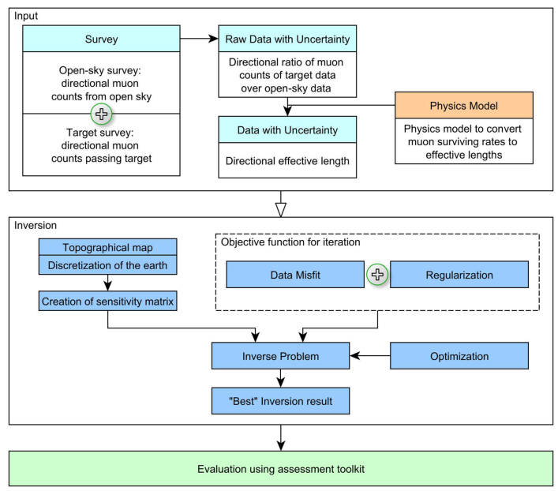




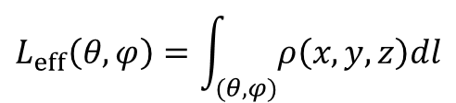

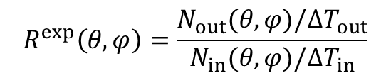

2.3 Forward and Inversion
Relation among variables:
$$L_{eff}$$
$$E_{min}(L_{eff})$$
R$(θ,L)$
$$−\frac{dE}{dl}=a\left(E\right)+b\left(E\right)E$$
R $=\frac{\int_{E_{min}}^{∞}{\text{Φ}\left(E,θ\right)dE}}{\int_{E_{0}}^{∞}{\text{Φ}\left(E,θ\right)dE}}$
Measured survival rate ：
$$R^{exp}\left(θ,φ\right)=\frac{N_{out}(θ,φ)/∆T_{out}}{N_{in}(θ,φ)/∆T_{in}}$$
Effective length：
$$L_{eff}\left(θ,φ\right)=\int_{(θ,φ)}{ρ\left(x,y,z\right)dl}$$
Minimum energy required for muon to penetrate volume:
$$E_{min}=aL_{eff}+ b$$
Data analysis and 3D inversion workflow of the muography approach

Slide 13

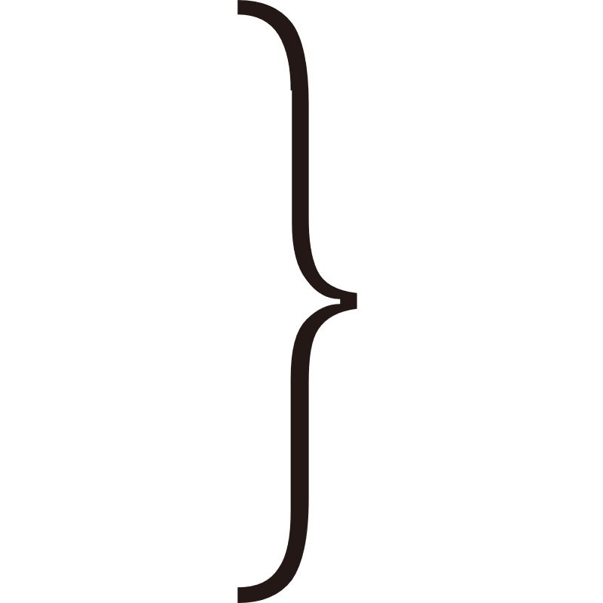


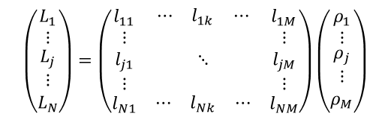








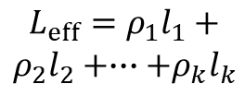


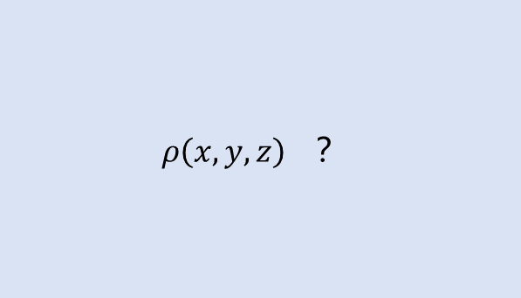


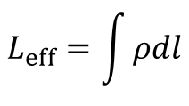
2.3 Forward and Inversion
$$ρ\left(x,y,z\right) ？$$
discretization
$$(ρ_{1},l_{1})$$
$$L_{eff}=\int{ρdl}$$
$$(ρ_{3},l_{3})$$
$$(ρ_{2},l_{2})$$
$$ρ_{4}$$
$$l_{4}$$
$$L_{eff}=ρ_{1}l_{1}+$$
$$ρ_{2}l_{2}+∙∙∙+ρ_{k}l_{k}$$
$$(ρ_{6},l_{6})$$
$$(ρ_{5},l_{5})$$
$$(ρ_{7},l_{7})$$
$$(ρ_{k},l_{k})$$
Detector
$$∙∙∙$$
$$∙∙∙$$
$$(ρ_{1},l_{1})$$
$$(ρ_{3},l_{3})$$
$$(ρ_{2},l_{2})$$
$$ρ_{4}$$
$$\left(\begin{matrix}L_{1} \\ ⋮ \\ \begin{matrix}L_{j} \\ ⋮ \\ L_{N}\end{matrix}\end{matrix}\right)=\left(\begin{matrix}l_{11} & \begin{matrix}⋯ & l_{1k} & ⋯\end{matrix} & l_{1M} \\ \begin{matrix}⋮ \\ l_{j1} \\ ⋮\end{matrix} & ⋱ & \begin{matrix}⋮ \\ l_{jM} \\ ⋮\end{matrix} \\ l_{N1} & \begin{matrix}⋯ & l_{Nk} & ⋯\end{matrix} & l_{NM}\end{matrix}\right)\left(\begin{matrix}ρ_{1} \\ ⋮ \\ \begin{matrix}ρ_{j} \\ ⋮ \\ ρ_{M}\end{matrix}\end{matrix}\right)$$
$$L=Gρ$$
$$l_{4}$$
$$(ρ_{6},l_{6})$$
$$(ρ_{5},l_{5})$$
$$(ρ_{7},l_{7})$$
$$(ρ_{k},l_{k})$$
Detector1
Detector2
Detector3
Detector1
Detector2
Detector3

Slide 14


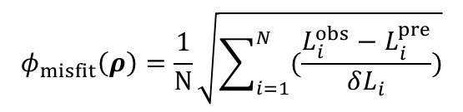

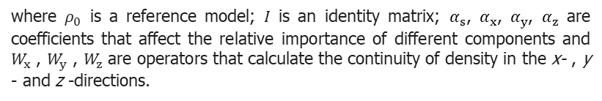
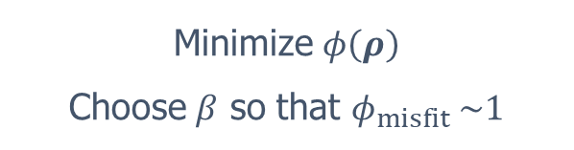



2.3 Inversion: common method
$$φ\left(ρ\right)=φ_{misfit}\left(ρ\right)+βφ_{m}\left(ρ\right)+γφ_{p}\left(ρ\right)$$
“fits the data”
$$φ_{misfit}\left(ρ\right)=\frac{1}{N}\sqrt{\sum_{i=1}^{N}{(\frac{L_{i}^{obs}−L_{i}^{pre}}{δL_{i}})}}$$
$β$: regularized factor
$γ$: penalty coefficient
$φ_{misfit}$ ~ 1
“conforms the geology”
where $ρ_{0}$ is a reference model; $I$ is an identity matrix; $α_{s}$, $α_{x}$, $α_{y}$, $α_{z}$ are coefficients that affect the relative importance of different components and $W_{x}$ , $W_{y}$ , $W_{z}$ are operators that calculate the continuity of density in the x- , y - and z -directions.
Minimize $φ\left(ρ\right)$
Choose $β$ so that $φ_{misfit} \sim 1$
$φ_{m}$ ~ 0
Constraint condition:$ρ_{low}<ρ<ρ_{up}$
Penalty function:

Slide 15
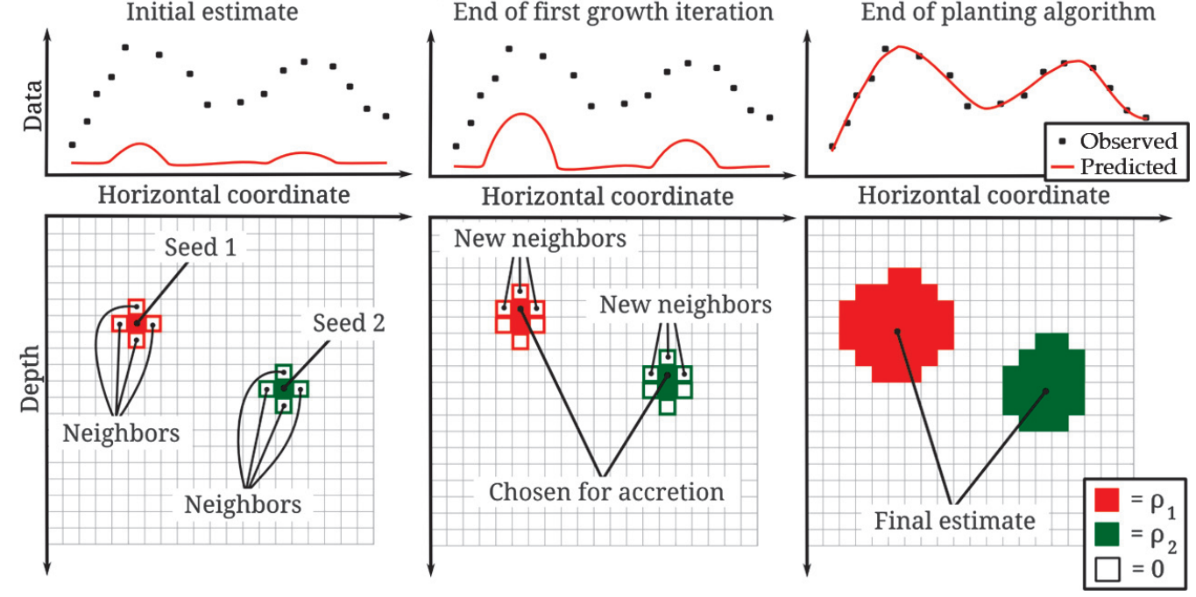
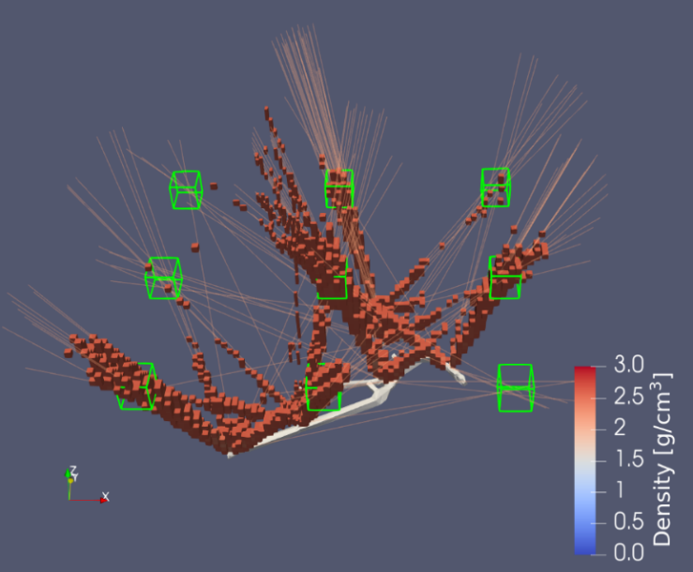
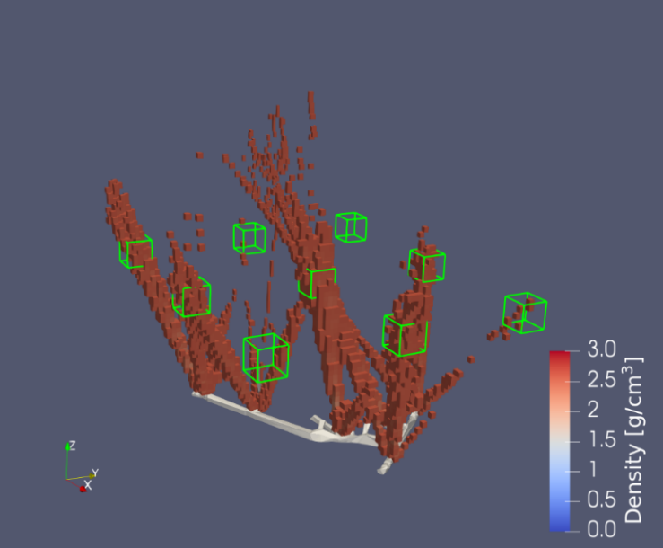
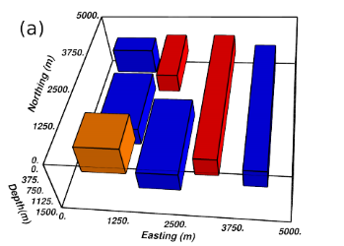

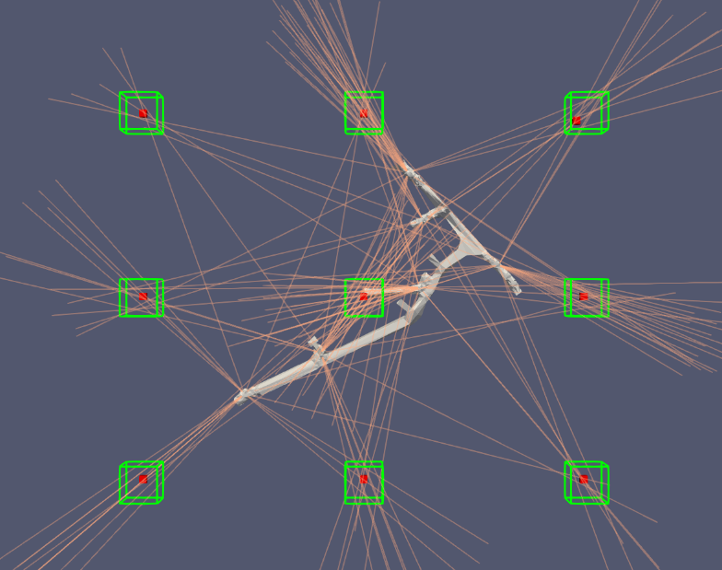
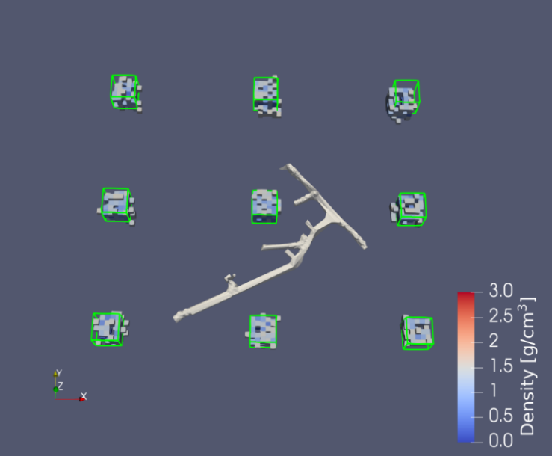
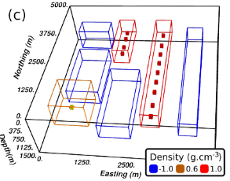
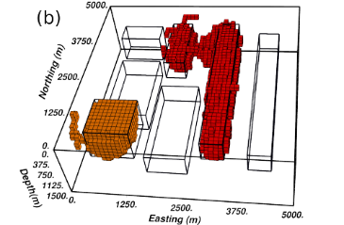
2.3 Inversion: “seed” method
(a)
(b)
cube A
cube A
common method
center cube
center cube
cube B
cube B
Model
(c)
(d)
Seed method
“Seeds”
Expanding result
[1] Uieda L, Barbosa V C F. Robust 3D gravity gradient inversion by planting anomalous densities[J]. Geophysics, 2012, 77(4): G55-G66.

Slide 16
01 / Introduction
02 / Muography System
03 / Cultural relics protection-Xi’an defensive walls
04 / Mineral Exploration-Zaozigou gold mine
05 / Summary and Prospect
Outline
Notes:
16

Slide 17


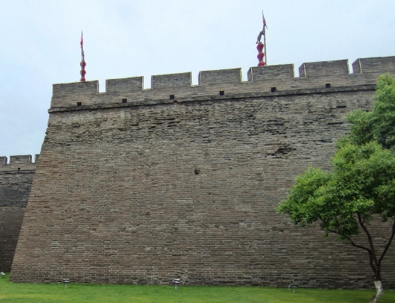
3.1 Cultural relics protection-Xi’an defensive walls
Xi’an
The capital of Shanxi Province, is located in northwest China.
Xi'an, identified by UNESCO as a "World Historic City" in 1981, is one of the important birthplaces of Chinese civilization and the Chinese nation, the starting point of the overland Silk Road, and the ancient capital of the Thirteen Dynasties.
Problems faced by conservation monitoring of large cultural properties:
Cultural relics can't move, can't destroy
Damage too deep to detect
Poor precision of detection results

Slide 18
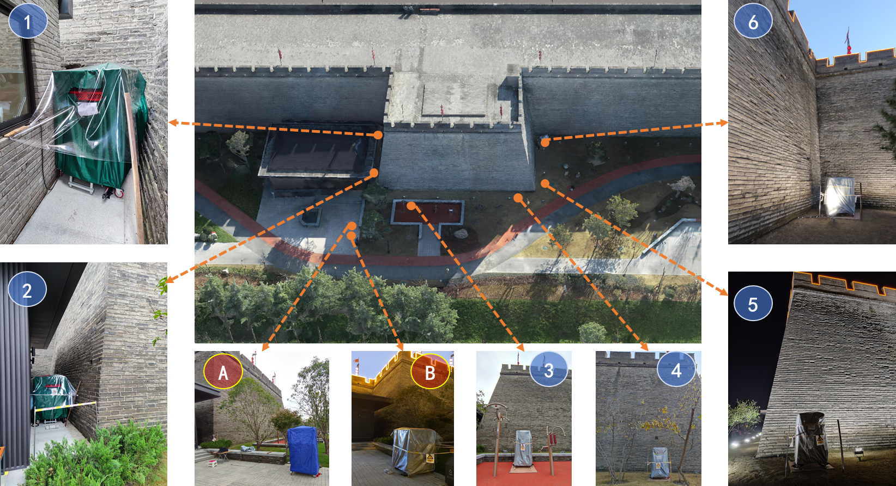
3.2 Rampart No.58
Target region： Rampart No.58
Experimental information
Location | Azimuth angle(°) | Zenith angle(°) | Duration(days) | Total count | Count rate(/h)
1 | 163.10 | 69.70 | 7.8 | 664708 | 4455
2 | 178.20 | 69.57 | 9.7 | 1168963 | 5769
3 | 270.66 | 60.55 | 13.9 | 1772770 | 8608
4 | 268.74 | 58.94 | 9.0 | 2040626 | 9287
5 | -9.10 | 69.96 | 8.2 | 1171220 | 6738
6 | 27.60 | 59.47 | 8.8 | 1761860 | 8698
A | 25.00 | 60.00 | 3.0 | 1175291 | 15366
B | 90.00 | 70.00 | 2.8 | 911615 | 10752
Layout of measurement location used in the on-site survey: (1-6) detector locations, (A and B) open-sky locations

Slide 19
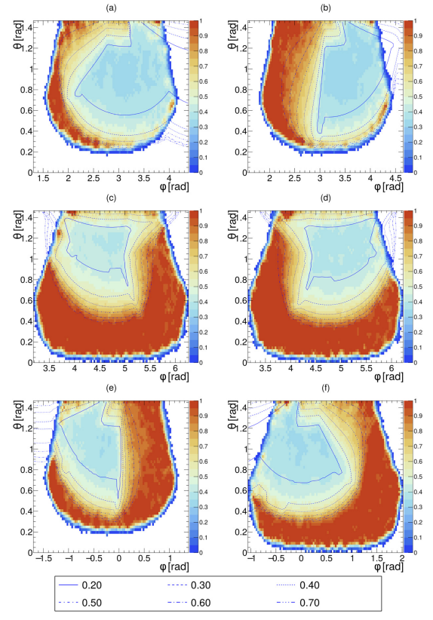


3.3 Data analysis
Comparison of measured and predicted survival rate at six measurement points
Comparison of measured and predicted effective lengths at six measurement points

Slide 20



3.4 Imaging results
Significance: $Sig\left(θ_{x},θ_{y}\right)=\frac{R_{meas}\left(θ_{x},θ_{y}\right)−R_{pre}\left(θ_{x},θ_{y}\right)}{σ_{meas}\left(θ_{x},θ_{y}\right)}$
Sig: Characterizing the degree of significance of the difference between the measured and predicted values, the larger the absolute value of Sig indicates that the more significant the difference between the measured and forward predicted results in this direction, the higher the confidence level of the existence of density anomalies.

Slide 21
01 / Introduction
02 / Muography System
03 / Cultural relics protection-Xi’an defensive walls
04 / Mineral Exploration-Zaozigou gold mine
05 / Summary and Prospect
Outline
Notes:
21

Slide 22




4.1 Mineral Exploration-Zaozigou gold mine
Hezuo
The capital of Gannan Tibetan Autonomous Prefecture in Gansu Province is located in the southwestern part of Gansu Province. The climate belongs to the alpine and humid type, with an average altitude of 3000 m.
Problems faced in the mineral exploration：
Electrical and magnetic methods are limited in scale and susceptible to interference.
Gravity and seismic methods have a large detection range but limited precision.
High cost of commonly used drilling methods.

Slide 23



4.2 Zaozigou gold mine experiment
The geological map of the Zaozigou deposit
On-site open-sky experiment
Magmatic intrusion and faulting cause diverse attitudes of rocks, making geophysical identification and investigation difficult.
Their average densities are 2.60, 2.64 and 2.63 g/cm³, respectively, when their gold grades are lower than 1.5. For higher grade areas, their average densities are greater than 2.7 g/cm³, less than 0.1 g/cm³ higher than surroundings.

Slide 24










4.2 Zaozigou gold mine experiment
5
6
1
2
4
3
CORMIS-1
CORMIS-2
CORMIS-3
CORMIS-4
CORMIS-5
CORMIS-6
Experimental position in the tunnel

Slide 25
4.2 Zaozigou gold mine experiment
Experimental information
Detector | Measurement location | Total counts | Effective measurement duration(day) | Count rate(per day)
CORMIS-1 | Free sky | 4345193 | 1.68 | 2587529.64
 | In tunnel | 331521 | 119.63 | 277.13
CORMIS-2 | Free sky | 6386753 | 2.55 | 2507761.93
 | In tunnel | 489450 | 149.66 | 3270.42
CORMIS-3 | Free sky | 5074 734 | 2.01 | 2529243.56
 | In tunnel | 639 393 | 144.18 | 4434.62
CORMIS-4 | Free sky | 4297 730 | 1.63 | 2629809.71
 | In tunnel | 947 499 | 153.78 | 6161.23
CORMIS-5 | Free sky | 6895 140 | 2.76 | 2495309.19
 | In tunnel | 291 823 | 123.78 | 2357.62
CORMIS-6 | Free sky | 4110 971 | 1.63 | 2527631.93
 | In tunnel | 462 379 | 167.38 | 2762.44

Slide 26


4.3 Data analysis
Comparison of measured and predicted survival rate at six measurement points
Comparison of measured and predicted effective length at six measurement points

Slide 27


























4.5 Inversion
$$Sig\left(θ_{x},θ_{y}\right)=\frac{R_{meas}\left(θ_{x},θ_{y}\right)−R_{pre}\left(θ_{x},θ_{y}\right)}{σ_{meas}\left(θ_{x},θ_{y}\right)}$$
A: Rays that $Sig<−3$
B: Rays that $Sig>2$
$$Sig>2$$
$$Sig>2$$
$$Sig>2$$
CORMIS-1
$$Sig<−3$$
$$Sig<−3$$
CORMIS-2
B1
B2
B3
$$Sig>2$$
$$Sig>2$$
$$Sig<−3$$
$$Sig<−3$$
CORMIS-3
CORMIS-4
B4
B5
B6
$$Sig>2$$
$$Sig>2$$
Select initial “seeds” (white grid) in the overlapping areas
CORMIS-5
CORMIS-6

Slide 28


4.6 Imaging results
Region | Density(compared to the bulk density) | Size($m^{3}$) | Classification
Above tunnel | Higher | 34333 | Gold ore body
B1 | Slightly lower | 6516 | Scarps
B2 | Slightly lower | 42920 | Mined-out area (uncompacted backfill)
B3 | Much lower | 8000 | Mined-out area
B4 | Much lower | 25648 | Stope
B5 | Slightly lower | 3672 | Limonitic siliceous slate structure
B6.1 | Much lower | 4860 | Mined-out area
B6.2 | Much lower | 9334 | Mined-out area
Reconstructed anomalies in region B1-B6 with the seed algorithm. Green surfaces: mined ore body model. Blue surface: the ore body models with uncertain mining status. The surface in B5: the model of the limonitic siliceous slate.
Discovered four mined-out areas; half of them are confirmed by the documentation.
Reconstructed the limonitic siliceous slate whose density are slightly different from the bulk density.

Slide 29
01 / Muography
02 / Muography System
03 / Cultural relics protection-Xi’an defensive walls
04 / Mineral Exploration-Zaozigou gold mine
05 / Summary and Prospect
Outline
Notes:
29

Slide 30
5.1 Summary
Achievement
Successful implemented domestic’s first application of Muography in cultural relics conservation
Successfully implemented Asia's first application of Muography in mineral exploration
Importance
The successful implementation of the experiment demonstrates that Muography has great advantages in the field of cultural relics conservation and mineral deposit exploration.
A complete data analysis process
Application to low-density-contrast ore body exploration
Analysis of altitudinal impacts on muography, and giving a simplified method to eliminate impact
Development of precise and efficient reconstruction algorithms: “seed” algorithm

Slide 31
5.2 Prospect
Detector
Miniaturization: for scenes where space is at a premium
Large size: improved imaging efficiency
Low cost, high reliability
2. Software platforms and algorithms
Lowering the threshold of use for non-professionals by integrating simulation, data analysis, forward and backward modelling into a single platform; optimizing algorithms to obtain reliable imaging in valid event situations.
3. On-site implementation
There is a lack of processes to produce and optimize the implementation of scenarios in the field and to assess the feasibility of the scenarios. There are many more existing scenarios to be developed.
Application scenarios of Muography

Slide 32


THANKS!
Notes:
32

