Slide 1
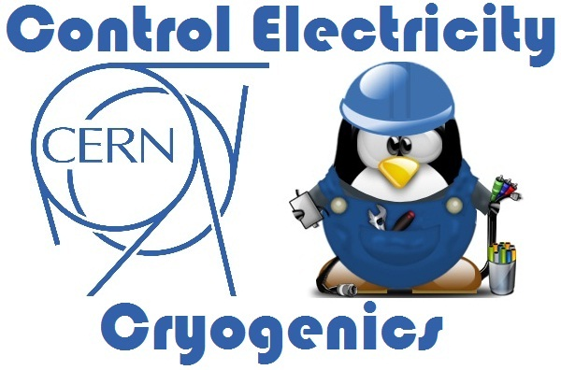

Electrical diagram automatic generation
TE-CRG-IC
Instrumentation and Controls (Electrical) for Cryogenics
Author
Nader MASAIF
Supervisor
Marco PEZZETTI
Thomas BARBE

Slide 2

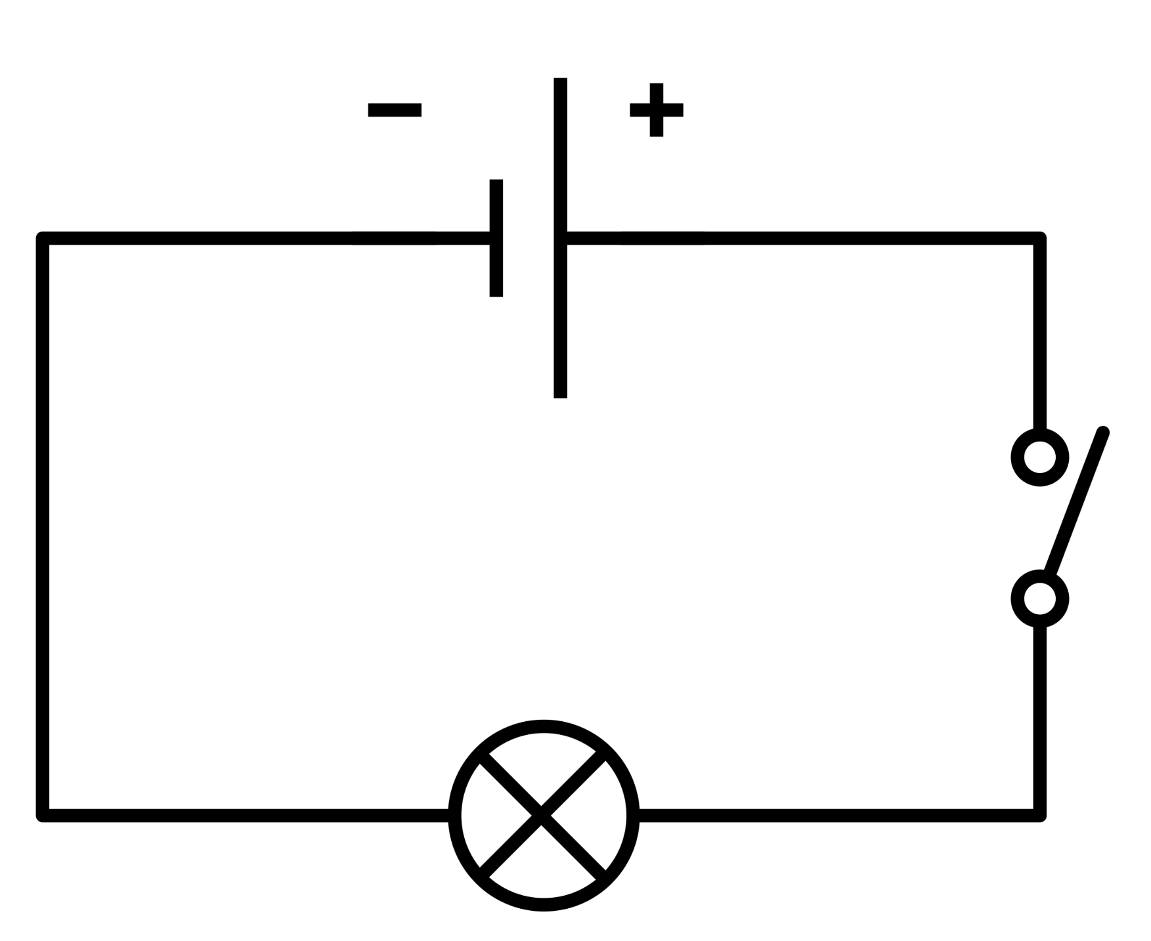
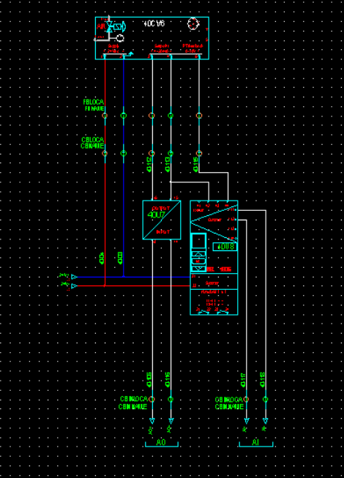



Tables of contents
Context
Electrical schemes
Introduction of blocks
PartList excel file and Python code
Generation
Continuous Integration

Slide 3
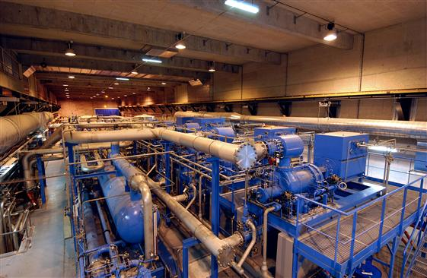

Context : Cryoplant
Welcome to This Cryoplant

Slide 4
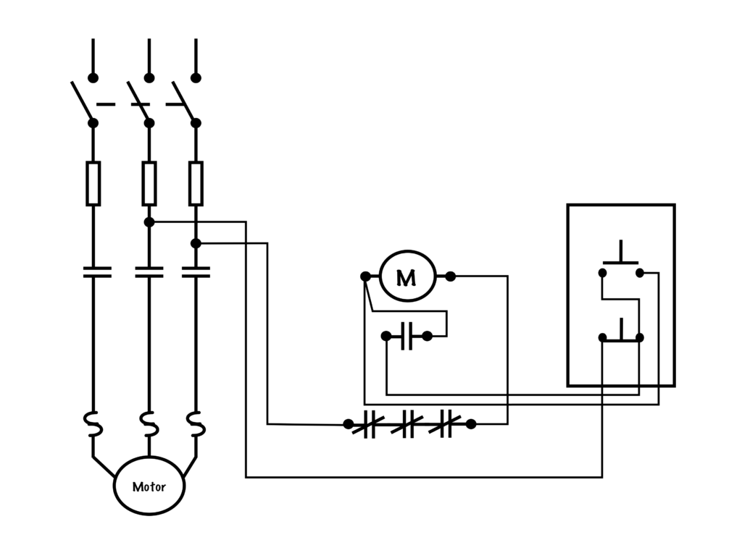
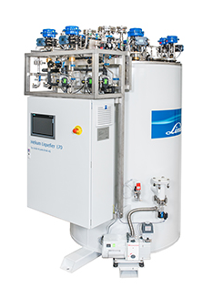
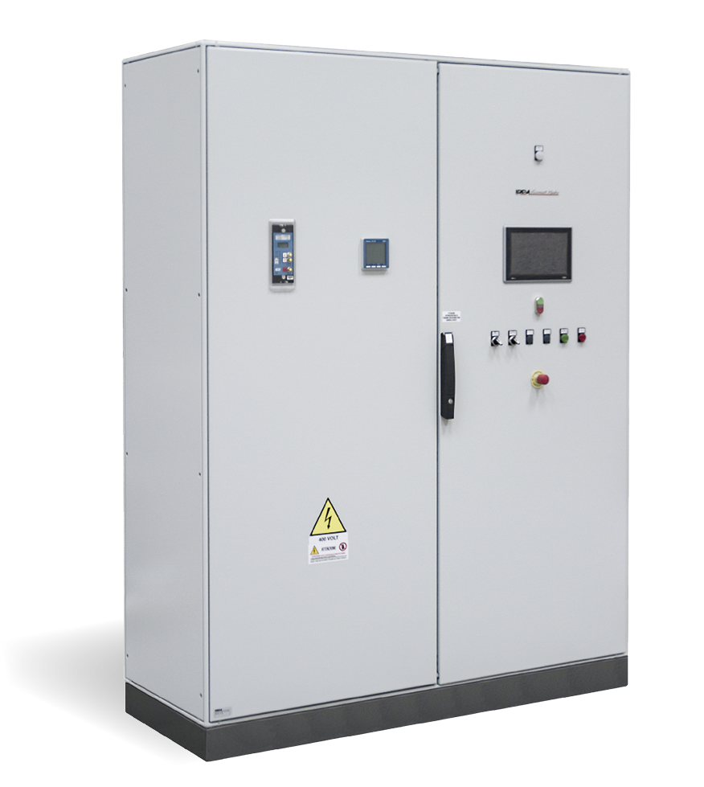
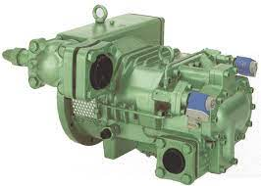

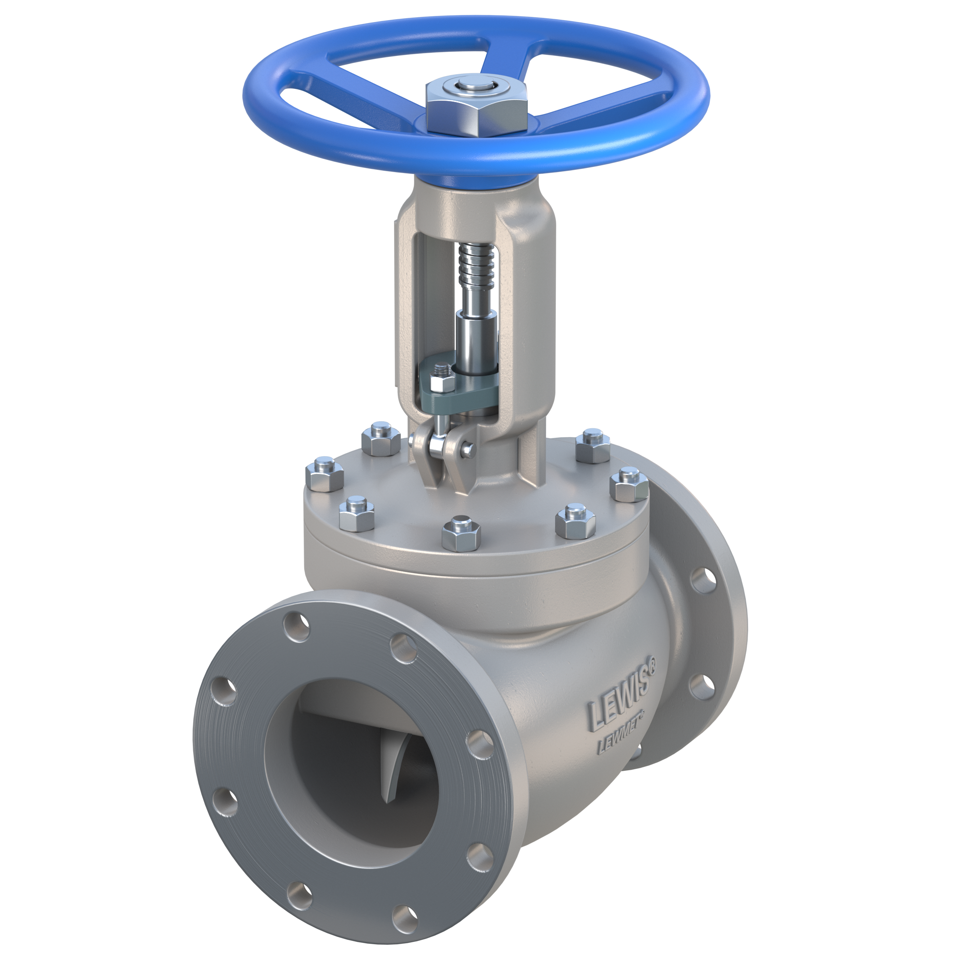
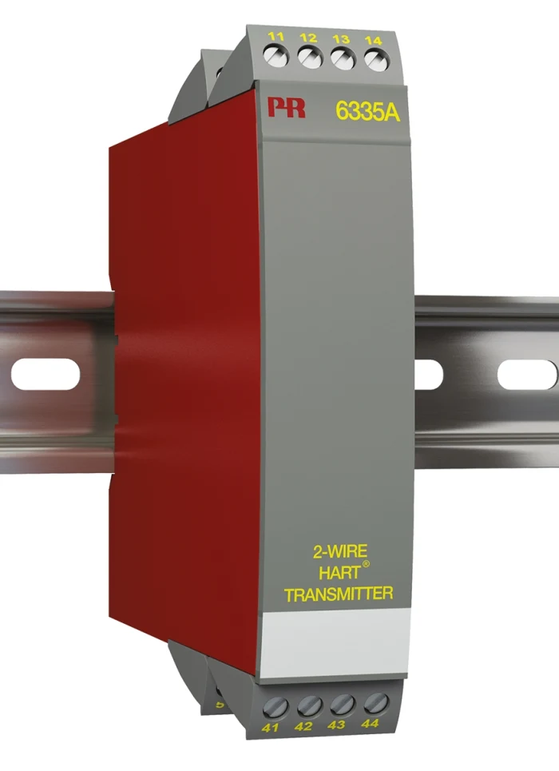
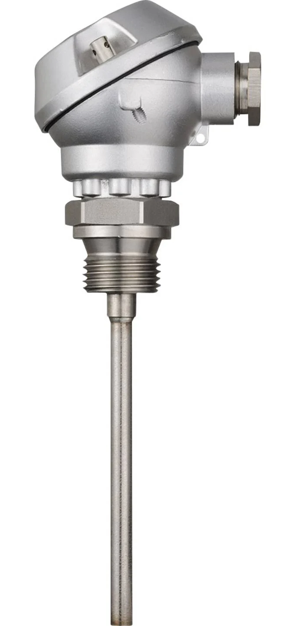
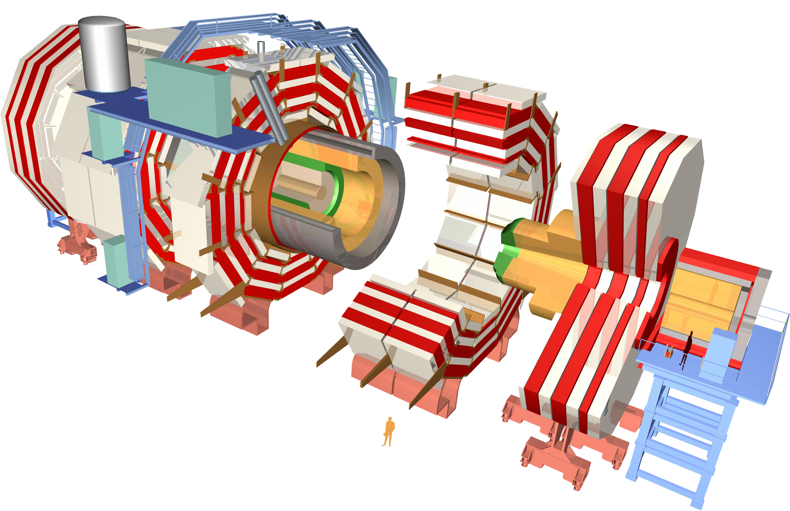
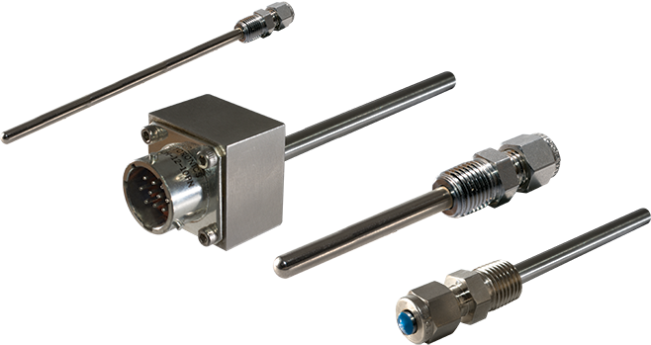
Context : Cryoplants
Electrical diagrams
COLDBOX
Cryoplants
Compressors
Coldbox
PLC
Cables
Instrumentation
Client

Slide 5





Context : "Automation of the process."
SECURITY
FAULT DETECTION
AVAILABILITY: component reliability, redundancy of strategic equipment
OPERABILITY: process performance and stability, automated/manual mode, human/machine interface for more than 20 YEARS
MAINTAINABILITY: obsolescence, component lifetime, standardisation, inter-compatibility

Slide 6






Context : PLC automatic configuration
COLDBOX
2014
Continuous Integration
CI provides a feedback mechanism to inform the user about the result of the process. CERN has applied this method successfully to the LHC tunnel cryogenics control system since 2015 allowing
Efficient and reliable development, updates, and redeployment of PLC-based industrial applications
Better code quality
Automatically testing the new modifications
Unicos DataBase
Compile

Slide 7


Context : Cryoplants
Electrical diagrams
COLDBOX
Cryoplants
Compressors
Coldbox
PLC
Cables
Instrumentation
Client

Slide 8


New goal : ADG (Automatic Diagram Generation)
CERN has developed solutions to address the challenges in designing, building, operating, and maintaining complex cryogenic process control systems.
Automate the generation of minimum 80% of electrical schematics
Reduce the manual work done by the electrical scheme designer
More automated process = More standardized electrical scheme
The project started in 2019 with Thomas BARBE and is on going.
However my goal is to try and make this process fluid and possible to
be used for all the projects and by anyone.
Objective

Slide 9
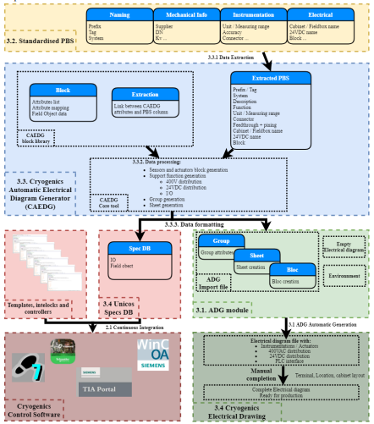
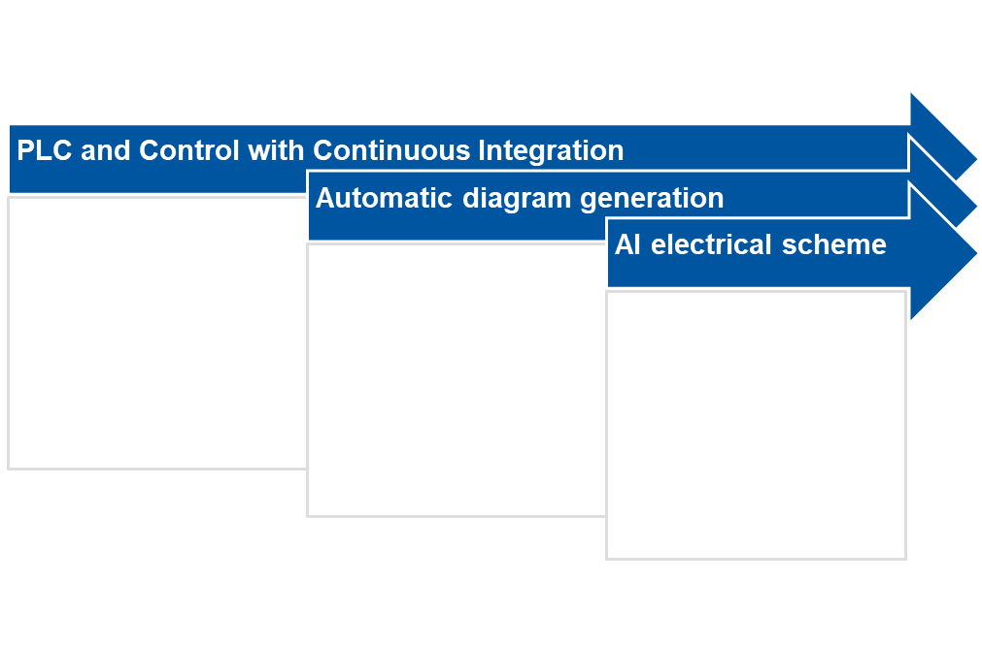
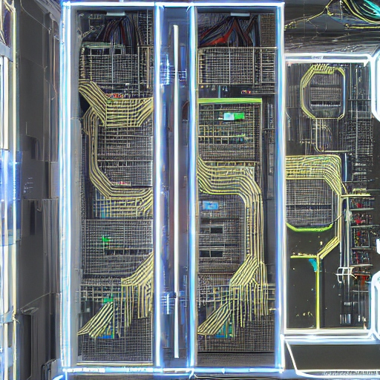
Status : CAEDG Workflow
The workflow for the generation of the cryogenics electrical diagram how it was imagined and how it will be applied.
2014
2019
2025
Future

Slide 10
Electrical Diagrams
Now that the context is set let’s deep into the Electrical diagrams universe and explain our path to Automatic generation
Manual Drawing
Introduction of concept of Blocks
Importance of Electrical diagrams
1
2
3

Slide 11
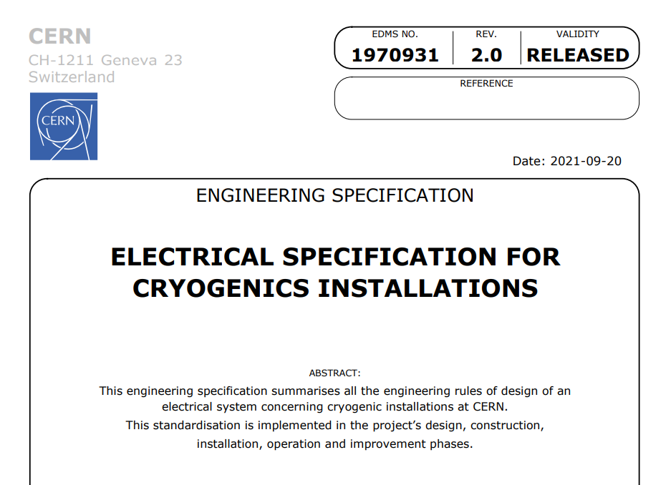
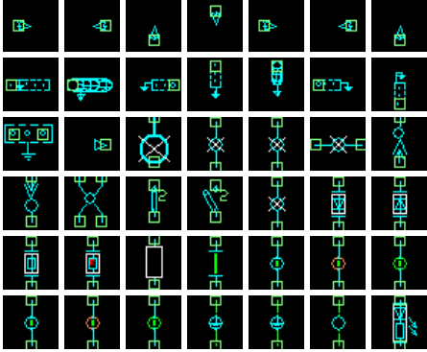

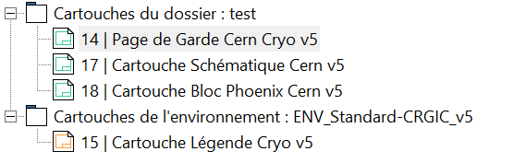
1- Importance of Electrical diagrams
The electrical schematic is a critical component of a control system, essential for seamless commissioning, easy fault diagnosis, and efficient maintenance. To improve the quality and clarity of electrical schematics, the CERN cryogenics electrical team, led by Simon MARTIN, has made significant investments in three areas:
Symbols
Blocks
“Cartouche”
Electrical specification
Software : Now:V5.R2
CRG SEE Environment

Slide 12
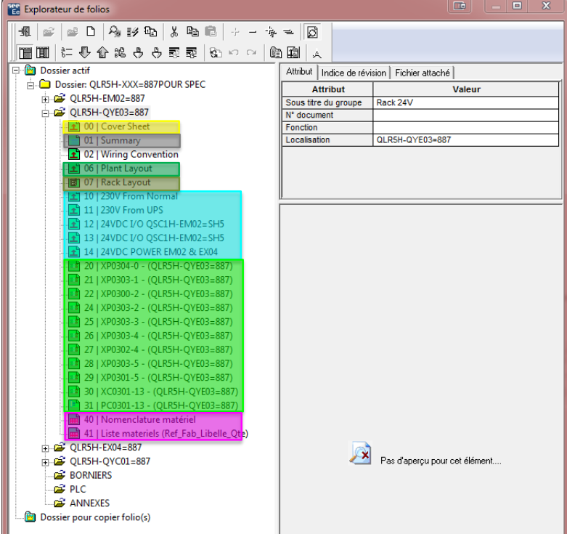
1- Importance of Electrical diagrams
The composition of an electrical diagram :
Cover Page
Summary
Plant Layout
Distribution : 400V / 230 V/ 24V
Instrumentation
Valves
Transmitters
Power
Actuators
Master
Terminal Block

Slide 13
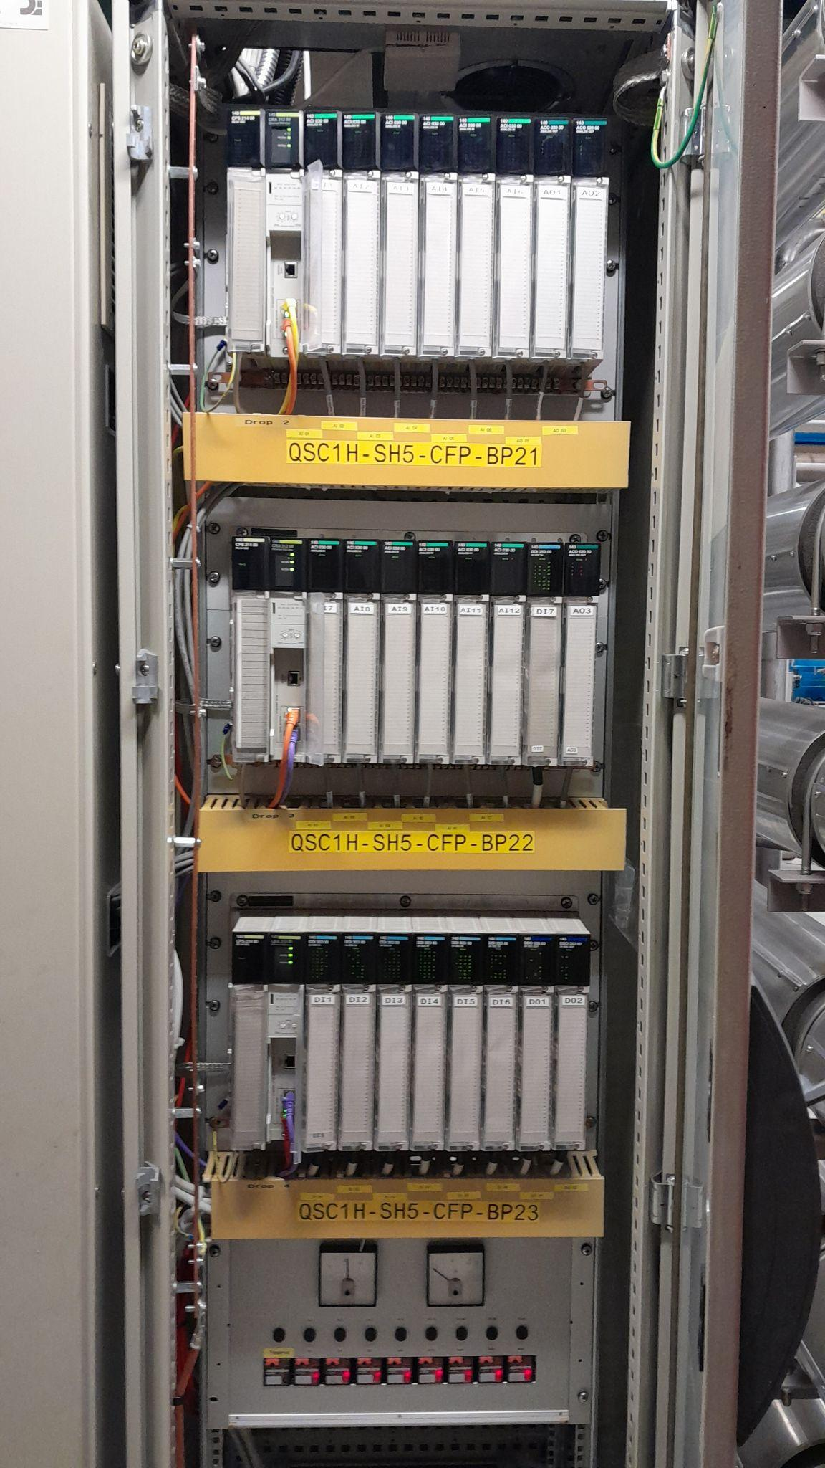
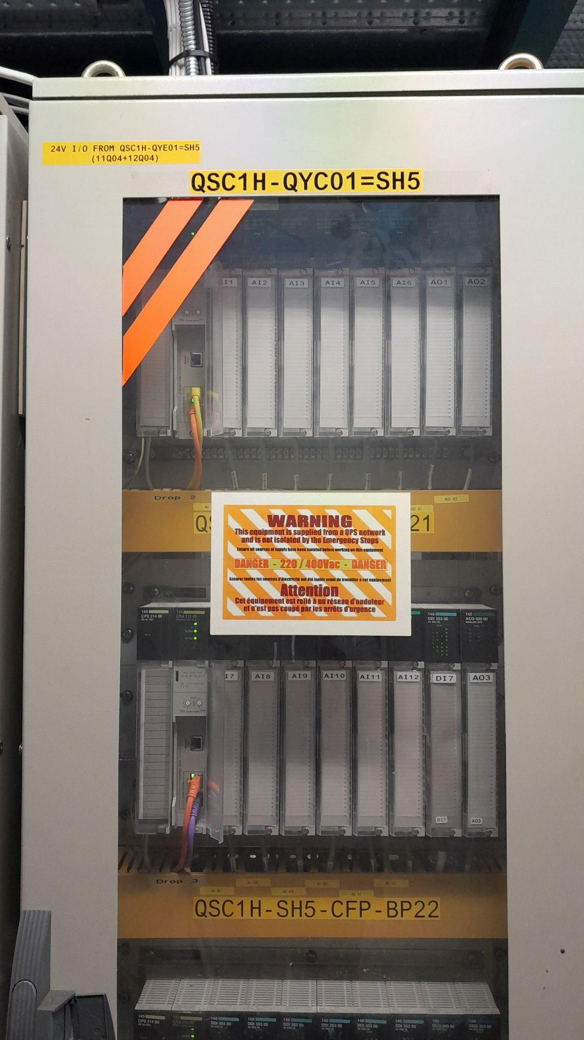
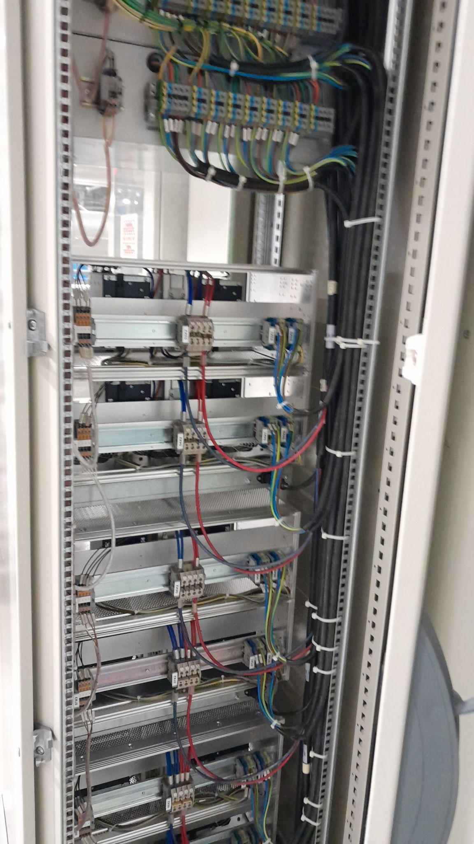
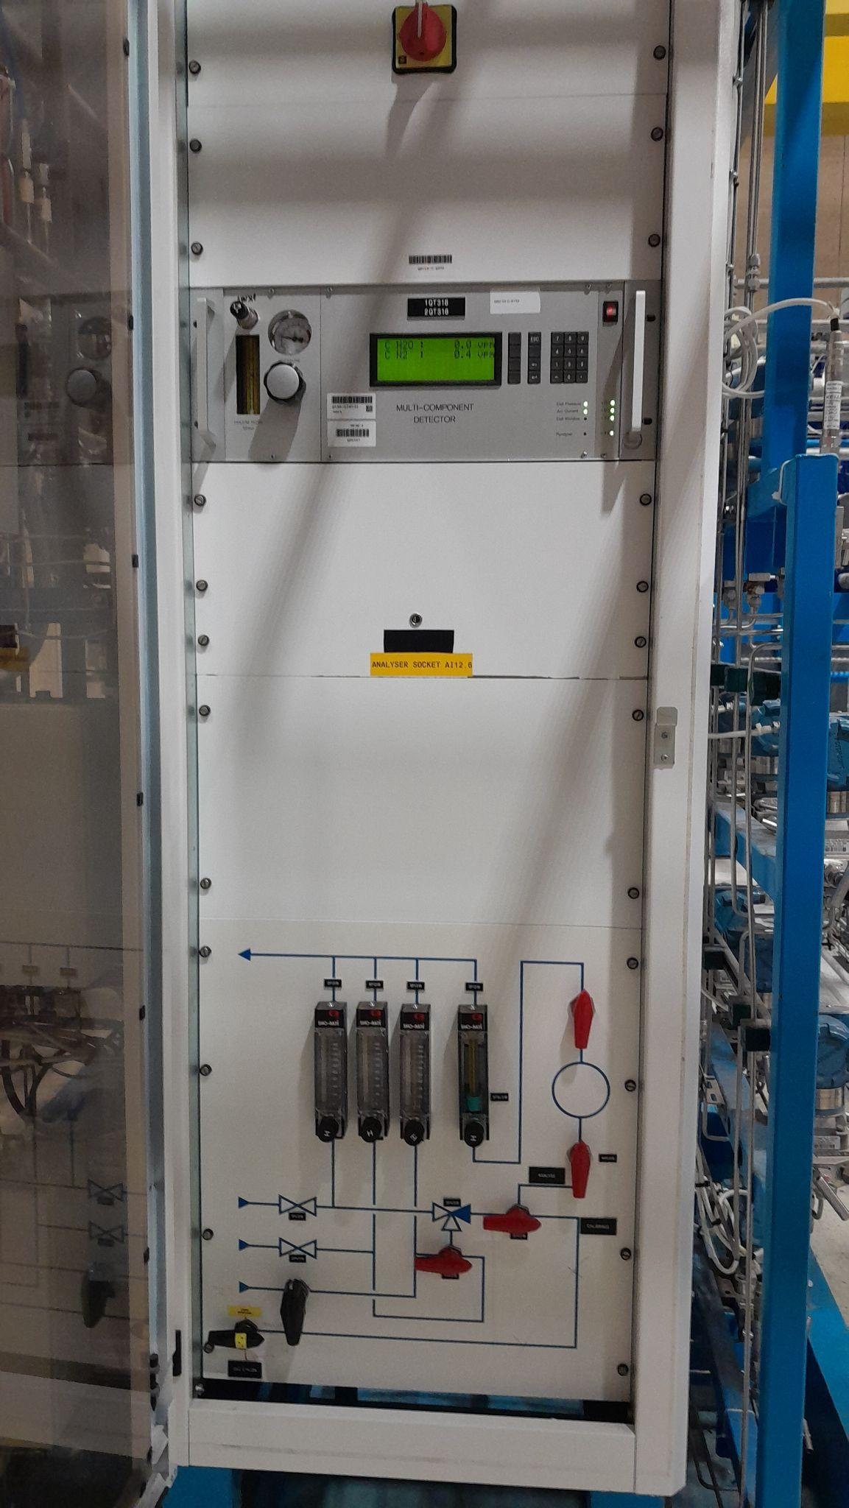
1- Importance of Electrical diagrams

Slide 14


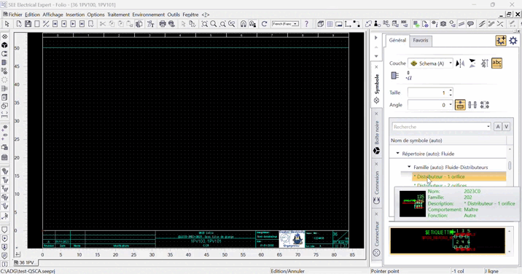



2- Visualisation : Manual Process
Manual Process
Symbols
Wires
Connections
Creation wire by wire and Symbols by symbols
Time consuming

Slide 15

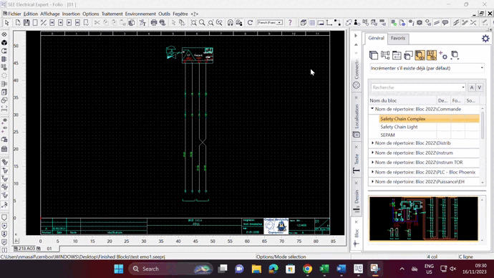


3- Introduction of blocks
The block is manually designed
We can save it
The block can be reused

Slide 16
Problems with blocks
Blocks contained actual locations from other installations
1
Need to fill the infos of each blocks
2
Time saving only in the drawing… (We can copy and paste)
3
To fix those problems we need to be able to change and add the datas directly

Slide 17

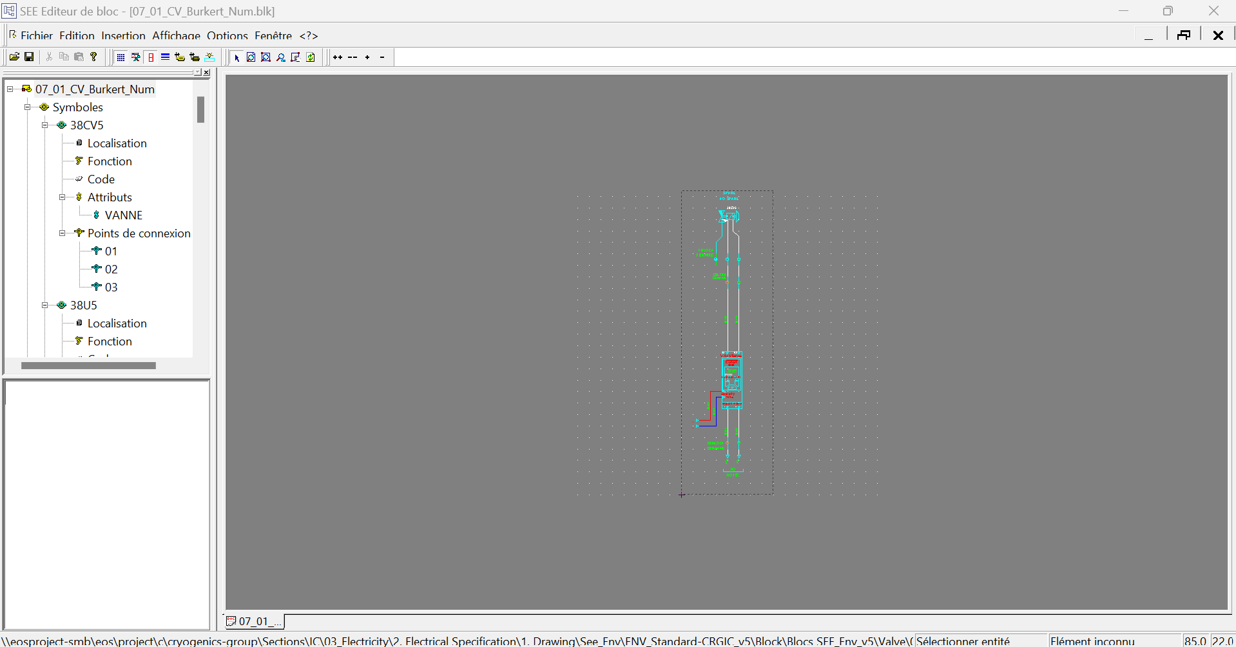

Block parameters
Adding generic parameters in Block Editor
Fieldbox Terminal
FieldBox Location
DI+/DI- DO+/DO- …
Cabinet Terminal
Cabinet Location
24V+/24V-
CabinetInTerminal
XXName
XXLocation
CabinetOutTerminalP
Sensor Type
Valve Position
…
All this information now constitutes the block's identity and can be completed when we choose to utilize it.
They need to be entered rigorously ⇔ Case sensitive

Slide 18
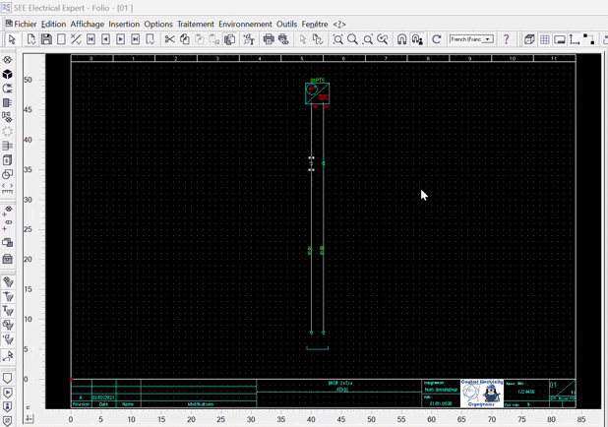
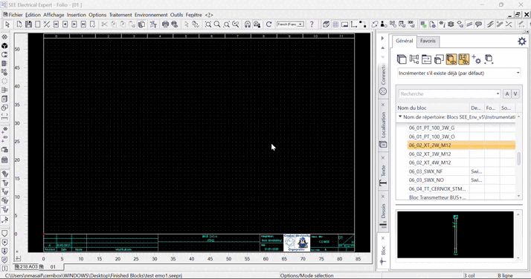

Block parameters
After incorporating parameters into the blocks, the utilization of blocks becomes more streamlined through SEE electrical's visual interface. This allows for the simultaneous addition of all necessary information, eliminating the need to input Cabinet and Fieldbox locations individually.

Slide 19


Block parameters : still problematic
We need to enter the parameters of each block one by one in SEE ELECTRICAL. We need to find a solution to bypass this.

Slide 20
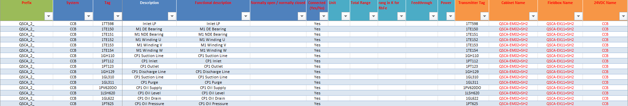
Introducing the Excel File : PartList
Excel files that already exist
Filled by all the CRG sections
IC Sections added the necessary informations
ADG DB

Slide 21







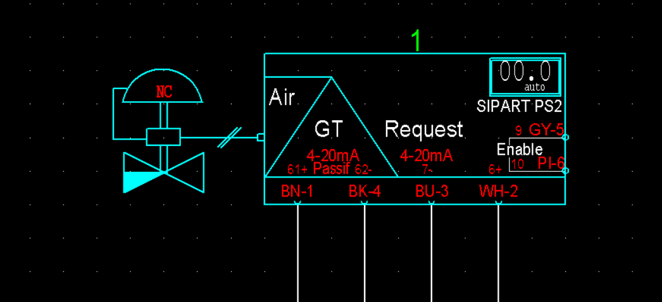
How to fill the excel file
Those are the categories that are important for our electrical diagram generation. The blue one are filled and decides by the IC Section
The prefix of the project : QSCA_1_H
If we connect the component or not. In case of spare.
Fieldbox Name
Name of the component
Fieldbox Name
The name of the Fieldbox related to the cabinet
Mechanical description of the component and how its function
The name of the cabinet related to the component ex : QSCA-EM01=SH2
Electrical Description
The description that will appear in the electrical scheme
Block
The name of the block we are going to use
Valve position (Open or Closed)
The position of the Valve : NO ou NC
Range
Power
Unit
Reference
Supplier
Categories that are already present in the PartList can be displayed in the Electrical scheme if desired.

Slide 22

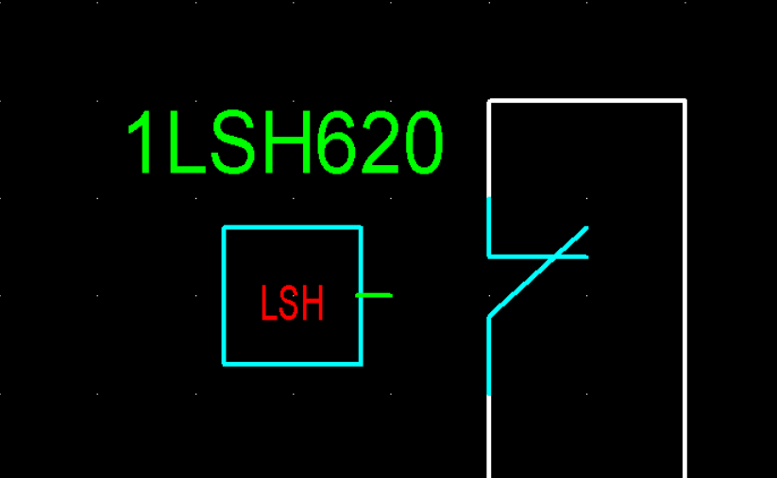
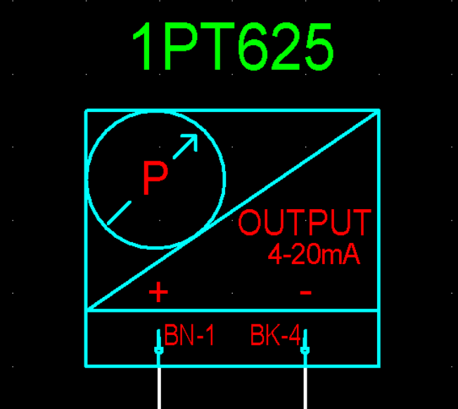
Standardized blocks
Homogeneity and Standard
Developing standardized blocks in accordance with specific standards.
Used with automatic generation
Uses in manual creation
Standard naming for blocks
FBLOCA (line 39)
FBNAME (line 39)
CBLOCA (line 35)
CBLOCA (line 35)
24V- (red wire)
24V+ (blue wire)
AI/AO/DI
CBINNAME (line 9)
CBINLOCA (line 9)
Wires numbers (line 11)
A document was created : “Block Creation Guideline” which will help everyone to create a block following the new standards. It also explains how to correctly add the parameters in SEE block editor.
We will add those infos in Electrical spec “EDMS : 1769454”
Block “Naming convention”
Dynamic blocks
01 - Commands
06 - Instrumentation
02 - Repartitor
07 - Valves
03 - Safety Relay
10 - Masters
05- Power

Slide 23

A situation update
Completed | Next Steps
Electrical Specification SEE Enviroment + Symbols Workflow defined Using the blocks New DataBase : PartList Standardised Blocks | Automatic Generation detailed process Refurbishments and New projects Demonstration Continuous integration
Let’s explain the work done for those next steps

Slide 24



Generation Process
Tomas Kubla started working on a python code will extract all the informations from the PartList Excel file and will generate an electrical diagram in SEE Electrical

Slide 25
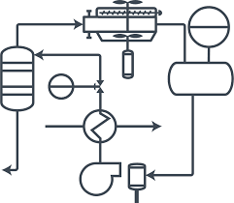

Generation Process : New project
P&ID
Part List Empty
PartList filled by other CRG sections
PartList completed by excel commands
PartList completed by IC section
Manual
Manual
Tag
Mechnical description
Electrical Description
Instrum description
Power /Unit…
FieldBox Terminal
Cabinet Terminal
Block Choice for the rest using block images

Slide 26



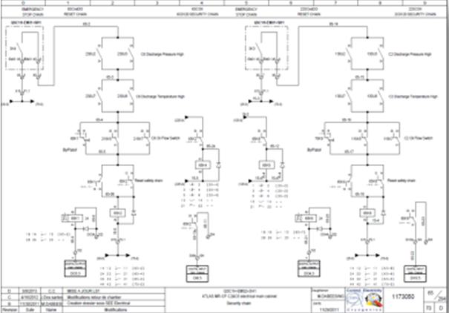
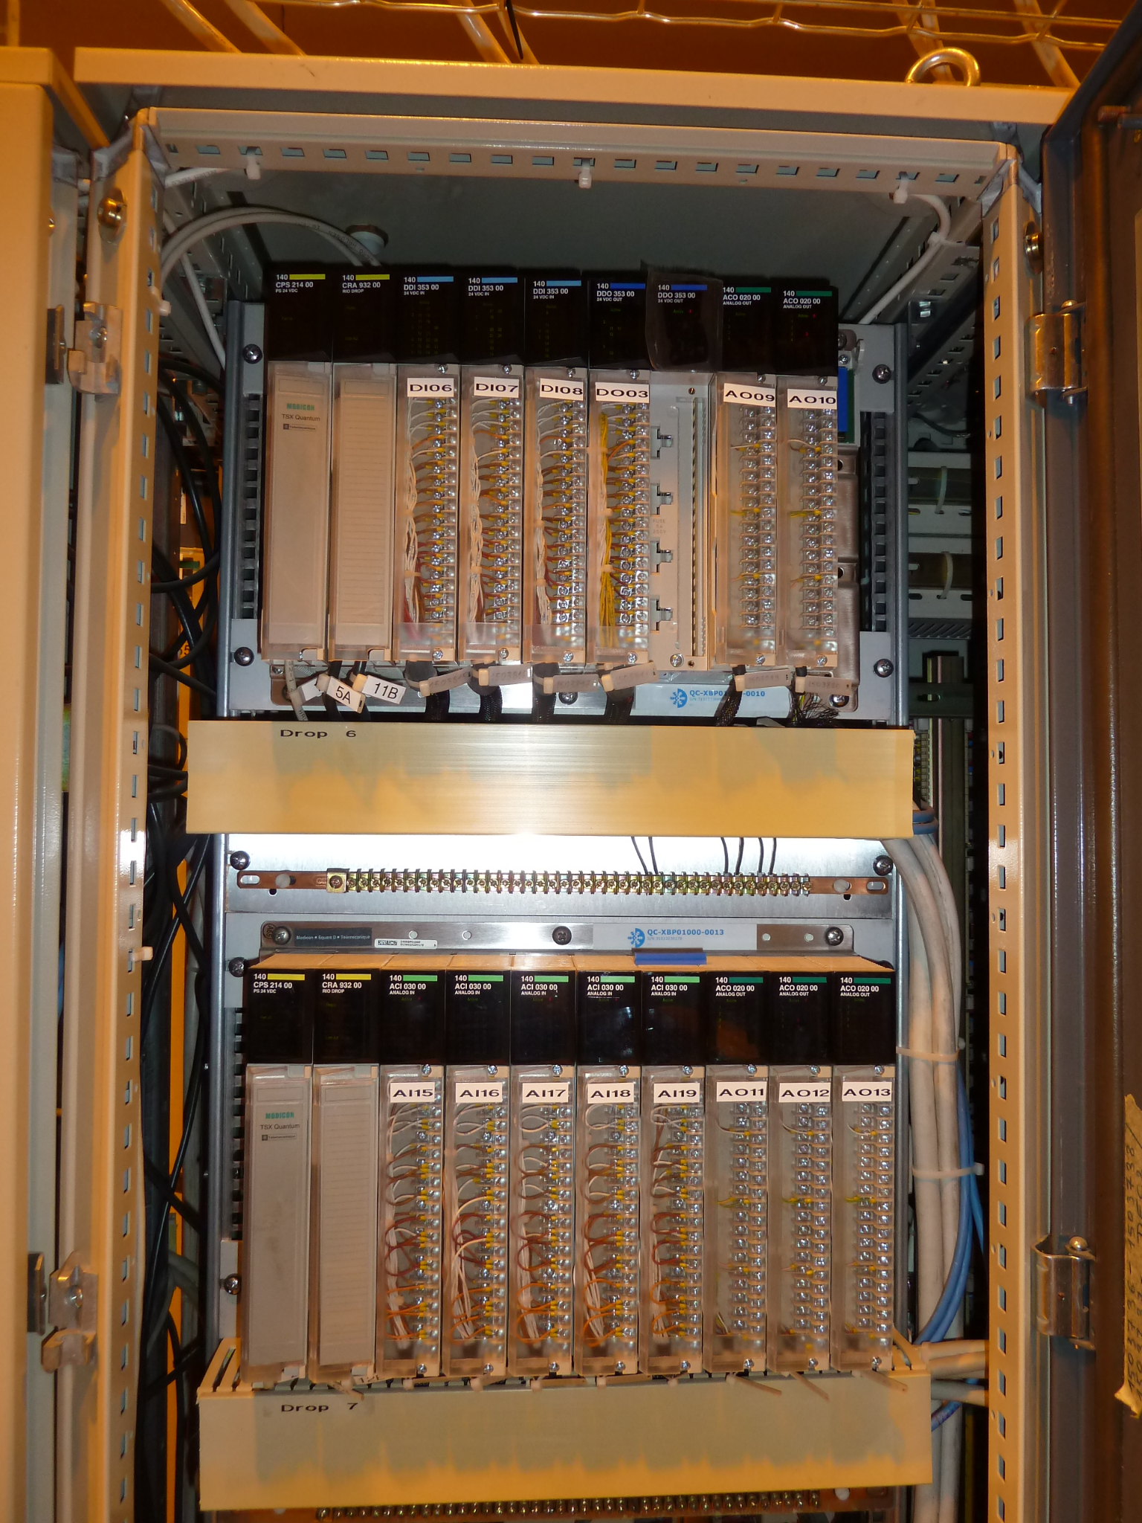
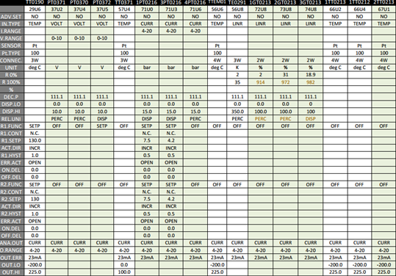
Refurbishments projects by ADG
At CERN, numerous projects are underway to renovate existing facilities. Many installations have already been established; however, refurbishment is essential to align with updated standards and regulations.
Our primary goal is to implement a robust system that functions effectively and is easily maintainable for the next 20 to 30 years.
Inputs :
Decreasing the workload
Automatise the process
New Electrical Standards
P&ID
Current Elec Diagram
DataBase Specs
Field Photos

Slide 27

Generation Process : Refurbishments
Manual
Adding the necessary changes : FieldBox / Components / Cables…
Part List Empty
PartList filled
New Partlist adjusted
Electrical Diagram
Electrical Scheme Unicos DataBase
Field Photos
PID
Automatic Diagram generation
Manual
Automatic
And what if we can automatically fill the excel from the past projects

Slide 28
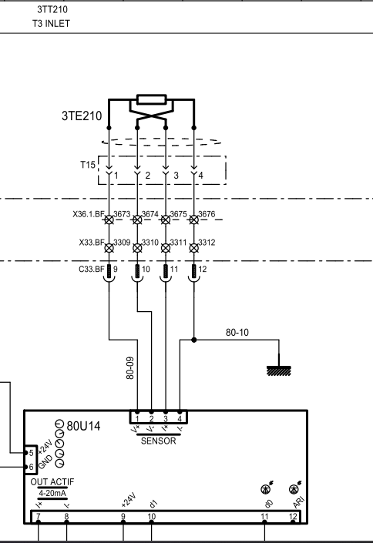


Futuristic Approach : IA ?
Description
Image Detection
Object Detection
Tag
Feeding the IA Algorithm
Field Box and cabinet
Detection of Blocks, tags, descriptions, and other elements.
Cernox
The complexity arises from the variations in each scheme, where designers employ different building blocks, adding an extra layer of intricacy to the project.

Slide 29


Automatic Diagram Generation Demo
Now let’s try to automatically generate
User Friendly Interface
Comparing with actual schematics
Collecting the specific infos for the project

Slide 30
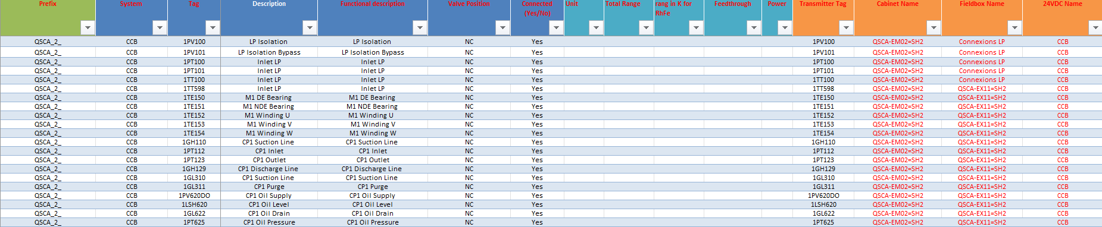
Automatic Diagram Generation Demo
First we fill our Excel PartList
In order to compare ADG with actual Electrical Scheme designed by CRG section, I am going to use QSCA-EM01=SH2

Slide 31


User Friendly Interface
An Application was created to make the Automatic generation more fluid and fancy
We start the application
Fill the infos
Select the right Part List Excel File
And then it generates

Slide 32
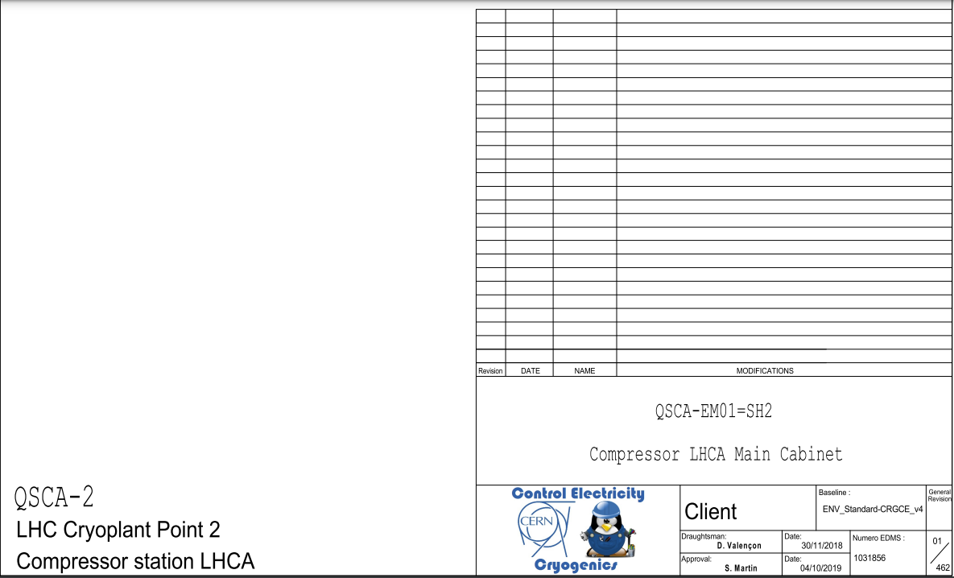
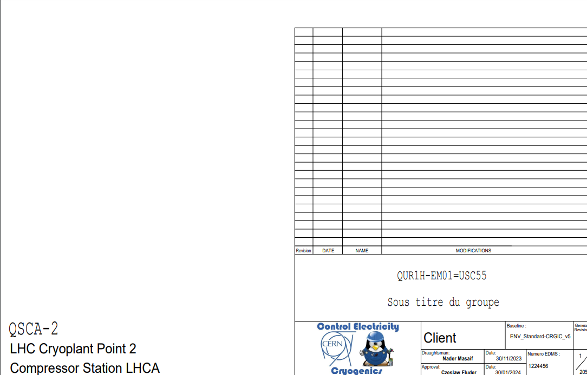
ADG Demonstration 1
QUR1H-EM01=USC55
Manually Designed by D. Valencon and S.M.Francois in 2018
Automatic Diagram Generation
#Nom Armoire
# Sous Titre 1
# Sous Titre 2
# Sous Titre 3

Slide 33
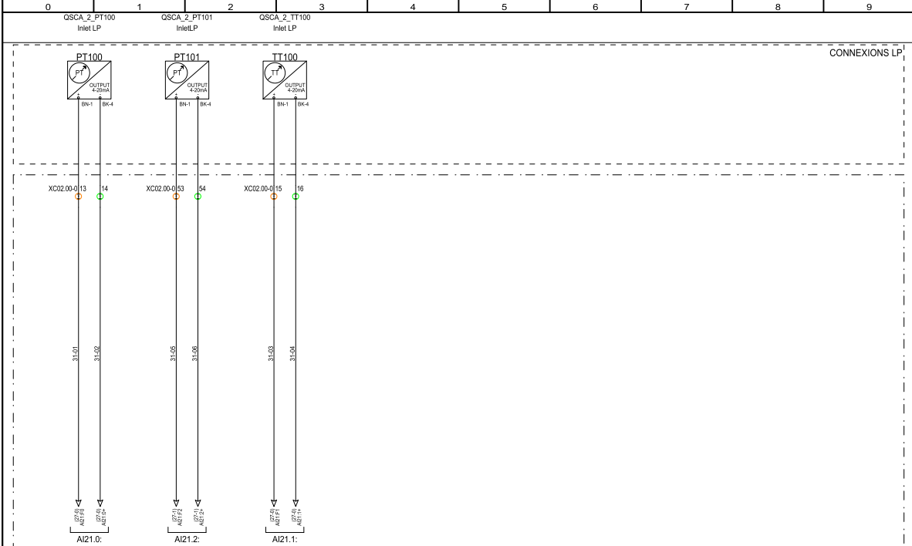
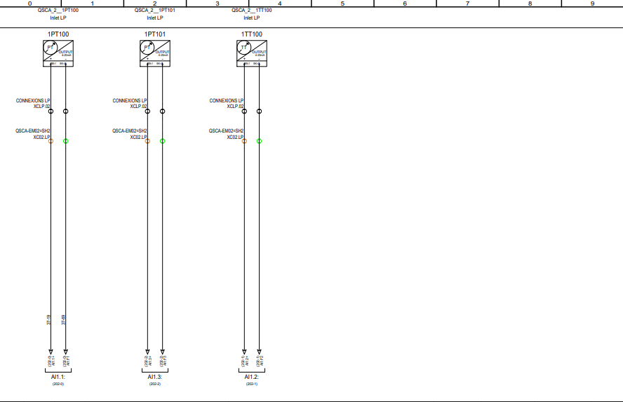
ADG Demonstration 2
QUR1H-EM01=USC55
Manually Designed by D. Valencon and S.M.Francois in 2018
Automatic Diagram Generation

Slide 34
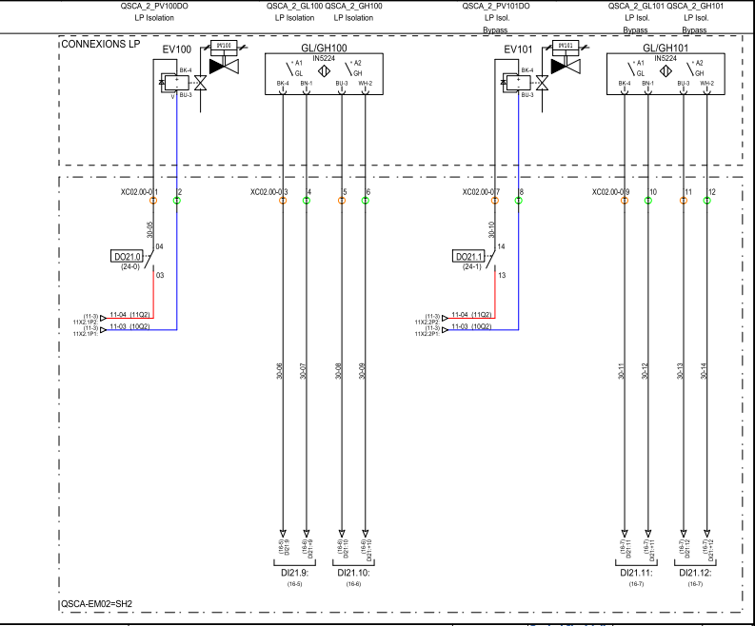
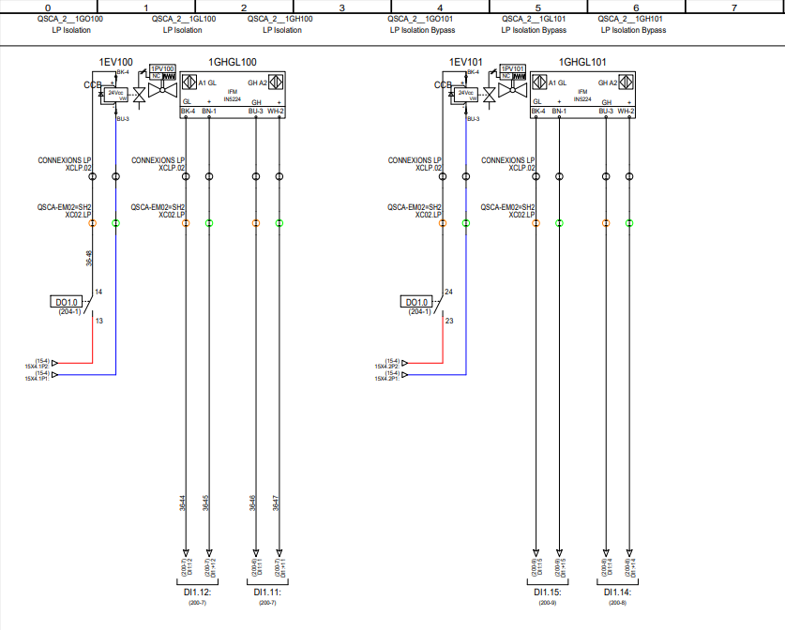
ADG Demonstration 3
QUR1H-EM01=USC55
Manually Designed by D. Valencon and S.M.Francois in 2018
Automatic Diagram Generation

Slide 35
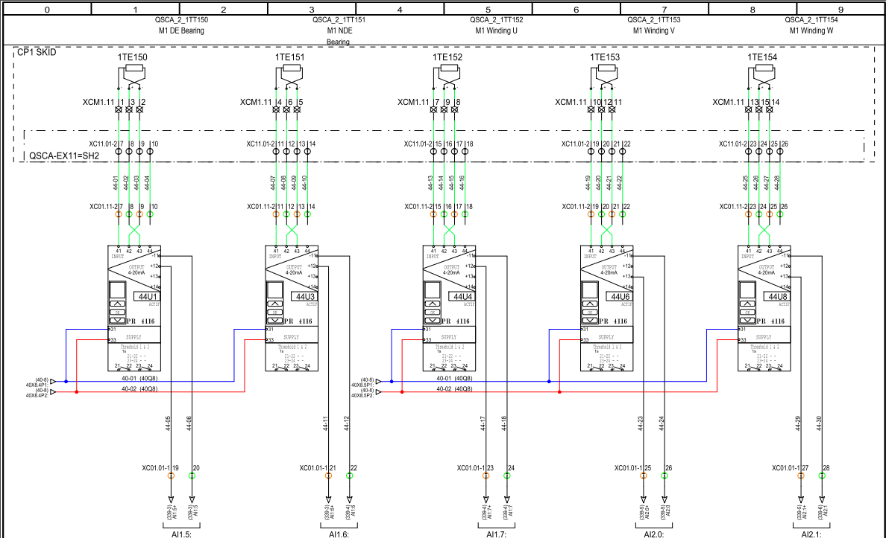
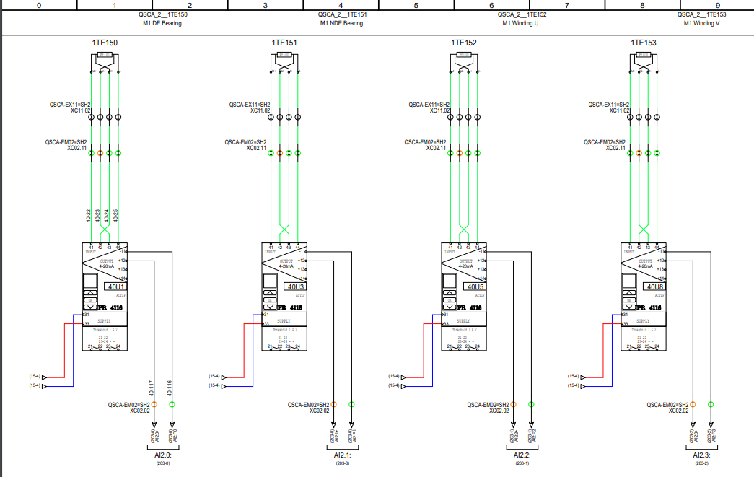
ADG Demonstration 4
QUR1H-EM01=USC55
Manually Designed by D. Valencon and S.M.Francois in 2018
Automatic Diagram Generation

Slide 36
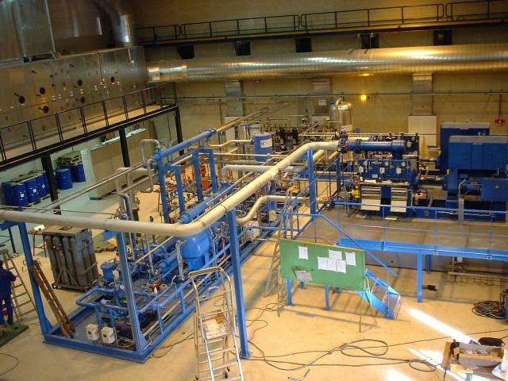
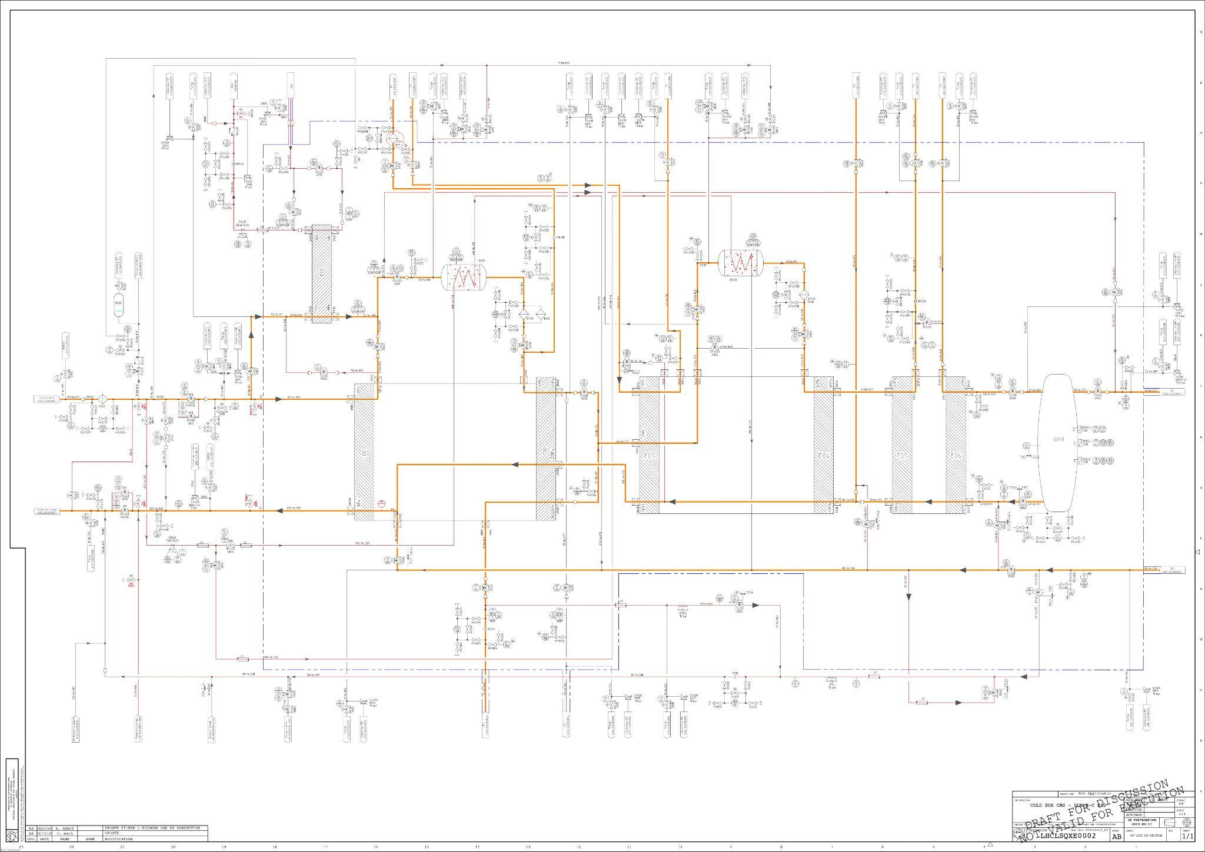
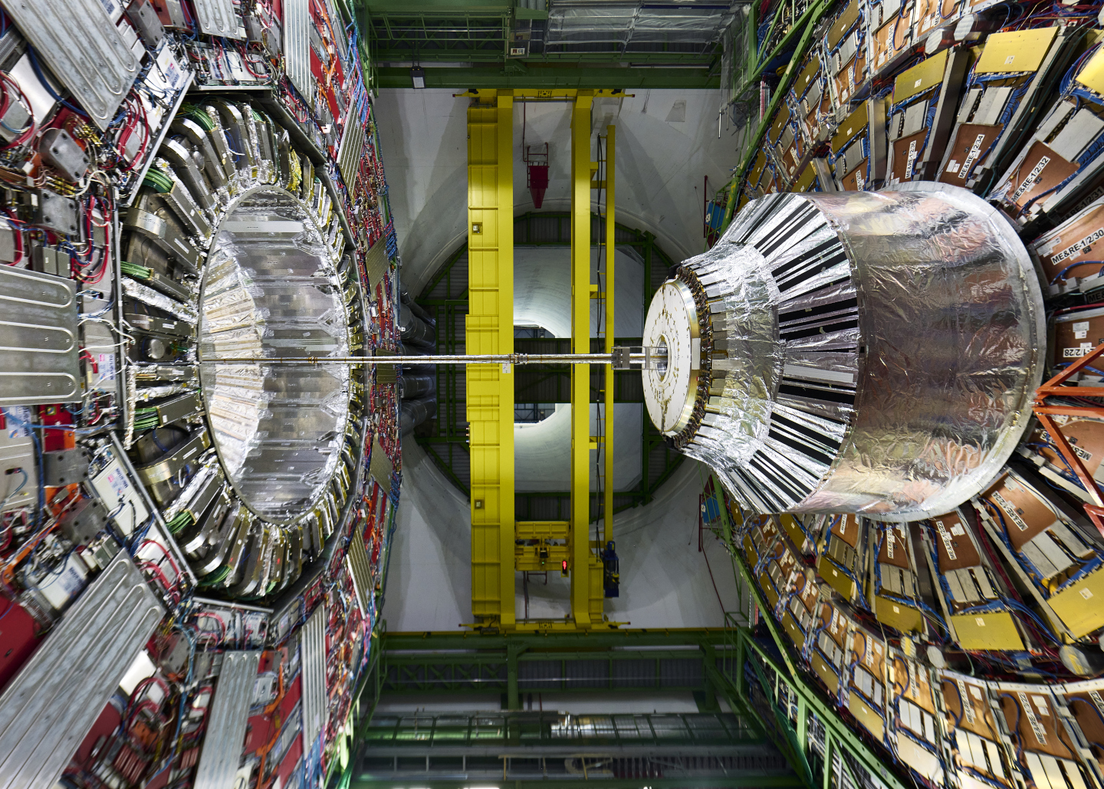



CMS Cold Box Refurbishments case study
EM01
EM02
EM03
Electrical diagrams generated automatically

Slide 37




Project planning (phases)
Step 1
Step 2
Step 3
Step 4
Documentation : Subfolders/ DataBase/ Blocks Specifications
Generating 70-80% of electrical diagrams
Using CI with GitLab in order to bypass SEE
Using AI to create automatic electrical diagrams
[AUTOSEE80] 65% progress

Slide 38



Step 3 : Using GitLab for CI
CI Systems automatically build the software whenever changes are pushed to the version control system (Git). This ensures that the code can be successfully compiled and that the build process is repeatable
GitLab Env
Problems
The goal is, when we modify our PartList in the Git Environment, the electrical scheme and the unicos database are updated automatically.
We are trying to fix those problems also

Slide 39


Is the use of CI relevant ?
The changes in electrical diagrams are occasional and do not happen frequently.
For the control it’s more frequent and there was a big number of errors due to coding.
The presence of certain issues in SEE Electrical suggests that the number of wires may vary from one generation to the next. Therefore, considering regeneration without addressing this problem is not feasible.
If we change some components
Manual changes
Nevertheless, we persist in our efforts, and through various new and refurbishment projects, we aim to enhance the Automatic Diagram Generation continuously, striving to achieve the optimal solution.
Like this we will avoid regenerating and completing the remaining 10%-20%.

Slide 40

THANKS FOR YOUR ATTENTION

Slide 41
Questions?
TE-CRG-IC
Controls and Electrical Support for Cryogenics

Slide 42
www.cern.ch

